Slide 1
RepoProof
Ethics & Data-Protection Design
Consultation brief · proposed use in COMP5339
Participation-only (2%) · human-approved · pseudonymous · local model · opt-in retention

Slide 2





RepoProof
A customised learning-comprehension check
Lecture
Learn Concept
Assignment
Practice
free rider
use AI without understanding
Tutor QA
time consuming
RepoProof
customised question
MCQ with explanation
(Assignment)
External Platform
Provide to lecturer
Student submits
a code project
Auto code analysis
extract verifiable facts
Generate questions
about THIS code
Instructor reviews
edits · approves
Student answers
(immediate feedback)
Understanding profile
per topic
checks comprehension of the specific code the student submitted.
Every question is generated from facts extracted from that project.
A human instructor reviews before any student sees it.
Notes:
What RepoProof is — A learning-comprehension check, not an AI-authorship detector

Slide 3
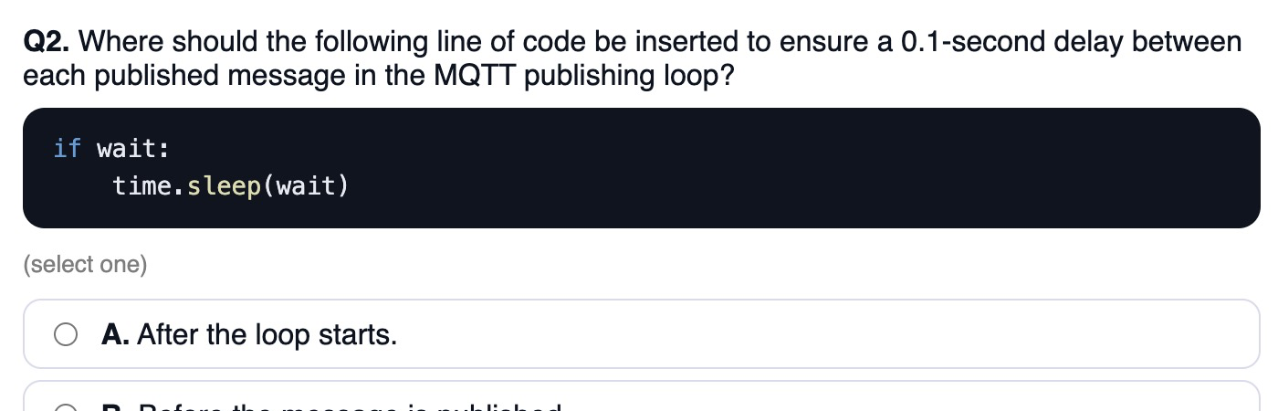
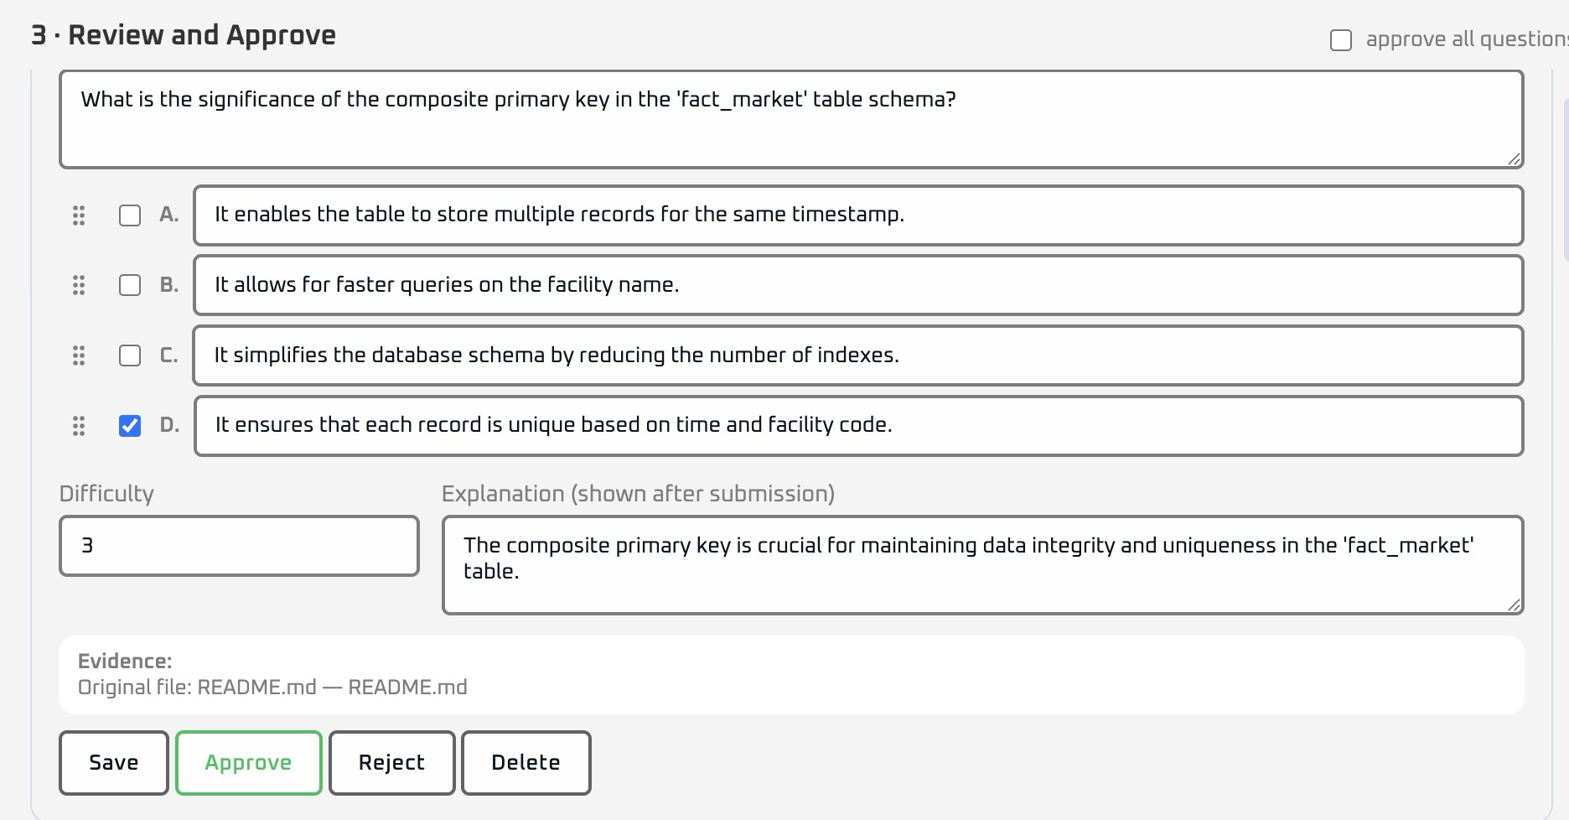
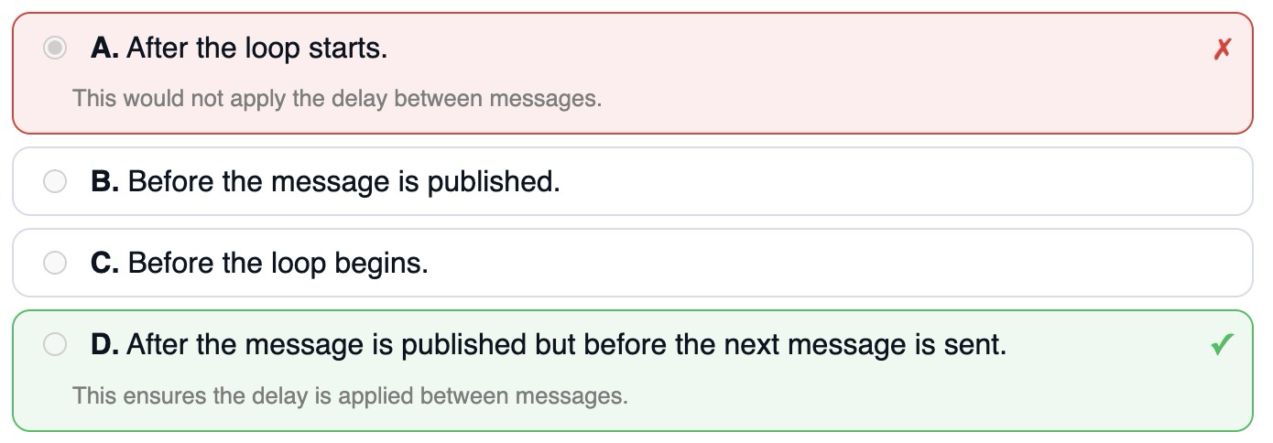
Proposed use in COMP5339
Low-stakes, formative, and instructor-controlled
2% participation mark
No academic disadvantage
Credit is for completing the quiz.
Students may opt out of cohort aggregate analytics; the 2% participation credit is unaffected.
Short quiz
Instructor-approved questions
5 MCQ, under ~3 minutes;
little incentive to game it.
Every question is human-reviewed before release.
Immediate feedback + explanations
Positioned as a learning aid.
Optional student survey (via Qualtrics)
Voluntary feedback on the experience;
not required and not linked to the mark.
Notes:
[Sources]
- CARE - Substudy guidelines v1c 2026-05-13.docx
- CARE - Substudy (Prospective) PIS v1b 2025-08-15.docx

Slide 4
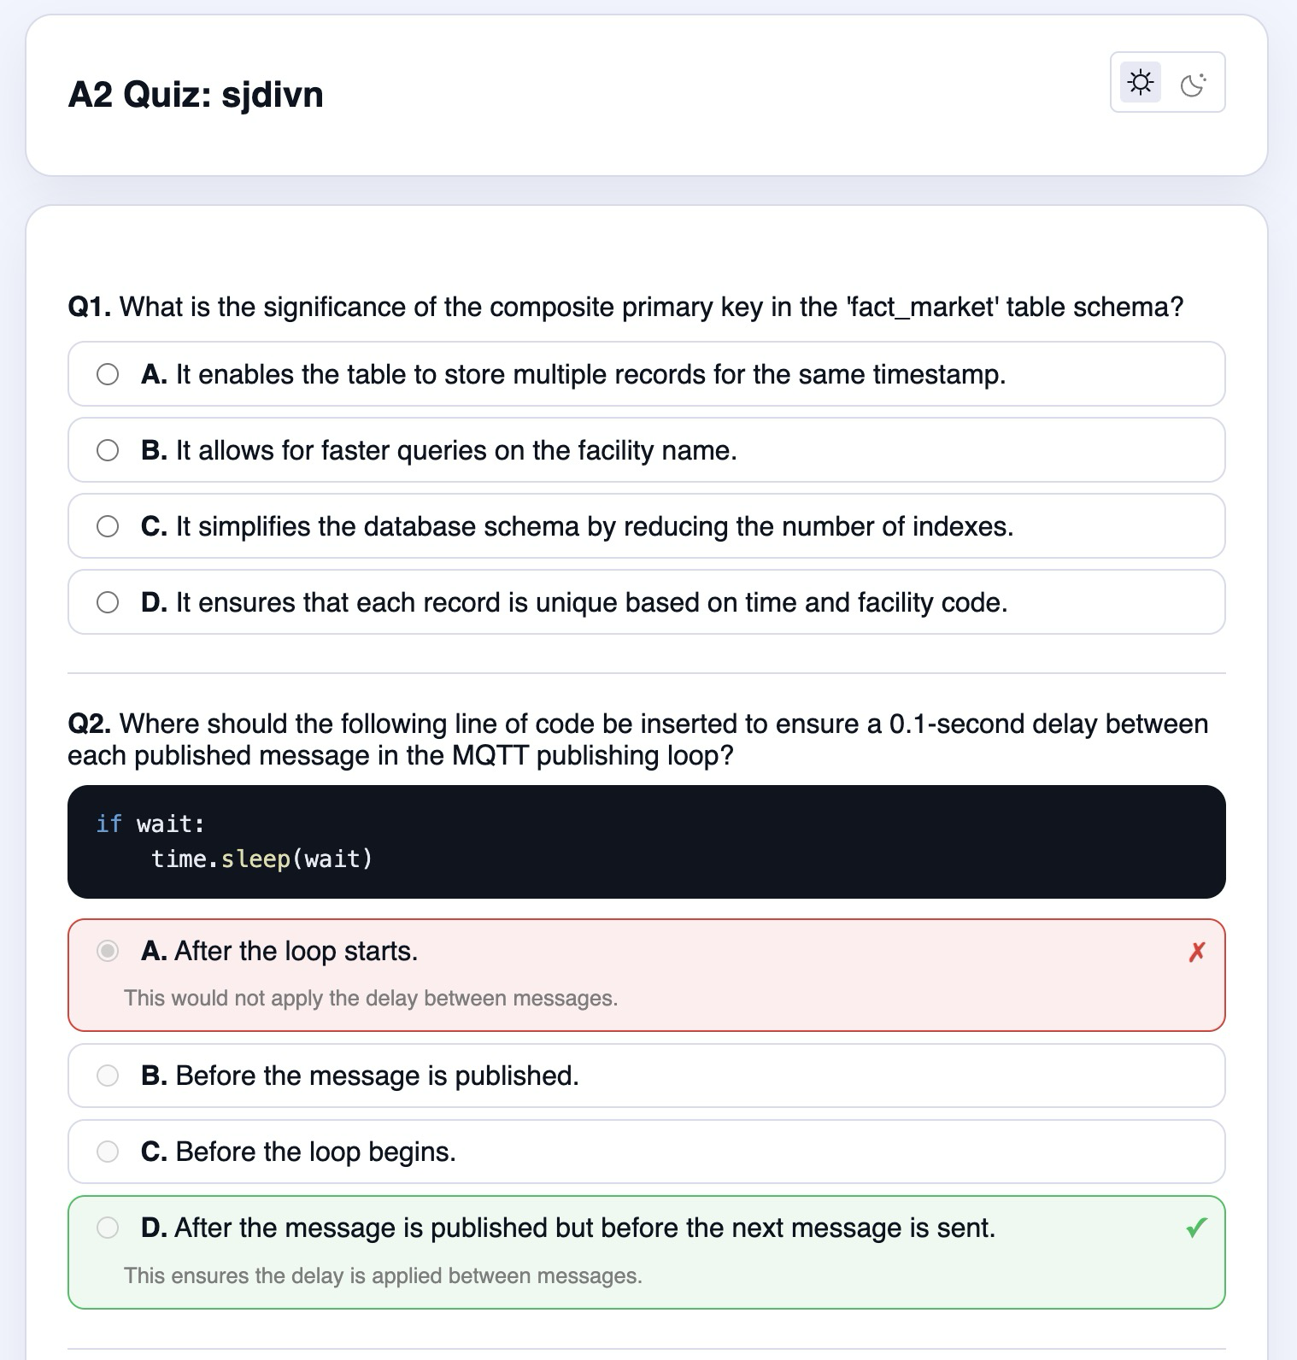
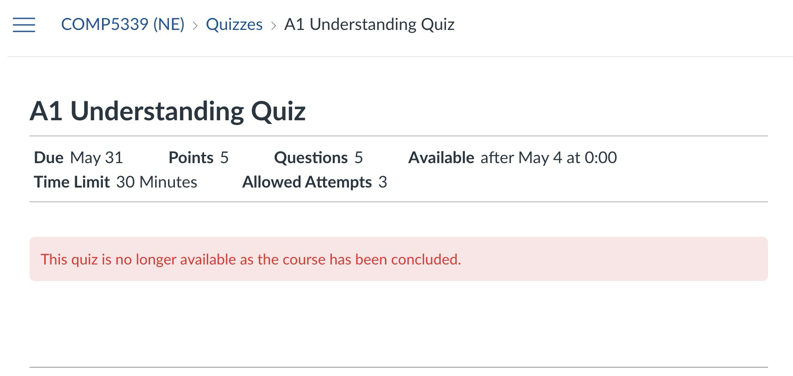

Identity separation
Students click a personalised link; their SID never reaches RepoProof
A personalised link carries the RepoID, so the SID never leaves USYD systems
CARE staff
provide mapping
RepoProof
folder | RepoID
1 | sjdivn, ejhud, cjudfc
2 | wjdui, dkoud
… | …
SID | folder | RepoID
900000001 | 1 | sjdivn
900000002 | 1 | ejhud
900000003 | 1 | cjudfc
900000004 | 2 | wjdui
… | … | …
A1 Understanding Quiz: sjdivn
1. Customised Question
2. Short MCQ Quiz
Canvas deliver
RepoID only
Complete your Quiz Here:
https://repoproof/comp5339/a1/sjdivn
3. Immediate Feedback
Paste your finished code here
RepoProof stores:
sjdivn-sjdivn
Submit
RepoID | folder | answers
sjdivn | 1 | [A, B, C, B, A]
ejhud | 1 | [D, B, C, C, A]
cjudfc | 1 | [A, B, D, B, B]
wjdui | 2 | [B, B, C, B, D]
Marks are participation-only. Correctness never affects the grade.
copy code
4. get code
Notes:
Identity separation — Students click a personalised link; their SID never reaches RepoProof
[Sources]
- CARE - Substudy guidelines v1c 2026-05-13.docx

Slide 5
What RepoProof retains
Original submissions are deleted after 1 month. Individual research records require opt-in; approved cohort aggregates may use opt-out.
Data | Purpose | Retention | Consent | Identifiability
Original submission (notebook / project files) | Generate questions Handle quiz enquiries | Delete 1 month after deadline, including backups | Required for teaching; excluded from research without opt-in | RepoID (pseudonymous)
Extracted structural features (no code text in 5-year set) | Reproduce generation Evaluate COMP5339 tool | Opt-in only: de-identify at 1 month; retain 5 years on RDS | Explicit opt-in; withdraw before 1-month cutoff | De-identified; remove IDs, filenames and student-defined symbols
Quiz answers (no mark impact) | Immediate feedback De-identified understanding analysis | Operational: 1 month Opt-in research set: 5 years | Teaching use required; research retention requires opt-in | RepoID operationally; de-identified before analysis
De-identified and aggregated learning analytics | Topic distributions Timing/performance and cross-semester trends | De-identified aggregate analysis retained 5 years on RDS | Proposed opt-out for cohort aggregate analytics; subject to CARE approval; no effect on 2% | Semester, topic, duration and completion-period bands; report groups ≥ 5
Optional Qualtrics survey | Evaluate the learning experience | Anonymous responses retained 5 years on RDS | Explicit opt-in; withdraw before submission only | Anonymous; never linked to RepoID
Operational = required for teaching, deleted after 1 month. Individual research = opt-in. Cohort aggregate analytics = proposed opt-out, subject to CARE approval.
Notes:
[Sources]
- CARE - Substudy guidelines v1c 2026-05-13.docx
- CARE - Substudy (Prospective) PIS v1b 2025-08-15.docx

Slide 6
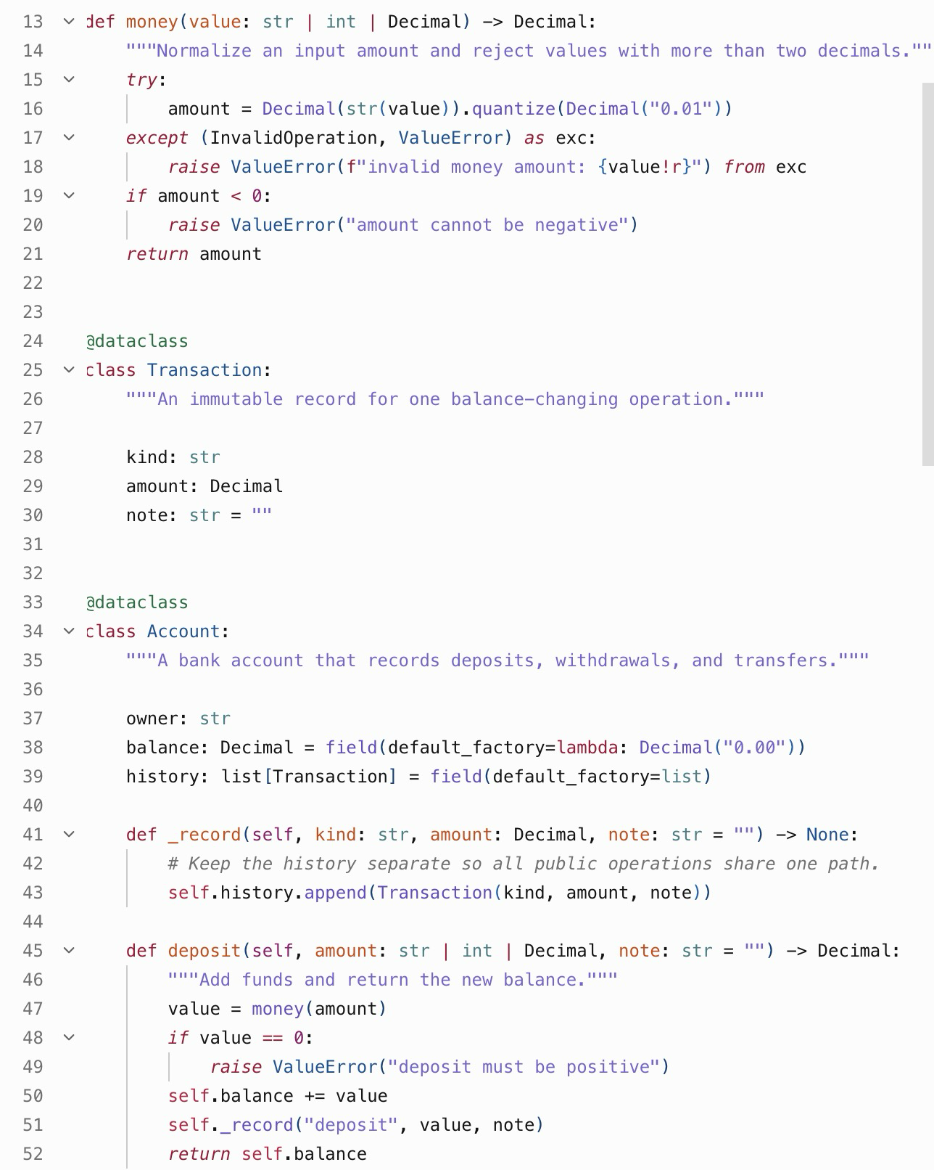
Operational source data vs five-year research data
Operational submission
Operational code chunks
Answers at cutoff
Purpose: generate questions and resolve enquiries
Delete: 1 month after the quiz deadline, including backups
FIVE-YEAR DE-IDENTIFIED FEATURE SET
• semester and assignment
• question topic and response/correctness
• broad duration band
• early / middle / late completion-period band
• project-structure and complexity counts
• question-review outcomes
Supports topic distributions, timing/performance analysis and comparisons across semesters.
Removed before research analysis:
SID · RepoID · exact timestamp · filenames · symbols · comments · URLs · source text
RepoID | answers
sjdivn | [A, B, C, B, A]
ejhud | [D, B, C, C, A]
cjudfc | [A, B, D, B, B]
wjdui | [B, B, C, B, D]
… | …
{
"study_record_id": "random-study-code",
"semester": "2026-S2",
"assignment": "A1",
"question_topic": "control flow",
"response": "B",
"correct": true,
"duration_band": "2–3 minutes",
"completion_period": "middle",
"complexity_band": "moderate"
}
Lecturer reporting only:
• topic-level response/correctness distributions
• duration-band vs correctness distributions
• early/middle/late group comparisons
• semester trends and teaching-change comparisons
• suppress or combine every subgroup with n < 5
No SID, RepoID, exact timestamp, filename, symbol, comment, URL or source text.
Anonymous survey
Explicit opt-in No RepoID link Withdraw before submission Retain 5 years on RDS
Notes:
[Sources]
- RepoProof proposed data-minimisation design
- CARE - Substudy guidelines v1c 2026-05-13.docx

Slide 7
How it fits CARE — and what's left to confirm
Proposed for CARE umbrella coverage (2025/HE001132), subject to Working Party approval
Safeguards participation-only (2%) · human-approved · SID stays within USYD · local model only · withdraw by RepoID before cutoff · aggregate reporting (groups ≥ 5)
CARE mapping individual research retention → opt-in · cohort aggregate analytics → proposed opt-out (approval pending) · 2% unaffected · 5 yrs on RDS
1
Independent de-identification
A CARE staff member outside the research team holds the SID ↔ RepoID list and de-identifies data before analysis (also resolves the conflict of interest).
2
Conflict-of-interest oversight
Tool built by an enrolled student; supervisor is the unit lecturer. Independent sign-off, students informed, and participation cannot affect standing.
3
Data, code & hosting governance
Confirm consent for five-year cross-semester analysis, feature de-identification, hosting region, role-based access, backup deletion, incident response, and secure transfer to RDS.
4
Unit coverage
Confirm COMP5339 is on the CARE Programs & Units list, so the sub-study is in scope.
Notes:
[Sources]
- CARE - Substudy guidelines v1c 2026-05-13.docx
- CARE Umbrella Ethics - Sub-Study proposal (v1a).pdf

Slide 8
Deployment & governance checklist
Known from repository documentation; ? = not documented or not yet decided
Known architecture FastAPI · SQLite (WAL) · local project directory · events store derived metadata, not raw code
Privacy mode LOCAL_ONLY can disable OpenAI · local LLM receives structured evidence only · instructor reviews questions before release
1
Hosting & data location
Live URL: repoproof.chingyu.site · hosting provider: Squarespace · data region: ap-southeast-2 Sydney · production server/DB location: aws-ec2 · encryption at rest: ?
2
Access & role separation
Creator access: shared password + HMAC-signed HttpOnly session (8 h) + IP login throttle. Per-user roles: none. Student developer / lecturer / CARE staff permissions: ?
3
Deletion & backups
Manual deletion APIs exist. Automatic 1-month deletion: ? · backup location and deletion evidence: ?
4
Research operations
UI currently records opt-in. Cohort opt-out control: ? · CARE de-identification/export: ? · RDS transfer: ? · incident plan: ? · code/IP wording: ?
Notes:
[Sources]
- README.md
- app/config.py
- app/db.py
- app/main.py
- docs/解釋.md
- docs/flow/2 Project Intake.md
- docs/flow/6 Structured Path.md
- docs/flow/7 Persistence.md
- docs/flow/8-2 Take and Score.md

