Slide 1
RepoProof
Ethics & Data-Protection Design
Consultation brief · proposed use in COMP5339
Participation-only (2%) · human-approved · pseudonymous · local model · opt-in retention

Slide 2





About the Project: RepoProof
A customised learning-comprehension check
Lecture
Learn Concept
Assignment
Practice
free rider
use AI without understanding
Tutor QA
time consuming
RepoProof
customised question
MCQ with explanation
(Assignment)
External Platform
Provide to lecturer
Student submits
a code project
Auto code analysis
extract verifiable facts
Generate questions
about THIS code
Instructor reviews
edits · approves
Student answers
(immediate feedback)
Understanding profile
per topic
checks comprehension of the specific code the student submitted.
Every question is generated from facts extracted from that project.
A human instructor reviews before any student sees it.
Notes:
What RepoProof is — A learning-comprehension check, not an AI-authorship detector

Slide 3
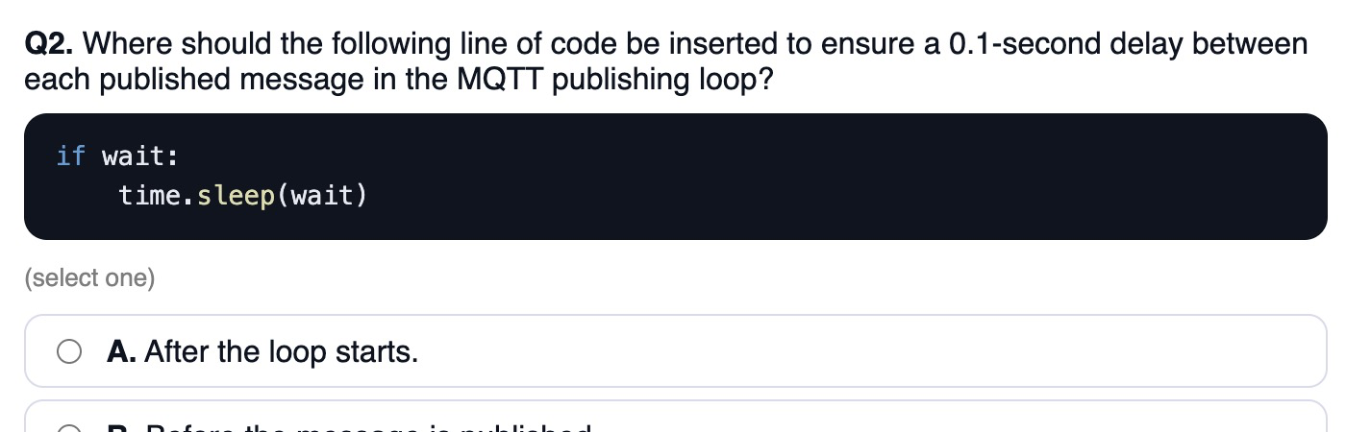
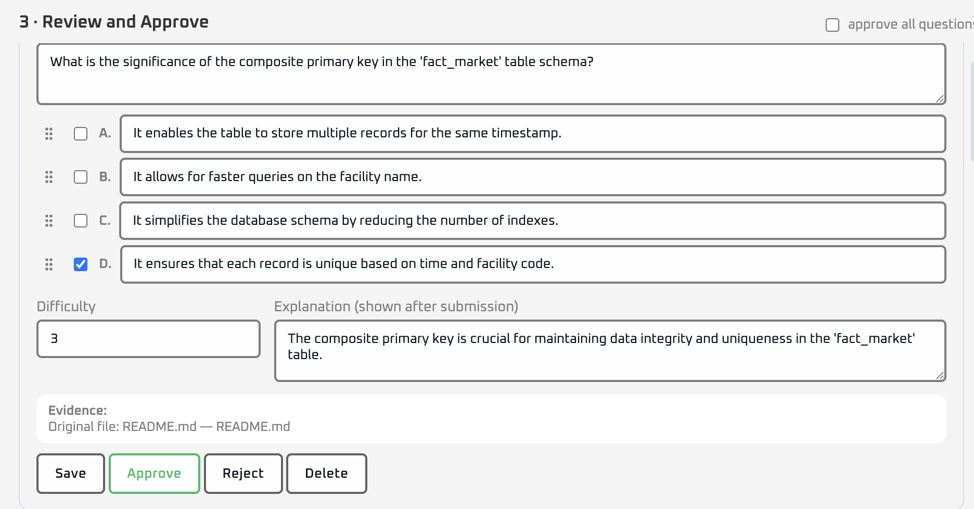
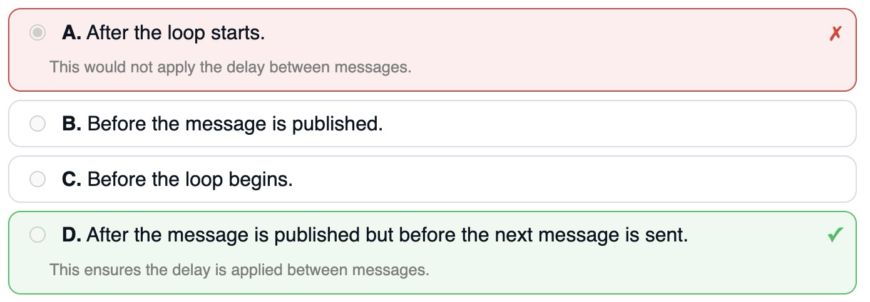
Proposed use in COMP5339
Low-stakes, formative, and instructor-controlled
2% participation mark
Equivalent alternative
Credit is for completing the quiz.
Students who opt out of data retention still earn the 2% the same way.
Short quiz
Instructor-approved questions
5 MCQ, under ~3 minutes;
little incentive to game it.
Every question is human-reviewed before release.
Immediate feedback + explanations
Positioned as a learning aid.
Optional student survey (via Qualtrics)
Voluntary feedback on the experience;
not required and not linked to the mark.

Slide 4
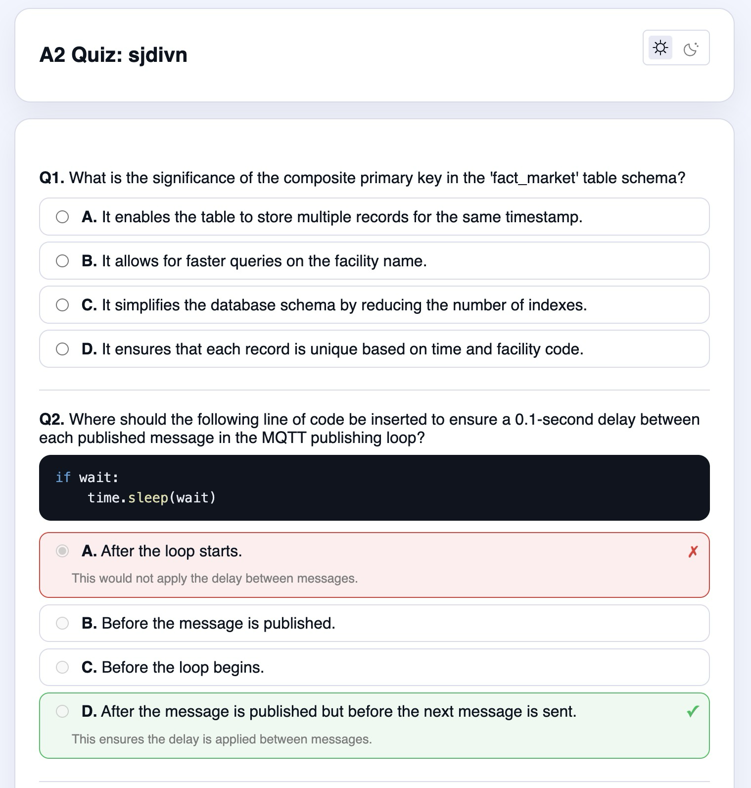
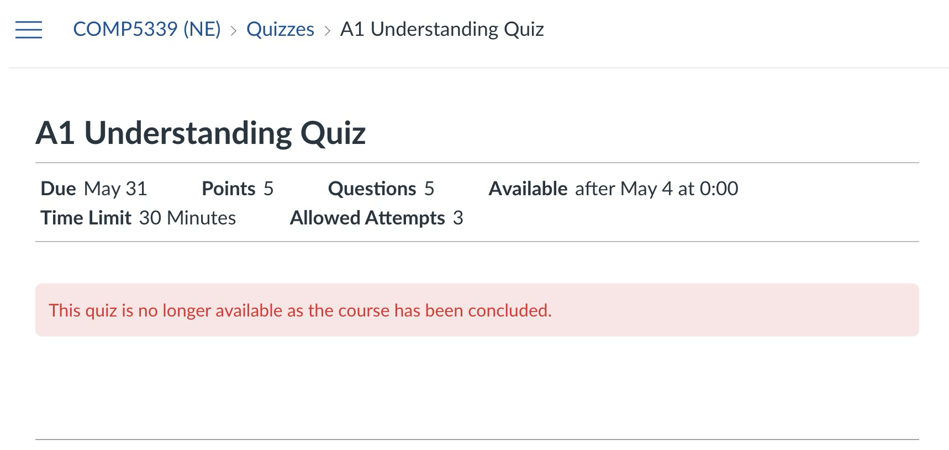

Identity separation
Students click a personalised link; their SID never reaches RepoProof
A personalised link carries the RepoID, so the SID never leaves USYD systems
CARE staff
provide mapping
RepoProof
folder | RepoID
1 | sjdivn, ejhud, cjudfc
2 | wjdui, dkoud
… | …
SID | folder | RepoID
540791765 | 1 | sjdivn
559246987 | 1 | ejhud
560746291 | 1 | cjudfc
537599017 | 2 | wjdui
… | … | …
A1 Understanding Quiz: sjdivn
1. Customised Question
2. Short MCQ Quiz
Canvas deliver
RepoID only
Complete your Quiz Here:
https://repoproof/comp5339/a1/sjdivn
3. Immediate Feedback
Paste your finished code here
RepoProof stores:
sjdivn-sjdivn
Submit
RepoID | folder | answers
sjdivn | 1 | [A, B, C, B, A]
ejhud | 1 | [D, B, C, C, A]
cjudfc | 1 | [A, B, D, B, B]
wjdui | 2 | [B, B, C, B, D]
Marks are participation-only. Correctness never affects the grade.
copy code
4. get code
Notes:
Identity separation — Students click a personalised link; their SID never reaches RepoProof

Slide 5
What RepoProof retains
The 2% is never tied to research data. At the 1-month cutoff, individual data is de-identified (not deleted); aggregates kept indefinitely.
Data | Purpose | Retention | Consent | Identifiability
Original submission (notebook / project files) | Generate questions quiz appealing | Deleted 1 month after quiz deadline | Operational (not required) | RepoID (pseudonymous)
Extracted code representation (functions, classes, module/call graph, complexity) — no verbatim code in 5-yr set | Reproduce generation improve this unit's tool aggregate understanding | De-identified at 1 mo · retained 5 yrs on RDS (opt-in, CARE) | Opt-in · revocable | De-identified
Quiz answers (no mark impact) | Live immediate feedback understanding analysis | Feedback/dispute ≈1 month · retained (opt-in), de-identified — 5 yrs | Feedback = operational; retention = opt-in | RepoID → de-identified
Coarse timestamp / duration (to the hour) | Understanding analysis (aggregation) for lecturer | Retained (opt-in) — 5 yrs | Opt-in · revocable | Aggregate, min group ≥ 5
Optional survey | Improve this unit's tool | Retained (5 yrs) | Opt-in · anonymous | Anonymous (not linked to RepoID)
Operational = necessary for teaching, auto-deleted. Opt-in retained = evaluate & improve this unit (COMP5339), explicit consent, revocable, own deletion date.

Slide 6
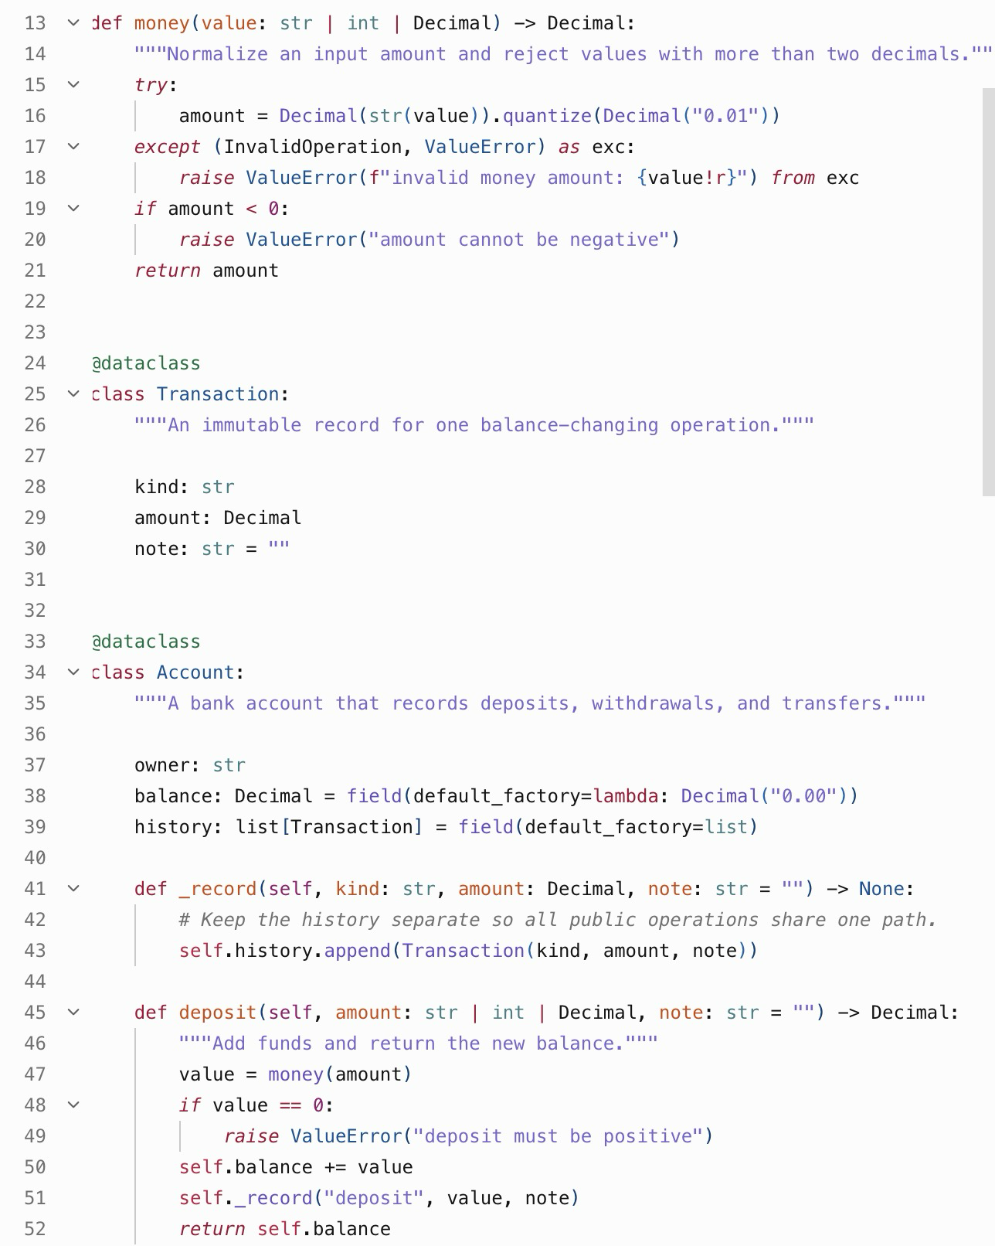
What the retained data actually looks like
assignment Folder student uploaded
chunks of programming code
student answer
Purpose: for answering student concerns about assessment question
Delete: 1 month after quiz deadline
c0 structure - Project file structure
c1 imports bank.py Imports in bank.py
c2 module_var bank.py Constant MAX_DAILY_TRANSFER (bank.py)
c3 module_var bank.py Constant SUPPORT_URL (bank.py)
c4 class bank.py Class Transaction
c5 class bank.py Class Account
c6 function bank.py Function money (bank.py)
c7 function bank.py Function Account._record (bank.py)
c8 function bank.py Function Account.deposit (bank.py)
c9 function bank.py Function Account.withdraw (bank.py)
c10 function bank.py Function Account.statement (bank.py)
c11 function bank.py Function transfer (bank.py)
c12 source BankService.java Java file BankService.java (lines 1-70)
c13 flow bank.py Call flow from transfer (bank.py)
c14 callgraph - Approximate call graph
c15 module_graph - Module graph summary
c16 symbol_table - Symbol table summary
c17 complexity - Static complexity indicators
c18 sql_analysis - SQL analysis summary
RepoID | answers
sjdivn | [A, B, C, B, A]
ejhud | [D, B, C, C, A]
cjudfc | [A, B, D, B, B]
wjdui | [B, B, C, B, D]
… | …
{
"id": "c6",
"kind": "function",
"title": "Function money (bank.py)",
"text": "Function money in bank.py (lines 14-22).\nParameters: value.\nDocstring: Normalize an input amount and reject values with more than two decimals.\nCode:\ndef money(value: str | int | Decimal) -> Decimal:\n \"\"\"Normalize an input amount and reject values with more than two decimals.\"\"\"\n try:\n amount = Decimal(str(value)).quantize(Decimal(\"0.01\"))\n except (InvalidOperation, ValueError) as exc:\n raise ValueError(f\"invalid money amount: {value!r}\") from exc\n if amount < 0:\n raise ValueError(\"amount cannot be negative\")\n return amount",
"file": "bank.py",
"start_line": 14,
"end_line": 22,
"snapshot": "local-test",
"evidence_types": [
"symbol_table",
"data_flow_graph",
"control_flow_graph"
]
}
feedback survey
optional participation

Slide 7
How it fits CARE — and what's left to confirm
Covered by the CARE umbrella ethics (2025/HE001132) as a prospective sub-study
Safeguards participation-only (2%) · human-approved · SID never leaves USYD · local model only · withdraw by RepoID until the 1-month cutoff · aggregate-only (min group ≥ 5)
CARE mapping research retention → opt-in (explicit consent) · 2% participation unaffected · analysis on de-identified data · retained 5 yrs on University Research Data Store
1
Independent de-identification
A CARE staff member outside the research team holds the SID ↔ RepoID list and de-identifies data before analysis (also resolves the conflict of interest).
2
Conflict-of-interest oversight
Tool built by an enrolled student; supervisor is the unit lecturer. Independent sign-off, students informed, and participation cannot affect standing.
3
Student code & IP
Which PIS/Consent wording licenses retaining a de-identified representation to evaluate & improve this unit (COMP5339), including future semesters?
4
Unit coverage
Confirm COMP5339 is on the CARE Programs & Units list, so the sub-study is in scope.

