Slide 1

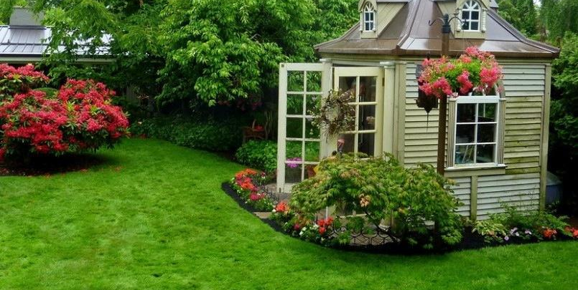
P442 TEAM PROJECT
GARDEN PLANT MONITOR
Ching Yuen Ng Brian Rak

Slide 2
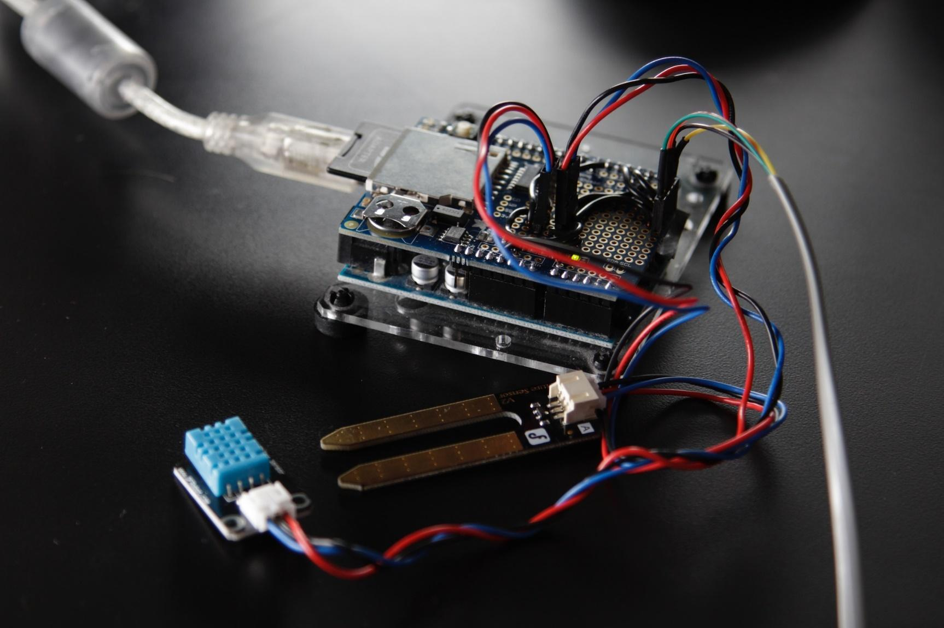
What are we trying to do?
The basic idea of our project is to create a sustainable self-watering garden all controlled by two stm32f30x processors/boards.

Slide 3
Goals
Create an autonomous garden system
Make the system capable of watering plants more precisely and effectively than humans
Make the garden data available from inside the home
Allow the garden to be completely self-sustaining by running on solar

Slide 4
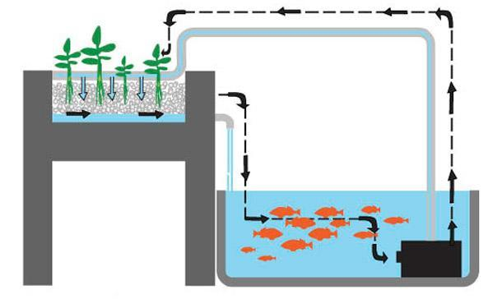
Inspiration
Our eventual goal is a full aquaponics garden.
Notes:
Run from Approximately 2:21 – 4:00+

Slide 5
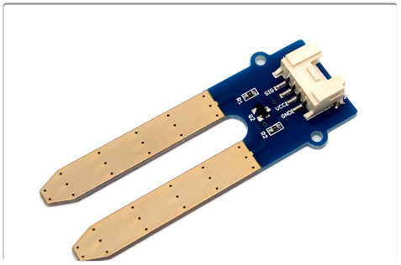
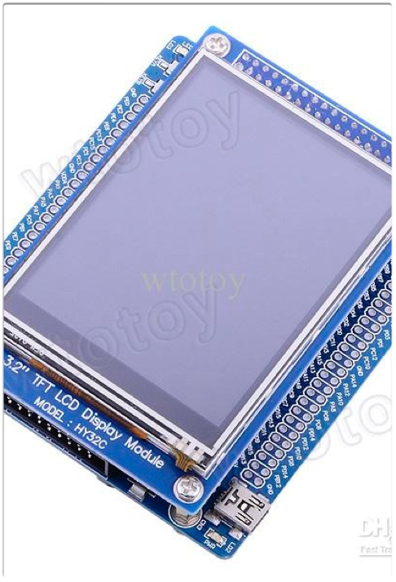
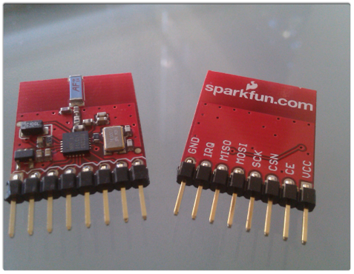
Tools

Slide 6
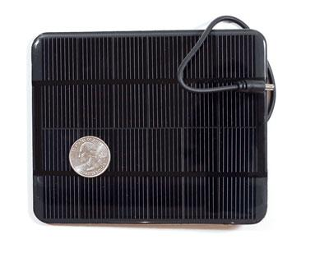
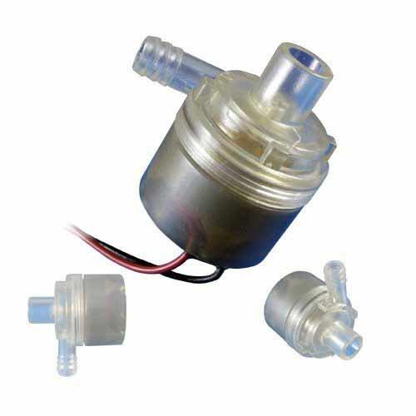
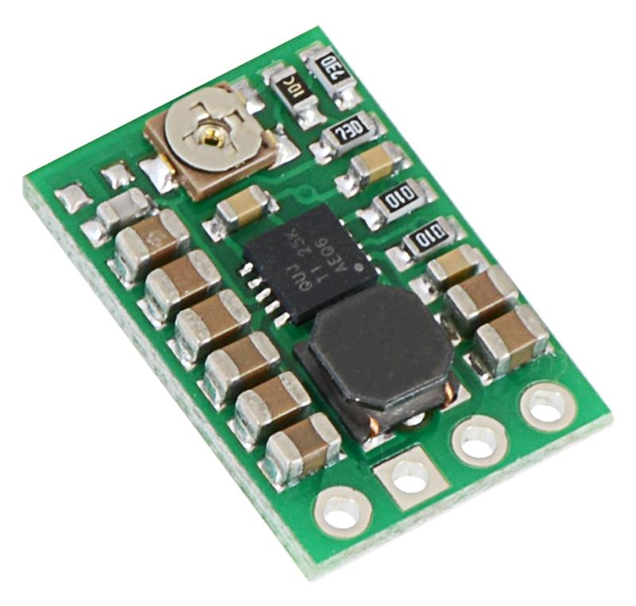
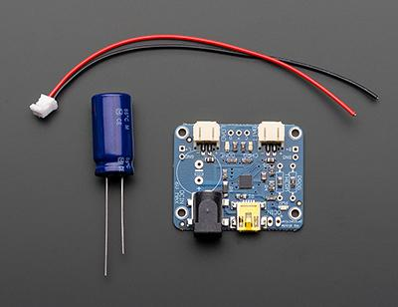
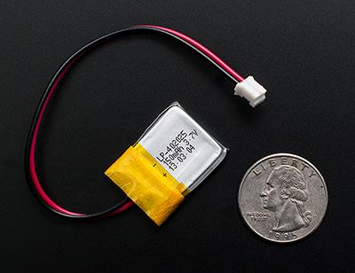
More Tools

Slide 7
Checklist
Gather temperature/moisture data from plants at periodic interval
Turn on water supply if needed
Send data wirelessly to indoor device
Graph the data using the LCD display
Manage power states when not in use
Use solar power to be self-sustaining

Slide 8
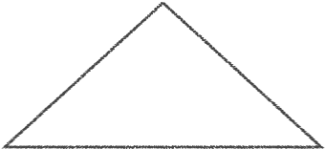





DEV1
LCD DISPLAY
IN HOUSE
GARDEN
WIRELESS
WATER
PUMP
DEV2
YARD

Slide 9
Block Diagram
Nordic
RTC
SPI3
LCD
Wireless
Water Pump Motor
LSE
STM32
SPI2
DMA
Nordic
SPI3
Bust/boost
Regulator
DAC
STM32
Moisture Sensor
Lithium
Battery
Solar charger
Solar panel
Solar Power Supply

Slide 10
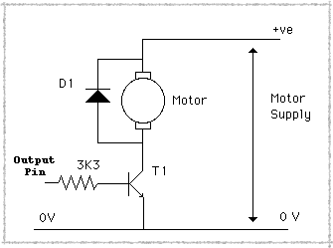
Driving the Water Pump
Notes:
http://www.thebox.myzen.co.uk/Workshop/Motors_1.html

Slide 11
Technical Profile
Moisture Sensor
Item | Min | Max | Unit
Voltage | 3.3 | 5 | V
Current | 0 | 35 | mA
Output
Dry Soil | 0 | 300
Humid Soil | 300 | 700
Water | 700 | 950

Slide 12
LCD - ST7735R
Dimensions | 132x162 bits
Colors: | Full Color/ RGB (666), 8-color/RGB (111)
Programmable Pixel/Color Format | Supports 12/16/18 pixel
SPI | 3 or 4 line
Voltage Range | Source: 3.0-4.5V, Gate (high) 10.0-15V, Gate (low) 13-7.5V

Slide 13
Water Pump
Input: DC 5~6V
Output: 1.0L/min or 0.264 gallon/min
Cut-off: 1M (3ft ) @6V
Current: 300mA@6V
Intake: 9mm Dia.
Outlet: 7mm Dia.
Self-prime: No
Submersible: Yes
Life span: > 20,000hrs @ 1600rpm~4200rpm
Noise: << 20dB
Fluid Temp: 100'C/212F (non-submersed)
Ambient Temp: 50C/122F (submersed)
Size(L*W*D): 32mmx22mmx36mm (1.26" X 0.87" X 1.42")
Weight (net): 2.0oz

Slide 14
Solar Power
Panel
Output Power | 2.0W
Output Voltage | 6V
Output Current | 330mA
Connection | 3.5x1.3mm DC jack connector
Charger
Capacity | 3.7V/4.2V Lithium Ion Battery
Compatibility | 6V Solar, 5V USB
Temperature Monitoring | Monitors battery for heat
Max Charge Rate | 50-500mA
Lithium Ion Battery
Output Voltage | 4.2V (fully charged) - 3.7V
Circuit Protection | Prevents Over/Under charging
Output Capacity | 150mAh or 0.6W
Buck/Boot Regulator
Adjusted Output | 2.5V - 8V
Voltage Range | 2.7V - 11.8V

Slide 15
Expected Normal Working Conditions
Solar panel should be placed outside or near window
Solar panel receives approximately 10 hours of sun
Only the solar panel, moisture sensor, and pump should be exposed to water/moisture
Water pump attached to a tank of water that is assumed to be always full or near-full
Moisture sensor remains in the bottom of the plant with no maintenance needed
STM32f30x standby mode will be used when possible to conserve power
The stm32 with LCD will require USB power (or equivalent) and will use no power-saving modes

Slide 16
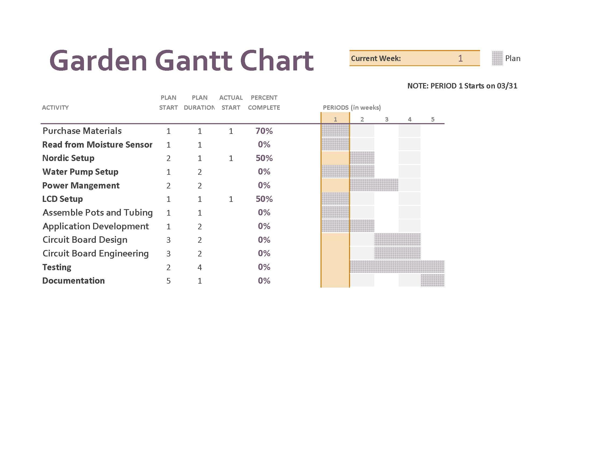
Notes:
Gantt Chart: https://www.youtube.com/watch?v=sA67g6zaKOE

Slide 17
Cost
stm32f30x (2) | $50 ($25 each)
Moisture Sensor | $5
nordic X 2 | $40 ($20 each)
Solar power supply | $25
Pump motor | $14
LCD | $30
Solar Charger | $17
Buck/Boost Regulator | $6
Lithium Ion Battery | $6
Tubing/Pots/Misc Components | ~$25
Total | $228 (production cost would be lower)

Slide 18
Questions?

