Slide 1

Predictive analysis final Assessment ban210 ZAA
Chin Hooi Yap
Student ID: 132415217

Slide 2
Breast Cancer dataset
Breast Cancer Recurrence
201 instance of no-recurrence
85 instances of recurrence
Parameters includes:
Name | Description | Values
Class | Recurrence events? (Target Variable) | no-recurrence-events, recurrence-events
Age | Age range | 10-19, 20-29, 30-39, 40-49, 50-59, 60-69, 70-79, 80-89, 90-99
Menopause | Menopause momento | lt40, ge40, premeno
Tumor-size | Tumor size excised in mm | 0-4, 5-9, 10-14, 15-19, 20-24, 25-29, 30-34, 35-39, 40-44, 45-49, 50-54, 55-59
Inv-nodes | A metric of presence | 0-2, 3-5, 6-8, 9-11, 12-14, 15-17, 18-20, 21-23, 24-26, 27-29, 30-32, 33-35, 36-39
Node-caps | A metric of presence | yes, no
Deg-malig | Tumor Histological grade | 1, 2, 3
Breast | Breast affected | left, right
Breastquad | Breast quadrant | left-up, left-low, right-up, right-low, central
Irradiat | Radiotherapy | yes, no

Slide 3
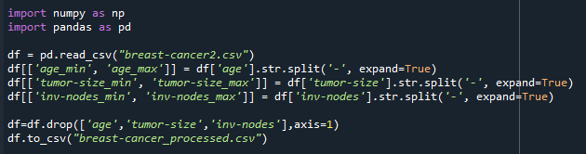
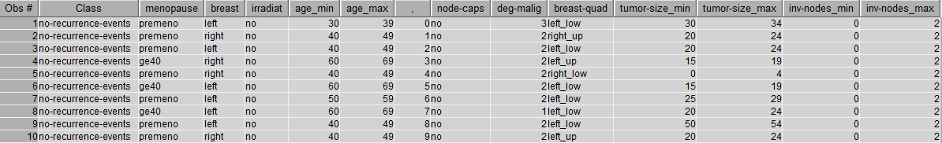
Data preprocessing
Python Code Used:
Inherent issues with data using ranges:
10-19, 20-29
Split them into two columns
Age to Age_min and Age_max
Output:

Slide 4
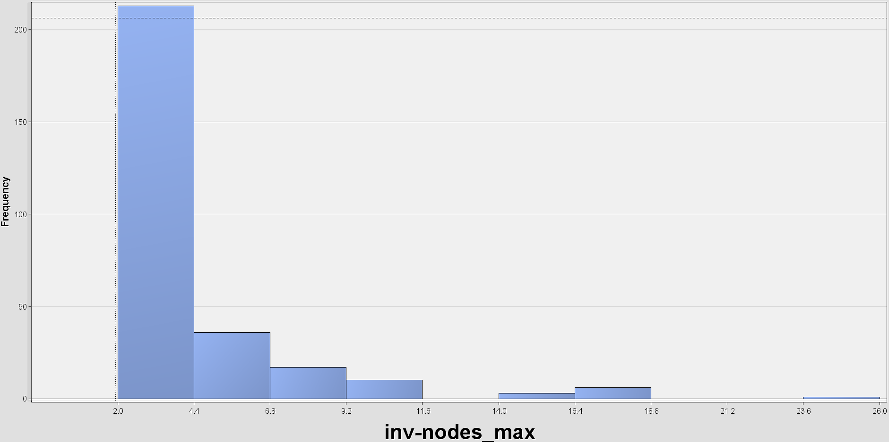
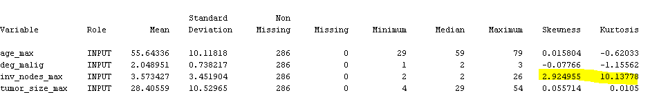
Exploration Data Analysis (EDA) – Univariate analysis
StatExplore
No missing values and outliers in variables
High skewness observed in variable inv_nodes_max
To perform transformation before regression analysis

Slide 5
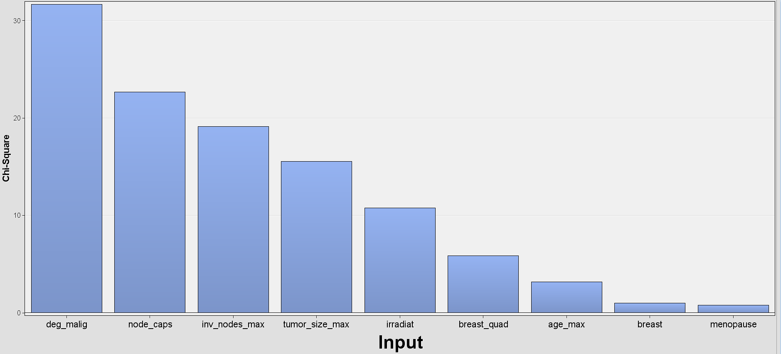
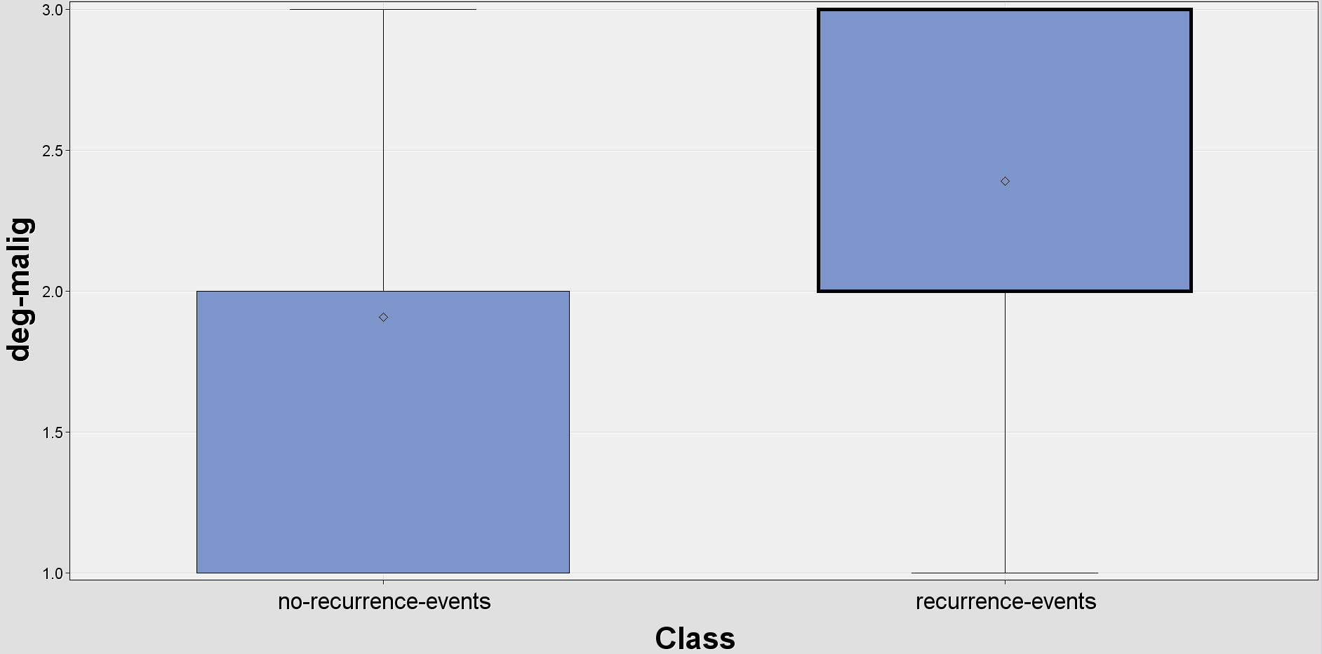
Exploration Data Analysis (EDA) – Univariate analysis
Relationship with Target Variables:
Variables such as deg-malig, node_caps, inv_nodes_max has strong relationship with target variable based on Chi-Square Plot
deg-malig has obvious relationship with the target variable
Chi-Square Plot
Boxplot of deg-malig

Slide 6
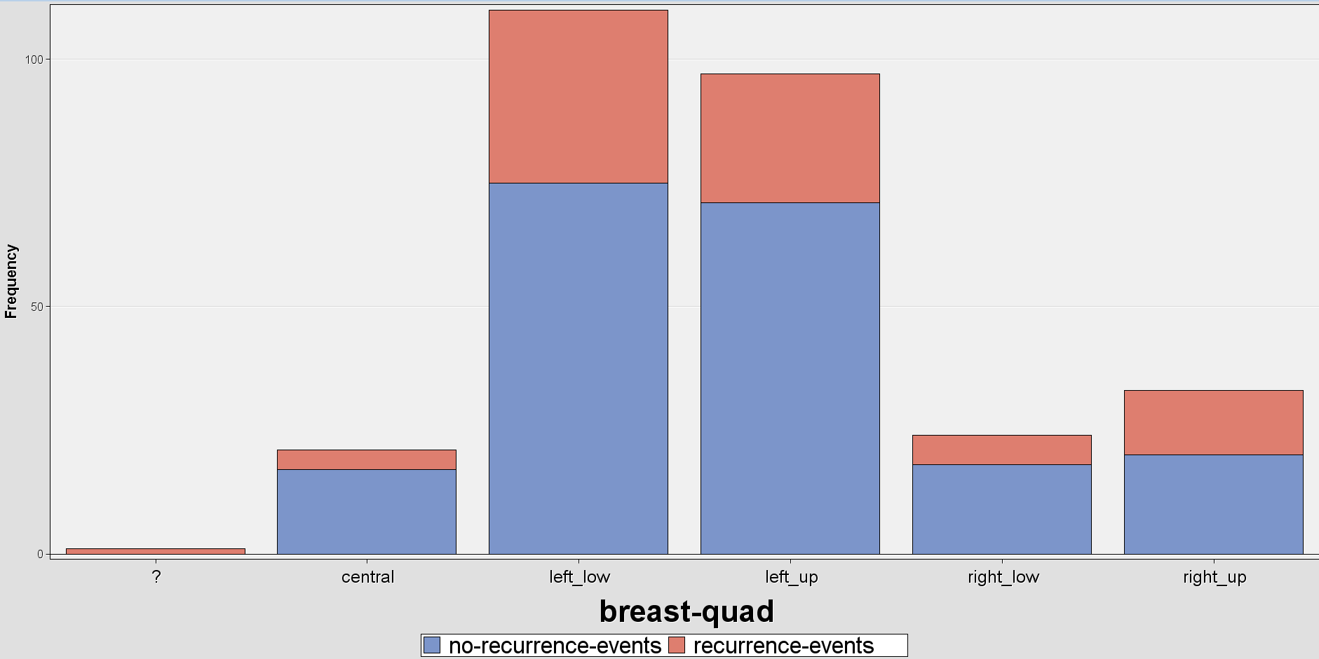
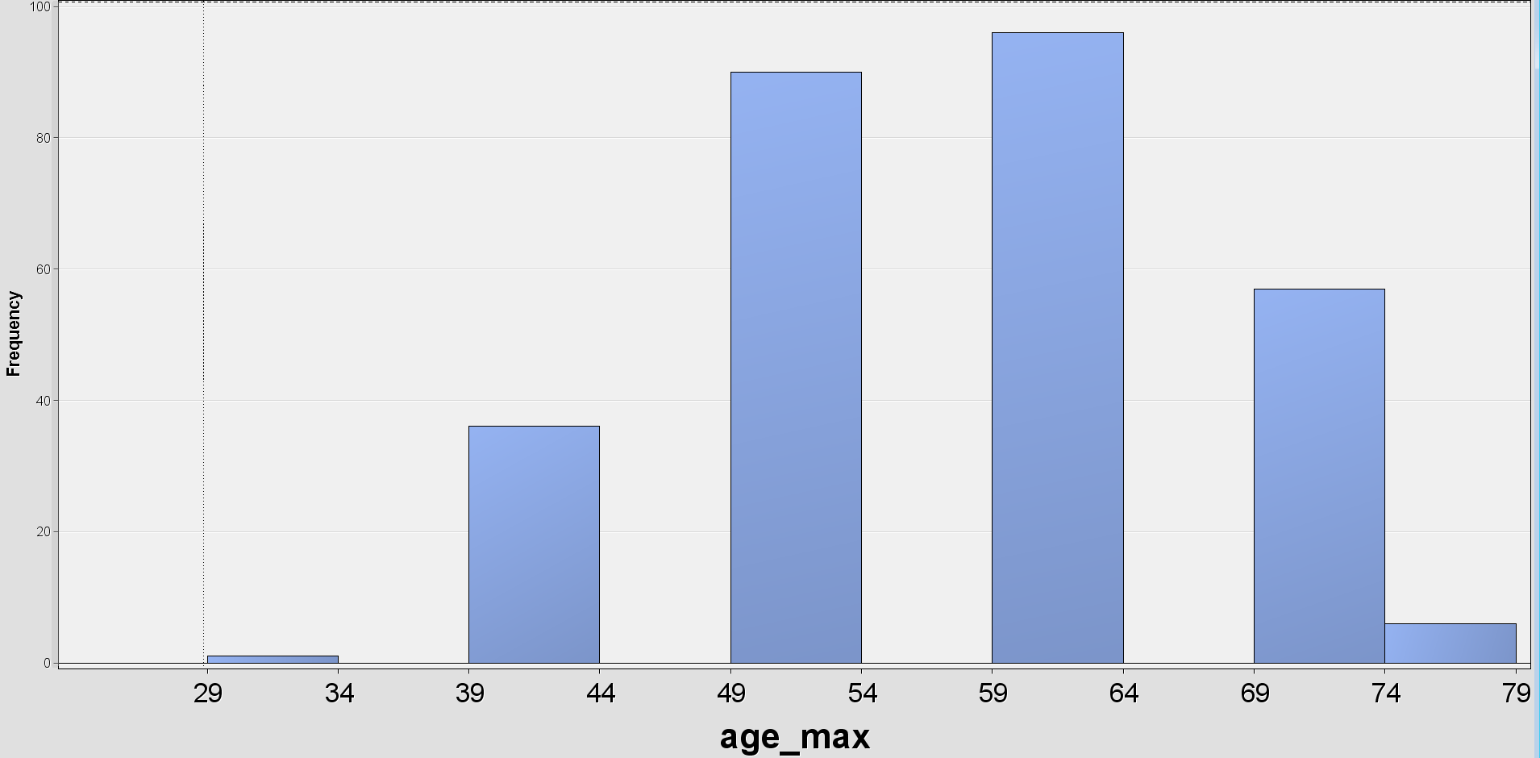
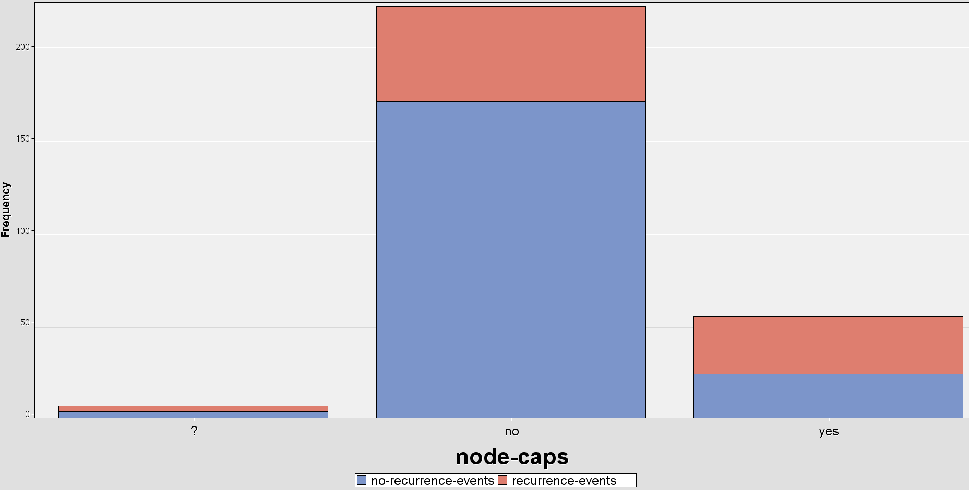
Exploration Data Analysis (EDA) – Other findings
Other Interesting Finding:
Brest Cancer commonly happen:
At the left quadrant of the breasts
Among women of 45-65 years old
With no node-caps
Premenopause or greater than 40 years old
Bar plot of breast-quad
Histogram of age_max
Node-caps

Slide 7
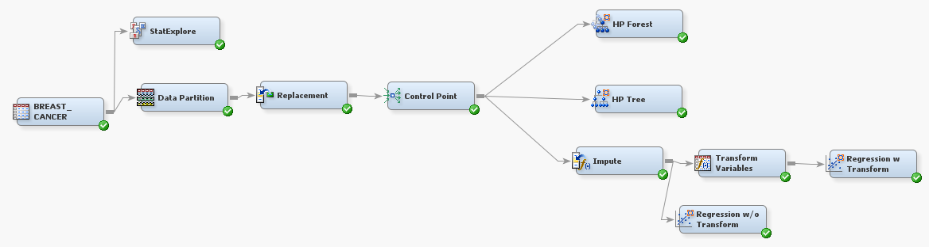
Predictive Modeling
Diagram:

Slide 8
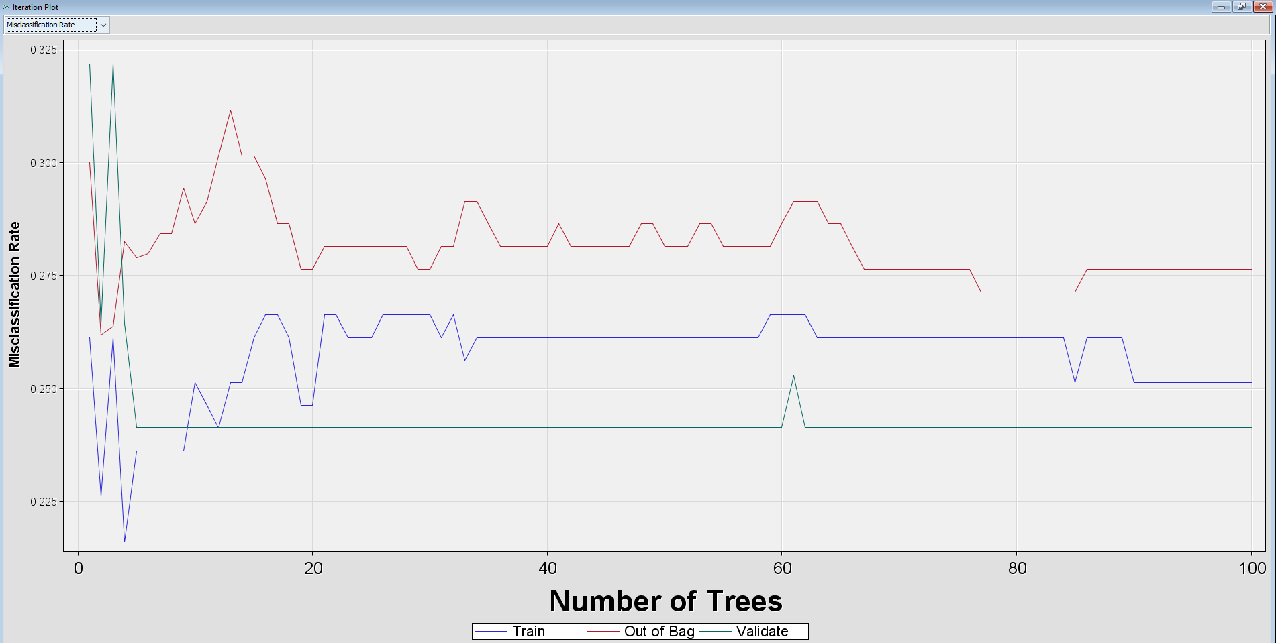
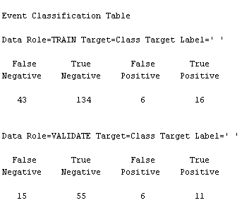
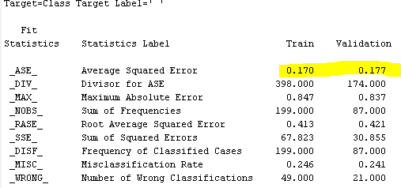
Predictive Modeling
Random Forest
Misclassification Plot
Maximum of 20 trees after finding that no improvement in misclassification after 20 trees
Average Squared Error of 0.177
Fit statistics:
Classification Performance:

Slide 9
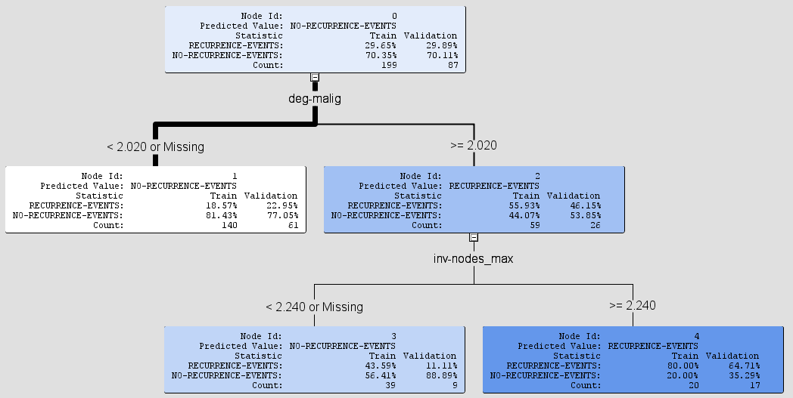
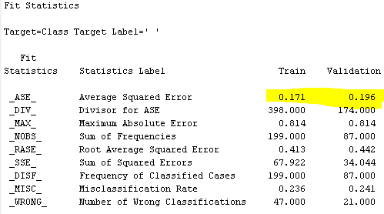
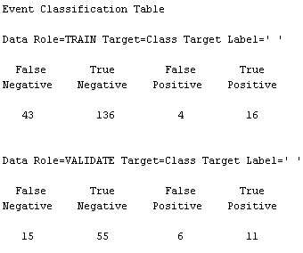
Predictive Modeling
Decision Tree
10-fold Cross Validation – ensure consistency in performance
Hyperparameter:
Maximum Depth: 10,
Maximum leaf size: 5
Average Squared Error of 0.196
Fit statistics:
Classification Performance:

Slide 10
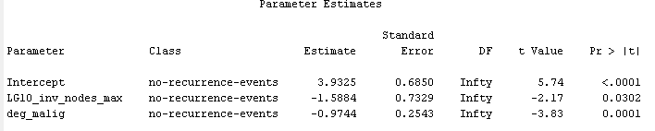

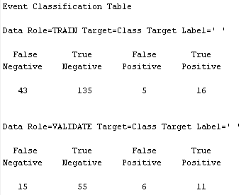
Predictive Modeling
Logistic Regression
Logistic Regression Parameters
Additional steps of Imputation and Transformation
Average Squared Error of 0.185
Improvement from 0.2 to 0.185 by using Transformation
Fit statistics:
Classification Performance:

Slide 11
Model comparison
Average Squared Error
Random Forest has the best performance- lowest ASE
Ensemble effect
Logistic Regression second-best performance
Significant improvement with Transformation
Prove that model complexity is not that important
Model | Averaged Squared Error (Validation)
Random Forest | 0.177
Decision Tree | 0.196
Logistic Regression without Transformation | 0.2
Logistic Regression with Transformation | 0.185

Slide 12
Conclusion
deg-malig has clear relationship with target variable
Brest Cancer commonly happen:
At the left quadrant of the breasts
Among women of 45-65 years old
With no node-caps
Premenopause or greater than 40 years old
Random Forest has the best ASE followed by Logistic Regression
Model Complexity is not the key to good predictive model

Slide 13
Thank you

