Slide 1

EEE 306 : POWER SYSTEM I LABORATORY
Project Title:
Load Forecasting Using Parallel CNN and LSTM Architecture
Supervised By:
Dr. Md. Nasim Ahmed Dewan
Professor, EEE, BUET
Shafayeth Jamil
Adjunct Lecturer, BUET
Prepared By:
Mithon Rahman (1906028)
Chinmoy Biswas(1906029)
Abrar Al-Shadid Abir(1906030)
Vivek Chowdhury (1906031)
Sabir Mahmud (1906032)
Nafis Faisal (1906033)

Slide 2
Outline
Objective
Load Forecasting and It’s Importance
Purposes of the Algorithms
Prediction Process
Data Collection
Data Visualization
Training and Testing
Conclusion

Slide 3
Objective
To get familiar with load-forecasting for economic power system planning and operation.
Understanding the importance of different neural networks in forecasting tasks.
Understanding the variation of loads due to human behavior, temperature and holiday events.
Improving the model in order to get better performance and result.

Slide 4
Load Forecasting and It’s Importance
Load Forecasting:
A technique to predict the power/energy.
Uses numerical techniques or AI algorithms (i.e - Neural Networks).
Can be short-term (a few hours), medium-term (a few weeks up to a year) or long-term (over a year).
Have to keep in mind about the factors that affect the loads. (i.e-temperature, humidity, holidays etc.)

Slide 5
Load Forecasting and It’s Importance
Importance:
Plays an effective role in power system planning.
Reduces electrical waste, improves revenue and ensures stable operation of a power system.
Helps to determine future fuel requirements for operating a power plant.

Slide 6
Purposes of the Algorithms
Algorithms Used:
Convolutional Neural Network (CNN)
Long Short-Term Memory (LSTM)
Feed Forward (FF)

Slide 7
Prediction Process
We used the short-term load forecasting method.
We will predict hourly load
Written in Python using the Pytorch module.
BUET Power Plant Load Data which will be our historical load sequence.
Temperature, relative humidity, precipitation, wind speed at a 50 meter average, near Azimpur area were collected from NASA website
Also, Holidays and Day of the week are taken under consideration for better prediction.

Slide 8
Prediction Process
Purposes:
CNN components extract rich features from historical load sequences.
LSTM is used to model the daily/weekly periodicity of loads, temperatures, holiday, the hour of a day and the day of a week due to the regular work and lifestyle of people.
Deep Feed-forward component takes the outputs of LSTMs as inputs.

Slide 9

Data Collection
Collected the temperature, Relative Humidity, Precipitation, Wind Speed data easily from google.
But collecting the historical load sequence data (year 2015,2016,2020 and 2021) from BUET Power Plant was a tough task.
Because the data provided were hard copies.
Some of the data were missing.
Digitalized the data by hands and preprocessed them.
Historical load data collection

Slide 10

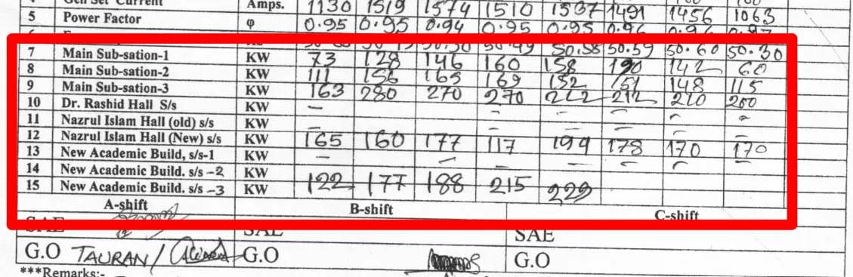
Data Collection
Only the data from 8am to 11pm were present in the log sheet.
We calculated total loads for a particular hour of a particular day of a particular month of a particular year.
All these data were entered manually in Excel.

Slide 11
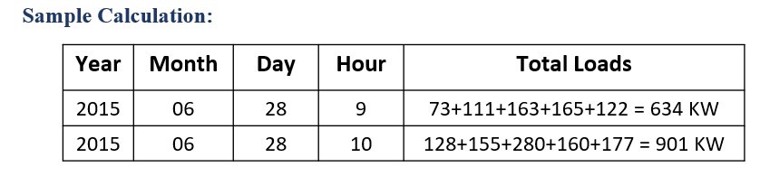
We calculate the total load supplied by the BUET power plant irrespective of the substation

Slide 12
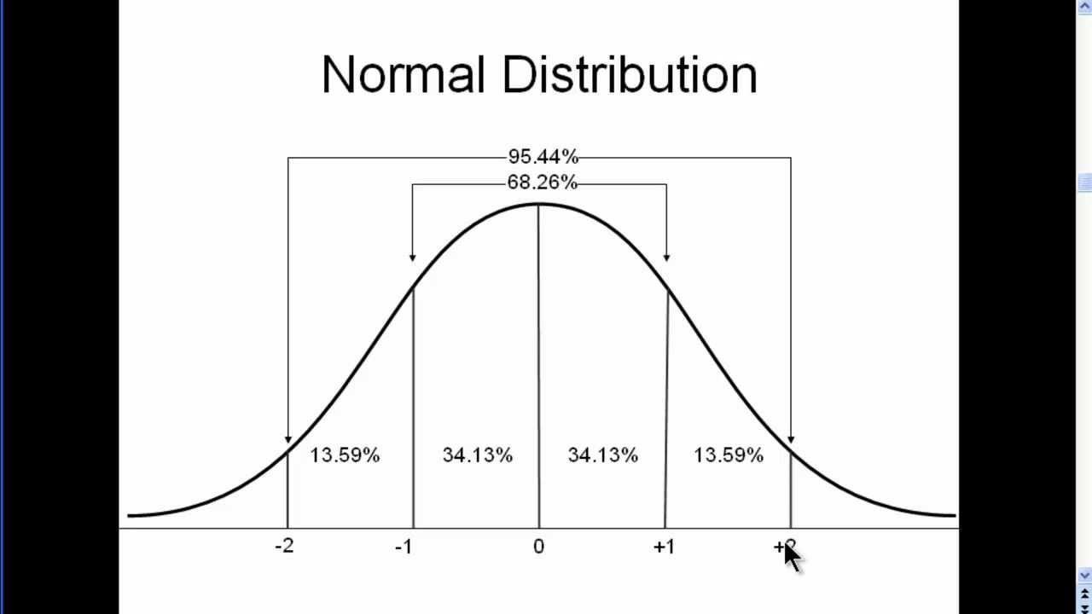
Data Collection
•There were a lot of missing data. Out of potentially of almost 23k data (4 years worth) there were only 9k available.
•But LSTMs require continuous time series data.
•We thus filled out the missing data considering a normal distribution of load at a particular hour.
•We then scaled all the data from -1 to 1 to make it usable in the model.

Slide 13
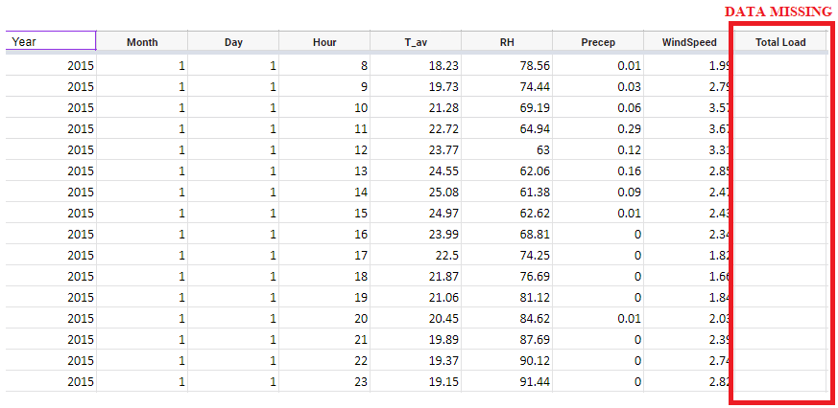
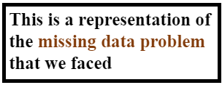
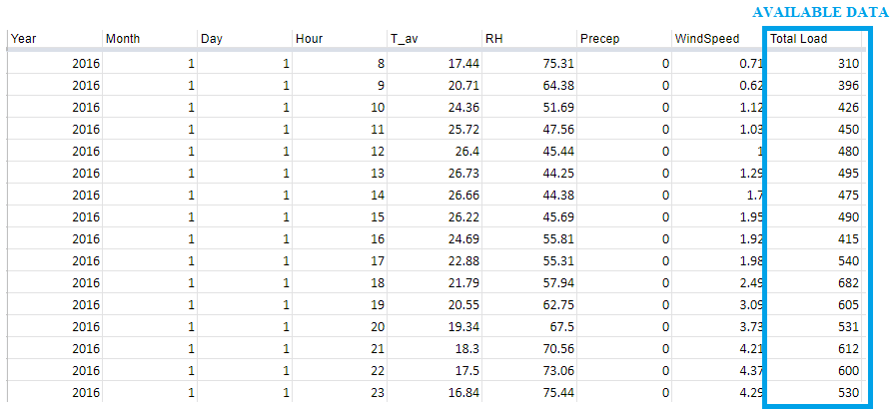
Data Collection

Slide 14
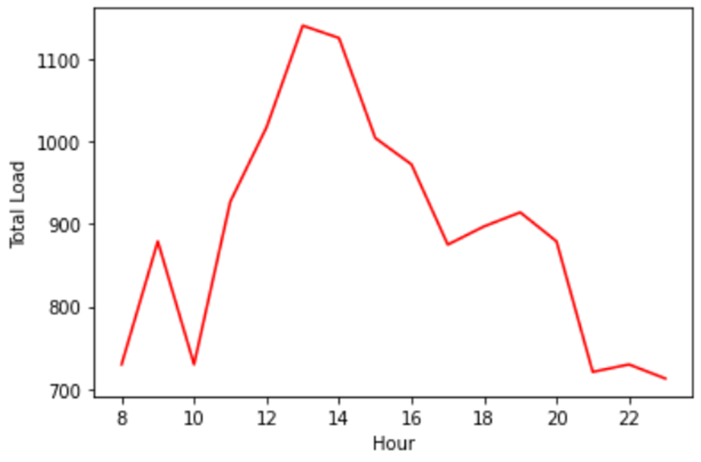
Data Visualization
Fig: Hourly load demand of 03/03/2022
Notice the bell shape of the hourly data

Slide 15
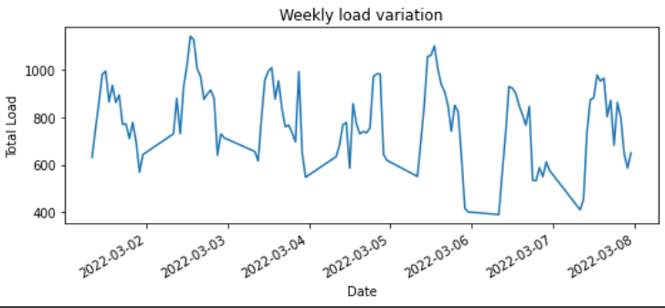
Data Visualization
Fig. Weekly load variation of the first week of March 2022
Notice the periodicity of the weekly data

Slide 16
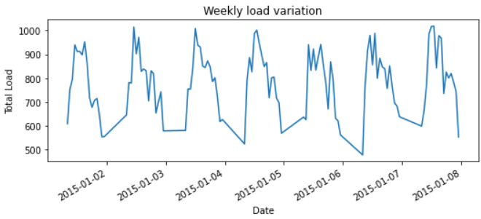
Data Visualization
Fig. Weekly load variation of the first week of January 2015 (synthesized)
In 2015, a lot of data were missing.
An hourly normal distribution of load gives a similar weekly load variation curve like the previous.

Slide 17
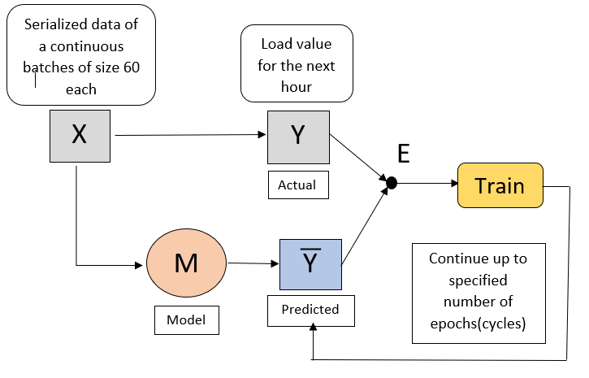
Training and Testing
ERROR
For training, we have a set of input data and corresponding truth output.
From the model we get the predicted output. The model learns based on their error.

Slide 18
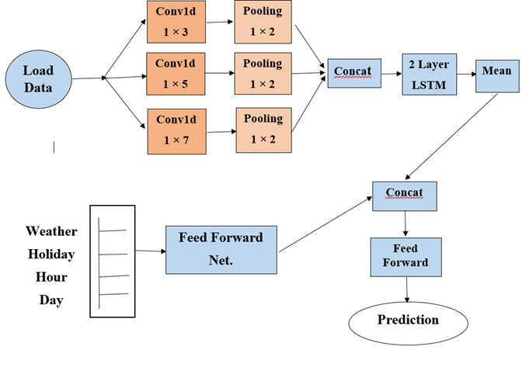
Training and Testing
Used continuous data from 1/1/2015 from 22/8/2021 [67%] as training
Tested from 23/8/2021 to 31/12/2022 [rest] for 20 cycles (or epochs).
At first, we used a parallel CNN and LSTM, which was ineffective.

Slide 19
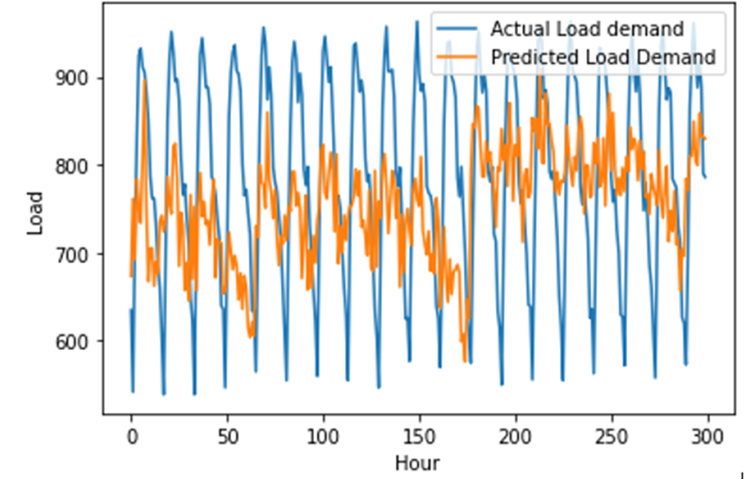
Training and Testing
Using that model, we faced the dreaded vanishing gradient problem which means the model was not learning properly.

Slide 20
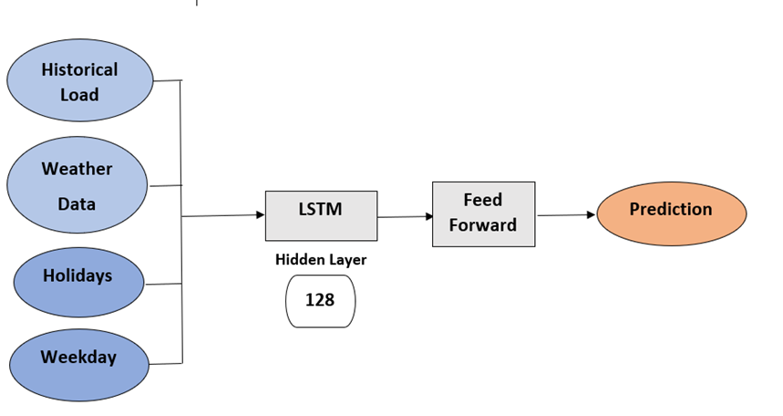
Training and Testing
So, we implemented a new model:

Slide 21
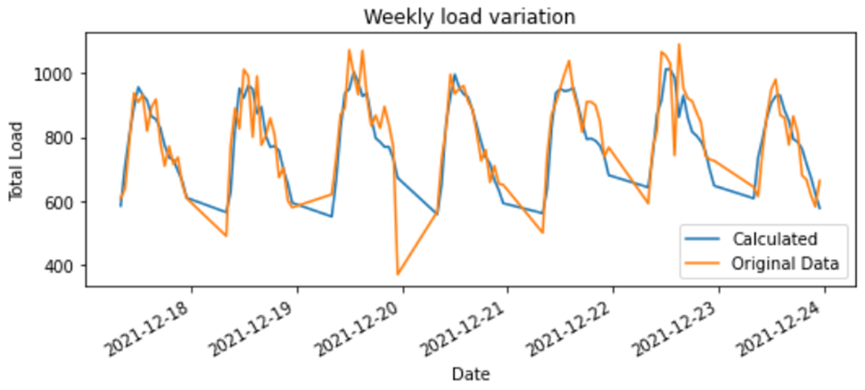
Training and Testing
This model gave pretty accurate results

Slide 22
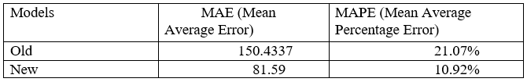
Training and Testing
A comparison of mean average error and mean average percentage error between the two models is given below:

Slide 23
Conclusion
We got pretty good results from such sparse time series data.
Our predictions would have been more accurate if we could get access to the whole data bank of BUET Power Plant.
There may be more efficient neural network architectures, but our current model gives fairly good result.

Slide 24
THE END
ANY QUESTIONS ?

