Slide 1

OBJECT ORIENTED PROGRAMMING USING JAVA

Slide 2
Course Type: | Foundation |  | L | T | P | Credits
 |  |  | 3 | 1 | 4 | 5
COURSE CREDITS

Slide 3
COURSE OUTCOME
Examine | CO1: To examine different programming structures in a platform independent language such as wrapper classes, collections, exceptions, and multithreading.
Explain | CO2: To explain the concepts of object-oriented programming like encapsulation, abstraction, inheritance and polymorphism. Also java specific implementation of features like collection framework and multithreading would be covered.
Implement | CO3:Make use of GUI and database based programming to develop Applications for real life problems.

Slide 4
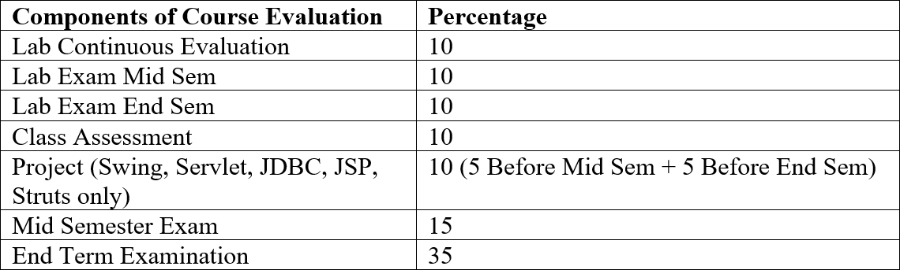
EVALUATION COMPONENT

Slide 5
RESOURCES
Edx-Object Oriented Programming in Java.
https://www.edx.org/course/introduction-to-java-programming- starting-to-code
Coursera-Object Oriented Programming in Java Specialization.
https://www.coursera.org/specializations/object- oriented-programming
MIT OpenCourseWare-Introduction to Programming in Java.
https://ocw.mit.edu/courses/electrical-engineering-and-computer- science/6-092-introduction-to-programming-in-java-january-iap-2010/

Slide 6
RESOURCES
Edx-1 month audit access by Microsoft account.
GTx: Introduction to Object-Oriented Programming with Java I: Foundations and Syntax Basics
GTx: Introduction to Object-Oriented Programming with Java II: Object-Oriented Programming and Algorithms
GTx: Introduction to Object-Oriented Programming with Java III: Exceptions, Data Structures, Recursion, and GUIs
GTx: Data Structures & Algorithms I: ArrayLists, LinkedLists, Stacks and Queues
GTx: Data Structures & Algorithms II: Binary Trees, Heaps, SkipLists HashMaps

Slide 7
LABTOOL
Lab Platform
CodeTantra (Continuous Labs & Exams)
IDE
Eclipse
Netbeans
IntelliJ IDEA

Slide 8
FUNDAMENTALS

Slide 9
OUTLINE
Introduction to Java
Bytecode
JVMArchitecture
Applications of Java
Types of JavaApplication History of Java Features of Java
Simple Java Program
◾
◾
◾
◾

Slide 10
INTRODUCTION TO JAVA
Java is a general purpose programming language.
It is High Level language.
Java was originally developed by James Gosling at Sun Microsystems in 1995.
Java is a language that is platform independent.
A platform is the hardware and software environment in which a programs run.
Java has its own Java Runtime Environment (JRE) andAPI.

Slide 11
INTRODUCTION TO JAVA (CONT…)
Java code is once compiled, it can run on any platform without recompiling or any kind of modification.
“Write Once RunAnywhere”
The aforementioned feature of Java is supported by Java Virtual Machine (JVM).
First, Java code is complied into bytecode. This bytecode gets interpreted on different machines. Java bytecode is the result of the compilation of a Java program, an intermediate representation of that program which is machine independent.

Slide 12
BYTECODE
When we write a program in Java, at first, the compiler compiles the program and a bytecode is generated.
When we wish to run this .class file on any other platform, we can do so.
After the first compilation, the generated bytecode is now run by the Java Virtual Machine and the processor is not in consideration (only java installation is required).
Implementation of JVM is based on stack.

Slide 13
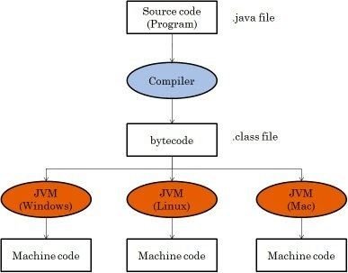
BYTECODE (CONT…)
S
Fig 1: Bytecode

Slide 14
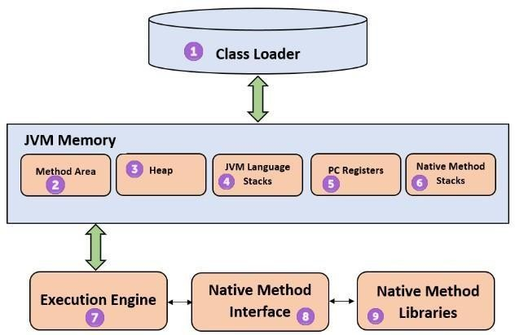
JVMARCHITECTURE
Fig 2: JVM architecture

Slide 15
APPLICATIONS OF JAVA
Approx. 3 Billion devices run java. Some of them are as follows:
Desktop applications
Web applications
Enterprise applications (banking)
Mobile
Embedded system
Smart card
Robotics
Games

Slide 16
TYPES OF JAVAAPPLICATION
There are 4 type of java applications:
Standalone Application: An application that install on each system (AWT and Swing are used).
Web Application: An application that runs on the server side and creates dynamic page (servlet, jsp, etc are used).
Enterprise Application: An application that is distributed in nature, such as banking applications. It has the advantage of high level security and load balancing.
Mobile Application: An application that is created for mobile devices (Android and Java ME are used).

Slide 17
HISTORY OF JAVA
James Gosling, Mike Sheridan, and Patrick Naughton initiated the Java language project in June 1991. The small team of sun engineers called Green Team.
Firstly, it was called "Greentalk" by James Gosling and file extension was .gt.
After that, it was called Oak and developed as a part of the Green project.
In 1995, Oak was renamed as "Java“.
JDK 1.0 released in 23 Jan 1996.

Slide 18
FEATURES OF JAVA
There are many features of Java:
Object-oriented
Platform independent
Secure
Robust
Portable
Dynamic
High performance
Multithread
Distribute

Slide 19
SIMPLE JAVA PROGRAM
To create a simple java program, you need to create a class that contains main method.
class Hello
{
public static void main(String args[])
{
System.out.println(“Hello World”);
}
}

Slide 20
SIMPLE JAVA PROGRAM (CONT…)
Save: Save as Hello.java
To compile: javac Hello.java
To execute: java Hello
Output: Hello World

Slide 21
SIMPLE JAVA PROGRAM (CONT…)
class keyword is used to declare a class.
public keyword is an access modifier, which represents visibility. It means it is
visible to all.
static is a keyword. If we declare any method as static, it is known as the static method. The core advantage of the static method is that there is no need to create an object to invoke the static method. The main method is executed by the JVM, so it doesn't require to create an object to invoke the main method. Thus, it saves memory.
void is the return type of the method. It means it doesn't return any value.
main represents the starting point of the program.
String args [] is an array of strings which stores arguments passed by command line while starting a program.
System.out.println() is used to print statement. Here, System is a class, out is
the object of PrintStream class, println() is the method of PrintStream class.
14

Slide 22
SIMPLE JAVA PROGRAM (CONT…)
The subscript notation in Java array can be used after type, before the variable or after the variable.
public static void main(String[] args)
public static void main(String []args)
public static void main(String args[])

Slide 23
SIMPLE JAVA PROGRAM (CONT…)
Valid Java main method signature:
public static void main(String[] args)
public static void main(String []args)
public static void main(String args[])
public static void main(String... args)
static public void main(String[] args)

Slide 24
SIMPLE JAVA PROGRAM (CONT…)
Invalid Java main method signature:
public void main(String[] args)
static void main(String[] args)
public void static main(String[] args)

Slide 25
SIMPLE JAVA PROGRAM (CONT…)
Giving a semicolon at the end of a class is optional in Java.
class Hello
{
public static void main(String args[])
{
System.out.println(“Hello World”);
}
};

Slide 26
THANK YOU
?

