Slide 1


OBJECT ORIENTED PROGRAMMING USING JAVA

Slide 2
Introduction to Array
Array: An ordered collection of values with two distinguishing characters:
Ordered and fixed length
Homogeneous. Every value in the array must be of the same type
The individual values in an array are called elements. The number of elements is called the length of the
array
Each element is identified by its position number in the array, which is called index. In Java, the index numbers begin with 0.

Slide 3
Array declaration
An array is characterized by Element type
Length
type[ ] identifier = new type[length];
Default values in initialization
numerics boolean objects
0
false null

Slide 4
An array of objects
Elements of an array can be objects of any Java class.
Example: An array of 5 instances of the student class
Student[] topStudents = new Student[5];

Slide 5
Defining length
Use named constant to declare the length of an array.
private static final in N_JUDGES = 5; double[ ] scores = new double[N_JUDGES];
Or read the length of an array from the user.

Slide 6
Selecting elements
Identifying an element
array[index]
Index can be an expression Cycling through array elements
for (int i = 0; i < array.length; i++) { operations involving the ith element
}

Slide 7
Two-dimensional arrays
Each element of an array is an array (of the same dimension)
int[][] A = new int[3][2]
An array of three arrays of dimension two
A[0][0]
A[1][0]
A[2][0]
A[0][1]
A[1][1]
A[2][0]
3-by-2 matrix

Slide 8
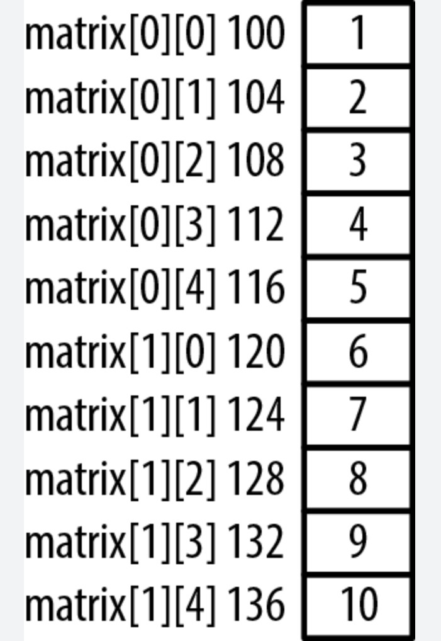
Memory allocation (row orientation)

Slide 9
Initializing a two-dimensional array
Static int A[3][2] = {
{1, 4},
{2, 5},
{3, 6}
};
A 3-by-2 matrix

Slide 10
Some Programming Questions (Assume int data type)
Q. WAP to find the peak element in an unsorted array which is not smaller than its neighbors. Array has to be taken as input.
Q. WAP to check if any triplets exist in an unsorted array whose sum is equal to x. Here x is taken as input from user and the unsorted array is also to be taken as input.
Q. WAP to find Kth largest and Kth smallest numbers in an array. Both K and array are taken as input.
Q. WAP to find all pairs of elements in a sorted array whose sum is equal to a given no. x. Here x is taken as input and unsorted array is also taken as input.

Slide 11
Swapping Values of Two Variables
Miscellaneous
No temporaries!
x = x + y; y = x - y;
x = x - y;
Value stored in
x y
a b
a+b b
a+b a
b a
Sometime we write 4.0 / 8, which is a mixed-type expression
Java defines only: int / int, double / double
to perform the mixed-type numerical operation, Java needs to convert the
operands to be of the same type idea

Slide 12
Widening Primitive Conversions
Widening primitive conversions are those that do not lose information about the overall magnitude of a numeric value
Java defines 19 primitive conversions as widening primitive conversions
byte → short, int, long, float, double short → int, long, float, double
char → int, long, float, double int → long, float, double
long → float, double
float → double
They are generally safe because they tend to go from a small data type to a larger one (such as a short to an int)
can problems happen in some of the cases?

Slide 13
Narrowing Primitive Conversions
Java defines 23 primitive conversions as narrowing primitive conversions
byte → char
short → char → | byte, byte, | char short
int → long → | byte, byte, | short, short, | char char, | int
float → | byte, | short, | char, | int, long
double→ | byte, | short, | char, | int, long, float
Narrowing primitive conversions may lose overall magnitude of a numeric value, or precision

Slide 14
How Do Data Conversions Happen?
Implicitly: arithmetic (numeric) promotion
occurs automatically when the operands of a binary arithmetic operator
(note “=“ is not one) are of different types
the promotion uses widening conversion, i.e.,
if either operand is double, the other is converted to double otherwise, if either operand is float, the other is converted to float otherwise, if either operand is long, the other is converted to long otherwise, both operands are converted to int
Examples:
4.0 / 8 (which / is it: double/double, float/float, int/int)
4 / 8.0 (which / is it: double/double, float/float, int/int)
- 4 + 5 / 9 + 1.0 + 5 / 9 / 10.0 (what is the value?)

Slide 15
How Do Data Conversions Happen?
Implicitly: string conversion
applies only to the operands of the operator +
occurs automatically: when one of the operands is a string, the other operand is converted to a string
Examples:
System.out.println( “Year: “ + 2000 ); System.out.println( “Year: “ + (2000 + 5) ); System.out.println( “Year: “ + 200 + 5); System.out.println( 200 + 5 + “Year: “ );

Slide 16
How Do Data Conversions Happen?
Implicitly: assignment conversion
occurs automatically when the value of an expression is assigned to a variable of another type:
only widening primitive conversions are allowed
or a special case of narrowing primitive conversions: the expression is a constant of type int: e.g., 2 * 200 the type of the variable is byte, short or char
the compiler can check to be sure that the value is representable by the type of the variable
Examples:
byte theAnswer = 42; // is this OK?
float myFloat1 = 2;
float myFloat1 = 2.0;
// is this OK?
// is this OK?
float myFloat3 = theAnswer; // is this OK?

Slide 17
How Do Data Conversions Happen?
Explicitly: Casting
Casting is the most powerful and dangerous technique for data conversions
Both widening and narrowing conversions can be
accomplished by explicitly casting a value
To cast, the type is put in parentheses in front of the value/variable being converted
for example, if total and count are integers, but we want a floating
point result when dividing them, we can explicitly cast total to be a
float:
result = (float) total / count;

Slide 18
Casting
Pay particular attention when you forcefully cast a narrowing conversion, e.g.,
when you cast a float/double to an int, the float/double is just
truncated to an int (e.g., 0.99 is truncated to 0), not rounded
to an int (e.g., 0.5 will be rounded to 1)
Example:
double myDouble = 2.4 / 3.0;
int myInt = (int) myDouble;
// what is the value of myInt ?

Slide 19
Some Programming Questions (Assume int data type)
Q. WAP to take a matrix as input. Then figure out which row has the maximum sum.
Q. WAP to sort an array of 0s, 1s, and 2s. Array has to be taken as input.
Advance Conceptual Problem – Coin Change

Slide 20
String
20
String and character processing
Class java.lang.String
Class java.lang.StringBuffer
Class java.lang.Character
Class java.util.StringTokenizer

Slide 21
Fundamentals of Characters and Strings
21
Characters
“Building blocks” of non-numeric data
’a’, ’$’, ’4’
String
Sequence of characters treated as single unit May include letters, digits, etc.
Object of class String
String name = “Frank N. Stein”;
Class String
Provides nine constructors
Null constructor String() has no characters and a length of zero
String (array, offset, number of characters)

Slide 22

Outline
22
// Fig. 11.1: StringConstructors.java
// String class constructors.
import javax.swing.*;
4
5 public class StringConstructors {
6
7
8
9
10
11
12
13
14
15
16
17
18
19
20
21
22
String default constructor instantiates empty string
Str
a
ingConstructors.jav
Constructor copies String
public static void main( String args[] )
{
char charArray[] = { 'b', 'i', 'r', 't', 'h', ' ', 'd', 'a byte byteArray[] = { ( byte ) 'n', ( byte ) 'e',
Constructor copies character array
', 'y' }; _{Line 17}
( byte ) 'w', ( byte ) ' ', ( byte ) 'y',
( byte ) 'e', ( byte ) 'a', ( byte ) 'r' };
Constructor copies
Line 18
character-array subset
String s = new String( "hello" );
Line 19
// use String constructors String s1 = new String( ); String s2 = new String( s );
String s3 = new String( charArray ); String s4 = new String( charArray, 6, 3 ); String s5 = new String( byteArray, 4, 4 ); String s6 = new String( byteArray );
Constructor copies byte-array subset
Line 20
Constructor copies byte array
Lin
e 21
Line 22
© 2003 Prentice Hall, Inc. All rights reserved.

Slide 23

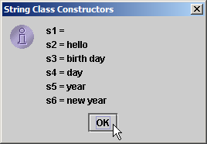
Outline
23
23 24 // append Strings to output 25 String output = "s1 = " + s1 + "\ns2 = " + s2 + "\ns3 = " + s3 + 26 "\ns4 = " + s4 + "\ns5 = " + s5 + "\ns6 = " + s6; 27 28 JOptionPane.showMessageDialog( null, output,
29 |  | "String Class Constructors", JOptionPane.INFORMATION_MESSAGE | );
30
31 |  | System.exit( 0 );
32 | }
33
34 } // end class StringConstructors
StringConstructors.jav a
© 2003 Prentice Hall, Inc. All rights reserved.

Slide 24
String Methods length, charAt and getChars
24
Method length
Determine String length
Like arrays, Strings always “know” their size
Unlike array, Strings do not have length instance variable
s1.length()
Method charAt
Get character at specific location in String
s1.charAt( offset )
Method getChars
Get entire set of characters in String
s1.getChars( start, first after, charArray, start );

Slide 25
Outline
25
// Fig. 11.2: StringMiscellaneous.java
// This program demonstrates the length, charAt and getChars
// methods of the String class.
import javax.swing.*;
5
6 public class StringMiscellaneous {
7
public static void main( String args[] )
{
String s1 = "hello there";
char charArray[] = new char[ 5 ];
12
13 String output = "s1: " + s1;
14
// test length method
output += "\nLength of s1: " + s1.length();
17
// loop through characters in s1 and display reversed
output += "\nThe string reversed is: ";
20
for ( int count = s1.length() - 1; count >= 0; count-- )
output += s1.charAt( count ) + " ";
StringMiscellaneous.ja va
Line 16
Line 21
Determine number of characters in String s1
Append s1’s characters in reverse order to String output
© 2003 Prentice Hall, Inc. All rights reserved.

Slide 26
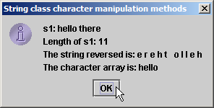
Outline
26
23
24
25
26
27
28
29
30
31
32
33
34
35
36
37
38 } // end class StringMiscellaneous
// copy characters from string into charArray s1.getChars( 0, 5, charArray, 0 );
output += "\nThe character array is: ";
for ( int count = 0; count < charArray.length; count++ ) output += charArray[ count ];
JOptionPane.showMessageDialog( null, output, "String class character manipulation methods", JOptionPane.INFORMATION_MESSAGE );
System.exit( 0 );
Copy (some of) s1’s characters to charArray
StringMiscellaneous.ja va
Line 25
}
© 2003 Prentice Hall, Inc. All rights reserved.

Slide 27
Comparing Strings
27
Comparing String objects
Should not use == (true only if the strings are at the same address, i.e., same string) Primitives contain values, objects contain addresses
Method equals (true if the strings are identical)
Method equalsIgnoreCase
Method compareTo
a.compareTo(b), 0 if a and b are same, negative if a<b, positive if a>b Method regionMatches
a.regionMatches(start, b, start, num of chars) (true if the strings are identical)

Slide 28
Outline
28
// Fig. 11.3: StringCompare.java
// String methods equals, equalsIgnoreCase, compareTo and regionMatches.
import javax.swing.JOptionPane;
4
5 public class StringCompare {
6
public static void main( String args[] )
{
String s1 = new String( "hello" );
String s2 = "goodbye";
String s3 = "Happy Birthday";
String s4 = "happy birthday";
13
14
15
16
17
18
19
20
21
22
23
24
25
26
27
StringCompare.java
Line 18
// s1 is a copy of "hello"
Line 24
String output = "s1 = " + s1 + "\ns2 = " + s2 + "\ns3 = " + s3 + "\ns4 = " + s4 + "\n\n";
// test for equality
if ( s1.equals( "hello" ) ) // true output += "s1 equals \"hello\"\n";
else
output += "s1 does not equal \"hello\"\n";
Method equals tests two objects for equality using lexicographical comparison
// test for equality with ==
if ( s1 == "hello" ) // false; they are not the same object output += "s1 equals \"hello\"\n";
else
output += "s1 does not equal \"hello\"\n";
Equality operator (==) tests if both references refer to same object in memory
© 2003 Prentice Hall, Inc. All rights reserved.

Slide 29
Outline
29
28
29
30
31
32
33
34
// test for equality (ignore case)
Test two objects for equality, but ignore case of letters in Strings
if ( s3.equalsIgnoreCase( s4 ) )
output += "s3 equals s4\n";
else
// tru
e
StringCompare.java
output += "s3 does not equal s4\n";
Line 30
Lines 36-40
35 36 37 | // test compareTo output += "\ns1.compareTo( s2 "\ns2.compareTo( s1 ) is " |  |  |  | ) + | is " + s1.compareTo( s2.compareTo( s1 ) +
38 | "\ns1.compareTo( | s1 | ) is | " | + | s1.compareTo( | s1 | ) +
39 | "\ns3.compareTo( | s4 | ) is | " | + | s3.compareTo( | s4 | ) +
40 | "\ns4.compareTo( | s3 | ) is | " | + | s4.compareTo( | s3 | ) +
41
Method compareTo
compares String objects
s2 ) +
"\n\n
"; Line
43 and 49
Method regionMatches
42
43
44
45
46
47
48
49
50
51
52
// test regionMatches (case sensitive) if ( s3.regionMatches( 0, s4, 0, 5 ) )
output += "First 5 characters of s3 and s4 match\n"; else
compares portions of two
String objects for equality
output += "First 5 characters of s3 and s4 do not match\n";
// test regionMatches (ignore case)
if ( s3.regionMatches( true, 0, s4, 0, 5 ) )
output += "First 5 characters of s3 and s4 match"; else
output += "First 5 characters of s3 and s4 do not match";
© 2003 Prentice Hall, Inc. All rights reserved.

Slide 30
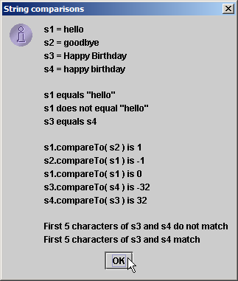
Outline
30
53
54 |  | JOptionPane.showMessageDialog( null, output,
55 |  | "String comparisons", JOptionPane.INFORMATION_MESSAGE );
56
57 |  | System.exit( 0 );
58 | }
59
60 } // end class StringCompare
StringCompare.java
© 2003 Prentice Hall, Inc. All rights reserved.

Slide 31
Outline
31
// Fig. 11.4: StringStartEnd.java
// String methods startsWith and endsWith.
import javax.swing.*;
4
5 public class StringStartEnd {
6
public static void main( String args[] )
{
String strings[] = { "started", "starting", "ended", "ending" };
String output = "";
11
// test method startsWith
for ( int count = 0; count < strings.length; count++ )
14
if ( strings[ count ].startsWith( "st" ) )
output += "\"" + strings[ count ] + "\" starts with \"st\"\n";
17
18 output += "\n";
19
// test method startsWith starting from position
// 2 of the string
for ( int count = 0; count < strings.length; count++ )
23
if ( strings[ count ].startsWith( "art", 2 ) )
output += "\"" + strings[ count ] +
"\" starts with \"art\" at position 2\n";
StringStartEnd.java
Line 15
Line 24
Method startsWith determines if String starts with specified characters
© 2003 Prentice Hall, Inc. All rights reserved.

Slide 32
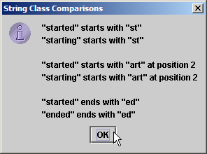
Outline
32
27
28
29
30
31
32
33
34
35
36
37
38
39
40
41
42 } // end class StringStartEnd
output += "\n";
// test method endsWith
for ( int count = 0; count < strings.length; count++ )
StringStartEnd.java
if ( strings[ count ].endsWith( "ed" ) )
output += "\"" + strings[ count ] + "\" ends with \"ed\"\n";
Line 33
JOptionPane.showMessageDialog( null, output,
"String Class Comparisons", JOptionPane.INFORMATI
ON_MESSAGE );
Method endsWith
System.exit( 0 );
determines if String ends
}
with specified characters
© 2003 Prentice Hall, Inc. All rights reserved.

Slide 33
Locating Characters and Substrings in Strings
33
Search for characters in String
Method indexOf
indexOf(char), indexOf(char,start)
indexOf(string), indexOf(string,start)
Method lastIndexOf
lastIndexOf(char), lastIndexOf(char,start) lastIndexOf(string), lastIndexOf(string,start)

Slide 34
Outline
34
// Fig. 11.5: StringIndexMethods.java
// String searching methods indexOf and lastIndexOf.
import javax.swing.*;
4
5 public class StringIndexMethods {
6
7
8
9
10
11
12
13
14
15
16
17
18
19
20
21
22
23
24
25
26
27
StringIndexMethods.jav a
public static void main( String args[] )
{
String letters = "abcdefghijklmabcdefghijklm";
Lines 12-16
// test indexOf to locate a character in a string
String output = "'c' is located at index " + letters.indexOf( 'c' );
Method indexOf finds first
occurrence of character in String
Lines 19-26
output += "\n'a' is located at index " + letters.indexOf( 'a', 1 );
output += "\n'$' is located at index " + letters.indexOf( '$' );
// test lastIndexOf to find a character in a string output += "\n\nLast 'c' is located at index " +
letters.lastIndexOf( 'c' );
Method lastIndexOf finds last occurrence of character in String
output += "\nLast 'a' is located at index " + letters.lastIndexOf( 'a', 25 );
output += "\nLast '$' is located at index " + letters.lastIndexOf( '$' );
© 2003 Prentice Hall, Inc. All rights reserved.

Slide 35
Outline
35
28
29
30
31
32
33
34
35
36
37
38
39
40
41
42
43
44
45
46
47
48
49
50
51
52
53
54 } // end class StringIndexMethods
// test indexOf to locate a substring in a string output += "\n\n\"def\" is located at index " +
letters.indexOf( "def" );
output += "\n\"def\" is located at index " + letters.indexOf( "def", 7 );
StringIndexMethods.jav a
output += "\n\"hello\" is located at index " + letters.indexOf( "hello" );
Lines 29-46
Methods indexOf and lastIndexOf can also find occurrences of substrings
// test lastIndexOf to find a substring in a string output += "\n\nLast \"def\" is located at index " +
letters.lastIndexOf( "def" );
output += "\nLast \"def\" is located at index " + letters.lastIndexOf( "def", 25 );
output += "\nLast \"hello\" is located at index " + letters.lastIndexOf( "hello" );
JOptionPane.showMessageDialog( null, output,
"String searching methods", JOptionPane.INFORMATION_MESSAGE );
System.exit( 0 );
}
© 2003 Prentice Hall, Inc. All rights reserved.

Slide 36
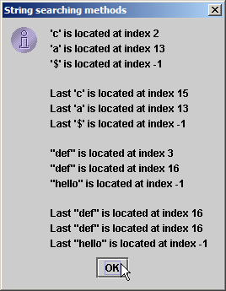
Outline
36
StringIndexMethods.jav a
© 2003 Prentice Hall, Inc. All rights reserved.

Slide 37
Extracting Substrings from Strings
37
Create Strings from other Strings
Method substring
substring(start) (all the way to the end)
substring(start, first after)

Slide 38
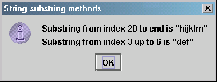
Outline
38
1 // Fig. 11.6: SubString.java
2 // String class substring methods.
3 import javax.swing.*;
4
5 public class SubString {
6
7
8
9
10
11
12
13
14
15
16
17
18
19
20
21
22
23
24 } // end class SubString
SubString.java
public static void main( String args[] )
{
String letters = "abcdefghijklmabcdefghijklm";
Line 13
Beginning at index 20, _{ne 16}
// test substring methods
String output = "Substring from index 20 to end is " +
"\"" + letters.substring( 20 ) + "\"\n";
Li
extract characters from
String letters
output += "Substring from index 3 up to 6 is " + "\"" + letters.substring( 3, 6 ) + "\"";
Extract characters from index 3
to 6 from String letters
JOptionPane.showMessageDialog( null, output,
"String substring methods", JOptionPane.INFORMATION_MESSAGE );
System.exit( 0 );
}
© 2003 Prentice Hall, Inc. All rights reserved.

Slide 39
Concatenating Strings
39
Method concat
Concatenate two String objects
s1.concat( s2 )

Slide 40
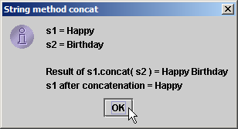
Outline
40
1 // Fig. 11.7: StringConcatenation.java
2 // String concat method.
3 import javax.swing.*;
4
5 public class StringConcatenation {
6
7
8
9
10
11
12
13
14
15
16
17
18
19
20
21
22
23 } // end class StringConcatenation
StringConcatenation.ja va
public static void main( String args[] )
{
String s1 = new String( "Happy " ); String s2 = new String( "Birthday" );
Concatenate String s2
e 14
to String s1
Lin
String output = "s1 = " + s1 + "\ns2 = " + s2;
Line 15
output += "\n\nResult of s1.concat( s2 ) = " + s1.concat( s2 );
output += "\ns1 after concatenation = " + s1;
However, String s1 is not modified by method concat
JOptionPane.showMessageDialog( null, output,
"String method concat", JOptionPane.INFORMATION_MESS
AGE );
System.exit( 0 );
}
© 2003 Prentice Hall, Inc. All rights reserved.

Slide 41
Miscellaneous String Methods
41
Miscellaneous String methods
Return modified copies of String replace(char,char) toUpperCase() toLowerCase()
trim() (remove all white space from beginning and end of string)
Return character array
toCharArray()

Slide 42
Outline
42
// Fig. 11.8: StringMiscellaneous2.java
// String methods replace, toLowerCase, toUpperCase, trim and toCharArray.
import javax.swing.*;
4
5 public class StringMiscellaneous2 {
6
7
8
9
10
11
12
13
14
15
16
17
18
19
20
21
22
23
24
25
StringMiscellaneous2.j
ava
public static void main( String args[] )
{
String s1 = new String( "hello" ); String s2 = new String( "GOODBYE" ); String s3 = new String( " spaces " );
Use method replace to return s1
copy in which every occurrence of
17
Line
‘l’ is replaced with ‘L’
Use method toUpperCase to
return s1 copy in which every character is uppercase
Line 20
Line 21
String output = "s1 = " + s1 + "\ns2 = " + s2 + "\ns3 = " + s3;
// test method replace
output += "\n\nReplace 'l' with 'L' in s1: " + s1.replace( 'l', 'L' );
Use method toLowerCase to
Line
+
24
return s2 copy in which every
// test toLowerCase and toUpperCase
character is uppercase
output += "\n\ns1.toUpperCase() = " + s1.toUpperCase()
"\ns2.toLowerCase() = " + s2.toLowerCase();
Use method trim to return s3 copy in which whitespace is eliminated
// test trim method
output += "\n\ns3 after trim = \"" + s3.trim() + "\"";
© 2003 Prentice Hall, Inc. All rights reserved.

Slide 43
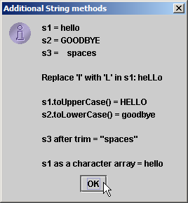
Outline
43
26
27
28
29
30
31
32
33
34
35
36
37
38
39 } // end class StringMiscellaneous2
// test toCharArray method
char charArray[] = s1.toCharArray(); output += "\n\ns1 as a character array = ";
Use method toCharArray to
return character array of s1
for ( int count = 0; count < charArray.length; ++count ) output += charArray[ count ];
StringMiscellaneous2.j ava
JOptionPane.showMessageDialog( null, output,
"Additional String methods", JOptionPane.INFORMATION_MESSAGE );
Line 27
System.exit( 0 );
}
© 2003 Prentice Hall, Inc. All rights reserved.

Slide 44
String Method valueOf
44
String provides static class methods
Method valueOf
Returns String representation of object, data, etc.
toString cannot be used with primitives, but valueOf can

Slide 45
Outline
45
// Fig. 11.9: StringValueOf.java
// String valueOf methods.
import javax.swing.*;
4
5 public class StringValueOf {
6
7
8
9
10
11
12
13
14
15
16
17
18
19
20
21
22
23
24
25
26
StringValueOf.java
public static void main( String args[] )
{
char charArray[] = { 'a', 'b', 'c', 'd', 'e', 'f' }; boolean booleanValue = true;
char characterValue = 'Z'; int integerValue = 7;
long longValue = 10000000L;
float floatValue = 2.5f; // f suffix indicates that 2.5 is a float double doubleValue = 33.333;
Object objectRef = "hello"; // assign string to an Object reference
Lines 20-26
String output = "char array = " + String.valueOf( charArray ) + "\npart of char array = " + String.valueOf( charArray, 3, 3 ) +
"\nboolean = " + String.valueOf( booleanValue ) + "\nchar = " + String.valueOf( characterValue ) + "\nint = " + String.valueOf( integerValue ) + "\nlong = " + String.valueOf( longValue ) + "\nfloat = " + String.valueOf( floatValue ) + "\ndouble = " + String.valueOf( doubleValue ) + "\nObject = " + String.valueOf( objectRef );
static method valueOf of class String returns String representation of various types
© 2003 Prentice Hall, Inc. All rights reserved.

Slide 46
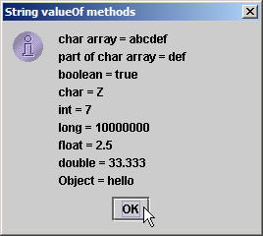
Outline
46
27
28 |  | JOptionPane.showMessageDialog( null, output,
29 |  | "String valueOf methods", JOptionPane.INFORMATION_MESSAGE );
30
31 |  | System.exit( 0 );
32 | }
33
34 } // end class StringValueOf
StringValueOf.java
© 2003 Prentice Hall, Inc. All rights reserved.

Slide 47
Class StringBuffer
47
Class StringBuffer
When String object is created, its contents cannot change
StringBuffer used for creating and manipulating dynamic string data
i.e., modifiable Strings
Can store characters based on capacity
Capacity expands dynamically to handle additional characters Uses operators + and += for String concatenation

Slide 48
StringBuffer Constructors
48
Three StringBuffer constructors
Default creates StringBuffer with no characters Capacity of 16 characters
toString method can be used to convert StringBuffer object into String object

Slide 49
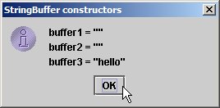
Outline
49
1 // Fig. 11.10: StringBufferConstructors.java
2 // StringBuffer constructors.
3 import javax.swing.*;
4
5 public class StringBufferConstructors {
6
7
8
9
10
11
12
13
14
15
16
17
18
19
20
21
22
23 } // end class StringBufferConstructors
Default constructor creates
empty StringBuffer with
capacity of 16 characters
Strin
gBufferConstructo a
rs.jav
Line 9
public static void main( String args[] )
{
StringBuffer buffer1 = new StringBuffer(); StringBuffer buffer2 = new StringBuffer( 10 ); StringBuffer buffer3 = new StringBuffer( "hello" );
Second constructor creates empty
StringBuffer with capacity of
specified (10) characters
Third constructor creates StringBuffer with String “hello” and capacity of 21 characters
Line 10
Line 11
String output = "buffer1 = \"" + buffer1.toString() + "\"" + "\nbuffer2 = \"" + buffer2.toString() + "\"" + "\nbuffer3 = \"" + buffer3.toString() + "\"";
JOptionPane.showMessageDialog( null, output,
"StringBuffer constructors", JOptionPane.INFORMATION_MESSAG
Lines 13-15
E );
Method toString returns
System.exit( 0 );
String representation of
}
StringBuffer
© 2003 Prentice Hall, Inc. All rights reserved.

Slide 50
50
StringBuffer Methods length, capacity, setLength and ensureCapacity
Method length
Return StringBuffer length
Method capacity
In general, capacity is 16 characters more than initial string Return StringBuffer capacity
Method setLength
Increase or decrease StringBuffer length
Characters may be discarded or null characters added
Method ensureCapacity
Set StringBuffer capacity
Guarantee that StringBuffer has minimum capacity

Slide 51
Outline
51
// Fig. 11.11: StringBufferCapLen.java
// StringBuffer length, setLength, capacity and ensureCapacity methods.
import javax.swing.*;
4
5 public class StringBufferCapLen {
6
7
8
9
10
11
12
13
14
15
16
17
18
19
20
21
22
23
24
StringBufferCapLen.jav
a
Line 12
public static void main( String args[] )
{
StringBuffer buffer = new StringBuffer( "Hello, how are you?" );
Method length returns
StringBuffer length
String output = "buffer = " + buffer.toString() + "\nlength = " buffer.length() + "\ncapacity = " + buffer.capacity();
Method capacity returns
StringBuffer capacity
+
Line 12
buffer.ensureCapacity( 75 );
output += "\n\nNew capacity = " + buffer.capacity();
Line 14
Line 17
Use method ensureCapacity
buffer.setLength( 10 );
output += "\n\nNew length = " + buffer.length() + "\nbuf = " + buffer.toString();
to set capacity to 75
Use method setLength
to set length to 10
JOptionPane.showMessageDialog( null, output, "StringBuffer length and capacity Methods", JOptionPane.INFORMATION_MESSAGE );
© 2003 Prentice Hall, Inc. All rights reserved.

Slide 52
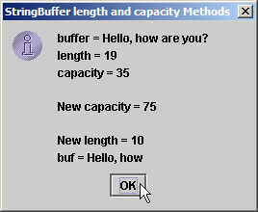
Outline
52
25
26
27
28 } // end class StringBufferCapLen
System.exit( 0 );
}
StringBufferCapLen.jav a
Only 10 characters from
StringBuffer are printed
Only 10 characters from
StringBuffer are printed
© 2003 Prentice Hall, Inc. All rights reserved.

Slide 53
StringBuffer Methods charAt, setCharAt, getChars and reverse
53
Manipulating StringBuffer characters
Method charAt
Return StringBuffer character at specified index Method setCharAt
Set StringBuffer character at specified index
Method getChars
Return character array from StringBuffer
getChars (start, first after, char array,
Method reverse
Reverse StringBuffer contents
start)

Slide 54
Outline
54
// Fig. 11.12: StringBufferChars.java
// StringBuffer methods charAt, setCharAt, getChars and reverse.
import javax.swing.*;
4
5 public class StringBufferChars {
6
7
8
9
10
11
12
13
14
15
16
17
18
19
20
21
22
23
24
25
StringBufferChars.java
public static void main( String args[] )
{
StringBuffer buffer = new StringBuffer( "hello there" );
Return StringBuffer ₁₂₋₁₃
Lines
Line 1
characters at indices 0
and 4, respectively
6
String output = "buffer = " + buffer.toString() + "\nCharacter at 0: " + buffer.charAt( 0 ) + "\nCharacter at 4: " + buffer.charAt( 4 );
Lines 22-23
char charArray[] = new char[ buffer.length() ]; buffer.getChars( 0, buffer.length(), charArray, 0 ); output += "\n\nThe characters are: ";
Return character array from StringBuffer
for ( int count = 0; count < charArray.length; ++count ) output += charArray[ count ];
Replace characters at indices 0 and 6 with ‘H’ and ‘T,’ respectively
buffer.setCharAt( 0, 'H' ); buffer.setCharAt( 6, 'T' );
output += "\n\nbuf = " + buffer.toString();
© 2003 Prentice Hall, Inc. All rights reserved.

Slide 55
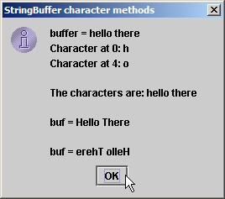
Outline
55
26
27
28
29
30
31
32
33
34
35
36 } // end class StringBufferChars
buffer.reverse();
output += "\n\nbuf = " + buffer.toString();
JOptionPane.showMessageDialog( null, output, "StringBuffer character methods", JOptionPane.INFORMATION_MESSAGE );
System.exit( 0 );
Reverse characters in
StringBuffer
StringBufferChars.java
Lines 26
}
© 2003 Prentice Hall, Inc. All rights reserved.

Slide 56
StringBuffer append Methods
56
Method append
Allow data values to be added to the end of a StringBuffer object
string1 + string2 compiled as StringBuffer(string1).append(string2)
string1 += string2 compiled as string1 = StringBuffer(string1).append(string2)

Slide 57
Outline
57
// Fig. 11.13: StringBufferAppend.java
// StringBuffer append methods.
import javax.swing.*;
4
5 public class StringBufferAppend {
6
7
8
9
10
11
12
13
14
15
16
17
18
19
20
21
22
23
24
25
26
27
StringBufferAppend.jav a
public static void main( String args[] )
{
Object objectRef = "hello"; String string = "goodbye";
char charArray[] = { 'a', 'b', 'c', 'd', 'e', 'f' }; boolean booleanValue = true;
char characterValue = 'Z'; int integerValue = 7; long longValue = 10000000;
float floatValue = 2.5f; // f suffix indicates 2.5 is a float double doubleValue = 33.333;
StringBuffer lastBuffer = new StringBuffer( "last StringBuffer" );
Line 21
Line 23
Line 25
Line 27
StringBuffer buffer = new StringBuffer();
Append String “hello” to StringBuffer
buffer.append( objectRef );
buffer.append( " " ); // each of these contains two
spaces
buffer.append( string );
Append String “goodbye”
buffer.append( " " );
buffer.append( charArray );
Append “a b c d e f”
buffer.append( " " );
buffer.append( charArray, 0, 3 );
Append “a b c”
© 2003 Prentice Hall, Inc. All rights reserved.

Slide 58
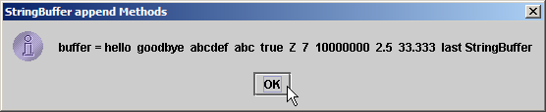
Outline
58
28
29
30
31
32
33
34
35
36
37
38
39
40
41
42
43
44
45
46
47
48
49
50 } // end StringBufferAppend
buffer.append( " " ); buffer.append( booleanValue );
buffer.append( " " );
buffer.append( characterValue );
StringBufferAppend.jav a
buffer.append( " " );
Append boolean, char, int,
long, float and double
buffer.append( integerValue );
buffer.append( " " );
buffer.append( longValue );
buffer.append( " " );
Line 29-39
buffer.append( floatValue );
buffer.append( " " );
buffer.append( doubleValue );
buffer.append( " " );
buffer.append( lastBuffer );
JOptionPane.showMessageDialog( null,
"buffer = " + buffer.toString(), "StringBuffer append Methods", JOptionPane.INFORMATION_MESSAGE );
System.exit( 0 );
}
© 2003 Prentice Hall, Inc. All rights reserved.

Slide 59
StringBuffer Insertion and Deletion Methods
59
Method insert
Allow data-type values to be inserted into StringBuffer insert (before, object)
Methods delete and deleteCharAt
Allow characters to be removed from StringBuffer delete (start, first after) deleteCharAt (index)

Slide 60
Outline
60
// Fig. 11.14: StringBufferInsert.java
// StringBuffer methods insert and delete.
import javax.swing.*;
4
5 public class StringBufferInsert {
6
7
8
9
10
11
12
13
14
15
16
17
18
19
20
21
22
23
24
25
26
StringBufferInsert.jav a
public static void main( String args[] )
{
Object objectRef = "hello"; String string = "goodbye";
char charArray[] = { 'a', 'b', 'c', 'd', 'e', 'f' };
boolean booleanValue = true; char characterValue = 'K'; int integerValue = 7;
long longValue = 10000000;
Lines 20-26
float floatValue = 2.5f; // f suffix indicates that 2.5 is a float
double doubleValue = 33.333; StringBuffer buffer = new StringBuffer();
buffer.insert( 0, objectRef );
buffer.insert( 0, " " ); // each of these contains two spaces
buffer.insert( 0, string );
buffer.insert( 0, " " );
Use method insert to insert data in beginning of StringBuffer
buffer.insert( 0, charArray );
buffer.insert( 0, " " );
buffer.insert( 0, charArray, 3, 3 );
© 2003 Prentice Hall, Inc. All rights reserved.

Slide 61
Outline
61
27
28
29
30
31
32
33
34
35
36
37
38
39
40
41
42
43
44
45
46
47
48
49
50
51
52
53 } // end class StringBufferInsert
buffer.insert( 0, " " ); buffer.insert( 0, booleanValue );
buffer.insert( 0, " " );
buffer.insert( 0, characterValue );
Use method insert to insert data in beginning of StringBuffer
StringBufferInsert.jav a
buffer.insert( 0, " " );
buffer.insert( 0, integerValue );
buffer.insert( 0, " " );
buffer.insert( 0, longValue );
buffer.insert( 0, " " );
Lines 27-38
buffer.insert( 0, floatValue );
Use method deleteCharAt to remove character from index 10 in StringBuffer
buffer.insert( 0, " " );
buffer.insert( 0, doubleValue );
Line 42
tring();
Line 43
String output = "buffer after inserts:\n" + buffer.toS
buffer.deleteCharAt( 10 );
buffer.delete( 2, 6 );
// delete 5 in 2.5
// delete .333 in 33.333
Remove characters from indices 2 through 5 (inclusive)
output += "\n\nbuffer after deletes:\n" + buffer.toString()
JOptionPane.showMessageDialog( null, output,
"StringBuffer insert/delete", JOptionPane.INFORMATION_MESSAGE );
System.exit( 0 );
;
}
© 2003 Prentice Hall, Inc. All rights reserved.

Slide 62
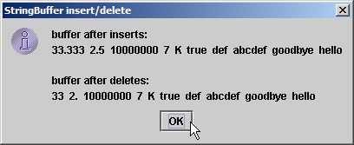
Outline
62
StringBufferInsert.jav a
© 2003 Prentice Hall, Inc. All rights reserved.

Slide 63
Class Character
63
Treat primitive variables as objects
Type wrapper classes
Boolean Character Double Float Byte Short Integer Long
We examine class Character

Slide 64
Outline
64
// Fig. 11.15: StaticCharMethods.java
// Static Character testing methods and case conversion methods.
import java.awt.*;
import java.awt.event.*;
import javax.swing.*;
6
public class StaticCharMethods extends JFrame {
private char c;
private JLabel promptLabel;
private JTextField inputField;
private JTextArea outputArea;
12
// constructor builds GUI
public StaticCharMethods()
{
super( "Static Character Methods" );
17
Container container = getContentPane();
container.setLayout( new FlowLayout() );
20
promptLabel = new JLabel( "Enter a character and press Enter" );
container.add( promptLabel );
inputField = new JTextField( 5 );
24
StaticCharMethods.java
© 2003 Prentice Hall, Inc. All rights reserved.

Slide 65
Outline
65
25 inputField.addActionListener( 26
27 | new ActionListener() { // anonymous inner class
28
29 | // handle textfield event
30 | public void actionPerformed( ActionEvent event |  | )
31 | {
32 | String s = event.getActionCommand();
33 | c = s.charAt( 0 );
34 | buildOutput();
35 | }
36
37 | } // end anonymous inner class
38
39 ); // end call to addActionListener 40 container.add( inputField ); outputArea = new JTextArea( 10, 20 ); container.add( outputArea ); 44
45 | setSize( 300, 220 ); | // set the window size
46 | setVisible( true ); | // show the window
47
48 | } // end constructor
49
StaticCharMethods.java
© 2003 Prentice Hall, Inc. All rights reserved.

Slide 66
Outline
66
50
51
52
53
54
55
56
57
58
59
60
61
62
63
64
65
66
67
68
69
70
71
72
73
74 } // end class StaticCharMethods
// display character info in outputArea private void buildOutput()
{
outputArea.setText( "is defined: " + Character.is
Determine whether c is
defined Unicode digit
"\nis digit: " + Character.isDigit( c ) + "\nis first character in a Java identifier: " Character.isJavaIdentifierStart( c ) +
"\nis part of a Java identifier: " + Character.isJavaIdentifierPart( c ) + "\nis letter: " + Character.isLetter( c ) +
Defined( c ) +
+
StaticCharMethods.java
Determine whether c can be used ne 54
Li
as first character in identifier
"\nis letter or digit: " + Character.isLetterOrDigit( c ) "\nis lower case: " + Character.isLowerCase( c ) +
"\nis upper case: " + Character.isUpperCase( c ) +
"\nto upper case: " + Character.toUpperCase( c ) +
₊ Line 56
Line 58
Determine whether c can be used as identifier character
"\nto lower case: " + Character.toLowerCase( c ) );
}
Line 59
Determine whether c is a letter
// create StaticCharMethods object to begin execution public static void main( String args[] )
{
StaticCharMethods application = new StaticCharMethods();
application.setDefaultCloseOperation( JFrame.EXIT_ON_CLOSE );
}
Line 60
Lines 61-62
Determine whether
c is letter or digit
Determine whether c is uppercase or lowercase
© 2003 Prentice Hall, Inc. All rights reserved.

Slide 67
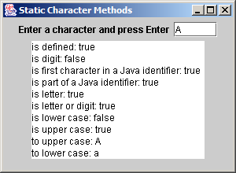
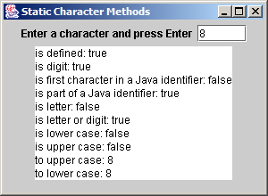
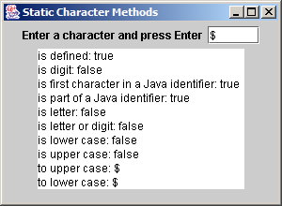
Outline
67
StaticCharMethods.java
© 2003 Prentice Hall, Inc. All rights reserved.

Slide 68
Class StringTokenizer java.util.StringTokenizer
68
Partition String into individual tokens (substrings, words) Use delimiter (default is space, tab, newline, return) StringTokenizer tokens = new StringTokenizer(addressLine); StringTokenizer tokens = new StringTokenizer(addressLine, “ ,;.?!”);
tokens.countTokens() (number of tokens in the string) tokens.nextToken() (return next token) tokens.hasMoreTokens() (true or false)

Slide 69
Outline
69
// Fig. 11.18: TokenTest.java
// StringTokenizer class.
import java.util.*;
import java.awt.*;
import java.awt.event.*;
import javax.swing.*;
7
public class TokenTest extends JFrame {
private JLabel promptLabel;
private JTextField inputField;
private JTextArea outputArea;
12
// set up GUI and event handling
public TokenTest()
{
super( "Testing Class StringTokenizer" );
17
Container container = getContentPane();
container.setLayout( new FlowLayout() );
20
promptLabel = new JLabel( "Enter a sentence and press Enter" );
container.add( promptLabel );
23
24 inputField = new JTextField( 20 );
TokenTest.java
Line 24
inputField contains String to be parsed by StringTokenizer
© 2003 Prentice Hall, Inc. All rights reserved.

Slide 70
Outline
70
25
26
27
28
29
30
31
32
33
34
35
36
37
38
39
40
41
42
43
44
45
46
47
48
49
50
51
52
53
inputField.addActionListener(
new ActionListener() { // anonymous inner class
Use StringTokenizer to parse String
using default delimiter “ \n\t\r”
// handle text field event
TokenTest.j
ava
public void actionPerformed( ActionEvent event )
{
StringTokenizer tokens =
new StringTokenizer( event.getActionCommand() );
Line 33
Count number of tokens
outputArea.setText( "Number of elements: " + tokens.countTokens() + "\nThe tokens are:\n" );
Line 36
while ( tokens.hasMoreTokens() ) outputArea.append( tokens.nextToken() + "\n" );
Lines 38-39
}
} // end anonymous inner class
Append next token to outputArea,
); // end call to addActionListener
as long as tokens exist
container.add( inputField );
outputArea = new JTextArea( 10, 20 ); outputArea.setEditable( false ); container.add( new JScrollPane( outputArea ) );
setSize( 275, 240 ); setVisible( true );
// set the window size
// show the window
}
© 2003 Prentice Hall, Inc. All rights reserved.

Slide 71
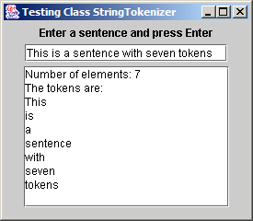
Outline
71
54
55
56
57
58
59
60
61
62 } // end class TokenTest
// execute application
public static void main( String args[] )
{
TokenTest application = new TokenTest(); application.setDefaultCloseOperation( JFrame.EXIT_ON_CLOSE );
}
TokenTest.java
© 2003 Prentice Hall, Inc. All rights reserved.

Slide 72
THANK YOU

