Slide 1

OBJECT ORIENTED PROGRAMMING USING JAVA

Slide 2
OUTLINE
Modifiers IN JAVA
Class level access modifiers
Member level access modifiers

Slide 3
JAVA MODIFIERS
A modifier is a keyword placed in a class, method or variable declaration that changes how it
operates.
There are two types of java modifiers, they are
Java Access Modifiers
public
private
protected
Default (No modifiers
Non-Access Modifiers
final
static
abstract
synchronized
strictfp
native
transient
volatile

Slide 4
JAVA ACCESS MODIFIER
Usage of these access modifiers is restricted to two levels. The two levels are
class level access modifiers and member level access modifiers.
Class level access modifiers (java classes only): Only two access modifiers is allowed, public and no modifier
If a class is ‘public’, then it CAN be accessed from ANYWHERE.
If a class has ‘no modifier’, then it CAN ONLY be accessed from ‘same package’.
Member level access modifiers : For the inner classes all the four access modifiers are allowed
public,private, protected and no modifier is allowed

Slide 5




PREDICT THE OUTPUT:

Slide 6



PREDICT THE OUTPUT:

Slide 7
MEMBER LEVEL ACCESS MODIFIERS
• public and no modifier – the same way as used in class level.
private – members CAN ONLY access.
protected – CAN be accessed from ‘same package’ and a subclass existing in any package can access. (outside package we can access protected members only in child classes and should be by child reference only that is we can't use parent reference to call protected members from outside package.)

Slide 8
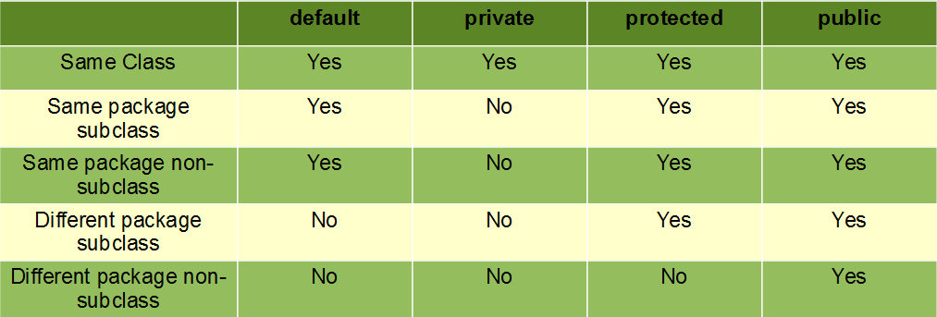
ACCESSIBILITY WHILE USING DIFFERENT MODIFIERS
The least accessible modifier is private.
The most accessible modifier is public.

Slide 9
DIFFERENT PACKAGES WITH DEFAULT ACCESSIBILITY
package pack1; classTest
{
public void methodOne( )
{
System.out.println(“Public MemberAccess Modifier”);
}
}
package pack2; import pack1.Test; classTest1
{
public static void main(String args[])
{
Test t=newTest(); // CannotAccess t.methodOne(); //Cannot access
}
}

Slide 10
SAME PACKAGE WITH DEFAULT ACCESSIBILITY
package pack1; classTest
{
void methodOne( )
{
System.out.println(“Public MemberAccess Modifier”);
}
}
package pack1; import pack1.Test; classTest1
{
//This is optional
public static void main(String args[])
{
Test t=newTest(); //Allow to access t.methodOne(); //Allow to access
}
}

Slide 11
SAME PACKAGE WITH PUBLIC ACCESSIBILITY AND EXTENDS
package pack1; public classTest
{
protected void methodOne( )
{
System.out.println(“Protected MemberAccess Modifier”);
}
}
package pack1;
import pack1.Test;// Optional
classTest1 extendsTest
{
public static void main(String args[])
{
Test t=newTest(); t.methodOne(); //Can access Test1 b = newTest1(); b.methodOne(); //Can access Test c = newTest1( );
c.methodOne(); //Can access due to Same Package
}
}

Slide 12
DIFFERENT PACKAGES WITH PUBLIC ACCESSIBILITY AND EXTENDS
package pack1; public classTest
{
protected void methodOne( )
{
System.out.println(“Protected Member
package pack2;
Access Modifier”);
}
}
import pack1.Test;
classTest1 extendsTest
{
public static void main(String args[])
{
Test t=newTest(); t.methodOne(); // CannotAccess Test1 b = newTest1(); b.methodOne(); // CanAccess Test c = newTest1();
c.methodOne(); // CannotAccess due to
parent Reference
}
}

Slide 13
DIFFERENT PACKAGES WITH PUBLIC ACCESSIBILITY
package pack1; public classTest
{
public void methodOne( )
{
System.out.println(“PublicAccess Modifier”);
}
}
package pack2; import pack1.Test; classTest1
{
public static void main(String args[])
{
Test t=newTest(); t.methodOne();
}
}

Slide 14
SAME PACKAGE WITH DEFAULT ACCESSIBILITY
package pack1; classTest
{
public void methodOne( )
{
System.out.println(“DefaultAccess Modifier”);
}
}
package pack1; import pack1.Test; classTest1
{
public static void main(String args[])
{
Test t=newTest();
t.methodOne();
}
}

Slide 15
DIFFERENT PACKAGES WITH DEFAULT ACCESSIBILITY
package pack1; classTest
{
public void methodOne( )
{
System.out.println(“DefaultAccess Modifier”);
}
}
package pack2; import pack1.Test; classTest1
{
public static void main(String args[])
{
Test t=newTest(); t.methodOne();
}
}

Slide 16
IMPORTANT POINTS:
public is the least restrictive access modifier in Java programming language and its bad practice to declare variable, method or class by default public
Making class or instance variable public is also violated principle of Encapsulation which is not good at all and affects maintenance badly.
Instead of making variable public you should make it private and provided public getter and setter.
In Java name of file must be same with public class declared in the file.

Slide 17
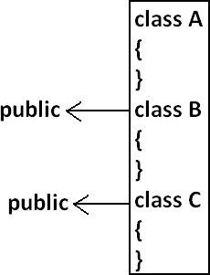


IMPORTANT POINTS:
A java Program can contain any no. of classes but at most one
class can be declared as public.
If there is a public class the name of the Program and name of the public class must be matched otherwise we will get compile time error.
If there is no public class then any name we gives for java source file.
If there is no public class then we can use any name for java
source file there are no restrictions

Slide 18
IMPORTANT POINTS:
The main () method of an application has to be public. Otherwise, it could not be called by a Java interpreter (such as java) to run the class.
private keyword in Java: private keyword or modifier in java can be applied to member field, method or nested class in Java.
You cannot use private modifier on top level class. private variables, methods and class are only accessible on the class on which they are declared.
Private is highest form of Encapsulation Java API provides and should be used as much as possible.

Slide 19
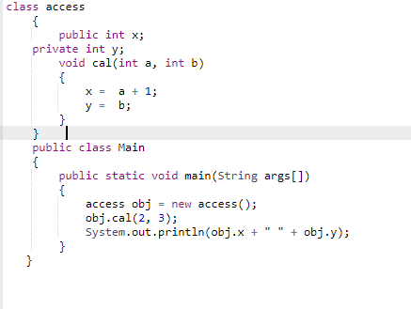
PREDICT THE OUTPUT:

Slide 20

PREDICT THE OUTPUT:
Output

Slide 21
CAN YOU CREATE A SUB CLASS TO THE FOLLOWING CLASS?
classA
{
privateA()
{
//First Constructor
}
privateA(int i)
{
//Second Constructor
}
}

Slide 22
CAN YOU CREATE A SUB CLASS TO THE FOLLOWING CLASS?
classA
{
privateA()
{
//First Constructor
}
Answer:No, you can’t create sub classes to that class
which has only private constructors.
privateA(int i)
{
//Second Constructor
}
}

Slide 23
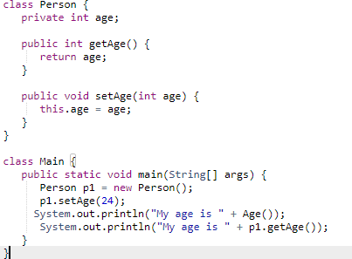
ENCAPSULATION EXAMPLE:
The whole idea behind encapsulation is to hide the implementation details from users. If a data member is private it means it can only be accessed within the same class. No outside class can access private data member (variable) of other class.

Slide 24
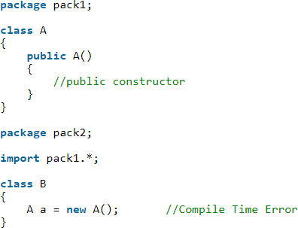
WHY WE CAN’T INSTANTIATE CLASS-A IN THE BELOW CODE OUTSIDE THE PACKAGE EVEN THOUGH IT HAS PUBLIC CONSTRUCTOR?

Slide 25
OUTLINE
PACKAGES IN JAVA

Slide 26
PACKAGES IN JAVA
A java package is a group of similar types of classes, interfaces and sub-packages.
Think of it as a folder in a file directory.
Package in java can be categorized in two form, built-in package and user-defined package.
There are many built-in packages such as java, lang, awt, javax, swing, net, io, util, sql etc.
Banking Application
TRANSACTION(PACKAGE) LOAN(PACKAGE)
.CLASS FILE .CLASS FILE
.CLASS FILE .CLASS FILE
ACCOUNTS (PACKAGE)
.CLASS FILE
.CLASS FILE

Slide 27
ADVANTAGE OF JAVA PACKAGE
The classes contained in the packages of the other programs can be easily reused.
Java package is used to categorize the classes and interfaces so that they can be easily maintained.
Java package provides access protection.
Java package removes naming collision.

Slide 28
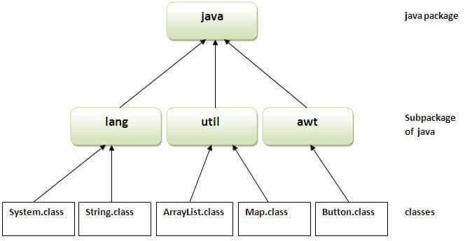
PACKAGE : EXAMPLE

Slide 29
HIERARCHICAL REPRESENTATION OF JAVA.AWT PACKAGE
java
Package Containing awt package
awt
Color
Package Containing classes
Graphics
Font
Classes Containing methods
Image

Slide 30
CREATING PACKAGE: EXAMPLE
//save as Simple.java package mypack; public class Simple{
public static void main(String args[]){
System.out.println("Welcome to package");
}
}
NOTE: If no package is specified, the classes in the file goes into a special unnamed package (the same unnamed package for all files).

Slide 31
HOW DOESTHE JAVA RUN-TIME SYSTEM KNOWWHERETO LOOK FOR PACKAGESTHATYOU CREATE?
First, by default, the Java run-time system uses the current working directory as its starting point. Thus, if your package is in a subdirectory of the current directory, it will be found.
Second, you can specify a directory path or paths by setting the CLASSPATH environmental variable.
Third, you can use the-classpath option with java and javac to specify the path to your classes.

Slide 32
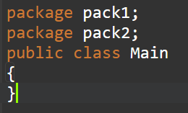
PREDICT THE OUTPUT?

Slide 33
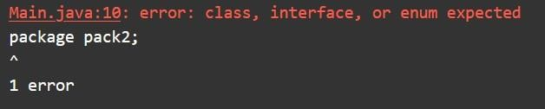
PREDICT THE OUTPUT?
Note:Only one package is valid in java,more than one package in a single source code invalid in
java

Slide 34
NAMING CONVENTIONS
Package can be named using standard java naming rule. Where it
begins with lowercase letters. This between package names and class name.
Example:
double y= java.lang.Math.sqrt();
makes easy to distinguish
Package
name
class name
method name

Slide 35
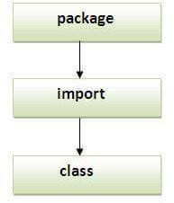
SEQUENCE OF THE PROGRAM:
Note: If you import a package, all the classes and interface of that package will be imported excluding the classes and interfaces of the subpackages. Hence, you need to import the subpackage as well.

Slide 36
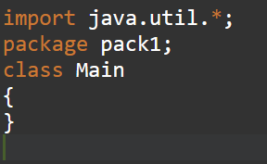
PREDICT THE OUTPUT?

Slide 37
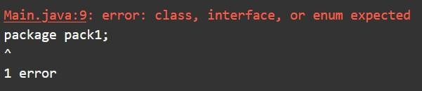
PREDICT THE OUTPUT?

Slide 38
HOW TO ACCESS PACKAGE FROM ANOTHER PACKAGE?
There are three ways to access the package from outside the package.
Implicit class import:- import package.*;
Explicit class import:- import package.classname; (improves readability of code) Fully qualified name.
Note: after package name use .* after class name use ;

Slide 39
WHICH IS CORRECT?
import java.util.Scanner;
import java.util. Scanner.*;
import java.util.*;
import java.util;

Slide 40
WHICH IS CORRECT?
import java.util. Scanner;(Correct)
import java.util. Scanner.*;(Wrong)
import java.util.*;(correct)
import java.util;(wrong)

Slide 41
USING PACKAGENAME.*
If you use package.* then all the classes and interfaces of this package will be accessible but not sub-packages.
The import keyword is used to make the classes and interface of another package accessible to the current package.

Slide 42
EXAMPLE
//save byA.java package pack; public class A{ public void msg()
{System.out.println("Hello");}
}
//save by B.java
package mypack; import pack.*; class B{
public static void main(String args[]){ A obj = new A();
obj.msg();
}
}
Output:
HELLO

Slide 43
USING PACKAGENAME.CLASSNAME
If you import package.classname then only declared class of this package will be accessible.
//save byA.java
package pack; public classA{
public void msg(){System.out.println("Hello");
}
}
//save by B.java package mypack; import pack.A;
Output:Hello
class B{
public static void main(String args[]){ A obj = newA();
obj.msg();
}
}

Slide 44
USING FULLY QUALIFIED NAME
If you use fully qualified name then only declared class of this package will be accessible. Now there is no need to import. But you need to use fully qualified name every time when you are accessing the class or interface.
It is generally used when two packages have same class name e.g. java.util and
java.sql packages contain Date class.

Slide 45
//save by A.java package pack; public class A{
EXAMPLE:
public void msg(){System.out.println("Hello");}
Output:Hello
}
//save by B.java package mypack; class B{
public static void main(String args[]){
pack.A obj = new pack.A();//using fully qualified name obj.msg();
}
}

Slide 46
EXAMPLE:
class test
{
Public static void main(string[] args)
{
Note:
Problem with readability
Increase length code
Solve this problem using import statement. It is no required to use fully qualified name we can use short name directly.
Java.util.Arraylist l=new java.util.ArrayList();
}
}

Slide 47
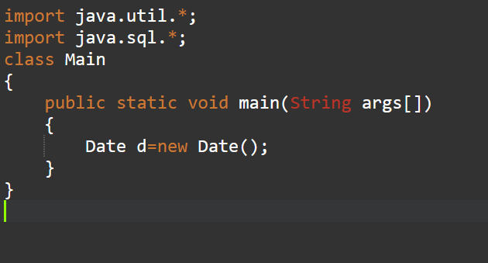
EXAMPLE:

Slide 48
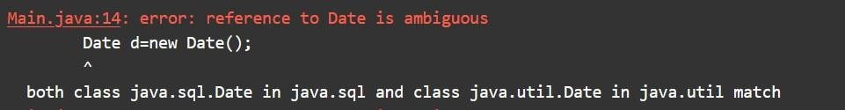
EXAMPLE:

Slide 49
MULTIPLE PACKAGE SCENARIO:
In that scenario:
Highest priority will go to explicit class import
Next level will goes to classes present in current working directory (default package)
Implicit class import

Slide 50
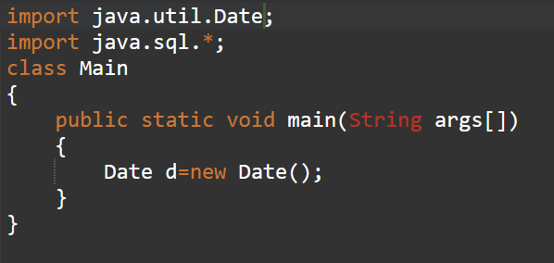
EXAMPLE:
Gives priority to explicit import
This code executes fine

Slide 51
WHICH ONE ISVALID?? (IMPORTINGA PACKAGETO USE PATTERN
CLASS IN PROGRAM)
Java-> util-> regrex-> pattern
Import java.*;
Import java.util.*;
Import java.util.regex.*;
No import required

Slide 52
WHICH ONE ISVALID?? (IMPORTINGA PACKAGETO USE PATTERN
CLASS IN PROGRAM)
Java-> util-> regrex-> pattern
Import java.*;
Import java.util.*;
Import java.util.regex.*;
No import required

Slide 53
DEFAULT:PACKAGES AVAILABLE IN JAVA
Java.lang package is by default package available in all java program hence we don’t need to write import.
class example
{
public static void main (String[] Args) String s= new String(“main”);
}
}

Slide 54
STATIC IMPORT
According to sun: usage of static import reduces code improves readability
But according to www expert (like us): usage of static import creates confusion and reduces readability
Hence if there is not specific requirement it is not recommended to use static import.
for static import:
Explicit (import static packagename.classname.staticmember
example import static java.lang.math.sqrt;
Implicit (import static package name .classname.*)
example:import static java.lang.math.*;

Slide 55
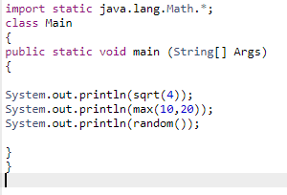
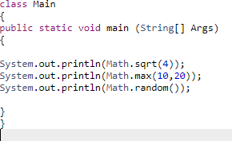

EXAMPLE
Without static import
With static import

Slide 56
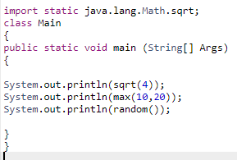
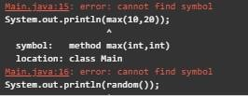
EXAMPLE
With static import

Slide 57
EXAMPLE
Class system (present in java lang)
{
Static printstream out;
}
// (out is a static variable present in system class of the type print stream)
System.out.println() //(print is method present in the system class)

Slide 58
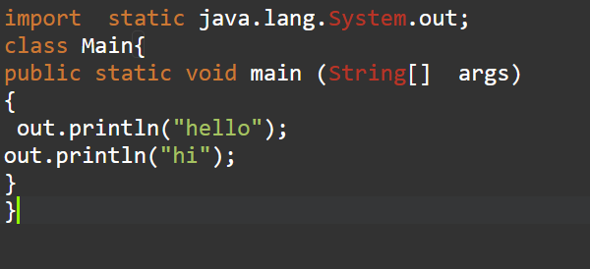

EXAMPLE

Slide 59
WHICH PACKAGE ISVALID?
import java.lang.Math.*;
import static java.lang.Math.*;
import java.lang.Math.sqrt*;
import static java.lang.Math.sqrt();
import java.lang.Math.sqrt;
import static java.lang.Math.*;
import java.lang;
import static java.lang;
import java.lang.*;
import static java.lang.*;

Slide 60
WHICH PACKAGE IS VALID?
import java.lang.Math.*; (invalid after class ; not star)
import static java.lang.Math.*;(valid)
import java.lang.Math.sqrt*; (invalid : will take, till class level not till data member)
import static java.lang.Math.sqrt(); (invalid not bracket open or close)
import java.lang.Math.sqrt; (invalid)
import static java.lang.Math.*;(valid)
import java.lang; (invalid .* required)
import static java.lang; (invalid always talks about class and data member)
import java.lang.*; (valid)
import static java.lang.*;(invalid)

Slide 61
OUTLINE
Non-Access Modifier in Java
Final
Abstract

Slide 62
JAVA MODIFIERS
A modifier is a keyword placed in a class, method or variable declaration that changes how it
operates.
There are two types of java modifiers, they are
Java Access Modifiers
public
private
protected
Default (No modifiers
Non-Access Modifiers
final
static
abstract
synchronized
strictfp
native
transient
volatile

Slide 63
FINAL
It is the modifier applicable for classes, methods and variables.
If a method declared as the final then we are not allowed to override that method in the child class.
Whatever the methods parent has by default available to the child.
Methods • If the child is not allowed to override any method,that method we have to declare with
final in parent class.That is final methods cannot overridden.
If a class declared as the final then we can't creates the child class that is
inheritance concept is not applicable for final classes.
Class
If a variable declared as the final then we need to look for the type of variables
Variables
and then correspondingly actions need to be taken (discussed later in the slides).

Slide 64
EXAMPLE
final class Test
{
void methodOne( )
{
System.out.println(“Protected Member Access Modifier”);
}
}
class Test1 extends Test
{
public static void main(String args[])
{
Test t=newTest(); t.methodOne(); Test1 b = newTest1(); b.methodOne();
Test c = newTest1(); c.methodOne();
}
Every method present inside a final class is always final by default whether we are declaring or not. But every variable present inside a final class need not be final.
}

Slide 65
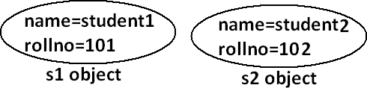
FINAL VARIABLES IN INSTANCE VARIABLES
If the value of a variable is varied from object to object such type of variables are called instance variables.
For every object a separate copy of instance variables will be created.
For the instance variables it is not required to perform initialization explicitly jvm will always provide default values.

Slide 66
FINAL VARIABLES IN INSTANCE VARIABLES
If the instance variable declared as the final compulsory we should perform initialization explicitly and JVM won't provide any default values. whether we are using or not otherwise we will get compile time error.
classTest |  |  | classTest
{ |  |  | {
 | int i; |  | final int i;
} |  |  | }
For the final instance variables we should perform initialization before constructor
completion. That is the following are various possible places for this.
Initialization while declaration, instance initialization block, and constructor.

Slide 67
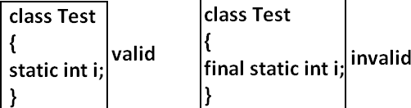
FINAL VARIABLES IN STATIC VARIABLES
If the static variable declare as final then compulsory we should perform initialization explicitly whether we are using or not otherwise we will get compile time error.(The JVM won't provide any default values)
For the final static variables we should perform initialization before class loading completion otherwise we will get compile time error. That is the following are possible places.
Initialization while declaration and inside static block.

Slide 68
FINAL VARIABLES IN LOCAL VARIABLES
To meet temporary requirement of the Programmer sometime we can declare the variable inside a method or block or constructor such type of variables are called local variables.
For the local variables jvm won't provide any default value compulsory we should perform initialization explicitly before using that variable.
The only applicable modifier for local variables is final if we are using any other modifier we will get compile time error.
classTest
{
public static void main(String [] args) { final int i; System.out.println(“Bennett”);
}
}

Slide 69
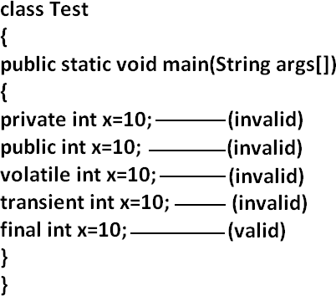
FINAL VARIABLES IN LOCAL VARIABLES

Slide 70
THANK YOU
?

