Slide 1

OBJECT ORIENTED PROGRAMMING USING JAVA

Slide 2
OUTLINE
Introduction
Default Exceptional handler
try
catch
finally throw throws
◾
◾
◾
◾

Slide 3
WHAT IS EXCEPTION??
Dictionary Meaning: Exception is an abnormal condition.
An unwanted / unexpected event that disturbs, normal flow of the program (execution) is called exception.
In java, exception is an event that disrupts the normal flow of the program.
It is an object which is thrown at runtime. Example
Read data from remote file, locating at Bennett University (file not found exception)
Online class exception- scenario, where during class your internet stop working.

Slide 4
TYPES OF PROGRAM ERRORS
We distinguish between the following types of errors:
Syntax errors: errors due to the fact that the syntax of the language is not respected.
Semantic errors: errors due to an improper use of program statements.
Logical errors: errors due to the fact that the specification is not respected.
From the point of view of when errors are detected, we distinguish:
Compile time errors: syntax errors and static semantic errors indicated by the compiler.
Runtime errors: dynamic semantic errors, and logical errors, that cannot be detected by the compiler(debugging).

Slide 5
WHAT IS THE PURPOSE OF EXCEPTIONAL HANDLING??
Example:
Opend db connetion
Open connection Read the data
Sql exception
Request 3
Request 1
server
Request 10
Close connection
Request 2
Problem: Because of exception we should not block or miss something. Solution: Exceptional Handling
Example: Problem: Writing code on code zinger, suddenly power cut occur then it may lead to loss of data.
Solution: Have power back up.

Slide 6
EXCEPTION HANDLING IN JAVA
The exception handling in java is one of the powerful mechanism to handle the runtime errors so that normal flow of the application can be maintained.
Exceptional handling does not mean repairing an exception.
Here we have to provide alternative way to continue the rest of the program
normally is the concept of exceptional handling.
Example: Our programming requirement is to read data from remote file locating at Bennett university. At run time, if Bennett university file is not available. If we want that our program should not terminated abnormally, then we have to provide some local file to continue rest of the program normally. This way of defining alternative is nothing but exception handling.

Slide 7
ADVANTAGE OF EXCEPTION HANDLING
The core advantage of exception handling is to
maintain the normal flow of the application.
Exception normally disrupts the normal flow of the application that is why we use exception handling.
Suppose there is 6 statements in your program and there occurs an exception at statement 3, rest of the code will not be executed i.e. statement 4 to 6 will not run. If we perform exception handling, rest of the statement will be executed. That is why we use exception handling in java.
Let's take a scenario:
statement 1;
statement 2;
statement 3; //exception occurs
statement 4;
statement 5;
statement 6;

Slide 8
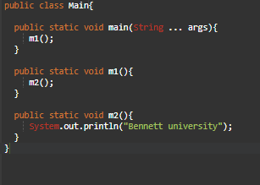
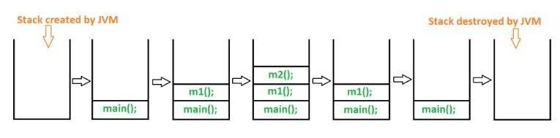
RUNTIME STACK MECHANISM
Runtime Stack Mechanism as its name indicates is a Stack that have been created by JVM for each Thread at
the time of Thread creation, JVM store every methods calls performed by that Thread in the Stack.
Each entry or method call called "activation record" / "stack frame".
Output : Bennett University

Slide 9
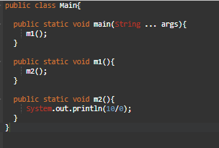

DEFAULT EXCEPTIONAL HANDLING IN JAVA
Output

Slide 10
DEFAULT EXCEPTIONAL HANDLING IN JAVA (PROCESS)
If an exception raised, the method in which it’s raised is responsible for the creation of Exceptions object by including the following information:
Name of the Exception
Description of the Exception
Stack Trace
After creating Exception object the method handover it to the JVM.
JVM checks for Exception Handling code in that
method.
If the method doesn’t contain any Exception handling code then JVM terminates the method abnormally and removes the corresponding entry from the stack.
JVM identify the caller method and checks for Exception Handling code in that method. If the caller doesn’t contain any exception handling code then JVM terminates that method abnormally and removes the corresponding entry from the stack.
This process will be continue until main() method.
If the main() method also doesn’t contain exception handling code the JVM terminates that main() method and removes the corresponding entry from the stack.
Just before terminating the program abnormally JVM handovers the responsibility of exception handling to the Default Exception Handler which is the component of JVM.
Default Exception Handler just print exception information to the console in the following format:
Name of Exception: Description
Stack Trace (Location of the Exception)

Slide 11
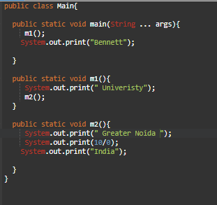
EXAMPLE:

Slide 12

EXAMPLE:

Slide 13
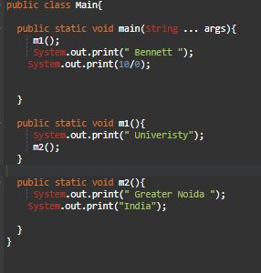
PREDICT THE OUTPUT??

Slide 14
PREDICT THE OUTPUT??

Slide 15
NOTE:
If at least one method terminates abnormally then termination of a program is
abnormal.
If we are not satisfied with the default then we will go for customised exceptional handling

Slide 16
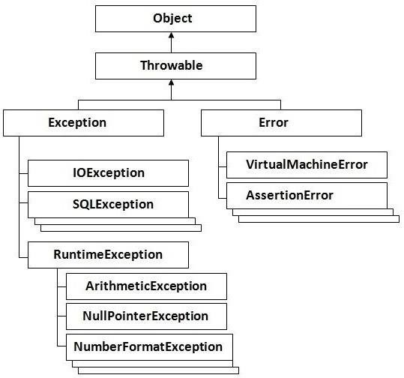
HIERARCHY OF JAVA EXCEPTION CLASSES
Object class is the parent class of all the classes in java
In Java, all errors and exceptions are represented with Throwable class.
When an error occurs within a method, the method creates an object (of any subtype of Throwable) and hands it off to the runtime system.
The object, called an exception object.
Exception object contains information about the error, including its type and the state of the program when the error occurred.
Creating an exception object and handing it to the runtime
system is called throwing an exception.

Slide 17
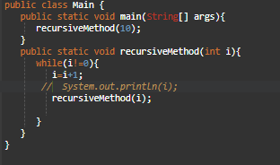
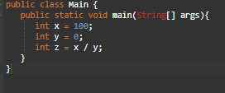
EXCEPTIONVS ERROR
Most of the time Exceptions are caused by programs and are recoverable.
Most of the time errors are not caused by our program , and these are due to lack of system resources. Errors are irrecoverable.
Error Example
Exception Example

Slide 18
TYPES OF EXCEPTION
There are mainly two types of exceptions:
checked and unchecked
where error is considered as unchecked exception.
The sun microsystem says there are three types of exceptions:
Checked Exception
Unchecked Exception
Error
Note: All exception occur at runtime

Slide 19
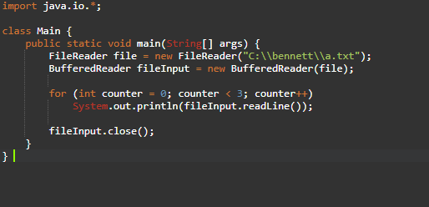
1) CHECKED EXCEPTION
The exception checked by the compiler for the smooth execution of the program during runtime.
The classes that extend Throwable class except RuntimeException and Error are known as
checked exceptions
e.g.IOException, SQLException etc.
Checked exceptions are checked at compile-time.

Slide 20
1) CHECKED EXCEPTION
The exception checked by the compiler for the smooth execution of the program during runtime.
The classes that extend Throwable class except RuntimeException and Error are known as
checked exceptions
e.g.IOException, SQLException etc.
Checked exceptions are checked at compile-time.
Output:
Exception in thread "main" java.lang.RuntimeException:Uncompilable source code -
unreported exception java.io.FileNotFoundException;must be caught or declared to be
thrown
at Main.main(Main.java:5)

Slide 21
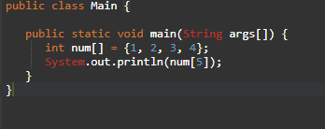
2) UNCHECKED EXCEPTION
The classes that extend RuntimeException are known as unchecked exceptions.
These include programming bugs, such as logic errors or improper use of an API. Runtime exceptions are ignored at the time of compilation.
e.g. ArithmeticException, NullPointerException, ArrayIndexOutOfBoundsException etc.
Unchecked exceptions are not checked at compile-time rather they are checked at runtime.

Slide 22
2) UNCHECKED EXCEPTION
The classes that extend RuntimeException are known as unchecked exceptions.
These include programming bugs, such as logic errors or improper use of an API. Runtime exceptions are ignored at the time of compilation.
e.g. ArithmeticException, NullPointerException, ArrayIndexOutOfBoundsException etc.
Unchecked exceptions are not checked at compile-time rather they are checked at runtime.

Slide 23
3) ERROR
Errors are irrecoverable
e.g. OutOfMemoryError, VirtualMachineError, AssertionError etc.

Slide 24
Checked Exception | Unchecked Exception
Checked exceptions occur at compile time. | Unchecked exceptions occur at runtime.
The compiler checks a checked exception. | The compiler does not check these types of exceptions.
These types of exceptions can be handled at the time of compilation. | These types of exceptions cannot be a catch or handle at the time of compilation, because they get generated by the mistakes in the program.
They are the sub-class of the exception class. | They are runtime exceptions and hence are not a part of the Exception class.
Here, the JVM needs the exception to catch and handle. | Here, the JVM does not require the exception to catch and handle.
Examples of Checked exceptions: File Not Found Exception No Such Field Exception Interrupted Exception No Such Method Exception Class Not Found Exception | Examples of Unchecked Exceptions: No Such Element Exception Undeclared Throwable Exception Empty Stack Exception Arithmetic Exception Null Pointer Exception Array Index Out of Bounds Exception Security Exception

Slide 25
COMMON SCENARIOS WHERE EXCEPTIONS MAY OCCUR
There are given some scenarios where unchecked exceptions can occur. They are as follows:
1) Scenario where ArithmeticException occurs
If we divide any number by zero, there occurs an ArithmeticException.
int a=50/0;//ArithmeticException

Slide 26
COMMON SCENARIOS WHERE EXCEPTIONS MAY OCCUR
2) Scenario where NullPointerException occurs
If we have null value in any variable, performing any operation by the variable occurs an NullPointerException.
String s=null;
System.out.println(s.length());//NullPointerException

Slide 27
COMMON SCENARIOS WHERE EXCEPTIONS MAY OCCUR
3) Scenario where NumberFormatException occurs
The wrong formatting of any value, may occur NumberFormatException.
Suppose I have a string variable that have characters, converting this variable into digit
will occur NumberFormatException.
String s="abc";
int i=Integer.parseInt(s);//NumberFormatException

Slide 28
COMMON SCENARIOS WHERE EXCEPTIONS MAY OCCUR
4) Scenario where ArrayIndexOutOfBoundsException occurs
if you are inserting any value in the wrong index, it would result ArrayIndexOutOfBoundsException as shown below:
int a[]=new int[5];
a[10]=50; //ArrayIndexOutOfBoundsException

Slide 29
JAVA EXCEPTION HANDLING KEYWORDS
There are 5 keywords used in java exception handling.
try
catch
finally
throw
throws

Slide 30
CUSTOMIZED EXCEPTIONAL HANDLING USING TRY AND CATCH
try block
Java try block is used to enclose the code that might throw an exception. It must be used within the method.
Java try block must be followed by either catch or finally block.

Slide 31
SYNTAX OF JAVA TRY-CATCH
try{
//code that may throw exception
}catch(Exception_class_Name ref){}
Syntax of try-finally block
try{
//code that may throw exception
}finally{}

Slide 32
CATCH BLOCK
Java catch block is used to handle the Exception.
It must be used after the try block only.
You can use multiple catch block with a single try.

Slide 33
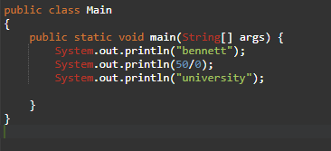
PROBLEM WITHOUT EXCEPTION HANDLING

Slide 34

PROBLEM WITHOUT EXCEPTION HANDLING
output

Slide 35
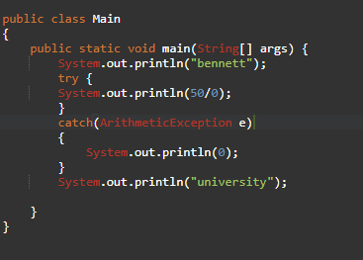
PROBLEM USING TRY-CATCH

Slide 36


PROBLEM USING TRY-CATCH
Risky code
The code which may rise an exception is called risky code and we have to define that code inside try block and corresponding handling code we have to define inside catch block.
output

Slide 37
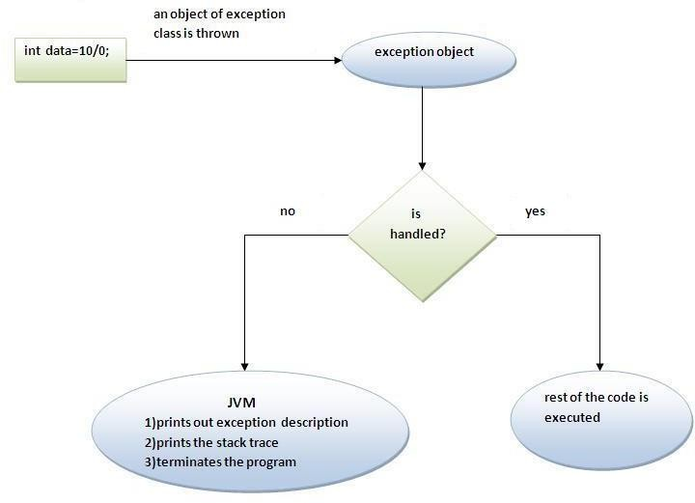
INTERNAL WORKING OF JAVA TRY-CATCH BLOCK

Slide 38
EXPLANATION
The JVM firstly checks whether the exception is handled or not. If exception is not handled, JVM provides a default exception handler that performs the following tasks:
Prints out exception description.
Prints the stack trace (Hierarchy of methods where the exception occurred).
Causes the program to terminate.
But if exception is handled by the application programmer, normal flow of the application is maintained i.e. rest of the code is executed.

Slide 39
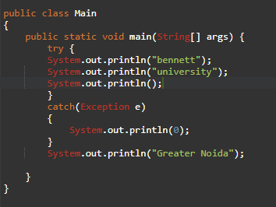
CONTROL FLOW INTRY CATCH
Case 1: if there is no exception

Slide 40

CONTROL FLOW INTRY CATCH
Case 1: if there is no exception
Order of execution
output
Termination:normal

Slide 41
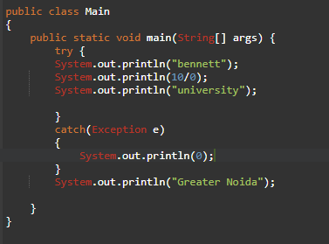
CONTROL FLOW INTRY CATCH
Case 2: if there is an exception in statement 2 of try

Slide 42

CONTROL FLOW INTRY CATCH
Case 2: if there is an exception in statement 2 of try
Order of
execution
output
Termination:normal
Note: Hence length of try block should be as less as possible and take only risky code inside try block Or go for multiple try block

Slide 43
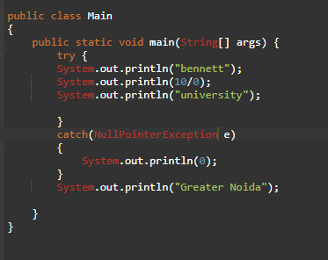
CONTROL FLOW INTRY CATCH
Case 3: if there is an exception in statement 2 and corresponding catch not matched

Slide 44

CONTROL FLOW INTRY CATCH
Case 3: if there is an exception in statement 2 and corresponding catch not matched
Order of execution
output
Termination:Abnormal

Slide 45
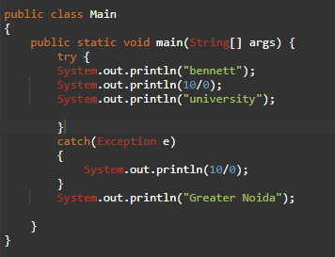
CONTROL FLOW INTRY CATCH
Case 4: if there is an exception in try as well as in catch statement or outside try statement

Slide 46
CONTROL FLOW INTRY CATCH
Case 4: if there is an exception in try as well as in catch statement or outside try statement
Order of execution
output
Termination:Abnormal

Slide 47
NOTE:
With in the try block if anywhere an exception occur then rest of the try wont be executed even though we handled that exception hence with in the try block we have to take only risky code and length of try block should be as less as possible.
In addition other than try block there may be chance of rising an exception inside catch and finally blocks.
If any statement which is not part of try block and an exception occur then it is always abnormal termination.

Slide 48
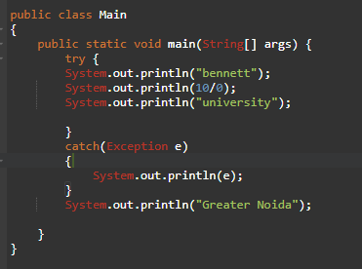
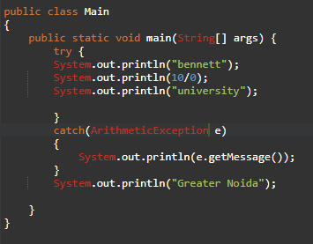
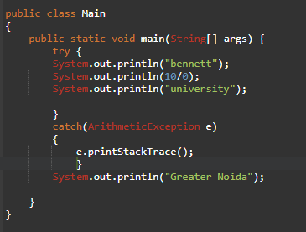



METHODS TO PRINT EXCEPTION INFORMATION
printStackTrace()
toString()
getMessage()

Slide 49
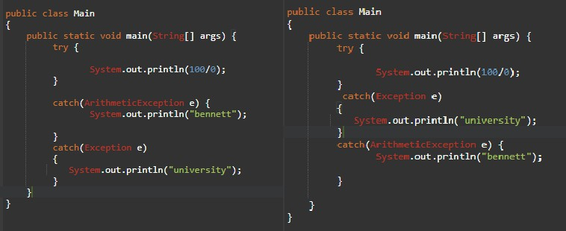
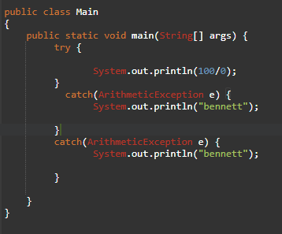

TRYWITH MULTIPLE CATCH BLOCKS
Case: 1
Case:2
Case:3

Slide 50
TRYWITH MULTIPLE CATCH BLOCKS
The way of handling an exception is varied from exception to exception, hence for every exception type it is highly recommended to take separate catch block
i.e. try with multiple catch block is always possible and recommended to use.
At a time only one Exception is occurred and at a time only one catch block is executed
Limitation
Order of execution is very important when having multiple catch, because first we will take child first and the parent exception, if we take parent exception first and then child exception you will surely get a compilation error.

Slide 51
TRY WITH MULTIPLE CATCH BLOCKS
If you have to perform different tasks at the occurrence of different Exceptions, use java multi catch block
public class TestMultipleCatchBlock{ public static void main(String args[]){ try{
int a[]=new int[5]; a[5]=30/0;
}
catch(ArithmeticException e){System.out.println("task1 is completed");}
catch(ArrayIndexOutOfBoundsException e){System.out.println("task 2 completed");}
catch(Exception e){System.out.println("common task completed");}
System.out.println("rest of the code...");
}
}

Slide 52
TRY WITH MULTIPLE CATCH BLOCKS
If you have to perform different tasks at the occurrence of different Exceptions, use java multi catch block
public class TestMultipleCatchBlock{ public static void main(String args[]){ try{
int a[]=new int[5]; a[4]=30/0;
}
catch(ArithmeticException e){System.out.println("task1 is completed");}
catch(ArrayIndexOutOfBoundsException e){System.out.println("task 2 completed");}
catch(Exception e){System.out.println("common task completed");}
System.out.println("rest of the code...");
}
}
Output:
task1 is completed rest of the code

Slide 53
TRY WITH MULTIPLE CATCH BLOCKS
If you have to perform different tasks at the occurrence of different Exceptions, use java multi catch block
public class TestMultipleCatchBlock{ public static void main(String args[]){ try{
int a[]=new int[5];
a[5]=30/1;
}
catch(ArithmeticException e){System.out.println("task1 is completed");}
catch(ArrayIndexOutOfBoundsException e){System.out.println("task 2 completed");}
catch(Exception e){System.out.println("common task completed");}
System.out.println("rest of the code...");
}
}

Slide 54
TRY WITH MULTIPLE CATCH BLOCKS
If you have to perform different tasks at the occurrence of different Exceptions, use java multi catch block
public class TestMultipleCatchBlock{ public static void main(String args[]){ try{
int a[]=new int[5];
a[5]=30/1;
}
catch(ArithmeticException e){System.out.println("task1 is completed");}
catch(ArrayIndexOutOfBoundsException e){System.out.println("task 2 completed");}
catch(Exception e){System.out.println("common task completed");}
System.out.println("rest of the code...");
Output:
task2 is completed Rest of the code
}
}

Slide 55
JAVA NESTED TRY BLOCK
The try block within a try block is known as nested try block in java.
Sometimes a situation may arise where a part of a block may cause one error and the entire block itself may cause another error. In such cases, exception handlers have to be nested.

Slide 56
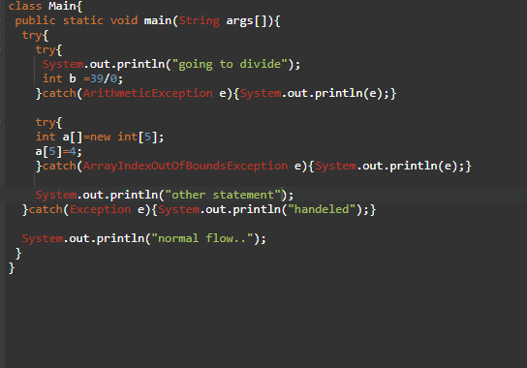

JAVA NESTED TRY BLOCK: EXAMPLE
output

Slide 57
JAVA FINALLY BLOCK
Finally block is used to perform clean-up activities that we related to try block , means what ever resources we open in the try block will be closed inside finally block.
Java finally block is a block that is used to execute important code such as closing connection, closing a file etc.
Java finally block is always executed whether exception is handled or not.
Java finally block follows try or catch block.

Slide 58
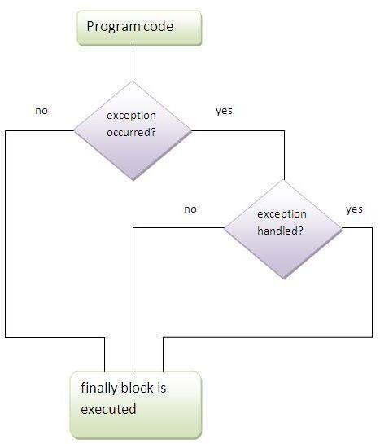

Slide 59
CASE 1: FINALLY EXAMPLE WHERE EXCEPTION DOESN'T OCCUR
class TestFinallyBlock{
public static void main(String args[]){
try{
int data=25/5; System.out.println(data);
}
catch(NullPointerException e){System.out.println(e);}
finally{System.out.println("finally block is always executed");} System.out.println("rest of the code...");
}
}

Slide 60
CASE 1: FINALLY EXAMPLE WHERE EXCEPTION DOESN'T OCCUR
class TestFinallyBlock{
public static void main(String args[]){
try{
int data=25/5; System.out.println(data);
}
catch(NullPointerException e){System.out.println(e);}
finally{System.out.println("finally block is always executed");} System.out.println("rest of the code...");
}
}
Output:
finally block is always executed rest of the code...

Slide 61
CASE 2: FINALLY EXAMPLE WHERE EXCEPTION OCCURS AND NOT
HANDLED.
class TestFinallyBlock1{
public static void main(String args[]){
try{
int data=25/0;
System.out.println(data);
}
catch(NullPointerException e){System.out.println(e);} finally{System.out.println("finally block is always executed");} System.out.println("rest of the code...");
}
}

Slide 62
CASE 2: FINALLY EXAMPLE WHERE EXCEPTION OCCURS AND NOT
HANDLED.
class TestFinallyBlock1{
public static void main(String args[]){
try{
int data=25/0;
System.out.println(data);
}
catch(NullPointerException e){System.out.println(e);}
Output:
finally block is always executed Exception in thread main
java.lang.ArithmeticException:/ by zero
finally{System.out.println("finally block is always executed");} System.out.println("rest of the code...");
}
}

Slide 63
CASE 3:FINALLY EXAMPLE WHERE EXCEPTION OCCURS AND HANDLED.
public class TestFinallyBlock2{
public static void main(String args[]){
try{
int data=25/0;
System.out.println(data);
}
catch(ArithmeticException e){System.out.println(e);}
finally{System.out.println("finally block is always exe
cuted");}
System.out.println("rest of the code...");
}
}
Output
Exception in thread
java.lang.ArithmeticException:/ by zero
finally block is always executed
rest of the code...
main
Note:
For each try block there can be zero or more catch blocks,but only one finally block.
The finally block will not be executed if program exits(either by calling System.exit()
or by causing a fatal error that causes the process
to abort).

Slide 64
THROW KEYWORD
Some times we can create exception object explicitly and handover the object manually for which we use throw keyword.
The Java throw keyword is used to explicitly throw an exception.
We can throw either checked or un-checked exception in java by throw keyword.
Hence the main objective of throw keyword is to handover the object manually to jvm.
Note: throw keyword are used for custom/ user defined exception.

Slide 65
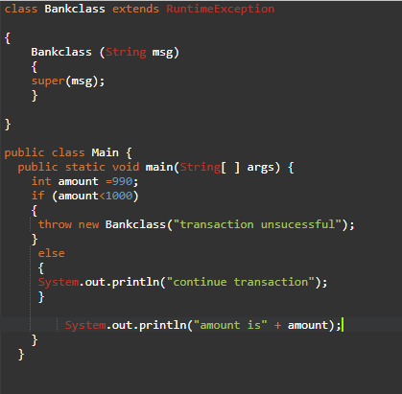

EXAMPLE
public class TestThrow1{
static void validate(int age){
if(age<18)
throw new ArithmeticException("not valid");
else
System.out.println("welcome to vote");
}
public static void main(String args[]){
validate(13);
System.out.println("rest of the code...");
}
}
Output:
Exception in thread main java.lang.ArithmeticException:not valid

Slide 66
JAVA EXCEPTION PROPAGATION
An exception is first thrown from the top of the stack and if it is not caught, it drops down the call stack to the previous method, If not caught there, the exception again drops down to the previous method, and so on until they are caught or until they reach the very bottom of the call stack. This is called exception propagation.
Note: the next line after throw exception will give us unreachable statement because compiler is aware about that statement that it is not going to execute.

Slide 67
JAVA EXCEPTION PROPAGATION: EXAMPLE
class TestExceptionPropagation1{
void m(){
public static void main(String args[]){
int data=50/0;
}
void n(){
m();
}
void p(){
try{
n();
TestExceptionPropagation1 obj=new TestExceptionPropagation1();
obj.p();
System.out.println("normal flow...");
}
}
}catch(Exception e){System.out.println("exception h andled");}
}

Slide 68
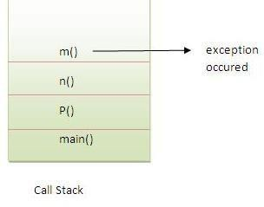
OUTPUT
exception handled
normal flow...

Slide 69
CHECKED EXCEPTION
class TestExceptionPropagation2{
void m(){
throw new java.io.IOException("de vice error");//checked exception
}
void n(){
m();
}
void p(){
try{ n();
}catch(Exception e){System.out.printl
n("exception handeled");}
}
public static void main(String args[]){
TestExceptionPropagation2 obj=new TestExce ptionPropagation2();
obj.p(); System.out.println("normal flow");
}
}

Slide 70
throws KEYWORD
The Java throws keyword is used to declare an exception.
To delegate the responsibility of exceptional handling to the caller method, caller method can be another method or jvm. Then caller method is responsible to handle the exception.
It gives an information to the programmer that there may occur an exception so it is better for the programmer to provide the exception handling code so that normal flow can be maintained.
Note: It is generally used for checked exception.
Throws keyword does not prevent us from abnormal termination

Slide 71
Syntax of java throws
return_type method_name() throws exception_class_name{
//method code
}

Slide 72
Which exception should be declared
checked exception only, because:
unchecked Exception: under your control so correct your code.
error: beyond your control e.g. you are unable to do anything if there occurs VirtualMachineError or StackOverflowError.

Slide 73
Which exception should be declared
checked exception only, because:
unchecked Exception: under your control so correct your code.
error: beyond your control e.g. you are unable to do anything if there occurs VirtualMachineError or StackOverflowError.

Slide 74
Example
import java.io.IOException;
class Testthrows1{
void m()throws IOException{
throw new IOException("device error");//checked exception }
void n()throws IOException{ m(); }
void p(){
try{ n();
}catch(Exception e){System.out.println("exception handled");} }
public static void main(String args[]){
Testthrows1 obj=new Testthrows1(); obj.p();
System.out.println("normal flow...");
} }

Slide 75
Example
import java.io.IOException;
class Testthrows1{
void m()throws IOException{
throw new IOException("device error");//checked exception }
void n()throws IOException{ m(); }
OUTPUT
exception handled
normal flow...
void p(){
try{ n();
}catch(Exception e){System.out.println("exception handled");} }
public static void main(String args[]){
Testthrows1 obj=new Testthrows1(); obj.p();
System.out.println("normal flow...");
} }

Slide 76
If you are calling a method that declares an exception, you must either caught or declare the exception.
There are two cases:
Case1:You caught the exception i.e. handle the exception using try/catch.
Case2:You declare the exception i.e. specifying throws with the method.

Slide 77
Case1:You handle the exception
import java.io.*;
class M{
void method()throws IOException{
throw new IOException("device error");
}
}
public class Testthrows2{
public static void main(String args[]){
try{
M m=new M();
m.method();
}catch(Exception e){System.out.println("exception handled");}
System.out.println("normal flow..."); }}

Slide 78
Case1:You handle the exception
import java.io.*;
class M{
void method()throws IOException{
throw new IOException("device error");
}
}
public class Testthrows2{
public static void main(String args[]){
try{
M m=new M();
m.method();
}catch(Exception e){System.out.println("exception handled");}
OUTPUT:
exception handled normal flow...
System.out.println("normal flow..."); }}

Slide 79
Case2:You declare the exception
A)In case you declare the exception, if exception does not occur, the code will be executed fine.
B)In case you declare the exception if exception occurs, an exception will be thrown at runtime because throws does not handle the exception.

Slide 80
A)Program if exception does not occur
import java.io.*;
class M{
void method()throws IOException{ System.out.println("device operation performed");
}
}
class Testthrows3{
OUTPUT:
device operation performed normal flow...
public static void main(String args[])throws IOException{//declare exception M m=new M();
m.method(); System.out.println("normal flow...");
} }

Slide 81
B)Program if exception occurs
import java.io.*;
class M{
void method()throws IOException{
throw new IOException("device error");
}
}
class Testthrows4{
public static void main(String args[])throws IOException{//declare exception
M m=new M(); m.method();
System.out.println("normal flow...");
}
}

Slide 82
B)Program if exception occurs
import java.io.*;
class M{
void method()throws IOException{
throw new IOException("device error");
}
}
class Testthrows4{
public static void main(String args[])throws IOException{//declare exception
M m=new M(); m.method();
Output:
Runtime Exception
System.out.println("normal flow...");
}
}

Slide 83
Difference between throw and throws in Java
No. | throw | throws
1) | Java throw keyword is used to explicitly throw an exception. | Java throws keyword is used to declare an exception.
2) | Checked exception cannot be propagated using throw only. | Checked exception can be propagated with throws.
3) | Throw is followed by an instance. | Throws is followed by class.
4) | Throw is used within the method. | Throws is used with the method signature.
5) | You cannot throw multiple exceptions. | You can declare multiple exceptions e.g. public void method()throws IOException,SQLException.

Slide 84
THANK YOU
?

