Slide 1

OBJECT ORIENTED PROGRAMMING USING JAVA

Slide 2
OUTLINE
Multithreading in java
Thread
Scheduler
Thread lifecycle

Slide 3
WHAT IS MULTITHREADING??
Multithreading is a Java feature that allows concurrent execution of two or more parts
of a program for maximum utilization of CPU.
Each part of such program is called a thread. So, threads are light-weight processes within a process.
Each of the threads can run in parallel.

Slide 4
APPLICATION OF MULTITHREADING?
Mobile application usage and updation.
Browsing displaying images in webpages.
Websites displaying ads.
Webcrawlers.

Slide 5
MOTIVATION OF MULTITHREADING?
We know sequential programming
Certain task block. E.g. read() in I/O
Blocking halts CPU time thus wasting CPU time.
Solution: Concurrent programming
Why???
Helps in better recourse utilization and throughput.
“But Concurrent programming is complex”

Slide 6
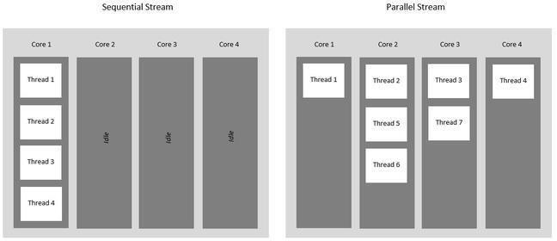
EXAMPLE:

Slide 7
THREADS
Post-os era- computers ran a single program.
OS- multiple processes to run on concurrent
Multitasking : switching CPU from processes to another(illusion of parallelism: does not imply parallelism-)
“Better resource utilization”
“ Better resource utilization leads to the development of threads”

Slide 8
THREADS
Single sequential flow of control within a process.
Light weight processes.
A process can have multiple threads.
Threads share processes wide recourses e.g. Memory.
Threads has its own PC, Stack and local variable.

Slide 9
BENEFITS OF THREADS
Exploiting multiple processors (thus achieving parallelism);
Always loosely coupled designs.
Better throughput even in single CPU machines.

Slide 10
THREADS TYPES
Daemon threads
Background threads which are useful for tasks such as garbage collection
Non-Daemon
Created within application
Main thread: created by JVM to run main()
JVM will not terminate if at least one non-daemon thread is running

Slide 11



Slide 12


Slide 13
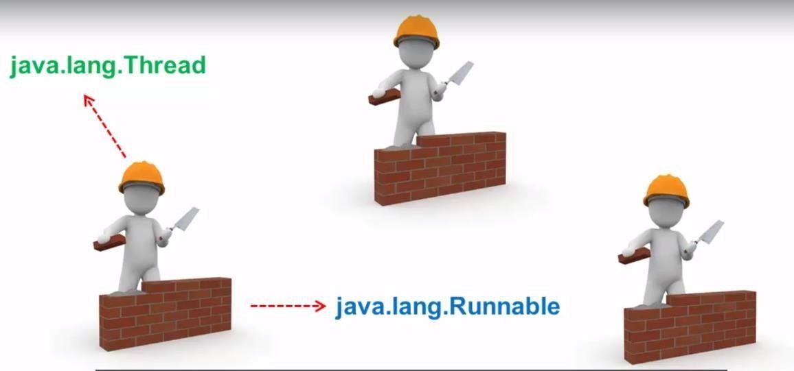

Slide 14
LAUNCHING A THREAD
Case 1: By extending thread class
Case 2: By implementing runnable interface
Create Task
Runnable task=new MyRunnable();
Runnable has exactly one method run()
Creating a thread with task
Thread thread=new Thread(task); // NEW
Start Thread
Thread.start(); //Runnable
New call stack with run() is created for thread

Slide 15
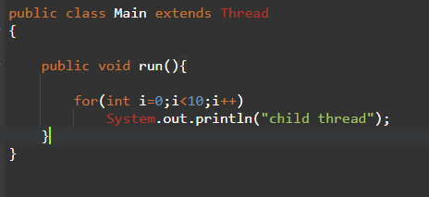
CASE 1: BY EXTENDING THREAD CLASS
Job of a
Defining a thread
thread

Slide 16
THREAD SCHEDULER
It is the part of jvm.
It is responsible to schedule threads.
If multiple threads are waiting to get a chance of execution , in which order threads are executed is done by thread scheduler.
We cant expect exact algorithm followed by thread scheduler it is varied from jvm to jvm, hence we cant expect thread execution order and exact order.
Hence whenever there is no guarantee of exact output, but we can provide all possible
outputs.

Slide 17
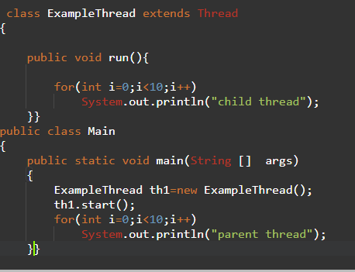
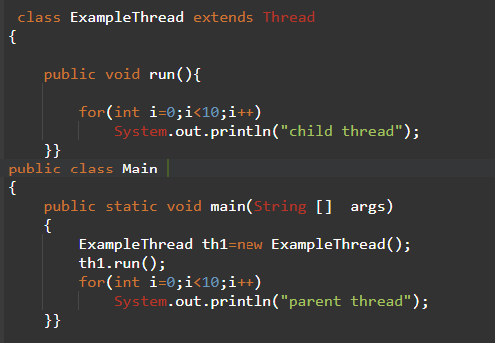
t.start() vs t.run()
DIFFERENCE BETWEEN

Slide 18
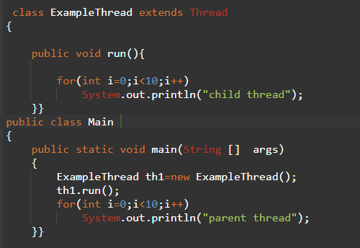
DIFFERENCE BETWEEN
t.start() vs t.run()
Number of thread:2
Here a new thread is created which is responsible for the execution of run method
Overloading not possible.
It is mandatory to override run() method.
Number of thread:1
Here a new thread is not created and is executed in a normal method call.
Overloading possible.
Otherwise don’t use thread.

Slide 19
THREAD LIFECYCLE
If run() methods conpletes
New
state
t.start()
Ready
state
Running
state
Dead
state
If thread scheduler allocates processor
Mythread t=new mythread();
Note:after starting a thread if we again start a thread illegalthreadstateelements
we will get a RE:

Slide 20
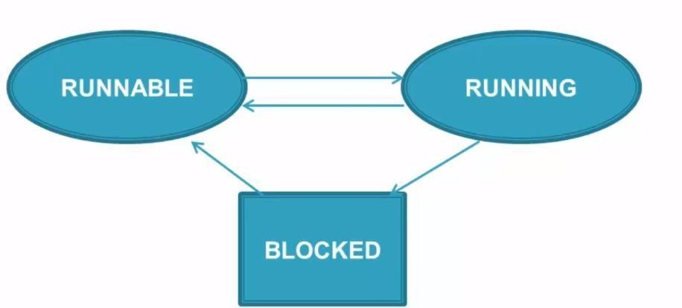
THREAD SCHEDULER

Slide 21
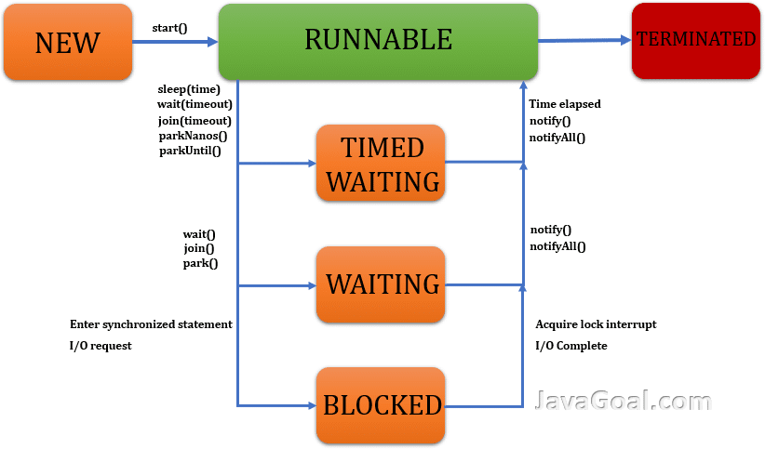
THREAD LIFECYCLE

Slide 22
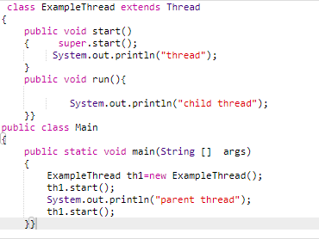
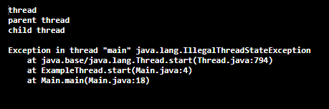
EXAMPLE

Slide 23
DEFINE A THREAD BY RUNNABLE INTERFACE
Runnable
interface
Thread class
Mythread
subclass
Myrunnable

Slide 24
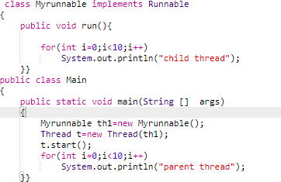
DEFINE A THREAD BY RUNNABLE INTERFACE

Slide 25
WHICH APPROACH WE SHOULD WE PREFER/RECOMMEND??
Case 1: By extending thread class
Case 2: By implementing runnable interface

Slide 26
WHICH APPROACH WE SHOULD WE PREFER/RECOMMEND??
Case 1: By extending thread class
Case 2: By implementing runnable interface

Slide 27
THREAD CLASS CONSTRUCTOR
Thread t=new Thread()
Thread t=new Thread(Runnable r)
Thread t=new Thread(String name)
Thread t=new Thread(Runnable target, String name)
Thread t=new Thread(ThreadGroup group, String name)
Thread t=new Thread(ThreadGroup group, Runnable target)
Thread t=new Thread(ThreadGroup group, Runnable target, String name)
Thread t=new Thread(ThreadGroup group, Runnable target, String name, long stackSize)

Slide 28
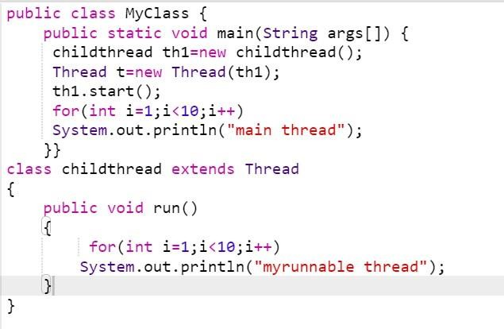
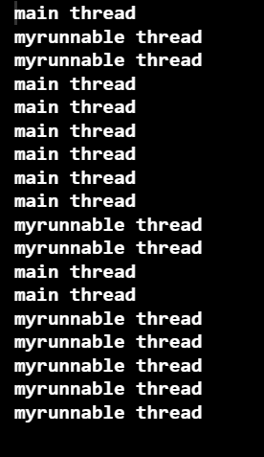

Slide 30
THREAD CLASS METHODS
Sr.No. | Method & Description
1 | public void start() Starts the thread in a separate path of execution, then invokes the run() method on this Thread object.
2 | public void run() If this Thread object was instantiated using a separate Runnable target, the run() method is invoked on that Runnable object.
3 | public final void setName(String name) Changes the name of the Thread object.There is also a getName() method for retrieving the name.
4 | public final void setPriority(int priority) Sets the priority of this Thread object.The possible values are between 1 and 10.
5 | public final void setDaemon(boolean on) A parameter of true denotes this Thread as a daemon thread.
6 | public final void join(long millisec) The current thread invokes this method on a second thread, causing the current thread to block until the second thread terminates or the specified number of milliseconds passes.
7 | public void interrupt() Interrupts this thread, causing it to continue execution if it was blocked for any reason.
8 | public final boolean isAlive() Returns true if the thread is alive, which is any time after the thread has been started but before it runs to completion.

Slide 31
THREAD CLASS METHODS
Sr.No. | Method & Description
1 | public static void yield() Causes the currently running thread to yield to any other threads of the same priority that are waiting to be scheduled.
2 | public static void sleep(long millisec) Causes the currently running thread to block for at least the specified number of milliseconds.
3 | public static boolean holdsLock(Object x) Returns true if the current thread holds the lock on the given Object.
4 | public static Thread currentThread() Returns a reference to the currently running thread, which is the thread that invokes this method.
5 | public static void dumpStack() Prints the stack trace for the currently running thread, which is useful when debugging a multithreaded application.

Slide 32
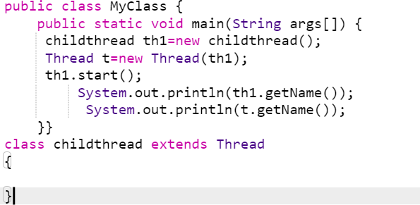
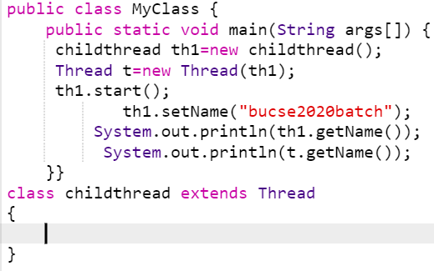


GETNAME AND SETNAME METHOD

Slide 33
GETNAME AND SETNAME METHOD

Slide 34
THREAD PRIORITY
It may be default priority set by jvm
It may be customized priority set by programmer
3 constants defined in Thread class:
public static int MIN_PRIORITY
public static int NORM_PRIORITY
public static int MAX_PRIORITY
Default priority of a thread is 5 (NORM_PRIORITY). The value of MIN_PRIORITY is 1 and the value of MAX_PRIORITY is 10.

Slide 35
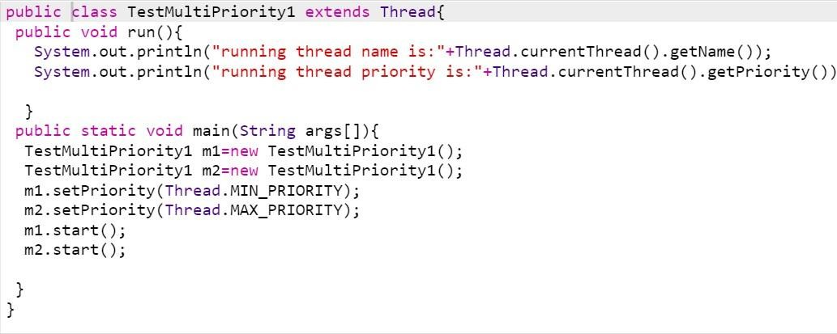
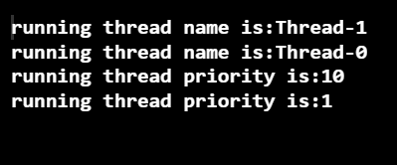
THREAD PRIORITY: EXAMPLE

Slide 36
METHODS THROUGH WHICH WE CAN PREVENT THREAD EXECUTION
1
yield()
2
join()
3
sleep()

Slide 37
YIELD():
A yield() method is a static method of Thread class and it can stop the currently executing thread and will give
a chance to other waiting threads of the same priority.
If in case there are no waiting threads or if all the waiting threads have low priority then the same thread will continue its execution.
The advantage of yield() method is to get a chance to execute other waiting threads so if our current thread takes more time to execute and allocate processor to other threads.
We can use the yield() method to temporarily release time for other threads. For example,
public void run() {
for (int i = 1; i <= lastNum; i++) { System.out.print(" " + i); Thread.yield();
}
}
Every time a number is printed, the current thread is yielded. So, the numbers are printed after the characters.

Slide 38
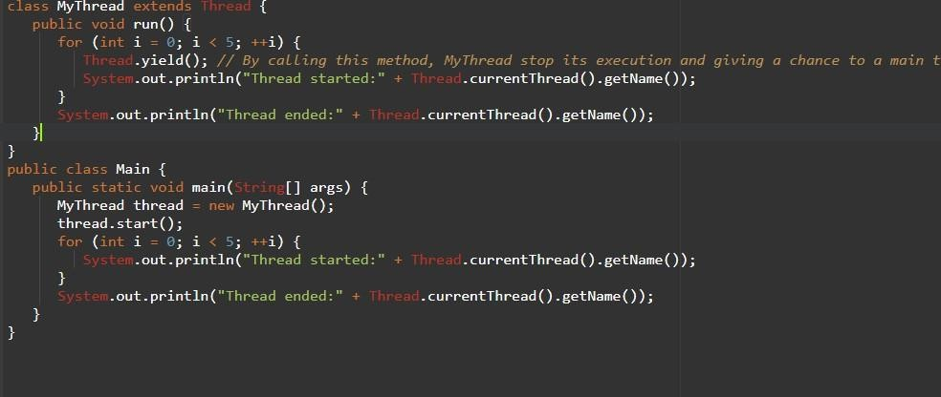
YIELD(): EXAMPLE

Slide 39
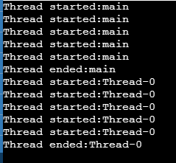
YIELD(): EXAMPLE

Slide 40
JOIN():
The join() method waits for a thread to die.
In other words, it causes the currently running threads to stop executing until the thread it joins with completes its
task.
If a thread want to wait until completing some other thread then we should go for join method.
For example if a thread t1 wants to wait until completing t2 then t1 has to call t2.join().
If t1 executes t2.join then immediately t1 will be entered into waiting state until t2 completes.
Once t2 completes then t1 can continue its execution.
public void run() {
Thread print100
Thread printA
Thread thread4 = new Thread(
new PrintChar('c', 40));
thread4.start();
try {
for (int i = 1; i <= lastNum; i++) { System.out.print(" " + i);
if (i == 50) thread4.join();
printA.join()
Wait for printA
}
to finish
}
catch (InterruptedException ex) {
printA finished
}

Slide 41
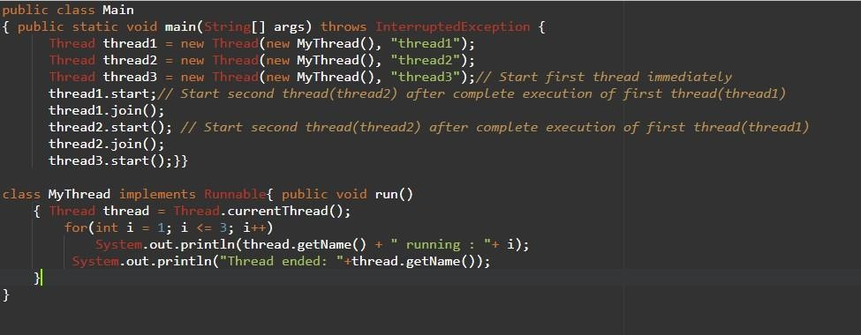
JOIN():EXAMPLE

Slide 42
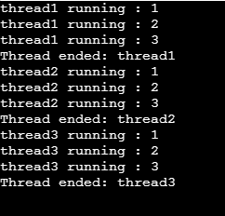
JOIN():EXAMPLE

Slide 43
SLEEP():
The sleep() method of Thread class is used to sleep a thread for the specified amount of time.
The java.lang.Thread.sleep(long millis) method causes the currently executing thread to sleep for the specified number of milliseconds, subject to the precision and accuracy of system timers and schedulers.
Method Whenever Thread.sleep() functions to execute, it always pauses the current thread
execution.
If any other thread interrupts when the thread is sleeping, then InterruptedException will be thrown.
If the system is busy, then the actual time the thread will sleep will be more as compared to that passed while calling the sleep method and if the system has less load, then the actual sleep time of the thread will be close to that passed while calling sleep() method.

Slide 44
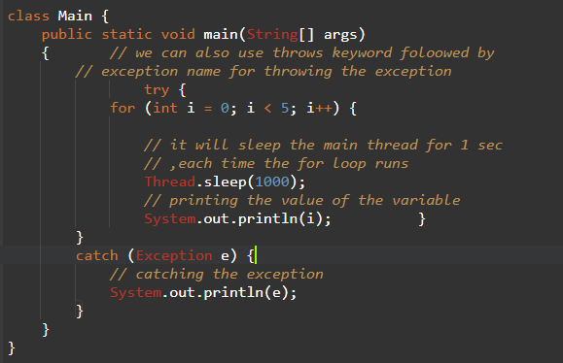

SLEEP():EXAMPLE

Slide 45

THREADS STATES
yield(), or
Running
time out
run() returns
Thread created
start()
New
Ready
run()
join()
Finished
interrupt()
sleep()
Target
wait()
finished
Wait for target
to finish
Wait for time
out
Time out
Wait to be notified
notify() or notifyAll()
Blocked
Interrupted()

Slide 46
SYNCHRONIZATION
Multi-threaded programs may often come to a situation where multiple threads try to access the same resources and finally produce erroneous and unforeseen results.
So it needs to be made sure by some synchronization method that only one thread can access the resource at a given point of time.
Cause race condition
Why do we require Synchronization? Ans: To achieve Consistency.
Step | balance | thread[i] | thread[j]
1 | 0 | newBalance = bank.getBalance() + 1;
2 | 0 |  | newBalance = bank.getBalance() + 1;
3 | 1 | bank.setBalance(newBalance);
4 | 1 |  | bank.setBalance(newBalance);

Slide 47
THE SYNCHRONIZED KEYWORD
The synchronized keyword can be used to mark four different types of blocks:
Instance methods
Static methods
Code blocks inside instance methods
Code blocks inside static methods
To avoid race conditions, threads must be prevented from simultaneously entering certain part of the program, known as critical region.
The critical is the entire deposit method. You can use the synchronized keyword to synchronize the method so that only one thread can access the method at a time.
public synchronized void deposit(double amount) { int newBalance= balance + amount;
Balance = newBalance;
}

Slide 48
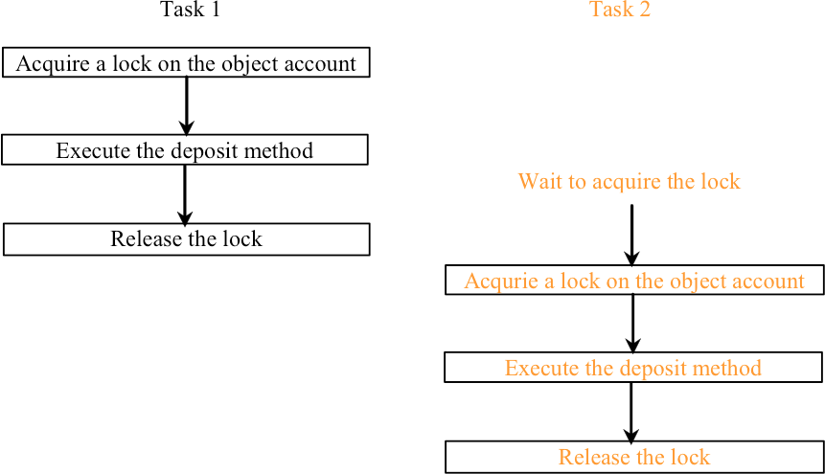
SYNCHRONIZING INSTANCE METHODS AND STATIC METHODS
With the deposit method synchronized, the preceding scenario cannot happen. If Task 2 starts to enter the method, and Task 1 is already in the method, Task 2 is blocked until Task 1 finishes the method.

Slide 49
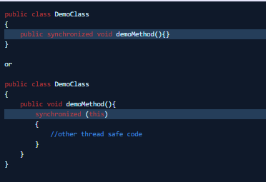
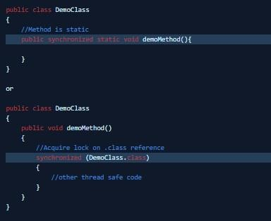
THE SYNCHRONIZED KEYWORD
The synchronized keyword can be used to mark four different types of blocks:
Instance methods
Static methods
Code blocks inside instance methods
Code blocks inside static methods

Slide 50
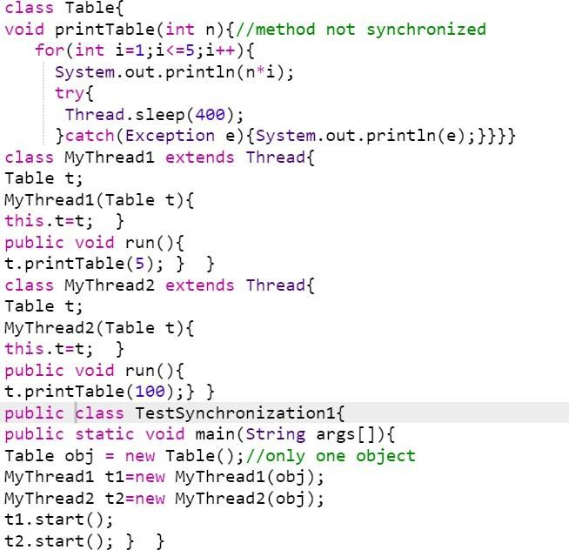

EXAMPLE:

Slide 51
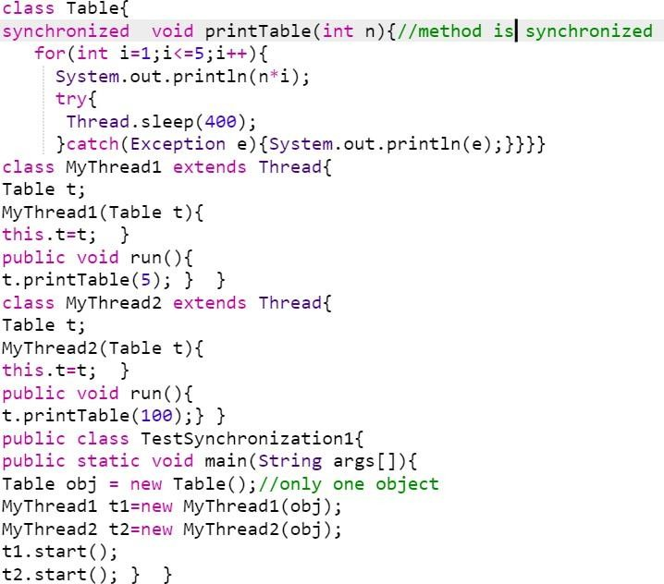
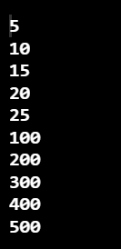
EXAMPLE:

Slide 52
SYNCHRONIZED BLOCK IN JAVA
Synchronized block can be used to perform synchronization on any specific resource of the method.
Suppose you have 50 lines of code in your method, but you want to synchronize only 5 lines, you can use synchronized block.
If you put all the codes of the method in the synchronized block, it will work same as the synchronized method
Syntax to use synchronized block: synchronized (object reference expression) {
//code block
}

Slide 53
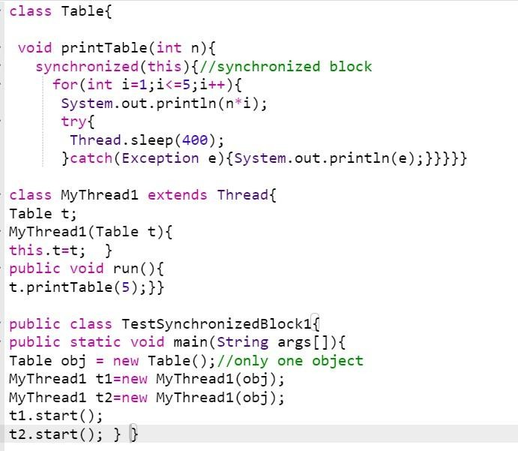
EXAMPLE:

Slide 54
DEADLOCK
Sometimes two or more threads need to acquire the locks on several shared objects. This could cause deadlock, in which each thread has the lock on one of the objects and is waiting for the lock on the other object. Consider the scenario with two threads and two objects, as shown. Thread 1 acquired a lock on object1 and Thread 2 acquired a lock on object2. Now Thread 1 is waiting for the lock on object2 and Thread 2 for the lock on object1. The two threads wait for each other to release the in order to get the lock, and neither can continue to run.
Step
Thread 1
Thread 2
1
2
3
4
5
6
synchronized (object1) {
synchronized (object2) {
// do something here
// do something here
synchronized (object2) {
// do something here
}
synchronized (object1) {
// do something here
}
} }
Wait for Thread 2 to release the lock on object2
Wait for Thread 1 to release the lock on object1

Slide 55
PREVENTING DEADLOCK
Deadlock can be easily avoided by using a simple technique known as resource ordering. With this technique, you assign an order on all the objects whose locks must be acquired and ensure that each thread acquires the locks in that order. For the example, suppose the objects are ordered as object1 and object2. Using the resource ordering technique, Thread 2 must acquire a lock on object1 first, then on object2. Once Thread 1 acquired a lock on object1, Thread 2 has to wait for a lock on object1. So Thread 1 will be able to acquire a lock on object2 and no deadlock would occur.

Slide 56









Outline
Process versus Thread
Synchronization
Multithreading with Java
Multithreading with C#
Multithreading with C++
Multithreading

Slide 57

Process versus Thread.
Synchronization
Multithreading

Slide 58
Process Model
A process is a sequential program in execution.
A process is a unit of computation.
Process components:
The program (code) to be executed.
The data on which the program will execute.
Resources required by the program.
The status of the process execution.
A process runs in an abstract machine environment (could be OS) that manages the sharing and isolation of resources among the community of processes.
Code
Data
Process Status
Resource
Abstract Machine Environment
Multithreading

Slide 59
Program and Process
Program and process – distinction?
A program is a static entity made up of program statements. The latter define the run-time behavior.
A process is a dynamic entity that executes a program on a
particular set of data.
Two or more processes could execute the same program, each using their own data and resources.
Multithreading

Slide 60
Thread Model
A thread is an alternative form (to the process) of schedulable unit of computation.
In the thread model:
Each thread is associated with a process.
A thread is an entity that executes by relying on the code and resources, holding by the associated process.
Several threads could be associated with a single process. Those threads share the code and resources of the process.
A thread allocates part of the process’s resources for its needs.
A thread has its own data and status.
Resource
Process
Thread
Data
Code
Data
Process Status
Thread Status
Multithreading

Slide 61
Thread Model
Control in a normal program usually follows a single thread of execution.
What differentiates threads from normal processes is the shared memory (objects), which is visible to all threads in a multi- threaded program.
A thread has much less overhead than a process so is sometimes called as light-weight process.
Multithreading allows an application to have multiple threads
of execution running concurrently.
Multithreading

Slide 62
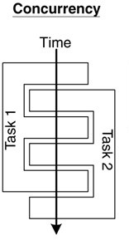
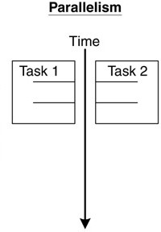
Concurrency and Parallelism
Concurrent multithreading systems give the appearance of several tasks executing at once, but these tasks are actually split up into chunks that share the processor with chunks from other tasks.
In parallel systems, two tasks are actually performed simultaneously. Parallelism requires a multi-CPU system.
Multithreading

Slide 63
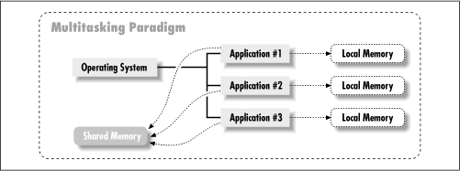
Multitasking
Multitasking operating systems run multiple programs simultaneously.
Each of these programs has at least one thread within it - single-threaded
process:
The process begins execution at a well-known point. In Java, C# or C++, the
process begins execution at the first statement of the function called main().
Execution of the statements follows in a completely ordered, predefined sequence for a given set of inputs.
While executing, the process has access to certain data – local, global, static
etc.
Multithreading

Slide 64
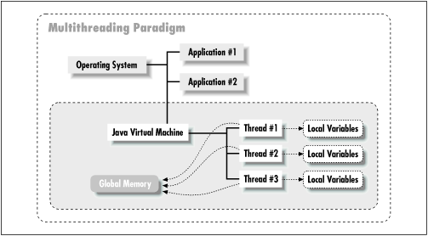
Multithreading
A program with multiple threads running within a single instance could be considered as a multitasking system within an OS.
In a multithreading program, threads have the following properties:
A thread begin execution at a predefined, well-known location. For one of the threads in the program, that location is the main() method; for the rest of the threads, it is a particular location the programmer decides on when the code is written.
A thread executes code in an ordered, predefined sequence.
A thread executes its code independently of the other threads.
The threads appear to have a certain degree of simultaneous execution.
Multithreading

Slide 65
Threading Models
There are typically two threading models supported by OS:
Cooperative Threading Model;
Preemptive Threading Model.
Cooperative Threading Model
In a cooperative system, a thread retains control of the processor until it decides to give it up (which might be never).
Supporting OS – Windows 3.x, Solaris, Mac OS.
The various threads have to cooperate with each other. If not, some of them will be starving (never given a chance to run).
Scheduling in most cooperative systems is done strictly by priority level - when the current thread gives up control, the highest-priority waiting thread gets control.
Multithreading

Slide 66
Threading Models
Preemptive Threading Model
In a preemptive system, some sort of timer is used by the operating system itself to cause a context swap.
Supporting OS – Windows 9x, XP, NT (2000), Solaris, Linux.
When the timer "ticks" the OS can abruptly take control away from the running thread and give control to another thread.
The interval between timer ticks is called a time slice.
To get to concurrency, the OS must do the thread scheduling.
Preemptive systems are less efficient than cooperative ones because the thread management must be done by the OS’ kernel, but they are easier to program (except their synchronization).
Multithreading

Slide 67






Synchronization
Background
Concurrent access to shared data may result in data inconsistency.
Maintaining data consistency requires mechanisms to ensure the
orderly execution of cooperating processes (or threads).
When do we need synchronization?
When two or more processes (or threads) work on the same data simultaneously.
Multithreading

Slide 68


Synchronization
Example:
Two threads are trying to update the same shared variable simultaneously:
The result is unpredictable.
The result depends on which of the two threads was the last one to change the value.
The competition of the threads for the variable is called race condition.
The first thread is the one who wins the race to update the variable.
Multithreading

Slide 69



Classical Synchronization Problems
Mutual exclusion
Only one process executes a piece of code (critical section) at any time.
OS examples: access to shared resources, e.g., a printer.
Sequencing
A process waits for another process to finish executing some
code.
OS examples: waiting for an event, e.g., ls (dir) command suspends until there is some data to read from the file system.
Multithreading

Slide 70











Classical Synchronization Problems
Bounded-buffer
(also referred to as the Producer-Consumer problem)
A pool of n buffers.
Producer processes put items into the pool.
Consumer processes take items out of the pool.
Issues: mutual exclusion, empty pool, and full pool.
OS examples: buffering for pipes, file caches, etc.
Multithreading

Slide 71


Classical Synchronization Problems
Readers-Writers
Multiple processes access a shared data object X.
Any number of readers can access X at the same time.
No writer can access it at the same time as a reader or another
writer.
Mutual exclusion is too constraining. Why?
Variations:
reader-priority: a reader must not wait for a writer;
writer-priority: a writer must not wait for a reader,
OS examples: file locks.
Multithreading

Slide 72

Classical Synchronization Problems
Dining Philosophers
5 philosophers with 5 chopsticks placed between them.
To eat requires two chopsticks.
Philosophers alternate between thinking and eating.
OS examples: simultaneous use of multiple resources.
Many examples, along with Java code
http://www.doc.ic.ac.uk/~jnm/book/book_applets/concurrency.ht ml
Multithreading

Slide 73


The Critical Section Problem
Definition:
A critical section is a piece of code that accesses a shared resource (data structure or device) that must not be concurrently accessed by more than one thread of execution.
Conditions:
n processes (or threads) all competing to use some shared data.
Each process has a code segment, called critical section, in which the shared data is accessed.
Problem:
How to ensure that when one process is executing in its critical section, no other process is allowed to execute in its critical section?
Multithreading

Slide 74
The Critical Section Problem - Example
Suppose that two processes are trying to increment the same variable. They both execute the statement
x := x + 1;
To execute this statement each process reads the variable x, then adds one to the value, then write it back.
Suppose the value of x is 3.
If both processes read x at the same time then they would get the same value 3.
If they then both added 1 to it then they would both have the value 4.
They would then both write 4 back to x.
The result is that both processes incremented x, but its value is only 4, instead of 5.
Multithreading

Slide 75




The Critical Section Problem
Solution – three requirements:
Only one process is allowed to be in its critical section at a time. Hence, the execution of critical sections is mutually exclusive.
If there is no process in its critical section, but some processes are waiting to enter their critical sections, only the waiting processes may compete for getting in. Ultimately, there must be progress in the resolution and one process must be allowed to enter.
Processes waiting to enter their critical sections must be allowed to do so in a bounded timeframe. Hence, processes have bounded waiting.
Multithreading

Slide 76





The Critical Section Problem
Critical sections are General Framework for process (thread) synchronization:
ENTRY SECTION CRITICAL SECTION CODE EXIT SECTION
The ENTRY SECTION controls access to make sure no more than one process Pi gets to access the critical section at any given time. It acts as a guard.
The EXIT SECTION does bookkeeping to make sure that
other processes that are waiting know that Pi has exited.
Multithreading

Slide 77
Semaphores
The Semaphores are a solution to the Critical Section Problem.
Help in making the Critical Section atomic.
A semaphores is:
a single integer variable S;
accessed via two atomic operations:
WAIT (sometimes denoted by P)
while S <= 0 do wait(); S := S-1;
SIGNAL (sometimes denoted by V)
S := S+1;
wake up a waiting process (if any);
Mutual Exclusion Semaphore
//**** initially S = 1
P( S ) //**** WAIT
CRITICAL SECTION
V( S ) //**** SIGNAL
WAITing processes cannot “lock out” a SIGNALing process.
Binary semaphores - S is restricted to take on only the values 0 and 1.
Multithreading

Slide 78
Topic
Multithreading with Java
Multithreading

Slide 79
Threads in Java
There are two ways to create a java thread:
By extending the java.lang.Thread class.
By implementing the java.lang.Runnable interface.
The run() method is where the action of a thread takes place.
The execution of a thread starts by calling its start() method.
class PrimeThread extends Thread { long minPrime; PrimeThread(long minPrime) {
this.minPrime = minPrime; }
public void run() {
// compute primes larger than minPrime . . .
}
}
The following code would then create a thread and start it running:
PrimeThread p = new PrimeThread(143); p.start();
Multithreading

Slide 80
Implementing the Runnable Interface
In order to create a new thread we may also provide a class that implements the java.lang.Runnable interface.
Preferred way in case our class has to subclass some other class.
A Runnable object can be wrapped up into a Thread object:
Thread(Runnable target)
Thread(Runnable target, String name)
The thread’s logic is included inside the run() method of the runnable object.
class ExClass
extends ExSupClass implements Runnable {
…
public ExClass (String name) {
}
public void run() {
…
}
}
class A {
…
main(String[] args) {
…
Thread mt1 = new Thread(new ExClass("thread1”)); Thread mt2 = new Thread(new ExClass("thread2”)); mt1.start();
mt2.start();
}
}
Multithreading

Slide 81
Implementing the Runnable Interface
Constructs a new thread object associated with the given Runnable object.
The new Thread object's start() method is called to begin execution of the new thread of control.
The reason we need to pass the runnable object to the thread object's constructor is that the thread must have some way to get to the run() method we want the thread to execute. Since we are no longer overriding the run() method of the Thread class, the default run() method of the Thread class is executed:
public void run() {
if (target != null) {
target.run();
}
}
Here, target is the runnable object we passed to the thread's constructor. So the thread begins execution with the run() method of the Thread class, which immediately calls the run() method of our runnable object.
Multithreading

Slide 82
Sleep, Yield, Notify & Wait Thread’s Functions
sleep(long millis) - causes the currently executing thread to sleep (temporarily cease execution) for the specified number of milliseconds.
yield() - causes the currently executing thread object to
temporarily pause and allow other threads to execute.
wait() - causes current thread to wait for a condition to occur (another thread invokes the notify() method or the notifyAll() method for this object). This is a method of the Object class and must be called from within a synchronized method or block.
notify() - notifies a thread that is waiting for a condition that the condition has occurred. This is a method of the Object class and must be called from within a synchronized method or block.
notifyAll() – like the notify() method, but notifies all the threads that are waiting for a condition that the condition has occurred.
Multithreading

Slide 83
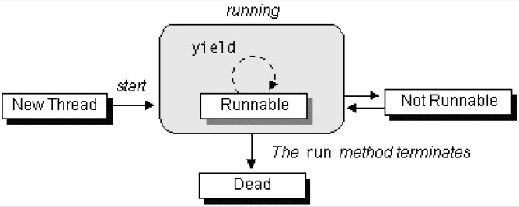
The Lifecycle of a Thread
The start() method creates the system resources necessary to run the thread, schedules the thread to run, and calls the thread's run() method.
A thread becomes Not Runnable when one of these events occurs:
Its sleep() method is invoked.
The thread calls the wait() method.
The thread is blocked on I/O operations.
A thread dies naturally when the run() method exits.
Multithreading

Slide 84
Thread Priority
On a single CPU, threads actually run one at a time in such a way as to provide an illusion of concurrency.
Execution of multiple threads on a single CPU, in some order, is
called scheduling.
The Java runtime supports a very simple scheduling algorithm (fixed priority scheduling). This algorithm schedules threads based on their priority relative to other runnable threads.
The runtime system chooses the runnable thread with the highest
priority for execution.
Multithreading

Slide 85
Thread Priority
If two threads of the same priority are waiting for the CPU, the scheduler chooses one of them to run in a round-robin fashion - each process is guaranteed to get its turn at the CPU at every system-specified time interval.
The chosen thread will run until:
A higher priority thread becomes runnable.
It yields (calls its yield() method), or its run() method exits.
On systems that support time-slicing, its time allotment has elapsed.
You can modify a thread's priority at any time after its creation by using the setPriority() method.
Multithreading

Slide 86

Synchronization of Java Threads
In many cases concurrently running threads share data and must consider the state and activities of other threads.
If two threads can both execute a method that modifies the state of an object then the method should be declared to be synchronized, those allowing only one thread to execute the method at a time.
If a class has at least one synchronized method, each instance of it has a monitor. A monitor is an object that can block threads and notify them when the method is available.
Example:
public synchronized void updateRecord() {
//**** critical code goes here …
}
Only one thread may be inside the body of this function. A second call will be blocked until the first call returns or wait() is called inside the synchronized method.
Multithreading

Slide 87
Synchronization of Java Threads
If you don’t need to protect an entire method, you can synchronize on an object:
public void foo() {
synchronized (this) {
//critical code goes here …
}
…
}
There are two syntactic forms based on the synchronized
keyword - blocks and methods.
Block synchronization takes an argument of which object to lock. This allows any method to lock any object.
The most common argument to synchronized blocks is this.
Block synchronization is considered more fundamental than method synchronization.
Multithreading

Slide 88





















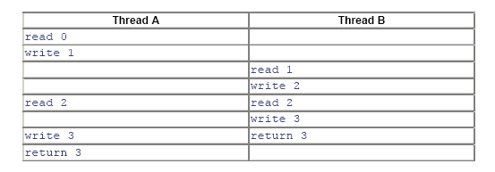
Applying Synchronization (Example)
Consider the following class:
class Even {
private int n = 0;
public synchronized int next(){
++n;
++n;
Declaring the next method as synchronized would resolve such conflicting problems.
return n; //**** next is always even
}
}
Without synchronizing, the desired postcondition may fail due to a storage conflict when two or more threads execute the next method of the same Even object.
Here is one possible execution trace:
Multithreading

Slide 89
Synchronization of Java Threads
To program the synchronization behavior we use the Object class’ methods wait(), notify() and notifyAll().
With these methods we allow objects to wait until another object
notifies them:
synchronized( waitForThis ) { try { waitForThis.wait();}
catch (InterruptedException ie) {}
}
To wait on an object, you must first synchronize on it.
InterruptedException is thrown when a thread is waiting, sleeping, or otherwise paused for a long time and another thread interrupts it using the interrupt method in class Thread.
Multithreading

Slide 90
Synchronization of Java Threads
A thread may call wait() inside a synchronized method. A timeout may be provided. If missing or zero then the thread waits until either notify() or notifyAll() is called, otherwise until the timeout period expires.
wait() is called by the thread owning the lock associated with a particular object.
notify() or notifyAll() are only called from a synchronized method. One or all waiting threads are notified, respectively. It’s probably better (safer) to use notifyAll(). These methods don't release the lock. The threads awakened will not return from their wait() call immediately, but only when the thread that called notify() or notifyAll() finally relinquishes ownership of the lock.
Multithreading

Slide 91
Synchronization of Java Threads
The wait() method releases the lock prior to waiting, and reacquires the lock prior to returning from the wait() method.
It is possible a synchronized method to make a self-call to another synchronized method on the same object without freezing up.
Methods that are not synchronized may still execute at any time, even if a synchronized method is in progress. In other words, synchronized is not equivalent to atomic, but synchronization can be used to achieve atomicity.
Multithreading

Slide 92
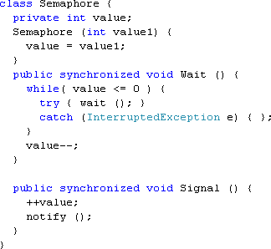
Java Semaphore - Example
Multithreading

Slide 93




















Protecting Static Fields
Locking an object does not automatically protect access to the
static fields of that object's class or any of its superclasses.
Access to static fields is instead protected via static synchronized
methods and blocks.
Consider the following class:
class Even {
public static int n = 0;
Will prevent outer access on n, until the end of the next() method.
public static synchronized int next(){
++n;
++n;
return n; //**** next is always even
//**** will lock n as well and
}
}
Multithreading

Slide 94
Java Threading API
:: Stopping Threads
The Thread class does contain a stop() method that allows you to stop a thread immediately: no matter what the thread is doing, it will be terminated.
However, the stop() method is very dangerous. In Java 2, the stop() method is
deprecated.
Why?
If a thread holds a lock at the time it is stopped, the lock will be released when
the thread stops.
But if the thread that is being stopped is in the middle of updating a linked list, for example, the links in the list will be left in an inconsistent state.
Hence, if we were able to interrupt a thread in the middle of this operation, we would lose the benefit of its obtaining the lock.
The reason we needed to obtain a lock on the list in the first place was to ensure that the list would not be found by another thread in an inconsistent state.
Multithreading

Slide 95
Java Threading API
:: The suspend() and resume() Methods
The suspend() and resume() methods are very dangerous and they became deprecated.
The problem with using the suspend() method is that it can conceivably lead to cases of lock starvation - including cases where the starvation shuts down the entire virtual machine.
If a thread is suspended while it is holding a lock, that lock remains held by the suspended thread. As long as that thread is suspended, no other thread can obtain the lock.
There is no danger in the resume() method itself, but since the resume() method is useful only with the suspend() method, it too has been deprecated.
Java Thread primitives deprecation: http://java.sun.com/j2se/1.5.0/docs/guide/misc/threadPrimitiveDe precation.html
Multithreading

Slide 96
Java Threading API
:: Thread Naming
It is possible to assign a String name to the Thread object itself:
void setName(String name) //assigns a name to the Thread instance
String getName() //gets the name of the Thread instance
The system does not use this string for any specific purpose.
We can use it for debugging. With an assigned name, the debugger and the toString() method display thread information in terms of a “logical" name instead of a number.
The naming support is also available as a constructor of the Thread class:
Thread(String name) constructs a thread object with a name that is already assigned. This constructor is used when threading by inheritance.
Thread(Runnable target, String name) constructs a thread object that is associated with the given Runnable object and is created with a name that is already assigned. This constructor is used when threading by interfaces.
Multithreading

Slide 97
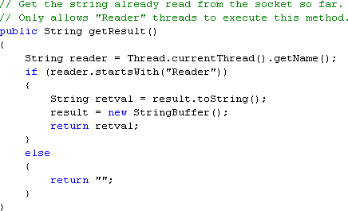
Java Threading API
:: Thread Access – The currentThread() Method
static Thread currentThread() gets the Thread object that represents the current thread of execution. The method is static and may be called through the Thread class name.
Why is this method important?
The Thread object for the current thread may not be saved anywhere, and even if it is, it may not be accessible to the called method.
In this code we are assuming that reader threads are threads whose names start with "Reader." This name could have been assigned by the setName() method earlier or when the threads were constructed.
To obtain a name, we need simply to call the getName() method. However, since we do not have the Thread object reference of the caller, we must call the currentThread() method to obtain the reference.
Multithreading

Slide 98
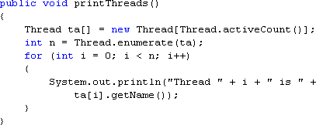
Java Threading API
:: Thread Access – Enumerating Threads in JVM
The Thread class provides methods that allow you to obtain a list of all the threads in the program:
static int enumerate(Thread threadArray[]) gets all the thread objects of the program and stores the result into the thread array. The value returned is the number of thread objects stored into the array. The method is static and may be called through the Thread class name.
static int activeCount() returns the number of threads in the program. The method is static and may be called through the Thread class name.
Multithreading

Slide 99
Topic
Multithreading with C#
Multithreading

Slide 100
C# Namespace System.Threading
Sytem.Threading is a powerful namespace for:
programming Threads in C#;
thread Synchronization in C#.
The most important class inside this namespace for manipulating threads is the class Sytem.Threading.Thread.
It can run other thread in our application process.
Threads in C# does not require a run() method;
A thread in C# is not considered as an object;
C# provides similar to Java set of primitives for operating on
threads.
Multithreading

Slide 101
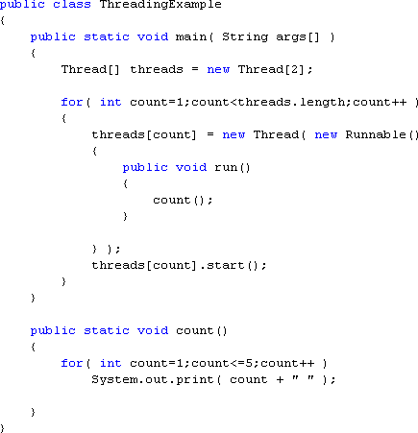
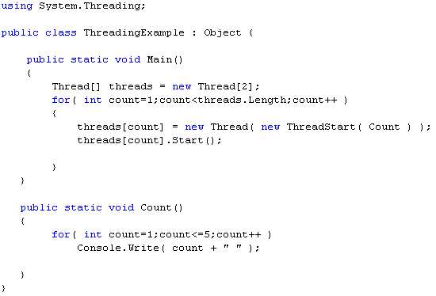
Java versus C#
Java Code
C# Code
Multithreading

Slide 102
Java’s java.lang.Thread – C#’s System.Threading.Thread
Java | C#
setDaemon( boolean on) method | IsBackground set property
isDaemon() method | IsBackground get property
isAlive() method | IsAlive get property
yield() method | Interrupt() method
isInterrupted() method | n/a
sleep( long millis ) and sleep( long millis, int nanos ) | Sleep( int millisecondTimeout ) and Sleep( System.TimeSpan ) methods
join(), and join( long millis ), and join( long millis, int nanos ) methods | Join(), Join( int millisecondTimeout ), and Join( System.TimeSpan ) methods
suspend() method | Suspend() method
resume() method | Resume() method
stop() method | Abort() method
Multithreading

Slide 103
Thread Synchronization
Java | C#
synchronized | lock
Object.wait() method | Monitor.Wait( object obj ) method
Object.notify() method | Monitor.Pulse( object obj ) method
Object.notifyAll() method | Monitor.PulseAll( object obj ) method
In addition to the lock construct, C# has provided access to its internal
methods to acquire and release locks:
Monitor.Enter( object obj );
Monitor.Exit( object obj ).
Using these methods can buy a programmer the same benefits as using the lock construct, but it can also provide more elaborate locking abilities, such as being able to lock variables in one method and have them released at different times or different points in the code, depending on the code path.
Multithreading

Slide 104
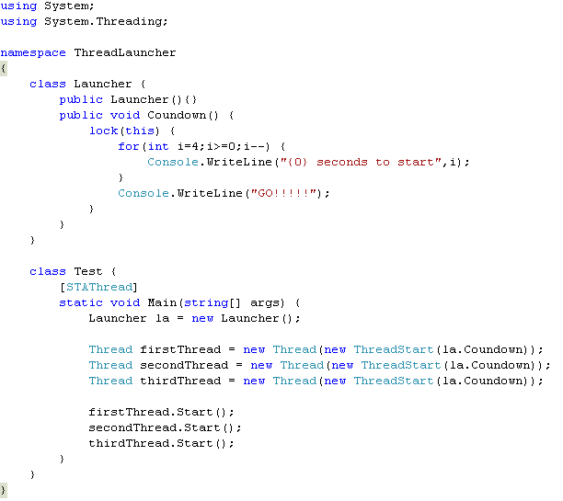
Example: Thread Synchronization
Multithreading

Slide 105
Topic
Multithreading with C++
Multithreading

Slide 106
C++ Has No Build-in Multithreading
C++ does not contain any built-in support for multithreaded applications. Instead, it relies entirely upon the operating system to provide this feature.
Using operating system functions to support multithreading gives you access to the full range of control offered by the execution environment.
Consider Windows. It defines a rich set of thread-related functions that enable finely grained control over the creation and management of a thread.
Example: Windows has several ways to control access to a shared resource - semaphores, mutexes, event objects, waitable timers, and critical sections.
Multithreading

Slide 107
Windows Thread Functions - CreateThread
Windows offers a wide array of Application Programming Interface (API) functions that support multithreading.
To use Windows’ multithreading functions, you must include
<windows.h> in your program.
To create a thread, use the Windows API CreateThread()
function. Its prototype is shown here:
HANDLE CreateThread(
LPSECURITY_ATTRIBUTES secAttr,
SIZE_T stackSize, LPTHREAD_START_ROUTINE threadFunc, LPVOID param,
DWORD flags,
LPDWORD threadID);
Multithreading

Slide 108
Windows Thread Functions - CreateThread
secAttr - a pointer to a set of security attributes pertaining to the thread. If secAttr is NULL, then the default security descriptor is used.
Each thread has its own stack – the stackSize parameter. If this integer value is zero, then the thread will be given a stack that is the same size as the creating thread.
Each thread of execution begins with a call to a function, called the thread function, within the creating process (like in C#).
Execution of the thread continues until the thread function returns.
The address of this function (that is, the entry point to the thread) is specified in threadFunc.
DWORD WINAPI threadfunc(LPVOID param);
Multithreading

Slide 109
Windows Thread Functions - CreateThread
param – specifies any argument that you need to pass to the new thread.
flags - determines the execution state of the thread:
If it is zero, the thread begins execution immediately.
If it is CREATE_SUSPEND, the thread is suspended state, awaiting execution.
It may be started using a call to ResumeThread().
created in a
threadID - the identifier associated with a thread is returned in this long integer pointer.
The function returns a handle to the thread if successful or NULL if a failure occurs.
The thread handle can be destroyed:
manually by calling CloseHandle();
automatically when the parent process ends.
Multithreading

Slide 110
Windows Thread Functions – TerminateThread
A thread terminates when its entry function returns.
We can also terminate threads manually:
TerminateThread( );
ExitThread( );
BOOL TerminateThread(HANDLE thread, DWORD status); VOID ExitThread(DWORD status);
thread - the handle of the thread to be terminated.
status - the termination status.
ExitThread() - terminates the thread that calls ExitThread().
TerminateThread() returns nonzero if successful and otherwise.
zero
Multithreading

Slide 111
Visual C++ Threading Model
The Visual C++ alternatives to CreateThread() and ExitThread()
are listed below. Both require the header file <process.h>.
_beginthreadex( );
_endthreadex( );
uintptr_t _beginthreadex( void *secAttr, unsigned stackSize,
unsigned ( stdcall *threadFunc)(void *), void *param,
unsigned flags,
unsigned *threadID);
void _endthreadex(unsigned status);
Multithreading

Slide 112
Suspending and Resuming Threads
A thread of execution can be suspended
SuspendThread().
It can be resumed by calling ResumeThread().
by calling
DWORD SuspendThread(HANDLE hThread);
DWORD ResumeThread(HANDLE hThread);
Multithreading

Slide 113
Windows Synchronization Objects
classic semaphore - when using a semaphore, the access to a resource can be completely synchronized.
mutex semaphore (mutex) - synchronizes a resource such that
one and only one thread or process can access it at any one time.
event object - can be used to block access to a resource until some other thread or process signals that it can be used. An event object signals that a specified event has occurred.
waitable timer - blocks a thread’s execution until a specific time.
timer queues - lists of timers.
critical section - prevents a section of code from being used by more than one thread at a time.
Multithreading

Slide 114
Using Mutex
CreateMutex() – creates a mutex object.
HANDLE CreateMutex( LPSECURITY_ATTRIBUTES secAttr,
BOOL acquire,
LPCSTR name);
Once you have created a semaphore, you use it by calling two related functions:
WaitForSingleObject() and ReleaseMutex().
To use a mutex to control access to a shared resource, wrap the code that accesses that resource between a call to WaitForSingleObject() and ReleaseMutex().
If (WaitForSingleObject(hMutex, 10000)==WAIT_TIMEOUT)
{ //**** handle time-out error }
//**** access the resource ReleaseMutex(hMutex);
Multithreading

Slide 115
References
Scott Oaks and Henry Wong, “Java Threads”, 2nd edition, O’Reilly
Bruce Eckel, "Thinking in Java", 3^{d} edition
Sun Microsystems, “The Java Tutorial, http://java.sun.com/docs/books/tutorial/essential/threads/
Sun Microsystems, JavaTM 2 Platform, Standard Edition, v 1.3.1
API Specification, http://java.sun.com/j2se/1.3/docs/api/overview-summary.html
Mike Gold October , Introduction to Multithreading in C#, C# Corner, June 2005
Multithreading in C++, Contributed by McGraw-Hill/Osborne, http://www.devarticles.com/c/a/Cplusplus/Multithreading-in-C/
Multithreading

Slide 116
THANK YOU
?

