Slide 1
Java Collections
1

Slide 2
Java 2 Collections
A collection is an object that groups multiple elements into a single unit
Very useful
» store, retrieve and manipulate data
» transmit data from one method to another
» data structures and methods written by hotshots in the field
Joshua Bloch, who also wrote the Collections tutorial

Slide 3
Collections Framework
Unified architecture for representing and manipulating collections.
A collections framework contains three things
» Interfaces
» Implementations
» Algorithms
10

Slide 4
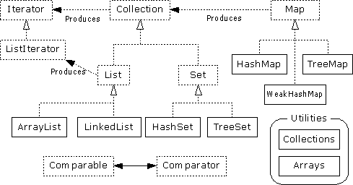
Collections Framework Diagram
10

Slide 5
Collection Interface
Defines fundamental methods
» int size();
» boolean isEmpty();
» boolean contains(Object element);
»
»
»
boolean add(Object element); // Optional boolean remove(Object element); // Optional Iterator iterator();
These methods are enough to define the basic behavior of a collection
Provides an Iterator to step through the elements in the Collection
10

Slide 6
Example - SimpleCollection
public class SimpleCollection {
public static void main(String[] args) { Collection c;
c = new ArrayList(); System.out.println(c.getClass().getName()); for (int i=1; i <= 10; i++) {
c.add(i + " * " + i + " = "+i*i);
}
Iterator iter = c.iterator(); while (iter.hasNext())
System.out.println(iter.next());
}
}
10

Slide 7
List Interface Context
Collection
List
10

Slide 8
List Interface
The List interface adds the notion of order to a collection
The user of a list has control over where an element is added in the collection
Lists typically allow duplicate elements
Provides a ListIterator to step through the elements in the list.
10

Slide 9
ListIterator Interface
Extends the Iterator interface
Defines three fundamental methods
» void add(Object o) - before current position
» boolean hasPrevious()
» Object previous()
The addition of these three methods defines the basic behavior of an ordered list
A ListIterator knows position within list
10

Slide 10
ArrayList and LinkedList Context
Collection
List
ArrayList
LinkedList
10

Slide 11
List Implementations
ArrayList
» low cost random access
» high cost insert and delete
» array that resizes if need be
LinkedList
» sequential access
» low cost insert and delete
» high cost random access
10

Slide 12
ArrayList
An ArrayList is one of the resizable list implementaions of the generic list
interface, the other being Vector Class.
Each ArrayList object has a capacity. The capacity is the size of the array used to store the elements in the list and it is as large as the list size. As the elements are added into the list, its capacity grows automatically.
The ArrayList concept provides the facility by creating an array of some default size. If it becomes insufficient to add more elements into this initial array then system creates a new larger array and copies the content of previous array into the new array and remaining space in new array for adding additional elements and this process keeps happening but programmer is not aware of this activity.
10

Slide 13
ArrayList Continued
An ArrayList object can only store references of Java Class objects and variables of primitive types such as int, float, double etc. can not be stored in an ArrayList.
An ArrayList object in not synchronized i.e multiple independent threads can access a particular ArrayList object simultaneously.
3-February-2003
cse403-10-Collections © 2003 University of Washington

Slide 14
ArrayList overview
Constant time positional access (it’s an array)
One tuning parameter, the initial capacity
public ArrayList(int initialCapacity) {
super();
if (initialCapacity < 0)
throw new IllegalArgumentException(
"Illegal Capacity: "+initialCapacity);
this.elementData = new Object[initialCapacity];
}

Slide 15
Some of the frequently used ArrayList Class Methods
boolean add(E e): Append a specified element e to the end of the concerned ArrayList object.
void add(int index, E element): Inserts the speicified element at the specified position in the concerned ArrayList.
int capacity(): returns the current capacity of the concerned ArrayList object.
void clear(): removes all of the elements from the concerned ArrayList object.
boolean contains(Object O): returns true if the concerned ArrayList object holds the reference of Object O passed as argument.
Iterator<E> interator: returns an iterator object to iterate over the elements of the concerned ArrayList object.
E set(int index, E element): Replaces the element at specified position in the list with specified element
int indexOf(Object O): returns the index of first occurrence of element O in
concerned ArrayList.

Slide 16
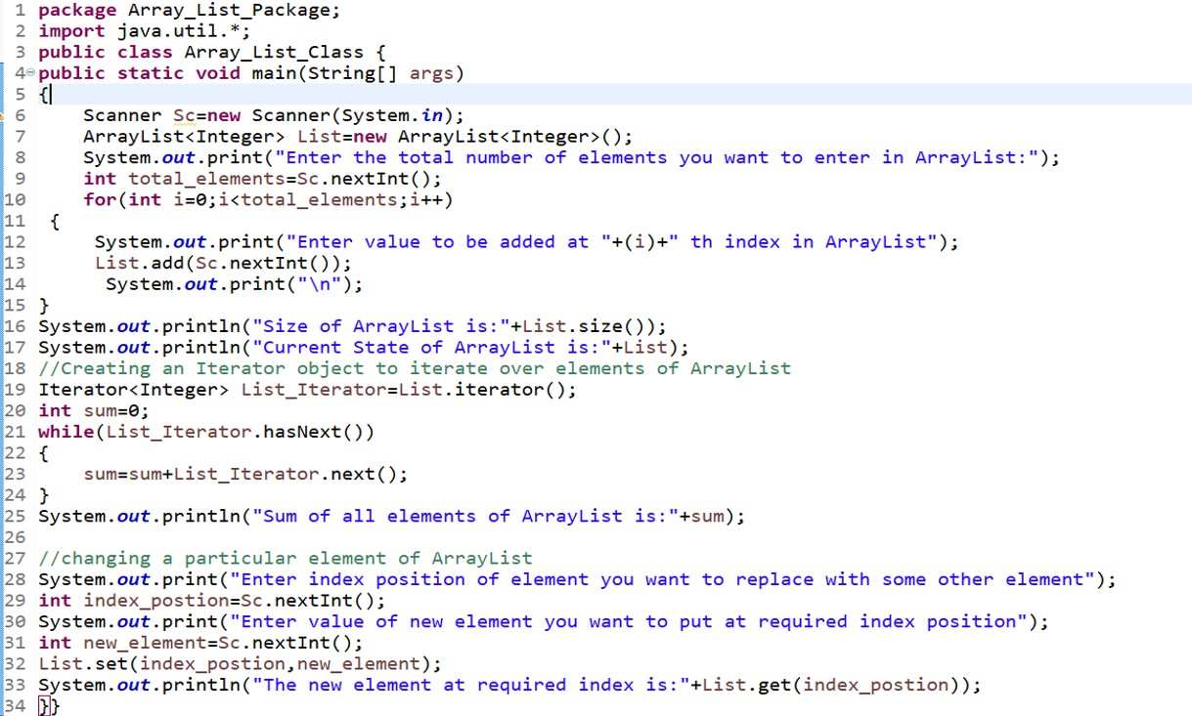

Slide 17
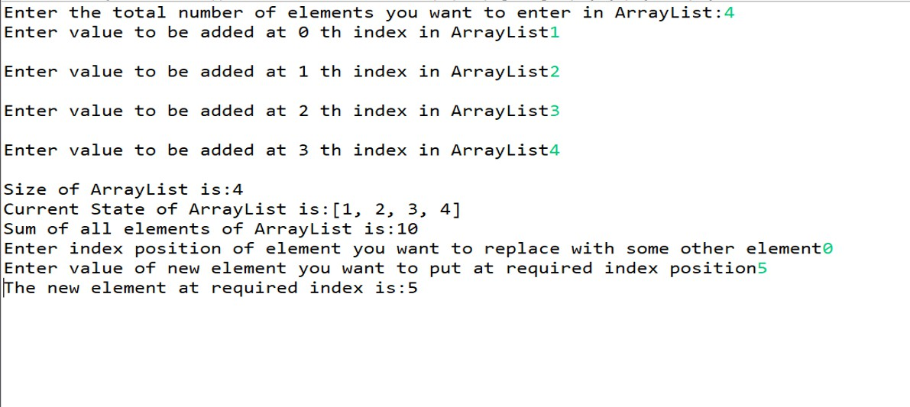

Slide 18
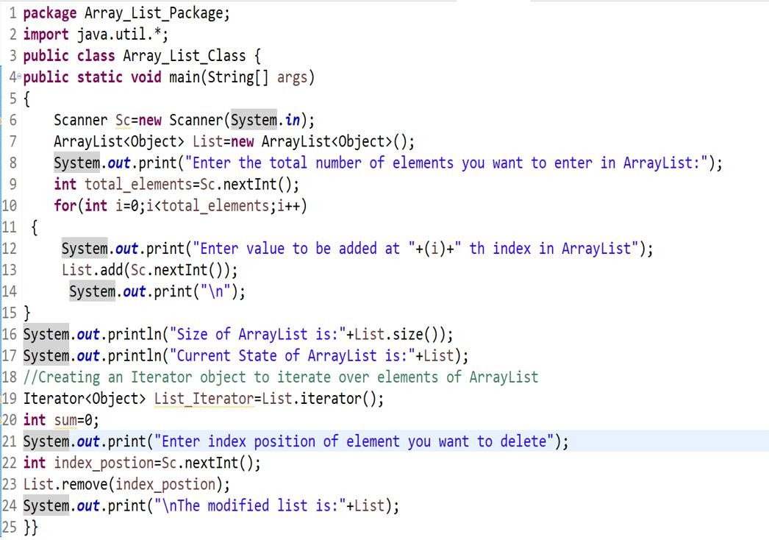

Slide 19
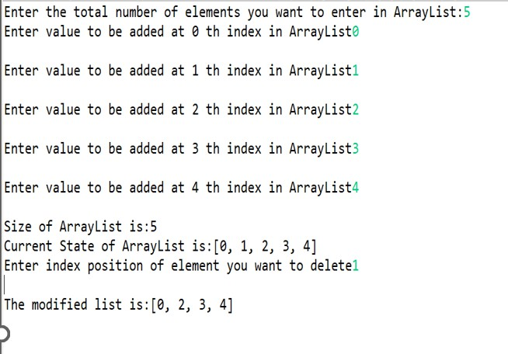

Slide 20
Vector Class
Like ArrayList, Vector generic class provides you a mechanism to implement a growable list of objects by initially creating a default size array and by creating new larger size arrays according to requirement similar to ArrayList
Elements can be accessed using index.
Each Vector Class object optimize storage management by maintaining two parameters capacity, and capacityIncrement. The capacity is always as larger as size of Vector object. Once the objects are added into Vector, the vector storage increases in chunks the size of capacityIncrement.
Like ArrayList, this class objects also provide iterator object to traverse its elements in a sequence.
The main difference between an ArrayList and Vector Class objects is that Vector Class objects are thread safe i.e. at a particular instant only a single thread can modify a particular Vector Class object but this not with an ArrayList object.
Most of the utility methods calls in ArrayList and Vector Classes are same.

Slide 21
Some of the frequently Vector Class Methods
boolean add(E e): Append a specified element e to the end of the concerned Vector object.
void add(int index, E element): Inserts the speicified element at the specified position in the concerned Vector.
int capacity(): returns the current capacity of the concerned Vector object.
void clear(): removes all of the elements from the concerned Vector object.
boolean contains(Object O): returns true if the concerned Vector object holds the reference of Object O passed as argument.
Iterator<E> interator: returns an iterator object to iterate over the elements of the concerned Vector object.
int indexOf(Object O): returns the index of first occurrence of element O in concerned ArrayList.
E set(int index, E e): replaces the element at specified index position with the
specified element.

Slide 22
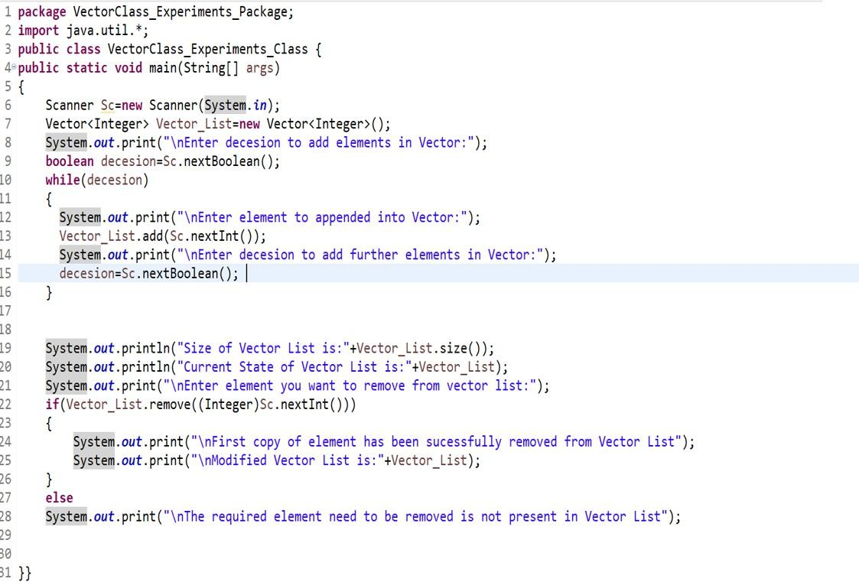

Slide 23
Stack Class in Java
The Stack class represents a last in first out(LIFO) stack of objects.
It extends the Vector Class with five operations that allow a Vector to be treated as a stack.
Those five additional operations are mentioned below
E peek(): determines the element at the top of stack without removing it.
E pop(): removes the object at the top of this stack and returns the value of this function
E push(E item): pushes an item at the top of this stack.

Slide 24
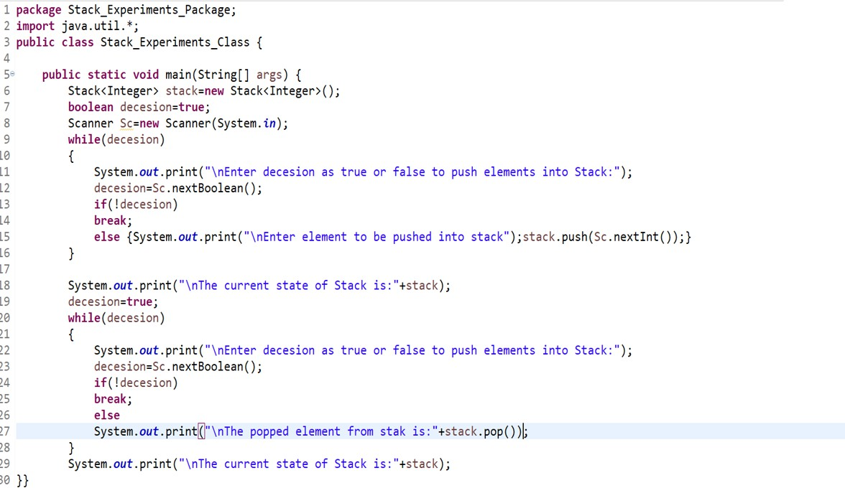

Slide 25
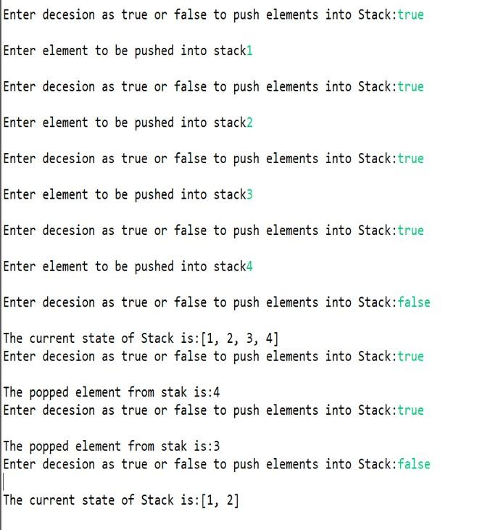

Slide 26
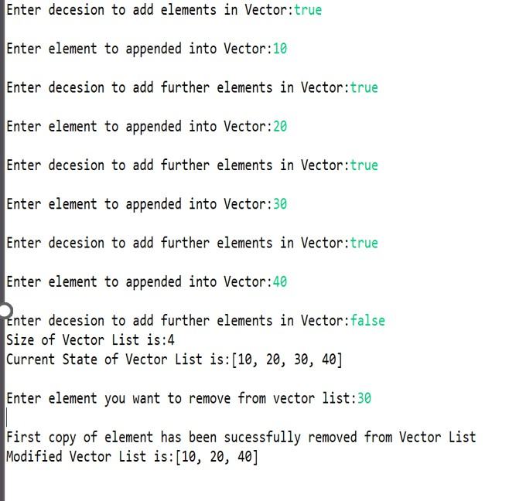

Slide 27
PriorityQueue
It is a collection in which elements are ordered according to their natural ordering, or by a comparator provided at Queue construction time depending upon type of constructor used.
The head of this queue is the least element with specified ordering.
A priority queue is unbounded, but has an internal capacity governing the size of the array used to store the elements on the queue.
As elements are added into queue it’s capacity grows automatically.
The implementation of PriorityQueue is not synchronized there multiple thread instances shold not access a PriorityQueue instance concurrently

Slide 28
Some most frequently used priority queue methods
boolean add(E e): Inserts the specified element in the priority queue.
comparator(): Returns the comparator used to order elements in this queue
or null is returned if natural ordering is used.
boolean contains(Object O): Returns true if the queue contains the specified element.
boolean offer(E e): returns true if the queue contains the specified element.
poll(): retrieves and removes the head of this queue or returns null if queue
is empty
remove(Object O): removes a single instance of the specified element from this queue of null is returned if queue is empty.
Int size(): Size of queue is returned
28

Slide 29
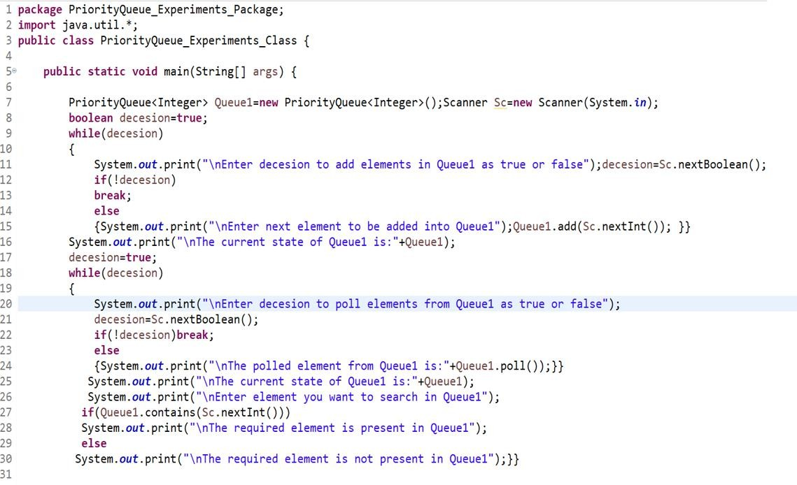

Slide 30
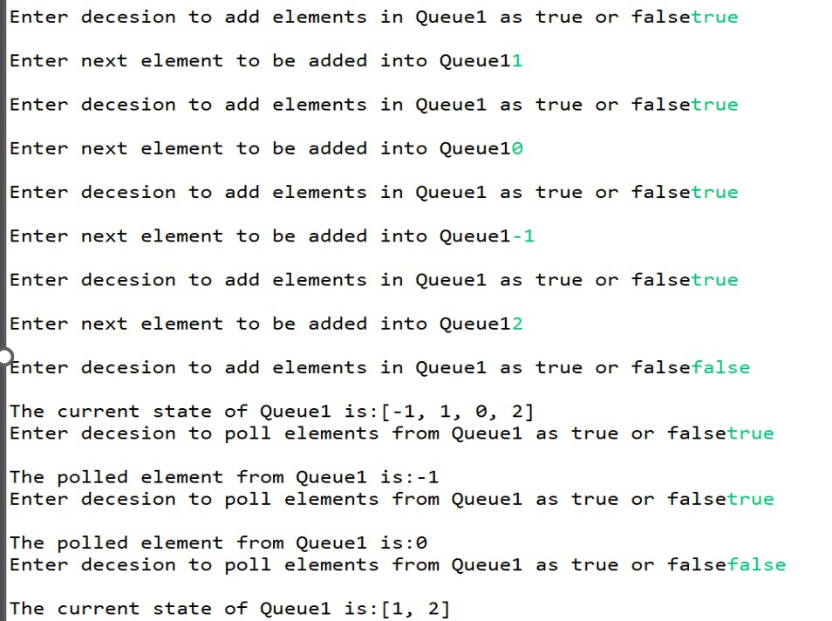

Slide 31
LinkedList overview
Stores each element in a node
Each node stores a link to the next and previous nodes
Insertion and removal are inexpensive
» just update the links in the surrounding nodes
Linear traversal is inexpensive
Random access is expensive
» Start from beginning or end and traverse each node while
counting

Slide 32
LinkedList entries
private static class Entry { Object element;
Entry next;
Entry previous;
Entry(Object element, Entry next, Entry previous) { this.element = element;
this.next = next;
this.previous = previous;
}
}
private Entry header = new Entry(null, null, null); public LinkedList() {
header.next = header.previous = header;
}

Slide 33
Some frequently used linked list methods
add(E e): The specified element e is appended at the end of the linked list.
add(int position, E element): the specified element is inserted at the
specified position in the linked list.
contains(Object o): returns true if object o is present in the linked list.
get(int position): returns the element at the specified position in the list
peek(): retrieves but does not removes the first element of the linked list
Remove(): retrieves and then removes the first element of the linked list
remove(int position): removes the element present at the specified position in the linked list.
set(int position, E e): replaces the element present at the specified position
with element e.

Slide 34
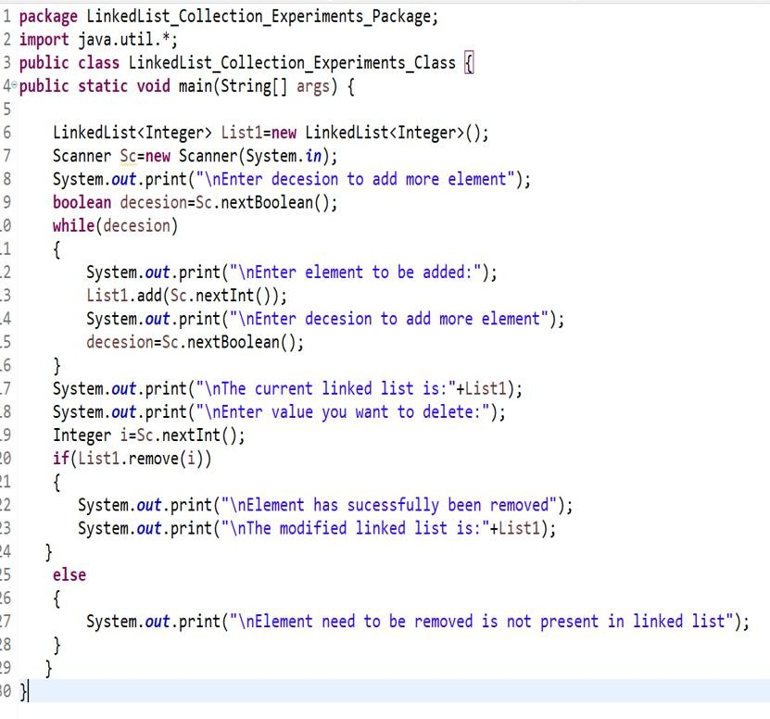

Slide 35
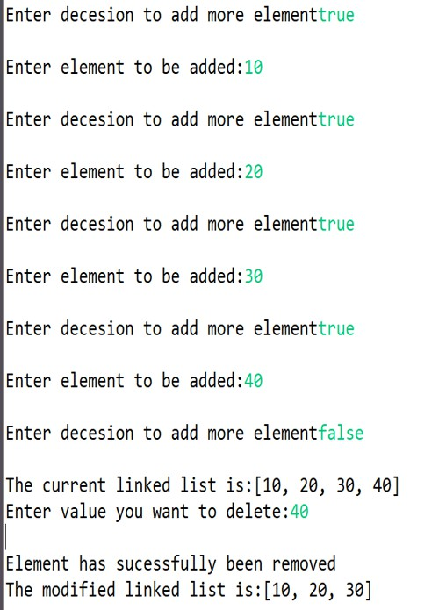

Slide 36
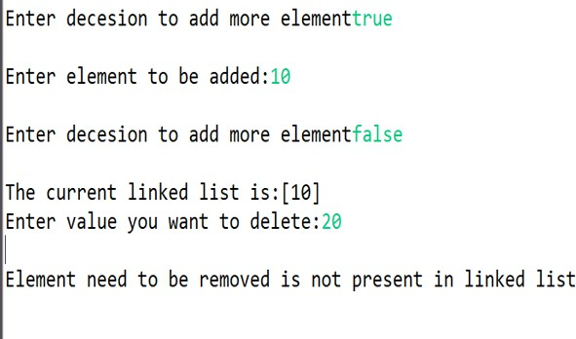

Slide 37
Set Interface Context
Collection
Set

Slide 38
Set Interface
Same methods as Collection
» different contract - no duplicate entries
Defines two fundamental methods
» boolean add(Object o) - reject duplicates
» Iterator iterator()
Provides an Iterator to step through the elements in the Set
» No guaranteed order in the basic Set interface
» There is a SortedSet interface that extends Set

Slide 39
HashSet and TreeSet Context
Collection
Set
HashSet
TreeSet

Slide 40
HashSet
Find and add elements very quickly
» uses hashing implementation in HashMap
Hashing uses an array of linked lists
» The hashCode() is used to index into the array
» Then equals() is used to determine if element is in the (short) list of elements at that index
No order imposed on elements
The hashCode() method and the equals() method must be compatible
» if two objects are equal, they must have the same
hashCode() value

Slide 41
Some most frequently used HashSet methods
boolean add(E e): The specified element e is added into the concerned
HashSet when the element is not alerady present.
Void clear(): All elements are removed from the concerned HashSet.
boolean contains(Object O): returns true if the concerned HashSet contains the specified element.
boolean isEmpty(): returns true if the concerned HashSet contains no
element.
boolean remove(Object O): removes the specified element from the concerned HashSet.
int size(): returns the size of the concerned HashSet.

Slide 42
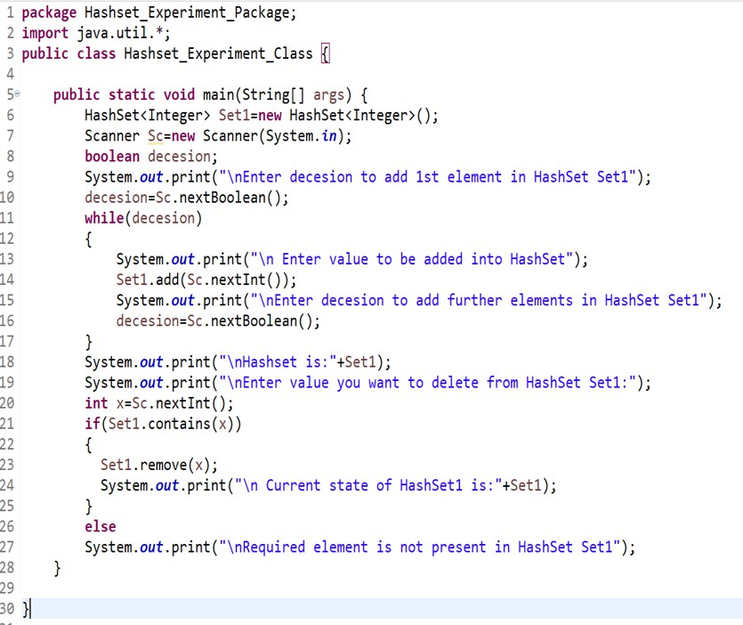

Slide 43
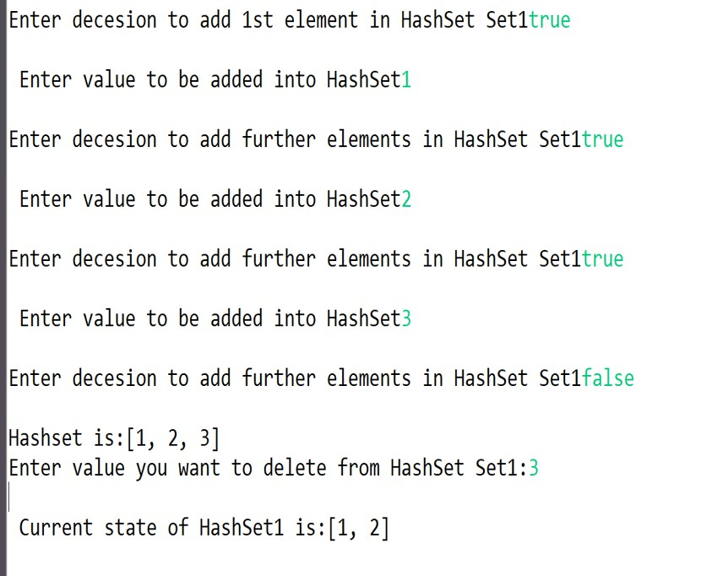

Slide 44
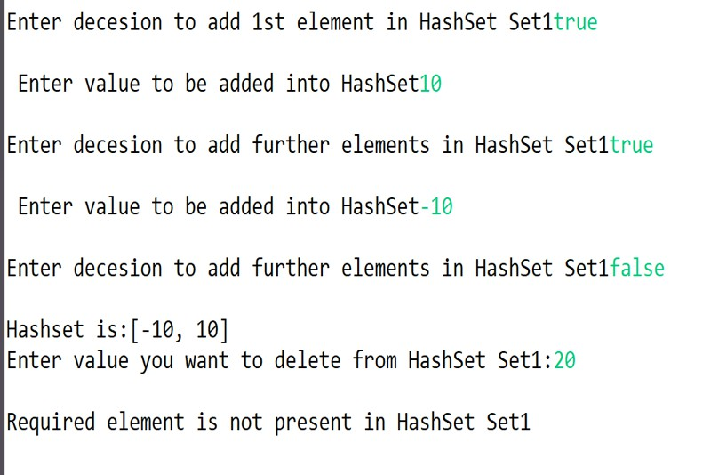

Slide 45
TreeSet
Elements can be inserted in any order
The TreeSet stores them in order
» Red-Black Trees out of Cormen-Leiserson-Rivest
An iterator always presents them in order
Default order is defined by natural order
» objects implement the Comparable interface
» TreeSet uses compareTo(Object o) to sort
Can use a different Comparator
» provide Comparator to the TreeSet constructor

Slide 46
Some most frequently used TreeSet methods
boolean add(E e): The specified element e is added into the concerned
TreeSet when the element is not alerady present.
Void clear(): All elements are removed from the concerned TreeSet.
boolean contains(Object O): returns true if the concerned TreeSet contains the specified element.
boolean isEmpty(): returns true if the concerned TreeSet contains no
element.
boolean remove(Object O): removes the specified element from the concerned TreeSet.
int size(): returns the size of the concerned HashSet.
E higher(E e): returns the least element in the concerned TreeSet strictly
greater than specified element or null if there is no such element.

Slide 47
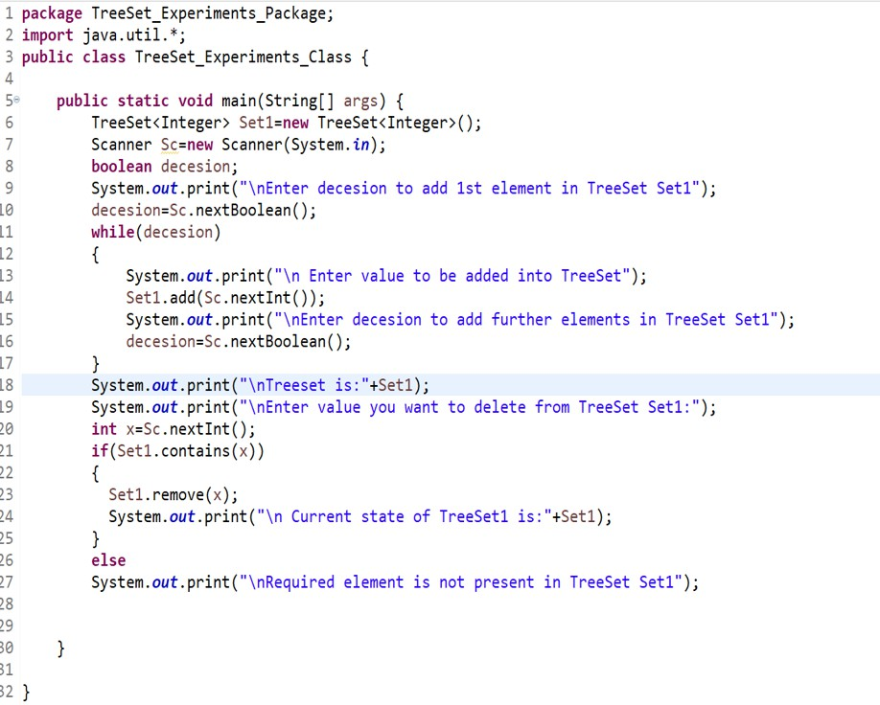

Slide 48
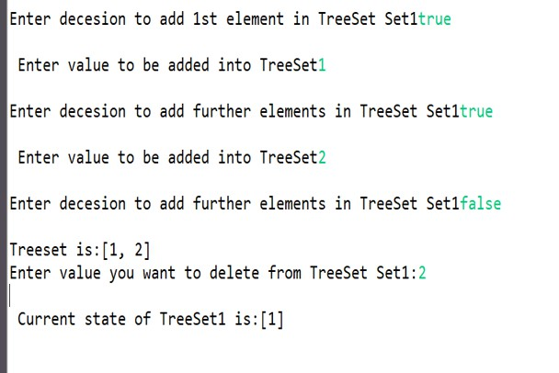

Slide 49
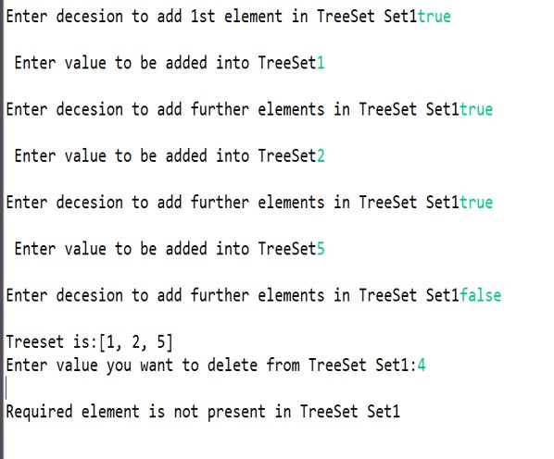

Slide 50
Linked Hash Set
It’s a direct descendant of the HashSet data structure, hence, contains non-duplicate elements at every given time.
LinkedHashSet maintains a linked list of the entries in the set, in the order in which they were inserted. This allows insertion-order iteration over the set.
That is, when cycling through a LinkedHashSet using an iterator, the elements will be returned in the order in which they were inserted.

Slide 51
Some most frequently used LinkedHashSet methods
boolean add(E e): The specified element e is added into the concerned
LinkedHashSet when the element is not alerady present.
Void clear(): All elements are removed from the concerned LinkedHashSet.
boolean contains(Object O): returns true if the concerned LinkedHashSet contains the specified element.
boolean isEmpty(): returns true if the concerned LinkedHashSet contains no
element.
boolean remove(Object O): removes the specified element from the concerned LinkedHashSet.
int size(): returns the size of the concerned LinkedHashSet.

Slide 52
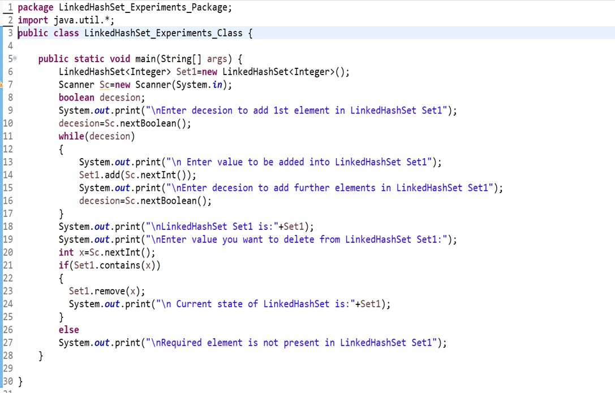

Slide 53
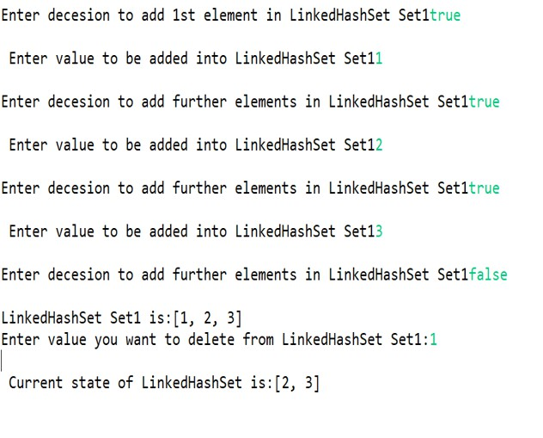

Slide 54
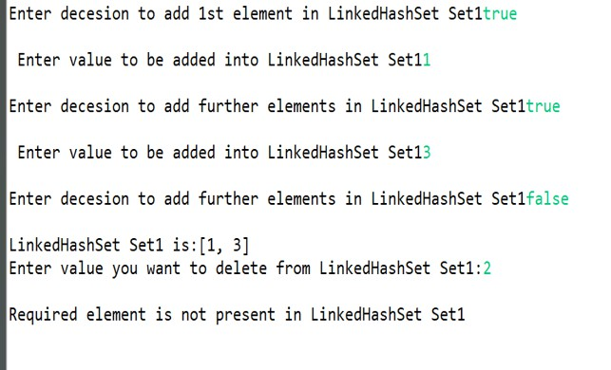

Slide 55
Map Interface Context
Map

Slide 56
Map Interface
Stores key/value pairs
Maps from the key to the value
Keys are unique
» a single key only appears once in the Map
» a key can map to only one value
Values do not have to be unique

Slide 57
HashMap
A HashMap is a implementation of Map interface and conceptually its similar to a Hashtable thus providing a key,value pair type recording of information.
A hashmap is created using following statement:
HashMap<K,V> Map1=new HashMap<K,V> where K may be any valid class a class for key objects and V may be any class for value objects. E.g HashMap<String,Integer> Map1=new HashMap<String,Integer> ();
This implementation provides a constant time performance of the basic
operations(get and put functions).
An instance of Hashmap has two parameters that affect its performance. Initial capacity and load factor. The capacity is the number of buckets in the hashtable and load factor is a measure of how full the hashmap is allowed to get before its capacity is increased.
A Hashmap based collection is not thread synchronized

Slide 58
Some frequently used HashMap methods
boolean containsKey(Object k): Returns true if concerned HashMap contains a mappting corresponding to Key k.
boolean containsValue(Object v): returns true is concerned HashMap contains atleast one key,value mapping in which value is v.
V get(Object k): returns the value to which specified key k is mapped or
null is returned if there is no mapping for key k.
V put(key k, value v): Associates the specified value v with specified key in the HashMap.
V remove(Object k): the mapping based on specified key k is removed from
the HashMap.
V replace(Key k, Value v): the entry based on key k is replaced if it is already present in HashMap.

Slide 59
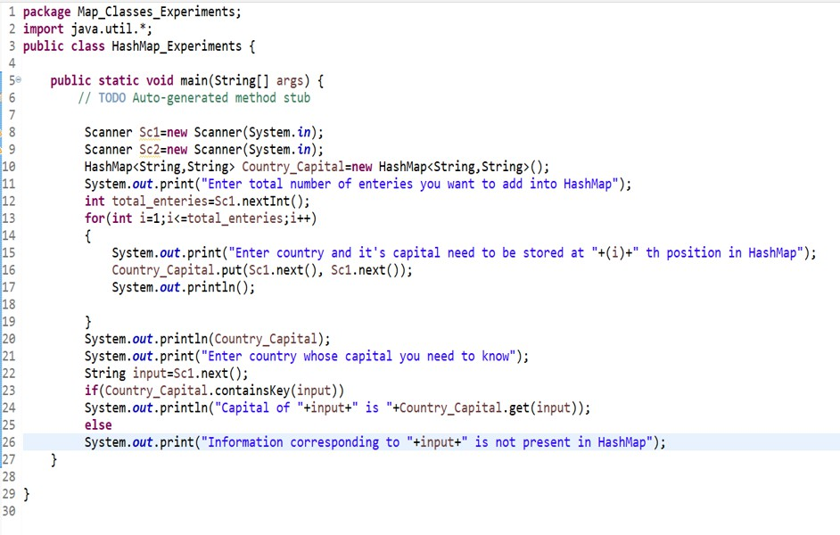

Slide 60
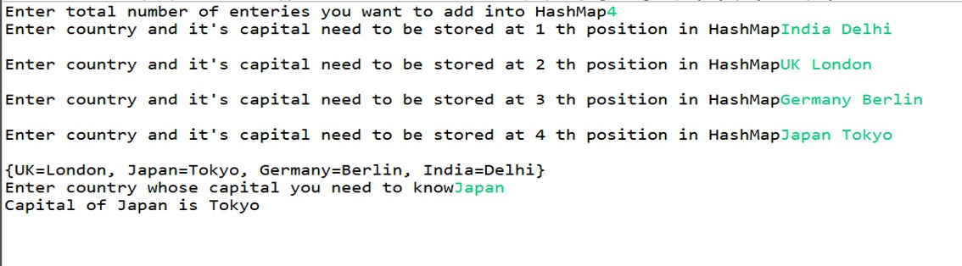

Slide 61
TreeMap
A TreeMap is also a key,value mapping based collection for information storage.
A TreeMap collection is collected using following Statement
TreeMap<Key,Value> Map1=new TreeMap<Key,Value>();
Conceptually it’s implementation is based on a red black tree thus elements are arranged according to their natural ordering.
Like HashMap, the implementation of a TreeMap object is not thread
Synchronized.

Slide 62
Some of the frequently used TreeMap Methods
ceilingEntry(Key k): returns a key,value pair based entry associated with
least key greater than or equal to the given Key k or null is returned.
ceilingKey(Key k): returns a key greater than or equal to the given Key k or null is returned.
containsKey(Object k): true is returned if there is mapping in TreeMap containing Key k.
containsValue(Object v): true is returned if there is atleast one mapping
with value v in TreeMap
get(Object k): the value v is returned corresponding to key k is mapping k,v is present in TreeMap otherwise null is returned.
put(Key k, Value v): a mapping corresponding to Key k and Value v is recorded in TreeMap

Slide 63
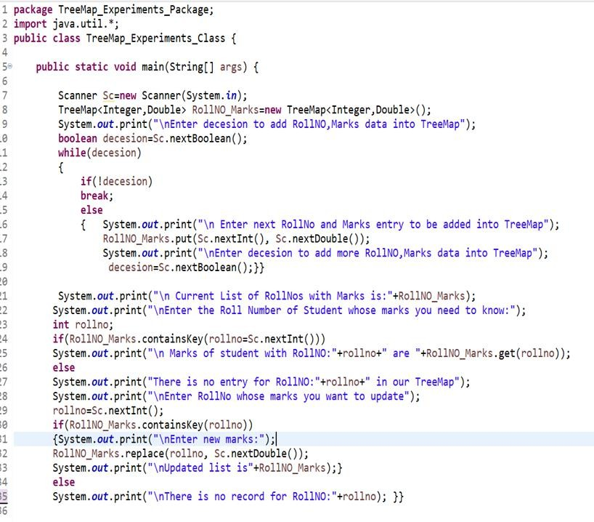

Slide 64
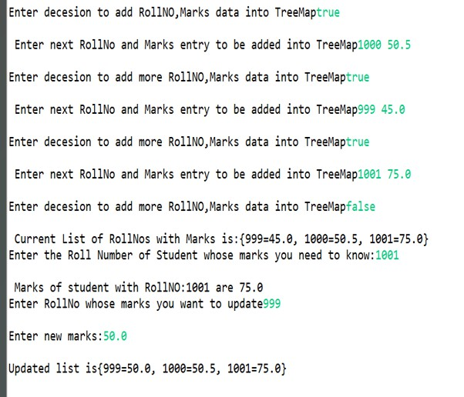

Slide 65
LinkedHashMap
It is an implementation of Map interface based upon the concepts of Hashtable and linkedlist.
This implementation is different from HashMap in that this collections
also maintains a double linkedlist consisting of all key,value pair enteries.
Like HashMap, it provides constant time operations.
Like HashMap it also allows permits null elements.
The implementation of LinkedHashMap is not synchronized.
65

Slide 66
Some frequently used LinkedHashMap Methods
containsValue(Object V): returns true if there is ateast one K,V mapping present in LinkedHashMap with value V.
get(Object k): returns the Object reference of value v corresponding to key
k.
put(Object k,Object v): inserts the k,v pair in the linkedhashmap
remove(object k): key value pair corresponding to key k is removed from
the linkedhashmap and the value v corresponding to key k is returned.
replace(Key k, Value v): the current value v1 corresponding to key k is replaced with value v is there is already an entry present corresponding to key k.
size(): current size of the linkedhashmap is returned

Slide 67
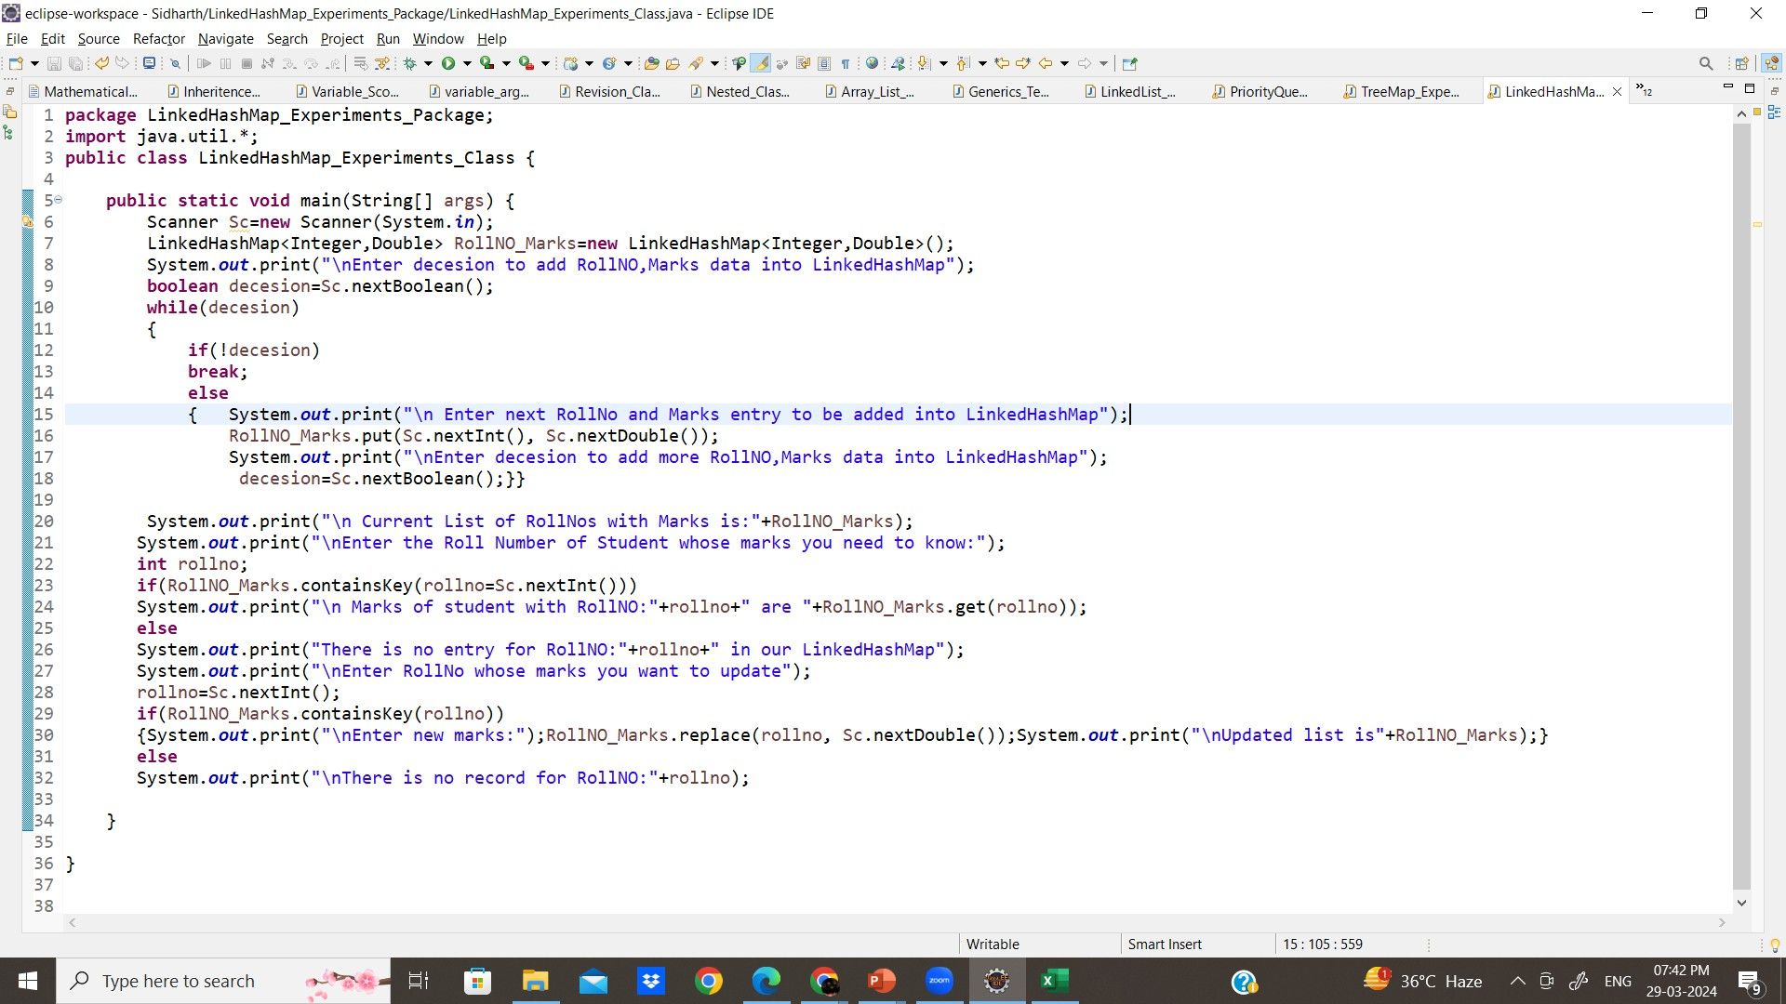

Slide 68
