Slide 1

OBJECT ORIENTED PROGRAMMING USING JAVA

Slide 2
OUTLINE
DataType
Variable
Variable Name
Operators
Precedence of Operators
Examples of Operators

Slide 3
DATATYPE
There are mainly two types of data type:
Primitive: Byte, short, int, long, float, double, boolean and char.
Non-primitive: String, arrays and classes

Slide 4
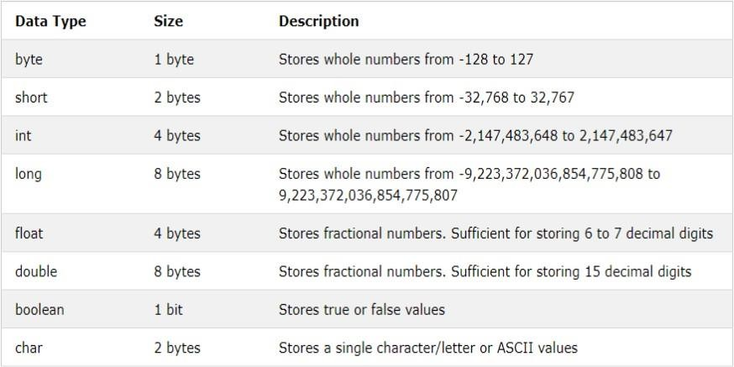
DATA TYPE (CONT.)

Slide 5
VARIABLE
A variables can be considered as a name given to the location in memory where values are stored.\
<datatype> <variable_name>
Can the value of variable be changed?
Yes

Slide 6
VARIABLE NAME
Use only the characters ‘a’ through ‘z’, ‘A’ through ‘Z, ‘0’ through ‘9’, character ‘_’, and character ‘$’.
A name can’t contain space character.
Do not start with a digit. Variable name can be of any length.
Case sensitive.
A name can not be a reserved word (A reserved word is a word which has a predefined meaning in Java. Example: int, double, true, etc.).

Slide 7
VARIABLE NAME (CONT…)
Can you answer that whether the below lines are correct or not?
int good-bye;
int shrift = 0;
char thisMustBeTooLong;
int bubble = 0, toil = 9, trouble = 8
int 8ball;
int double;

Slide 8
VARIABLE NAME (CONT…)
Answers of the last slide:
int good-bye; //bad variable name
int shrift = 0; //OK
char thisMustBeTooLong; //OK in syntax //but poor choice in variable name
int bubble = 0, toil = 9, trouble = 8 // “;” missing at the end
int 8ball; //can’t start with a digit
int double; //double is a reserve word

Slide 9
OPERATORS
There are many operators in Java::
Unary operators
Arithmetic operators
Relational operators
Bitwise operators
Logical operators
Assignment operators
Ternary operators

Slide 10
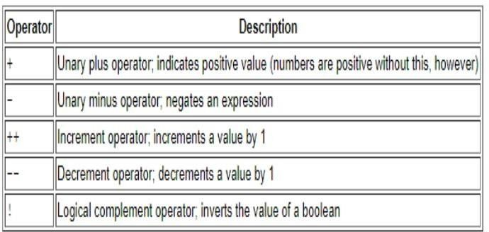
OPERATORS (CONT.…)
Unary operators:

Slide 11
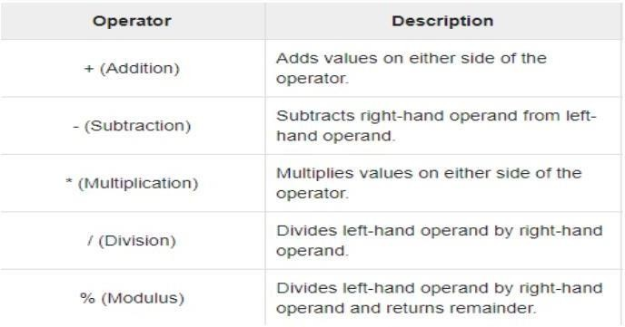
OPERATORS (CONT.…)
Arithmetic operators:

Slide 12
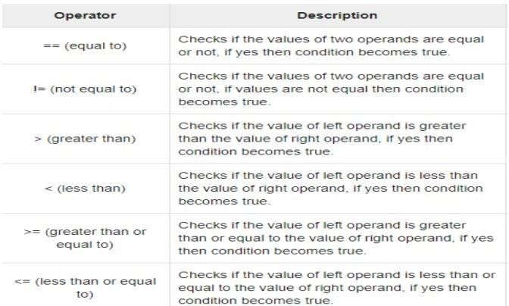
OPERATORS (CONT.…)
Relational operators:

Slide 13
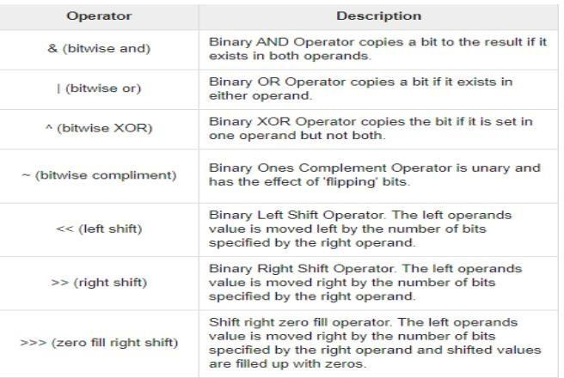
OPERATORS (CONT.…)
Bitwise operators:

Slide 14
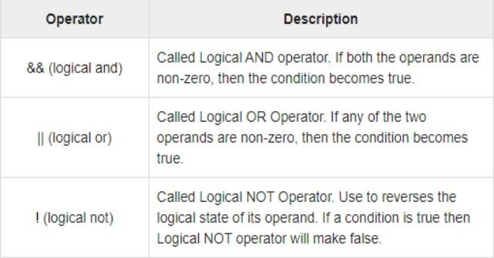
OPERATORS (CONT.…)
Logical operators:

Slide 15
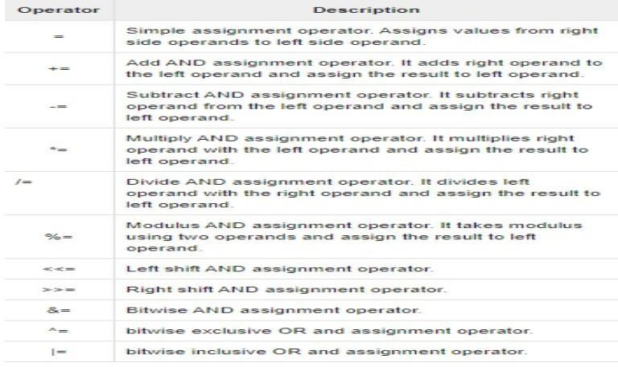
OPERATORS (CONT.…)
Assignment operators:

Slide 16
OPERATORS (CONT.…)
Ternary operators:
Conditional Operator ( ? : )

Slide 17
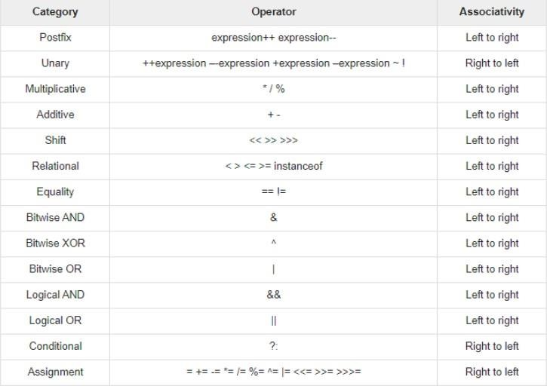
PRECEDENCE OF THE OPERATORS

Slide 18
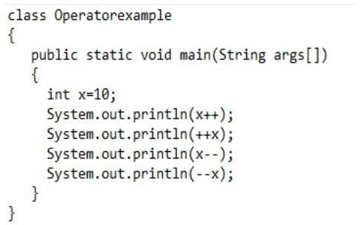
EXAMPLES OF OPERATORS

Slide 19
EXAMPLES OF OPERATORS
Output:
10
12
12
10

Slide 20
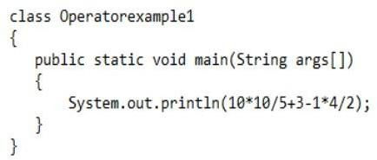
EXAMPLES OF OPERATORS (CONT.…)

Slide 21
EXAMPLES OF OPERATORS (CONT.…)
Output:
21

Slide 22
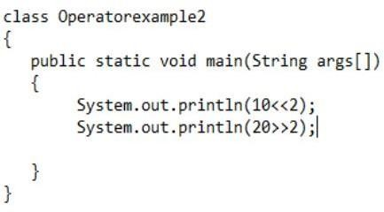
EXAMPLES OF OPERATORS (CONT.…)

Slide 23
EXAMPLES OF OPERATORS (CONT.…)
Output:
40
❖5

Slide 24
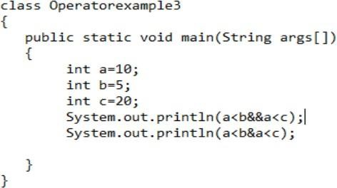
EXAMPLES OF OPERATORS (CONT.…)

Slide 25
EXAMPLES OF OPERATORS (CONT.…)
Output:
false
false

Slide 26
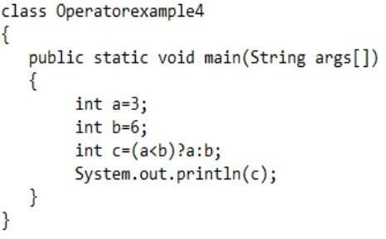
EXAMPLES OF OPERATORS (CONT.…)

Slide 27
EXAMPLES OF OPERATORS (CONT.…)
Output:
❖3

Slide 28
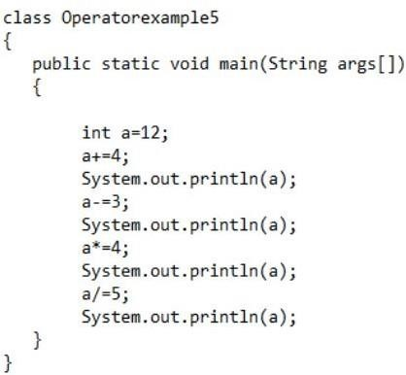
EXAMPLES OF OPERATORS (CONT.…)

Slide 29
EXAMPLES OF OPERATORS (CONT.…)
Output:
16
13
52
10

Slide 30
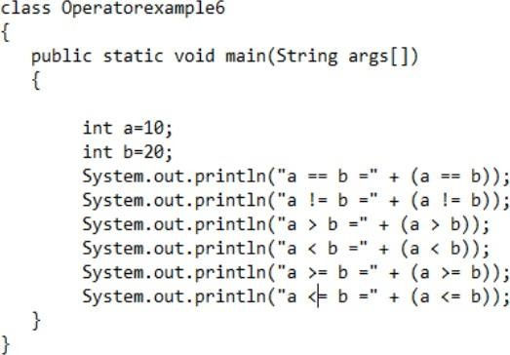
EXAMPLES OF OPERATORS (CONT.…)

Slide 31
EXAMPLES OF OPERATORS (CONT.…)
Output:
a == b = false
a != b =true
a > b =false
a < b =true
a >= b =false
a <= b =true

Slide 32
THANK YOU

