Slide 1

OBJECT ORIENTED PROGRAMMING USING JAVA

Slide 2
OUTLINE
Conditional Statements
IF statement
Switch

Slide 3
CONDITIONAL STATEMENTS
A conditional statement allows us to choose which statement will be executed. So, it is sometimes called as selection statement.
Conditional statement gives us the power to make decision.
Java has the following conditional statements:
❖If
❖if-else
❖nested-if
❖if-else-if
❖switch-case

Slide 4
IF STATEMENT
if statement is the most simple decision making statement.
It is used to decide whether a certain statement or block of statements will be executed.
Syntax: if(condition)
{
Statement 1;
Statement 2;
}

Slide 5
IF STATEMENT (CONT.…)
if is a Java reserved word.
The condition must be a Boolean expression. It must evaluate to either true or false.
If we do not give the curly braces ‘{’ and ‘}’ after if(condition), then, by default if statement considers the immediate statement inside its block.
Example:
if(condition)
statement 1; //Statement 1 will be executed statement 2;

Slide 6
IF STATEMENT (CONT.…)
if is a Java reserved word.
The condition must be a Boolean expression. It must evaluate to either true or false.
If we do not give the curly braces ‘{’ and ‘}’ after if(condition), then, by default if statement considers the immediate statement inside its block.
Example:
if(condition)
statement 1; //Statement 1 will be executed statement 2;

Slide 7
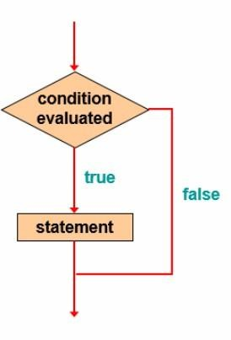
IF STATEMENT (CONT.…)

Slide 8
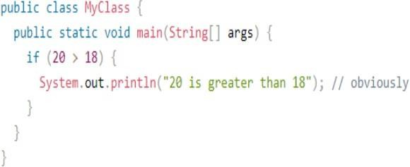
IF STATEMENT (CONT.…)

Slide 9
ELSE STATEMENT
Use the else statement to specify a block of code to be executed, if the condition is false.
Syntax:
if(condition)
{
Statement 1; // block of code to be executed, if the condition is true
}
else
{
Statement 2; // block of code to be executed, if the condition is false
}

Slide 10
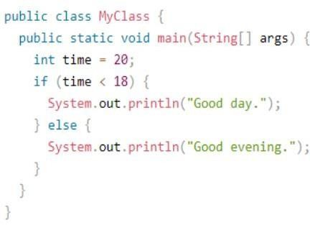
ELSE STATEMENT

Slide 11
ELSE STATEMENT
Output
Good evening.

Slide 12
ELSE-IF STATEMENT
Use the else if statement to specify a new condition if the first condition is false.
Syntax:
if(condition1)
{
Statement 1; // block of code to be executed, if the condition1 is true
}
else if (condition 2)
{
Statement 2; // block of code to be executed, if the condition1 is false and condition2 is true
}
else
{
Statement 3; // block of code to be executed, if the condition1 is false and condition2 is false
}

Slide 13
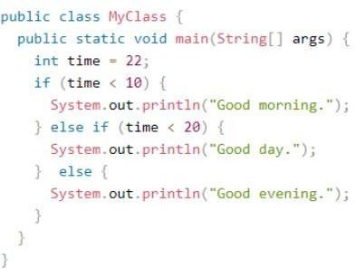
ELSE-IF STATEMENT (CONT.…)

Slide 14
ELSE-IF STATEMENT (CONT.…)
Output
Good evening.

Slide 15
SWITCH STATEMENT
The switch statement is a multi-way branch statement.
It provides an easy way to dispatch execution to different parts of code based on the value of the expression.
The switch expression is evaluated once.
The value of the expression is compared with the values of each case.
If there is a match, the associated block of code is executed.
The break and default keywords are optional.

Slide 16
SWITCH STATEMENT (CONT…)
Syntax:
switch(expression)
{
case x:
Statement 1; // code block
break;
case y:
Statement 2; // code block
break;
default:
Statement 3; // code block
}

Slide 17
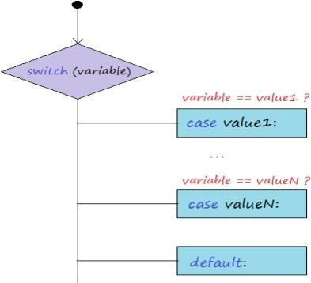
SWITCH STATEMENT (CONT…)

Slide 18
SWITCH STATEMENT (CONT…)
Break Keyword
When Java reaches a break keyword, it breaks out of the switch block.
This will stop the execution of more code and case testing inside the block.
When a match is found, and the job is done, it's time for a break.
There is no need for more testing.

Slide 19
SWITCH STATEMENT (CONT.…)
Default Keyword
The default keyword specifies some code to run, if there is no case match.

Slide 20
SWITCH STATEMENT (CONT.…)
Some important rule:
The default keyword specifies some code to run, if there is no case match.
The value for a case must be of the same data type as the variable in the switch.
The value for a case must be a constant or a literal. Variables are not allowed.
The break statement is used inside the switch to terminate a statement sequence.
The break statement is optional. If omitted, execution will continue on into the next case.
The default statement is optional and can appear anywhere inside the switch block. In case, if it is not at the end, then, a break statement must be kept after the default statement to omit the execution of the next case statement.

Slide 21
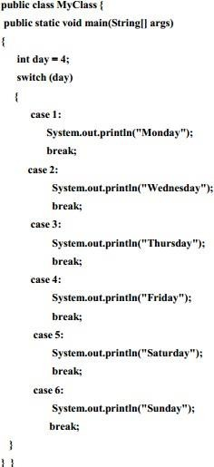
SWITCH STATEMENT (CONT.…)

Slide 22
SWITCH STATEMENT (CONT.…)
Output: Friday

Slide 23
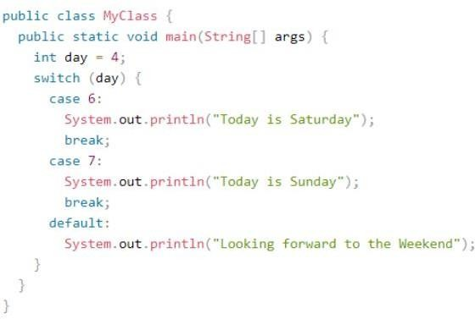
SWITCH STATEMENT (CONT.…)

Slide 24
SWITCH STATEMENT (CONT.…)
Output
Looking forward to theWeekend

Slide 25
THANK YOU
?

