Slide 1

OBJECT ORIENTED PROGRAMMING USING JAVA

Slide 2
OUTLINE
Loops
While Loop
Do-While Loop
For Loop
Nested Loop
Break and Continue in Loop

Slide 3
LOOPS
Loops can execute a set lines or statements as long as the specified condition is satisfied.
It mainly saves time.
There are mainly two types of loops:
Definite loop: A loop that executes a finite number of times.
Indefinite loop: A loop where it is difficult to determine in advance how many times it will be executed.

Slide 4
WHILE LOOP
In Java, while loop is used to iterate a part of the program several times.
Here, condition is evaluated first, and if it returns true, the statements or lines inside while loop are execute.
If we don’t know the number of iterations in advance then the best suitable loop is while loop.
Syntax: while(condition)
{
Statement 1;
Statement 2;
}

Slide 5
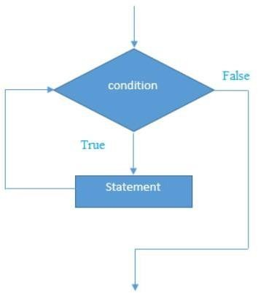
WHILE LOOP (CONT.…)

Slide 6
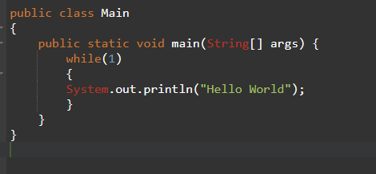

WHILE LOOP (CONT.…)
The argument to the while loop should be Boolean type. If we are using any other type we will get compile time error.
Output

Slide 7
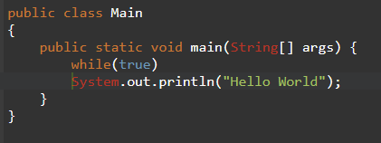
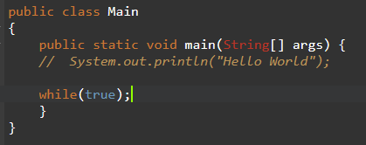
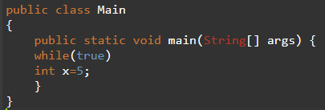
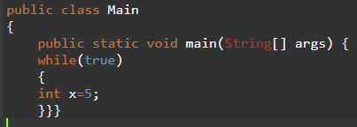
WHILE LOOP (CONT.…)
Curly braces are optional and without curly braces we can take only one statement which should not be declarative statement.

Slide 8


WHILE LOOP (CONT.…)
Curly braces are optional and without curly braces we can take only one statement which should not be declarative statement.

Slide 9
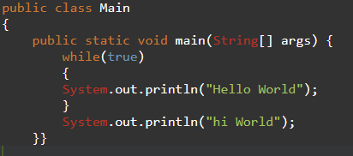
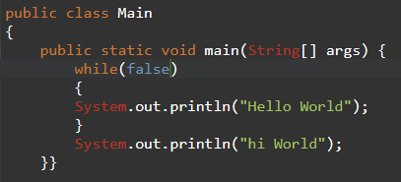
WHILE LOOP (CONT.…)

Slide 10


WHILE LOOP (CONT.…)

Slide 11
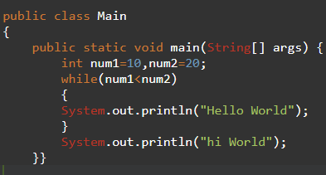
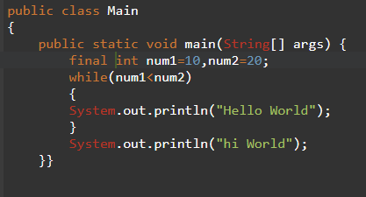
WHILE LOOP (CONT.…)

Slide 12
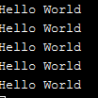

WHILE LOOP (CONT.…)

Slide 13
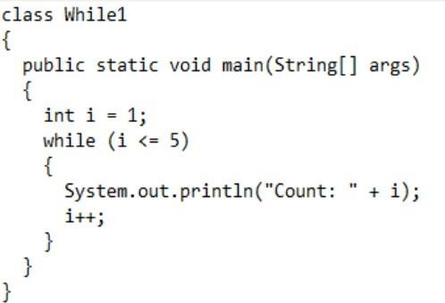
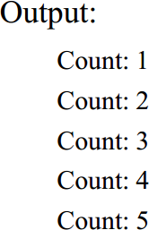
SIMPLE PROGRAM USING WHILE LOOP

Slide 14
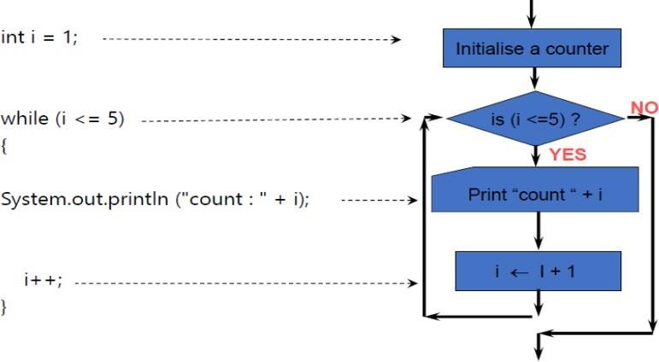
SIMPLE PROGRAM USING WHILE LOOP (CONT..)

Slide 15
DO-WHILE LOOP
Do-while loop is actually one kind of while loop.
This loop executes the lines or statements once before checking the condition. If the condition is true, it repeats the loop as long as the given condition is true.
If we want to execute loop body at least once then we should go for do- while loop
Syntax:
do
{
Statement 1;
Statement 2 ;
}
while(condition);

Slide 16
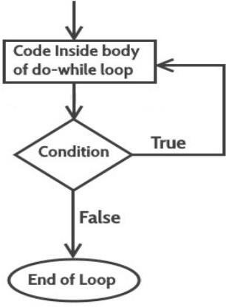
DO-WHILE LOOP(CONT.…)

Slide 17
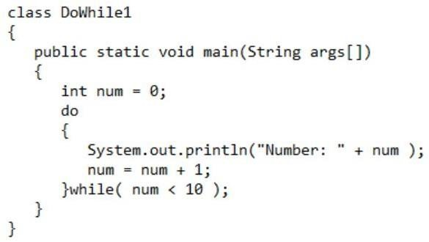
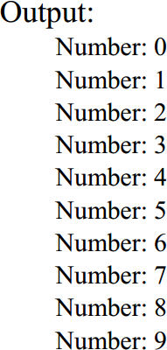
DO-WHILE LOOP(CONT.…)

Slide 18
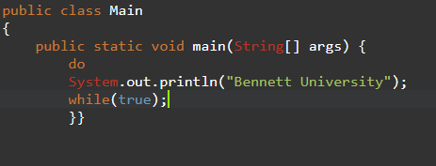
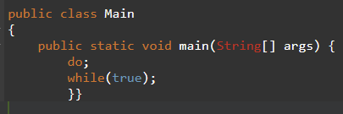
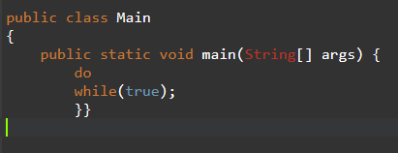
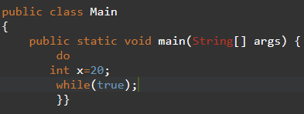
DO-WHILE LOOP
Curly braces are optional and without having curly braces we can take only one statement between do-while and should not be declarative statement.

Slide 19
DO-WHILE LOOP
Curly braces are optional and without having curly braces we can take only one statement between do-while and should not be declarative statement.

Slide 20
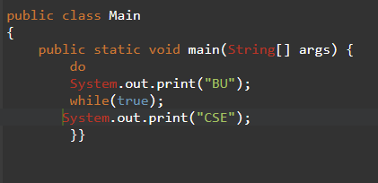
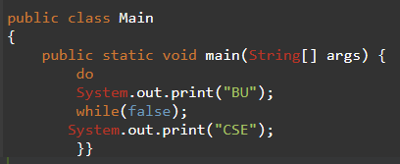
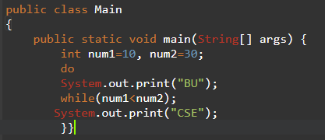
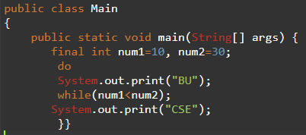
DO-WHILE LOOP (EXAMPLE)

Slide 21

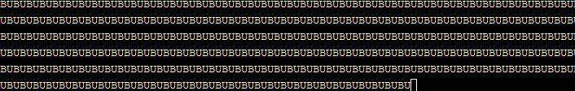
DO-WHILE LOOP (EXAMPLE)

Slide 22
FOR LOOP
For loop is concise version of while loop.
For loop is used, when we know exactly for how many times the code block will be executed.
There are mainly four parts in the entire for loop:
Initialization
Condition
Increment/decrement
Statement

Slide 23
FOR LOOP (CONT..)
Syntax:
for(initialization; condition (Boolean Expression); increment/decrement)
{
statement 1;
statement 2;
}
Note: Curly braces are optional & without curly braces we can take only one statement which should not be declarative
Initialization Section:
This will be executed only once.
Usually we declaring and performing initialization for the variables in this section.
Here we can declare multiple variables of same datatype but different datatype variables we can’t declare.
Example: int i=0, j=1;
int i=0, byte b=2;
int i=0, int j=0;

Slide 24

FOR LOOP (CONT..)
Syntax:
for(initialization; condition (Boolean Expression); increment/decrement)
{
statement 1;
statement 2;
}
Note: Curly braces are optional & without curly braces we can take only one statement which should not be declarative
Initialization Section:
This will be executed only once.
Usually we declaring and performing initialization for the variables in this section.
Here we can declare multiple variables of same datatype but different datatype variables we can’t declare.
Example: int i=0, j=1;
int i=0, byte b=2;
int i=0, int j=0;
In the initialization section we can take any valid java statement including :System.out.print(“”) also._

Slide 25
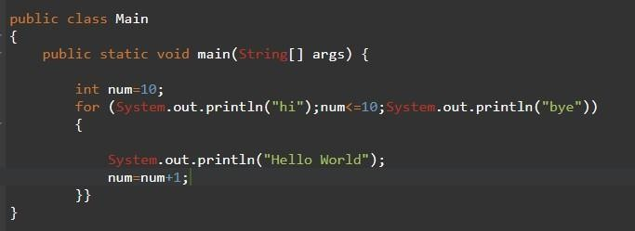
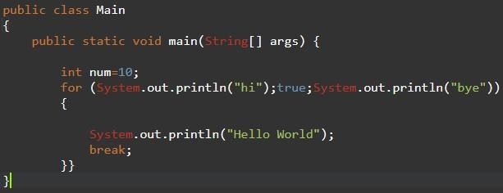
FOR LOOP (CONT..)

Slide 26


FOR LOOP (CONT..)

Slide 27
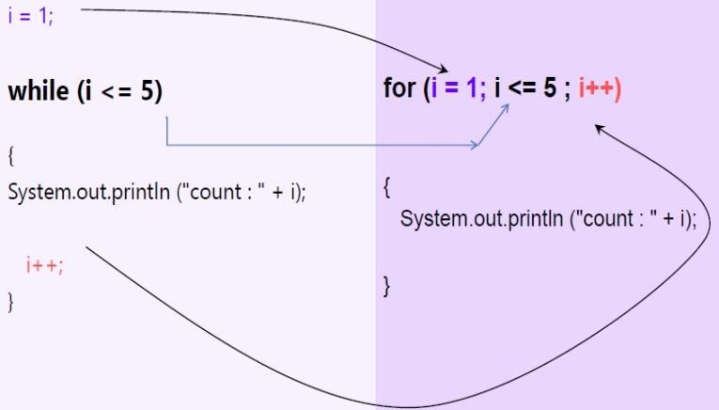
FOR LOOP (CONT..)

Slide 28
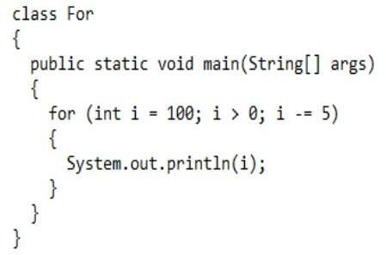
SIMPLE PROGRAM USING FOR LOOP

Slide 29
SIMPLE PROGRAM USING FOR LOOP
Output: 100
95
90
.
.
. 5

Slide 30
NESTED LOOP
Similar to nested if/else statements, loops can be nested as well.
The body of a loop can contain another loop.
For each iteration of the outer loop, the inner loop iterates completely .

Slide 31
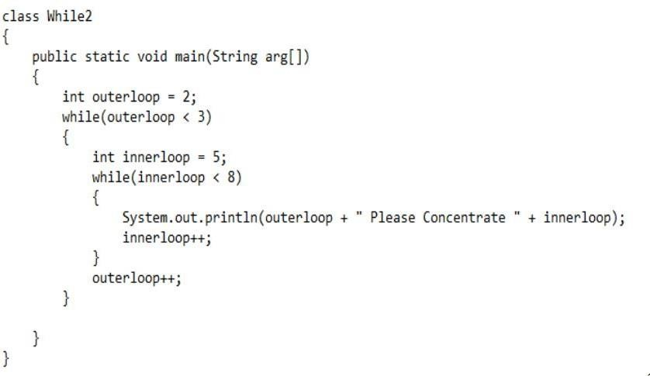
SIMPLE PROGRAM USING NESTED LOOP

Slide 32
SIMPLE PROGRAM USING NESTED LOOP
Output:
2 Please Concentrate 5
2 Please Concentrate 6
2 Please Concentrate 7

Slide 33
TRANSFER STATEMENTS:
Break:
We can use break statement for the following case.
With in switch to stop fall through
Inside loops to break the loop execution based on some condition.
Inside labelled blocks to breaks that block execution based on some condition.
Note: if we use break statement any where else we will get compile time error.

Slide 34
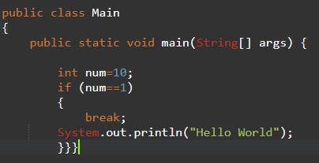
TRANSFER STATEMENTS:
Break:

Slide 35

TRANSFER STATEMENTS:
Break:
Output:

Slide 36
TRANSFER STATEMENTS:
Continue:
We can use continue statement to skip current iteration and continue for the next iteration inside loop.
If we are using continue outside of loops we will get compile time error.

Slide 37
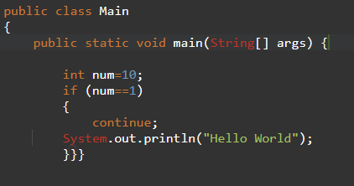
TRANSFER STATEMENTS:
Continue:

Slide 38

TRANSFER STATEMENTS:
Continue:

Slide 39
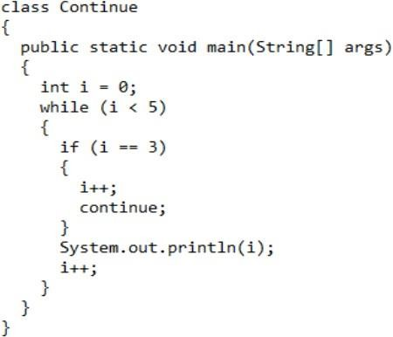
TRANSFER STATEMENTS:
Continue:

Slide 40
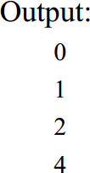
TRANSFER STATEMENTS:
Continue:

Slide 41
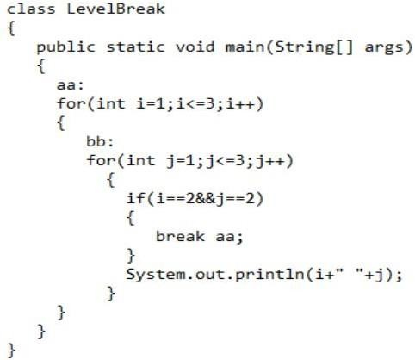
TRANSFER STATEMENTS:
Label:

Slide 42
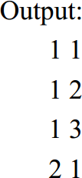
TRANSFER STATEMENTS:
Label:

Slide 43
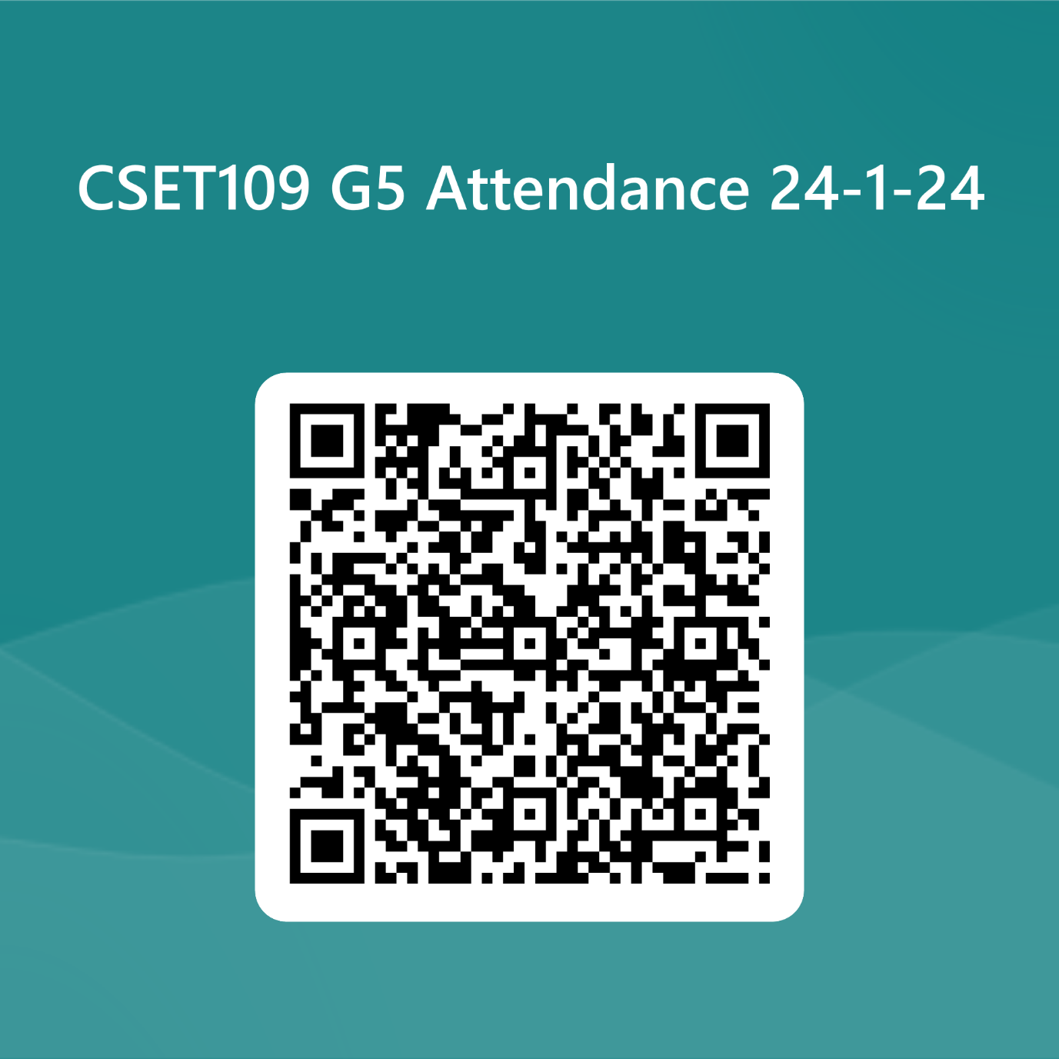
THANK YOU

