Slide 1

OBJECT ORIENTED PROGRAMMING USING JAVA

Slide 2
OUTLINE
Objects & Classes
Lifecycle of an Object

Slide 3
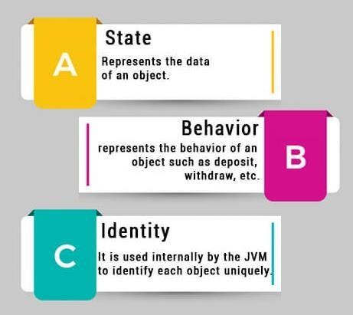
WHAT IS AN OBJECT IN JAVA?
An entity that has state and behavior is known as an object
e.g., chair, bike, marker, pen, table, car, etc.
An object has three characteristics:
State
Behavior
Identity
For Example, Pen is an object. Its name is Reynolds; color is white, known as its state. It is used to write, so writing is its behavior.
An object is an instance of a class.

Slide 4
CLASS
A class is a group of objects which have common properties. It is a template or blueprint from which
objects are created. It is a logical entity. It can't be physical.
A class in Java can contain:
Fields
Methods
Constructors
Blocks
Nested class and interface
Syntax to declare a class: class <class_name>{ field;
method;
}

Slide 5
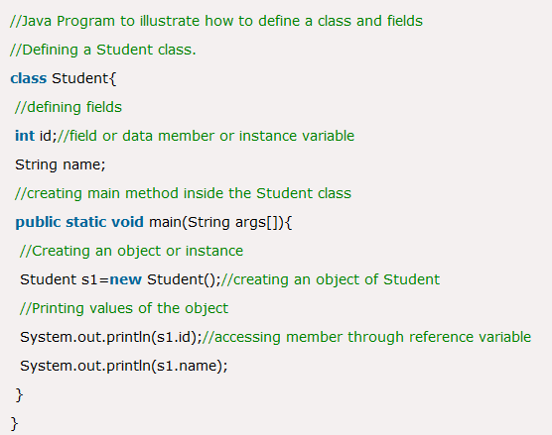
OBJECT AND CLASS EXAMPLE:

Slide 6
OBJECT AND CLASS EXAMPLE:
Output:
0
null

Slide 7
LIFECYCLE OF AN OBJECT
There are four parts in lifecycle of an Object:
Object creation
Object accessing
Object not accessing
Garbage collection

Slide 8
LIFECYCLE OF AN OBJECT (CONT..)
Object Creation:
We create an object by using new keyword.
We can initialize reference variable within the object.
public class Creation
{
public static void main(string args[])
{
Creation abc=new Creation();
}
}

Slide 9
LIFECYCLE OF AN OBJECT (CONT..)
Object accessing:
When we create an object , we can access it.
We can access it , till the statements/ conditions are true.
If were assign another object to an initialized reference variable, the previous object
becomes inaccessible.

Slide 10
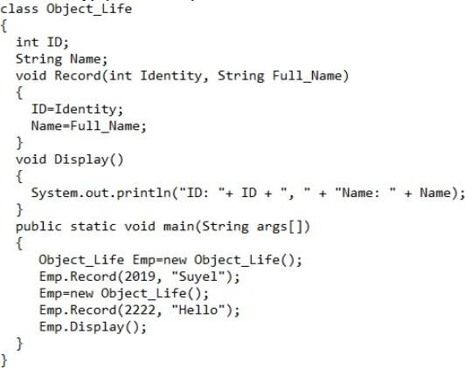
LIFECYCLE OF AN OBJECT (CONT..)
Object accessing (Example):

Slide 11
LIFECYCLE OF AN OBJECT (CONT..)
Object accessing (Example):
Output:
ID:2222,Name:Hello

Slide 12
LIFECYCLE OF AN OBJECT (CONT..)
Object not accessing:
An object become inaccessible, if it goes out of scope.
Then, the object is no longer be referenced and compiler makes garbage collection for the object.

Slide 13
LIFECYCLE OF AN OBJECT (CONT..)
Garbage collection:
It is a process by which Java programs perform automatic memory management.
Java programs converts to bytecode that can be run on a JVM.
Objects are created on the heap(a portion of memory) dedicated to the program.
If any object is not needed in future, the garbage collector finds these unused objects and deletes them.

Slide 14
LIFECYCLE OF AN OBJECT (CONT..)
Garbage collection:
Unreachable objects: An object has become unreachable , if it doesn’t contain any reference to it.
Object_Life Emp=new Object_Life();
Emp.Record(2021,“BU");
Emp=null;

Slide 15
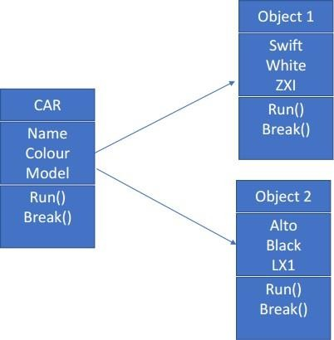

Slide 16
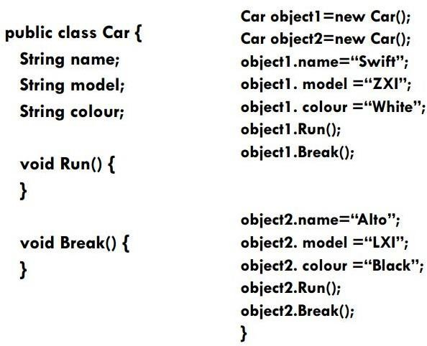

Slide 17
Method Types
There can be various types of methods (behavior declarations)
access methods : read or display states (or those that can be derived)
predicate methods : test the truth of some conditions
action methods, e.g., print
constructors: a special type of methods
they have the same name as the class
there may be more than one constructor per class (overloaded constructors)
they do not return any value
it has no return type, not even void
they initialize objects of the class, using the new construct:
e.g. m1 = new Month();
you do not have to define a constructor
the value of the state variables have default value

Slide 18
Example: The Account Class
We define an Account class to model a bank account
In our Account class we could define the following data:
rate, a double acctNumber, an integer acctName, a string balance, an integer
We might also define the following methods: Account constructor, to set up the object withdraw method, to withdraw from the account addInterest method, to add interest
toString method, returns a string describing the current state

Slide 19
Example: Account and Transactions
public class Account
{
public final double RATE = 0.035;
public long acctNumber; public String acctName; public double balance;
public Account (String owner, long account, double initial)
{
acctName = owner; acctNumber = account; balance = initial;
}
public double deposit (double amount)
{
balance = balance + amount;
return balance;
}
…
}
public static void main (String[] args)
{
Account aliceAcct = new Account
(“Alice", 11111, 100.00);
Account bobAcct = new Account (“Bob", 22222, 200.00);
Account charlesAcct = new Account
(“Charles", 33333, 300.00);
bobAcct.deposit (30.00);
…
}

Slide 20
public static void main (String[] args)
{
aliceAcct: Account
rate = 0.035
acctNumber = 11111 acctName = “Alice” balance = 100.00
Account aliceAcct = new Account (“Alice", 11111, 100.00);
Account bobAcct = new Account (“Bob", 22222, 200.00);
bobAcct: Account
rate = 0.035
acctNumber = 22222 acctName = “Bob” balance = 200.00
Account charlesAcct = new Account (“Charles", 33333,
300.00);
bobAcct.deposit (30.00);
charlesAcct: Account
…
rate = 0.035
acctNumber = 33333 acctName = “Charles” balance = 300.00
}

Slide 21
public static void main (String[] args)
{
aliceAcct: Account
rate = 0.035
acctNumber = 11111 acctName = “Alice” balance = 100.00
Account aliceAcct = new Account (“Alice", 11111, 100.00);
Account bobAcct = new Account (“Bob", 22222, 200.00);
bobAcct: Account
rate = 0.035
acctNumber = 22222 acctName = “Bob” balance = 230.00
Account charlesAcct = new Account (“Charles", 33333,
300.00);
bobAcct.deposit (30.00);
charlesAcct: Account
…
rate = 0.035
acctNumber = 33333 acctName = “Charles” balance = 300.00
}

Slide 22
Data Declarations: Class/Static Variables
Sometimes it is useful if all instances of objects of a class share the same copy of a variable, e.g.,
common constant variables
global statistics
the number of instances of objects created from a class
Declare variables using keyword static to create only one copy of the variable
Such variables are called static or class variables
Class/static variables are accessible to all methods in the class

Slide 23
Keeping Track of Account Objects
We want to keep track of the number of Account objects we ever created
In our Account class, we could add the following data:
static int counter, an integer that represents the number of accounts we ever created
since counter is static, it is shared by all account objects
in constructor, we increase counter by 1
public class Account
{
public final double RATE = 0.035; public String acctName;
public static int counter = 0; // NEW
public long acctNumber; public double balance;
public Account (String owner, long account, double initial)
{
acctName = owner; acctNumber = account; balance = initial; counter ++; // NEW
}

Slide 24
Example: The Account
Objects
0
Acount.counter

Slide 25
Example: The Account
Objects
aliceAcct: Account
1
acctNumber = 11111 acctName = “Alice” balance = 100.00
Acount.counter
After Account aliceAcct = new Account (“Alice", 11111, 100.00);

Slide 26
Example: The Account
Objects
aliceAcct: Account
2
acctNumber = 11111 acctName = “Alice” balance = 100.00
Acount.counter
bobAcct: Account
acctNumber = 22222 acctName = “Bob” balance = 200.00
After Account bobAcct = new Account (“Bob", 2222, 200.00);

Slide 27
Example: The Account
Objects
aliceAcct: Account
3
acctNumber = 11111 acctName = “Alice” balance = 100.00
Acount.counter
bobAcct: Account
acctNumber = 22222 acctName = “Bob” balance = 200.00
charlesAcct: Account
acctNumber = 33333 acctName = “Charles” balance = 300.00
After Account charlesAcct = new Account (“Charles", 33333, 300.00);

Slide 28
Methods
A program that provides some functionality can be long
and contains many statements
A method groups a sequence of statements and should provide a well-defined, easy-to-understand functionality
a method takes input, performs actions, and produces output
In Java, each method is defined within specific class

Slide 29










Method Declaration: Header
A method declaration begins with a method header
class MyClass
{ …
static int
min ( int num1, int num2 )
method
parameter list
name
The parameter list specifies the type
and name of each parameter
return type
The name of a parameter in the method declaration is called a formal argument
properties

Slide 30
Method Declaration: Body
The header is followed by the method body:
class MyClass
{
…
static int min(int num1, int num2)
{
int minValue = num1 < num2 ? num1 : num2; return minValue;
}
…
}

Slide 31
The return Statement
The return type of a method indicates the type of value that the method
sends back to the calling location
A method that does not return a value has a void return type
The return statement specifies the value that will be returned
Its expression must conform to the return type
31

Slide 32
Calling a Method
Each time a method is called, the values of the actual arguments in the invocation are assigned to the formal arguments
int num = min (2, 3);
static int min (int num1, int num2)
{
int minValue = (num1 < num2 ? num1 : num2); return minValue;
}

Slide 33
Method Control Flow
A method can call another method, who can call another method, …
main
min(num1, num2, num3)
println()
min(1, 2, 3);
…println(…)

Slide 34
Method Declarations
Instance methods: reflect the behaviors of objects created from the class
invocation:
inside class definition: just call the method name outside class definition: objVar.methodName(…)
can access both instance and class/static variables
Static/class methods
invocation:
inside class definition: just call the method name outside class definition: ClassName.methodName(…)
declare methods using keyword static for such methods
can access only class/static variables (why?)

Slide 35
Method Overloading
A class may define multiple methods with the same name-
--this is called method overloading
usually perform the same task on different data types
Example: The PrintStream class defines multiple println
methods, i.e., println is overloaded:
println (String s) println (int i) println (double d)
…
The following lines use the System.out.print method for different data types:
System.out.println ("The total is:");
double total = 0; System.out.println (total);
35

Slide 36
Method Overloading: Signature
The compiler must be able to determine which version of the method is being invoked
This is by analyzing the parameters, which form the signature of a method
the signature includes the type and order of the
parameters
if multiple methods match a method call, the compiler picks the best match
if none matches exactly but some implicit conversion can be done to match a method, then the method is invoke with implicit conversion.
the return type of the method is not part of the signature
36

Slide 37



Method Overloading
Version 1
Version 2
double tryMe (int x)
{
return x + .375;
}
double tryMe (int x, double y)
{
return x * y;
}
Invocation
result = tryMe (25, 4.32)

Slide 38
More Examples
double tryMe ( int x )
{
return x + 5;
}
Which tryMe will be called?
tryMe( 1 );
tryMe( 1.0 );
tryMe( 1.0, 2);
tryMe( 1, 2);
tryMe( 1.0, 2.0);
double tryMe ( double x )
{
return x * .375;
}
double tryMe (double x, int y)
{
return x + y;
}

Slide 39
Two Types of
Parameter Passing
If a modification of the formal argument
has no effect on the actual argument,
it is call by value
If a modification of the formal argument can change the value of the actual argument,
it is call by reference

Slide 40
Call-By-Value and Call-By-Reference
Depend on the type of the formal argument
If a formal argument is a primitive data type, a modification
on the formal argument has no effect on the actual argument
this is call by value, e.g. num1 = min(2, 3);
num2 = min(x, y); This is because primitive data types variables contain their values, and procedure call trigger an assignment:
<formal argument> = <actual argument>
int x = 2; int y = 3;
int num = min (x, y);
…
static int num( int num1, int num2)
{ … }
int x = 2; int y = 3; int num1 = x; int num2 = y;
{ … }

Slide 41
Call-By-Value and Call-By-Reference
If a formal argument is not a primitive data type, an operation on the formal argument can change the actual argument
this is call by reference
This is because variables of object type contain pointers to the data that represents the object
Since procedure call triggers an assignment
<formal argument> = <actual argument>
it is the pointer that is copied, not the object itself!
MyClass x = new MyClass(); MyClass y = new MyClass(); MyClass.swap( x, y);
…
static void swap( MyClass x1, MyClass x2)
{ … }
x = new MC(); y = new MC(); x1 = x;
x2 = y;
{ … }

Slide 42
Calling a Method: Value
num1
2
int num1 = 2; int num2 = 3; int
num2
num
3
25
0
num = SquareSum (num1, num2);
public int SquareSum (int num1,
{
num1 = num1 + num2; return num1 * num1;
}
int num2)
num1
5
2
num2
3

Slide 43
Calling a Method: Reference
Account bobAcct = new Account(“Bob”, 22222, 200.0);
double balance = 0;
doubleBalance (bobAcct);
acctNumber = 22222 acctName = “Bob” balance = _{400.00}
bobAcct
0
200.00
balance
static void doubleBalance(Account act)
{
double balance = act.getBalance(); ^{act}
act.setBalance( balance * 2 );
}
balance
200

Slide 44
Example: Parameter Passing
public class Num
{
private int value;
public Num(int update)
{
value = update;
}
public void setValue(int update)
{
value = update;
}
public String toString()
{
return value + “”;
}
}

Slide 45
Tracing the Parameters: Before changeValues()
a1 a2
a3
111
222
333
f1
f2
f3
public static void main(String[] args)
{
int a1 = 111;
Num a2 = new Num(222); Num a3 = new Num(333); tester.changeValues(a1, a2, a3);
public void changeValue(int f1,
Num f2, Num f3)
{
f1 = 999;
f2.setValue(888);
f3 = new Num(777);
}

Slide 46
Tracing the Parameters:
In tester.changeValues(a1, a2, a3)
a1 a2 a3
111
222
333
f1
f2
f3
111
public static void main(String[] args)
{
int a1 = 111;
Num a2 = new Num(222); Num a3 = new Num(333); tester.changeValues(a1, a2, a3);
public void changeValue(int f1,
Num f2, Num f3)
{
f1 = 999;
f2.setValue(888);
f3 = new Num(777);
}

Slide 47
Tracing the Parameters: f1=999
a1 a2 a3
111
222
333
f1
f2
f3
999
public static void main(String[] args)
{
int a1 = 111;
Num a2 = new Num(222); Num a3 = new Num(333); tester.changeValues(a1, a2, a3);
public void changeValue(int f1,
Num f2, Num f3)
{
f1 = 999;
f2.setValue(888);
f3 = new Num(777);
}

Slide 48
Tracing the Parameters: f2.setValue(888)
a1 a2 a3
111
888
333
f1
f2
f3
999
public static void main(String[] args)
{
int a1 = 111;
Num a2 = new Num(222); Num a3 = new Num(333); tester.changeValues(a1, a2, a3);
public void changeValue(int f1,
Num f2, Num f3)
{
f1 = 999;
f2.setValue(888);
f3 = new Num(777);
}

Slide 49
Tracing the Parameters:
f3 = new Num(777)
a1 a2
a3
111
888
333
f1
f2
f3
999
777
public static void main(String[] args)
{
int a1 = 111;
Num a2 = new Num(222); Num a3 = new Num(333); tester.changeValues(a1, a2, a3);
public void changeValue(int f1,
Num f2, Num f3)
{
f1 = 999;
f2.setValue(888);
f3 = new Num(777);
}

Slide 50
Tracing the Parameters: Return
a1 a2
a3
111
888
333
f1
f2
f3
777
public static void main(String[] args)
{
int a1 = 111;
Num a2 = new Num(222); Num a3 = new Num(333); tester.changeValues(a1, a2, a3);
public void changeValue(int f1,
Num f2, Num f3)
{
f1 = 999;
f2.setValue(888);
f3 = new Num(777);
}

Slide 51
TYPES OF VARIABLES
There are three types of variables in Java:
Local Variables
Instance Variables
Static Variable

Slide 52
LOCAL VARIABLES
A variable defined within a block or method or constructor is called local variable.
These variable are created when the block in entered or the function is called and destroyed after exiting from the block or when the call returns from the function.
The scope of these variables exists only within the block in which the variable is declared. i.e. we can access these variable only within that block.
Initialisation of Local Variable is Mandatory.
•

Slide 53
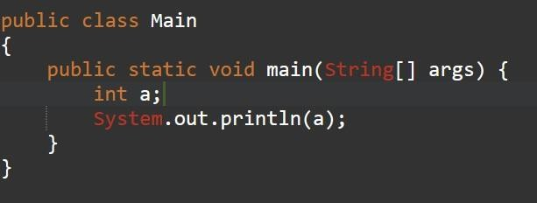
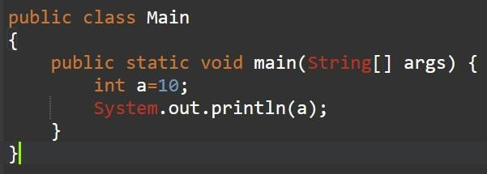
LOCAL VARIABLES

Slide 54

LOCAL VARIABLES

Slide 55
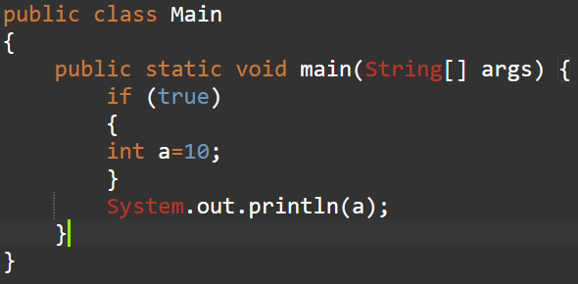
LOCAL VARIABLES

Slide 56

LOCAL VARIABLES

Slide 57
INSTANCE VARIABLES
Instance variables are non-static variables and are declared in a class outside any method, constructor or block.
As instance variables are declared in a class, these variables are created when an object of the class is created and destroyed when the object is destroyed.
Unlike local variables, we may use access specifiers for instance variables. If we do not specify any access specifier then the default access specifier will be used.
Initialisation of Instance Variable is not Mandatory. Its default value is 0
Instance Variable can be accessed only by creating objects.
•

Slide 58
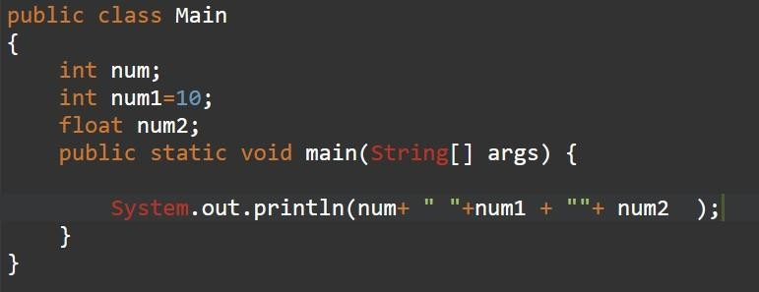
INSTANCE VARIABLES

Slide 59
INSTANCE VARIABLES

Slide 60
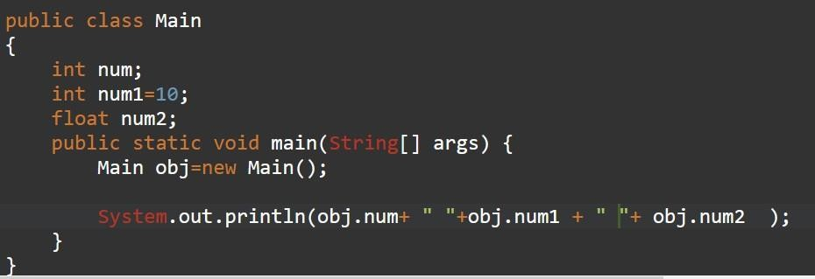
INSTANCE VARIABLES

Slide 61

INSTANCE VARIABLES

Slide 62
STATIC VARIABLES
Static variables are also known as Class variables.
These variables are declared similarly as instance variables, the difference is that static variables are declared using the static keyword within a class outside any method constructor or block.
Unlike instance variables, we can only have one copy of a static variable per class irrespective of how many objects we create.
Static variables are created at the start of program execution and destroyed automatically when execution ends.
Initialisation of Static Variable is not Mandatory. Its default value is 0
If we access the static variable like Instance variable (through an object), the compiler will show the warning message and it won’t halt the program. The compiler will replace the object name to class name automatically.
If we access the static variable without the class name, Compiler will automatically append the class name.
•
•

Slide 63
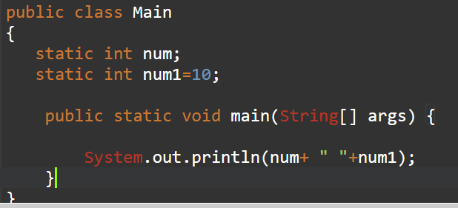
STATIC VARIABLES

Slide 64

STATIC VARIABLES

Slide 65
METHODS
We have used some existing methods without fully understanding their implementation
System.out’s print, println
String's length, charAt, indexOf, toUpperCase
Scanner's nextDouble, nextInt
BankAccount's withdraw, deposit
Java has thousands of methods
We often need to create our own

Slide 66
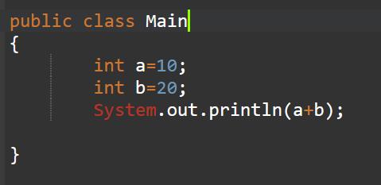
NEED OF METHODS

Slide 67
NEED OF METHODS
Compile time Error
Therefore in JAVA direct business logics are not allowed

Slide 68
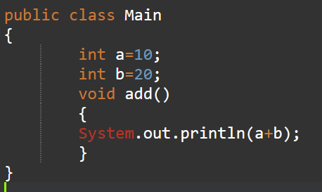
NEED OF METHODS
Solution:

Slide 69
NEED OF METHODS
Solution:
But here we will get runtime error: Main method not found in class Main

Slide 70
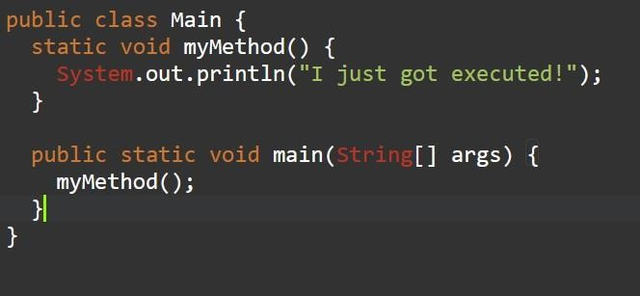
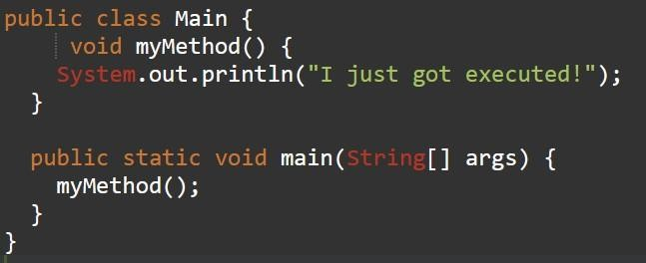
METHOD :EXAMPLE
Static Method
Instance Method

Slide 71

METHOD :EXAMPLE
Static Method
Instance Method

Slide 72
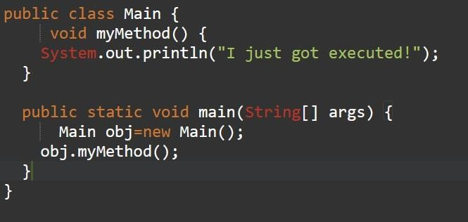
METHOD :EXAMPLE
Instance Method

Slide 73
Variables
At a given point, the variables that a statement can access are determined by the scoping rule
the scope of a variable is the section of a program in which the variable can be accessed (also called visible or in scope)
There are two types of scopes in Java
class scope
a variable defined in a class but not in any method
block scope
a variable defined in a block {} of a method; it is also called a local
variable

Slide 74
Java Scoping Rule
A variable with a class scope
class/static variable: a variable defined in class scope and has the static
property
it is associated with the class
and thus can be accessed (in scope) in all methods in the class
instance variable: a variable defined in class scope but not static
it is associated with an instance of an object of the class,
and thus can be accessed (in scope) only in instance methods, i.e., those non-static methods
A variable with a block scope
can be accessed in the enclosing block; also called local variable
a local variable can shadow a variable in a class scope with the same name
Do not confuse scope with duration
a variable may exist but is not accessible in a method,
e.g., method A calls method B, then the variables declared in method A exist but are not
accessible in B.

Slide 75
Scoping Rules (cont.): Variables in a method
There are can be three types of variables accessible in a method
:
class and instance variables
static and instance variables of the class
local variables
those declared in the method
formal arguments

Slide 76
Example1:
public class Box
{
private int length, width;
…
instance variables formal arguments local variables
public int widen (int extra_width)
{
private int temp1;
size += extra_width;
…
}
public int lenghten (int extra_lenth)
{
private int temp2;
size += extra_length;
…
}
…
}

Slide 77
Scope of Variables
public class Box
{
private int length, width;
…
public int widen (int extra_width)
{
private int temp1; size += extra_width;
…
}
public int lenghten (int extra_lenth)
{
private int temp2; size += extra_length;
…
}
…
}
Instance variables are accessible in all methods of the class
formal arguments are valid within their methods
Local variables are valid from the point of declaration to the end of the enclosing block

Slide 78
public class Test{
final static int NO_OF_TRIES = 3; static int i = 100;
public static int square ( int x ) {
// NO_OF_TRIES, x, i in scope
int mySquare = x * x;
// NO_OF_TRIES, x, i, mySquare in scope return mySquare;
}
public static int askForAPositiveNumber ( int x ){
// NO_OF_TRIES, x, i in scope
for ( int i = 0; i < NO_OF_TRIES; i++ ){
// NO_OF_TRIES, x, i in scope; local i shadows class i
System.out.print(“Input: “);
Scanner scan = new Scanner( System.in ); String str = scan.nextLine();
int temp = Integer.parseInt( str );
// NO_OF_TRIES, x, i, scan, str, temp in scope if (temp > 0) return temp;
}
// NO_OF_TRIES, x, i in scope
return 0;
} // askForPositiveNumber
public static void main( String[] args )
{…}
}

Slide 79
Class-Scope Variables (class and instance) and Methods in a Class
static/class
method
instance
method
can access | can access
cannot access | can access
static/class variable
instance variable
Accessibility of variables in methods defined in the same class

Slide 80
Recursive Procedures
Recursion: A way of defining a concept where the text of the definition refers to the concept that is being defined.
(Sounds like a buttery butter, but read on…)
In programming: A recursive procedure is a procedure which calls itself.
Caveat: The recursive procedure call must use a different argument that the original one: otherwise the procedure would always get into an infinite loop…
Classic example: Here is the non-recursive definition of fhe factorial function:
n! = 1· 2· 3· ··· · (n-1)· n
Here is the recursive definition of a factorial: (here f(n) = n!)
⎧
1 if n = 0
Code of recursive procedures, in functionfal(pnro)gr=am⎨ming languages like Java, is almost
identical to a recursive definition!
Example: The Java code for the Factorial function:
// recursive procedure for computing factorial
⎩n ⋅ f (n −1)
else
public static int Factorial(int n) {
if (n == 0) return 1;
else return n * Factorial(n- 1);
}
// base case
// recursive case

Slide 81
Content of a Recursive Method
Base case(s).
Values of the input variables for which we perform no recursive calls are called base cases (there should be at least one base case).
Every possible chain of recursive calls must eventually reach a base case.
Recursive calls.
Calls to the current method.
Each recursive call should be defined so that it makes progress towards a base case.

Slide 82
Visualizing Recursion
Recursion trace
A box for each recursive call
An arrow from each caller to callee
An arrow from each callee to caller showing return value
Example recursion trace:
call
return 4*6 = 24 final answer
recursiveFactorial (4)
call
return 3*2 = 6
recursiveFactorial (3)
call
return 2*1 = 2
recursiveFactorial (2)
call
return 1*1 = 1
recursiveFactorial (1)
call
return 1
recursiveFactorial (0)

Slide 83
Linear Recursion
Test for base cases.
Begin by testing for a set of base cases (there should be at
least one).
Every possible chain of recursive calls must eventually reach a base case, and the handling of each base case should not use recursion.
Recur once.
Perform a single recursive call. (This recursive step may involve a test that decides which of several possible recursive calls to make, but it should ultimately choose to make just one of these calls each time we perform this step.)
Define each possible recursive call so that it makes progress towards a base case.

Slide 84
A Simple Example of Linear Recursion
Algorithm LinearSum(A, n):
Input:
A integer array A and an integer n
= 1, such that A has at least n
elements
Output:
The sum of the first n integers in A
if n = 1 then return A[0] else
return LinearSum(A, n - 1) + A[n -
1]
Example recursion trace:
call
return 15 + A[4] = 15 + 5 = 20
LinearSum (A,5)
call
return 13 + A[3] = 13 + 2 = 15
LinearSum (A,4)
call
return 7 + A [2 ] = 7 + 6 = 13
LinearSum (A,3)
call
return 4 + A [1 ] = 4 + 3 = 7
LinearSum (A,2)
call
return A[0] = 4
LinearSum (A,1)

Slide 85
Reversing an Array
Algorithm ReverseArray(A, i, j):
Input: An array A and nonnegative integer indices i and j
Output: The reversal of the elements in A
starting at index i and ending at j
if i < j then
Swap A[i] and A[ j] ReverseArray(A, i + 1, j - 1)
return

Slide 86
Defining Arguments for Recursion
In creating recursive methods, it is important to define the methods in ways that facilitate recursion.
This sometimes requires we define additional paramaters that are passed to the method.
For example, we defined the array reversal method as ReverseArray(A, i, j), not ReverseArray(A).

Slide 87
Computing Powers
The power function, p(x,n)=x^{n}, can be defined recursively:
if n = 0
1
p(x, n) = ⎧
⎨x ⋅ p(x, n −1) else
⎩
This leads to an power function that runs in O(n) time (for we make n recursive calls).
We can do better than this, however.

Slide 88
Recursive Squaring
We can derive a more efficient linearly recursive algorithm by using repeated squaring:
if x = 0
⎧
1
⎪
p(x,(n −1) / 2)
p(x, n / 2)²
if x > 0 is odd if x > 0 is even
p(x, n) = x ⋅
2
⎨
⎪
For example,
⎩
₂4
₂5
₂6
₂7
= 2^{(4/2)2} = (2^{4/2})² = (2²)² = 4² = 16
= 2^{1+(4/2)2} = 2(2^{4/2})² = 2(2²)² = 2(4²) = 32
= 2^{(6/ 2)2} = (2^{6/2})² = (2³)² = 8² = 64
= 2^{1+(6/2)2} = 2(2^{6/2})² = 2(2³)² = 2(8²) = 128.

Slide 89
A Recursive Squaring Method
Algorithm Power(x, n):
Input: A number x and integer n = 0
Output: The value x^{n}
if n = 0 then return 1
if n is odd then
y = Power(x, (n - 1)/ 2) return x · y ·y
else
y = Power(x, n/ 2)
return y · y

Slide 90
Analyzing the Recursive Squaring Method
Algorithm Power(x, n):
Input: A number x and integer n
= 0
Output: The value x^{n}
if n = 0 then
Each time we make a recursive call we halve the value of n; hence, we make log n recursive calls. That is, this method runs in O(log n) time.
return 1
if n is odd then
y = Power(x, (n - 1)/
return x · y · y
y = Power(x, n/ 2)
return y · y
2)
else
It is important that we used a variable twice here rather than calling the method twice.

Slide 91
Tail Recursion
Tail recursion occurs when a linearly recursive method makes its recursive call as its last step.
The array reversal method is an example.
Such methods can be easily converted to non-recursive methods (which saves on some resources).
Example:
Algorithm IterativeReverseArray(A, i, j ):
Input: An array A and nonnegative integer indices i and j
Output: The reversal of the elements in A starting at index i and ending at j
while i < j do
Swap A[i ] and A[ j ]
i = i + 1
j = j - 1
return

Slide 92
THANK YOU

