Slide 1

OBJECT ORIENTED PROGRAMMING USING JAVA

Slide 2
OUTLINE
INHERITANCE IN JAVA

Slide 3
INHERITANCE IN JAVA
Inheritance in Java is a mechanism in which one object acquires all the properties and behaviours of a parent object. It is an important part of OOPs (Object Oriented programming system).
The idea behind inheritance in Java is that you can create new classes that are built upon existing classes.
When you inherit from an existing class, you can reuse methods and fields of the parent class.
Moreover, you can add new methods and fields in your current class also.

Slide 4
TERMS USED IN INHERITANCE
Class: A class is a group of objects which have common properties. It is a template or blueprint from which objects are created.
Sub Class/Child Class: Subclass is a class which inherits the other class. It is also called a derived class, extended class, or child class.
Super Class/Parent Class: Superclass is the class from where a subclass inherits the features. It is also called a base class or a parent class.
Reusability: As the name specifies, reusability is a mechanism which facilitates you to reuse the fields and methods of the existing class when you create a new class. You can use the same fields and methods already defined in the previous class.

Slide 5
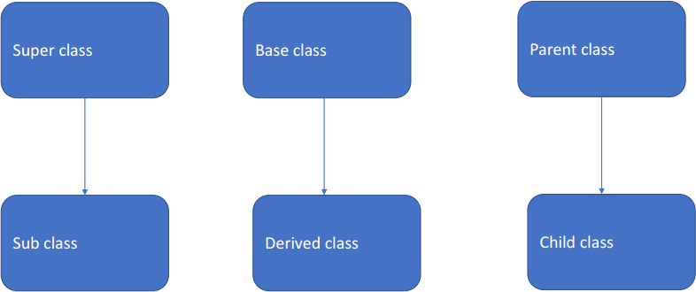
TERMINOLOGY

Slide 6
THE SYNTAX OF JAVA INHERITANCE
class Subclass-name extends Superclass-name
{
//methods and fields
}
The extends keyword indicates that you are making a new class that derives from an existing class. The meaning of "extends" is to increase the functionality .

Slide 7
EXAMPLE:
class p
{
public void m1()
{
System.out.println(“parent”);
}
}
class c extends p
{
public void m2()
{
System.out.println(“child”);
}
}
Note: Whatever member/method parent has,it is available for the child.

Slide 8
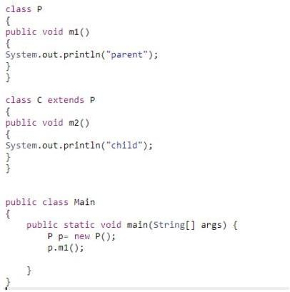
PREDICT THE OUTPUT: CASE 1

Slide 9
PREDICT THE OUTPUT: CASE 1
Output: parent

Slide 10
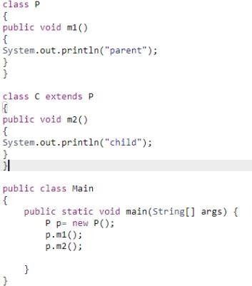
PREDICT THE OUTPUT: CASE 2

Slide 11
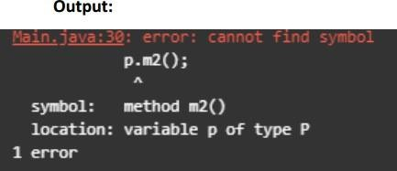
PREDICT THE OUTPUT: CASE 2

Slide 12
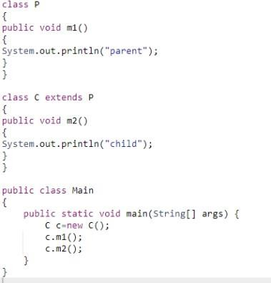
PREDICT THE OUTPUT: CASE 3

Slide 13
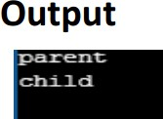
PREDICT THE OUTPUT: CASE 3

Slide 14
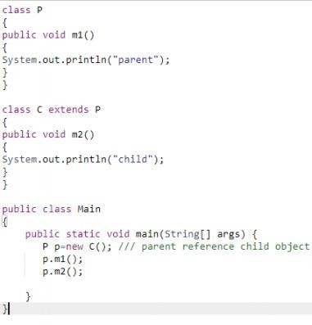
PREDICT THE OUTPUT: CASE 4

Slide 15
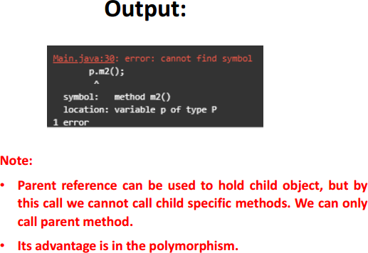
PREDICT THE OUTPUT: CASE 4

Slide 16
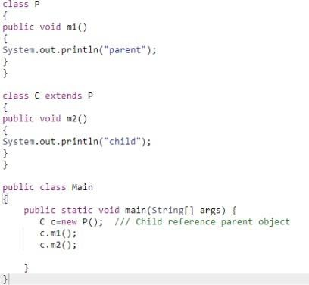
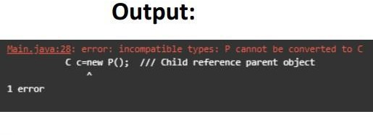
PREDICT THE OUTPUT: CASE 5

Slide 17
WHY USE INHERITANCE IN JAVA?
For Code Reusability.
For Method Overriding (so runtime polymorphism can be achieved)

Slide 18

ADVANTAGE OF INHERITANCE: EXAMPLE
I want to develop loan module for housing loan, vehicle loan, home loan.
Case 1: (without inheritance)
Hence, for this example it required 900 method, to develop entire loan module
Lets assume on an average 1 method requires 5 minutes
Therefore to develop it requires 900*5= 4500 minutes= 75 hours
Redundancy is high

Slide 19
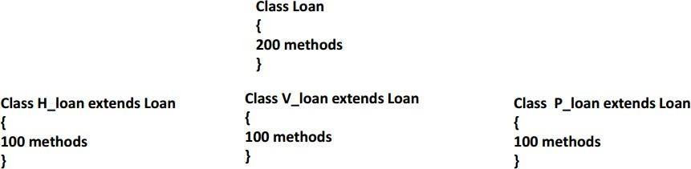
ADVANTAGE OF INHERITANCE: EXAMPLE
I want to develop loan module for housing loan, vehicle loan, home loan.
Case 1: (with inheritance)
All of them are loan, hence First find out the common methods , lets assume 200 methods are common. Therefore create a Loan class and then preform inheritance.
Therefore to develop it requires 500*5= 2500 minutes= 41.67 hours
Less code less development time (Code reusability, less development time).

Slide 20
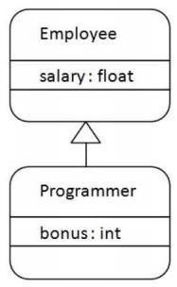
JAVA INHERITANCE EXAMPLE
Inheritance represents the IS-A relationship which is also known as a parent-child relationship.
As displayed in the figure, Programmer is the subclass and Employee is the superclass. The relationship between the two classes is Programmer ISA
Employee. | It | means | that
Programmer | is | a type | of
Employee.

Slide 21
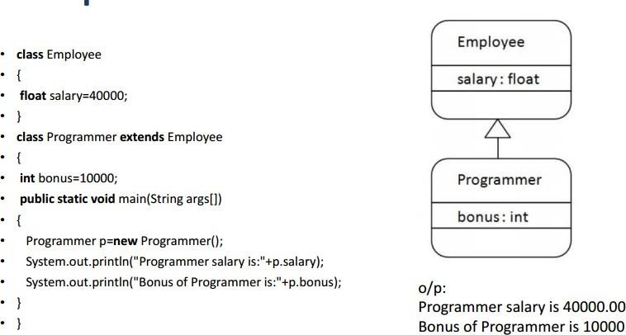
JAVA INHERITANCE EXAMPLE

Slide 22
IDEA OF INHERITANCE
Inheritance in java is a mechanism in which child class object acquires all the properties and behaviours of parent class object.
The idea behind inheritance in java is that you can create new classes that are built upon existing classes.
When you inherit from an existing class, you can reuse methods and fields of parent class, and you can add new methods and fields also.

Slide 23
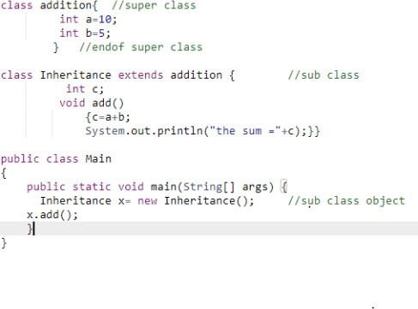
PREDICT THE OUTPUT:

Slide 24

PREDICT THE OUTPUT:

Slide 25
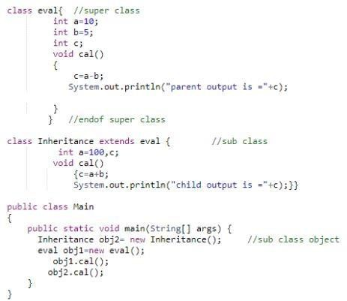
SAME NAME VARIABLE OR METHOD

Slide 26
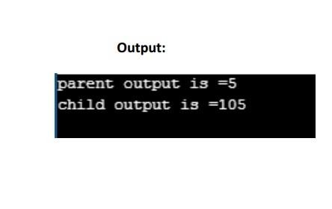
SAME NAME VARIABLE OR METHOD
Note:The derived class cannot inherit a member of the base class if the derived class declares another member with the same name.

Slide 27
OUTLINE
Method Overriding
Super Keyword
Types of Inheritance

Slide 28
METHOD OVERRIDING
If subclass (child class) has the same method as declared in the parent class, it is known as method overriding in Java.
In other words, If a subclass provides the specific implementation of the method that has been declared by one of its parent class, it is known as method overriding.
Usage of Overriding
Method overriding is used to provide the specific implementation of a method which is already provided by its superclass.
Method overriding is used for runtime polymorphism.

Slide 29
RULES FOR METHOD OVERRIDING
The method must have the same name as in the parent class
The method must have the same parameter as in the parent class.
There must be an IS-A relationship (inheritance).

Slide 30
EXAMPLE OF METHOD OVERRIDING
//Creating a parent class. class Vehicle{
//defining a method
void run(){System.out.println("Vehicle is running");}
}
//Creating a child class
class Bike2 extends Vehicle{
//defining the same method as in the parent class
void run(){System.out.println("Bike is running safely");}
public static void main(String args[]){ Bike2 obj = new Bike2();//creating object obj.run();//calling method
}
}

Slide 31
EXAMPLE OF METHOD OVERRIDING
//Creating a parent class.
class Vehicle{
//defining a method
void run(){System.out.println("Vehicle is running");}
}
//Creating a child class
class Bike2 extends Vehicle{
//defining the same method as in the parent class
void run(){System.out.println("Bike is running safely");}
o/p:
Bike is Running Safely
public static void main(String args[]){ Bike2 obj = new Bike2();//creating object obj.run();//calling method
}
}

Slide 32
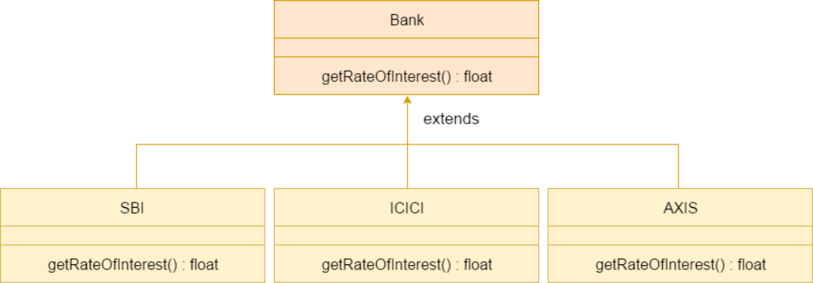
Consider a scenario where Bank is a class that provides functionality to get the rate of interest. However, the rate of interest varies according to banks. For example, SBI, ICICI and AXIS banks could provide 8%, 7%, and 9% rate of interest.
EXAMPLE OF METHOD OVERRIDING

Slide 33
A REAL EXAMPLE OF METHOD OVERRIDING
//Creating a parent class.
class Bank{
int getRateOfInterest(){return 0;}}
//Creating child classes.
class SBI extends Bank{
int getRateOfInterest(){return 8;} }
class ICICI extends Bank{
int getRateOfInterest(){return 7;} }
class AXIS extends Bank{
int getRateOfInterest(){return 9;} }
//Test class to create objects and call the methods
class Test2{
public static void main(String args[]){ SBI s=new SBI();
ICICI i=new ICICI();
AXIS a=new AXIS();
System.out.println("SBI Rate of Interest:"+s.getRateOfInterest()); System.out.println("ICICI Rate of Interest:"+i.getRateOfInterest()); System.out.println("AXIS Rate of Interest:"+a.getRateOfInterest());
} }
o/p:
SBI Rate of Interest:8 ICICI Rate of Interest:7 AXIS Rate of Interest:9

Slide 34
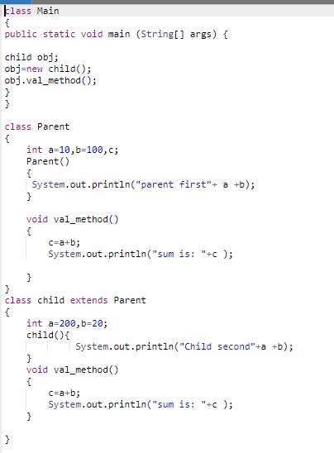
PROBLEM DESCRIPTION: NEED OF SUPER KEYWORD

Slide 35
PROBLEM DESCRIPTION: NEED OF SUPER KEYWORD
Step:1
null
Step:2
obj
a=0
b=0
c=0
obj
Child object
Step:3
a=10
b=100
c=0
obj
Child object
Step:4
a=200
b=20
c=220
obj
Child object

Slide 36
PROBLEM DESCRIPTION: NEED OF SUPER KEYWORD
O/P:
Parent first10100 Child second20020 Sum is 220

Slide 37
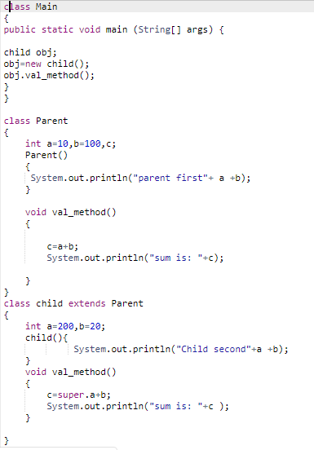

PROBLEM DESCRIPTION: NEED OF SUPER KEYWORD
Output
super.a executes parent class variable which is a=10;

Slide 38
THE SUPER KEYWORD
It is used to differentiate the members of superclass (immediate parent) from the
members of subclass, if they have same names.
super can be used to refer immediate parent class instance variable.
super can be used to invoke immediate parent class method.
super() can be used to invoke immediate parent class constructor.

Slide 39
SUPER CAN BE USED TO INVOKE PARENT CLASS VARIABLE
The first form of super acts somewhat like this, except that it always refers to the immediate superclass variables of the subclass in which it is used.
This usage has the following general form:
super.variable

Slide 40
SUPER CAN BE USED TO INVOKE PARENT CLASS VARIABLE
class Animal{
String color="white";
}
class Dog extends Animal{
String color="black";
void printColor(){ System.out.println(color);//prints color of Dog class System.out.println(super.color);//prints color of Animal class
}
}
class TestSuper1{ //class with a main method
public static void main(String args[]){
Dog d=new Dog(); d.printColor();
}}
//object of sub class

Slide 41
SUPER CAN BE USED TO INVOKE PARENT CLASS VARIABLE
class Animal{
String color="white";
}
class Dog extends Animal{
String color="black";
void printColor(){ System.out.println(color);//prints color of Dog class System.out.println(super.color);//prints color of Animal class
}
}
class TestSuper1{ //class with a main method
public static void main(String args[]){
Output:
black white
Dog d=new Dog(); d.printColor();
}}
//object of sub class

Slide 42
SUPER CAN BE USED TO INVOKE PARENT CLASS METHOD
The second form of super acts somewhat like this, except that it always refers to the immediate superclass method of the subclass in which it is used.
This usage has the following general form:
super.method()

Slide 43
SUPER CAN BE USED TO INVOKE PARENT CLASS METHOD
class Animal{
void eat()
{System.out.println("eating...");}
}
class Dog extends Animal{
void eat()
{System.out.println("eating bread...");}
void bark()
{System.out.println("barking...");}
void work(){
super.eat();
bark();
}
}
class TestSuper2{
public static void main(String args[]){ Dog d=new Dog();
d.work();
}}

Slide 44
SUPER CAN BE USED TO INVOKE PARENT CLASS METHOD
class Animal{
void eat()
{System.out.println("eating...");}
}
class Dog extends Animal{
void eat()
{System.out.println("eating bread...");}
void bark()
Output
{System.out.println("barking...");}
void work(){
super.eat();
bark();
eating... barking...
}
}
class TestSuper2{
public static void main(String args[]){ Dog d=new Dog();
d.work();
}}

Slide 45
USING SUPER TO CALL SUPERCLASS CONSTRUCTORS
A subclass can call a constructor defined by its superclass by use of the following form of super:
super(arg-list);
Here , arg-list specifies any arguments needed by the constructor in the
superclass.super( )
It always be the first statement executed inside a subclass constructor.
When a subclass calls super(), it is calling the constructor of its immediate superclass. Thus , super() always refers to the superclass immediately above the calling class.

Slide 46
USING SUPER TO CALL SUPERCLASS CONSTRUCTORS
class Animal{
Animal(){System.out.println("animal is created");}
}
class Dog extends Animal{ Dog(){
super(); //first statement
System.out.println("dog is created");
}
}
class TestSuper3{
public static void main(String args[]){ Dog d=new Dog();
}}

Slide 47
USING SUPERTO CALL SUPERCLASS CONSTRUCTORS
class Animal{
Animal(){System.out.println("animal is created");}
}
class Dog extends Animal{ Dog(){
super(); //first statement
System.out.println("dog is created");
}
}
class TestSuper3{
public static void main(String args[]){ Dog d=new Dog();
}}
Output
animal is created dog is created

Slide 48
NOTE:
Call to super() must be first statement in Derived(Student) Class constructor.
If a constructor does not explicitly invoke a superclass constructor, the Java compiler automatically inserts a call to the no-argument constructor of the superclass. If the superclass does not have a no-argument constructor, you will get a compile-time error. Object does have such a constructor, so if Object is the only superclass, there is no problem.
If a subclass constructor invokes a constructor of its superclass, either explicitly or implicitly, you might think that a whole chain of constructors called, all the way back to the constructor of Object. This, in fact, is the case. It is called constructor chaining..

Slide 49
TYPES OF INHERITANCE IN JAVA
There are four types of inheritance in java:
Single
Multilevel and
Hierarchical.
Hybrid
In java programming, multiple and hybrid inheritance is supported through interface only.

Slide 50
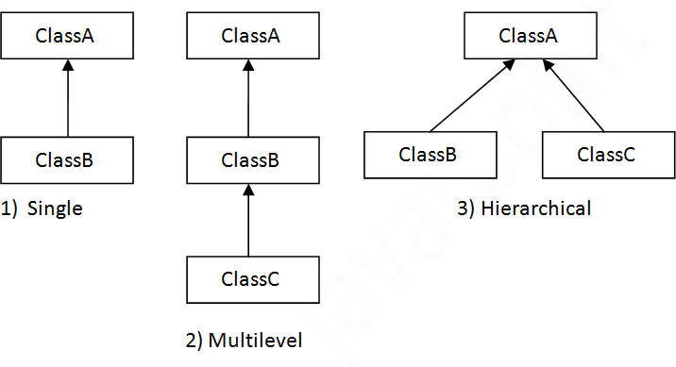
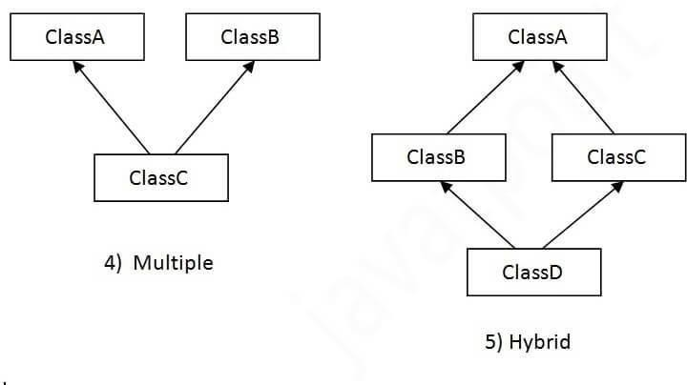
TYPES OF INHERITANCE IN JAVA

Slide 51
SINGLE INHERITANCE
class Animal
{
void eat()
{System.out.println("eating...");}
}
Note: When a class inherits another class, it is known as a single inheritance. In the example given below, Dog class inherits the Animal class, so there is the single inheritance.
class Dog extends Animal{
void bark()
{System.out.println("barking...");}
}
class TestInheritance{
public static void main(String args[]){ Dog d=new Dog();
d.bark();
d.eat();
}}

Slide 52
MULTILEVEL INHERITANCE
class Animal{
void eat()
{System.out.println("eating...");}
}
class Dog extends Animal{
void bark()
{System.out.println("barking...");}
}
class BabyDog extends Dog{
void weep(){System.out.println("weeping...");}
}
class TestInheritance2{
public static void main(String args[]){ BabyDog d=new BabyDog();
d.weep();
d.bark();
d.eat();
}
}
When there is a chain of inheritance, it is known as multilevel inheritance. As you can see in the example given below, BabyDog class
inherits the Dog class which again inherits the Animal class, so there is a multilevel inheritance.

Slide 53
MULTILEVEL INHERITANCE
class Animal{
void eat()
{System.out.println("eating...");}
}
class Dog extends Animal{
void bark()
{System.out.println("barking...");}
}
class BabyDog extends Dog{
void weep(){System.out.println("weeping...");}
}
class TestInheritance2{
public static void main(String args[]){ BabyDog d=new BabyDog();
d.weep();
d.bark();
d.eat();
}
}
When there is a chain of inheritance, it is known as multilevel inheritance. As you can see in the example given below, BabyDog class
inherits the Dog class which again inherits the Animal class, so there is a multilevel inheritance.
OUTPUT:
weeping... barking... eating...

Slide 54
HIERARCHICAL INHERITANCE
class Animal{
void eat()
{System.out.println("eating...");}
}
class Dog extends Animal{
void bark()
{System.out.println("barking...");}
}
class Cat extends Animal{
void meow()
{System.out.println("meowing...");}
}
class TestInheritance3{
public static void main(String args[]){ Cat c=new Cat();
c.meow();
When two or more classes inherits a single class, it is known as hierarchical inheritance. In the example given below, Dog and Cat classes inherits the Animal class, so there is hierarchical inheritance.
c.eat();
//c.bark();//C.T.Error
}}

Slide 55
HIERARCHICAL INHERITANCE
class Animal{
void eat()
{System.out.println("eating...");}
}
class Dog extends Animal{
void bark()
{System.out.println("barking...");}
}
class Cat extends Animal{
void meow()
{System.out.println("meowing...");}
}
class TestInheritance3{
public static void main(String args[]){ Cat c=new Cat();
c.meow();
When two or more classes inherits a single class, it is known as hierarchical inheritance. In the example given below, Dog and Cat classes inherits the Animal class, so there is hierarchical inheritance.
OUTPUT
meowing...
eating...
c.eat();
//c.bark();//C.T.Error
}}

Slide 56
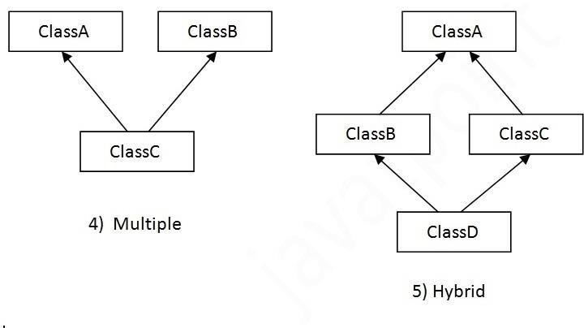
MULTIPLE INHERITANCE
When a class extends multiple classes i.e., known as multiple inheritance. For Example:
It is not allowed in Java through extends

Slide 57
WHY MULTIPLE INHERITANCE IS NOT SUPPORTED IN JAVA?
Consider a scenario where A, B and C are three classes. The C class inherits A and B classes. If A and B classes have same method and you call it from child class object.
There will be ambiguity to call method of A or B class.

Slide 58
WHY MULTIPLE INHERITANCE IS NOT SUPPORTED IN JAVA?
class A{
void add()
{a =10;
b=5;
c=a+b;} }
class B{
void add()
{a =10;
b=5; c=15;
d=a+b+c;}
class C extends A,B{//suppose if it were
Public Static void main(String args[]){ C obj=new C();
obj.add();//Now which add() method would be invoked?
} }

Slide 59
WHY MULTIPLE INHERITANCE IS NOT SUPPORTED IN JAVA?
To reduce the complexity and
simplify the language,
multiple inheritance is not supported in java.
Since compile time errors are better than runtime errors,
java renders compile time error if you inherit 2 classes.
So whether you have same method or different, there will be compile time error now.
Therefore, Inheritance is called Compile Time Mechanism.

Slide 60
class A{
void add()
{a =10;
b=5;
c=a+b;}
}
class B{
void sub()
{
a =10;
b=5;
c= a-b;
}
class C extends A,B{
Public Static void main(String args[]){
C obj=new C();
obj.add();
}
}
Output:
'{' expected
class C extendsA,B

Slide 61
Inheritance
Methods allows a software developer to reuse a sequence of statements
Inheritance allows a software developer to reuse classes by deriving a new class from an existing one.
The existing class is called the parent class, or superclass, or base
class.
The derived class is called the child class or subclass.
As the name implies, the child inherits characteristics of the parent. That is, the child class inherits the methods and data defined for the parent class

Slide 62













Inheritance
Inheritance relationships are often shown graphically in a
class diagram, with the arrow pointing to the parent class
Animal
weight : int
+ getWeight() : int
Inheritance should create an is-a relationship, meaning the child is a more specific version of the parent
Bird
+ fly() : void

Slide 63
Deriving Subclasses
In Java, we use the reserved word extends to establish an inheritance relationship
class Animal
{
// class contents int weight;
public void int getWeight() {…}
}
class Bird extends Animal
{
// class contents
public void fly() {…};
}

Slide 64
Class Hierarchy
A child class of one parent can be the parent of another
child, forming class hierarchies
Animal
Reptile
Bird
Mammal
Snake |  |  | Lizard
Horse |  |  | Bat
Parrot
At the top of the hierarchy there’s a default class
called Object.

Slide 65
Class Hierarchy
Good class design puts all common features as high in the hierarchy as
reasonable
inheritance is transitive
An instance of class Parrot is also an instance of Bird, an instance of Animal, …, and an
instance of class Object
The class hierarchy determines how methods are executed:
Previously, we took the simplified view that when variable v is an instance of class C, then a procedure call v.proc1() invokes the method proc1() defined in class C
However, if C is a child of some superclass C’ (and hence v is both an instance of C and an instance of C’), the picture becomes more complex, because methods of class C can override the methods of class C’ (next two slides).

Slide 66
Defining Methods in the Child Class: Overriding by Replacement
A child class can override the definition of an inherited method in favor of its own
that is, a child can redefine a method that it inherits from its parent
the new method must have the same signature as the parent's method, but can have different code in the body
In java, all methods except of constructors override the methods of their
ancestor class by replacement. E.g.:
the Animal class has method eat()
the Bird class has method eat() and Bird extends Animal variable b is of class Bird, i.e. Bird b = …
b.eat() simply invokes the eat() method of the Bird class
If a method is declared with the final modifier, it cannot be overridden

Slide 67
Defining Methods in the Child Class: Overriding by Refinement
Constructors in a subclass override the definition of an inherited constructor method by refining
them (instead of replacing them)
-Assume class Animal has constructors
Animal(), Animal(int weight), Animal(int weight, int livespan)
-Assume class Bird which extends Animal has constructors
Bird(), Bird(int weight), Bird(int weight, int livespan)
-Let’s say we create a Bird object, e.g. Bird b = Bird(5)
-This will invoke first the constructor of the Animal (the superclass of Bird) and then the constructor of
the Bird
This is called constructor chaining: If class C0 extends C1 and C1 extends C2 and … Cn-1 extends Cn = Object then when creating an instance of object C0 first constructor of Cn is invoked, then constructors of Cn-1, …, C2, C1, and finally the constructor of C
-The constructors (in each case) are chosen by their signature, e.g. (), (int), etc…
-If no constructor with matching signature is found in any of the class Ci for i>0 then the default constructor is
executed for that class
-If no constructor with matching signature is found in the class C0 then this causes a compiler errorFirst the new method must have the same signature as the parent's method, but can have different code in the body

Slide 68
Recap: Class Hierarchy
In Java, a class can extend a single other class
(If none is stated then it implicitly extends an Object class)
Animal
Reptile
Bird
Mammal
Snake |  |  | Lizard
Horse |  |  | Bat
Parrot
Imagine what would happen to method handling
rules if every class could extend two others…
(Answer: It would create multiple problems!₆)₈

Slide 69
Overloading vs. Overriding
Overloading deals with multiple methods in the same class with the same name but different signatures
Overloading lets you define a similar operation in different ways for different data
Overriding deals with two
methods, one in a parent class and one in a child class, that have the same signature
Overriding lets you define a similar operation in different ways for different object types

Slide 70
Controlling Inheritance
Visibility modifiers determine which class members are accessible and which
are not.
Members (variables and methods) declared with public visibility are accessible, and those with private visibility are not.
Problem: How to make class/instance variables visible only to its subclasses? Solution: Java provides a third visibility modifier that helps in inheritance situations: protected

Slide 71
The protected Modifier
The protected visibility modifier allows a member of a base class to be accessed in the child
protected visibility provides more encapsulation than public
does
protected visibility is not as tightly encapsulated as private
visibility
All these methods can access the pages instance variable.
Note that by constructor chaining rules, pages is an instance variable of every object of class Dictionary.
Book
protected int pages
+ getPages() : int + setPages(): void
Dictionary
+ getDefinitions() : int + setDefinitions(): void + computeRatios() : double

Slide 72
Object Class

Slide 73
The Object Class
A class called Object is defined in the java.lang package of the Java standard class library
All classes are derived from the Object class
even if a class is not explicitly defined to be the child of an existing class, it is assumed to be the child of the Object class
the Object class is therefore the ultimate root of all class hierarchies
The Object class contains a few useful methods, which are inherited by all classes
toString()
equals()
clone()

Slide 74
The Object Class: the toString Method
That’s why the println method can call toString for any object that is passed all objects are guaranteed to have a toString method via inheritance
The toString method in the Object class is defined to return a string that con
name of the object’s class and a hash value
Every time we have defined toString, we have actually been overriding it

Slide 75
The Object Class: the equals Method
The equals method of the Object class determines if two variables point to the same object (more shortly)
Many classes (which all implicitly extend an Object class) override equals to define equality in some other way, e.g. Integer.equals looks at the represented integer, etc.

Slide 76
OUTLINE
Constructors in java

Slide 77
CONSTRUCTOR
In Java, a constructor is a block of codes similar to the method. It is called when an instance of the class is created. At the time of calling constructor, memory for the object is allocated in the memory.
It is a special type of method which is used to initialize the object.
Every time an object is created using the new() keyword, at least one constructor is called.
It calls a default constructor if there is no constructor available in the class.
There are two types of constructors in Java:
Default (no-arg constructor)
parameterized constructor

Slide 78
RULES FOR CREATING JAVA CONSTRUCTOR
There are two rules defined for the constructor.
Constructor name must be the same as its class name
A Constructor must have no explicit return type
A Java constructor cannot be abstract, static, final, and synchronized.

Slide 79
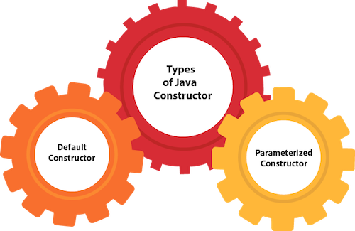
TYPES OF JAVA CONSTRUCTORS

Slide 80
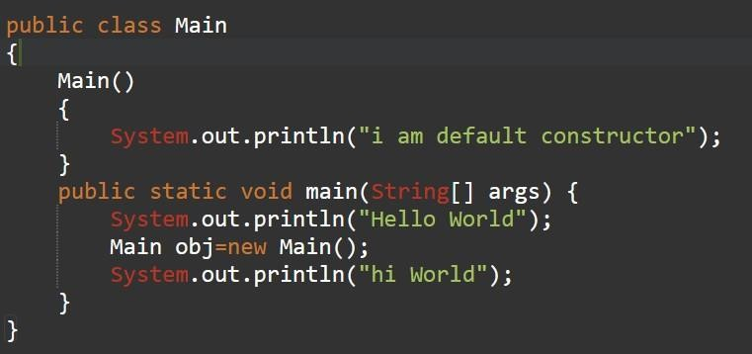
JAVA DEFAULT CONSTRUCTOR
A constructor is called "Default Constructor" when it doesn't have any parameter.
Example of default constructor

Slide 81
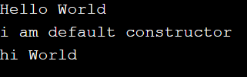
JAVA DEFAULT CONSTRUCTOR
A constructor is called "Default Constructor" when it doesn't have any parameter.
Example of default constructor

Slide 82
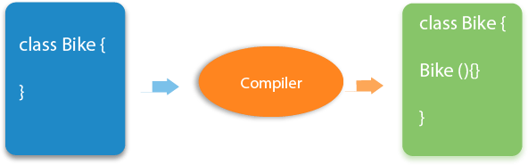
JAVA DEFAULT CONSTRUCTOR
If there is no constructor in a class, compiler automatically creates a default constructor..

Slide 83
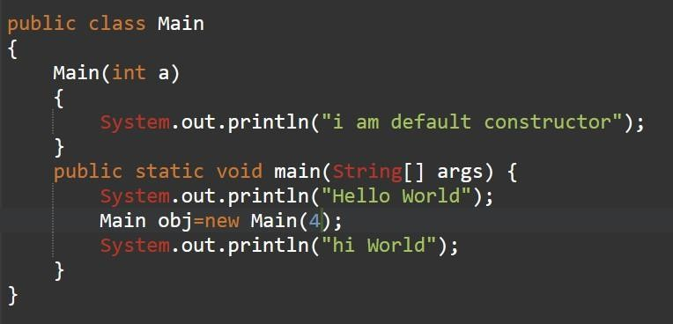
JAVA PARAMETERIZED CONSTRUCTOR
A constructor which has a specific number of parameters is called a parameterized constructor.
The parameterized constructor is used to provide different values to distinct objects. However, you can provide the same values also.

Slide 84
JAVA PARAMETERIZED CONSTRUCTOR
A constructor which has a specific number of parameters is called a parameterized constructor.
The parameterized constructor is used to provide different values to distinct objects. However, you can provide the same values also.

Slide 85
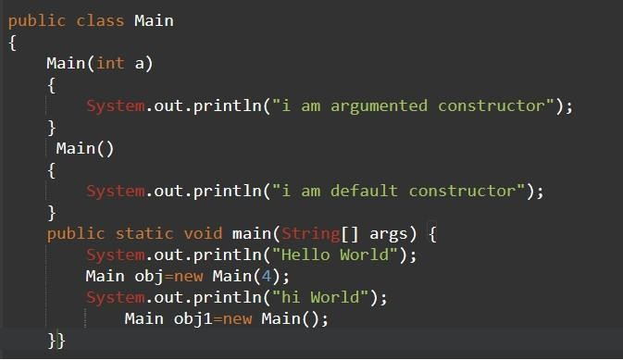
CONSTRUCTOR OVERLOADING IN JAVA
In Java, a constructor is just like a method but without return type. It can also be overloaded like Java methods.
Constructor overloading in Java is a technique of having more than one constructor with different parameter lists.

Slide 86
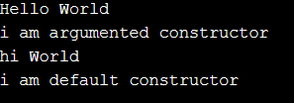
CONSTRUCTOR OVERLOADING IN JAVA
In Java, a constructor is just like a method but without return type. It can also be overloaded like Java methods.
Constructor overloading in Java is a technique of having more than one constructor with different parameter lists.

Slide 87
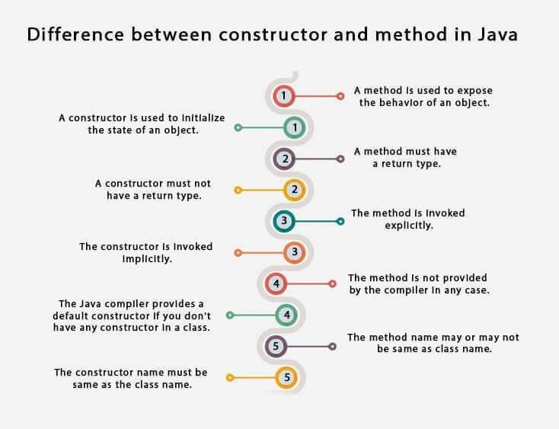

Slide 88
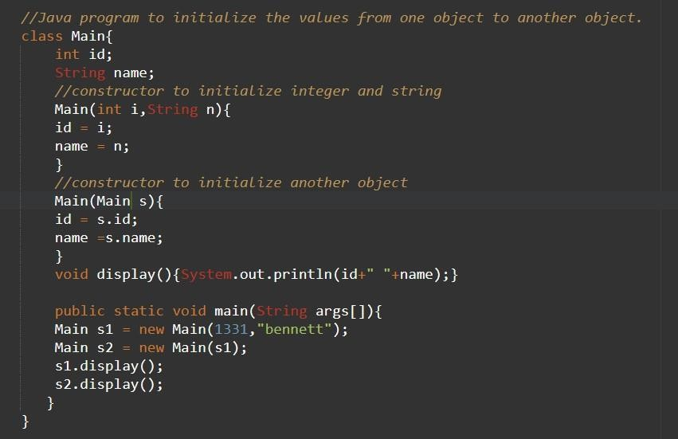

Slide 89


Slide 90
OUTLINE
Static Initialization Block (SIB)
Instance initialization block (IIB)

Slide 91
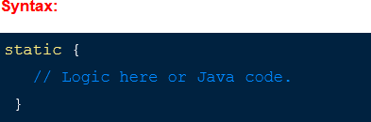
STATIC INITIALIZATION BLOCK (SIB)
A Block named as Static inside a class is called Static Initialization Block(SIB).
Hence, at the time of class loading if we want to perform any activity we have to define that inside a static block.
SIB’s are invoked only once at the time of the corresponding loading class or referred in to the memory.
Is used to initialize the static data member.
Static block can only access static variables and static methods of its class.

Slide 92
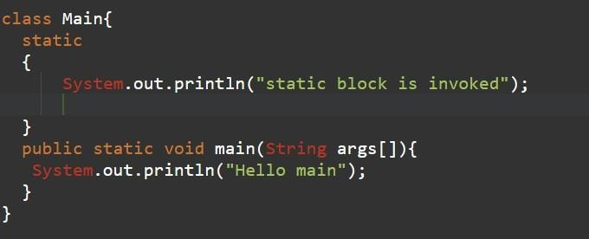
STATIC INITIALIZATION BLOCK (SIB): EXAMPLE

Slide 93

STATIC INITIALIZATION BLOCK (SIB): EXAMPLE

Slide 94
WHY STATIC BLOCK IS EXECUTED BEFORE MAIN METHOD?
When we execute a particular class, JVM performs two actions at the runtime. They are as:
JVM loads corresponding dot class file (byte code) into memory.
During the dot class file loading into memory, static block is executed. After loading the dot class file, JVM calls the main method to start execution. Therefore, static block is executed before the main method.

Slide 95
HOW MANYTIMES DOT CLASS FILE IS LOADED INTO MEMORY?
Dot class file is loaded into the memory only one time. So, only one time static block will be executed.
ORDER OF EXECUTION OF MULTIPLE STATIC BLOCKS IN JAVA?
A class can have any number of static initialization blocks that will execute in the same sequence as written in the program.
That is, the order of execution of multiple static initialization blocks is executed automatically from top to bottom during the dot class file loading.

Slide 96
USE OF STATIC BLOCK IN JAVA
There are mainly three uses of static block in java that are as follows:
The purpose of using a static initialization block is to write that logic inside static block that is executed during the class loading.
It is mostly used for changing default value of static variables.
It is used to initialize static variables of the class.

Slide 97
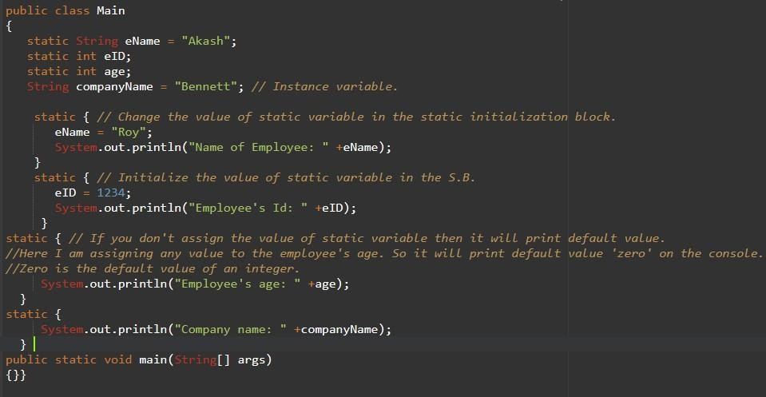
PREDICT THE OUTPUT

Slide 98
PREDICT THE OUTPUT

Slide 99
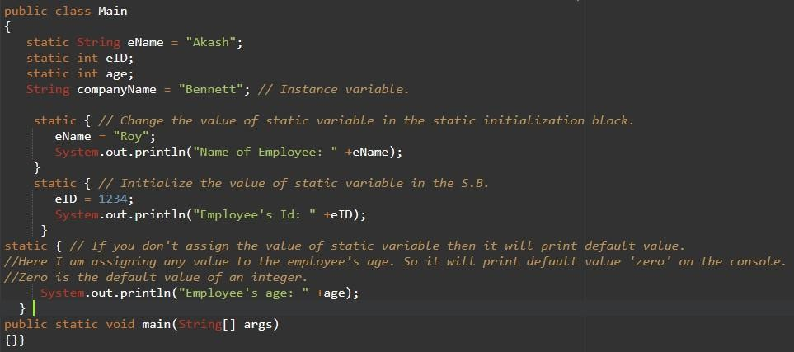
PREDICT THE OUTPUT

Slide 100

PREDICT THE OUTPUT

Slide 101
INSTANCE INITIALIZATION BLOCK
Instance Initializer block is used to initialize the instance data member. It run each time when object of the class is created.
The initialization of the instance variable can be done directly but there can be performed extra operations while initializing the instance variable in the instance initializer block.
No keyword is required to define an instance initialization block.
An instance initialization block is only executed when there is a call to the constructor for creating an object.
An instance initialization block can not only access static variables and static methods but also instance variables and instance methods of the class
Instance initialization block can run many times, whenever there is a call to the constructor of the class

Slide 102
INSTANCE INITIALIZATION BLOCK: SYNTAX
{
//This is called as instance block
}

Slide 103
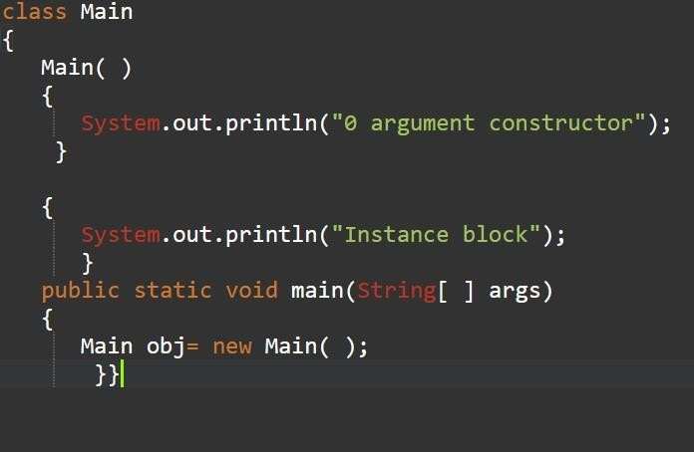
INSTANCE INITIALIZATION BLOCK: EXAMPLE

Slide 104

INSTANCE INITIALIZATION BLOCK: EXAMPLE

Slide 105
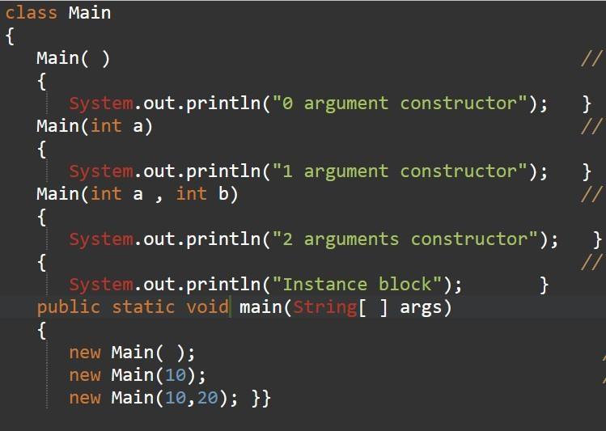
INSTANCE INITIALIZATION BLOCK: EXAMPLE

Slide 106
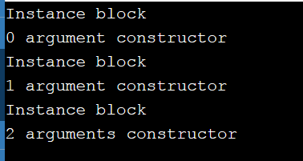
INSTANCE INITIALIZATION BLOCK: EXAMPLE

Slide 107
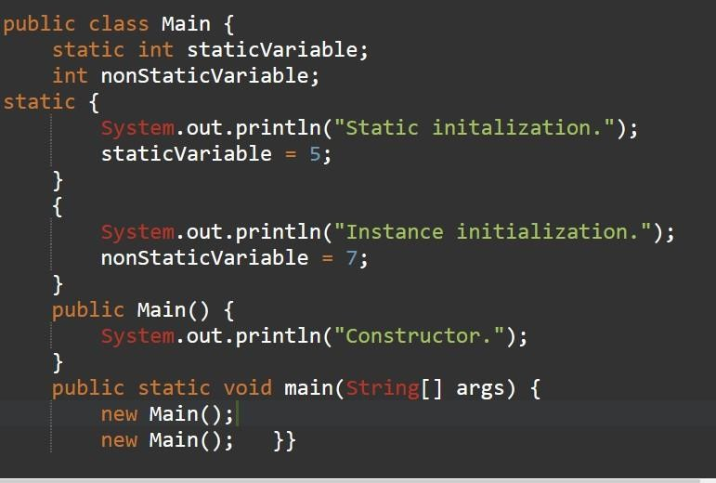
INSTANCE INITIALIZATION BLOCK: EXAMPLE

Slide 108
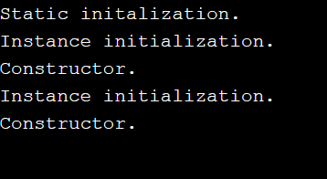
INSTANCE INITIALIZATION BLOCK: EXAMPLE

Slide 109
COMPARISON BETWEEN INSTANCE BLOCK AND CONSTRUCTOR-
Instance block | Constructor
Instance block logic are common for all the objects. | Constructor logic are specific to the objects.
Instance block will be executed only once for each object during its creation. | We can execute the constructors multiple times for a single object by placing the call to them in other constructors.
Instance block will be executed only as many times as there are number of objects created in the program. | It is not necessary for the constructors as they may be called explicitly.
Instance blocks are mainly used for writing the common logic which we want to execute for all the objects. | Constructors are mainly used for the initializing of objects.

Slide 110
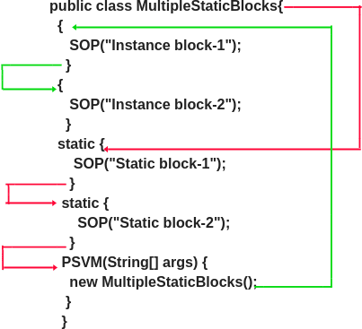
EXAMPLE:
Output:
Static block-1 Static block-2 Instance block-1 Instance block-2

Slide 111
THANK YOU

