Slide 1

VibeCraft: A Music Recommendation System
Welcome to VibeCraft, a machine learning-powered music recommendation system designed to deliver personalized song suggestions based on your musical taste. This presentation will explore the innovative techniques behind VibeCraft and demonstrate its ability to accurately match songs based on their vibe, genre, and mood.

Slide 2
What is VibeCraft?
Personalized Recommendations
Audio Feature Analysis
Suggesting music based on your taste
Analyzing characteristics for similar songs

Slide 3
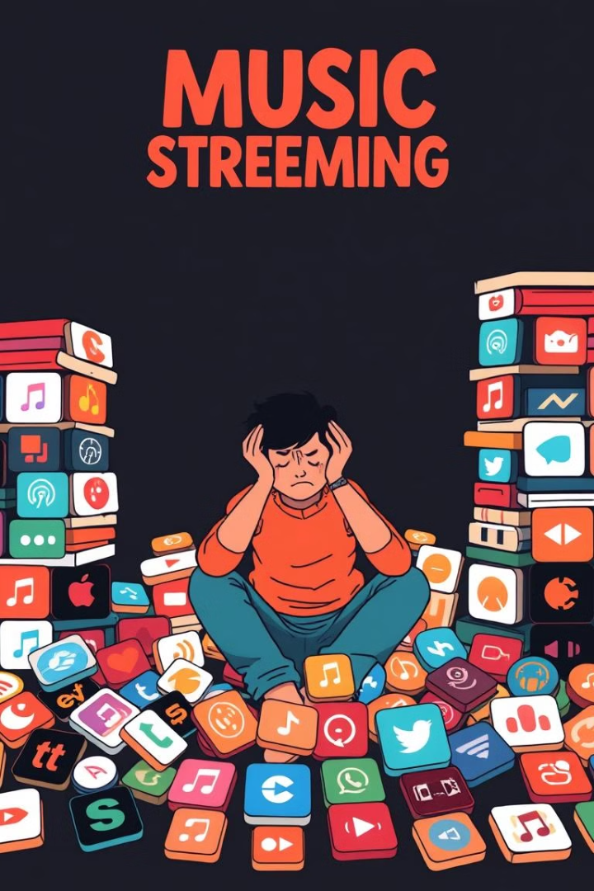
The Need for VibeCraft
Overwhelming Choice
Nuanced Similarity
Vast amount of music available
Traditional systems may not capture it
Audio Focus
VibeCraft focuses on audio for accuracy

Slide 4
Related Work
Current Music Recommendation Systems
Challenges
VibeCraft's Unique Approach
Often rely on user behavior and metadata
Focuses on audio characteristics for deeper similarity
Spotify, Apple Music, etc.

Slide 5

Key Techniques
1
1. K-Means Clustering
2
2. PCA and t-SNE
Groups songs with similar features
Reduce data complexity, visualize clusters
3
3. Cosine Similarity
Measures similarity based on feature vectors

Slide 6
Methodology
User Input: Song name and year
1
2
Data Retrieval: Fetch song details and audio features
Clustering: Apply K-means to group songs by audio features
3
4
Dimensionality Reduction: Use PCA and t-SNE for visualization
Recommendation: Find closest songs based on cosine similarity
5

Slide 7
Data Preprocessing
Data Sources
Data Columns
Handling Missing Data
Spotify API, Music Databases
Valence, energy, loudness, tempo, etc.
Gracefully handles non-existent songs

Slide 8


K-Means Clustering
Why K-Means?
1
Groups songs based on similar audio features
Implementation
2
K-Means with 20 clusters for diversity

Slide 9
Dimensionality Reduction
PCA
1
Reduces dimensionality of audio features
t-SNE
2
Projects high-dimensional data into 2D

Slide 10
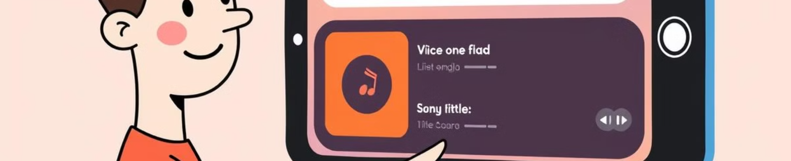



Recommendation Algorithm
Process
Cosine Similarity
Recommendation
Calculate the center of the input song's features
Measure distance between the input and other songs
Recommend the closest songs

Slide 11
User Testing & Results
User Testing
Sample Output
Users tested with diverse songs, providing feedback on the accuracy and relevance of recommendations.
Input Song: "Bloody Sweet" (2023)
"Dark Shadows" by Artist X (2023)
Visualizations assessed clustering and alignment of recommended songs.
"Sweet Summer Vibes" by Artist Y (2022)
"Chill Wave" by Artist A (2023)
"Melancholy Beats" by Artist Z (2023)

Slide 12



Future Scope & Conclusion
Incorporate User Preferences
1
Enhance recommendations through user-specific input
Dataset Expansion
2
Expand genres and song diversity for wider coverage
Advanced Models
3
Explore deep learning for improved feature extraction

