Slide 1
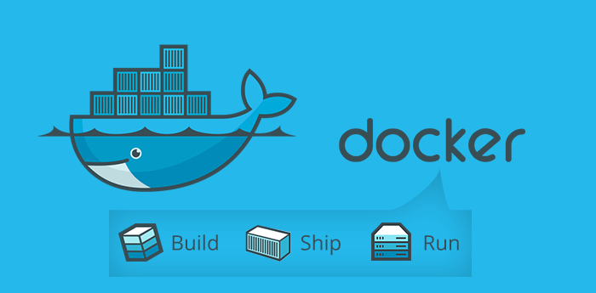
Docker for dummies

Slide 2
What is Docker?
Created by Docker inc.
Open Source engine that automates the deployment of applications into containers.
Lightweight and fast.
Portable and easy to build
Different to a Virtual Machine
Notes:
Docker is open source, it is a container based technology
It is lightweight, fast, portable and easy to build.
Hotel analogy
Explain how it is different to a VM.

Slide 3
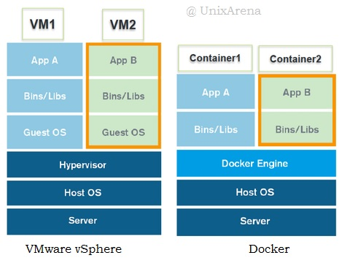
VM vs Docker
Notes:
VM – Hypervisor used to create and run virtual machines, this is generally quite resource heavy.
- Also each new instance of the VM needs it’s own operating system which again takes up a lot of resources.
Docker – Uses a Docker Engine which is light to run. This is used for creating and running docker containers.
- As you can see in the containers there is no OS. This means that it does not take up much resources and you can have multiple containers running off the same machine without affecting performance.

Slide 4
When to use Docker?
Version control.
Distribute or collaborate with other users.
Running code in the same environment as the server.
Multiple phases of development.
Notes:
Use for version control of your application - E.g currently we have our gitlab and mattermost servers. We have dockerized them and are using them as testing environments.
Distribute/Collaborate – E.g For our project we are pulling the official image for gitlab.
Running code in the same environment as the server – This defeats the whole idea of “It works on my computer” e.g a Dev gives his app to a work mate and the app does not work on his computer. Having everything in the same environment means that in theory it should work anywhere.
When your project goes through Multiple phases of development – This is similar to version control where you don’t want to just do everything on your live production environment in case something bad happens.

Slide 5
What is a Dockerfile?
Textfile
Each line is a command.

Slide 6
What is a Docker image?
Template for container.
Uses a series of layers.

Slide 7
What is a Docker container?
Runtime component of an image.
Multiple containers.
Isolation.

Slide 8
What is DockerHub?
Central repo for Docker.
Search for repo’s.
Pull repo’s.
Push to a repo.

Slide 9
How do you make a container?

Slide 10
Example use case of Docker

