Slide 1
Multiple Regression
Chinki Rai
Shruti Natekar
Nikta Farsaei

Slide 2
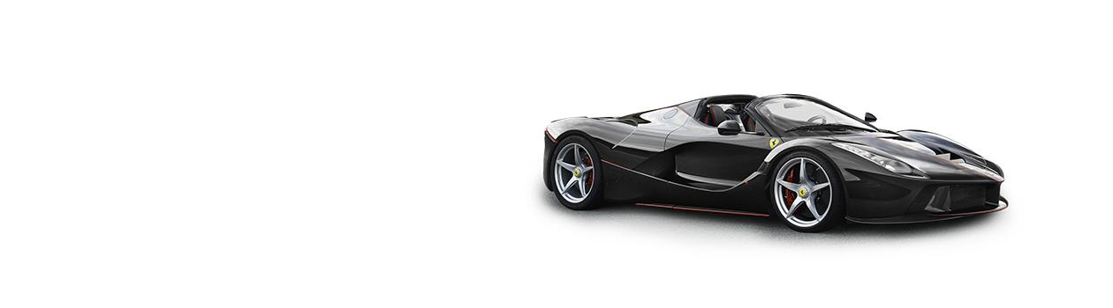
Introduction
Source of Data : https://archive.ics.uci.edu/ml/datasets/Auto+MPG
"The data concerns city-cycle fuel consumption in miles per gallon, to be predicted in terms of 3 multivalued discrete and 5 continuous attributes." (Quinlan, 1993)
Attribute Information:
Response variable (Y) = Miles per Gallon(MPG) (continuous)
Predictors:
X1= weight(continuous)
X2= displacement(continuous)
X3= acceleration(continuous)
X4= Horsepower(continuous)
Notes:
*NA values
*AIC

Slide 3
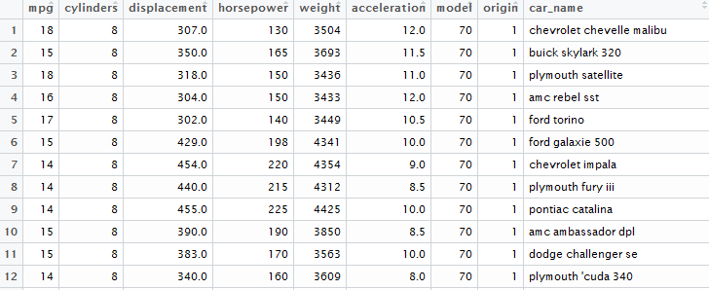
The Gest of the Auto MPG Data Set
Notes:
*A cylinder is the power unit of an engine it’s the chamber where the gasoline is burned and turned into power.,4,6,8
*Displacement is the total volume of all the cylinders in an engine
*if you were to lift 33,000 pounds one foot over a period of one minute, you would have been working at the rate of one horsepower.
* Acceleration is the rate of change of velocity with time.

Slide 4
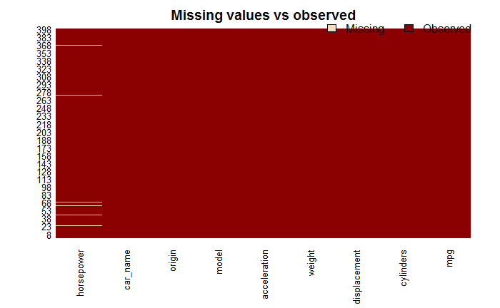
Missing Value Graph
Notes:
library(Amelia)
missmap(Car_MPG, main = "Missing values vs observed")

Slide 5
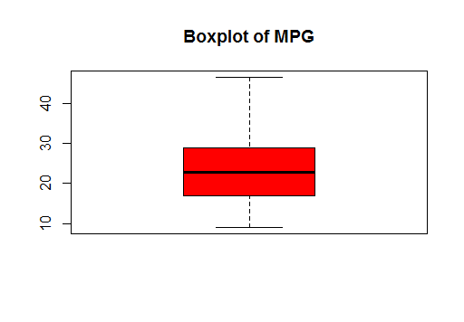
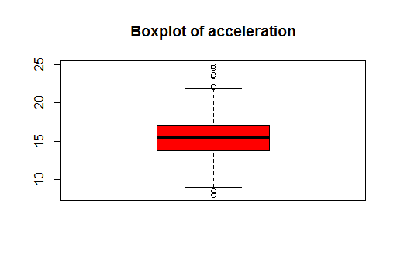
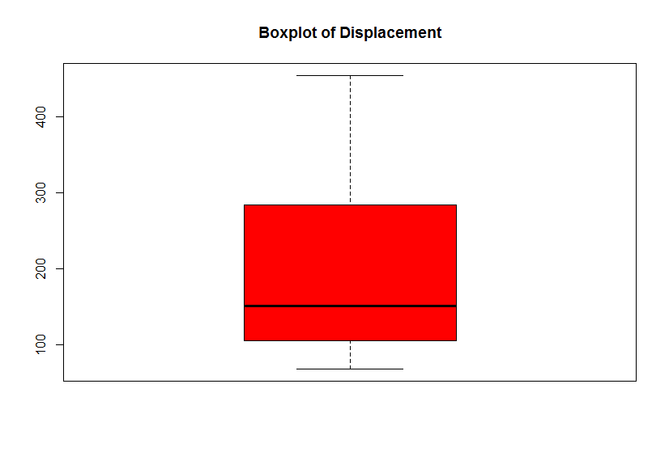
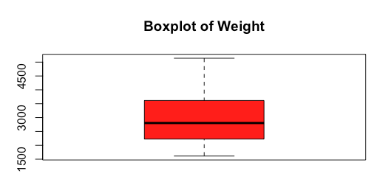
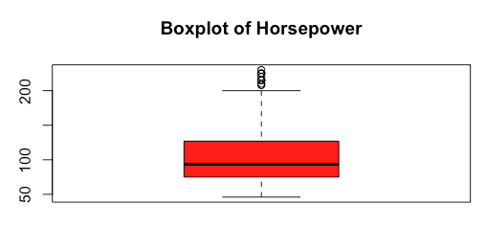
Descriptive Statistics
Notes:
median,skewed,outliers

Slide 6
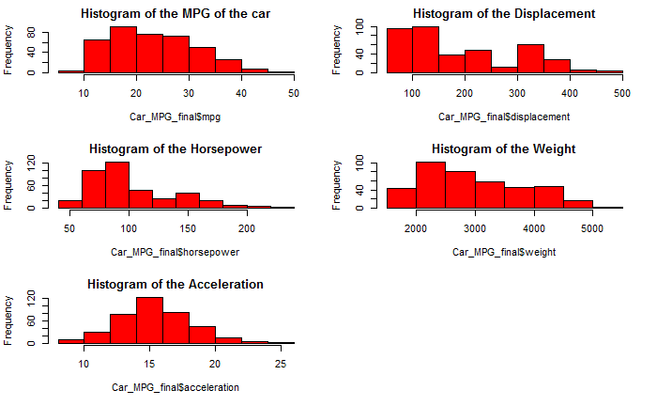
Histogram of Response and Predictor Variables

Slide 7
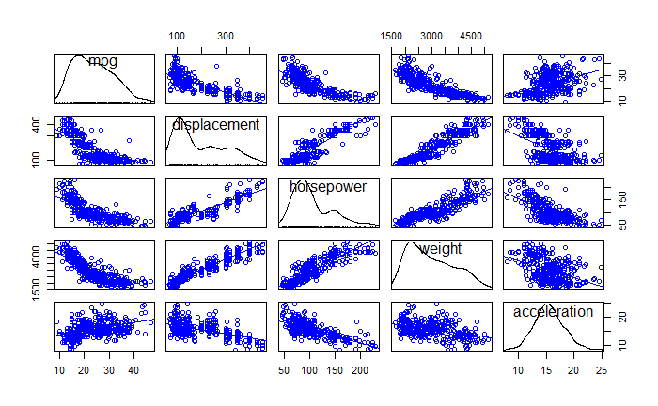
Scatterplot Matrix of the Variables
Notes:
Note: Based on the scatterplot, we decided that transformation is needed.Negative correlation and non -linear trend

Slide 8
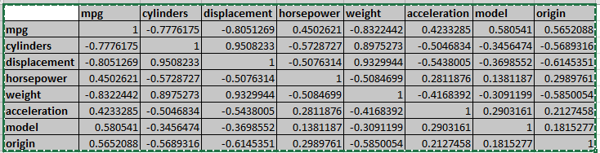
Correlation Testing of the Variables

Slide 9
Multiple Regression Theoretical Model
E(MPG) = β₀ + β₁ * weight + β₂ *displacement + β₃ * acceleration + β₄ * horsepower + β₅ * weight * acceleration + β₆ weight * horsepower + β₇ * horsepower* acceleration + β₈ * horsepower * displacement
Notes:
After the AIC and a lot of analysis of the data , we came up with this model as our final regression model. As you can see we have mpg as our response variable with weight, displacement, acceleration and horsepower as our predictors with interactions between weight and horsepower, horsepower and acceleration and horsepower and displacement.
Now I am gonna talk about the trial and error on how we came up with this model.

Slide 10
Original model regression results
Significant variables :
(Intercept) 2.8e-16 ***
Weight 0.03621 *
Displacement 0.00651 **
Horsepower 0.00199 **
Displacement*Horsepower 0.04591 *
R² : 0.7582
Overall p value : < 2.2e-16
Notes:
Interpretations :even though we knew that we need some transformations for our model based on the scatterplot matrix, we still went ahead and run a regression on our original model .Based on the scatterplot matrix, above results, and failed constant variance and normality tests, we decided to transform the data in order to check if we can get a more significant output. We went ahead and did diagnostics and remedial measurements to check the normality, equal variances and outliers.

Slide 11
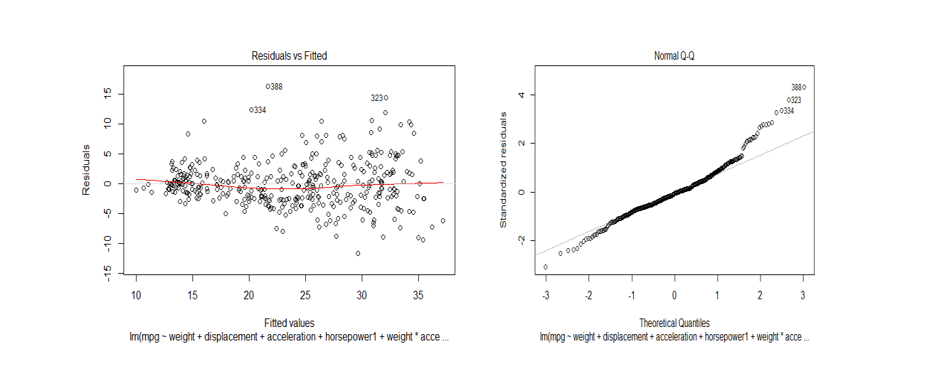
Diagnostics and Remedial Measurements
Notes:
These are the residual plots, and we can see that residuals are not scattered evenly. It failed the non constant variance test. We observed some outliers in the plot. Normal Q-Q plot shows normally distributed residuals with some outliers.

Slide 12
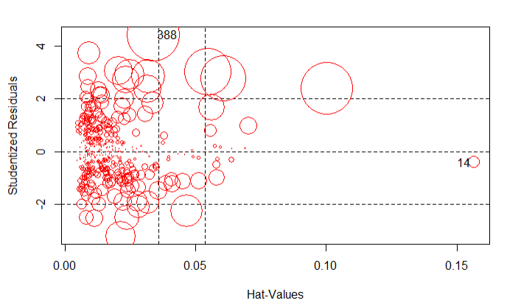
Outliers plot
Notes:
We did bonferroni test for outliers and also plotted the influence plot and got 2 extreme outliers so we went ahead and removed points 14 & 388 is significant outlier.

Slide 13
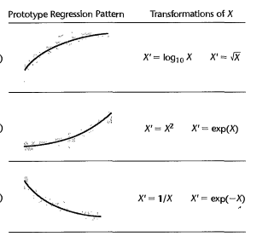
Transformation’s of X’s based on shape of a plot
Horsepower - Square root transformation
Weight & Displacement - Inverse transformation
Acceleration - Square (x2) transformation
Notes:
Based on the scatter plot matrix that Chinki talked about , we knew we need some transformations so we went ahead and transformed our X’s.

Slide 14
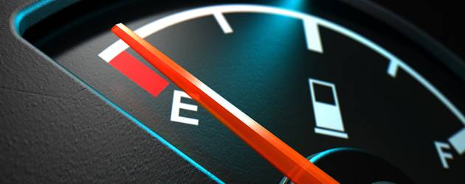
Regression with Transformed X’s and No Outliers
Significant Variables :
Displacement 0.00346 **
Acceleration 0.00286 **
Weight:Acceleration 0.00149 **
Displacement:Horsepower 0.00731 **
Acceleration:Horsepower 0.00747 **
R² : 0.759
Overall p value: < 2.2e-16
Notes:
After transformation of X’s and removal of outliers, we got the above results but we failed constant variance and normality tests, so we decided to transform Y(mpg) based on boxcox transformation in order to check if we are able to get a more significant output.

Slide 15
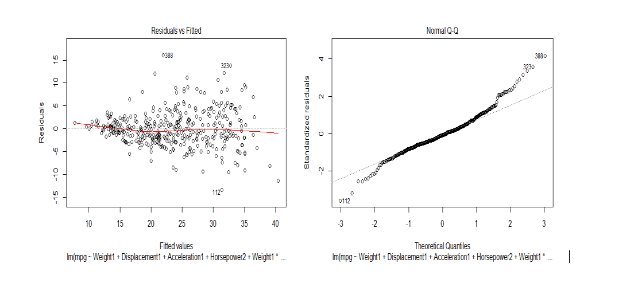
Diagnostics and Remedial Measurements
Notes:
Residual plot shows the non constant variances and the cone shaped of residuals, hence we decided to do the Y’ transformation with the help of boxcox lambda value.

Slide 16
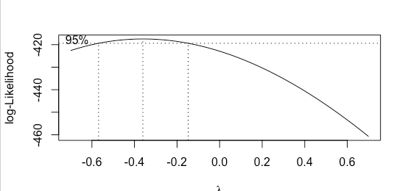
Box Cox Transformation of Y(mpg)
Notes:
Based on the boxcox transformation, we can see that lambda is very close to -0.5. Therefore, we transformed Y (mpg) by inverse of the sqrt of Y [1/sqrt(Y)]

Slide 17
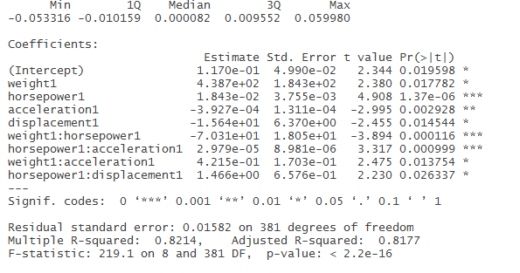
Final Regression Model
Notes:
In the Final regression model with X and Y transformed and outliers removed , we got overall significant p values and an R- squared of 81.77%, which is quite large and can be predicted as more values are on the line and linear relationship can be predicted. Before interpreting the coefficients we will see the diagnostics.

Slide 18

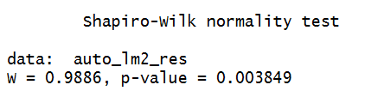

Non-Constant Variance and Shapiro Wilk Test
Notes:
Based on the R output, the p value of Non-Constant Variance Test is not significant, and we failed to reject the null hypothesis that variances are constant.
The Shapiro Test is ~ 0.99. Though P-value is very small W=0.98 so we can assume Normality of the residuals.

Slide 19
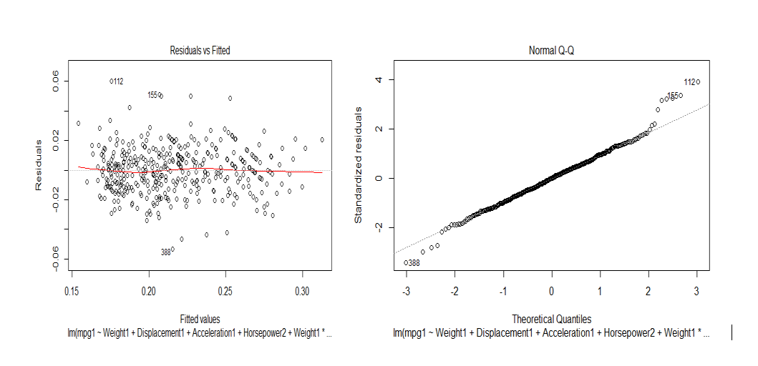
Diagnostics of final model
Notes:
Residual plot of final model shows the scattered residuals and can be interpreted as constant variances with the proof of formal tests of variance test.

Slide 20
Interpretations of regression coefficients
One unit change in Weight decreases MPG when Horsepower is held constant & increases MPG when Acceleration is held constant.
One unit change in Horsepower increases MPG by some units when Acceleration & Displacement is held constant.

Slide 21
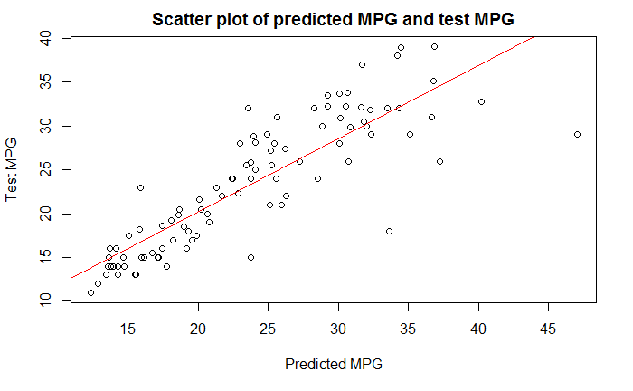
Checking the Accuracy of the Model
Random sample of Data 90% Training and 10% Test dataset.
Ran regression on training Data.
Predicted test data based on the model.
Notes:
To check the performance of the model, We divided the data into training(90%) and test(10%) dataset. Performed model analysis on the training data. We predicted mpg values based on test data and the plotted original mpg form test data with predicted mpg and we can see that they are more or over linear and we can say that our model is a good fit.

Slide 22

Prediction based on real data for 1982 models
Make | Model | Estimated MPG by Factory | Predicted MPG by Our Final Regression Model | 95% Confidence Interval
Honda | Civic | 40.9 | 38 | (36.6, 39.4)
Honda | Accord | 36.8 | 36 | (34.7, 37.2)
Toyota | Corolla | 35.9 | 34.1 | (33.1, 35.0)

Slide 23
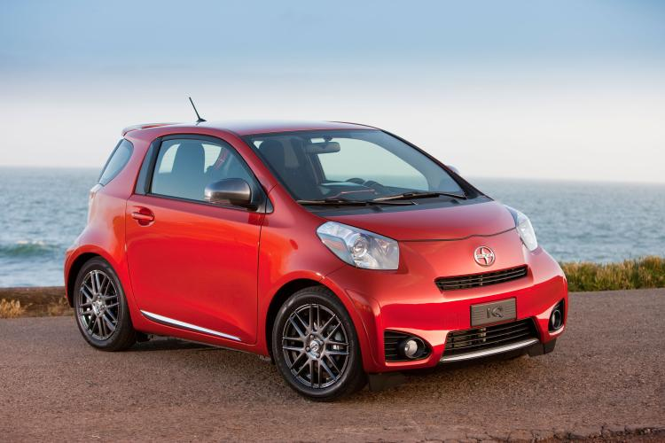
Summary

Slide 24
Fun exercise for your summer break
Notes:
If you want to predict your car MPG, go ahead and get weight, acceleration , displacement and horsepower values and use our model.

Slide 25
Thank you !!!

