Slide 1
Medication Reviews from WebMD

Slide 2
Outline
Why scrape for WebMD reviews?
Methods : What was scraped and how
Which SNRI’s are the best rated and why?

Slide 3
Why scrape for WebMD reviews
Insights:
Public perception
Factors affecting drug satisfaction
Useful for:
Drug company marketing
Medical care professionals
Not useful for:
Patients seeking medical advice

Slide 4
Drug reviews Scraped
Cymbalta (Duloxetine) – 4589 reviews
Effexor (Venlafaxine) – 3047 reviews
Pristiq (Desvenlafaxine) – 1169 reviews
… These fall under the classification of SNRI’s
SNRI’s (Serotonin and Norepinephrine Update Inhibitors) - Used to treat depressive disorders and chronic pain
Stakes : Depression drug market potentially worth 16.8 billion by 2020
https://globenewswire.com/news-release/2016/05/10/838292/0/en/Global-Depression-Drug-Market-Poised-to-Surge-from-USD-14-51-Billion-in-2014-to-USD-16-80-Billion-by-2020-MarketResearchStore-Com.html

Slide 5
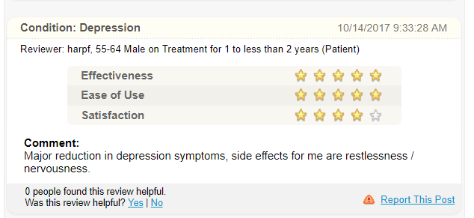
WebMD review format
From each review we can extract:
Condition
Age (category)
Gender
Review date
Treatment time
Ratings (focus on satisfaction)
Comment

Slide 6
Methods & Tools:
WebMD: Scrape & Clean
Question
Hypothesis
Test
Reevaluation
Observation
Scrapy, Pandas
Pandas
Matplotlib
Scipy Stats
T-Tests, Chi sq contingency
Output: Gain actionable insights to better prescribe / market medication

Slide 7
Observations & Questions

