Slide 1
Drug Reviews from WebMD
NYCDSA Web Scraping Project
Michael Chin
2/14/2018

Slide 2
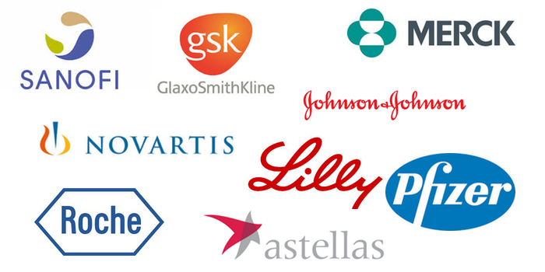

Why scrape for WebMD reviews?
Insights:
Public perception
Factors affecting drug satisfaction
Useful for:
Drug company marketing
Medical care professionals
Not useful for:
People in need of medical attention

Slide 3
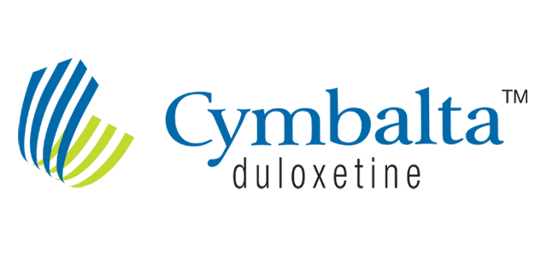



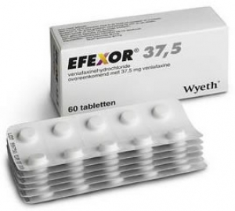
Drug reviews Scraped
4589 reviews
1169 reviews
3047 reviews
Depression Drug Market expected to be valued at 16.8 billion USD by 2020

Slide 4
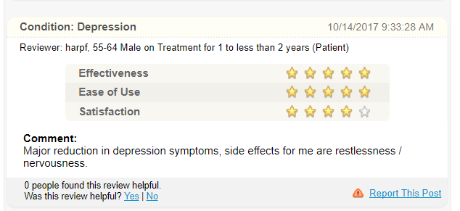
WebMD review format
From each review we can extract:
Condition
Age (category)
Gender
Review date
Treatment time
Ratings (focus on satisfaction)
Comment
Total observations scraped: 8303 over 3 medications

Slide 5
Observations & Questions
General description of dataset:
Question: Is there really a difference in satisfaction between these three drugs?
Drug | Most frequent |  |  | Avgerage
 | Condition | Age range | Gender | Satisfaction
Cymbalta | Depression | 45 – 54 | Female | 2.9 / 5
Effexor | Depression | 45 – 54 | Female | 3.1 / 5
Pristiq | Depression | 45 – 54 | Female | 3.1 /5

Slide 6
Initial Hypothesis
Hypothesis: ‘Satisfaction’ is significantly different between each drug
Problem: ‘Satisfaction’ distribution not normal
Workaround: Bin population into ‘Poor’ (1 – 2) and ‘Good’ (4 – 5) and test frequency of categories
‘Bad’ Reviews
‘Good’ Reviews

Slide 7
Comparing ratio of ‘Good’ to ‘Bad’ reviews across drugs
Chi Sq. Stat. | 38.6
P - value | 4.2 e-9
Cymbalta receives more ‘Poor’ reviews than competing products.
Why?

Slide 8
A look at conditions being treated
Test condition | Drug vs Condition | Condition vs Rating
Chi Sq. Stat. | 38.6 | 41.1
P - value | 4.2 e-9 | 1.4 e-10
Cymbalta’s low ratings stem from customer dissatisfaction with it as a pain medication. Effexor and Pristiq are rarely prescribed for that purpose

Slide 9
Identifying factors differentiating Effexor and Pristiq
Treatment time may be a factor in reviewer response to Effexor or Requires further investigation

Slide 10
Conclusions & Next Steps
Despite similar demographics, not all SNRI’s are the same in reviewers eyes
Patient satisfaction of Cymbalta driven lower from poor reviews associated with pain treatment
What can be done next:
Logistic Regression Model

Slide 11




Tools
NumPy &
Data clean-up
SciPy

Slide 12
Methods & Tools:
WebMD: Scrape & Clean
Question
Hypothesis
Test
Reevaluation
Observation
Scrapy, Pandas
Pandas
Pyplot
Scipy Stats:
T-Test, Chi Sq.
Output: Actionable insights

Slide 13
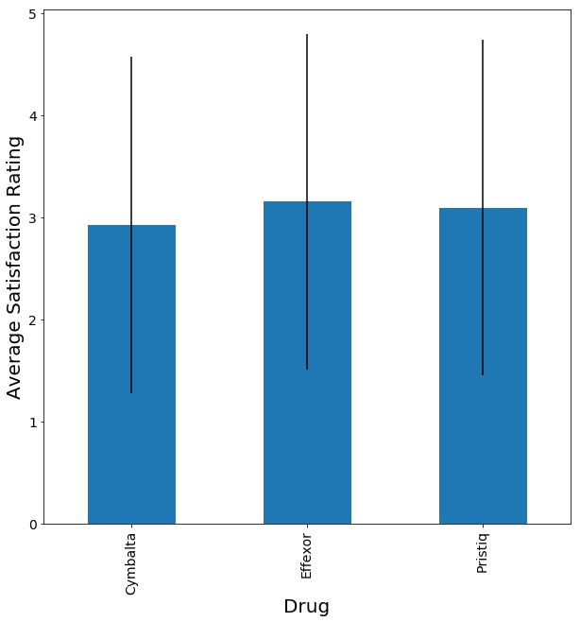
Bonus slides

Slide 14
Drug reviews Scraped
Cymbalta (Duloxetine) – 4589 reviews
Effexor (Venlafaxine) – 3047 reviews
Pristiq (Desvenlafaxine) – 1169 reviews
… These fall under the classification of SNRI’s
SNRI’s (Serotonin and Norepinephrine Uptake Inhibitors) - Used to treat depressive disorders and chronic pain
Stakes : Depression drug market potentially worth 16.8 billion by 2020
https://globenewswire.com/news-release/2016/05/10/838292/0/en/Global-Depression-Drug-Market-Poised-to-Surge-from-USD-14-51-Billion-in-2014-to-USD-16-80-Billion-by-2020-MarketResearchStore-Com.html

Slide 15
Outline
Why scrape for WebMD reviews?
Methods : What was scraped and how
Which SNRI’s are the best rated and why?

