Slide 1

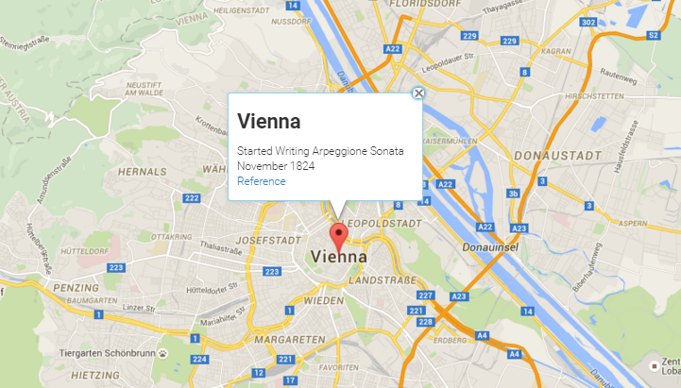
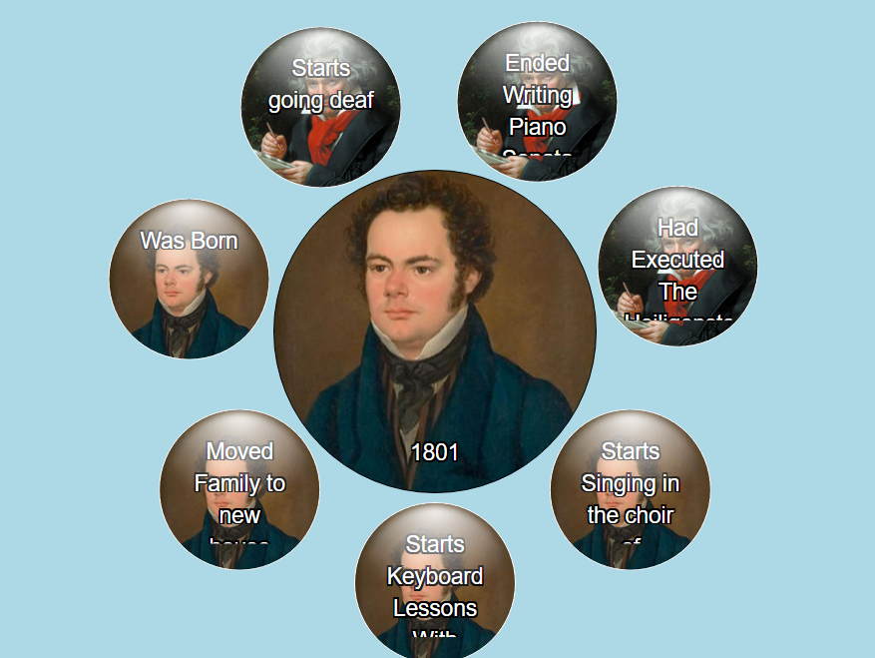
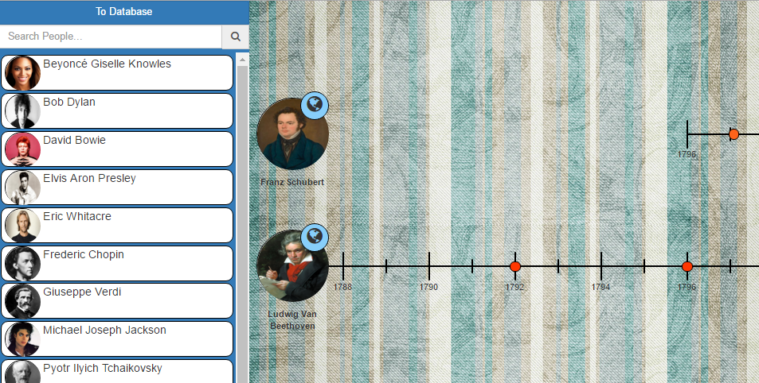
EECS Computer Science Capstone
Historical Data Visualization
Michael Thornbrugh, Sam Sudekum, Zack Zastrow, Lei Wang, Chinmay Ratnaparkhi
Spring 2016
Objective
Screenshots
Our goal was to create a dynamic historical data visualization tool, incorporating different ways to view data in order to better suit users' needs, and to facilitate retention and understanding of the information presented.
While many different data visualization tools, such as timelines, exist across the web, few make the leap to include the different presentations of data within a single application. With the addition of views - like a map to display events - users have the ability to transition to a perspective that highlights the important aspects of the information.
Application
Future Expansions
Our Application is meant to be used primarily for research purposes.
You can utilize our application for:
Determining the location of a famous musician throughout their life.
Finding events that occurred during the same time period such as finding if two composers composed similar pieces during the same time frame.
Exploring information that you may not have thought to look for, but is linked to your research focus.
Spreading your knowledge to others by improving the data already in the application.
While we're very happy with the tools we've created, improvements and additions will always be a natural part of development with any progressive application.
Future Additions:
Improve upon the speed of the application
Improve the usability of each of the views
Implement the ability for external datasets to be used such as a csv file
Improve the algorithm that the bubble view uses to pick better related events
Test it out at: http://tl-js.github.io/histViewer/

