Slide 1

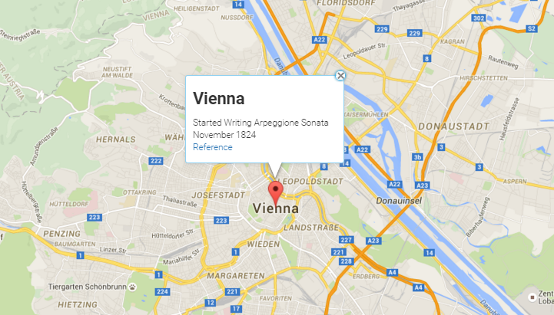
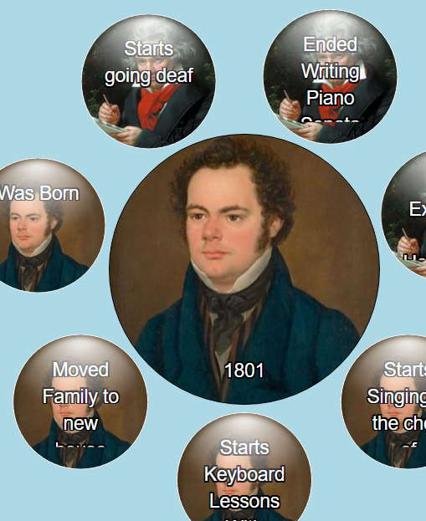
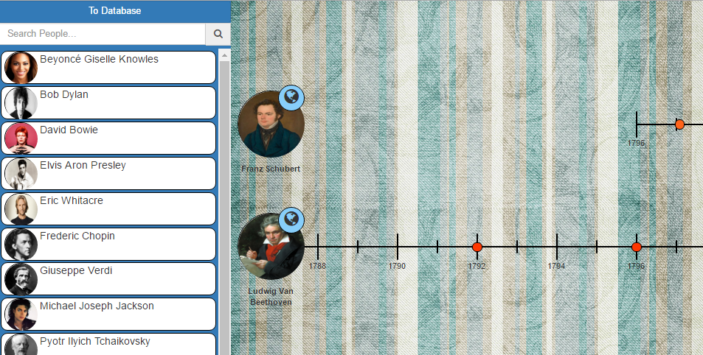
EECS Computer Science Capstone
Historical Data Visualization
Michael Thornbrough, Sam Sudekum, Zack Zaztrow, Lei Wang, Chinmay Ratnaparkhi
Spring 2016
Objective
Screenshots
Our goal was to create a dynamic historical data visualization tool, incorporating different ways to view data in order to better suit users' needs, and to facilitate the retention and improve understanding of the information presented.
While many different data visualization tools such as timelines exist across the web, few make the leap to include the different presentations of data within a single application. With the addition of views like a map to display events, users have the ability to transition to a perspective that highlights the locations famous people traveled during their lives.
Additionally, our application allows users to view the history of multiple people and/or places relationally. Using multiple timelines, we have given users the ability to simulatneously view the history of their subjects side by side. Similarly, our “bubble” view allows users to start with a single event, and based on information about that event, traverse time to discover new and different, but related events.
Applications
Future Expansions
While we're very happy with the tools we've created, improvements and additions will always be a natural part of development with any progressive application.
http://tl-js.github.io/histViewer/

