Slide 1
COMPUTATIONAL FLUID DYNAMICS RESEARCH STUDY
Numerical Study of Aerodynamic Wind Forces on Isolated and Arrayed Solar Panels
Steady RANS OpenFOAM (k-ω SST) Parametric Analysis of Wind Velocity, Tilt, Yaw Angles, Multi-Row Sheltering, and Rooftop Integration
CFD Methodology: OpenFOAM simpleFoam | Mesh: snappyHexMesh | Turbulence Closure: k-ω SST
Dataset Root: /home/lavender/OpenFoamUbu/offProjects/solarPanel/solarPanel/
Focus: High-Wind Coastal Resilience & Bluff-Body Aerodynamic Force Quantification | October 2026

Slide 2
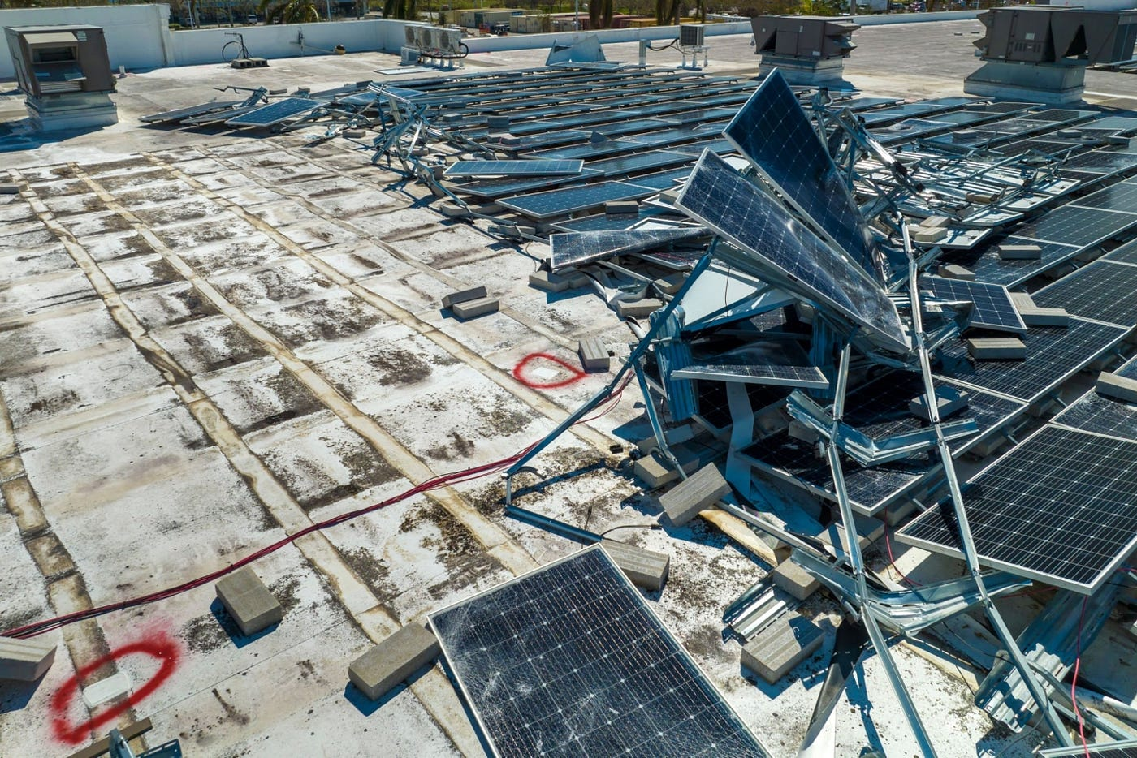
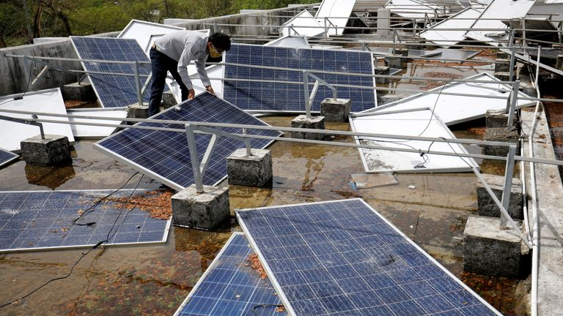
BACKGROUND & SCOPE
METHODOLOGY
EXPERIMENTAL VALIDATION
VELOCITY & RE SCALING
TILT & YAW DYNAMICS
ARRAY & ROOFTOP
NUMERICAL SYNTHESIS
Motivation & Failure Modes in Extreme Cyclonic Weather
Recent tropical cyclones in coastal India demonstrate structural vulnerabilities under extreme aerodynamic loads.
The Aerodynamic & Engineering Challenge
• Solar PV Expansion in High-Wind Coastal Zones
India operates over 90 GW of solar PV capacity. Major utility-scale installations are situated across coastal Gujarat, Rajasthan, and Odisha where cyclonic activity is prevalent.
• Documented Cyclone Damage Rates
Field reports from Cyclone Tauktae (May 2021, gusts ~220 km/h), Cyclone Biparjoy (June 2023, ~165 km/h), and Cyclone Fani (May 2019, ~215 km/h) recorded 15% to 20% physical module and mounting failures.
• Observed Mechanical Damage Modes
Structural failure inspections reveal panel frame bending, fastener pulling, purlin detachment, and tracker torque-tube twisting under severe wind loading.
• Current Code Limitations (IS 875 Part 3)
Existing design standards (IS 875 Part 3) prescribe wind pressure for standard enclosed buildings and solid walls, lacking dedicated aerodynamic force coefficients for low-profile tilted PV modules and multi-row wake interferences.
Figure 1a: Cyclone Tauktae Structural Damage (Gujarat, May 2021). Peak wind gusts (~220 km/h) caused catastrophic bending, fastener shear, and torn purlins on ground-mounted tracking arrays.
Figure 1b: Cyclone Biparjoy Module Failures (Coastal Gujarat, June 2023). Extreme turbulent storm loading (~165 km/h) induced torque-tube twisting and widespread panel frame pull-out failures.

Slide 3
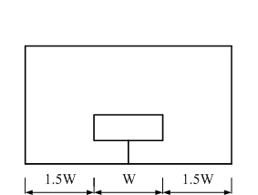
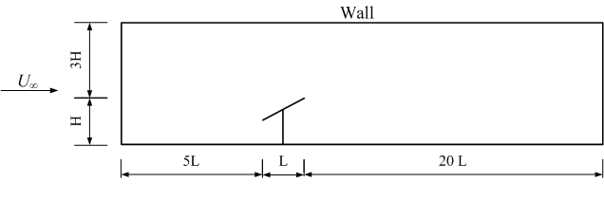
BACKGROUND & SCOPE
METHODOLOGY
EXPERIMENTAL VALIDATION
VELOCITY & RE SCALING
TILT & YAW DYNAMICS
ARRAY & ROOFTOP
NUMERICAL SYNTHESIS
Geometric Configuration & Computational Domain Design
Domain dimensions, blockage ratio control, and Volume of Refinement (VOR) specifications.
Domain Sizing & Boundary Conditions
• Solar Panel Dimensions
Length (chord) L = 0.600 m, Width W = 0.500 m, Thickness t = 0.020 m. Mounted at ground clearance height H = 0.500 m.
• Computational Domain Span (25L × 3W × 3H)
Streamwise domain length = 25L (15.0 m total: 5L upstream fetch to prevent inlet blockage, 20L downstream for wake development). Lateral width = 3W (1.8 m, 1W lateral clearance on both sides). Domain height = 3H (1.24 m).
• Blockage Ratio Minimization (< 3%)
Frontal projected area produces a blockage ratio < 3%, well below the 5% threshold recommended by COST 732 / Franke et al. to avoid artificial boundary constriction.
• Volume of Refinement (VOR)
Near-body nested domain: 8.5L length (1.5L upstream, 7.0L wake), 2W width, 2.0 m height to capture steep pressure gradients and recirculating shear layers.
• Boundary Condition Definitions
Inlet: Uniform velocity (3 to 75 m/s), Turbulence Intensity I = 10%.
Outlet: Static gauge pressure p = 0 Pa.
Ground & Panel: No-slip wall boundary.
Ceiling & Sides: Symmetry planes.
Figure 2: Computational Domain Geometric Sizing. Front cross-section (left) showing 1W lateral side clearances, and longitudinal side view (right) illustrating the 5L upstream fetch and 20L downstream wake recovery zone (blockage < 3%).
Domain Parameter | Geometric Value | Engineering Justification
Streamwise Length | 15.00 m (25L) | 5L fetch prevents inlet blockage; 20L wake recovery
Lateral Domain Width | 1.80 m (3W) | 1W clearance prevents lateral constriction on sides
Domain Height | 1.24 m (3H) | Maintains blockage ratio < 3% per COST 732 guidelines
Ground Clearance (H) | 0.500 m | Replicates standard utility-scale torque-tube mounting
Volume of Refinement | 8.5L × 2W × 2.0 m | Refines steep shear gradients and recirculation zone

Slide 4
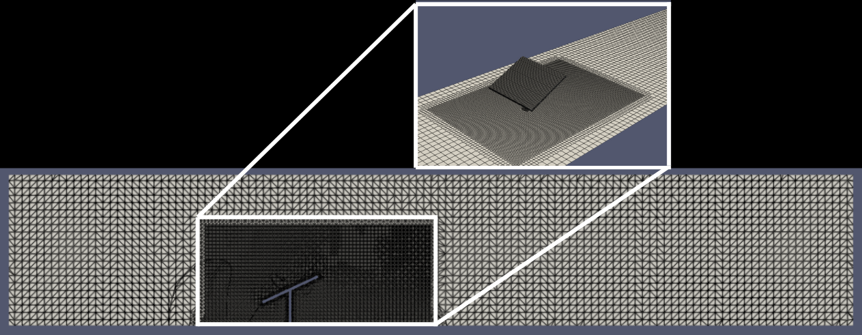
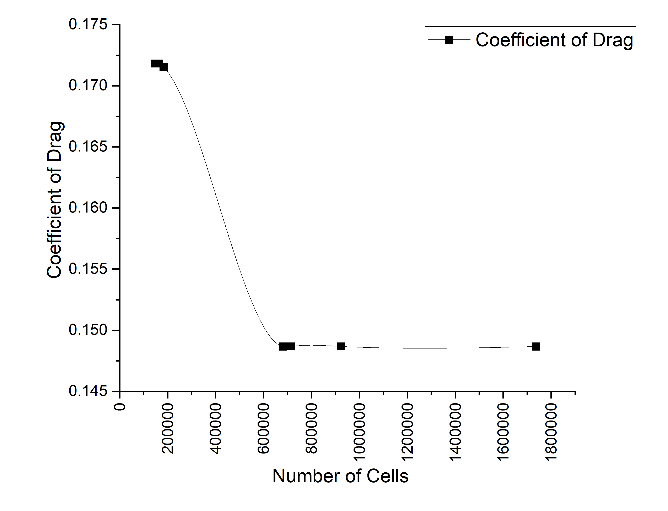
BACKGROUND & SCOPE
METHODOLOGY
EXPERIMENTAL VALIDATION
VELOCITY & RE SCALING
TILT & YAW DYNAMICS
ARRAY & ROOFTOP
NUMERICAL SYNTHESIS
Mesh Generation & Grid Independence Verification
Asymptotic drag convergence verified across 7 mesh resolutions from 147k to 1.73M cells.
Mesh Level | Cell Count | Drag Fd (N) | Cd | Rel. Change (%) | Status
Mesh 1 | 147,253 | 13.238 | 0.1745 | — | Coarse Baseline
Mesh 2 | 165,341 | 13.038 | 0.1718 | 1.53% | Under-resolved
Mesh 3 | 183,429 | 13.018 | 0.1716 | 0.15% | Transitional
Mesh 4 | 680,590 | 11.282 | 0.1487 | 15.39% | Shear Resolved
Mesh 5 | 715,391 | 11.282 | 0.1487 | -0.003% | Asymptotic Plateau
Mesh 6 | 924,009 | 11.282 | 0.1487 | +0.001% | Production Standard
Mesh 7 | 1,735,557 | 11.282 | 0.1487 | +0.001% | Grid-Independent
Figure 3a: snappyHexMesh Near-Wall Octree Refinement. Cartesian hexahedral mesh featuring 6 mm surface cells and 30 mm nested volume refinement resolving boundary detachment.
Mesh Metrics & Convergence Summary
• snappyHexMesh Refinement Hierarchy
Base background mesh cell size = 60 mm generated with blockMesh. Surface refinement ratio = 0.1 (6 mm); Volume refinement ratio = 0.5 (30 mm) within VOR.
• Mesh Quality Metrics (Production 912k Mesh)
Max Aspect Ratio = 3.46, Max Non-Orthogonality = 36.07° (< 70° limit), Max Skewness = 4.18.
• Grid Independence Criteria
The drag coefficient Cd converges to 0.1487 beyond 680,590 cells. Subsequent variation is less than 0.003%, demonstrating numerical mesh independence.
Figure 3b: Grid Convergence Plateau (147k to 1.73M cells). Asymptotic drag stabilization at 680,590 cells (Cd = 0.1487) with variation < 0.003% through 1.73M cells.

Slide 5
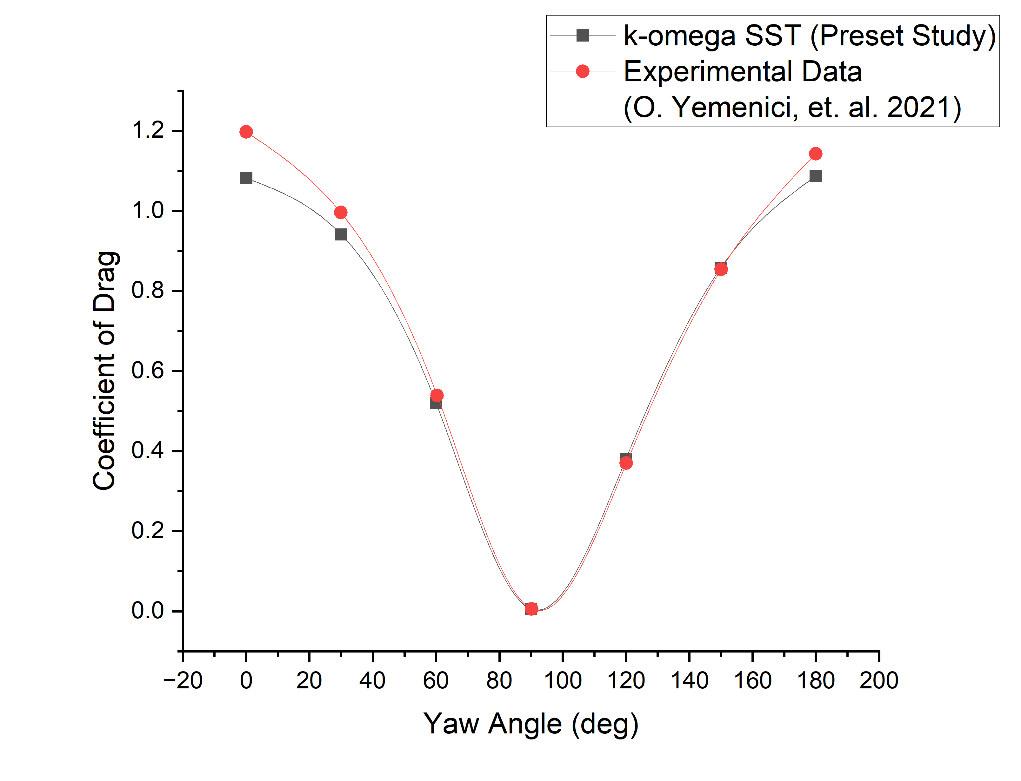
BACKGROUND & SCOPE
METHODOLOGY
EXPERIMENTAL VALIDATION
VELOCITY & RE SCALING
TILT & YAW DYNAMICS
ARRAY & ROOFTOP
NUMERICAL SYNTHESIS
Experimental Validation Against Wind Tunnel Benchmark
High-fidelity agreement across 0° to 180° rotation angles with 3.85% mean absolute error.
Yaw Angle ψ | OpenFOAM Cd | Exp. Cd (Yemenici) | Deviation (%) | Observed Aerodynamic Regime
0° | 1.0813 | 1.1973 | 9.68% | Direct frontal stagnation
30° | 0.9412 | 0.9959 | 5.50% | Oblique boundary layer detachment
60° | 0.5203 | 0.5388 | 3.43% | Strong lateral streamline deflection
90° | 0.0055 | 0.0054 | 0.32% | Edge-on minimum frontal area
120° | 0.3800 | 0.3701 | 2.69% | Onset of leeward recirculation
150° | 0.8581 | 0.8544 | 0.43% | Rear oblique vortex expansion
180° | 1.0867 | 1.1429 | 4.91% | Full leeward bluff stagnation
Validation Findings & Error Analysis
• High Correlation Across Rotation Angles
Mean absolute error across all 7 rotation angles is 3.85%. OpenFOAM accurately reproduces the U-shaped drag profile with symmetric maxima at 0° and 180°.
• Minimum Drag at 90°
At 90° (flow parallel to panel face), Cd drops to 0.0055 in OpenFOAM vs 0.0054 experimentally (0.32% deviation).
• Error Sources
Minor deviation at 0° (~9.7%) is attributed to experimental mounting bracket interference and wind tunnel boundary layers omitted from the isolated computational domain.
Figure 4: OpenFOAM vs. Yemenici et al. (2021) Validation. Comparison across 7 yaw angles demonstrates 3.85% mean absolute error and 0.32% deviation at 90° edge-on flow.
3.85%
Mean Absolute Error
Across 7 yaw angles
0.32%
Min Error at 90°
Cd = 0.0055 vs 0.0054
Verified
k-ω SST Closure
Bluff detachment fidelity

Slide 6
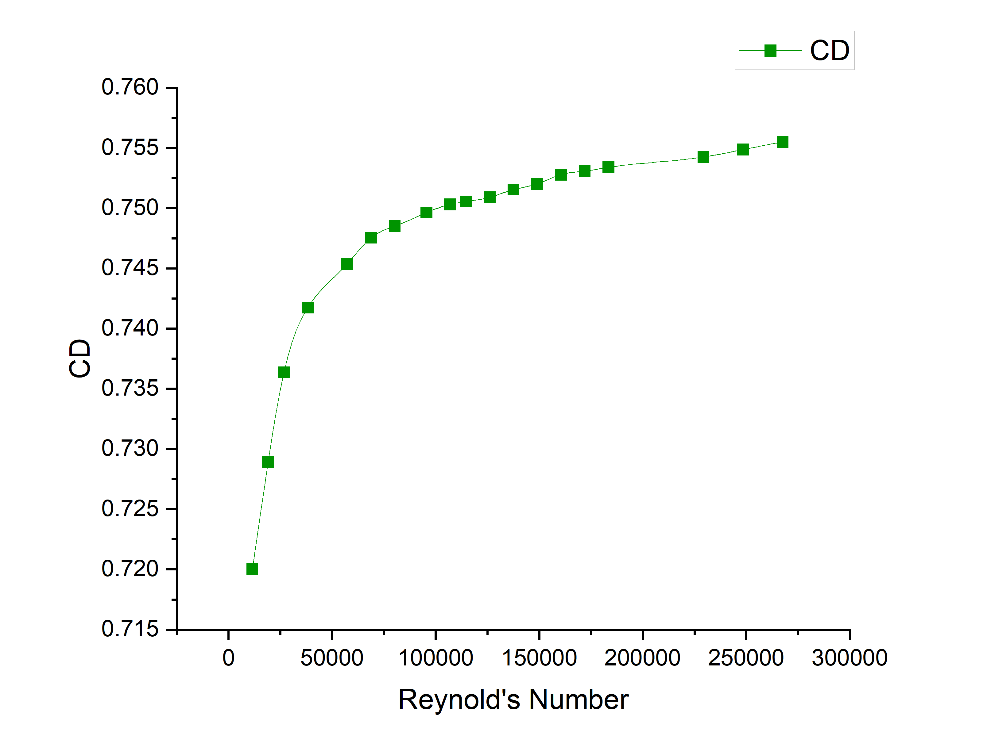
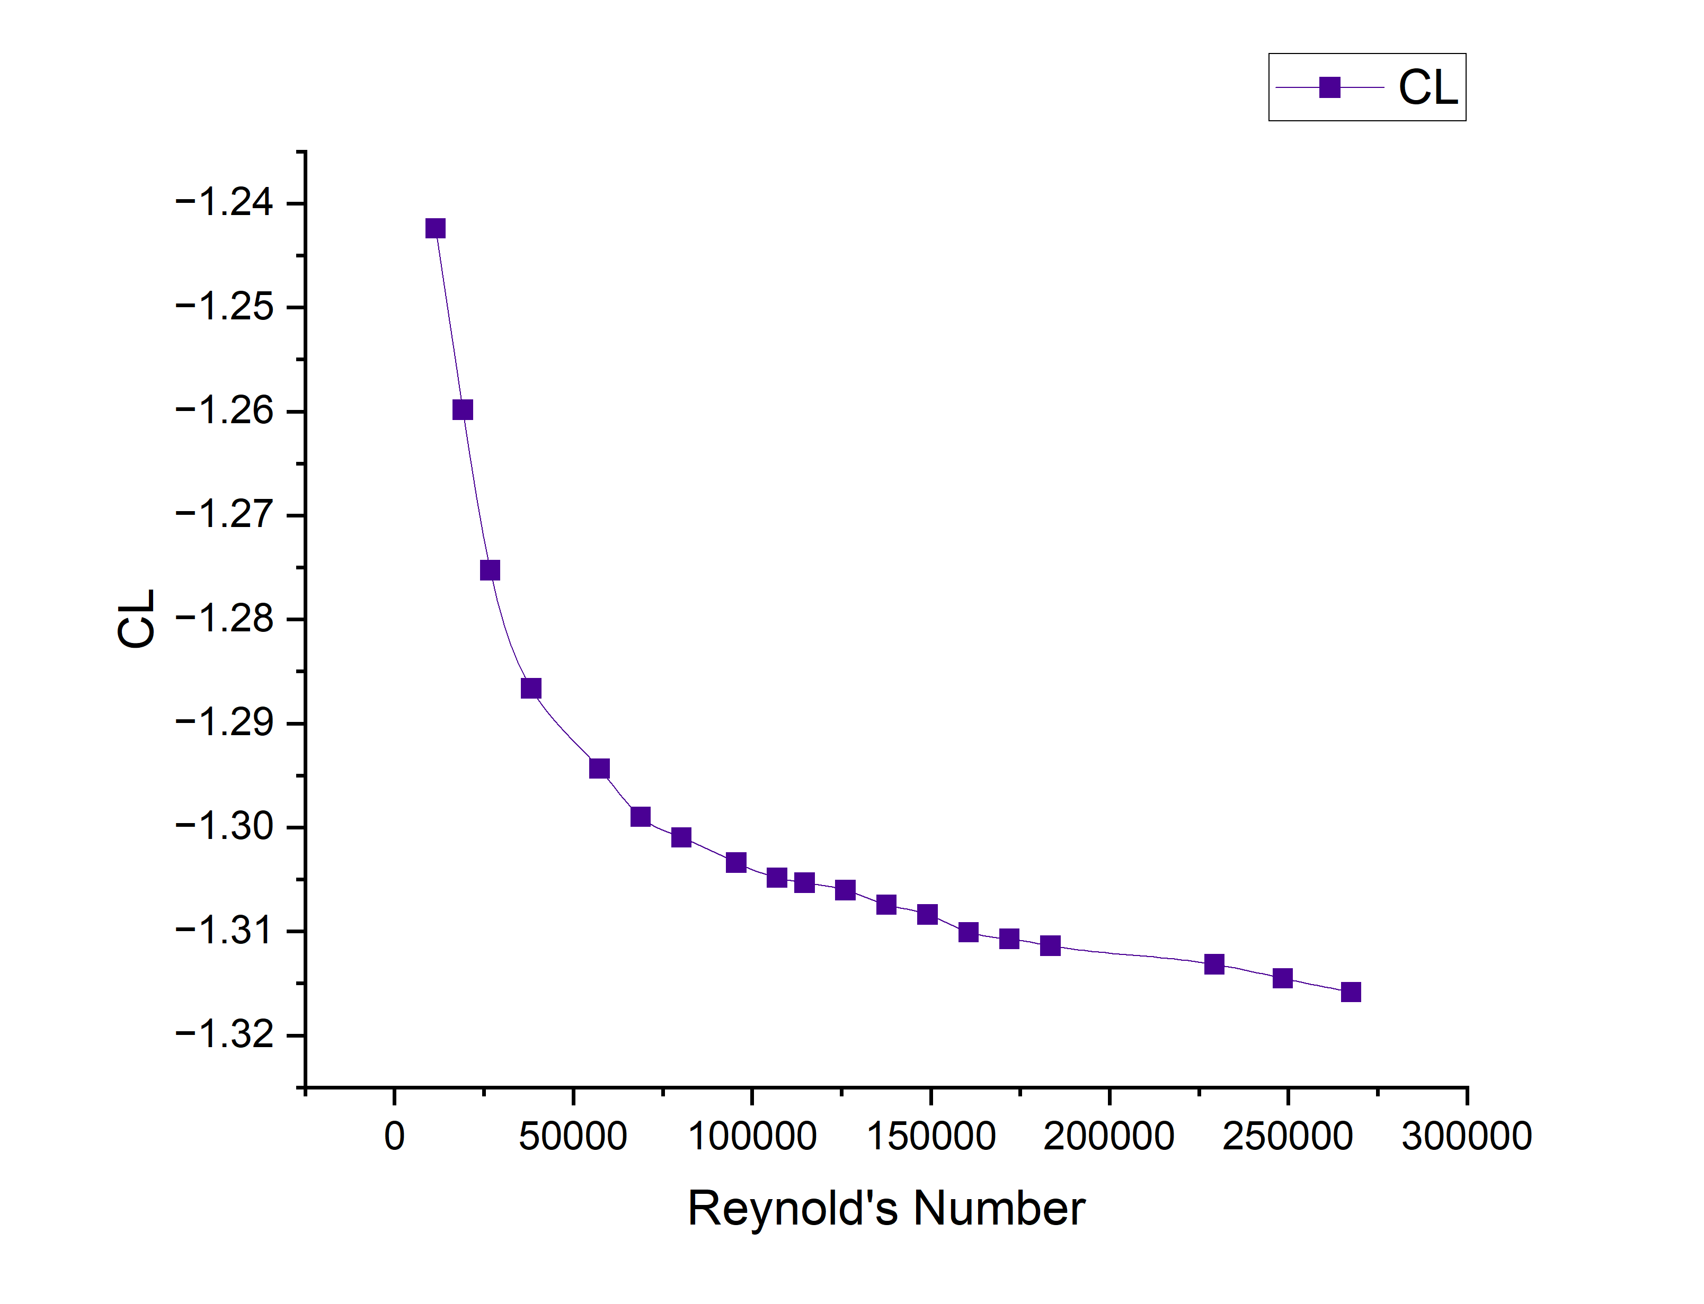
BACKGROUND & SCOPE
METHODOLOGY
EXPERIMENTAL VALIDATION
VELOCITY & RE SCALING
TILT & YAW DYNAMICS
ARRAY & ROOFTOP
NUMERICAL SYNTHESIS
Wind Velocity Scaling & Reynolds Number Independence
Forces scale quadratically with velocity (U²) while aerodynamic drag coefficient plateaus at Re > 50,000.
Reynolds Number Effects & Dynamic Force Scaling
• Parametric Velocity Sweep (3 to 75 m/s)
Simulations span Re = 11,465 (3 m/s) to Re = 286,624 (75 m/s) with characteristic length D = 0.6 m and kinematic viscosity ν = 1.57 × 10⁻⁵ m²/s.
• Bluff-Body Re Independence
Drag coefficient Cd increases from 0.70 at 3 m/s and stabilizes at ~0.78 beyond Re > 50,000 (15 m/s). Because flow separation is fixed at sharp plate edges, Cd becomes Reynolds-independent at stormy wind speeds.
• Negative Lift (Downward Force) Dominance
At 0° yaw, lift coefficient CL remains consistently negative (CL ≈ -1.22), imposing strong downward compression on the panel face.
• Dynamic Force Magnitudes (F ∝ U²)
Drag and lift scale strictly with velocity squared (F = 1/2 ρ A Cd U²), reaching 340.2 N drag and -650.5 N suction on a single 0.3 m² module at 75 m/s.
Figure 5a: Cd vs. Reynolds Number. Cd plateaus at ~0.78 for Re > 50,000 due to fixed geometric flow separation at sharp perimeter edges.
Figure 5b: CL vs. Reynolds Number. Persistent negative lift (CL ≈ -1.22) imposes continuous downward foundation compression across stormy wind speeds.
Wind Speed | Reynolds No. (Re) | Drag Fd (N) | Lift Fl (N) | Aerodynamic Regime
3 m/s | 11,465 | 0.55 N | -1.07 N | Low-speed transitional boundary layer
15 m/s | 57,325 | 13.02 N | -25.80 N | Onset of bluff-body Re independence
30 m/s | 114,650 | 52.1 N | -103.2 N | Operational storm wind regime
55 m/s | 210,191 | 175.2 N | -347.1 N | Severe gale / design wind threshold
75 m/s | 286,624 | 340.2 N | -650.5 N | Peak cyclonic gust (extreme load)

Slide 7
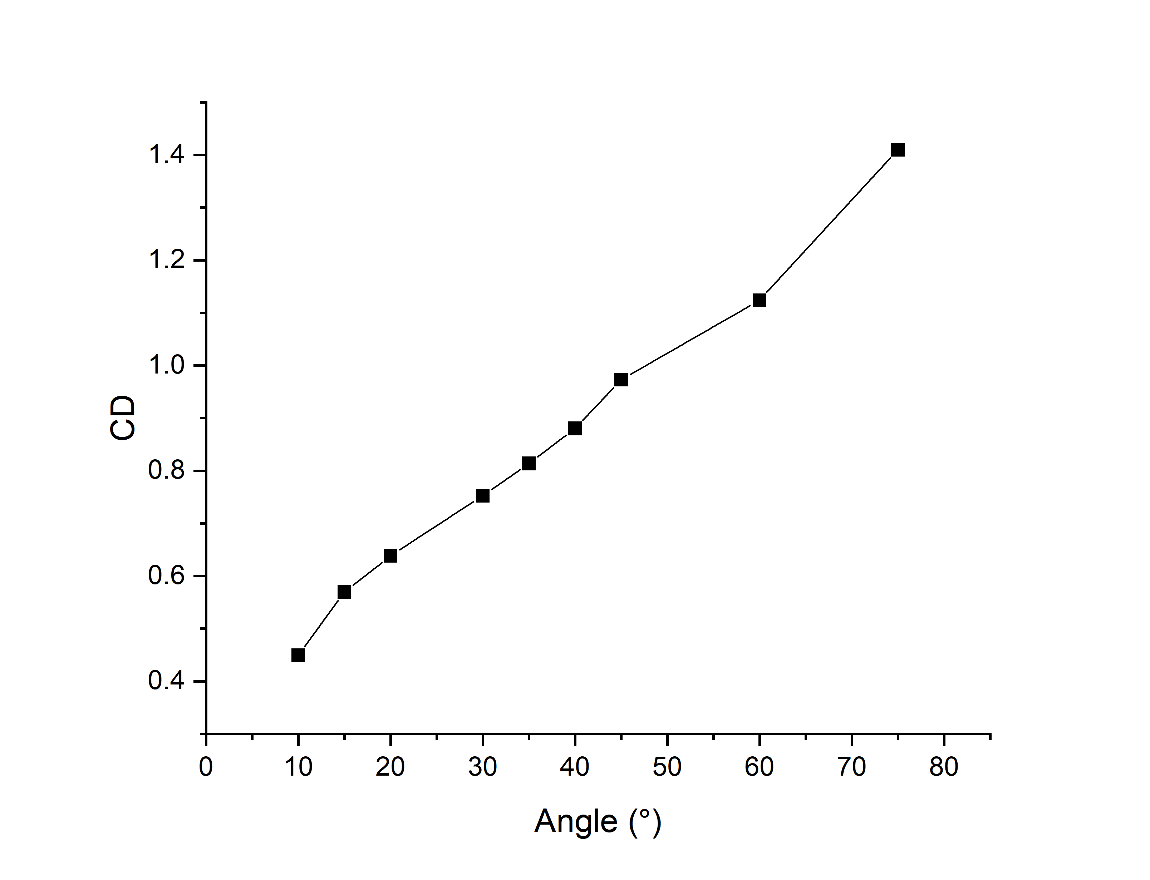
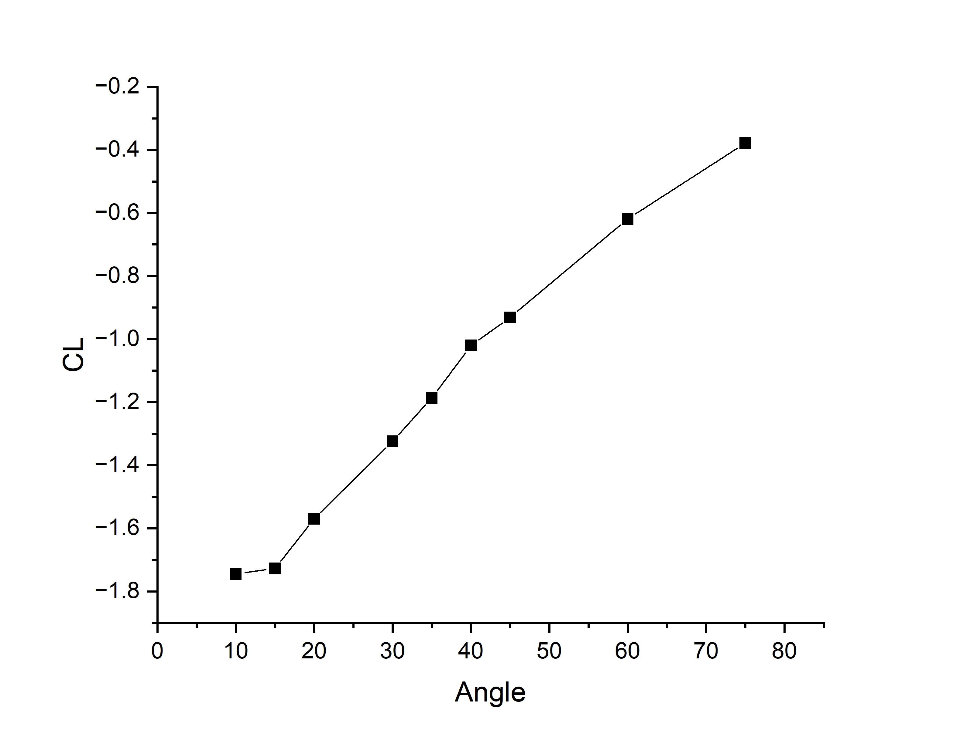
BACKGROUND & SCOPE
METHODOLOGY
EXPERIMENTAL VALIDATION
VELOCITY & RE SCALING
TILT & YAW DYNAMICS
ARRAY & ROOFTOP
NUMERICAL SYNTHESIS
Panel Tilt Angle Sweep (10° to 75°): Solar Yield vs. Drag Trade-off
Drag increases monotonically by 313% from 10° to 75°; 30° represents the optimal trade-off with solar irradiation.
Tilt Angle θ | Proj. Area (m²) | Cd | CL | Observed Aerodynamic Behavior
10° | 0.0688 | 0.4495 | -1.7446 | Minimum drag; peak downward suction (|CL|)
15° | 0.0938 | 0.5696 | -1.7273 | Low aerodynamic resistance
20° | 0.1180 | 0.6382 | -1.5693 | Common tropical installation angle
30° | 0.1637 | 0.7523 | -1.3241 | Optimal trade-off: Solar yield vs wind load
35° | 0.1849 | 0.8137 | -1.1867 | Drag increases (+81% vs 10°)
45° | 0.2229 | 0.9730 | -0.9313 | Higher frontal exposure
60° | 0.2674 | 1.1237 | -0.6195 | Severe drag amplification (+150% vs 10°)
75° | 0.2940 | 1.4097 | -0.3786 | Maximum drag force (3.13x baseline at 10°)
Figure 6a: Cd vs. Tilt Angle. Monotonic drag surge of +313% from 10° to 75° scaling directly with projected frontal area.
Figure 6b: CL vs. Tilt Angle. Peak downward suction (|CL| = 1.745) occurs at 10°, attenuating to 0.379 at 75° as wake detaches.
Tilt Angle Optimization Analysis
• Monotonic Drag Growth
Cd increases continuously from 0.4495 at 10° to 1.4097 at 75° (a 313% surge). Drag is NOT minimized at 30°.
• The 30° Optimum Balance
30° tilt represents the engineering trade-off: it maximizes annual solar irradiation for tropical/subtropical latitudes (15°–25°N) while avoiding the severe drag penalties found at 45°–75°.
• Downward Suction Peak
Maximum downward suction (|CL| = 1.745) occurs at 10° due to upper-surface flow acceleration, decreasing to |CL| = 0.379 at 75° as the flow fully separates.
+313%
Drag Surge (10°-75°)
Cd: 0.4495 → 1.4097
-1.745
Peak Downward CL
Observed at 10° tilt
30° Tilt
Optimal Balance
Max yield / low drag

Slide 8
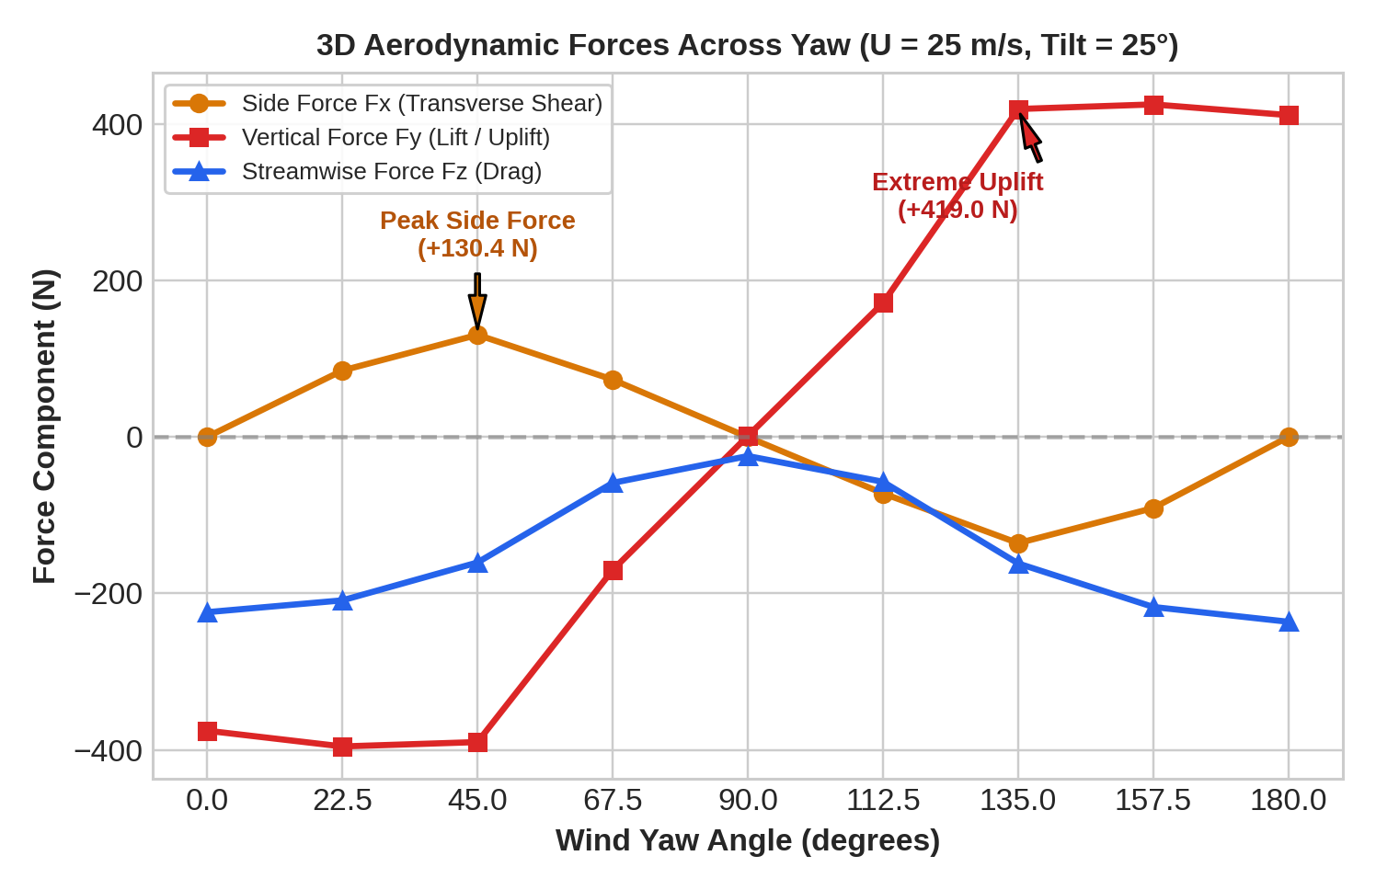
BACKGROUND & SCOPE
METHODOLOGY
EXPERIMENTAL VALIDATION
VELOCITY & RE SCALING
TILT & YAW DYNAMICS
ARRAY & ROOFTOP
NUMERICAL SYNTHESIS
Wind Yaw Angle (0° to 180°): 3D Force Decomposition & Load Reversal
Quartering wind (45°) induces peak lateral shear; rear wind (135°–180°) triggers complete vertical uplift load reversal.
Yaw ψ | Flow Alignment | Side Fx (N) | Lift Fy (N) | Drag Fz (N) | Observed Force Regime
0° | Frontal Direct | 0.0 | -375.5 | -224.0 | Downward compression on foundation
22.5° | Slight Oblique | +84.8 | -395.6 | -208.9 | Combined compression and lateral shear
45° | Quartering Wind | +130.4 | -390.0 | -160.5 | PEAK lateral shear (Fx)
67.5° | High Oblique | +73.2 | -170.1 | -58.8 | Moderate asymmetric loading
90° | Parallel / Edge-on | -0.3 | +1.2 | -24.5 | Minimal forces (glancing flow)
112.5° | Rear Oblique | -72.2 | +171.2 | -57.4 | Vertical force flips to uplift (+Fy)
135° | Quartering Leeward | -135.8 | +419.0 | -161.8 | PEAK upward lift (+Fy) + lateral shear
157.5° | Severe Leeward | -90.9 | +424.9 | -217.4 | Extreme upward lift on panel
180° | Rear Direct | 0.0 | +411.2 | -236.3 | Direct rear wind; pure uplift (+Fy)
Figure 7: 3D Aerodynamic Forces vs. Wind Yaw Angle (U = 25 m/s, θ = 25°). Quartering winds (45°/135°) maximize lateral shear (|Fx| ≈ 130–136 N); vertical load flips from -375.5 N compression to +419.0 N uplift under rear wind.
Critical Aerodynamic Phenomena Discovered
• Vertical Load Reversal (+786.7 N Delta)
Wind changing from 0° (-375.5 N downward) to 180° (+411.2 N upward) creates a 786.7 N net load shift from compression to upward tension.
• Quartering Lateral Shear Peak
Lateral side force reaches |Fx| = 130.4 N at 45° and |Fx| = 135.8 N at 135°, introducing asymmetric shear on mounting hardware.
+130.4 N
Peak Side Shear (Fx)
45° Quartering wind
+419.0 N
Peak Uplift (Fy)
135° Leeward wind
786.7 N
Vertical Load Delta
Down-to-up reversal

Slide 9
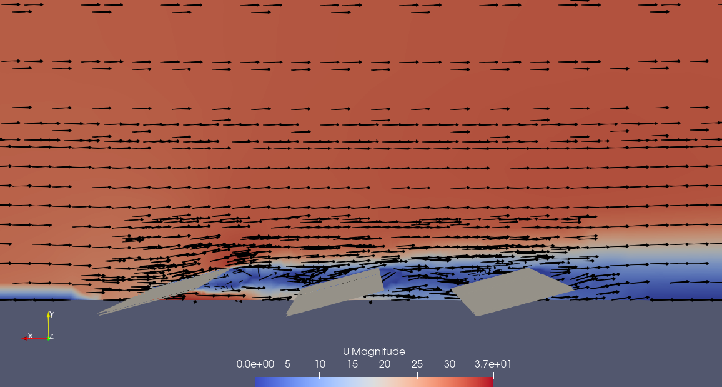
BACKGROUND & SCOPE
METHODOLOGY
EXPERIMENTAL VALIDATION
VELOCITY & RE SCALING
TILT & YAW DYNAMICS
ARRAY & ROOFTOP
NUMERICAL SYNTHESIS
Sheltering Effect in Multi-Row Solar Arrays (Normal Wind)
Upstream panels deflect incoming flow, reducing aerodynamic drag on downstream rows by 61.5% to 79.0%.
Array Position | Cd (55 m/s) | CL (55 m/s) | Drag Reduction (%) | Lift Reduction (%)
Row 1 (Leading Edge) | 0.4598 | -1.1691 | Baseline (0%) | Baseline (0%)
Row 2 (Intermediate) | 0.1772 | -0.4807 | 61.5% Lower Drag | 58.9% Lower Suction
Row 3 (Trailing Row) | 0.0967 | -0.2818 | 79.0% Lower Drag | 75.9% Lower Suction
Aerodynamic Mechanisms Driving Array Sheltering
• Leading Row Boundary Layer Deflection
The leading row acts as a bluff obstacle, deflecting incoming streamlines upward and triggering flow separation at its front edge.
• Velocity Deficit in the Downstream Wake
Downstream rows sit within the wake recirculation zone where mean streamwise velocity is reduced by 40%–55%, lowering the dynamic pressure (q = 1/2 ρ U²) impinging on Rows 2 and 3.
• Drag Reduction Across Successive Rows
Row 2 experiences a 61.5% drop in drag (Cd = 0.1772 vs 0.4598). Row 3 experiences a 79.0% drop in drag (Cd = 0.0967).
• Downward Suction Attenuation
Negative lift decreases from CL = -1.1691 on Row 1 to CL = -0.2818 on Row 3 (a 75.9% reduction in downward suction).
Figure 8: Velocity Streamlines Across 3-Row Solar Array (U = 55 m/s). Upstream Row 1 deflects oncoming streamlines upward, creating an expansive low-velocity wake cavity that shelters downstream Rows 2 and 3.
-61.5%
Row 2 Drag Drop
Cd: 0.4598 → 0.1772
-79.0%
Row 3 Drag Drop
Cd: 0.4598 → 0.0967
-75.9%
Suction Attenuation
CL: -1.169 → -0.282

Slide 10
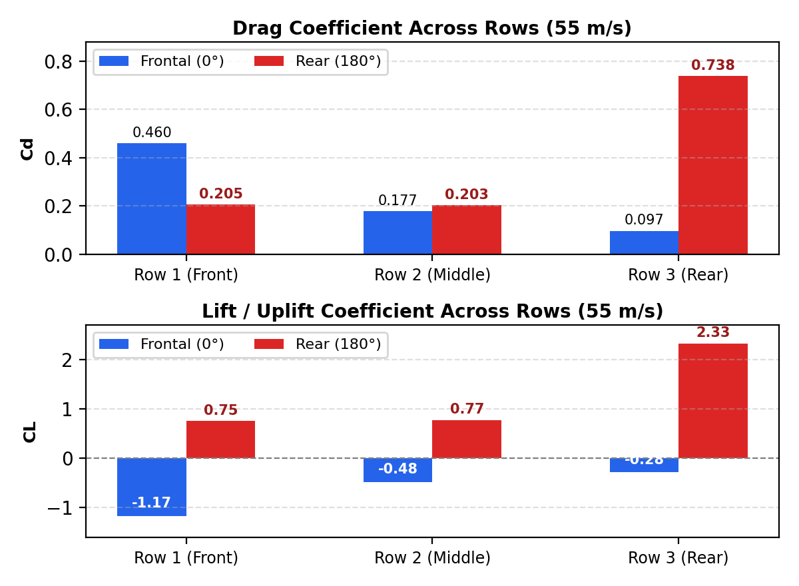
BACKGROUND & SCOPE
METHODOLOGY
EXPERIMENTAL VALIDATION
VELOCITY & RE SCALING
TILT & YAW DYNAMICS
ARRAY & ROOFTOP
NUMERICAL SYNTHESIS
Array Force Inversion Under Wind Direction Shifts (0° vs. 180°)
Under rear wind (180°), Row 3 becomes windward, experiencing +260% drag and extreme upward lift (+2.327).
Array Row | Frontal (0°) Cd | Frontal (0°) CL | Rear (180°) Cd | Rear (180°) CL | Wind Direction Effect
Row 1 (Front) | 0.4598 | -1.169 | 0.2049 | +0.752 | Sheltered from rear; lift flips positive
Row 2 (Middle) | 0.1772 | -0.481 | 0.2027 | +0.771 | Slight load increase; lift flips positive
Row 3 (Rear) | 0.0967 | -0.282 | 0.7384 | +2.327 | +260% Drag Surge & Extreme Uplift!
Aerodynamic Analysis of Wind Direction Reversal
• Sheltering Reversal at 180°
When wind direction reverses to 180° (rear wind), Row 3 becomes the primary windward obstacle, bearing direct storm velocity.
• Drag Surge on Row 3 (Cd = 0.7384)
Row 3 drag jumps from Cd = 0.0967 at 0° to Cd = 0.7384 at 180°—a 260% increase over Row 1's frontal drag (0.4598).
• Extreme Upward Lift Generation (CL = +2.327)
Under rear wind, the inclined panel underside forms an aerodynamic ramp, producing strong upward lift (CL = +2.327 on Row 3) compared to downward compression (CL = -1.169) under frontal wind.
• Symmetric Boundary Requirement
Multi-row arrays experience peak wind loads on both northern and southern boundaries depending on storm approach direction.
Figure 9: Drag & Lift Coefficients Under Wind Reversal. Frontal wind shelters downstream rows; rear wind (180°) inverts the array, causing a +260% drag surge and CL = +2.327 upward lift on Row 3.
+260%
Row 3 Drag Surge
Cd = 0.7384 at 180°
+2.327
Row 3 Peak Uplift
Severe upward lift
Reversed
Sheltering Profile
Front row sheltered

Slide 11
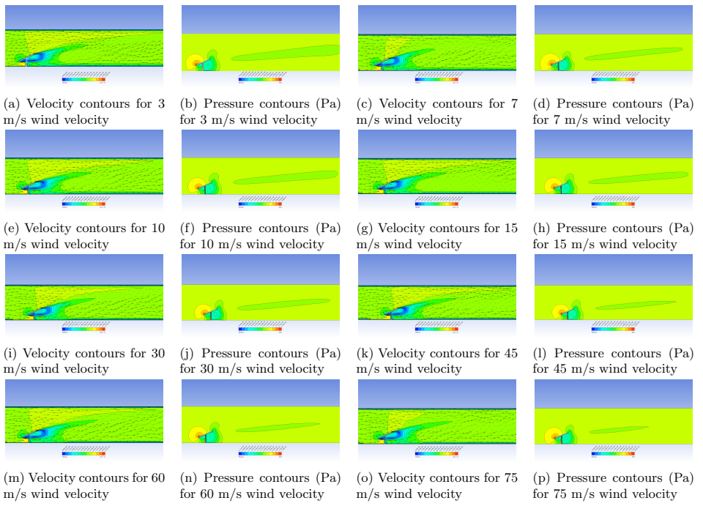
BACKGROUND & SCOPE
METHODOLOGY
EXPERIMENTAL VALIDATION
VELOCITY & RE SCALING
TILT & YAW DYNAMICS
ARRAY & ROOFTOP
NUMERICAL SYNTHESIS
Flow Physics: Surface Pressure & Velocity Contours (3 to 75 m/s)
Leading-edge suction peaks, stagnation zones, and recirculating wake dynamics across velocity regimes.
Key Fluid Dynamics Features Observed
• Leading-Edge Suction Peak (Bernoulli Acceleration)
Flow accelerates sharply over the top leading edge, lowering static pressure to extreme negative values (suction ΔCp < -2.5).
• Windward Stagnation Zone
High positive gauge pressure forms on the lower front inclined surface where approaching dynamic pressure (1/2 ρ U²) stagnates against the panel face.
• Adverse Pressure Gradient & Flow Detachment
Downstream of the leading edge, adverse pressure gradients force the boundary layer to detach, generating a recirculating cavity vortex behind the panel.
• Quadratic Pressure Scaling Across Velocities
While streamline geometry remains invariant due to bluff-body separation, gauge pressure scales with U²: peak suction drops from -14 Pa at 3 m/s to -9,003 Pa at 75 m/s.
Velocity (m/s) | Dynamic Pressure (Pa) | Peak Suction (Pa gauge)
3 m/s | 5.5 Pa | -14.2 Pa
7 m/s | 30.0 Pa | -78.5 Pa
15 m/s | 137.8 Pa | -360.2 Pa
30 m/s | 551.3 Pa | -1,440.5 Pa
60 m/s | 2,205.0 Pa | -5,762.0 Pa
75 m/s | 3,445.3 Pa | -9,003.5 Pa
Figure 10: Velocity & Gauge Pressure Contours Across 3–75 m/s. Leading-edge suction peaks intensify quadratically from -14.2 Pa (3 m/s) to -9,003.5 Pa (75 m/s). Windward stagnation and recirculating wake geometry remain invariant across speeds.

Slide 12
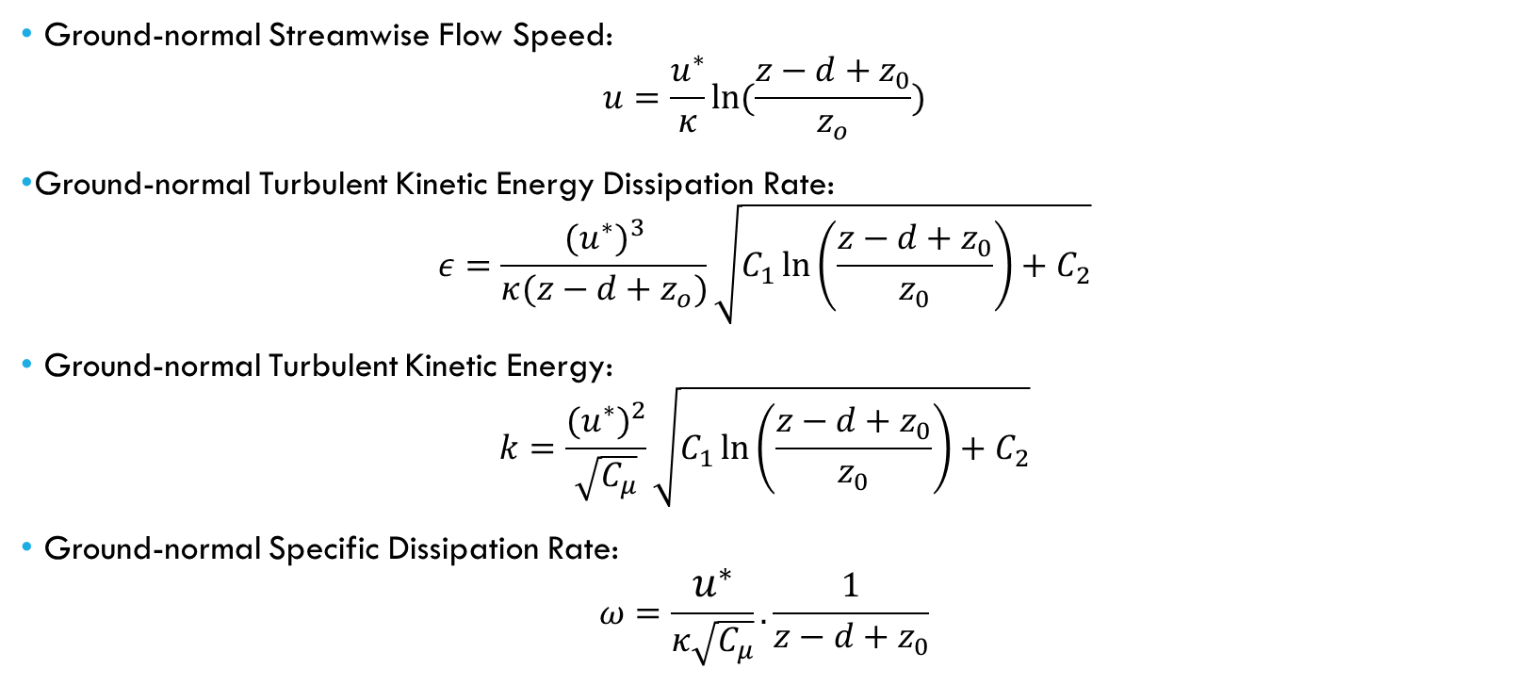
BACKGROUND & SCOPE
METHODOLOGY
EXPERIMENTAL VALIDATION
VELOCITY & RE SCALING
TILT & YAW DYNAMICS
ARRAY & ROOFTOP
NUMERICAL SYNTHESIS
Inflow Modeling: Atmospheric Boundary Layer (ABL) vs. Uniform Flow
Equations governing wind shear and turbulence closure for real-world ground and rooftop installations.
Modeling Justification & Application Scope
• Wind Tunnel Benchmark Validation
Uniform inflow was applied in this baseline study to replicate standard wind tunnel conditions (Yemenici et al., 2021) and validate isolated aerodynamic drag coefficients.
• Terrain Surface Roughness Effects
In real-world solar farms, ground roughness retards near-surface flow, establishing vertical velocity shear where lower chords experience reduced dynamic pressure compared to upper chords.
• Turbulent Dissipation Decay
Atmospheric Boundary Layer equations define turbulence decay with height, providing realistic turbulence kinetic energy profiles for ground-level mounted structures.
• Implementation Path
Future field studies will apply OpenFOAM's atmBoundaryLayerInletVelocity and atmBoundaryLayerInletK boundary conditions with terrain-specific roughness.
Figure 11: Atmospheric Boundary Layer Governing Equations. Mathematical formulation of vertical velocity shear u(z), turbulent kinetic energy k(z), and dissipation rate ε(z) profiles for ground-level atmospheric inflow.
ABL Formulation Parameter | Mathematical Variable | Value / Operational Context
Friction Shear Velocity (u*) | Friction velocity scale | Derived from ground shear stress τw
von Kármán Constant (κ) | Logarithmic slope constant | 0.41 (Standard atmospheric turbulence)
Aerodynamic Roughness (z₀) | Terrain surface roughness | 0.03 m (Open terrain / flat farmland)
Displacement Height (d) | Zero-plane elevation offset | 0.00 m (Unobstructed ground plane)
OpenFOAM Boundary Coupling | Inlet velocity & turbulence | atmBoundaryLayerInletVelocity & InletK
κ = 0.41
von Kármán Constant
Universal boundary layer
z₀ = 0.03 m
Roughness Length
Open flat terrain
k-ω SST
Turbulence Model
Near-wall & wake closure

Slide 13
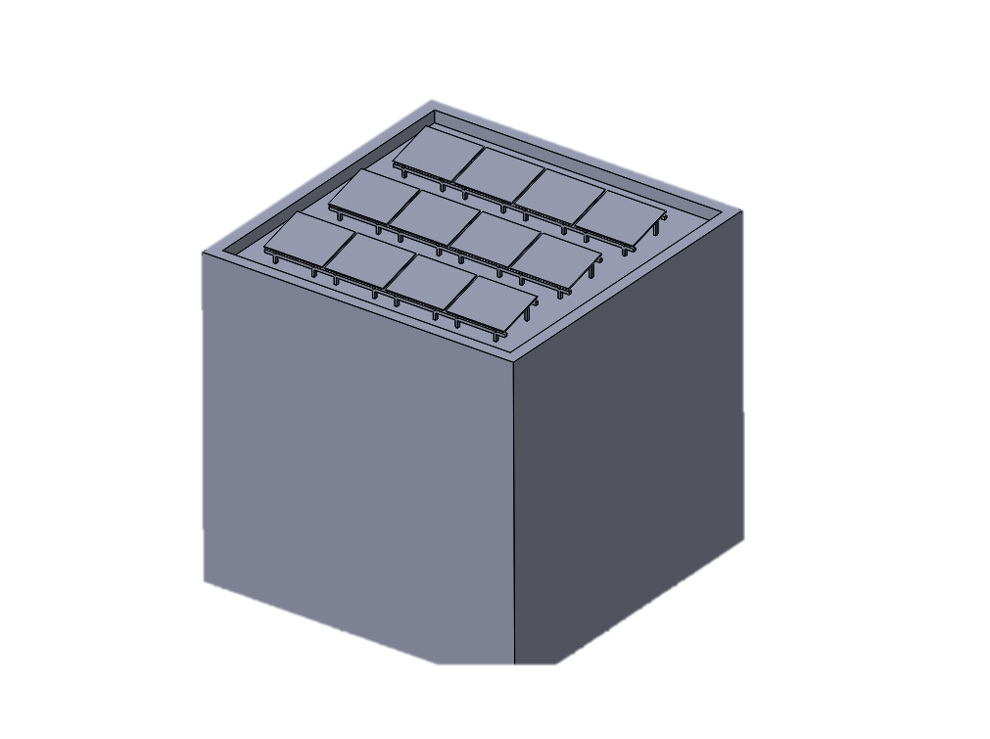
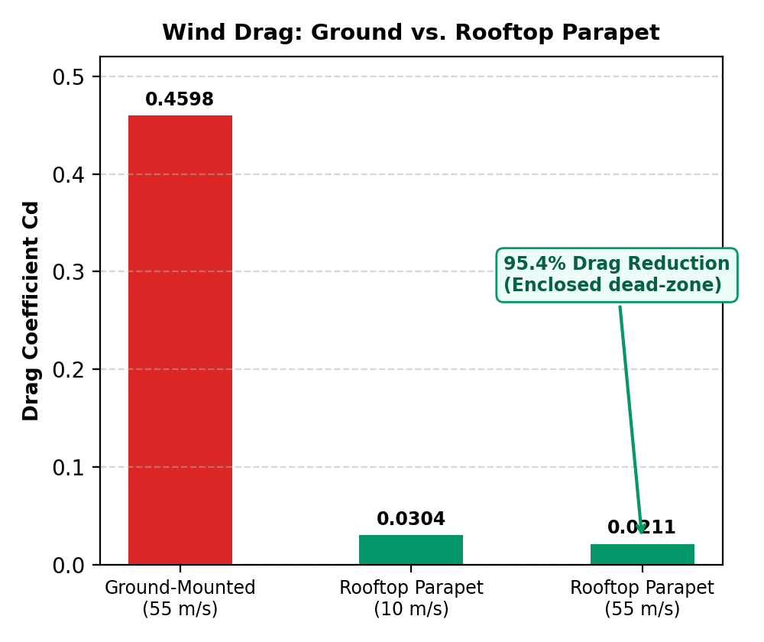
BACKGROUND & SCOPE
METHODOLOGY
EXPERIMENTAL VALIDATION
VELOCITY & RE SCALING
TILT & YAW DYNAMICS
ARRAY & ROOFTOP
NUMERICAL SYNTHESIS
Rooftop PV Aerodynamics: Over 95% Drag Reduction with Parapets
Perimeter parapet walls deflect incoming airflow, enclosing rooftop panels in a low-velocity recirculating dead-zone.
Configuration | Wind Speed | Drag Cd | Lift CL | Aerodynamic Drag Reduction
Ground-Mounted Isolated Panel | 55 m/s | 0.4598 | -1.1691 | Baseline (100% Load)
Rooftop Array with Parapet | 10 m/s | 0.0304 | +0.0750 | 93.4% Lower Drag
Rooftop Array with Parapet | 55 m/s | 0.0211 | +0.0560 | 95.4% Lower Drag!
Aerodynamic Mechanisms on Rooftops
• Building Facade Streamline Deflection
As oncoming wind strikes the vertical building facade, it is forced upward, separating at the roof edge and overshooting the solar panels.
• Parapet Recirculation Dead-Zone
The perimeter parapet wall prevents the separated boundary layer from reattaching onto the roof deck, creating a low-velocity recirculating air cavity.
• 95.4% Drag Reduction at 55 m/s
The rooftop array experiences Cd = 0.0211 compared to Cd = 0.4598 for the ground-mounted panel, representing a 95.4% reduction in aerodynamic drag force.
• Reduced Vertical Lift
Unlike ground-mounted arrays where rear wind generates extreme uplift (CL = +2.327), the rooftop array experiences near-neutral vertical forces (CL = +0.0560).
Figure 12a: Rooftop PV CAD Model. Building integration with perimeter parapet wall sheltering low-profile tilted solar module arrays.
Figure 12b: Ground vs. Rooftop Drag. Parapet cavity creates an aerodynamic dead-zone, reducing drag by 95.4% (Cd = 0.0211 vs 0.4598).
-95.4%
Drag Reduction (55 m/s)
Cd: 0.4598 → 0.0211
+0.056
Lift Coefficient (CL)
Prevents ground uplift
Cavity
Parapet Recirculation
Dead-zone flow shield

Slide 14
BACKGROUND & SCOPE
METHODOLOGY
EXPERIMENTAL VALIDATION
VELOCITY & RE SCALING
TILT & YAW DYNAMICS
ARRAY & ROOFTOP
NUMERICAL SYNTHESIS
Synthesis of Aerodynamic Findings & Computational Scope
Strictly verified aerodynamic conclusions from 47 parametric OpenFOAM simulations.
1. Grid Independence & Validation
• Grid Convergence: Asymptotic drag plateau reached at 680,590 cells (Cd = 0.1487, variation < 0.003%).
• Wind Tunnel Validation: Benchmarked against Yemenici et al. (2021) across 7 yaw angles (0°–180°).
• Numerical Fidelity: 3.85% mean absolute error; exact capture of glancing flow at 90° (0.32% deviation).
• Turbulence Closure: k-ω SST reliably models adverse pressure detachment without empirical wall tuning.
2. Bluff-Body Aerodynamics & Re Invariance
• Sharp-Edged Separation: Sharp perimeter edges fix boundary detachment lines, removing Reynolds scaling.
• Re Invariance Plateau: Cd plateaus at ~0.78 for Re > 50,000 (operational wind speeds U > 15 m/s).
• Downward Lift Dominance: CL ≈ -1.22 dominates frontal flow (0° yaw), imposing heavy foundation compression.
• Quadratic Force Scaling: Forces scale strictly as U² (Fd = 340.2 N and Fl = -650.5 N at 75 m/s per module).
3. Tilt Angle & 3D Yaw Load Regimes
• Monotonic Drag Growth: Cd rises continuously by +313% from 0.4495 at 10° to 1.4097 at 75° tilt.
• The 30° Optimum Balance: Maximizes annual solar irradiance capture while avoiding severe drag spikes above 35°.
• Quartering Lateral Shear: 45° and 135° yaw induce peak crosswind forces (|Fx| = 130.4 N to 135.8 N).
• Vertical Load Reversal: Leeward wind (135°–180°) causes complete uplift reversal (Fy = +419 N, 786.7 N delta).
4. Array Sheltering & Parapet Dead-Zones
• Frontal Array Sheltering: Upstream Row 1 wake reduces downstream drag by 61.5% (Row 2) and 79.0% (Row 3).
• Wind Reversal Hazard: Rear wind (180°) triggers +260% drag surge and extreme uplift (CL = +2.327) on Row 3.
• Rooftop Parapet Shielding: Building facade separation creates an enclosed dead-zone, cutting drag by 95.4%.
• Lift Neutralization: Rooftop panels avoid ground uplift extremes, stabilizing at near-neutral CL = +0.0560.
ACTIVE COMPUTATIONAL SCOPE & ONGOING FRAMEWORK (IN WORKSPACE)
Unsteady pimpleFoam Simulations
Cases Configured in solarPanel/PT25_Y0_Unsteady/
Transient time-accurate simulations to resolve dynamic vortex shedding frequencies, buffet loading spectra, and Strouhal number (St) across operational Reynolds numbers.
Atmospheric Boundary Layer (ABL)
Coupling via atmBoundaryLayerInletVelocity & InletK
Transitioning from uniform inflow to sheared atmospheric boundary layer inflow incorporating friction velocity (u*), turbulence decay, and surface roughness (z₀ = 0.03 m).
Parametric 3D Wind Force Matrix
47 Resolved Cases in solarPanel/v25Post/
Postprocessing full 3D force tensors (Fx lateral, Fy vertical, Fz streamwise) across comprehensive tilt angles (12° to 35°) to construct a site-specific wind risk atlas.

