Slide 1

NETWORK SECURITY ASSIGNMENT-4
GROUP -28
IIT2018105:BINDU
IIT2018118:AYUSHI GUPTA
IIT2018120:SANJANA
IIT2018138: T S CHINMAY
IIT2018147:NILANG VASAVA

Slide 2
THEORY QUESTION
Q- What is the risk of using short-length keys in SSL or TLS? What type of attack can an intruder try if the keys are short?
Solution-
SSL certificates signed using RSA Keys less than 2048 bits are considered weak,as given advances in computing power make them increasingly vulnerable to be broken in a reasonable time frame .A successful attack of this nature would provide an attacker with clear text access to Encrypted data as it’s in transit between client and server.

Slide 3
In cryptography, key size or key length is the number of bits in a key used by a cryptographic algorithm (such as a cipher).Key length defines the upper-bound on an algorithm's security (i.e. a logarithmic measure of the fastest known attack against an algorithm), since the security of all algorithms can be violated by brute-force attacks. Ideally, the lower-bound on an algorithm's security is by design equal to the key length (that is, the security is determined entirely by the key length, or in other words, the algorithm's design doesn't detract from the degree of security inherent in the key length).Nevertheless, as long as the security (understood as 'the amount of effort it would take to gain access') is sufficient for a particular application, then it doesn't matter if key length and security coincide.

Slide 4
This is important for asymmetric-key algorithms, because no such algorithm is known to satisfy this property.The actual degree of security achieved over time varies, as more computational power and more powerful mathematical analytic methods become available. For this reason, cryptologists tend to look at indicators that an algorithm or key length shows signs of potential vulnerability, to move to longer key sizes or more difficult algorithms.
The solution to this problem is that in the chain with the RSA key less than 2048 bits in length are replaced with a longer key and any certificates signed with old certificates are re-issued. All the attacks which are possible in Diffie Hellman and RSA are present in SSL and TLS due to short key length.Man in the middle attack and brute force are some examples.

Slide 5
IMPLEMENTATION:
Implement the phase 1 of the hand-shake protocol (ignore version and the Compression Method). After that calculate the Master secret using pre-master secret . Cipher suite is given as (TLS_DH_annon_WITH_RC4_128_MD5 ).

Slide 6
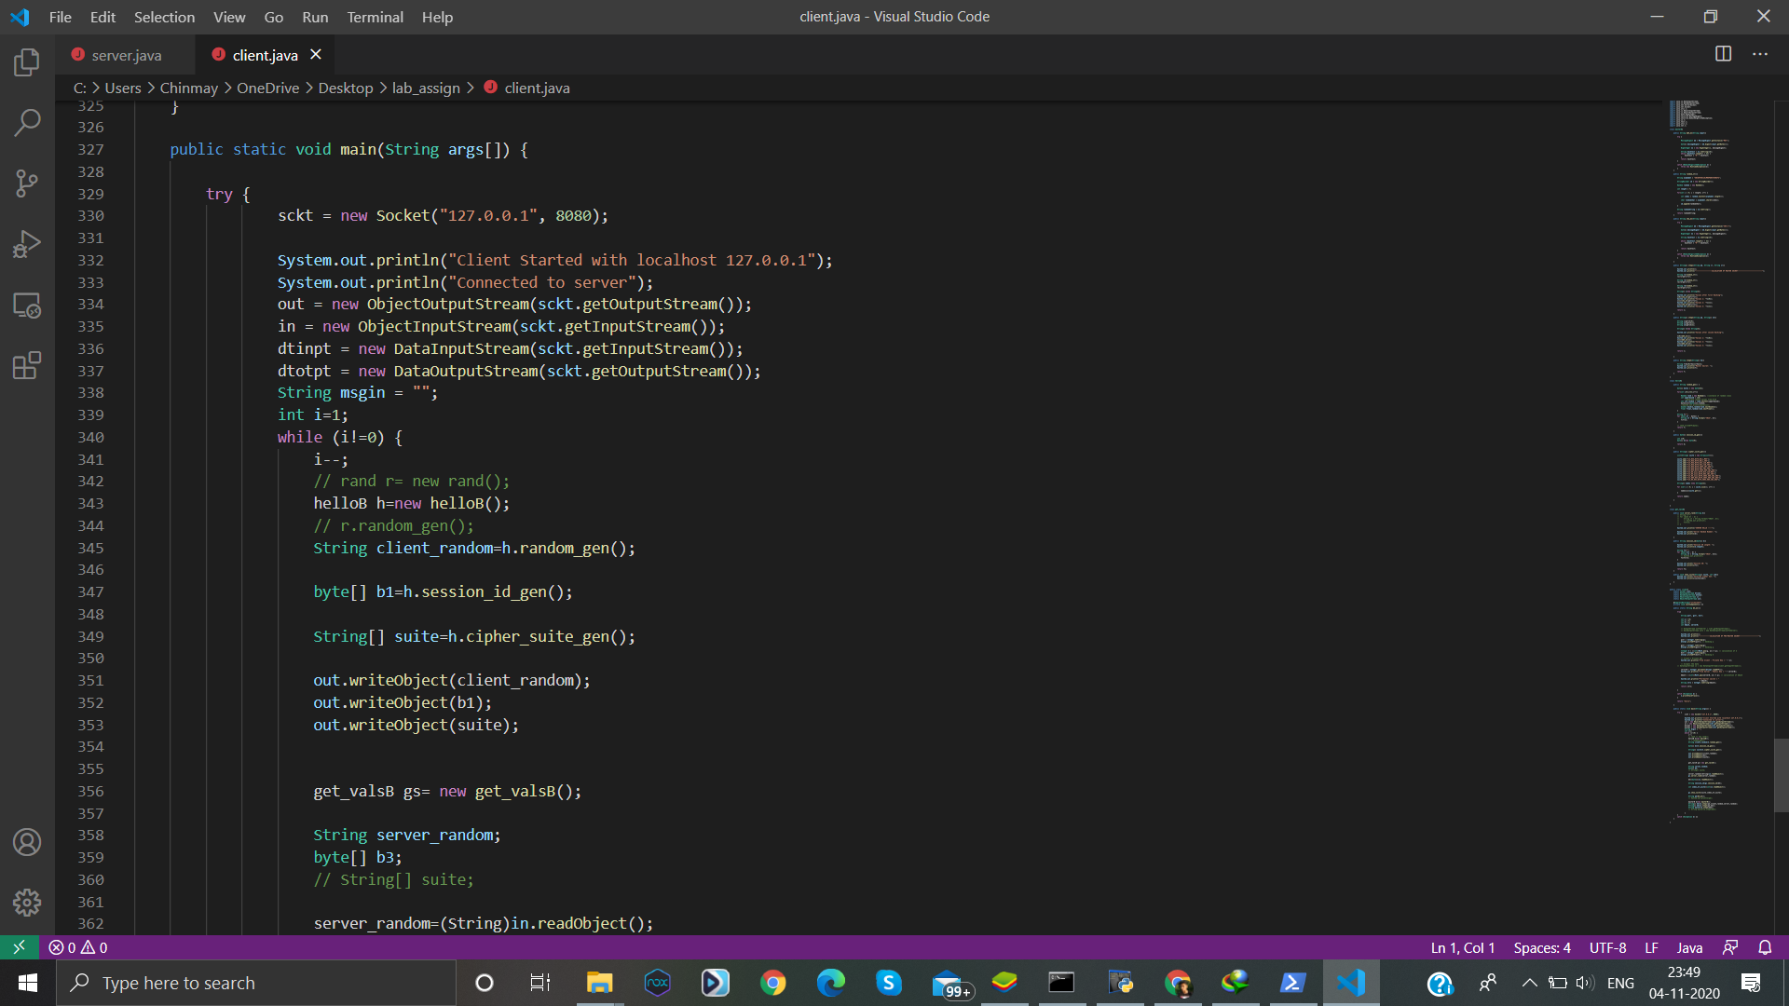
Main Function of Client program

Slide 7
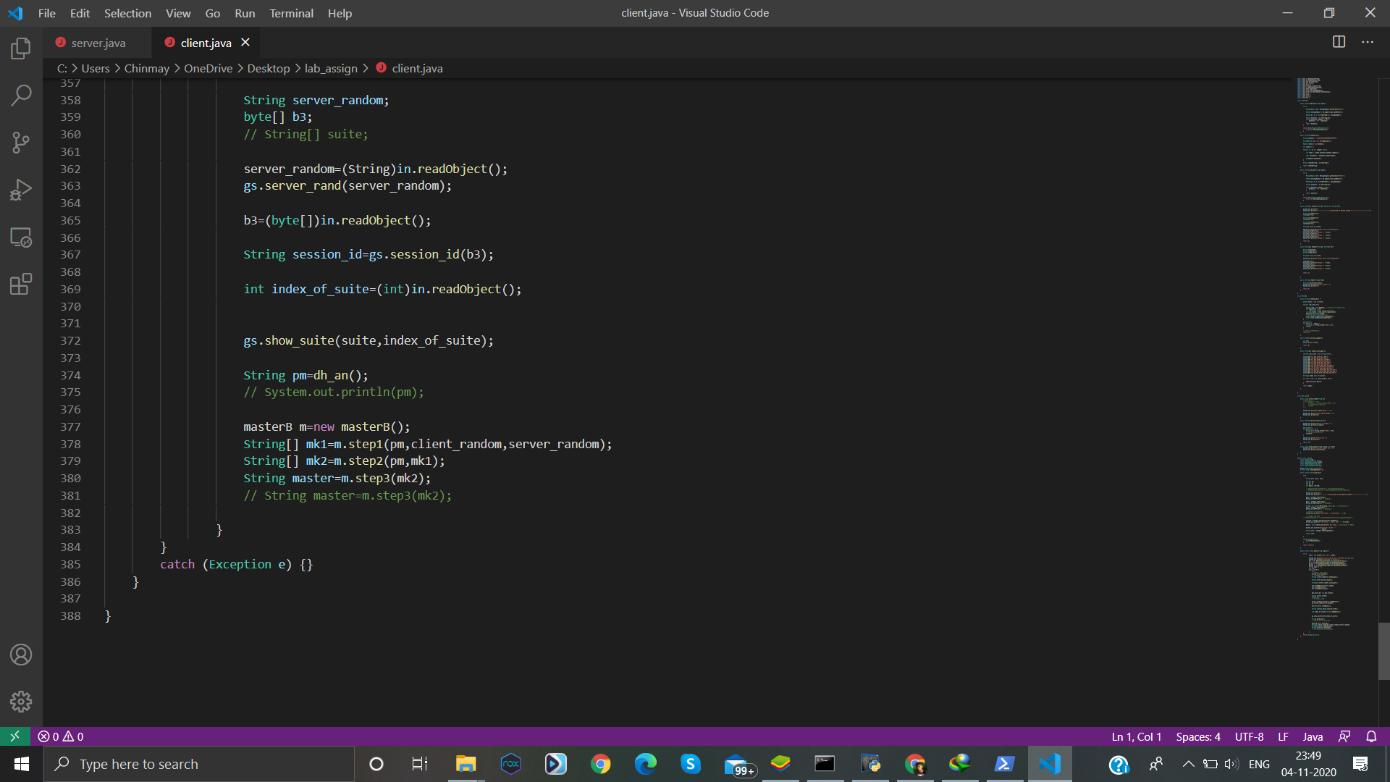

Slide 8
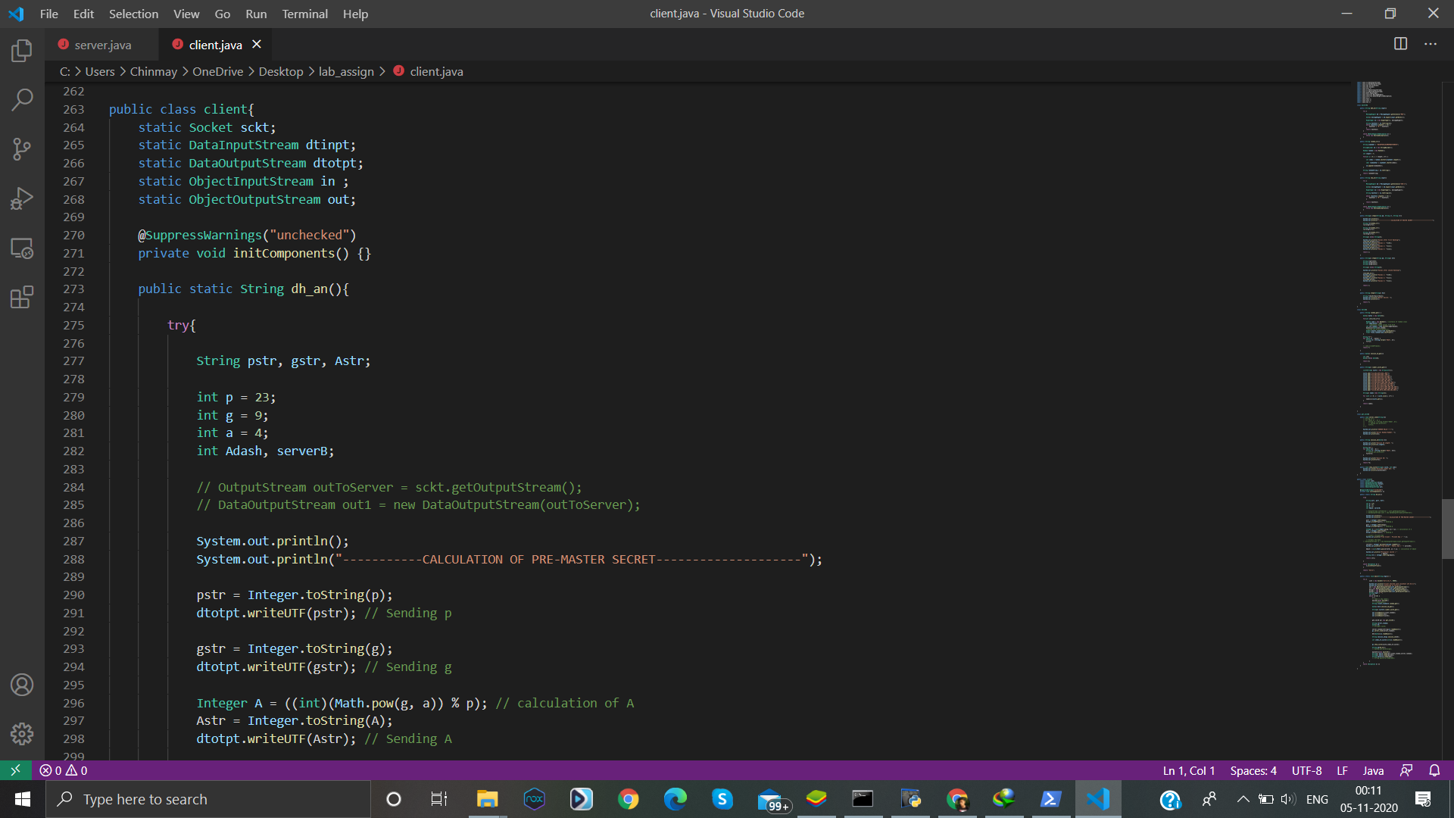
Client Function

Slide 9
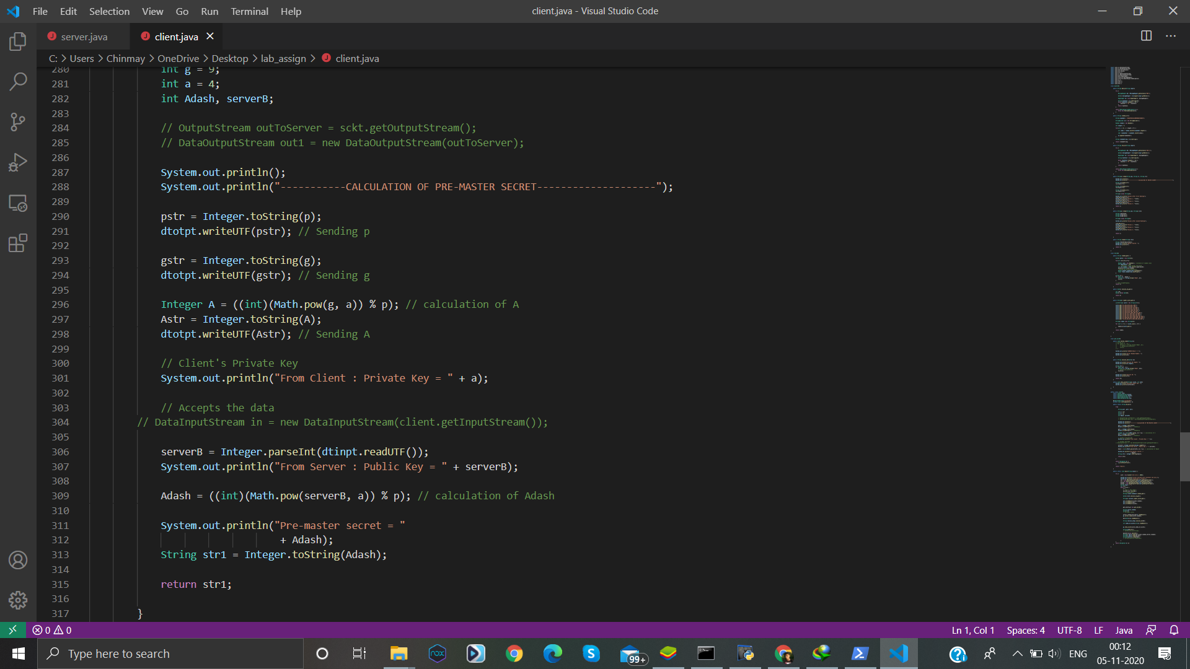

Slide 10
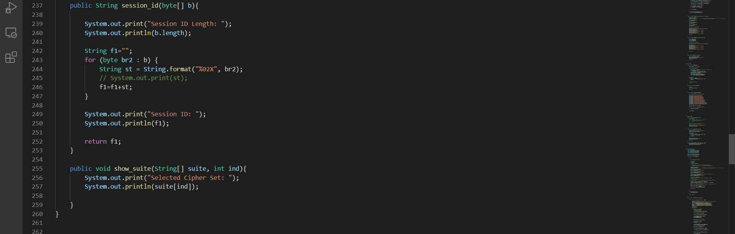
Function to generate Session Id

Slide 11
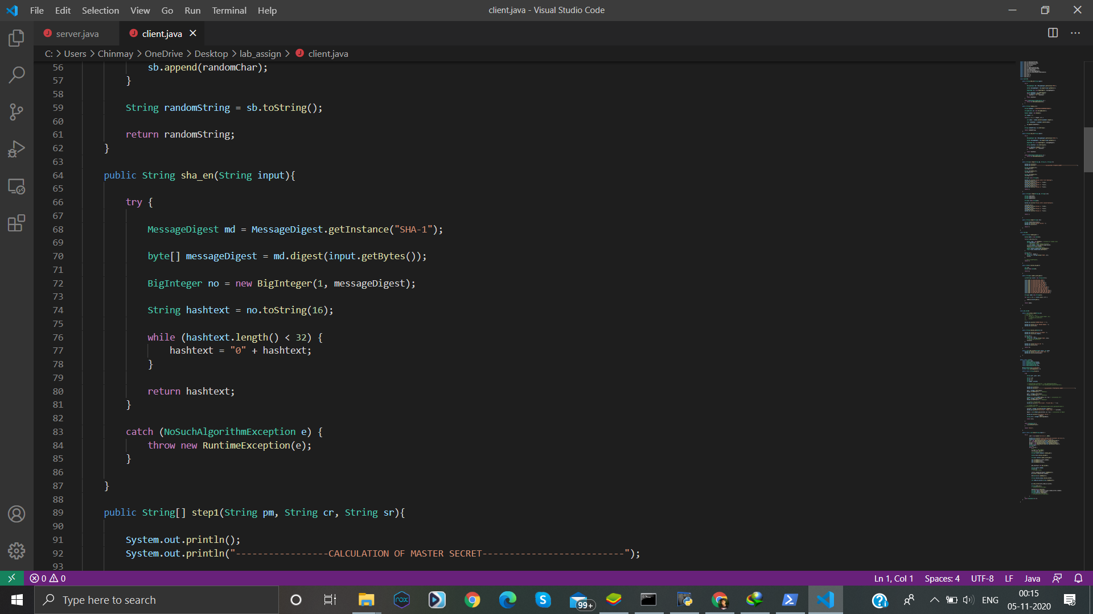
Function for Sha_encryption
_

Slide 12
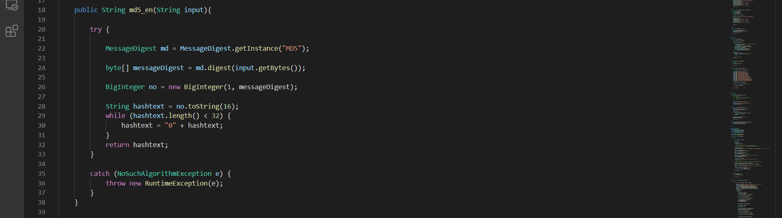
Function used for MD5 hashing

Slide 13
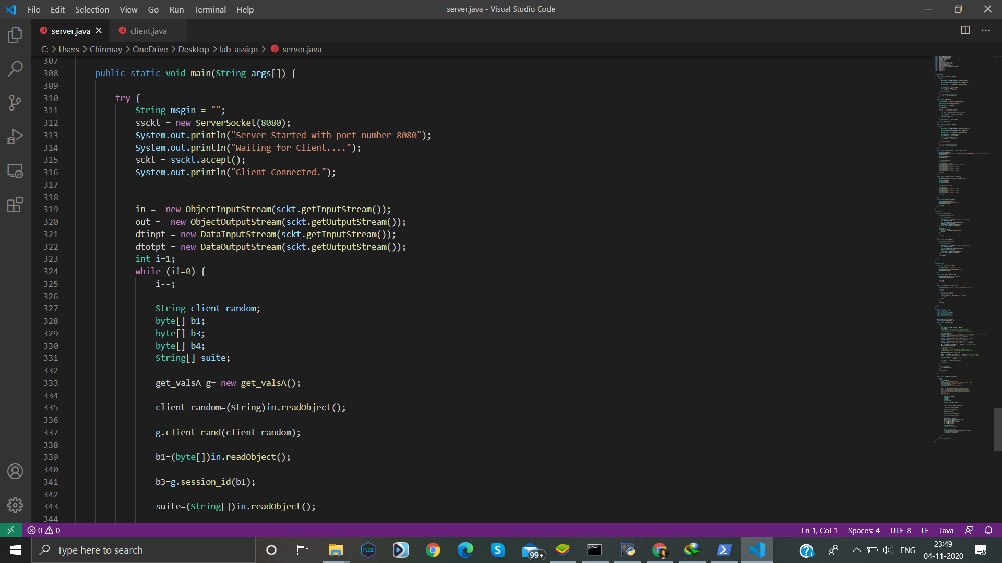
Main Function of server program

Slide 14
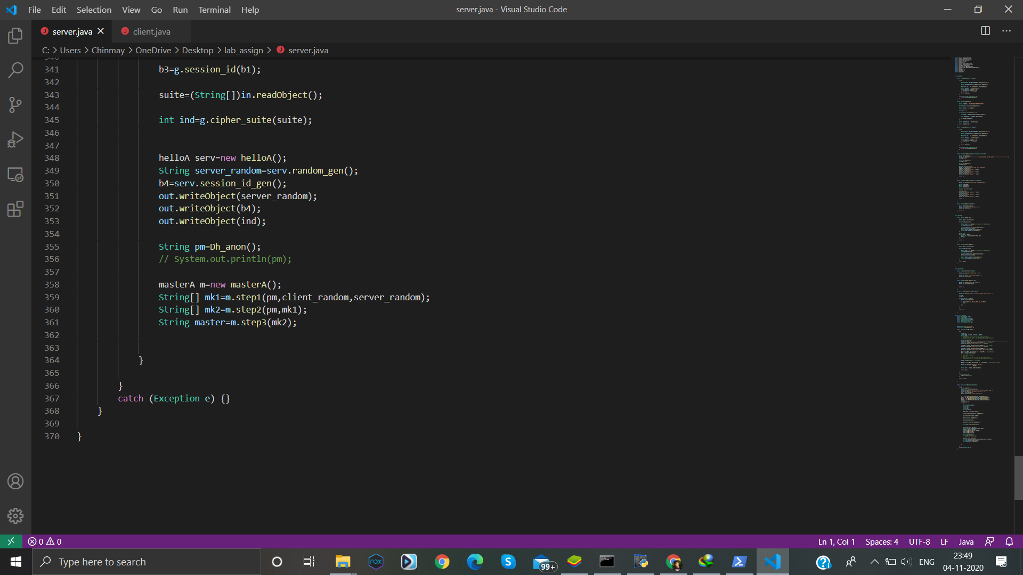

Slide 15
