Slide 1
NETWORK SECURITY ASSIGNMENT
IMPLEMENTATION OF FIAT-SHAMIR
BINDU IIT2018105
AYUSHI GUPTA IIT2018118
SANJANA IIT2018120
TS CHINMAY IIT2018138
NILANG VASAVA IIT2018147
V Semester B.Tech, Department of Studies in Computer Science,
Indian institute of information technology Allahabad,Allahabad, India

Slide 2
What is fiat shamir protocol?
It is One of the most well-known protocols identification using zero knowledge proof protocol and is proposed by Amos Fiat and Adi Shamir. It uses the zero-knowledge interactive proofs for entity authentication.

Slide 3
Zero knowledge identification proof
A Zero knowledge proof is a method where one party can prove (prover) to another party (verifier) without revealing knowledge of secret itself.
Zero Knowledge proofs can be used for identification.The traditional form of identification is by use of a secret key, password or pin, but this scheme is extremely insecure since they are easy to guess, for example, through an exhaustive search. Recently, biometric parameters like fingerprints, retinal scans or facial recognition are used, but they are not comfortable, and they give value to body parts, which can have many disadvantages. Another common scheme is using digital signatures and public-key cryptography. An identification scheme consists essentially of two separate stages- Initialization and operation.

Slide 4
In public-key identification schemes, during the first stage each user generates a private key and a public key. A Trusted Authority is required to ensure the link between each user and his public key. At the end of the operation stage the verifier can accept or reject the identification.
A Zero Knowledge identification proof must satisfy the three conditions:
Completeness: If a statement is true and both parties follow the same protocol correctly, then the verifier naturally becomes convinced
Soundness: If statement is false, the verifier will almost certainly not be convinced (Probabilistically Checkable Proof constructions rely on repetition until probability of falsehood or plain coin flip luck approaches zero).
Zero-knowledge: If the statement is true, no verifier learns anything other than the fact that the statement is true.

Slide 5
Fiat shamir explained further:
There are several variants of the Fiat–Shamir identification protocol:
1. To classify these is based on the number of secrets.
2. To distinguish between identity-based and public-key based one.
In both, a trusted center made public n = p ⋅ q such that p and q are secret
primes only known to the centre.

Slide 6
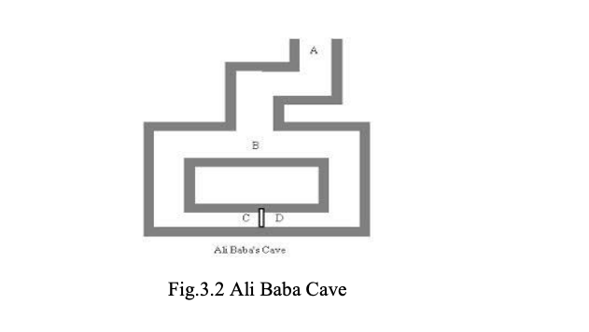
Cave Example :

Slide 7
Suppose there is an underground cave like the above cave with a door at both ends which will open with some magic word. Alice says that she knows the word and thus can open the door. Suppose both Alice and Bob are standing at the entrance point A, then Alice goes to B, where Bob can’t see Alice.
Alice can move to either right or left and it can be corresponded to the witness.
Then Bob comes to B and asks Alice to come from left or right and thus it corresponds to challenge.

Slide 8
If Alice knows the word, she can come from any side which is requested. Because if she is on the right side, she can come easily and if on the wrong side, she can use the magic word to come from the requested side.
This game can be repeated many times, Alice can win the game if she can pass the test all the time. The probability of her winning the game is very less if doesn’t have the private key (word).
So if the game is run N times and as each time Alice has ½ chance of winnig.so the chance of Alice winning the game is (1/2)N .

Slide 9
The Protocol:
Repeat the protocol t times:
Alice chooses uniformly random r and computes
z := r mod n and sends t to Bob.
Bob sends Alice bits ei ( ≤ i ≤ k).
Alice sends α :=r ∗ ∏_{ei=1} si^{ei} mod n.
Bob verifies that α² =∏_{ei=1} xi=z
If all the verifications are correct, Bob accepts.

Slide 10
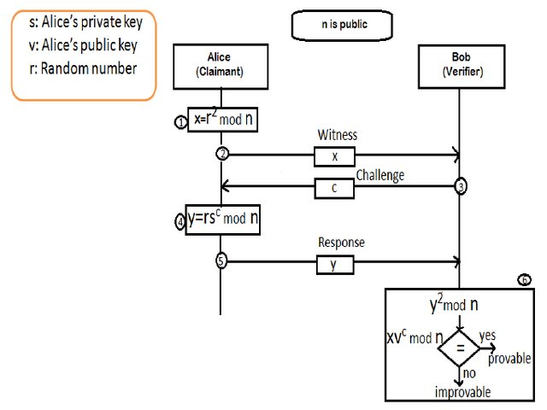

Slide 11
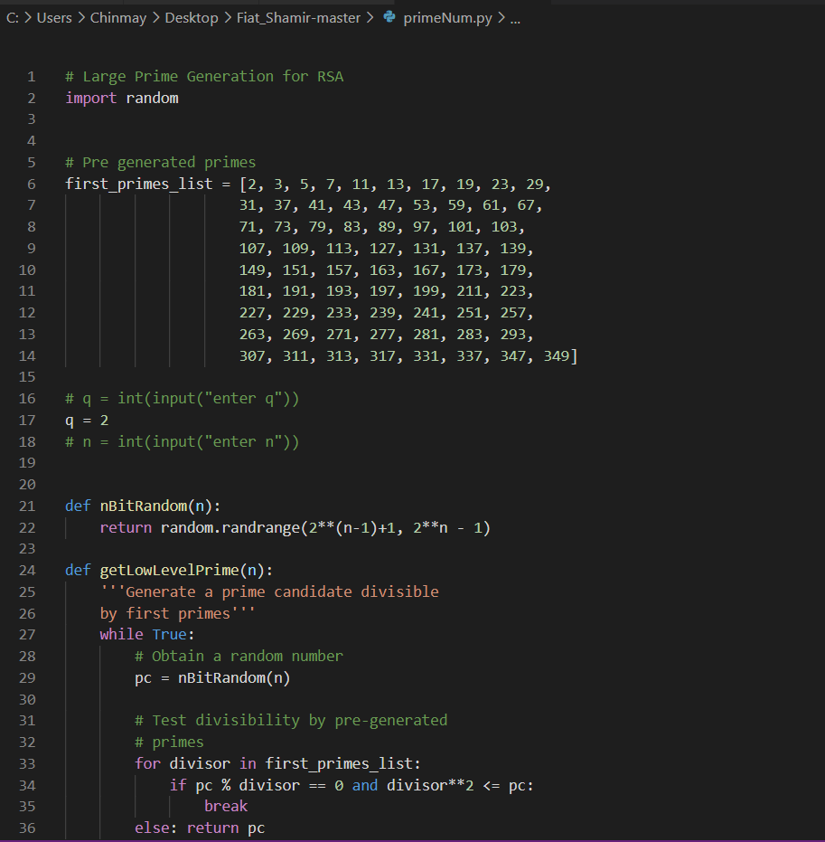
CODE TO GENERATE LARGE PRIME VALUES FOR N

Slide 12
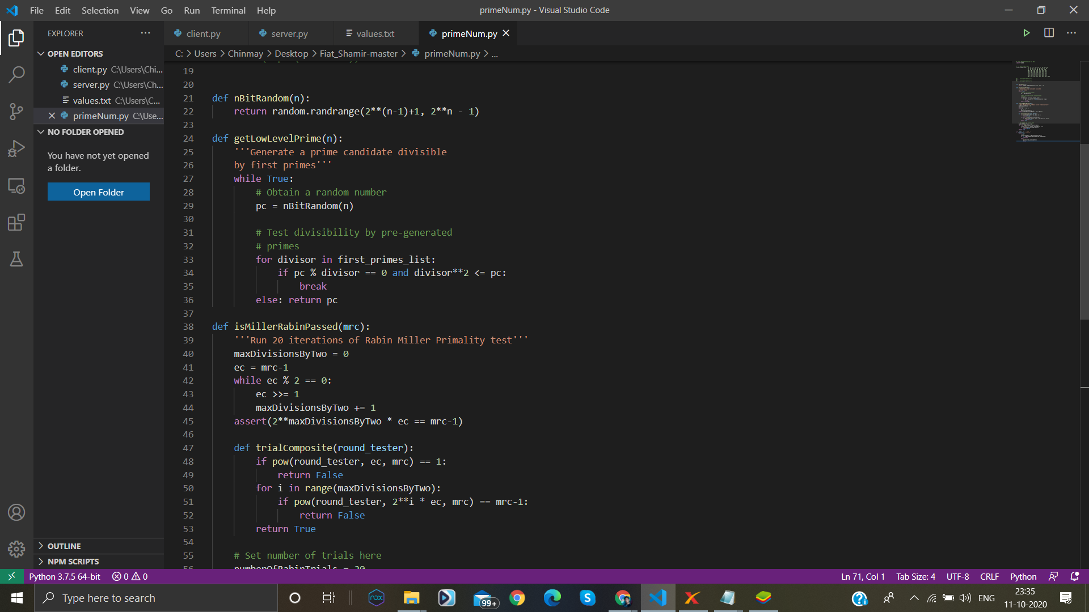

Slide 13
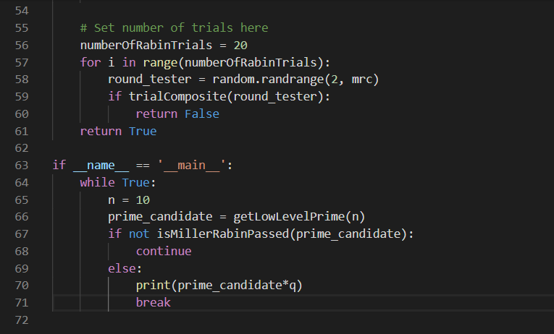

Slide 14
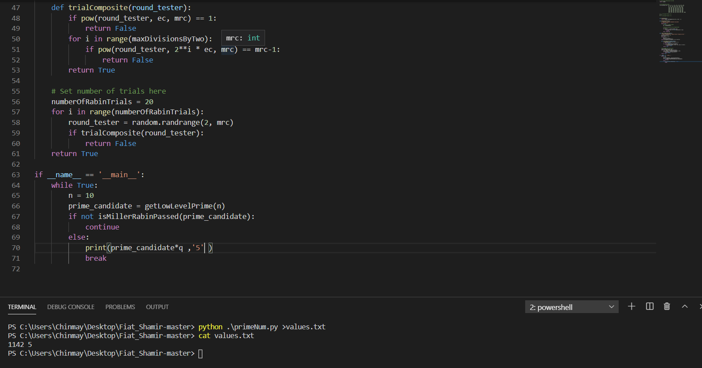
WHERE N = p*q ( p will be randomly generated large prime
Where as q would be any small prime ) eg .2
The client will take the values of N from the file values.txt.

Slide 15
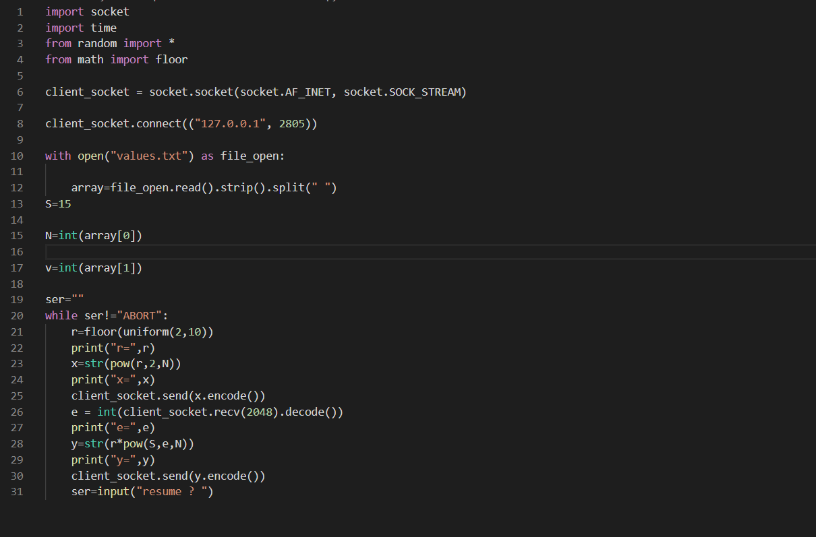
Client.py

Slide 16
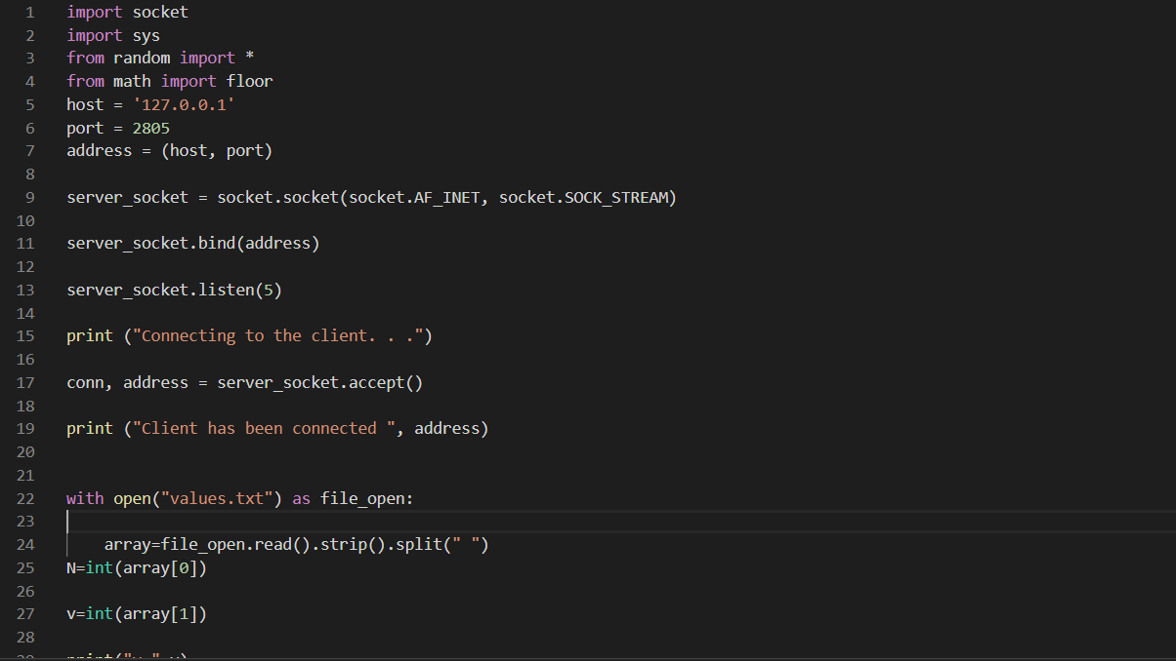
server.py

Slide 17
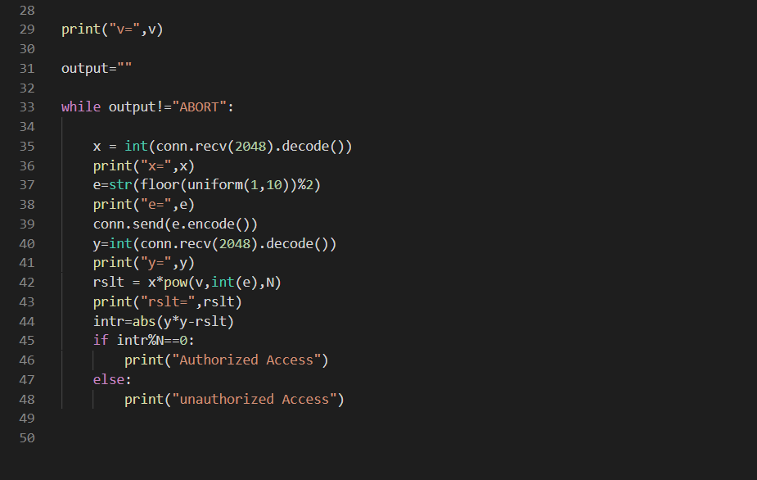
server.py

Slide 18
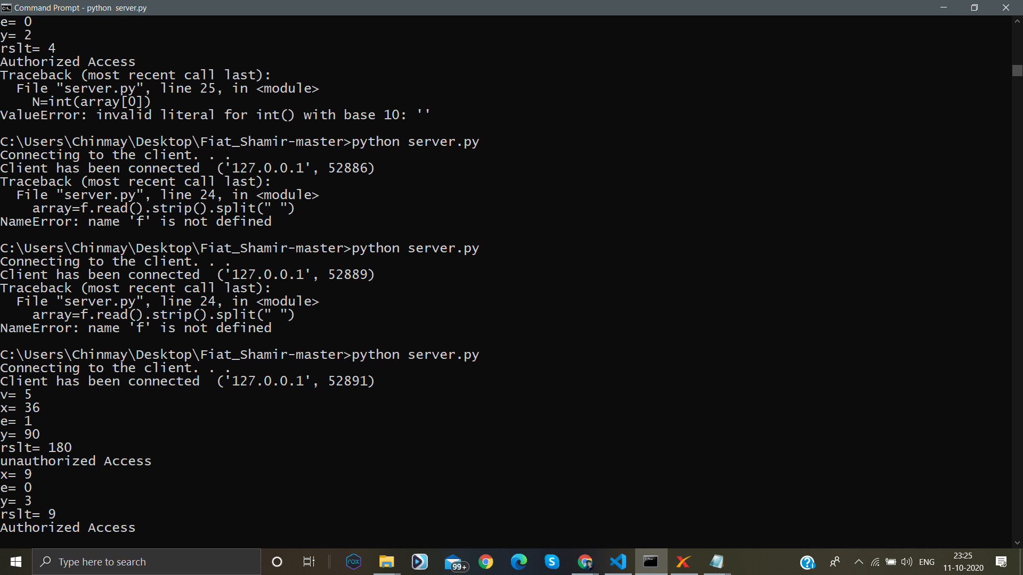

Slide 19
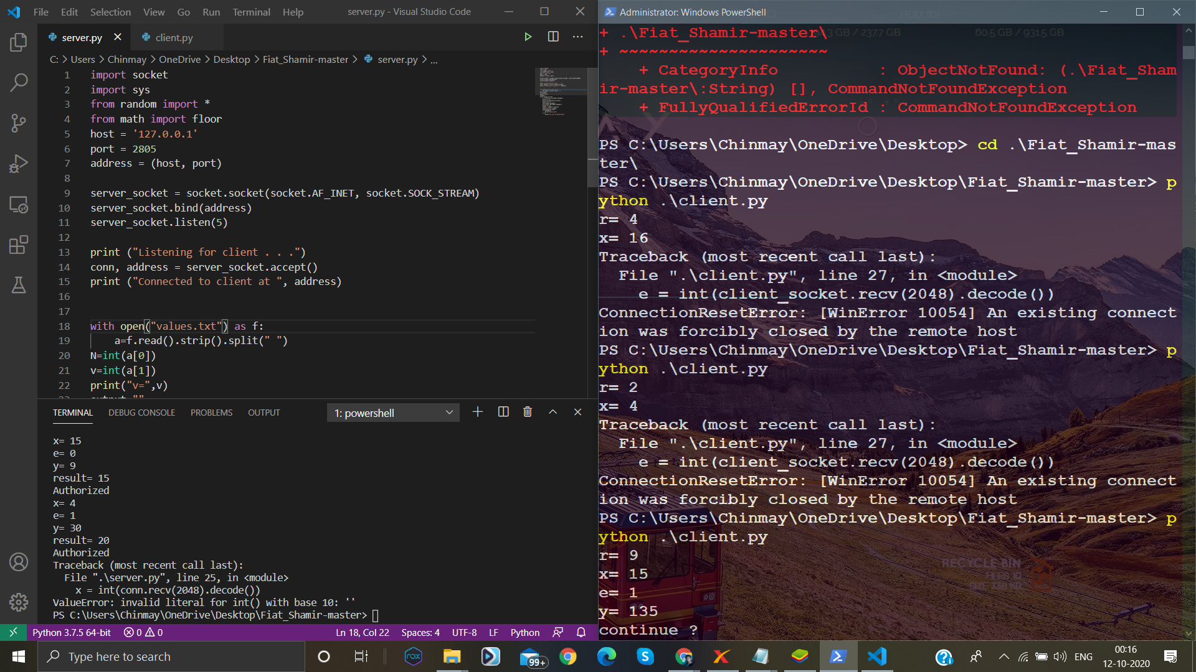

Slide 20
THANK YOU ..!!!!

