Slide 1
Sentiment Analysis of Real-Time Geo-Tagged Tweets
Qais Makani (A029)
Yash Rathod (A042)
Chinmay Parikh (A059)

Slide 2
Problem Statement
Due to leaps in social media and technology, Almost everyone is connected to social networks like Twitter
Companies which have a twitter account are followed by their customers and desire to know how well their product is doing by analyzing customer tweets
Its easy for human to decipher the tweets and sort them into categories. But computers don’t understand human language or the context of the tweet or concepts such as sarcasm
Therefore, there is a need for an application that does this using techniques like Natural Language Processing and Machine Learning

Slide 3
Approach
To implement an algorithm for automatic classification of text into positive or negative
We will work on classifying the opinionated text using Machine Language
We want to train a classifier to categorize free text according to the training data
Graphical representation of the sentiments in the form of 3D Globe

Slide 4
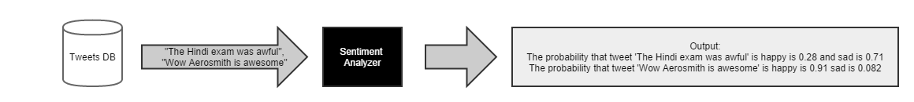
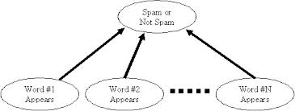
Project Overview
Output .db
Stream.py
Tweets.json
Store .py
Create Database .py
Tweets .db
Classifier.py
Twitter Public Stream

Slide 5

Web Globe

Slide 6
Challenges
The key challenges are:-
1) Named Entity Recognition – What the person is actually talking about, e.g. is 300 Spartans a group of Greeks or a movie?
2) Parsing - What is the subject and object of the sentence, which one does the verb and/or adjective actually refer to?
3) Sarcasm - If you don't know the author you have no idea whether 'bad' means bad or good
4) Twitter - abbreviations, lack of capitals, poor spelling, poor punctuation, poor grammar, ...

Slide 7
Contd..
Corpus –
the efficiency of the corpus is less as it is a prototype

Slide 8
Naïve Bayes
Naïve Bayesian is a probabilistic classifier based on Bayes theorem
Bayes theorem states that
P(A|B) = P(B|A) x P(A)
P(B)
P(A), the prior probability, is the initial degree of belief in A.
P(A|B), the conditional probability, is the degree of belief in A having accounted for B.
the quotient P(B|A)/P(B) represents the support B provides for A.

Slide 9
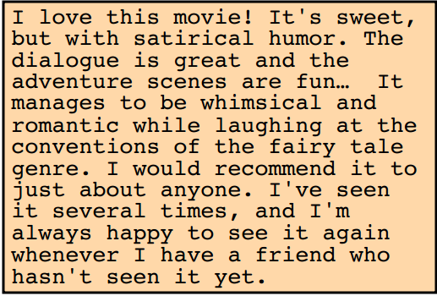
Contd..

Slide 10
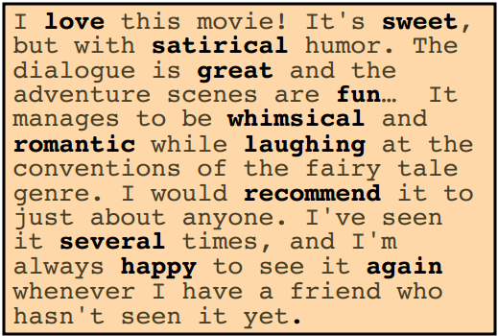

Slide 11
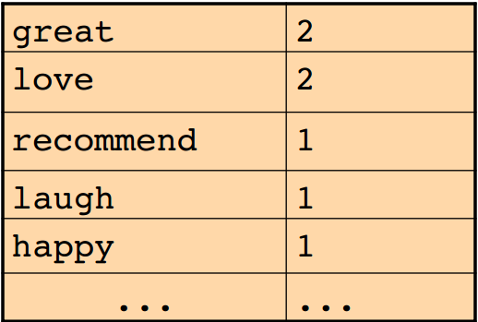

Slide 12
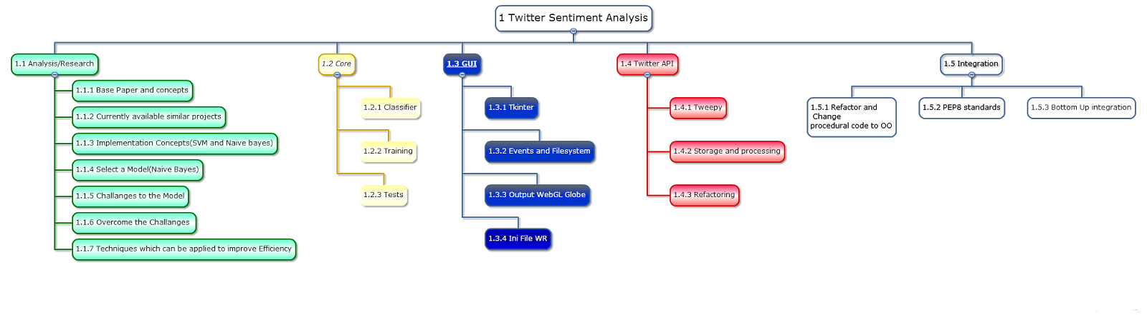
Project Plan

Slide 13
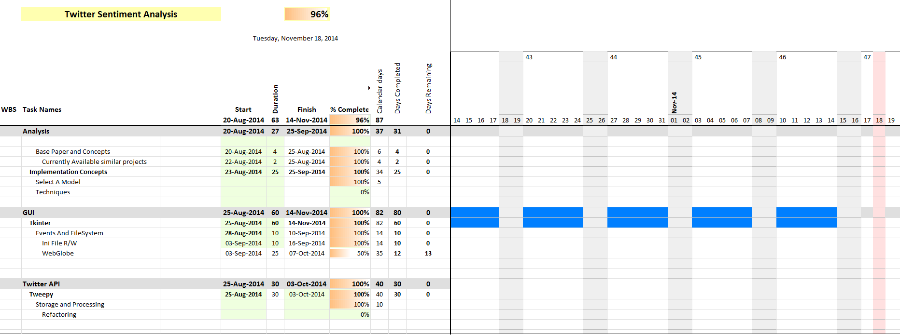
Work Done

Slide 14
Thank You !

