Slide 1
Utilizing RSA Archer Risk Management 5.0 Solution
Presented by:
Sweta Rao Nuty – A036
Amol Shah – A057
Aadit Shah – A058
Chinmay Parikh – A059

Slide 2
Introduction
Risk Management is a discipline of many avenues and techniques.
Every company faces different risks and has different business objectives. Hence, the process of managing risks to those objectives can vary from company to company.
This solution will help any organization in any domain to tackle different risks encountered to fulfill their business objectives.
RSA Archer Risk Management 5.0 Solution is:
Best of breed solution
Sustainable
Consistent
Flexible

Slide 3
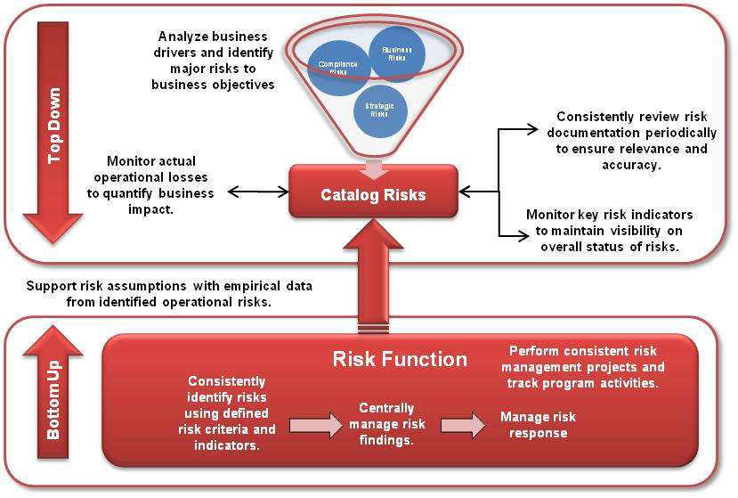
Top Down/Bottom Up Risk Management Approach

Slide 4
Top Down Risk Management
Using a "top down" approach, the organization identifies key business risks and catalogs those risks into a central repository.
These risks can be compliance, business, strategic or major operational risks and represent the executive-level risks that are "top of mind" for the organization.
The risks could be driven by several factors – major incidents or losses, regulatory compliance requirements or systemic issues in operations.
Once these risks are cataloged then the risks can be monitored over time. This includes:
Reviewing the risk documentation on a periodic basis to ensure the risks are properly evaluated and documented
Monitoring loss events to track actual operational losses associated with the risks
Implementing metrics or other indicators that will give insight on elements that may indicate that the risk is prevalent in the operational side of the organization.
Outcome: The organization has implemented a consistent, repeatable practice to address major risks in the organization.

Slide 5
Bottom Up Risk Management
The converse of the ―top down approach is to perform systematic assessments against operations to identify systemic, repeated or major risks within operations.
The risk function or risk organization analyzes various parts of the organization, assesses the risks, and initiates remediation efforts.
Typically this process involves pre-built risk assessments (questionnaires) that are filled out by process, business or technology owners in order to identify risks.
The process could also make use of technology tools such as vulnerability scanners or other security tools.
The Risk Management solution is focused on non-technology oriented risk identification methods such as questionnaires, risk assessments, risk analysis on projects, etc.
The bottom up approach involves several components:
A method to manage the process by which risk analysts identify risks
Defined risk criteria and indicators to identify the risks
A central repository to manage the findings generated from those risk assessments
A clear path to treat risks through remediation, transfer or acceptance of risk.

Slide 6
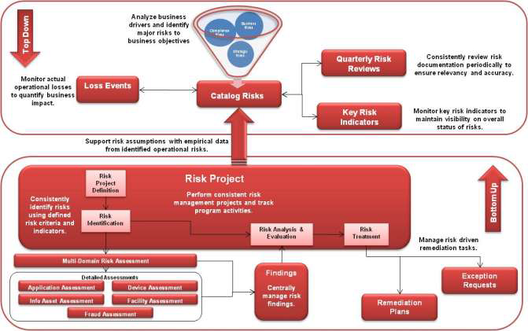
Connecting the Top and Bottom
Outcome: RSA Archer Solution

Slide 7
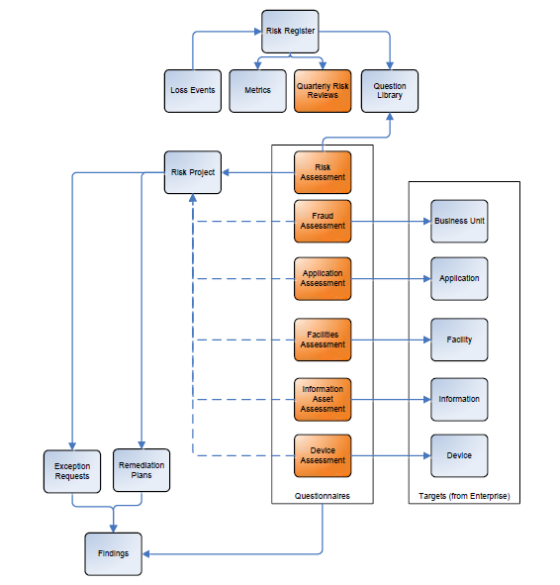
Solution Structure

Slide 8
What is Solution Structure? - 1
Risk Register:
The Risk Register is a centralized, structured method to catalog risks across the organization to provide an enterprise view of potential issues.
The Risk Register can then be used to drive risk and compliance activities such as risk monitoring or compliance/audit activities.
For each risk in the Risk Register, information is captured on the overall risk, impacts, likelihood and response.
Metrics: The Metrics application provides the means to establish periodic measurements for objectives, including key performance indicators (KPIs) and key risk indicators (KRIs).
Loss Events: The Loss Events application provides an effective response mechanism to internal exposures and external events that pose risk in the form of financial loss to the organization.

Slide 9
What is Solution Structure? - 2
Quarterly Risk Review: The Quarterly Risk Review is a questionnaire that targets each Risk Register entry. The purpose of the questionnaire is to prompt the risk owner to verify the documentation of the Risk Register entry. This ensures that the documentation in the Risk Register stays current.
Question Library: The Question Library application supports the Archer Policy, Risk, Compliance and Vendor Management solutions.
Risk Project: The Risk Project application enables the risk function to manage the operational activities of the risk program through project management and an integrated risk methodology.
Questionnaires: The Questionnaire function in the RSA Archer eGRC Platform provides a fully functional survey/questionnaire tool.

Slide 10
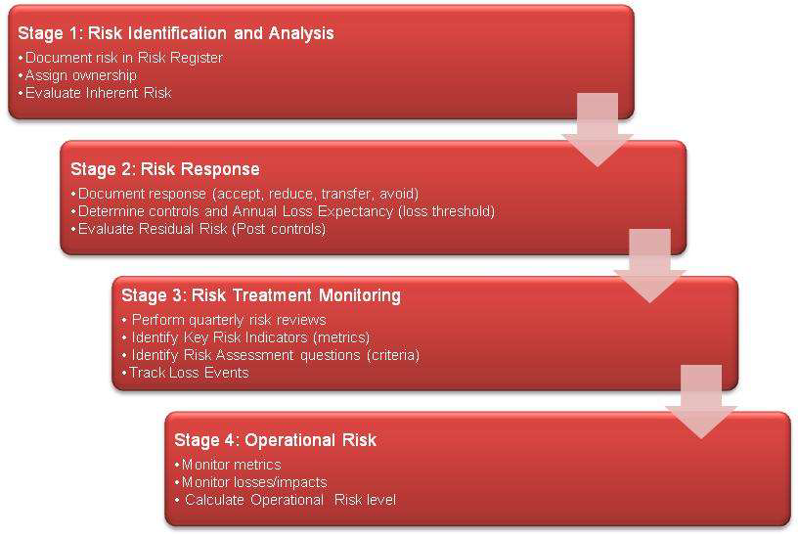
Risk Register Lifecycle

Slide 11
Risk Register Lifecycle - 1
Stage 1: Risk Identification and Analysis: The process of identifying a Risk Register entry can be performed using various methods.
For example, executives in the company might be queried on their critical business risks.
Another method may be regulatory driven – such as credit or liquidity risk.
Finally, risks may be identified through operational means such as significant loss events or operational failures.
The Risk Management solution is not designed to facilitate this initial identification but rather to support it and provide the repository for the output.
Stage 2: Risk Response: The risk response stage is first determined by the reaction of the organization to the risk.
Four ways to respond to a risk:
Accept the risk as a part of business and essentially make no changes to mitigate the risk
Reduce the risk through the implementation of controls
Avoid the risk through the cessation of the business activity
Share the risk through some type of transfer of the risk to some other party such as insurance.

Slide 12
Risk Register Lifecycle - 2
Stage 3: Risk Treatment and Monitoring
Risk treatment and monitoring in the Risk Register allows the organization to track the activities related to the risk in the form of the quarterly risk reviews, key risk indicators, related questions, findings and related loss events.
The risk treatment and monitoring stage is when the risk is being watched over time.
Stage 4: Operational Risk: The operational risk component of the Risk Register is based on the data generated during the risk treatment and monitoring stage.
The RSA Archer Risk Management solution has a pre-built model to calculate an "operational risk level". The three factors that are included in this calculation are:
% of failed metrics: Are metrics not meeting expectations? This field is calculated based on the status of the KRIs associated with the risk.
% of non-compliance controls: Are controls not working properly? This field is calculated on the compliance rating of the control procedures associated with the risk.
% of open findings: Are risk assessments identifying issues related to the risk in operational processes? This field is calculated on the overall status of the findings associated with the risk.

Slide 13
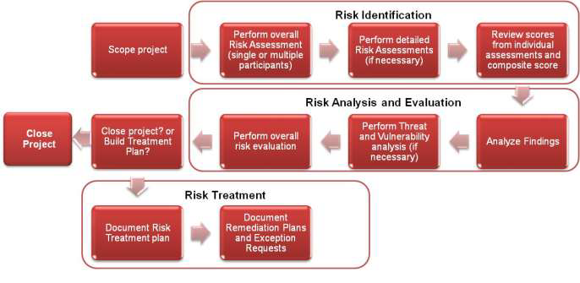
Risk Project Lifecycle

Slide 14
References
http://www.emc.com/collateral/customer-profiles/h11661-rsa-archer-cp.pdf
http://germany.emc.com/campaign/germany/it-sa/assets/emc-it-sa-rsa-archer-risk-management.pdf

Slide 15
Thank you ☺

