Slide 1
Sentiment Analysis of Real Time Geo-Tagged Tweets
Chinmay Parikh (A059)
Qais Makani (A029)
Yash Rathod (A042)

Slide 2
Introduction
Sentiment Analysis or opinion mining (polarity i.e, + or -)
Deals with the computational treatment of opinion, sentiments and subjectivity in text
Helpful in conducting market research
For example, what do people on Twitter think, is Chinese food in San Francisco good or bad?
People’s opinion can be analyzed by extracting their tweets
Example: “the food tastes bad”

Slide 3
Problem Statement
Due to leaps in social media and technology, Almost everyone is connected to social networks like Twitter.
Companies which have a twitter account are followed by their customers and desire to know how well their product is doing by analyzing customer tweets.
Its easy for human to decipher the tweets and sort them into categories.But computers don’t understand human language or the context of the tweet or concepts such as sarcasm.
Therefore, there is a need for an application that does this using techniques like Natural Language Processing and Machine Learning.

Slide 4
Challenges
The key challenges are:-
1) Named Entity Recognition – What the person is actually talking about, e.g. is 300 Spartans a group of Greeks or a movie?
2) Parsing - What is the subject and object of the sentence, which one does the verb and/or adjective actually refer to?
3) Sarcasm - If you don't know the author you have no idea whether 'bad' means bad or good
4) Twitter - abbreviations, lack of capitals, poor spelling, poor punctuation, poor grammar, ...

Slide 5
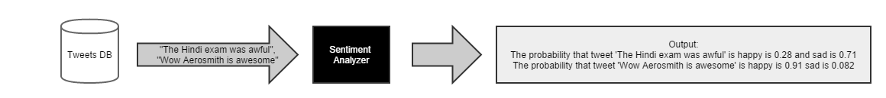
Approach
To implement an algorithm for automatic classification of text into positive or negative
We will work on classifying the opinionated text using Machine Language
We want to train a classifier to categorize free text according to the training data
Graphical representation of the sentiments in the form of 3D Globe

Slide 6
Project & Tools
Referred research papers (in references)
Tools:
Sentiment 140
Trackur
Streamcrab

Slide 7
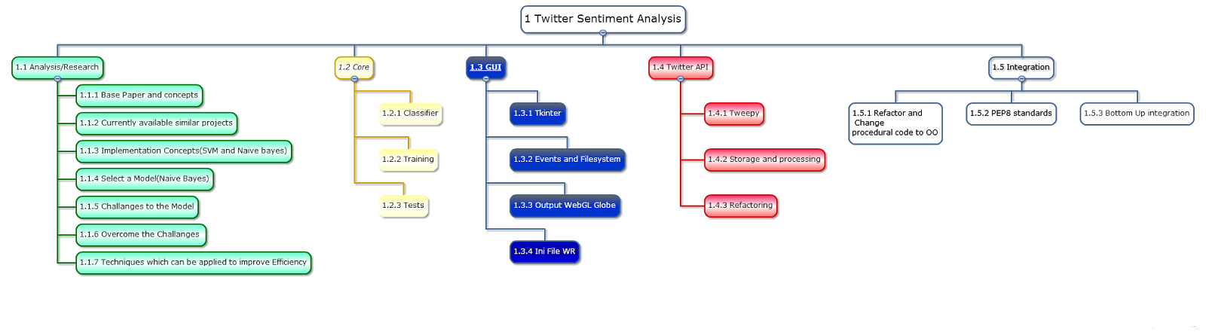
Project Plan

Slide 8
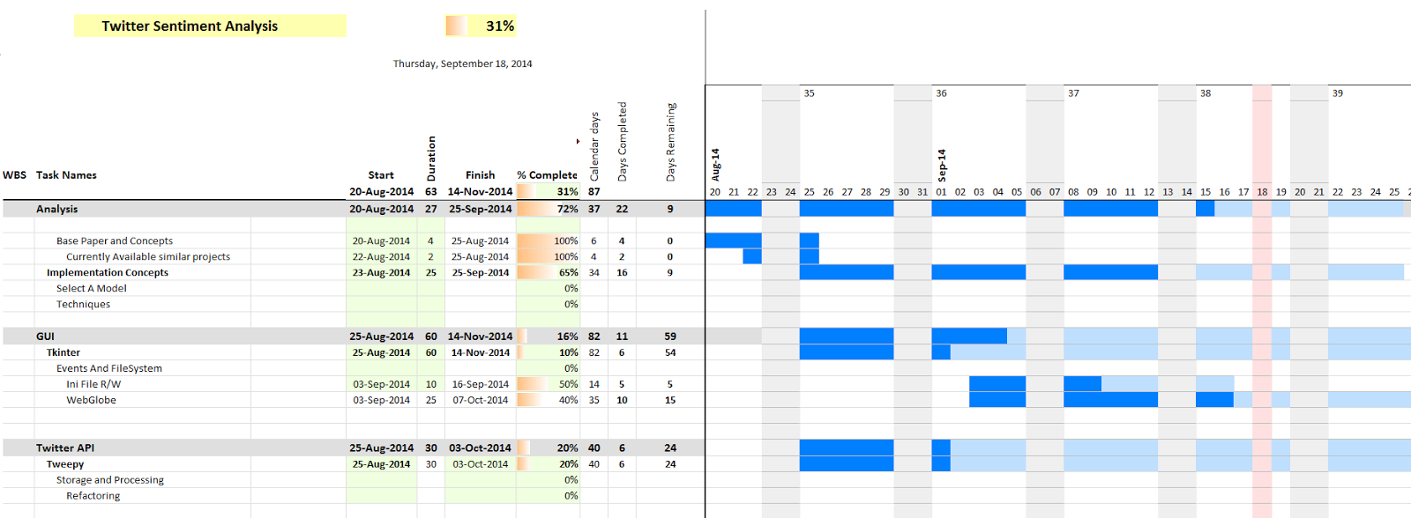
Gantt Chart

Slide 9

Graphical Representation

Slide 10
References
Language-independent Bayesian sentiment mining of Twitter by Alex Davies (University of Cambridge) & Zoubin Ghahramani (University of Cambridge) August 21, 2011, San Diego CA USA . Copyright 2011 ACM 978-1-4503-0225-8.
(http://eprints.pascal-network.org/archive/00008437/01/Language_Indepedent_Bayesian_Sentiment_Mining_of_Twitter.pdf)
Fast and accurate sentiment classification using an enhanced Naive Bayes model. Vivek Narayanan1, Ishan Arora2, Arjun Bhatia3. Department of Electronics Engineering, Indian Institute of Technology (BHU), Varanasi, India.
(http://arxiv.org/ftp/arxiv/papers/1305/1305.6143.pdf)

Slide 11
Contd..
TweePy Library – (www.tweepy.org)
B. Pang and L. Lee. "Opinion Mining and Sentiment Analysis" in Foundations and Trends in Information Retrieval, 2008.
B. Pang and L. Lee. "A Sentimental Education: Sentiment Analysis Using Subjectivity Summarization Based on “Minimum Cuts” in Proceedings of ACL, 2004.

Slide 12
THANK YOU !!

