Slide 1


SDM COLLEGE OF ENGINEERING AND TECHNOLOGY, Dharwad-580002 (An autonomous institution affiliated to Visvesvaraya Technological University, Belgaum – 590018) Department of Information Science and Engineering 5TH SEMESTER B.E ACADEMIC YEAR: 2023-24 MINOR PROJECT 21USIL505 “RAKTDAAN”
PROJECT GUIDE PROJECT COORDINATOR Dr Jagadeesh Pujari Dr Varsha Jadhav
TEAM MEMBERS PID-09
1. CHINMAY MAGI - 2SD21IS013
2. SOHAN MUKHTEDAR - 2SD21IS048
3. VISHAL K SAKLATHI - 2SD21IS061

Slide 2
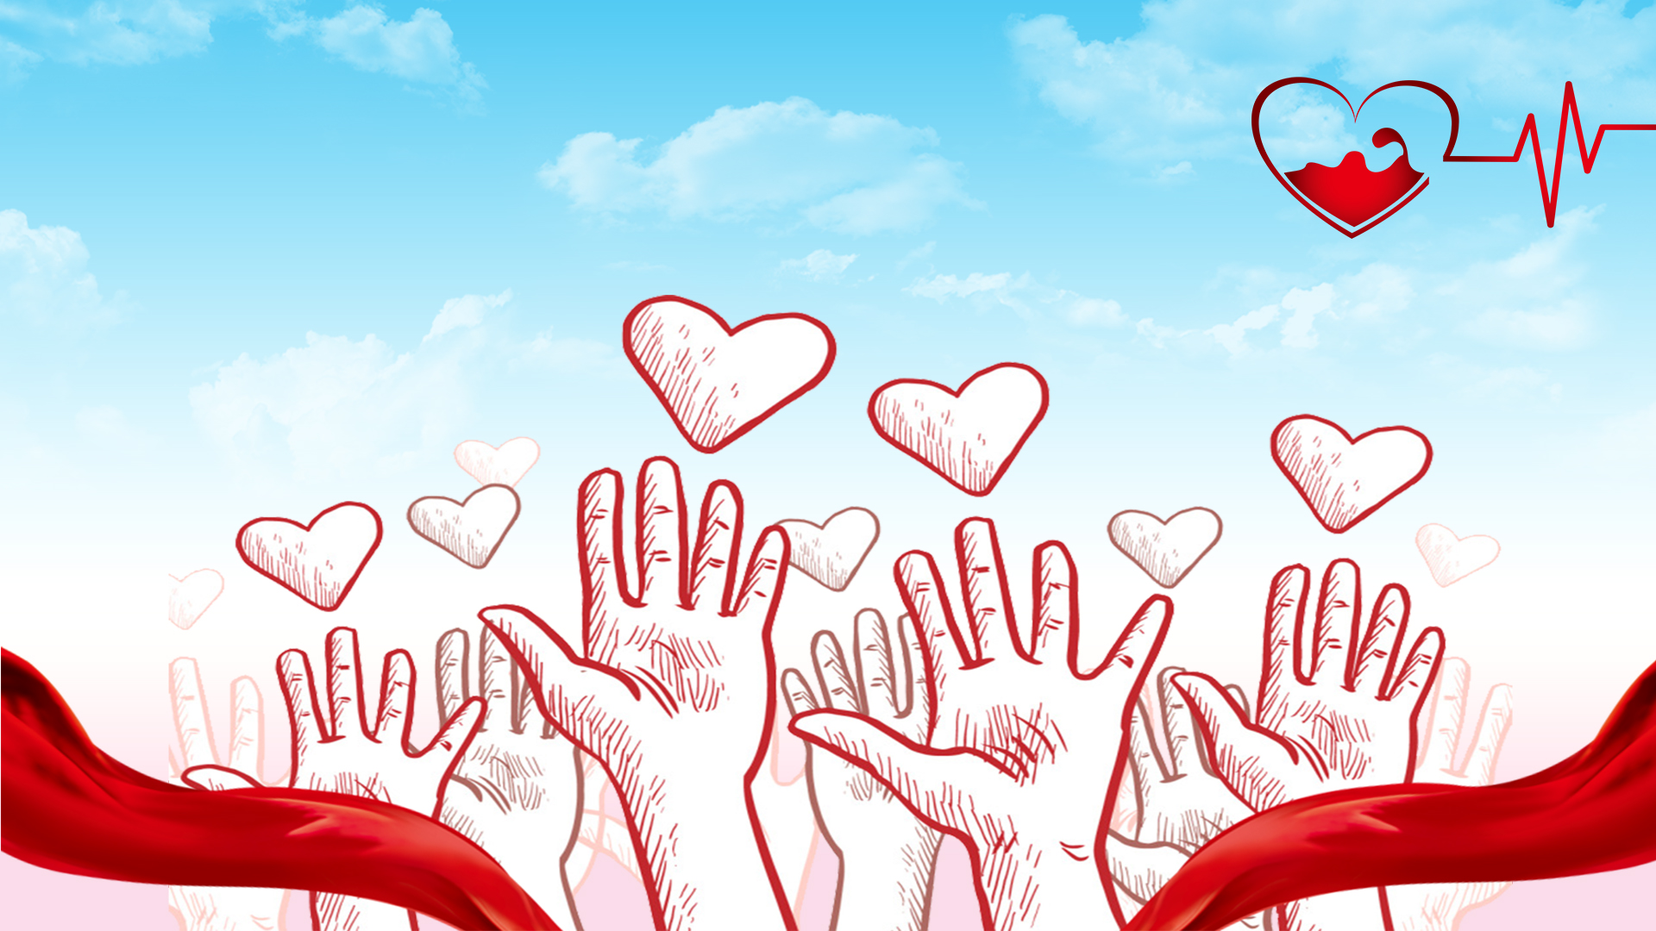

Blood donation app "Embrace the Lifesaver Within…"
Mirjam Nilsson​

Slide 3
Table of contents
CONTENTS | PAGE NO.
INTRODUCTION | 4
PROBLEM STATEMENT | 5
OBJECTIVES | 6
SOFTWARE REQUIREMENTS | 7
FUNCTIONALITY | 8
ARCHITECHTURAL DESIGNS | 9
NON FUNTION | 10
RESULTS | 11
LIMITATIONS | 12
APPLICATIONS REFERENCES SUMMARY | 12 14 15

Slide 4
introduction
4
Introducing “Raktdaan” a groundbreaking blood donation app revolutionizing the way we save lives. In a world of constant medical emergencies, timely access to blood is crucial. This innovative app bridges the gap between donors and patients, ensuring convenient and rewarding contributions. With a user-friendly interface, search donor features, and incentives for donors, “Raktdaan” simplifies the donation process, setting a new standard in lifesaving initiatives.
“Raktdaan” helps in transforming the landscape of blood donations, making it more accessible, engaging, and impactful for everyone involved. Together, we can make a significant difference in the lives of those in critical need​.

Slide 5
Problem Statement
5
The existing blood donation system faces significant challenges in efficiently connecting donors with recipients, resulting in critical shortages during emergencies and an inefficient utilization of available blood sources. Our project aims to address these issues by developing the “Raktdaan” app, which seeks to revolutionize the way blood donation is conducted, making it more accessible, organized, and responsive to the ever-present demand for blood.

Slide 6
Objectives
➢ To enable users to register as blood donors, providing their contact information, blood type, and eligibility details.
➢ To let users to send out emergency blood requests, allowing users to respond quickly and streamlining the donation process.
➢ To provide a search module that allows to search for potential donors with required blood group , and near by locations.
➢ Ensuring screening of user’s eligibility to donate blood based on factors like recent donations, medical history, and travel & recent activities.
➢ To Improve the availability of blood for medical emergencies, strengthen community engagement in blood donation, and enhance the overall efficiency of blood management.

Slide 7
SOFTWARE REQUIREMENTS
Android Studio for coding, testing, and debugging
Programming Language like dart (Flutter) for Android app development
Database Management technologies like MongoDB Atlas Cloud are required for cloud synchronization of user registration, blood requests, medical history, and blood group information.

Slide 8
Methodology
User Registration
Home Page
Request For Blood
View Requests
Search for Donors
Blood Facts
Donor profile
Donor status

Slide 9
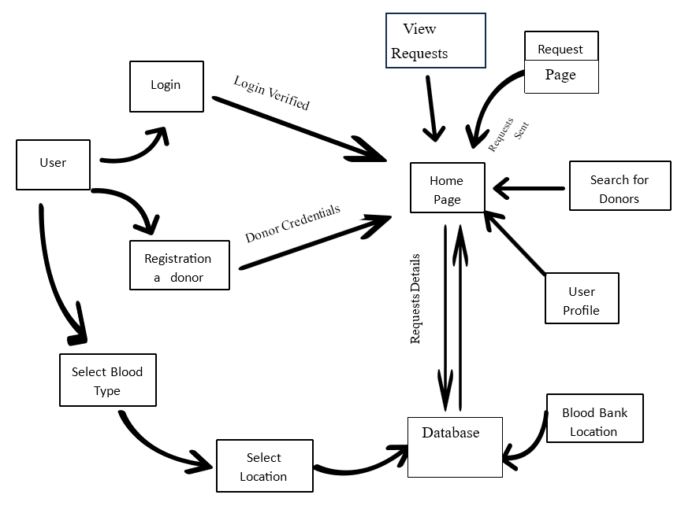
Architectural Design

Slide 10
Non Functional
10
Performance
Security
User Interface
Compatibility
Reliability
Scalability
Accessibility
Localization
Integration

Slide 11
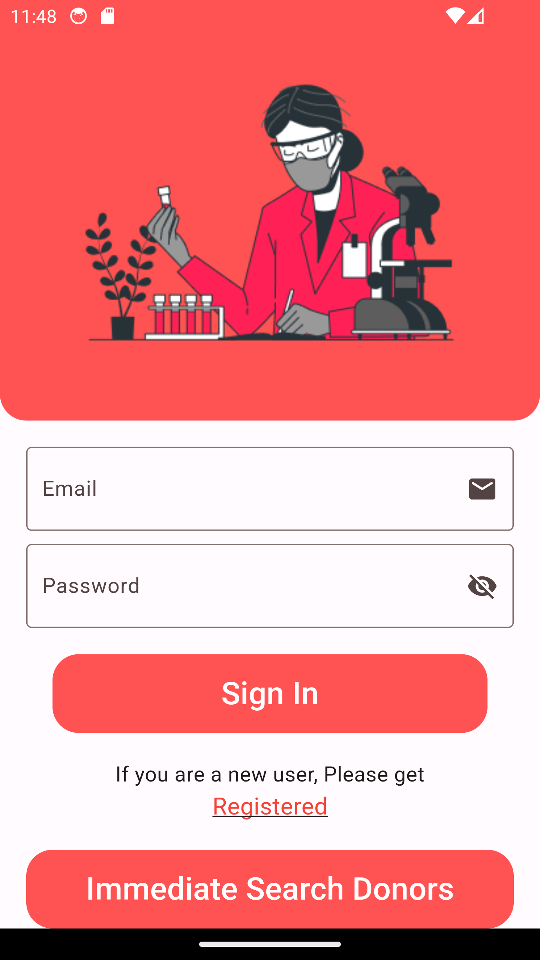
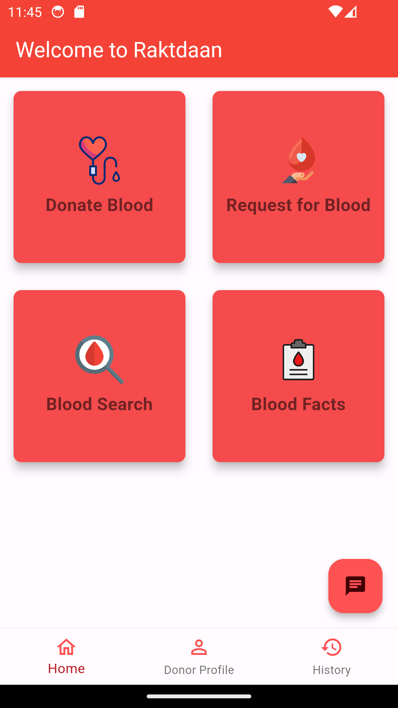
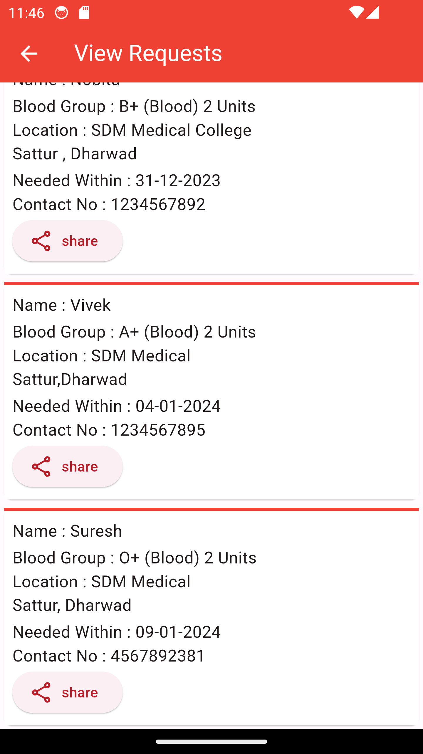
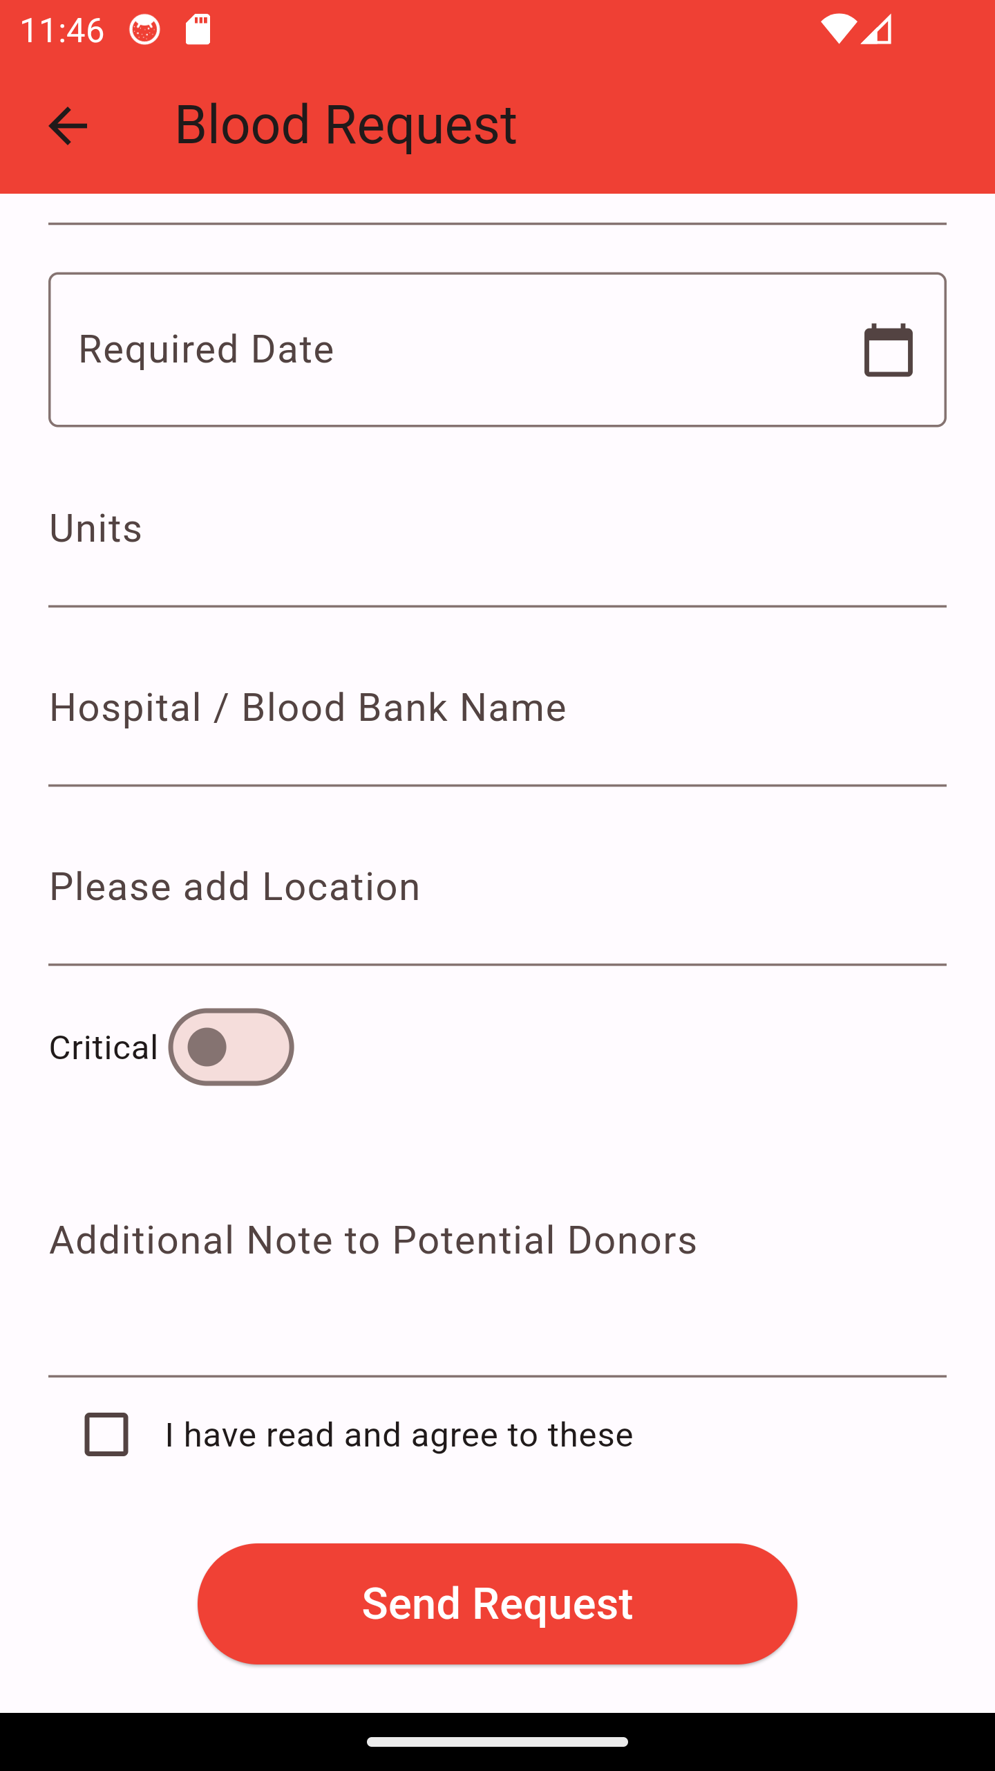
results
Various layouts of our app:
Login page
Home page
View Requests

Slide 12
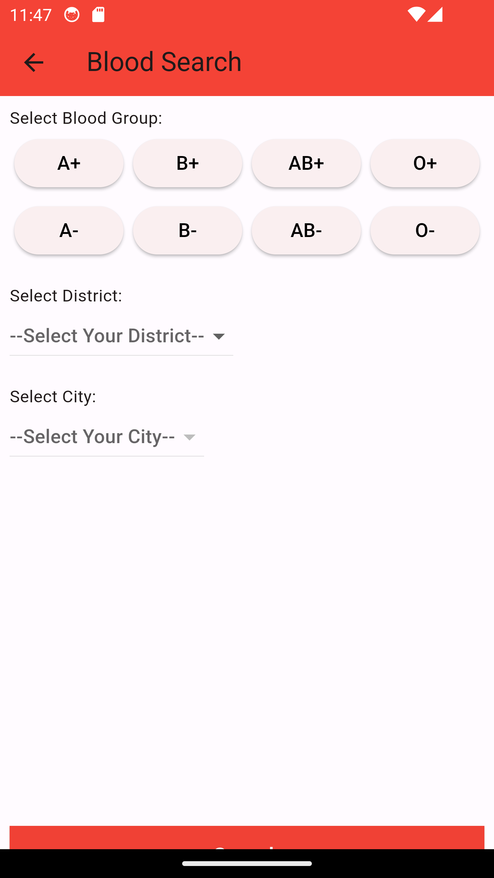
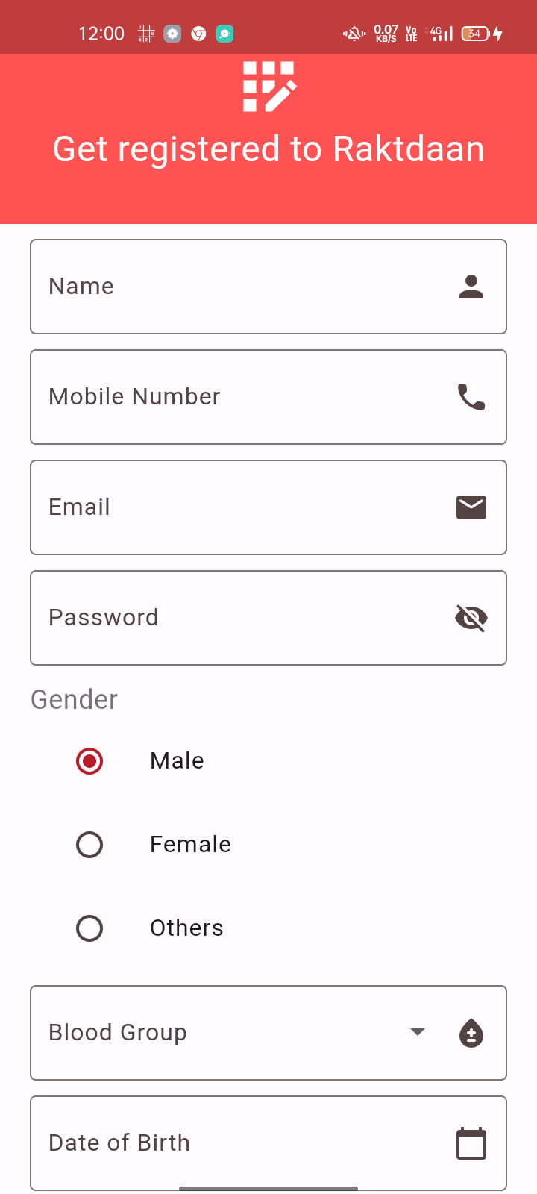
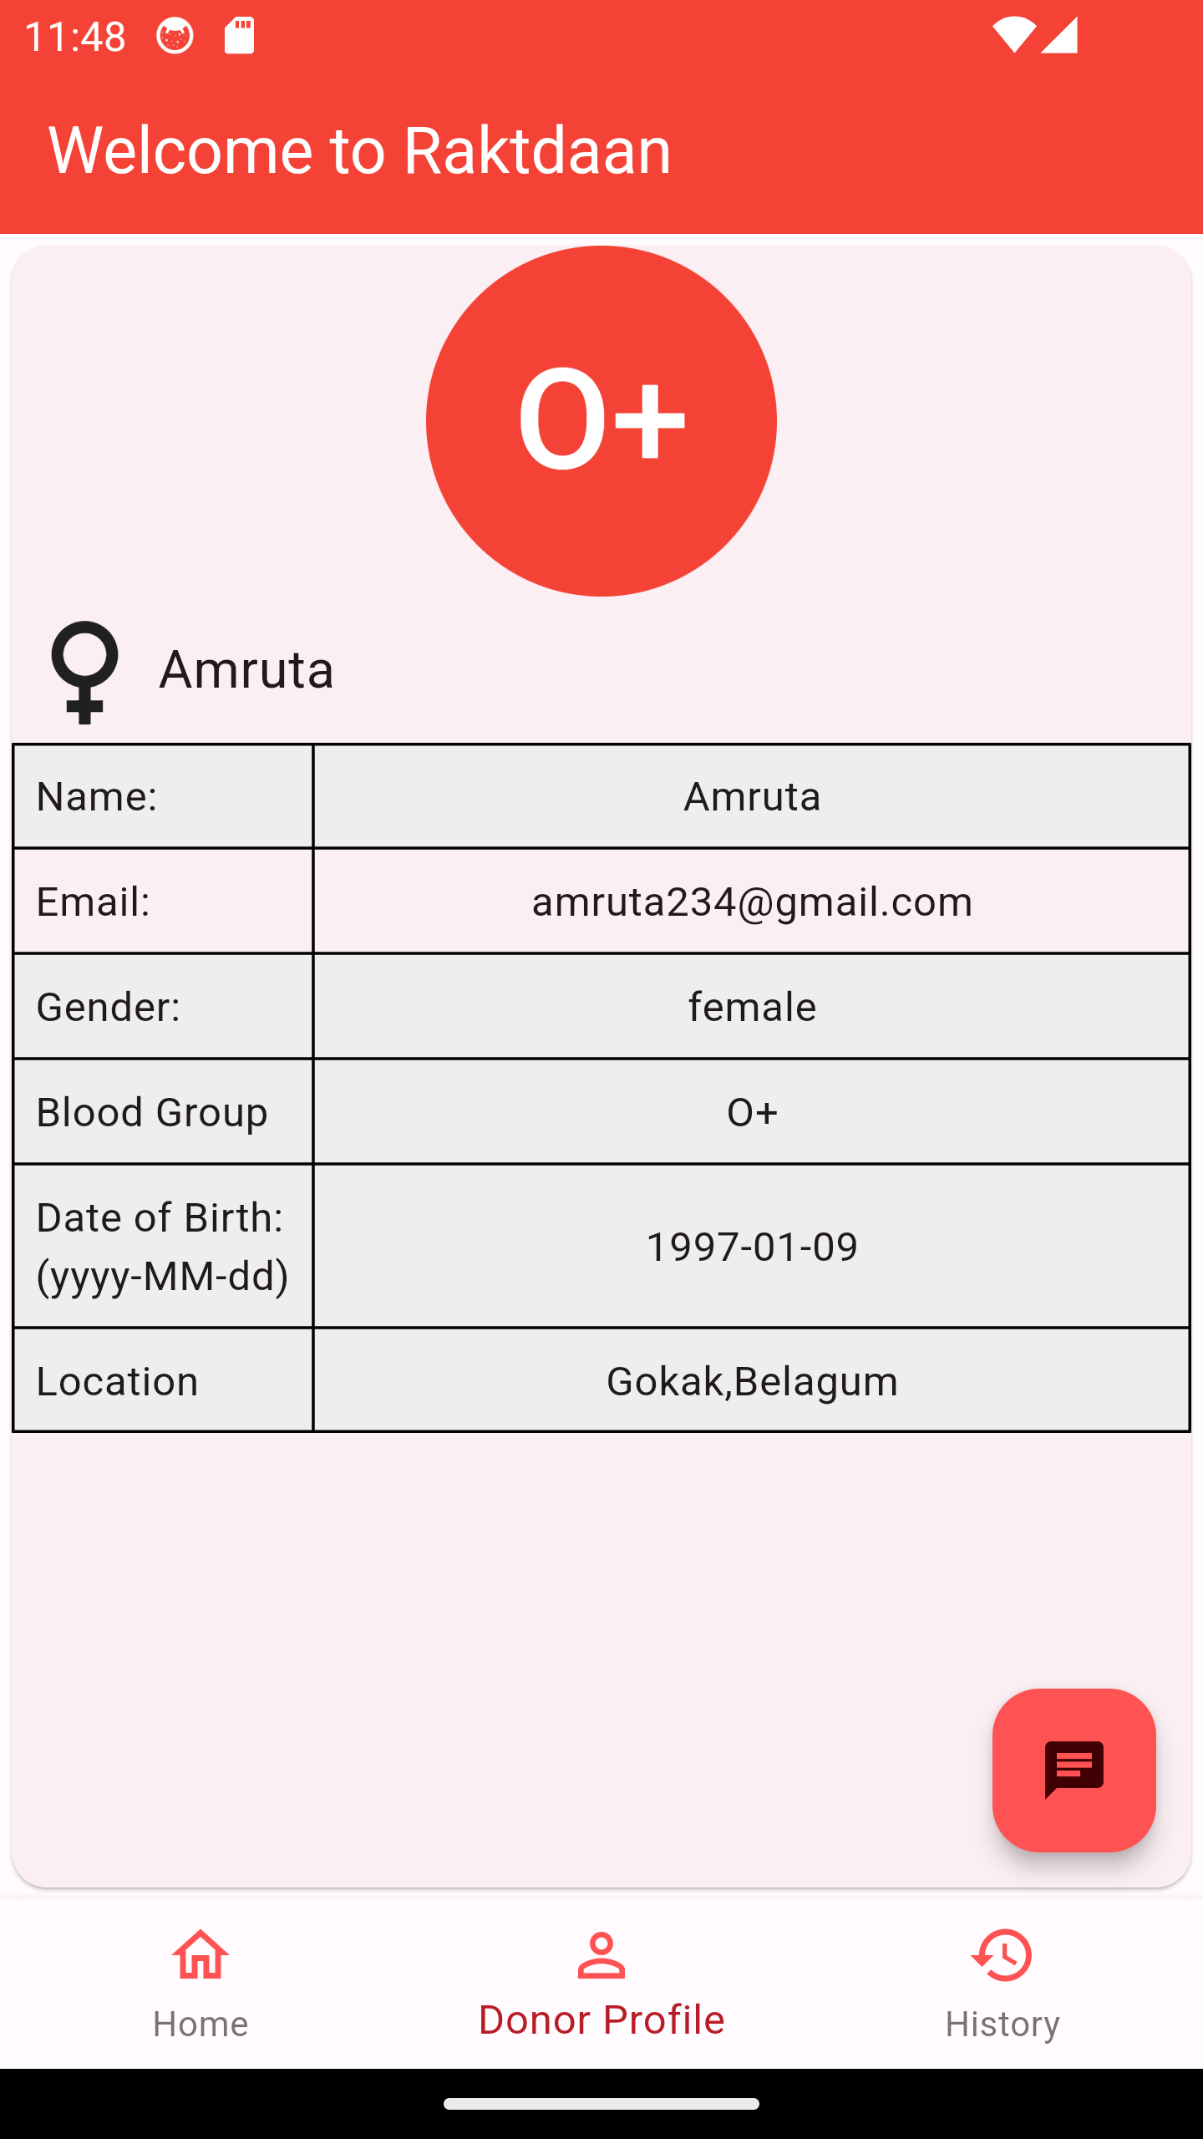
Contd.
Blood Search
Profile Page
Registration

Slide 13
Limitations
Rakthdaan
Some of the main limitations of the project are as follows:
The system does not support languages other than English language.
The database has location details bounded only to Karnataka.
Though donor locations can be specified, it lacks connection to real time Geo-location
Application
Some of the main applications of the project are as follows:
Enable hospitals, medical facilities, and patients to post urgent requests for specific blood types, which donors can respond to
Helps users to find nearby blood donors, making it easier for them to request blood
Offer incentives or rewards to encourage regular blood donation, such as badges, certificates, or recognition
Provide information about the importance of blood donation, blood facts, the donation process, and health guidelines for donors
Create a community of donors and recipients, fostering a sense of unity and social responsibility

Slide 14
REFERENCES
1] S P Kurlekar, K Pranali, R Komal M, Shrutika M, Aishwarya Kurlekar, S P, Pranali K, Shrutika M., & Aishwarya M. “Android app for Quick Access of Blood Bank” (2017) Journal of Embedded Systems and Processing, 2(1)
[2] S Periyanayagi, A Manikandan, M Muthukrishnan and M Ramakrishnan, Professor and students of Ramco Institute of Technology, Rajapalayam, India. “BDoor App-Blood Donation Application using Android Studio “(2021) Journal of Physics Conference Series.
[3] M. R. A. Hamlin, J. A. Mayan “Blood donation and life saver-blood donation app” (2016) Published in International Conference on Control, Instrumentation, Communication and Computational Technologies.
[4] Brislin M.R.A et al, ‘Blood Donation and Life Saver App’, 2nd Int. (2017) Conf. on Communication and Electronics Systems (ICCES), DOI:10.1109/CESYS.2017.8321318, pp 446-451.
[5] Clementeena A, Sankar K and Kannan S, ‘A Study on Blood Bank Management System’,(2014),Middle East Journal of Scientific Research, Vol. 19, No. 8, pp 1123-1126.
Web references
https://nevonprojects.com/online-blood-bank-project
https://www.phptpoint.com/projects/blood-bank-management-system
https://www.ncbi.nlm.nih.gov/pmc/articles/PMC5682362
https://dribbble.com/tags/blood_donation_app

Slide 15
SUMMARY
In conclusion, the development of “Raktdaan” App is guided by a structured methodology that places users' needs at the forefront. By employing cutting-edge technologies and techniques, adhering to data privacy regulations, and adopting a user-centric approach, we aim to create a dynamic and effective platform that not only connects blood donors with recipients but also plays a pivotal role in promoting and facilitating life-saving blood donations

Slide 16
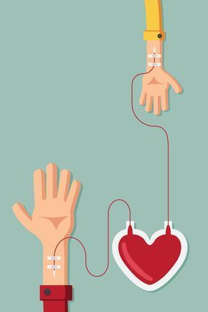
THANK YOU
16
Embrace the lifesaver within you…

