Slide 1
Context Switching Optimization in Multitasking Operating Systems
IT253
CHIKKERI CHINMAYA (211IT017)
KHUSHI GADLING (211IT031)
KARTIK RODAGI (211IT029)

Slide 2
Table of Contents
01
02
03
04
05
06
INTRODUCTION
METHODOLOGY
IMPLEMENTATION
FLOW-CHART
FINAL RESULT
CONCLUSION

Slide 3
INTRODUCTION
This project aims to optimize context switching in multitasking operating systems, which is essential for the concurrent execution of processes or threads. Context switching involves saving and restoring CPU state, managing file I/O, and coordinating interprocess communication.
However, these operations incur a significant cost in terms of CPU time and can limit system throughput and responsiveness. The project will analyze existing context-switching mechanisms and explore techniques to minimize unnecessary switches, reduce data saved/restored, and improve interprocess communication efficiency.
The goal is to improve system performance, responsiveness, and throughput by minimizing the computational overhead of context switches.

Slide 4
METHODOLOGY
Multi-Threaded Process
Manual Function Termination
A process is an instance of a program running on a computer. In this case, the process consists of five different functions that run independently of each other.
Each function represents a separate thread within the process.
Threads allow concurrent execution of multiple tasks within a single process, enabling better utilization of system resources.
As mentioned that we have given limits to each function manually, indicating that predefined termination points for each function.
It's unclear how we determine these limits or what actions are taken when a function reaches its termination point.
Since we used keyboard inputs as interrupts, it's possible that manually triggering some code that stops the execution of a particular function.

Slide 5
Interrupts and
Keyboard Inputs
Non-Kernel Level Implementation
A process is an instance of a program running on a computer. In wer case, the process consists of five different functions that run independently of each other.
Each function represents a separate thread within the process.
Threads allow concurrent execution of multiple tasks within a single process, enabling better utilization of system resources.
we mentioned that we haven't done kernel-level implementation to avoid potential harm to the PC internally.
Kernel-level implementation involves interacting directly with the operating system's kernel, which requires careful handling to ensure system stability and security.
By avoiding kernel-level implementation, we are limiting wer ability to have fine-grained control over thread execution and interrupts.

Slide 6
IMPLEMENTATION
We have implemented threads using the pthread_create and pthread_join functions, and we have also incorporated signals, handlers, and file operations into wer implementation. Here is a small brief on each of these components:
THREADS
SIGNALS
Threads represent concurrent execution paths within a process.
We have used the pthread_create function to create new threads within wer process. This function takes a function as an argument and creates a new thread that starts executing that function.
The pthread_join function is used to wait for the termination of a specified thread. It allows the calling thread to block until the target thread completes its execution.
Signals are software interrupts that allow a process to handle asynchronous events. WE have utilized three signals in wer implementation:
SIGINT: This signal is triggered by the user when they press CTRL + C. It is commonly used to interrupt the program's execution.
SIGQUIT: This signal is activated when the user wants to quit the process by pressing CTRL + \ (backslash).
SIGTSTP: This signal suspends the whole process when the user presses CTRL + Z.

Slide 7
HANDLERS
FILES
Handlers are functions that are executed in response to a specific signal being raised.
We have created five handler functions, each corresponding to a different signal. These handlers are responsible for performing actions when a signal is received.
The handlers likely interact with the threads or perform other operations based on the signal received.
Files are used to store data in wer implementation.
We have utilized files to store information about the threads, such as their latest stored values or retrieved values.
The files in wer implementation serve as a form of process control block (PCB), which contains information about the threads and their state.

Slide 8
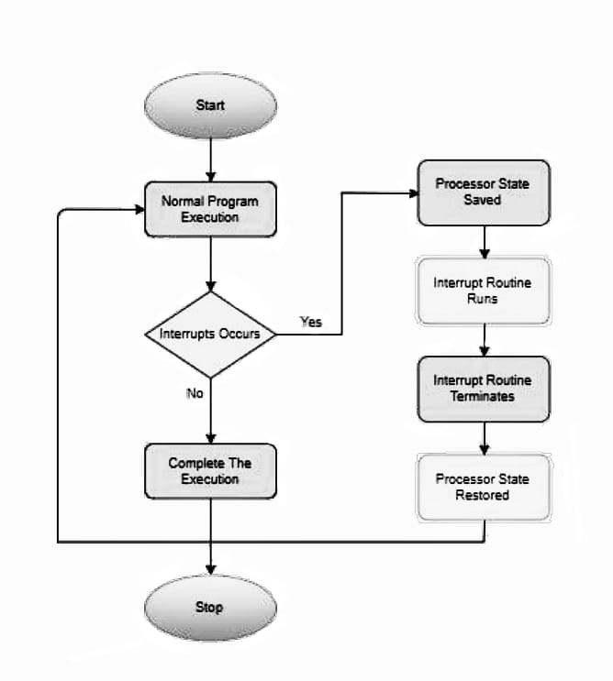
FLOWCHART
When an interrupt occurs, the CPU switches from the currently running process to another process. The Process Control Block (PCB) is responsible for storing the state of the previous process, including the values of registers and other relevant information. After the execution of the second process, the control is returned to the previous process, and it resumes execution from the point where it was interrupted earlier. This is achieved by restoring the saved state from the PCB, including the program counter and other relevant register values.

Slide 9
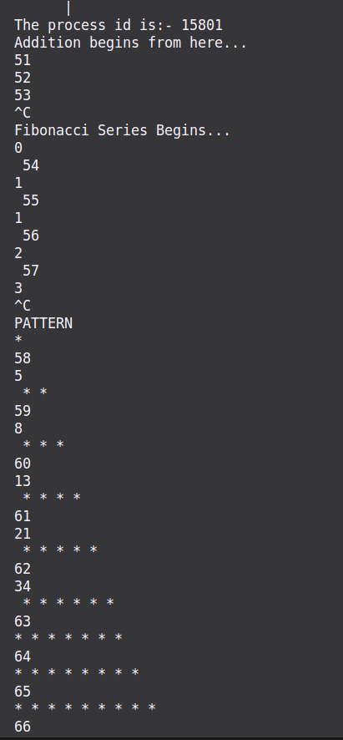
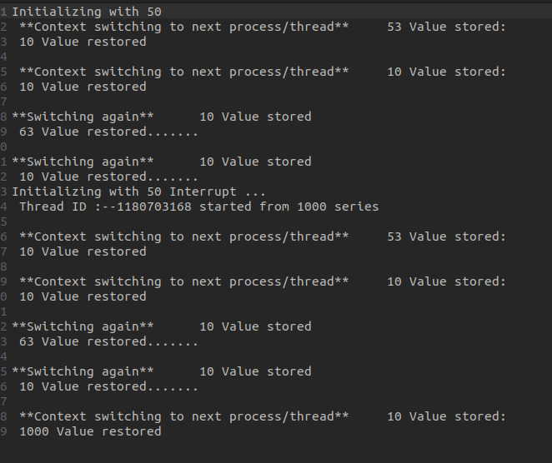
FINAL RESULT
SAMPLE logfile.txt
SAMPLE TERMINAL OUTPUT

Slide 10
CONCLUSION
In conclusion, the project has provided a basic implementation of thread-level context switching in a multitasking operating system. However, there is significant scope for further research and development in this field.
Future work can focus on refining and optimizing context-switching algorithms, exploring hardware support, considering real-time requirements, improving energy efficiency, addressing virtualization challenges, and enhancing security aspects.
These advancements will contribute to more efficient and robust multitasking operating systems, offering better performance and responsiveness in handling the concurrent execution of threads.

Slide 11
REFERENCES
The Resources And References were used to create the Project:-
Journals:
https://ieeexplore.ieee.org/document/707884
https://www.sciencedirect.com/topics/computer-science/context-switching
Websites:
https://www.javatpoint.com/what-is-the-context-switching-in-the-operating-system
https://www.academia.edu/38458323/A_Survey_Paper_on_Context_Switching
https://patents.google.com/patent/US8433889

Slide 12

Thanks!
Do we have any questions?

