Slide 1

Promises in JavaScript
Chinmay Naik

Slide 2
Overview
Async JavaScript APIs
Callbacks
Promises
Flow control with promises
Q.js

Slide 3
But first: Quick JS recap
single threaded
event loop

Slide 4
Guess the output
var syncOperation = function() { console.log("inside function"); return 100; }; var processResult = function(result) { console.log("Result is : " + result); }; var result = syncOperation(); console.log("after function call"); processResult(result);

Slide 5
Guess the output - Solution
inside function
after function call
Result is : 100
var syncOperation = function() { console.log("inside function"); // 1 return 100; }; var processResult = function(result) { console.log("Result is : " + result); // 3 }; var result = syncOperation(); console.log("after function call"); // 2 processResult(result);

Slide 6
How about this?
var asyncOperation = function() { setTimeout(function(){ console.log("inside function"); return 100; }, 1000); } var processResult = function(result) { console.log("Result is : " + result); } var result = asyncOperation(); console.log("after function call"); processResult(result);

Slide 7
How about this? - Solution
var asyncOperation = function() { setTimeout(function(){ console.log("inside function"); // 3 return 100; }, 1000); } var processResult = function(result) { console.log("Result is : " + result); // 2 } var result = asyncOperation(); console.log("after function call"); // 1 processResult(result);
after function call
Result is : undefined
inside function
umm.. Not good :-(

Slide 8
Callbacks to the rescue
after function call
inside function
Result is : 100
var asyncOperation = function(callback) { setTimeout(function(){ console.log("inside function"); callback(100); }, 1000); } var processResult = function(result) { console.log("Result is : " + result); } asyncOperation(processResult); console.log("after function call");

Slide 9
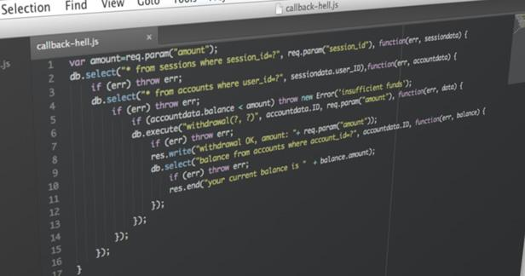
In real life

Slide 10
Revisit Async APIs
Sync
function getUser(username) {
var sql = "select * from user where u=?"; var user = query(sql, username); // blocking if (!user) { throw new Error("user not found"); } return user; }
Async
function getUser(username, callback) {
var sql = "select * from user where u=?"; query(sql, username, function(err, user) { if (err) { callback(err); } else if (!user) { callback(new Error("user not found")); } else { callback(null, user); } }); }

Slide 11
No return!
function getUser(username, callback) {
var sql = "select * from user where u=?"; query(sql, username, function(err, user) { // nobody gets this return value return user; }); }

Slide 12
No throw!
function getUser(username, callback) { query(sql, username, function(err, user) { // nobody can catch this error. if (err) throw err; // ugly }); }

Slide 13
Callbacks
No original stack
No return
No throw
There are no guarantees
How many times does callback gets called?
Does it get called with same or different parameters?
Side effect
Hard to compose, test and debug
All of this for being Async!

Slide 14
What if?
There’s inversion of control
Async methods returned values
We had exception style error bubbling
Async code were more sync-looking

Slide 15
Promises
Represent value of async operation
Can be pending, fulfilled or rejected
Only resolved once
Immutable once resolved
Either success or error
Exceptions become errors

Slide 16

Real life Promises

Slide 17
Promises
var fs = require(“fs”); function readFile(filename, enc) { return new Promise(function(fulfill, reject) { fs.readFile(filename, enc, function(err, res) { if (err) reject(err); else fulfill(res); }); }); } readFile("customer.json", "utf-8").then(console.log, console.error)

Slide 18
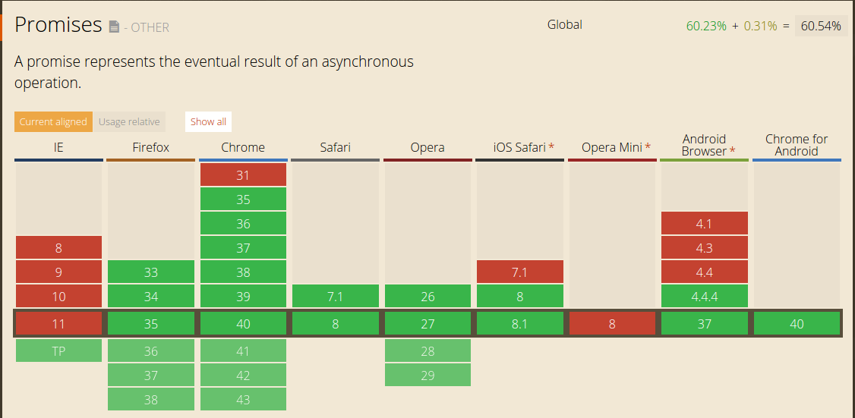
source: http://caniuse.com/#search=promises

Slide 19

q
bluebird
rsvp.js
when.js
and others...

Slide 20
Control flow with Promises
getUser('chinmay185', function (err, user) {
if (err) { handleError(err); }
else { doSomethingWithUser(user); } }); // becomes getUser('chinmay185')
.then(doSomethingWithUser, handleError);

Slide 21
Control flow with Promises
getUser('chinmay185', function (user) {
getTweets(user, function (tweets) {
updateTimeline(tweets) });
}); // becomes getUser('chinmay185')
.then(getTweets)
.then(updateTimeline);

Slide 22
With error handling
getUser('chinmay185', function (err, user) { if (err) { handleError(err); } else { getNewTweets(user, function (err, tweets) { if (err) { handleError(err); } else { updateTimeline(tweets, function (err) { if (err) handleError(err); }); } }); } });
getUser('chinmay185') .then(getNewTweets) .then(updateTimeline) .then(undefined, handleError);

Slide 23
More promise use cases
Q.all
Run tasks in parallel
Wrap existing callback apis - q.denodify()
Others...

Slide 24
Things to watch out for
Handle errors at least at the end of promise chain
Don’t nest promises unless really required
Break long promise chains into small readable functions

Slide 25
Thanks! Questions?

