Slide 1









Ideate
What is the goal?
What would you do if you had all the data?
What do you want to predict?
Acquire
How were the data sampled?
Which data are relevant?
Are there privacy issues?
Explore
Plot the data
Are there anomalies?
Are there patterns?
Model
Build a model
Fit the model
Validate the model
Present
What did we learn?
Do the results make sense?
Can we tell a story?

Slide 2



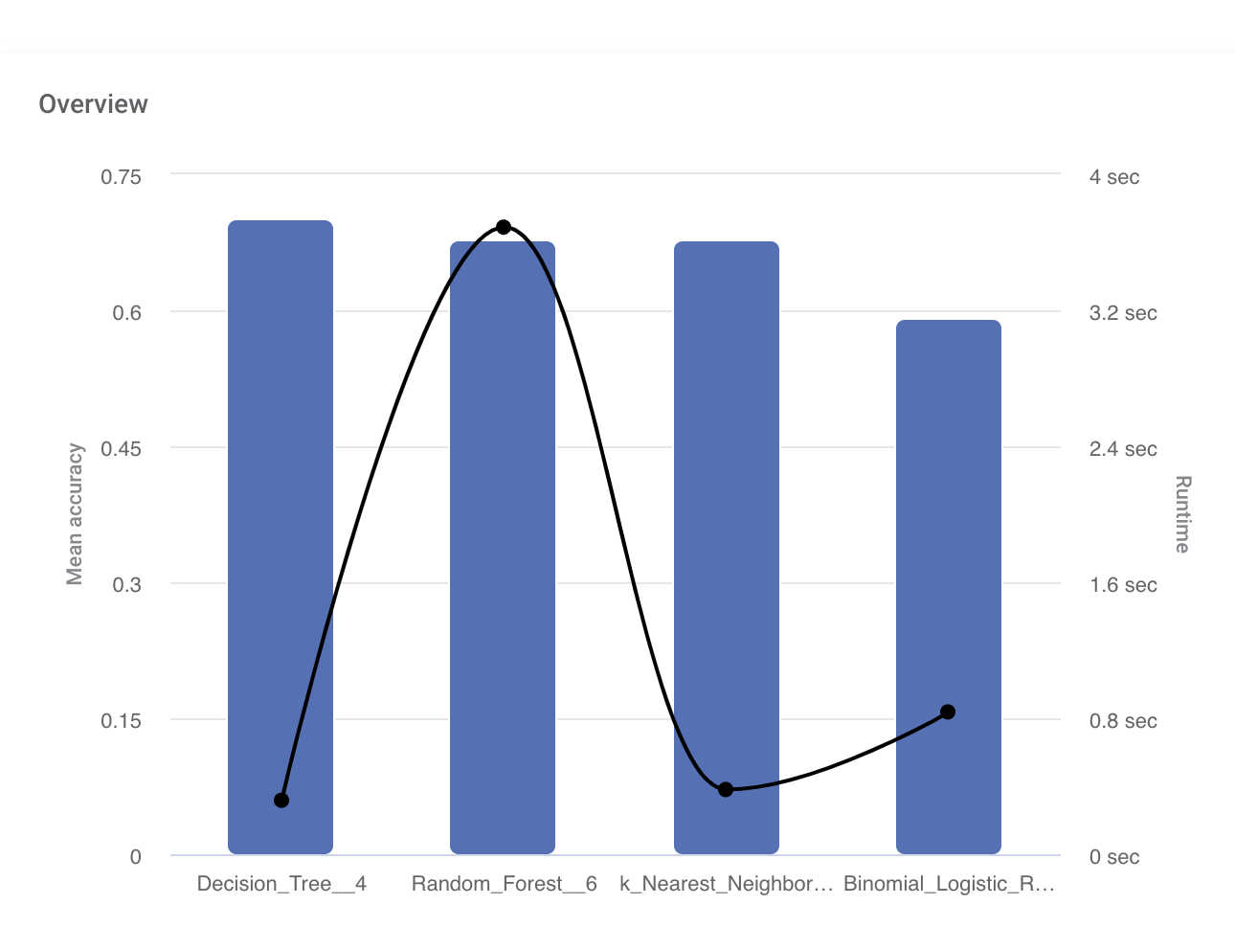
Topic : Marine Accident | Function Environmental Impact| Industry : Marine
THE GOAL
Predict environment pollution
Economic impact of accident
THE DATA SET
Marine-Accident dataset.
249 rows and 30 columns
Source
https://zenodo.org/record/5592999
THE IMPACT
Environment impact can be predicted as it is important considering CSR activities.
Estimated Cost is also needed to be known to under recovery steps..
Rubiwise
Ideate
Acquire
Explore
Model
Present
TOOL SET
TECHNIQUE:
Rubistudio : Statistical Analysis
RubiML : Model Building Classification Algorithms like Random forest,decision trees
RubiSight : Visualization
OUTPUT
Random forest performs the best.

Slide 3
Business Overview
Rubiwise
Ideate
Acquire
Explore
Model
Present
Marine Insurance: ML-based accident prediction and cost estimation can help marine insurance companies better assess the risks associated with their policies and set appropriate premiums.
Maritime Transportation: Accidents can cause significant disruptions to maritime transportation, resulting in delays, higher costs, and reputational damage. By predicting the likelihood of accidents and their associated costs, ML can help shipping companies optimize their operations and minimize their exposure to risk.
Environmental Protection: Marine accidents can have severe environmental consequences, including oil spills and other forms of pollution. ML can help environmental protection agencies quickly identify the cause of an accident and determine the extent of the damage, enabling them to take prompt action to mitigate its effects.
Government Regulation: Governments can use ML-based accident prediction and cost estimation to inform regulatory frameworks, set safety standards, and enforce compliance. By using data-driven approaches, policymakers can ensure that the marine industry operates safely and sustainably.
Risk Management: ML can be used to develop comprehensive risk management strategies for the marine industry. By identifying potential hazards and predicting their associated costs, businesses can take proactive measures to mitigate risk and reduce their exposure to financial losses.

Slide 4
Problem Statement and Objective
Rubiwise
Ideate
Acquire
Explore
Model
Present
Maritime accidents, often affect in large scale over the environment, society and economy. Many such ships accidents have occurred in the past decades.
Thus, it becomes difficult to the shipping companies to understand the factors that causes accidents, and the impact on economy and environment
Based on Problem statement we have following objective.
To Predict whether Accident causes Environmental pollution.
To predict Economic impact and provide data-driven directions.

Slide 5
Dataset
Rubiwise
Ideate
Acquire
Explore
Model
Present
Dataset is about Marine accidents occurring from 1983 to 2020.
Published in year 2021
Naval_v2 file contains 249 rows and 30 columns.
Dataset Contains of 30 features that consists of Accident types, Ship attributes, Weather attributes, Human Factors Analysis and Classification System, Person on Boards Raw.

Slide 6
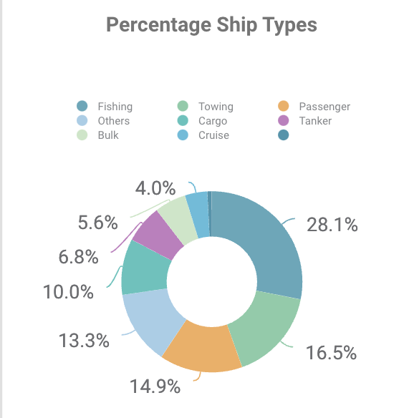
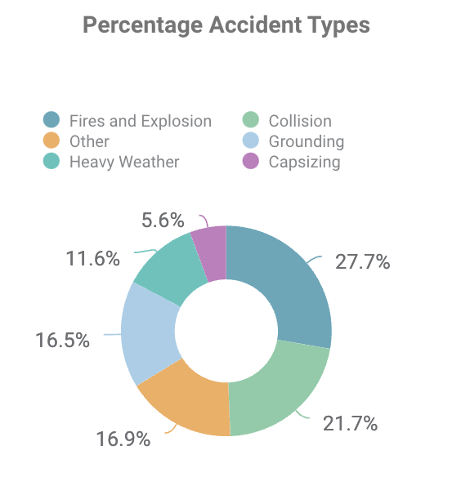
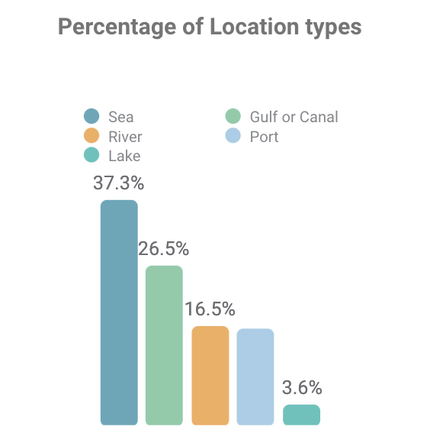
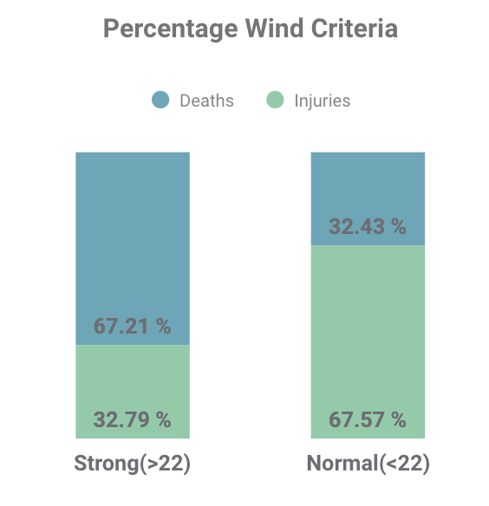
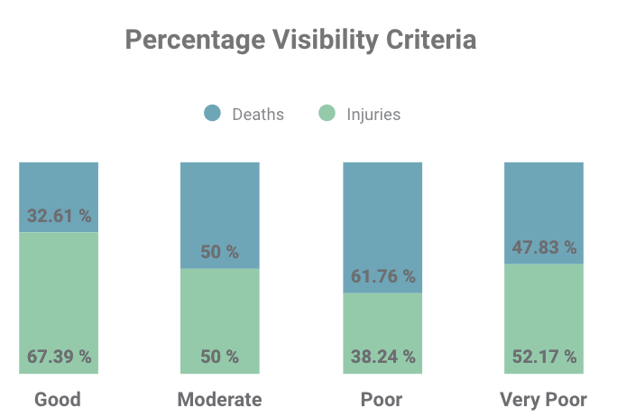
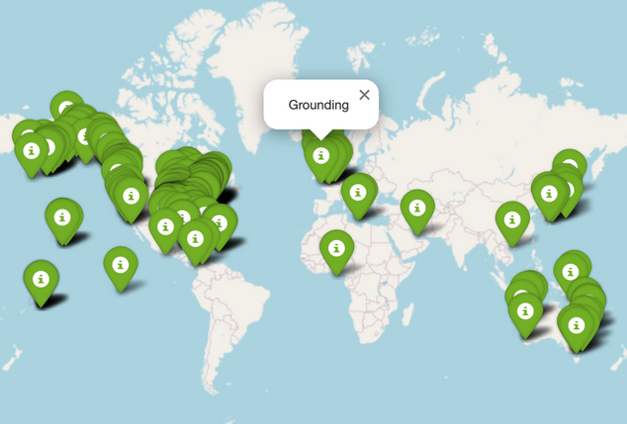
Insights
Rubiwise
Ideate
Acquire
Explore
Model
Present
Accident by Locations

Slide 7
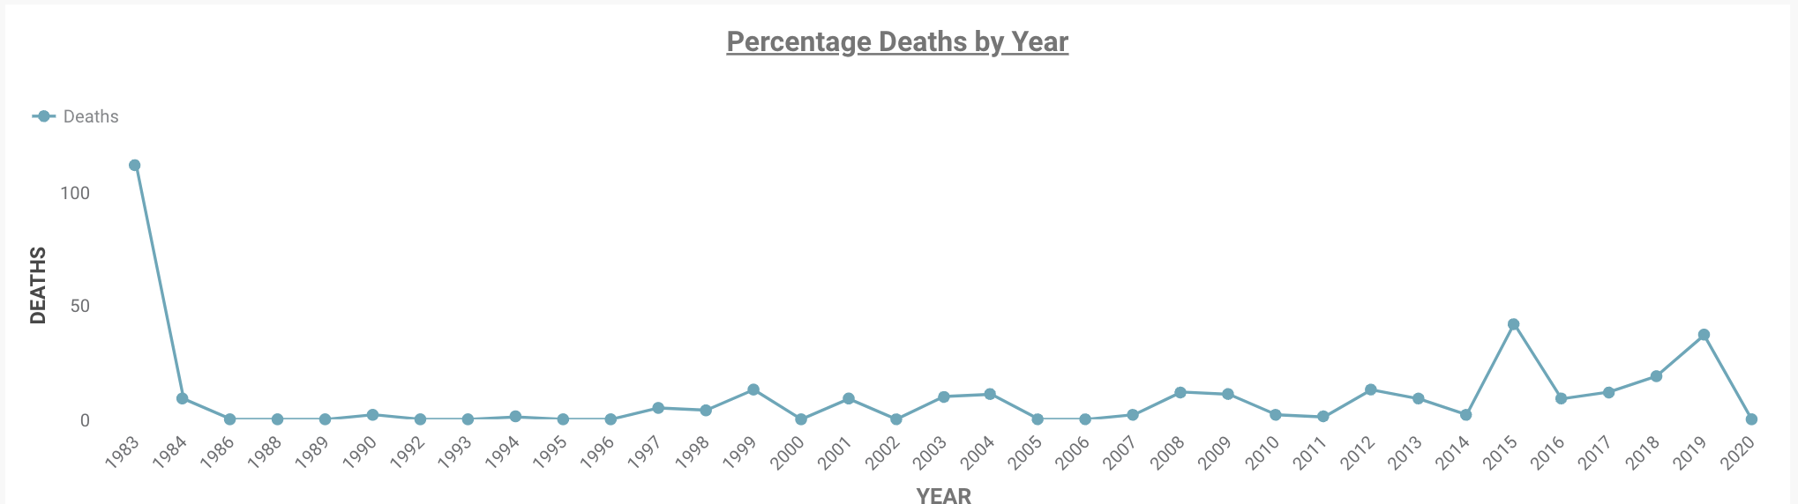
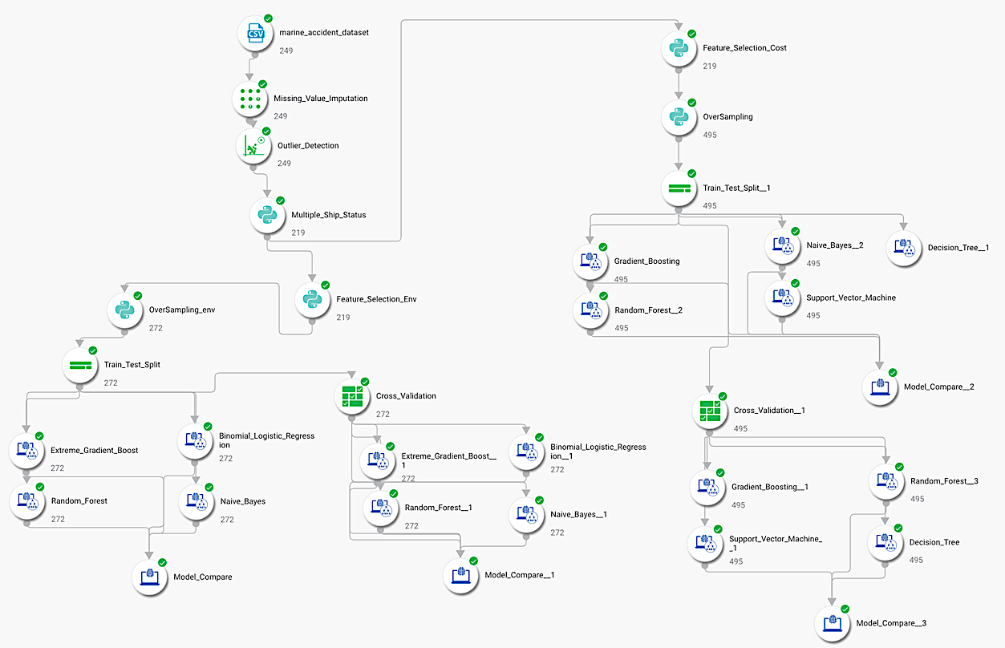
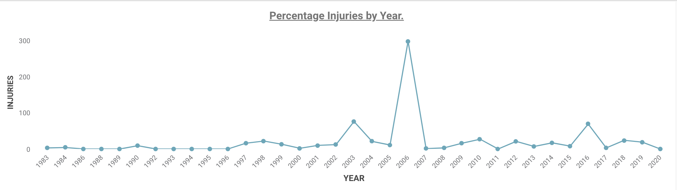
Rubiwise
Ideate
Acquire
Explore
Model
Present
Deaths by Years
Flow on Rubiscape
Injuries by Years

Slide 8
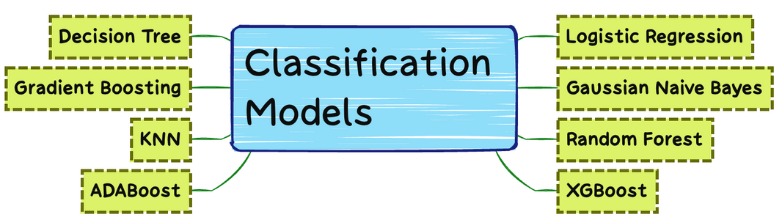
Model Building
Rubiwise
Ideate
Acquire
Explore
Model
Present
Importing the dataset​ “Marine_Accident”.
Missing Value Imputation
Checking Distribution
Handling Outliers
Encoding and Normalization
Feature Selection
Classification Algorithms like XGBoost, Random Forest Naive Bayes, KNN, Logistic Regression.
Hyperparameters Tunning

Slide 9
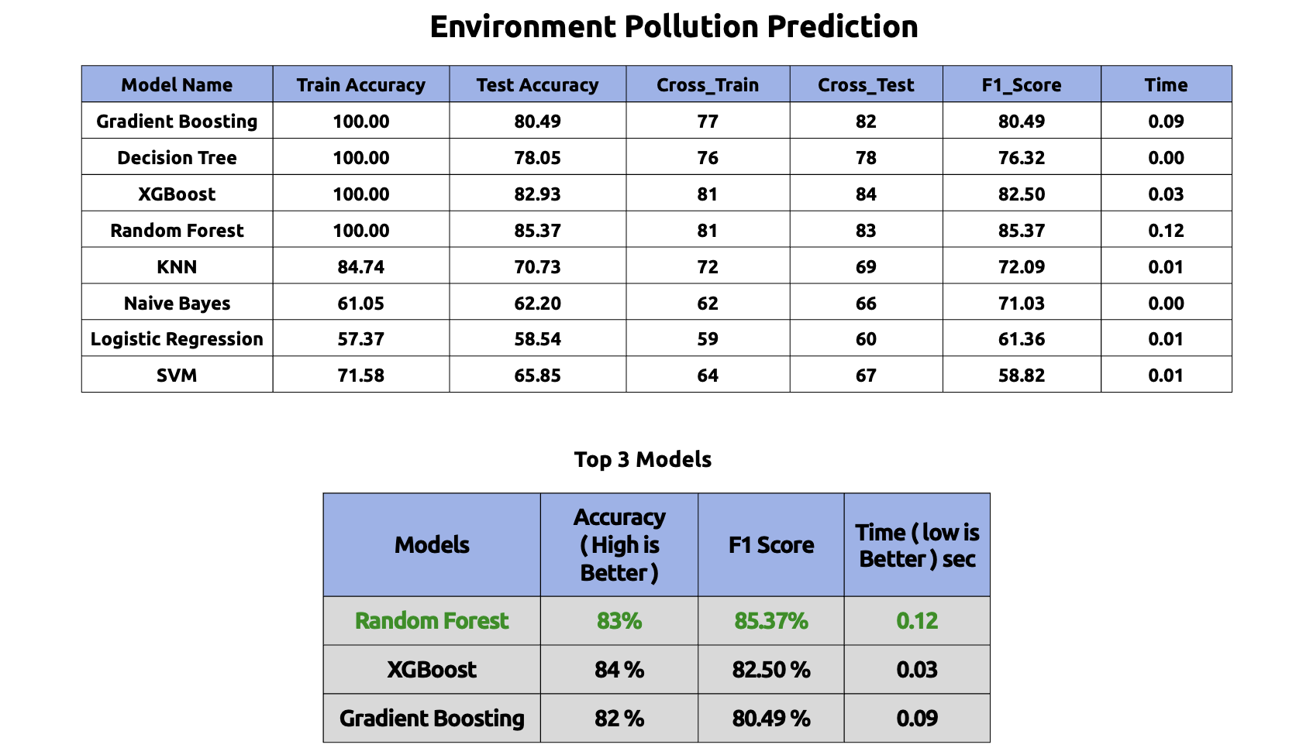
Result Summary 1
Rubiwise
Ideate
Acquire
Explore
Model
Present

Slide 10
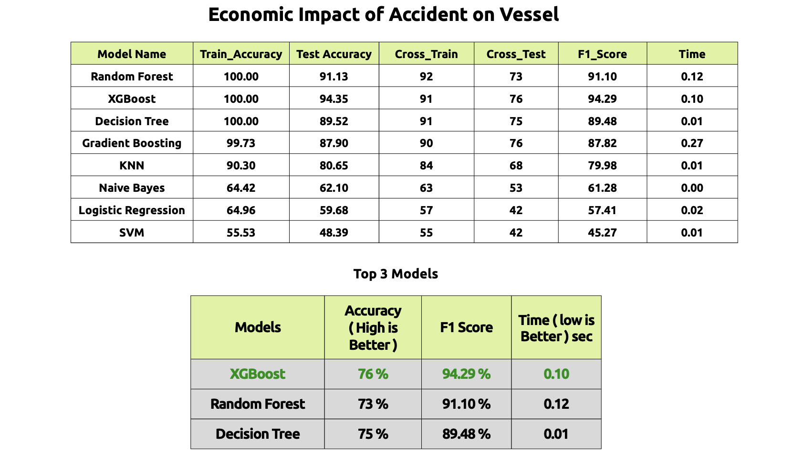
Result Summary 2
Rubiwise
Ideate
Acquire
Explore
Model
Present

Slide 11
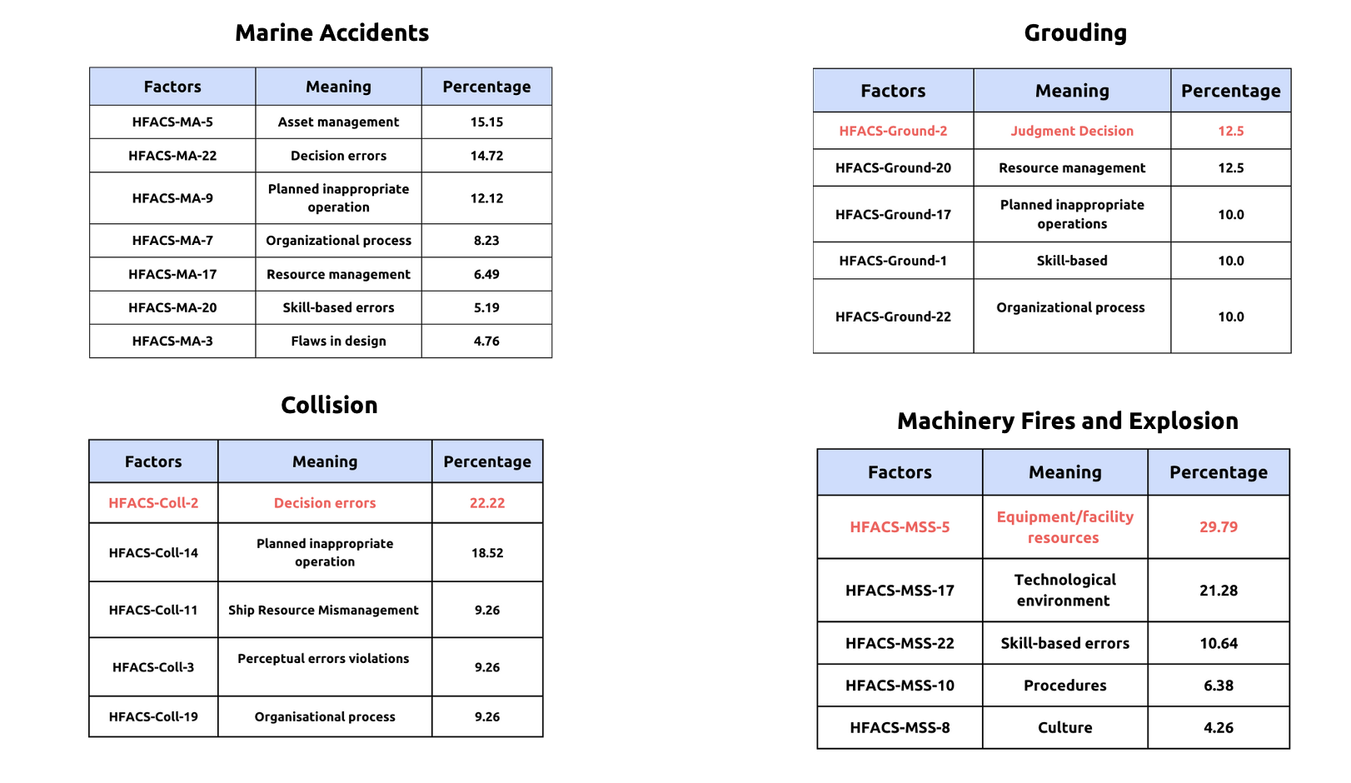
Contribution of top human factors
Rubiwise
Ideate
Acquire
Explore
Model
Present

Slide 12
Conclusion
Rubiwise
Ideate
Acquire
Explore
Model
Present
Human factors contributing to each incident is shown and corresponding environment and financial impact.
we predict whether an incident causes Environment Pollution or not at 83% Accuracy, also we predict the Accidents impact on cost for the company.
Concluded the most important features that play role in Pollution.

Slide 13
Business Impact
Rubiwise
Ideate
Acquire
Explore
Model
Present
Accurate Prediction: ML can accurately predict the likelihood of marine accidents and their associated costs, allowing businesses to prepare for and mitigate their impact.
Cost Reduction: By predicting accidents and their costs, businesses can take proactive measures to reduce their exposure to financial losses and minimize the impact on their operations.
Improved Safety: ML-based accident prediction can help identify potential hazards and improve safety measures, reducing the risk of accidents and associated costs.
Environmental Protection: ML can help protect the environment by quickly identifying the cause and extent of damage from marine accidents, enabling prompt action to be taken.
Efficient Resource Allocation: By predicting accidents and their costs, businesses can optimize resource allocation and make informed decisions about risk management.
Better Decision Making: ML can provide businesses with valuable insights into the factors that contribute to marine accidents, enabling better decision making and risk assessment.
Competitive Advantage: ML-based accident prediction and cost estimation can give businesses a competitive advantage by enabling them to better manage risk and improve operational efficiency.
Regulatory Compliance: By using data-driven approaches to identify and mitigate risk, businesses can ensure compliance with regulatory frameworks and standards.
Improved Reputation: By reducing the impact of marine accidents, businesses can protect their reputation and maintain customer trust.
Innovation: ML can drive innovation in the marine industry by enabling businesses to develop new risk management strategies and improve operational efficiency.

Slide 14
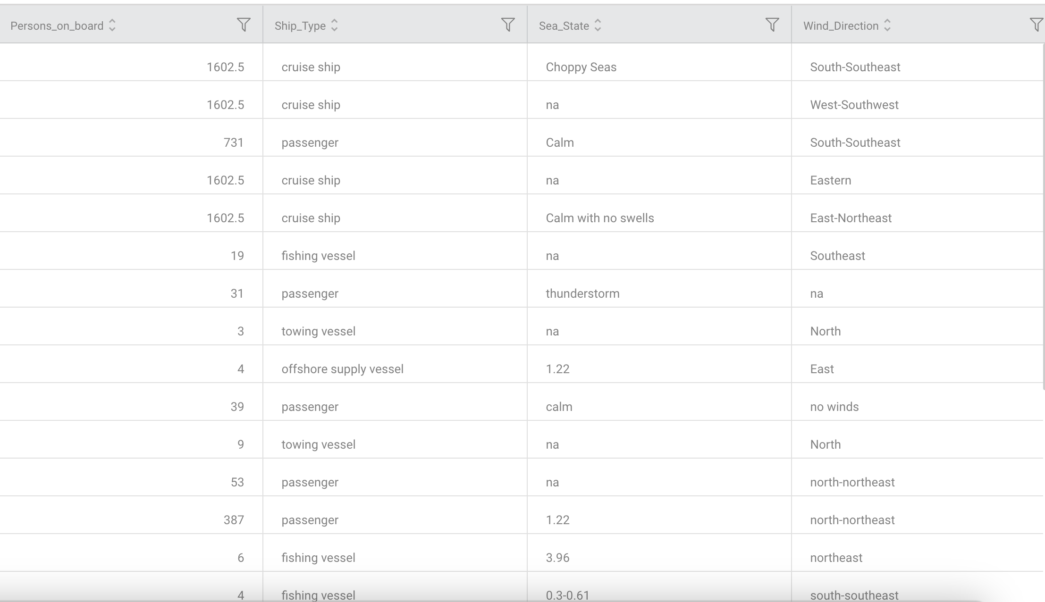

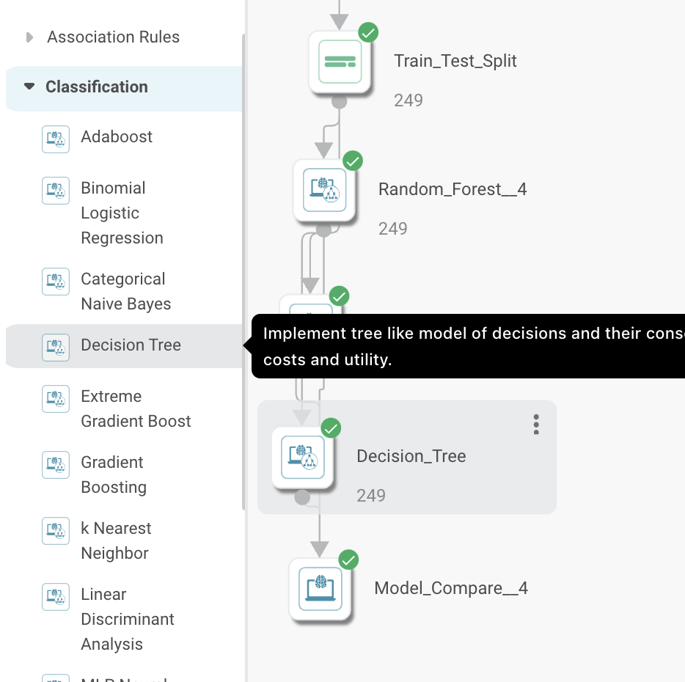
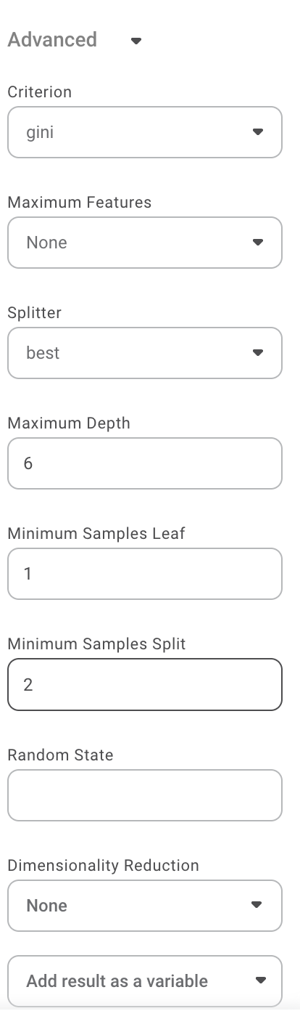
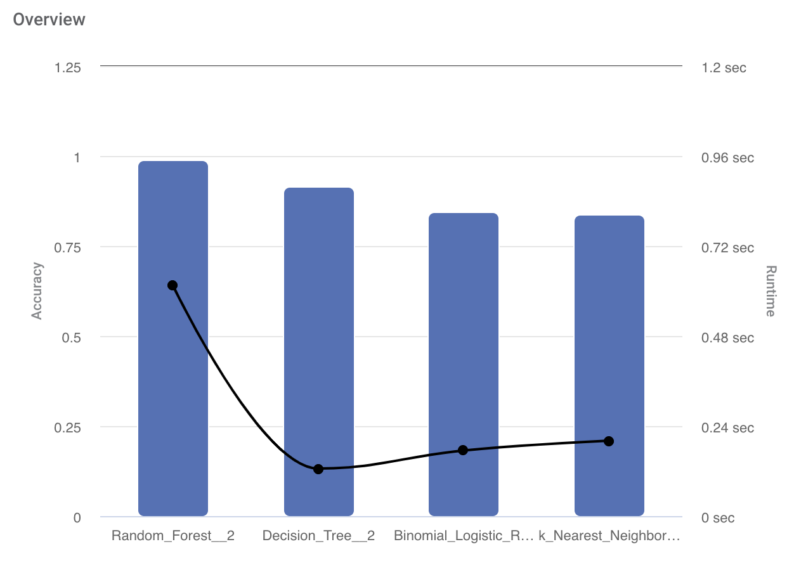
Rubiwise
Ideate
Acquire
Explore
Model
Present
Rubiscape Model Ops
Dataset
Accident types
Model Selection
Model Config
Environment Prediction
Shipping vessel cost prediction

