Slide 1
Tic Tac Toe Using Python

Slide 2
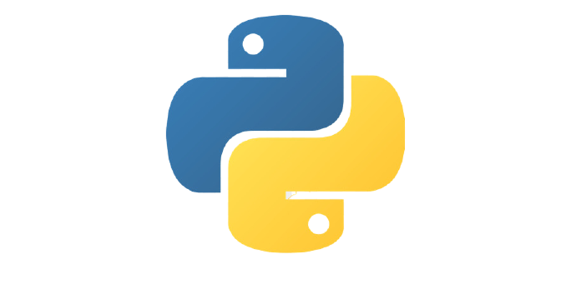
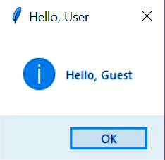
Why Python?
Python offers multiple option in the development/developing GUI i.e graphical user interface . Which is a standard Python inteerface to Tk Gui Toolkit shipped with python. Tkinter with python is the fastest and also the easiest way to create any GUI applications. Creating Gui using Tkinter with Python is a easy task.
eg:

Slide 3
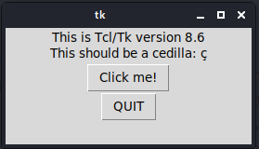
Tkinter :
The tkinter package (“Tk interface”) is the standard Python interface to the Tk GUI toolkit. Both Tk and tkinter are available on most Unix platforms, as well as on Windows systems.
Running python -m tkinter from the command line should open a window demonstrating a simple Tk interface:

Slide 4
PROCESS :
OUTPUT:
GUI
(Graphical User Interface)
Import the required libraries
Defining different functions for various operations
tkinter, random
button, click, etc

Slide 5

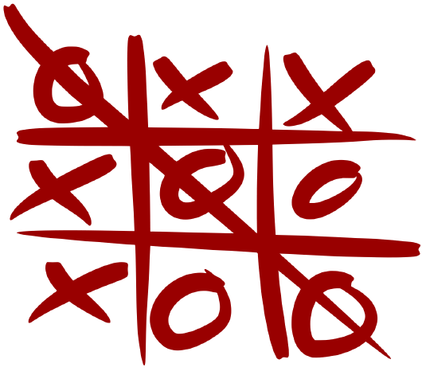
The Game :
Tic-Tac-Toe is a very simple two-player game. So only two players can play at a time. This game is also known as a Noughts and Crosses or X's and O's game.

Slide 6
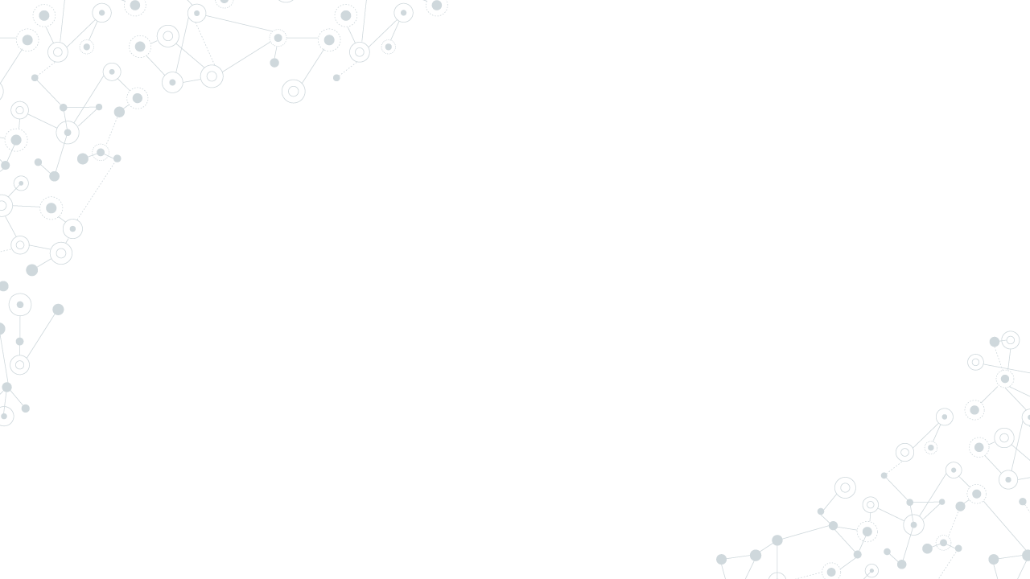
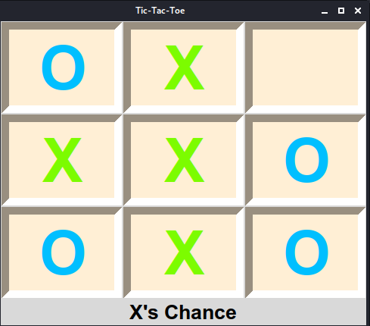
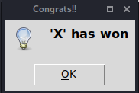
OUTPUT:

Slide 7
Thanks!
Any questions?

