Slide 1
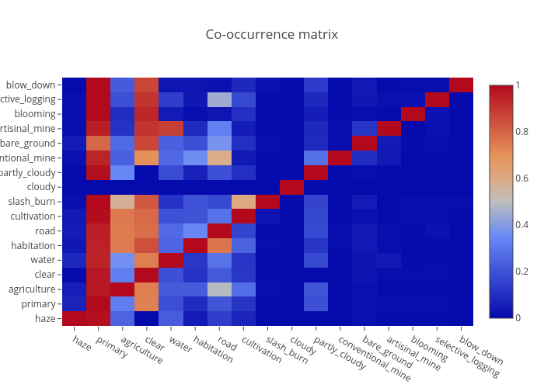
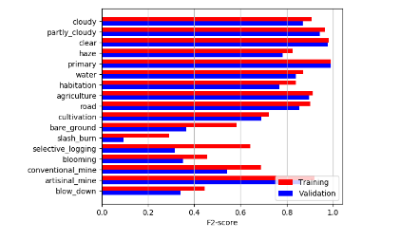
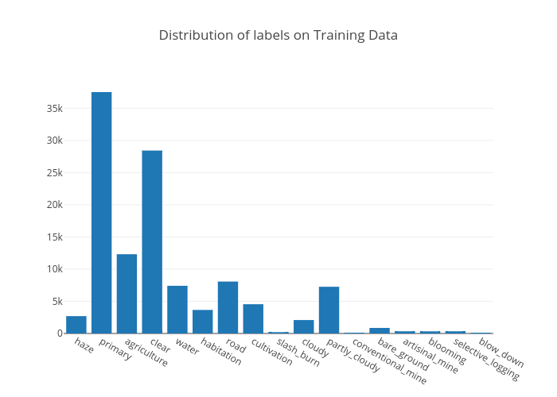

Multi-label Classification of Amazon Forest Satellite Images
Rajanie Prabha Chinmay Prabhakar Min-An Chao
Introduction
Given the dataset of satellite images of Amazon forests, the goal is to analyze the changes in patterns by classifying the data with respect to atmospheric conditions and various land cover types. This was a Kaggle competition organized by Planet.
Input Dataset
40,480 training samples and 61,192 test samples by kaggle.
Type of data - JPG(3 channels) and TIFF(4 channels, extra channel for Near- Infrared).
Total 17 labels to be classified.
Each raw image size – 256 x 256
Each image should have exactly one atmospheric label and may have more than one land type labels.
Discussions and Results
Evaluation : F2 score
Various Data Augmentation techniques applied like
crop, flip and rotate.
Architectures
Mix Model for using Tiff and jpg Dataset
RGB +NIR+2 Normalized vegetation/water indexes
Split 6 input channels into 3 + 3
AlexNet | SGD | Sigmoid loss | LR = 0.3 | F2 score=88.01
VGG-16 |  |  |  | 92.36
ResNet18 |  |  |  | 92.76
ResNet34
DenseNet121 |  |  |  | 92.56
DenseNet169 |  |  |  | 92.58
DenseNet201 |  |  |  | 92.60
ResNet 18 (JPG)
RGB DATA
ResNet(Scratch)
(TIF)
NIR + 2 indexes
ResNet 18 (JPG)
RGB DATA
FC 256
FC 256
FC 17
PREDICTION
F2 score :
Notes:
1

