Slide 1
LS-06 · FROM HANDSHAKE TO CONTRACT
ACCORD
From a chat to a commitment both sides have checked.
TEAM BIG LEAGUES
Notes:
Introduce the team and the problem statement LS-06. One line: Accord turns a messy WhatsApp deal into an agreement both people have actually checked, with proof nobody can quietly change.

Slide 2
Deals happen on WhatsApp. Then they drift.
₹48,000
₹45,000
₹46,500
₹54,000
→
→
→
500 cards
first quote
500 cards
"thoda kam karo"
500 cards
"theek hai, done"
600 cards
order changed
Which number was agreed? Memory, screenshots and a long chat are not proof, and a formal contract feels too aggressive between people who have worked together for years.
Notes:
Walk through the sample chat. Each number is a real message. The price moves four times and the order itself changes. Three weeks later each person remembers a different number. A contract is too heavy for this, and a chat is weak proof.

Slide 3
Four things go wrong
01
Terms drift
02
Vague words
Price and quantity change mid-chat and nobody tracks which version won.
"Next week", "usual advance", "around 50k" feel clear in chat, useless in a dispute.
03
Hard topics skipped
04
One-sided proof
Cancellation, late delivery, defects, GST and disagreements never come up.
A chat can be edited or deleted, and the other person never confirmed the same version.
Notes:
Target users are small dealers: printers, tailors, caterers, contractors, resellers, freelancers. Almost none use written contracts.

Slide 4
Read it. Then both sides check it.
1
2
3
Add evidence
Read terms
Settle gaps
Chat, voice notes, screenshots
Price, delivery, payment, GST
Vague and missing, with nudges
4
5
6
Send
Customer checks
Keep proof
Private invite link
Each term vs the messages
Hash chain and PDFs
Notes:
Six steps. The key difference is step 5: the customer checks each term against the original messages, not just signs a document.

Slide 5
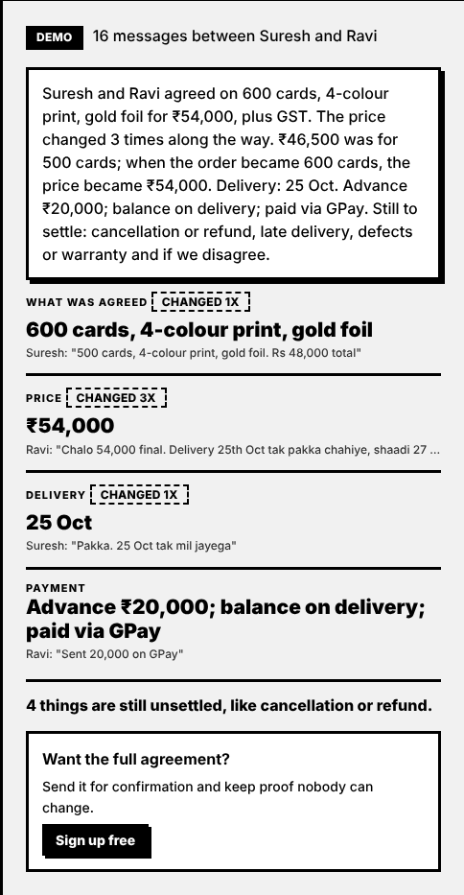
See it work on a real Hinglish chat
₹54,000 + GST
Final price for 600 cards, not the last number it saw.
Why it changed
Order moved from 500 to 600, so the price moved.
Every term sourced
Tap through to the exact message.
What is still open
Cancellation, late delivery, defects, disputes.
Notes:
This is the public demo on the landing page. No login. Press the button on the sample chat. Point at the summary: 46,500 was for 500 cards, when the order became 600 the price became 54,000. Every term shows the exact message it came from.

Slide 6
What makes Accord different
Facts, not just a signature
Customer verifies each term before approval; the server enforces it.
Follows the negotiation
A price belongs to a quantity. Old prices stay as history with the reason.
Finds what is missing
Six standard gaps, each with a friendly nudge to send.
Private by design
Customer sees only the messages cited behind each term.
Models are checked
Any AI answer is verified against the chat before it is shown.
Notes:
Other tools turn a chat into a contract and collect a signature. We aim at getting two people to actually agree on the same facts. We only reviewed PakkaWork's public listing, so describe it carefully.

Slide 7
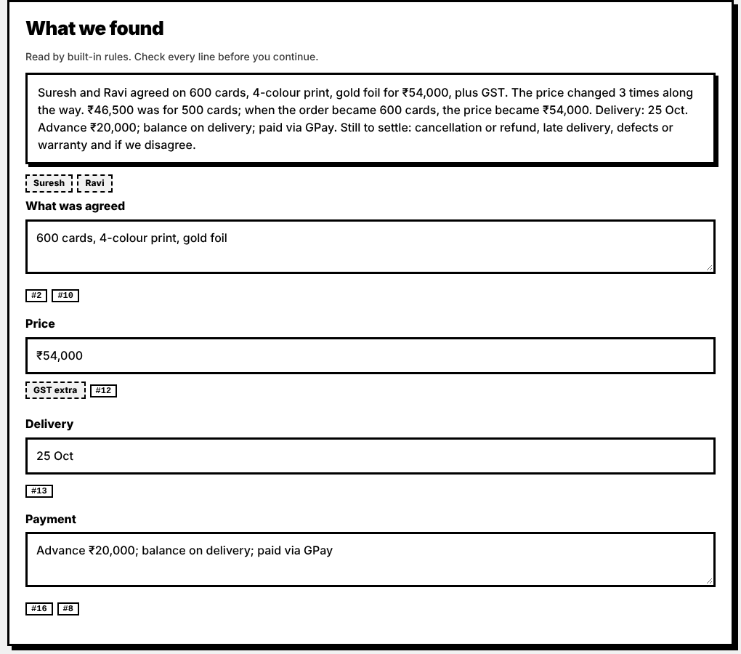
It understands how a deal moves
Tag every amount
price, advance, balance or per-piece rate
Track the quantity
500 cards, then 600
Accepted by the other side?
"theek hai … done" counts, a lone quote does not
Keep the history
46,500 for 500 cards → 54,000 for 600
Rules reader: under 1 ms, works offline.
Notes:
The first version took the last amount in the chat as the price and showed 54k when someone expected 46k. The fix: tag every amount, track quantity over time, tie each price to the quantity in force, and only accept a price the other side agreed to. A later quote nobody accepted is flagged and does not win.

Slide 8
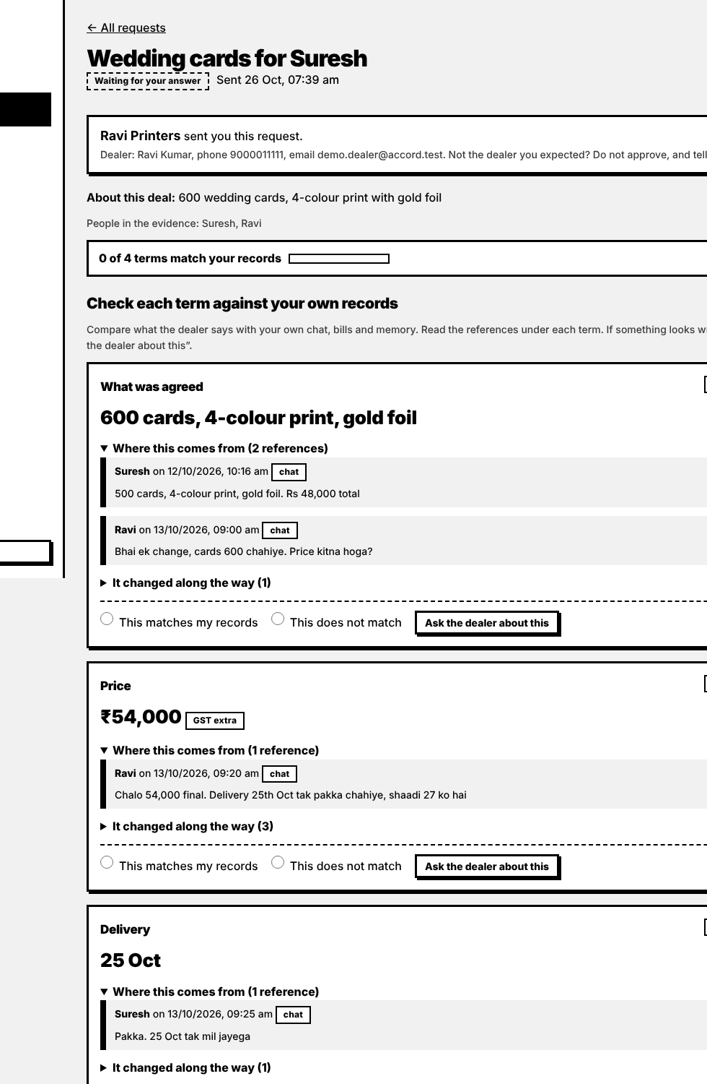
The customer checks each term themselves
Only cited messages
They never see the dealer's whole chat.
Match or mismatch
A mismatch becomes a change request with their note.
Approve is locked
Until every term is checked, enforced on the server.
Linked by private link
Never by guessing an email or phone number.
Notes:
This is the customer view. Each term shows only the messages cited behind it. They mark match or does not match. The approve button stays locked until every term is checked, and the server enforces that, not only the button.

Slide 9
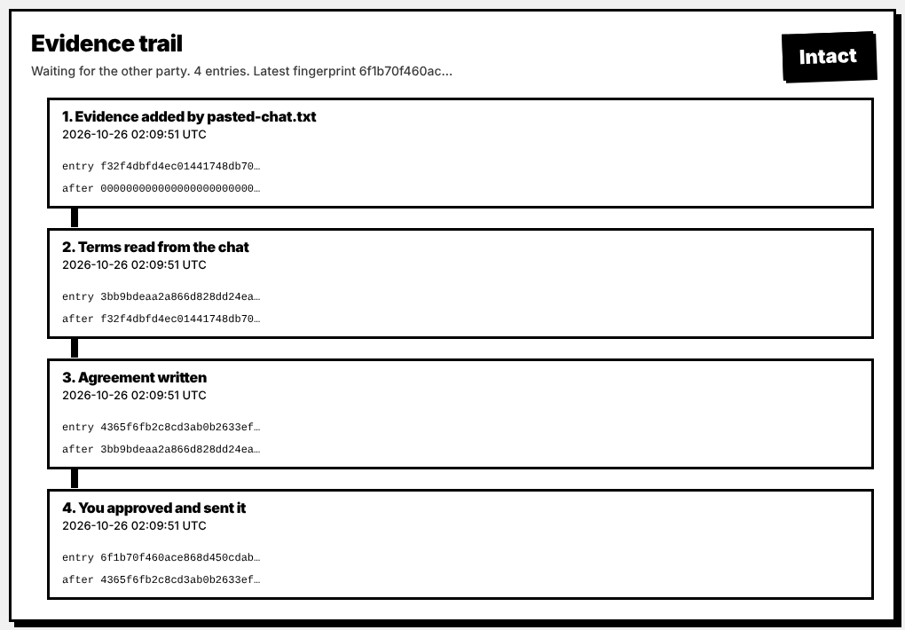
Proof you can't quietly change
1 Evidence added
2 Terms read
3 Agreement written
4 Approved
Each entry stores the hash of the one before it. Agreement and evidence report download as PDFs.
Notes:
Every upload, edit, agreement and approval becomes one entry with its own SHA-256 and the hash of the previous entry. Change anything old and every later hash stops matching. The dealer page has a Simulate tampering button so you can watch the check fail during the demo.

Slide 10
How it fits together
Browser
FastAPI server
Storage
Landing demo, dealer pages, customer portal, confirm link
→
Login and roles, parser, extraction, safety check, evidence chain, PDF export
→
SQLite file and uploaded files
↓
Term extraction
Ollama
→
Rules reader (default), Ollama local model, Claude (optional)
qwen2.5:7b on the Mac, optional
Notes:
Plain HTML, CSS and JavaScript in the browser; FastAPI in Python on the server; one SQLite file plus an uploads folder. Extraction has three engines: the rules reader, an optional local model through Ollama, and optional Claude. Every model answer passes through the safety check.

Slide 11
Stack and where AI is used
STACK
AI
Python, FastAPI, Uvicorn
SQLite (one file, no setup)
Plain HTML, CSS, JavaScript
scrypt passwords, HttpOnly sessions
SHA-256 evidence chain
reportlab for PDFs
pytest and Playwright for testing
Default reader: rules, no AI
Optional local model: Ollama running qwen2.5:7b on a MacBook
Optional Claude API
Answer forced into fixed JSON, with one worked example
Safety check corrects wrong prices
Built with Claude as coding assistant
Notes:
Be upfront: we used Claude to help write the code. Inside the product, the default reader has no AI. The local model and Claude are optional and always checked against the chat.

Slide 12
Tested, not just demoed
39/39
< 1 ms
~55
9
automated tests passing
to read the sample chat
API endpoints
database tables
WHAT THE TESTS PROVE
Final price follows the quantity change: ₹54,000 for 600 cards
A quote nobody accepted does not become the price
Approval is blocked until every term is checked
Changing a stored file or past entry is caught; one dealer cannot see another's data
Notes:
39 automated tests, all passing. They cover accounts, privacy between dealers, the approval gate, evidence chain tamper detection, PDF access rules and the extraction logic including the 500 to 600 cards case. Be honest: we have not measured accuracy on a large set of real chats.

Slide 13
Honest status, and what comes next
NOT DONE YET
NEXT
OTP is simulated: code shown on screen, no SMS
No WhatsApp integration; users upload an export
Not a legal e-signature; enforceability and stamp duty vary by state
No accuracy benchmark on real chats yet
Rules reader does not read Kannada script
Real SMS OTP and licensed e-sign
WhatsApp Business: send nudges directly
Postgres, backups, privacy policy
Test on many real chats and improve from failures
Kannada and Hindi scripts, reminders, multi-party deals
Notes:
Separate clearly what is demonstrated from what is simulated or planned. The OTP on the confirm link is a demo flow: the code shows on screen, no SMS is sent. The local model path is built and tested against a fake server; confirm it on the Mac before presenting.

Slide 14
TEAM BIG LEAGUES
Informal doesn't have to mean unprovable.
Chinmay S
Bhakti Chethan
Ayush Iyer
Ayush Prashanth
Backend
UI / UX
AI integration
UI and landing page
Thank you. Questions?
Notes:
Close with the one-liner. Invite questions. Likely questions: legal validity (it is evidence of agreement plus mutual confirmation, not a replacement for a lawyer), what if the AI is wrong (every term is editable and checked by both sides), why not a template (nobody fills one in mid-conversation).

