Slide 1
Codagami Anime Recommender
Data Mining Project

Slide 2
Group-15
Chinmaya Singal | 180207 | chinmaya@iitk.ac.in
Dipesh Khandelwal | 180249 | dipeshk@iitk.ac.in
Rythm Agarwal | 180636 | rythm@iitk.ac.in
Sakshi | 180653 | sakshisa@iitk.ac.in
Sarthak Dubey | 180674 | srthkdb@iitk.ac.in

Slide 3
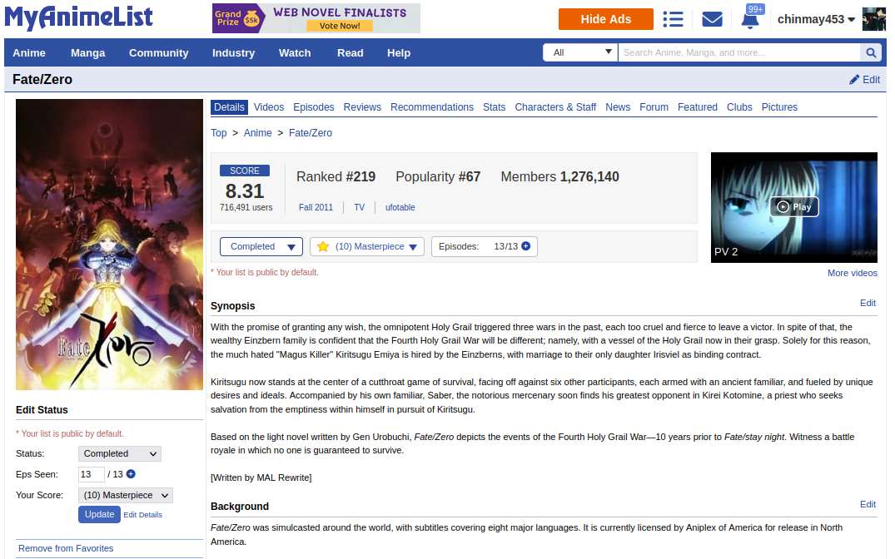
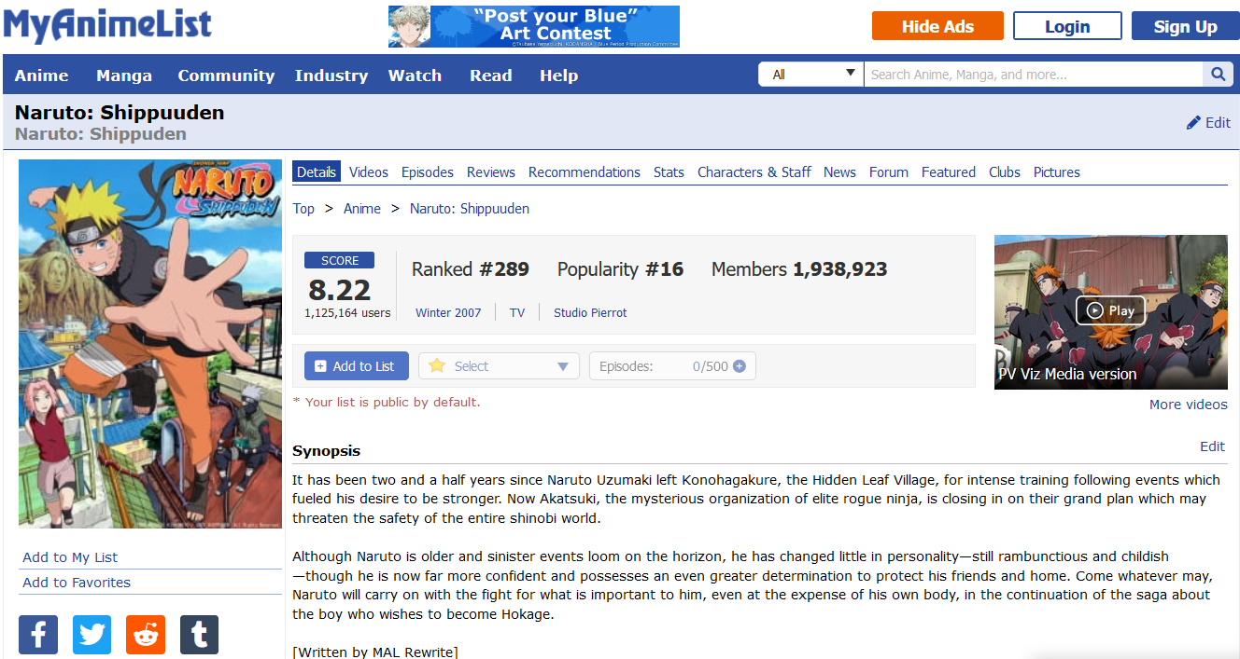
Data Source

Slide 4
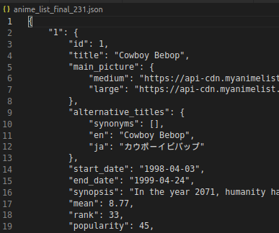
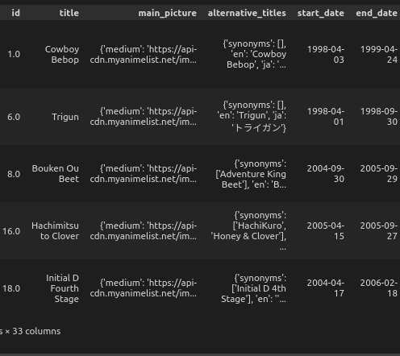
Data retrieval and processing
Json Data collected from MAL API
Data converted and processed to pandas Dataframe for analysis

Slide 5
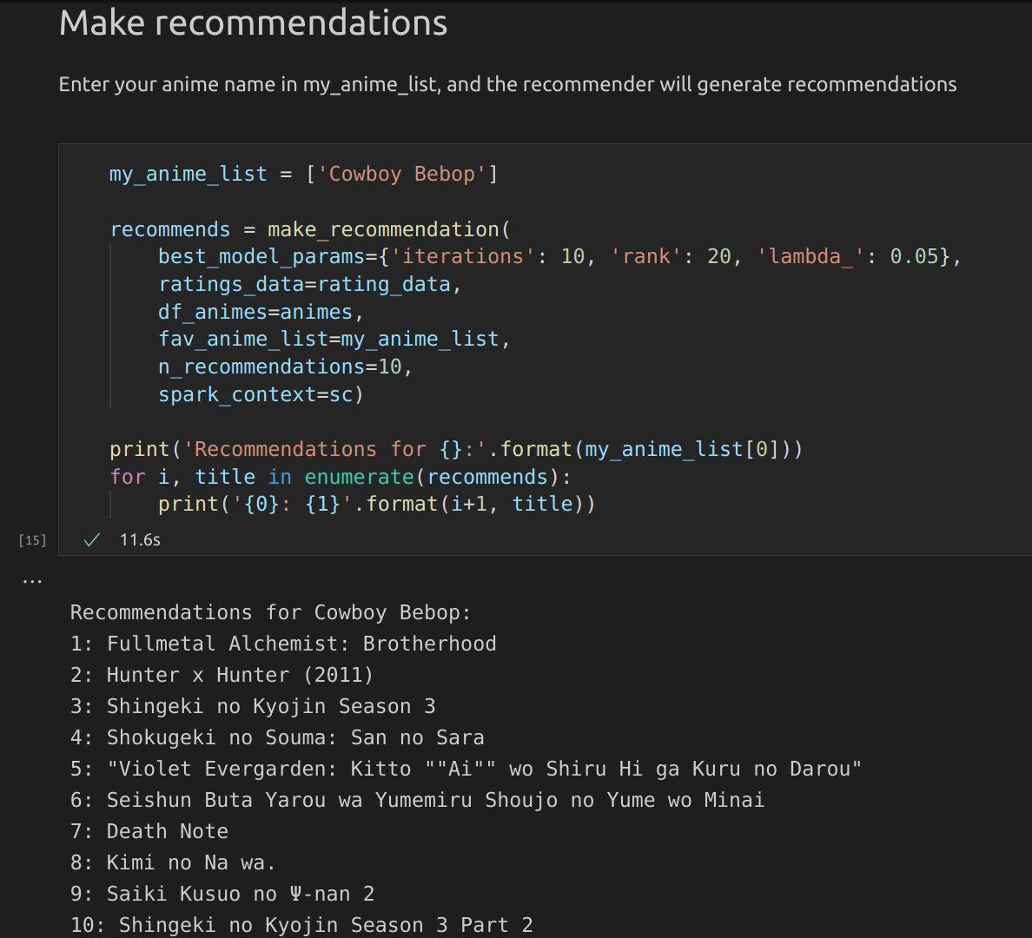
ALS based Recommender
Alternating Least Square (ALS) Matrix Factorization based Collaborative Filtering

Slide 6
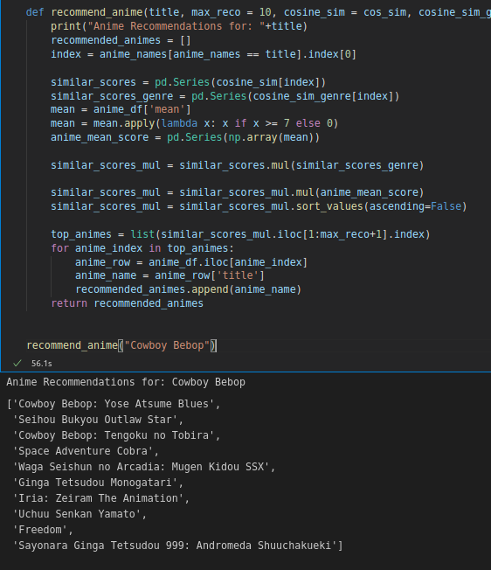
TF-IDF based Recommender
Term Frequency — Inverse Document Frequency (TF-IDF) based recommendation systems are content based recommenders

Slide 7
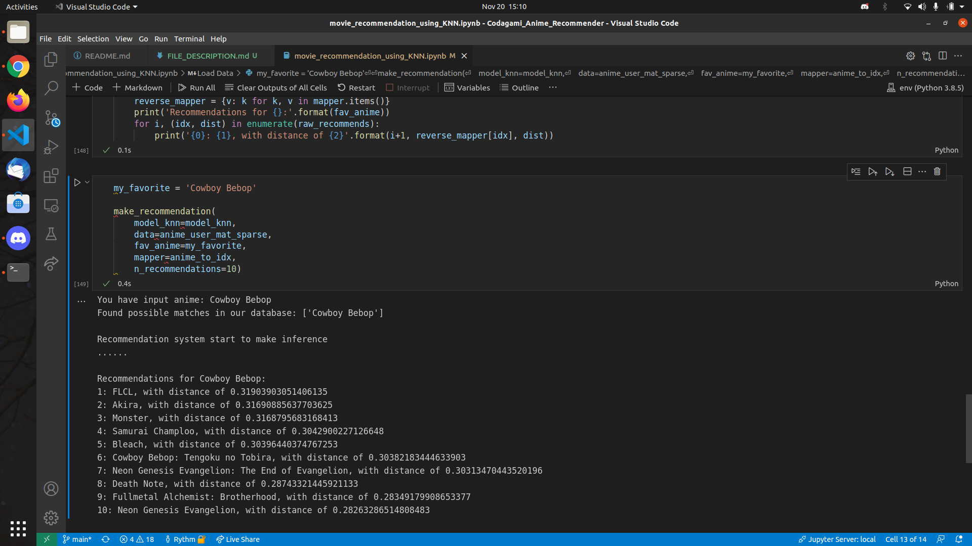
KNN based Recommender
K- Nearest Neighbours (KNN) item based collaborative filtering

Slide 8
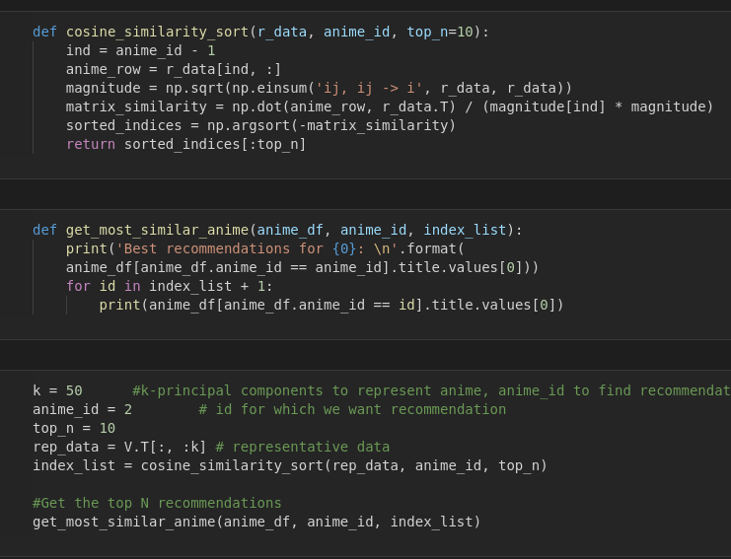

SVD based Recommender

Slide 9
Insights and Analysis

Slide 10
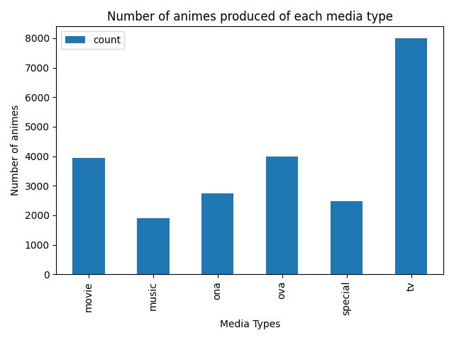
Number of animes produced of each media type

Slide 11
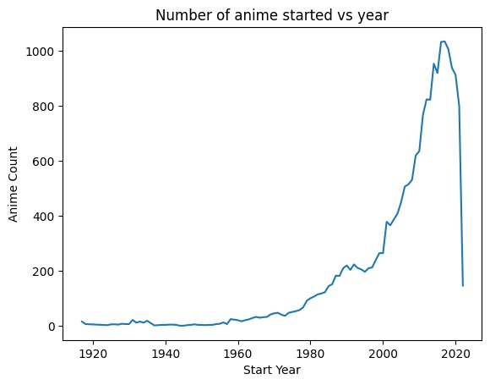
Number of animes aired with time
The dip in the number of animes started during 2020−21 is due to the COVID−19 pandemic.

Slide 12
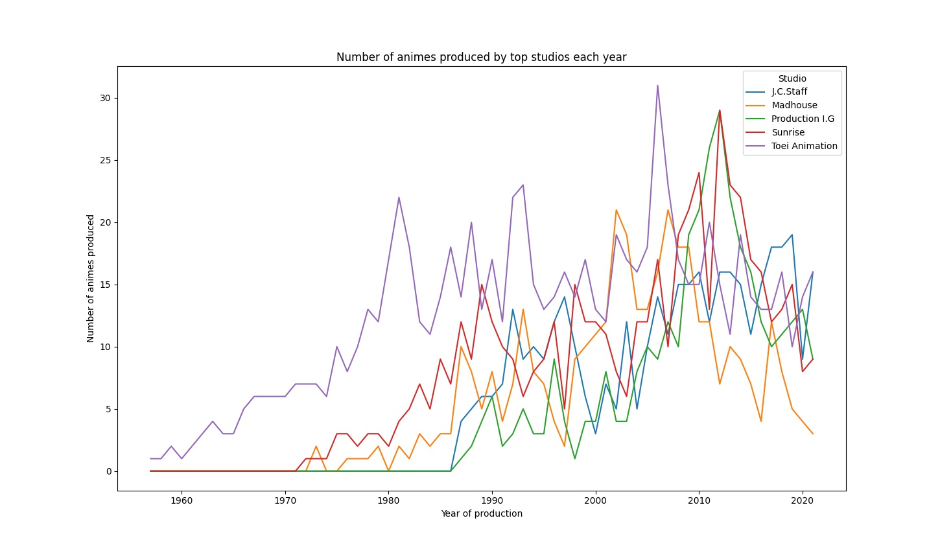
Number of animes produced by top studios with time

Slide 13
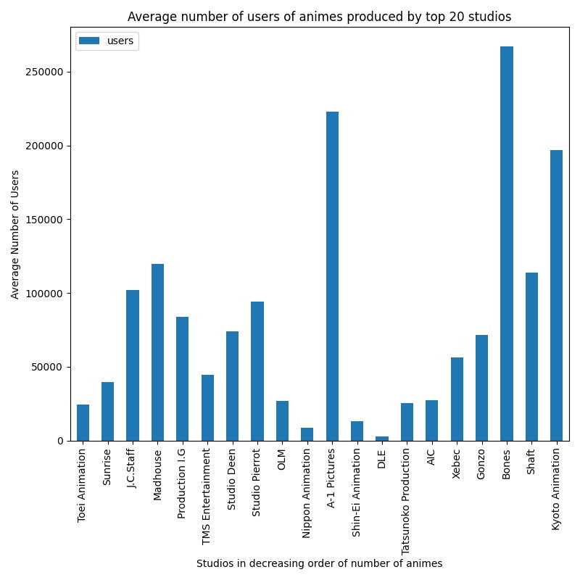
Viewership of Top Studios
Bones has the largest viewership among top studios

Slide 14
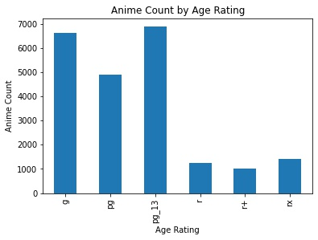
Distribution of animes based on age rating

Slide 15
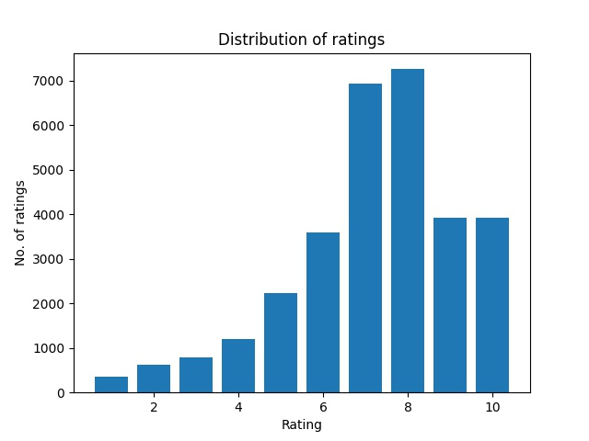
Frequency of various ratings given by viewers

Slide 16
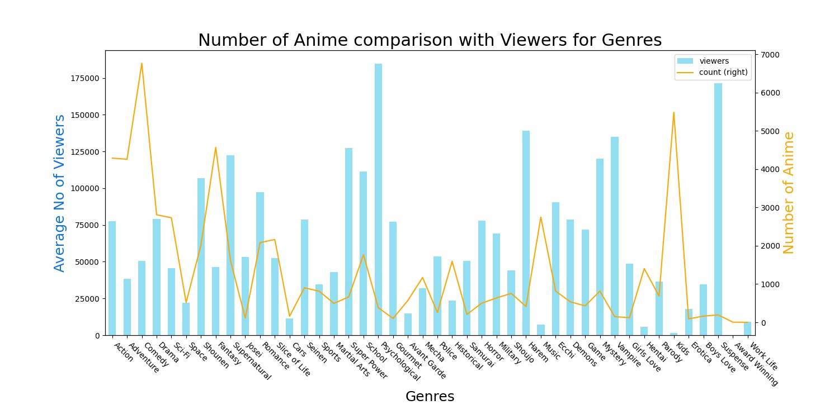

Slide 17
Arigatō Gozaimasu!

