Slide 1
Smart Railway Level-Crossing Safety Controller with Emergency Override
Arduino Uno • Tinkercad simulation • scale-model prototype
Presented by Team 1:
V Chinmaya Datta
N Jathin
Ch Sai Krishna
S Konda Reddy
Notes:
Introduce the project: a fail-safe level-crossing controller on an Arduino Uno, simulated in Tinkercad using only parts that work the same in real life.

Slide 2
What the project is and why
The problem
Basic crossing logic (entry sensor on, exit sensor off) breaks for long or paused trains, and a failed sensor looks exactly like 'no train'.
The solution
An Arduino-based controller that counts axles in and out, estimates train speed to time the warning, and goes to a safe state when anything is doubtful.
What it controls
Road signals (green, yellow, red), a servo barrier, flashing railway LEDs and a buzzer, plus an emergency override button.
Student prototype for a scale model, validated in simulation. It is not a certified railway safety system.
Notes:
A basic crossing only checks entry and exit flags. This one counts axles, predicts arrival and fails safe. Stress that it is a student prototype.

Slide 3








Components used
Arduino Uno
2 force sensors
Servo motor
6 road LEDs
The controller. Runs a non-blocking state machine.
Entry and exit axle detection (model track).
The barrier arm, moved smoothly 1° at a time.
Green, yellow, red on two approaches, sharing 3 pins.
2 railway LEDs
Piezo buzzer
Pushbutton
Resistors, capacitor
Red warning flashers that alternate.
Different patterns for warning, emergency, fault, stall.
Emergency override on a hardware interrupt (D2).
10k, 470k, 470 Ω, 330 Ω, 220 Ω; 470 µF across servo power.
Notes:
Every part simulated in Tinkercad is the same part you would use on a real breadboard.

Slide 4
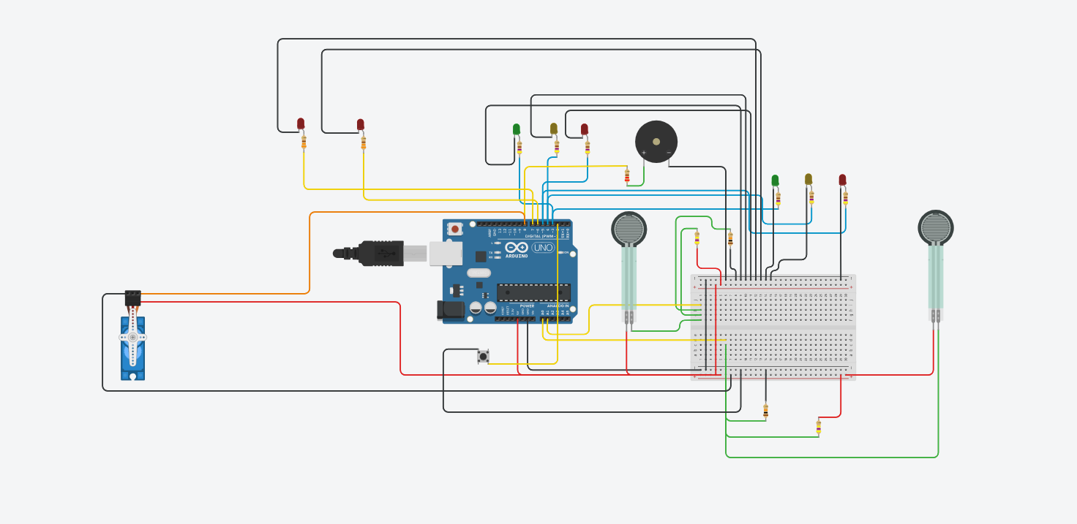
Circuit built in Tinkercad
Pin | Connected to
A0 | Entry force sensor
A1 | Exit force sensor
D2 | Emergency button
D3 / D4 / D5 | Road green / yellow / red (2 LEDs each)
D6 / D7 | Railway warning LEDs
D8 | Buzzer via 220 Ω
D9 | Servo (barrier)
Key details
Each sensor: FSR in parallel with 470 kΩ, 10 kΩ pull-down to GND. Road LEDs 470 Ω each, railway LEDs 330 Ω, 470 µF capacitor across the servo supply.
Notes:
Walk through the diagram briefly: sensors on A0 and A1, road LEDs on D3 to D5, flashers on D6 and D7, buzzer on D8 through 220 ohms, servo on D9, button on D2.

Slide 5
Sensing: axle counting
≈ 21
300–900
0
Idle reading (0.10 V)
Pressed (axle)
Broken wire = FAULT
Reading a press
Counting axles
Counts as pressed above 300 and released below 150 (hysteresis). Edges closer than 40 ms are ignored (debounce). One press equals one axle, so holding a press never double counts.
Entry sensor adds 1, exit sensor subtracts 1. The crossing reopens only when axles out ≥ axles in. This handles any train length and a train that pauses inside the section.
Notes:
The 470k bypass is what makes failures visible: idle reads a small non-zero value, a broken wire reads zero. Entry adds, exit subtracts, reopen only when balanced.

Slide 6
Inside one sensor: failures become visible
5 V
Idle: reads about 21
Nothing pressed: 5 V × 10k ÷ (470k + 10k) ≈ 0.1 V.
FSR
470 kΩ
to A0
Pressed: reads 300 to 900
FSR resistance drops, so the voltage rises. Above 300 counts as an axle.
10 kΩ
Wire cut: reads 0
GND
The 10 kΩ pulls the node to 0 V. A reading of 0 means FAULT, not 'no train'.
In real life the 470 kΩ is soldered at the sensor end, so a cut in either lead reads 0.
Notes:
The 470k resistor keeps the idle reading above zero, so a broken wire (reading 0) can be told apart from an idle sensor.

Slide 7
Speed and constant warning time
How it is calculated
Axle gap | Speed | ETA | Warning starts
1000 ms | 60 mm/s | 10 s | 5 s after first axle
500 ms | 120 mm/s | 5 s | Immediately
300 ms | 200 mm/s | 3 s | Immediately
speed = axle spacing ÷ gap between axles
ETA = distance to crossing × gap ÷ spacing
warning starts at first axle + (ETA − 5 s)
Defaults: 60 mm spacing, 600 mm to crossing.
Fail-safe
No second axle within 1.5 s: warn anyway.
Result
Normal sequence: 2 s yellow plus 1.35 s of barrier travel, so the barrier is down about 1.65 s before a train that holds its speed arrives. Slow trains are held off; fast trains get a warning at once, with a shorter yellow and a faster barrier. ETA assumes constant speed.
Notes:
Speed comes from the first two entry axles because their spacing is known. Entry-to-exit speed is only known after the train has passed, so it is only logged.

Slide 8
State machine (non-blocking)
1 CLEAR
Road green, barrier open
2 APPROACH
Speed → ETA, hold-off
3 WARNING
Yellow 2 s + beep
4 CLOSING
Red, barrier lowers
5 OCCUPIED
Counting axles in/out
6 EXITING
Out ≥ in, 1.5 s quiet
7 CLEARING
Barrier lifts, road red
Back to 1 CLEAR
Road green again
FAULT / EMERGENCY (from any state)
Road goes red (via yellow if needed), barrier closes and stays closed, flashers run and the buzzer sounds. FAULT is a long low tone; EMERGENCY is a fast beep. An operator must press the button to reset.
Notes:
Seven normal states plus FAULT and EMERGENCY reachable from anywhere. The road never jumps from green to red; it passes through yellow, even in an emergency.

Slide 9
One train, start to finish
0 s
First entry axle detected
1 s
Second axle: speed and ETA calculated
5 s
Warning: yellow, flashers, beep
7 s
Red; barrier starts lowering
≈ 8.4 s
Barrier closed, ~1.6 s before arrival
10 s
Train reaches the crossing
Exit
Exit axles counted until out ≥ in
+ 1.5 s
Quiet period over: barrier lifts, road red
Done
Barrier up: road green, train log printed
Times are measured from the first axle. Example: 60 mm axle spacing, 600 mm to the crossing.
Notes:
Example for a slow train with a 1 s gap between the first two axles. A fast train skips the wait and starts warning at once.

Slide 10
Emergency override and fault handling
Trigger | How it is detected | Response
Emergency button | Interrupt on D2, 300 ms debounce | Yellow 2 s, then red, barrier closed, fast beep. Second press reopens.
Wire break | Reading below 3 for 300 ms | FAULT (latched)
Stuck sensor | Pressed for more than 30 s | FAULT (latched)
Wrong order | Exit axle with nothing inside | FAULT (latched)
Stalled train | Occupied for more than 30 s | Siren alarm, barrier stays closed
A FAULT clears only when the operator presses the button and both sensors read healthy.
Notes:
The button uses a hardware interrupt so it is never missed. The second press means the operator confirms the crossing is clear, because the controller cannot know that itself.

Slide 11
Where the novelty comes from
Axle counting
Constant warning time
Wiring-level fault detection
Replaces simple entry/exit flags, as real railways do.
Speed-based timing, no extra hardware needed.
One 470 kΩ resistor per sensor makes failures visible.
Interrupt-driven override
Safe signal sequencing
Same parts as real life
No delay() anywhere, so a press is never missed.
Yellow before red, road stays red until barrier is up.
Nothing is simulator-only; Serial log gives per-train data.
Notes:
Be honest: each idea exists in real railways. The novelty is combining them on a low-cost model with a fail-safe design, using only real parts.

Slide 12
How it is tested
Test | Action | Expected result
Normal train | Entry twice about 1 s apart, then exit twice | Hold-off, yellow, red, barrier closes, then reopens; train log printed
Fast train | Entry twice about 0.3 s apart | Warning starts immediately
Single axle | Entry once and wait | Warning after 1.5 s (fail-safe)
Long train | Entry 4 times, exit 3 times | Stays OCCUPIED until the 4th exit
Emergency | Press button in any state | Yellow, red, barrier closed; second press reopens
Wrong order | Exit sensor first | FAULT; button acknowledges
Wire break | Disconnect the A0 wire | FAULT after about 0.3 s
In Tinkercad a 'press' means dragging the sensor slider up, then back to 0.
Notes:
Demonstrate in this order. Remember to release the sensor fully between presses.

Slide 13
Key takeaways
Safer logic
Smarter timing
Axle counting replaces fragile entry/exit flags.
Speed-based warning keeps the road blocked for less time.
Fails safe
Built to be real
Faults, stalls and emergencies all end in a red road and a closed barrier.
Every simulated part works the same on a real breadboard.
Thank you
Notes:
Close on the four points, then invite questions.

