Slide 1
Solar Radiation
Prediction
By Chinmaya M R

Slide 2
TABLE OF CONTENTS
1.
5.
2.
6.
3.
4.
Problem Statement
About the Data
Feature Selection
Model Building
Data Preprocessing
7.
EDA
Evaluation of models
8.
Deployment

Slide 3
Problem Statement
Develop a predictive model to estimate solar radiation using time, date, temperature, and humidity data. The dataset comprises historical records from Hawaii.
Objectives: data preprocessing, model selection, training, hyperparameter tuning, and evaluation. Create a user-friendly interface for solar radiation predictions. Aims to enhance solar energy planning and environmental sustainability.

Slide 4
About the Data
The dataset consists of historical weather data from Hawaii, comprising various features such as UNIX timestamps, date, time, radiation (the dependent variable), temperature, pressure, humidity, wind direction, wind speed, time of sunrise, and time of sunset. The main objective of this dataset is to explore and analyze the relationship between weather conditions and radiation levels, and to build a predictive model to estimate radiation levels based on the given weather-related attributes. This dataset is valuable for understanding the impact of weather on radiation and could be useful for applications in solar energy and climate research.

Slide 5
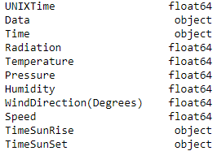
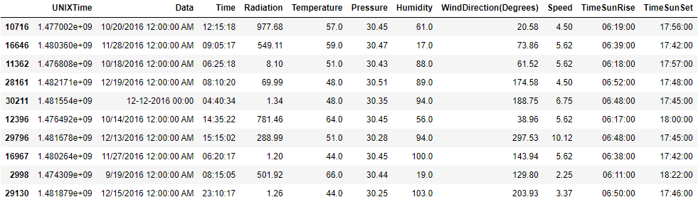
Features given in the Dataset

Slide 6
Data Preprocessing
Preprocessing is performed to transform the raw data into a format suitable for analysis and modeling. It helps in improving the data quality, handling missing values, and creating meaningful features that enhance the performance of predictive models. The conversion of timestamps and timezones ensures consistent and accurate representation of time-related data. Feature engineering adds valuable insights, and dropping unnecessary columns reduces the dimensionality of the dataset. Overall, preprocessing improves the efficiency and effectiveness of subsequent data analysis and model building tasks.

Slide 7
The preprocessing steps performed on the dataset are as follows:
Conversion of Timestamps: The 'UNIXTime' column is converted to a proper datetime format to represent the time of the day.
Timezone Conversion: The data is initially in UTC timezone, and it is converted to the 'Pacific/Honolulu' timezone (Hawaii time) to match the location of the data collection.
Feature Engineering: Additional features are derived from the timestamp, such as 'MonthOfYear', 'DayOfYear', 'WeekOfYear', 'TimeOfDay(h)', 'TimeOfDay(m)', and 'TimeOfDay(s)'. These features provide more meaningful insights into the temporal patterns and variations in the data.
Time Duration Calculation: The time of sunrise and sunset ('TimeSunRise' and 'TimeSunSet') is converted to a proper datetime format. Then, the 'DayLength(s)' feature is created to calculate the duration of daylight in seconds.
Dropping Unnecessary Columns: The 'Data', 'Time', 'TimeSunRise', and 'TimeSunSet' columns are dropped from the dataset as they are no longer needed for analysis or model building.

Slide 8
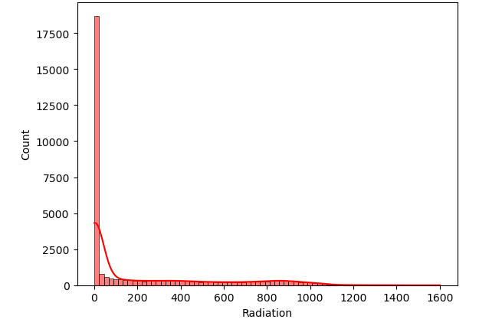
Exploratory data analysis
EDA involves visually exploring the dataset to gain insights and identify patterns, trends, and relationships between variables.
The graph shows a positively skewed distribution of the dependent variable, with a skewness value of 1.369. Outliers are present towards higher values, potentially impacting the data distribution. Consider using robust regression or nonlinear models instead of linear regression, which assumes normality. To mitigate the skewness effect, use robust measures or consider the median for statistical interpretation.

Slide 9
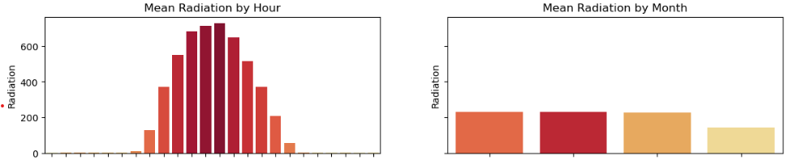
Mean Radiation by Hour and Month
The first graph shows the mean radiation with respect to time, and it displays an almost normally distributed pattern. The radiation levels appear to follow a consistent trend over time, with no significant deviations from the expected distribution.
The second graph illustrates the mean radiation with respect to each month. It consists of four bars, with three bars being of almost equal length, indicating similar mean radiation levels for those months. However, the fourth bar is slightly shorter, suggesting a slightly lower mean radiation level for that particular month compared to the others.
Overall, these graphs provide insights into the average radiation patterns over time and across months, indicating potential seasonal variations in solar radiation.

Slide 10
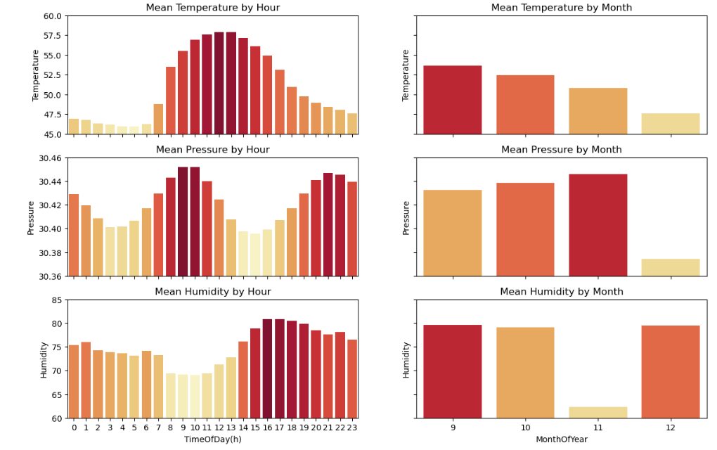
Mean Temperature by Hour and Month
The first graph represents the mean temperature with respect to time. It displays a distinct trend where the temperature decreases initially, then suddenly rises to a high point, and finally decreases again. This pattern indicates a cyclical behavior in temperature over time, possibly corresponding to seasonal changes or other periodic influences.
The second graph shows the mean temperature with respect to each month, depicted by four bars. Each successive bar is shorter than the one before it, indicating a decreasing mean temperature as the months progress. This pattern suggests a seasonal variation, where temperatures are higher in earlier months and gradually decrease towards the later months.
The graphs provide valuable insights into the temporal and seasonal patterns of mean temperature. Understanding these temperature patterns is crucial for analyzing climate trends, planning solar energy utilization, and making informed decisions related to temperature-sensitive activities throughout the year.

Slide 11
Mean Pressure by Hour and Month
The first graph represents the mean pressure with respect to time. It exhibits a repeating pattern of fluctuations, where the pressure decreases initially, then rises, and repeats this cycle. This cyclic behavior suggests the presence of periodic influences on atmospheric pressure over time, such as weather systems or other atmospheric phenomena.
The second graph illustrates the mean pressure with respect to each month, represented by four bars. The first three bars show a progressive increase in mean pressure, indicating higher pressure levels in those months compared to the previous ones. However, the fourth bar is the shortest, suggesting a drop in mean pressure for that particular month, possibly indicating a seasonal shift in atmospheric conditions.
These graphs provide valuable insights into the temporal and seasonal variations of mean pressure, contributing to a better understanding of atmospheric dynamics and weather patterns. The cyclic trends observed in the first graph may help in predicting pressure fluctuations, while the patterns seen in the second graph can assist in identifying monthly pressure changes for climate-related analyses and forecasting purposes.

Slide 12
Mean Humidity by Hour and Month
The first graph illustrates the mean humidity with respect to time, displaying a 24-hour pattern. The bars show fluctuations in a somewhat random order until 8 o'clock, followed by equal levels of humidity from 8 to 11. From 12 onwards, there is a gradual increase in humidity until 17, after which it starts decreasing again. This cyclic pattern suggests varying moisture levels throughout the day, possibly influenced by daily weather changes and environmental factors.
The second graph represents the mean humidity with respect to each month, featuring four bars. The 9th, 10th, and 12th months exhibit similar mean humidity levels, indicating consistent humidity patterns during these months. However, the 11th month has a lower mean humidity compared to the others, suggesting a distinct humidity behavior during that specific month.
These graphs offer insights into the diurnal and seasonal variations in mean humidity levels. The first graph's cyclic pattern may aid in understanding daily humidity fluctuations, while the second graph highlights variations in humidity for different months, helping to identify seasonal moisture trends. Understanding humidity patterns is essential for numerous applications, such as weather forecasting, agricultural planning, and managing indoor environments.

Slide 13
Feature Selection
Improve Model Performance: Reducing irrelevant and redundant features helps in focusing on the most informative ones, leading to better model accuracy and generalization.
Reduce Complexity: Fewer features simplify the model, making it easier to interpret and less computationally intensive.
Overfitting Prevention: Selecting relevant features minimizes the risk of overfitting, improving the model's ability to generalize to new data.

Slide 14
Method Used for Feature Selection
Recursive Feature Elimination
Recursive Feature Elimination (RFE) is a powerful feature selection technique often used in conjunction with RandomForest, a popular ensemble learning algorithm. RFE aims to enhance the performance and efficiency of machine learning models by iteratively removing the least important features from the dataset. The process starts with training the RandomForest model on all available features and then ranking the features based on their importance scores. The least important feature is subsequently eliminated, and the model is retrained on the updated feature set. This recursive process continues until the desired number of features or a predefined performance criterion is achieved. By selecting the most informative features, RFE helps the RandomForest model focus on relevant factors, improving predictive accuracy and reducing overfitting. Additionally, RFE makes the model more interpretable and computationally efficient, making it a valuable technique for dimensionality reduction and model optimization in various machine learning applications.

Slide 15
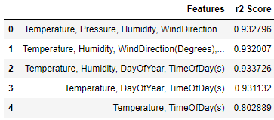
After applying RFE
Temperature
Humidity
Selected Features
Time of the day
(Seconds)
Day of the year

Slide 16
Model Building
We employed six machine learning algorithms for solar radiation prediction:
1.Linear Regression: A simple baseline model used to establish initial predictions.
2.K-Nearest Neighbors (KNN): Utilizes similar historical data points to estimate solar radiation levels for a given point.
3.Decision Tree: Makes predictions by creating a tree-like model of decisions based on the features.
4.Bagging (Random Forest): An ensemble model that combines multiple decision trees to improve accuracy.
5.AdaBoost: Another ensemble model that adapts weak learners (e.g., decision trees) to enhance predictive performance.
6.Random Forest: A powerful ensemble model that builds multiple decision trees and combines their predictions to yield robust results.
The dataset was split into training and testing sets to train and evaluate each model's performance.
The models were trained on the selected features using historical solar radiation data.
Performance metrics like Mean Absolute Error (MAE) and Root Mean Squared Error (RMSE) were used to assess model accuracy

Slide 17
Model Evaluation
R²
Adjusted R²
RMSE
Linear Regression
0.601398 0.601337 198.942253
KNeighborsRegressor
0.835233 0.835208 127.906318
AdaBoostRegressor
0.803291 0.803261 139.755577
DecisionTreeRegressor
0.893649 0.893633 102.760771
BaggingRegressor
0.932297 0.932287 81.989792
RandomForestRegressor
0.937777 0.937768 78.601625
Among the ensemble models, Random Forest exhibited the lowest MAE and RMSE values, making it the most accurate model for solar radiation prediction.

Slide 18
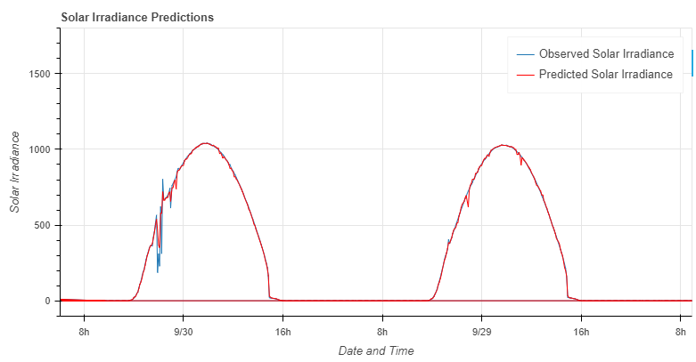

Slide 19

DEPLOYMENT
To make our solar radiation prediction model accessible to end-users, we deployed it using Flask, a lightweight and versatile web application framework in Python.
Flask allows us to create a web application with minimal boilerplate code, making it efficient and straightforward to deploy the model.
Flask provides excellent integration with Python and its libraries, enabling seamless model integration, data processing, and responses.
The use of Flask enhances the user experience as it provides a user-friendly interface for users to interact with the solar radiation prediction model.

Slide 20
Advantages of Flask
Lightweight: Flask is lightweight and does not require extensive resources, making it suitable for deploying models on servers with limited capabilities.
Easy to Learn and Use: Flask's simplicity makes it beginner-friendly, allowing developers to quickly set up a web application and deploy the model without much complexity.
Flexibility: Flask's modular design allows developers to choose only the necessary components for the project, offering greater flexibility in building the web application.
Extensive Documentation: Flask has comprehensive and well-documented resources, making it easy for developers to find solutions and troubleshoot issues.
Community Support: Flask has a large and active community of developers, which ensures timely updates, bug fixes, and continuous improvements.
Integrates Well with Machine Learning Libraries: Flask seamlessly integrates with popular Python libraries used in machine learning, such as NumPy, Pandas, and Scikit-learn, facilitating smooth model integration and data handling.
Scalability: While Flask is ideal for small to medium-scale applications, it can be scaled up efficiently by combining it with other technologies or deploying it on a more powerful server.

Slide 21
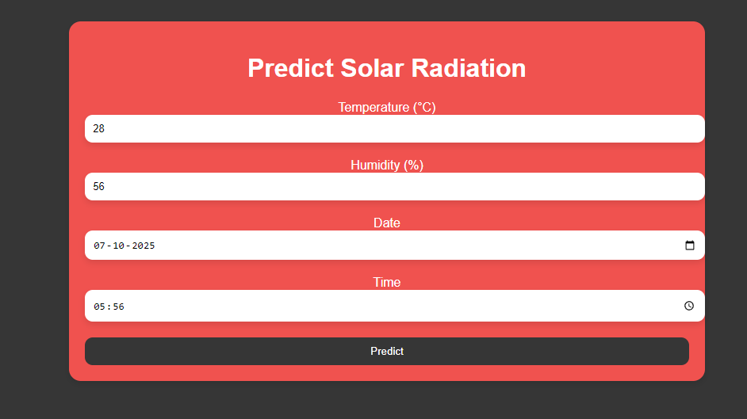
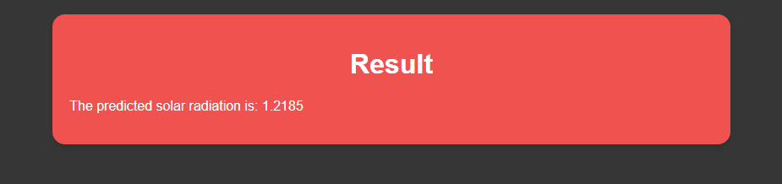
Deployed Result

Slide 22
Conclusion
In conclusion, our project successfully developed a predictive model for solar radiation estimation using machine learning algorithms. By analyzing historical solar radiation data and relevant environmental parameters, we created accurate predictions of solar radiation levels. Among the tested algorithms, Bagging (Random Forest) outperformed others, ensuring reliable predictions for solar energy planning and utilization.
The project's insights benefit businesses, policymakers, and energy planners, enabling optimized solar panel installations, improved grid management, and enhanced renewable energy integration. With data-driven decisions, businesses can enhance marketing strategies, product offerings, and customer engagement, leading to improved conversion rates and satisfaction.
Our project contributes to a greener and more sustainable energy future, leveraging the power of machine learning for renewable energy applications. The developed predictive model serves as a valuable tool for solar energy planning, paving the way for further advancements in renewable energy solutions.

Slide 23
THANK YOU

