Slide 1


Drift.ai
Private AI lifestyle drift audits
Replaces a 60-minute spreadsheet audit with a
2-minute private AI scan plus a report worth paying for.
Chinmay Arvind, Laeeq Ahmed | UMN | 0-1 Hackathon 2026

Slide 2
THE PROBLEM
📥 Download & clean bank CSVs manually
60
min
📊 Build spreadsheet formulas from scratch
average time to manually
audit spending drift
🔍 Guess which spending changes matter
❓ No explanation for why spending changed
Target user: early-career professionals after a raise, move, or routine change.
They want to know where the extra money went.
Budgeting apps tell you what you spent. None explain what your spending has become.

Slide 3

BEFORE VS. AFTER
BEFORE DRIFT
AFTER DRIFT
✗ Export bank CSV
✓ Import CSV
✗ Clean categories manually
✓ Drift finds spending changes
✗ Build spreadsheet formulas
✓ AI asks why it changed
✗ Compare months manually
✓ Behavior tag is saved
✗ Guess what changed
✓ Simulate future purchase
✗ Write a plan manually
✓ Export private PDF
✗ Repeat next month
✓ Done in 2 minutes

Slide 4




THE SOLUTION: DRIFT.AI
1
2
3
4
Scan
Pattern Lab
Intercept
Report
Compares earlier vs. recent monthly averages and flags drift.
Asks why a pattern started and saves a behavior tag.
Tests a future purchase and marks it intentional or risky.
Produces a private PDF with cited facts and a 30-day recovery path.

Slide 5

WHY AI IS CORE
AI is used for behavior insight, not the financial math.
Math
Computes Drift Score and category changes from the CSV
AI Interviews
Asks why the pattern started and follows up
AI Classifies
Tags reward spending, stress convenience, habit influence, or life event
AI Writes
Generates a short recovery path from the tag and overspend
AI Reports
Writes a cited review grounded in scan facts
Raw transactions stay in the browser. Local Qwen/Ollama runs the AI.

Slide 6


VALUE + WHY PAY
Report unlock is live in the MVP
60-minute manual audit becomes a 2-minute private scan
The PDF gives cited facts, behavior insight, and a 30-day recovery path
Raw transactions stay local, which matters for personal financial data
One-time payment keeps the ask simple and low friction

Slide 7


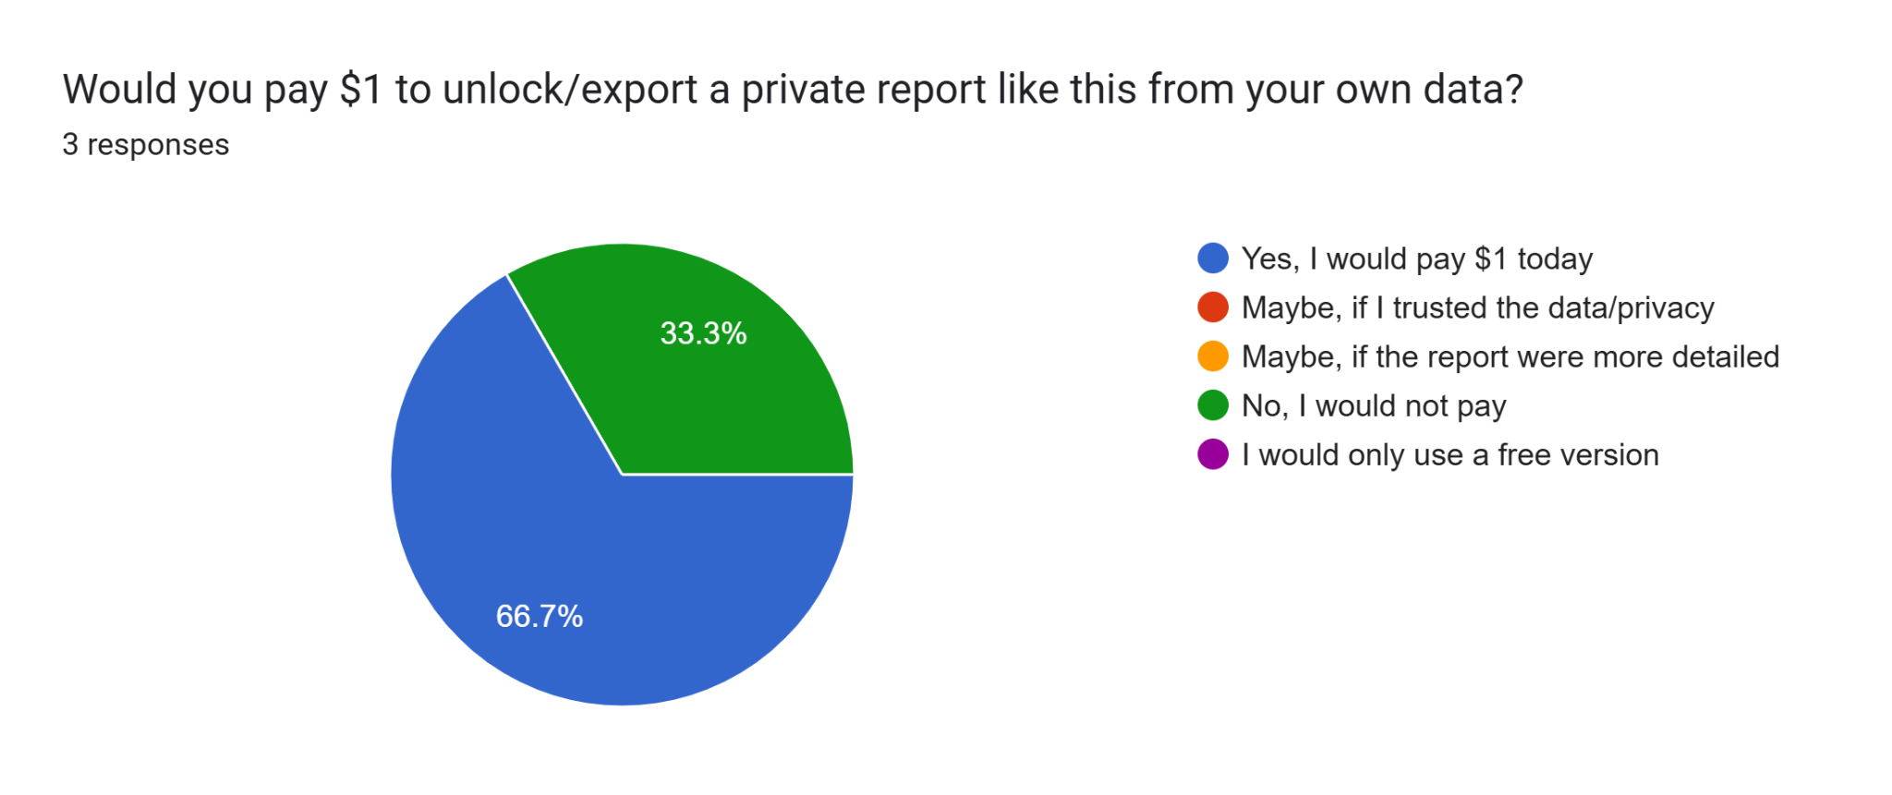

WORKING MVP / VALIDATION
Working MVP
$Payment Ready
CSV import, Drift Score, Pattern Lab, Intercept, PDF export, email, and Stripe all working.
Stripe checkout is live for report unlock and ready for payments.
Early User Interest
Got user interest results of 3 people from different backgrounds (finance, tech, product engineering). Positive interest in privacy and behavior insight.

Slide 8
DEMO
Link To Demo
Live app: drift-ai-lime.vercel.app

