Slide 1

School of information sciences
Big data and Data analytics
Child Mortality Data Analysis
Guided by, Presented By,
Deepak Rao Chinmaya Urs K A
(171046033)

Slide 2
CONTENTS
INTRODUCTION
DESCRIPTION OF DATASET
TOOLS USED FOR VISUALIZATION
ANALYSIS
VISUALISATION
CONCLUSION

Slide 3
INTRODUCTION
Child mortality, also known as child death, refers to the death of children under the age of 14 and encompasses neonatal mortality, under-5 mortality, and mortality of children aged 5-14

Slide 4
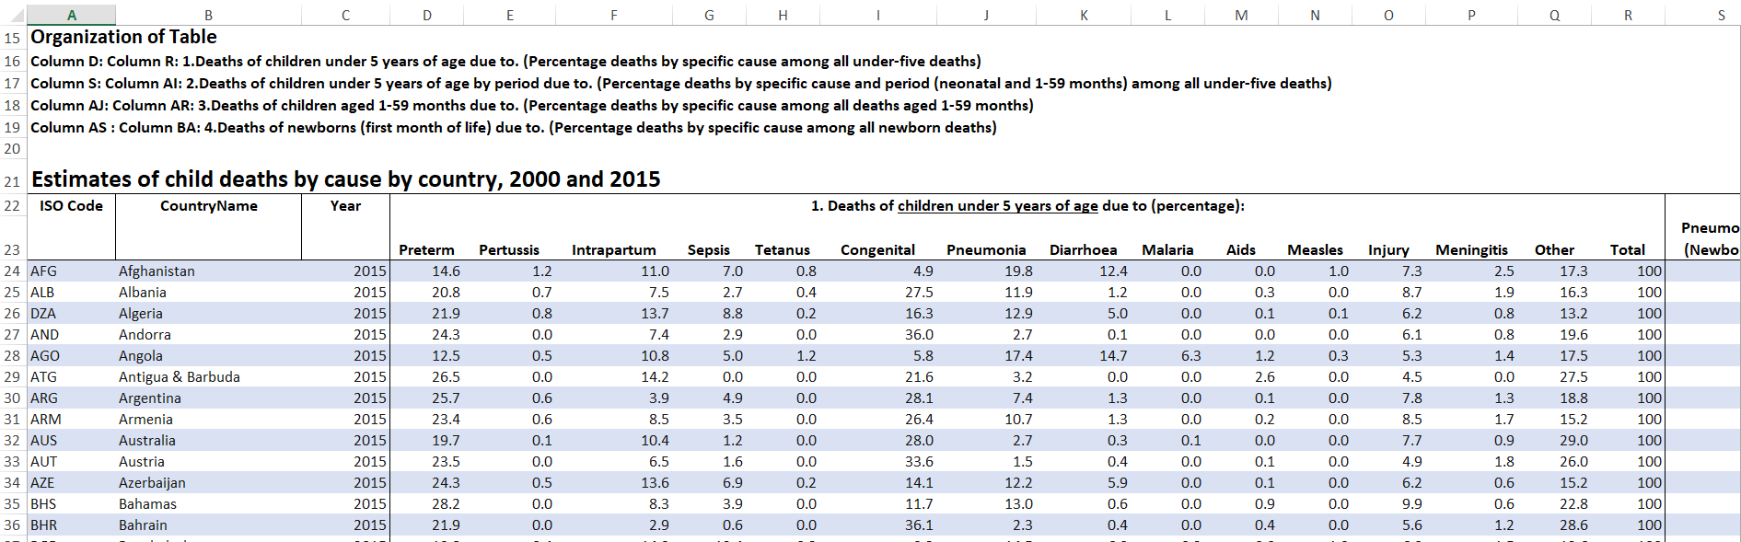
DESCRIPTION OF DATASET

Slide 5
TOOLS USED FOR VISUALIZATION
- matplotlib
- d3.js
Plotly
plotly.tools.set_credentials_file(username='qwerty03',api_key='zalzm7bui9')

Slide 6
ANALYSIS
How the cause of death have effected the developed and developing countries?
- Preterm
- Intraparturm
- Sepsis
- Congenital
- Pneumonia
- Injury
- Diarrhoea

Slide 7
CONT…
We are going to see whether these cause for deaths have been increased / decreased as years have been passed from 2000 to 2015 for Developing region
- Congenital
- Preterm
- Sepsis
- Intrapartum

Slide 8
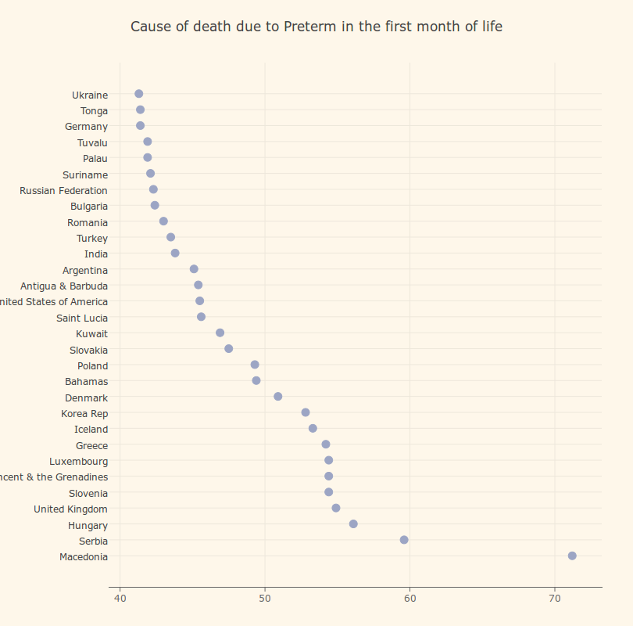
VISUALISATION
PRETERM

Slide 9
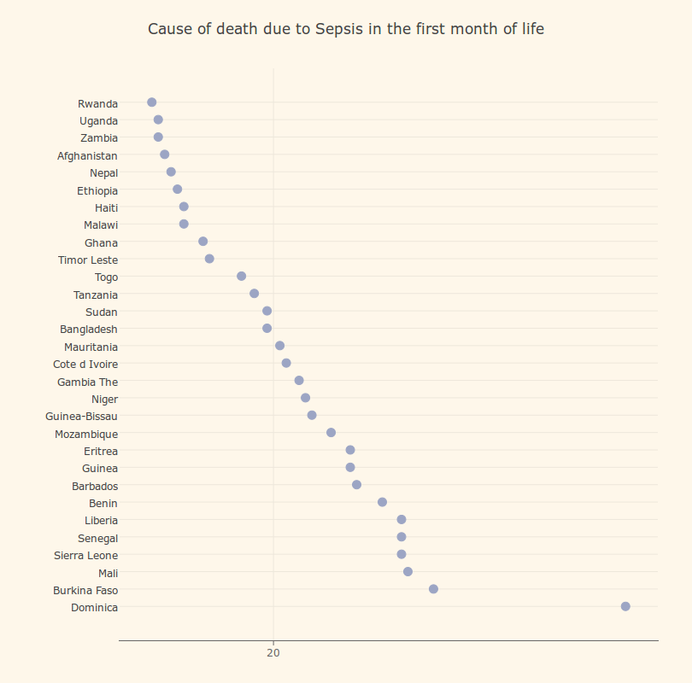
SEPSIS

Slide 10
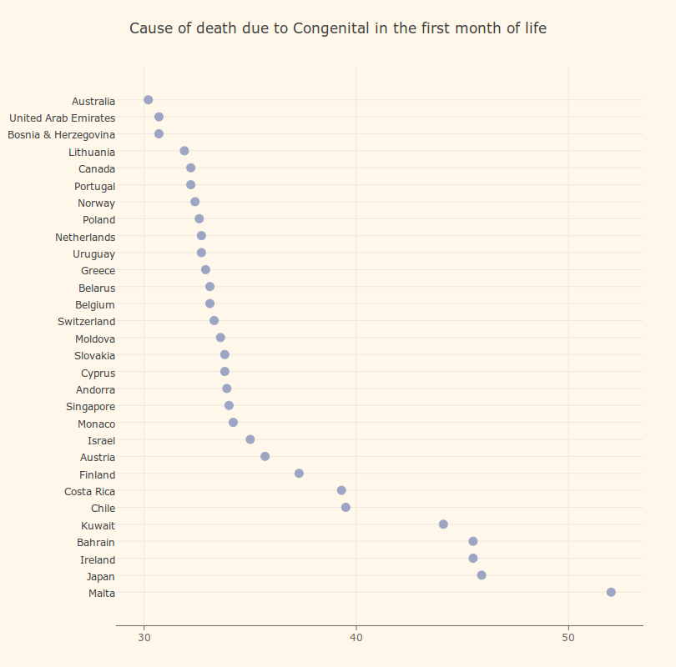
CONGENTIAL

Slide 11
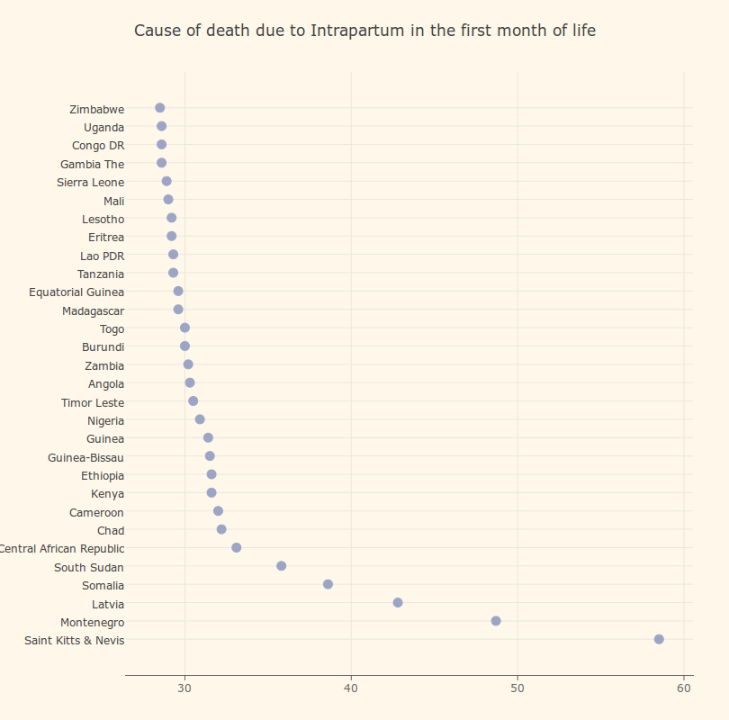
INTRAPARTUM

Slide 12
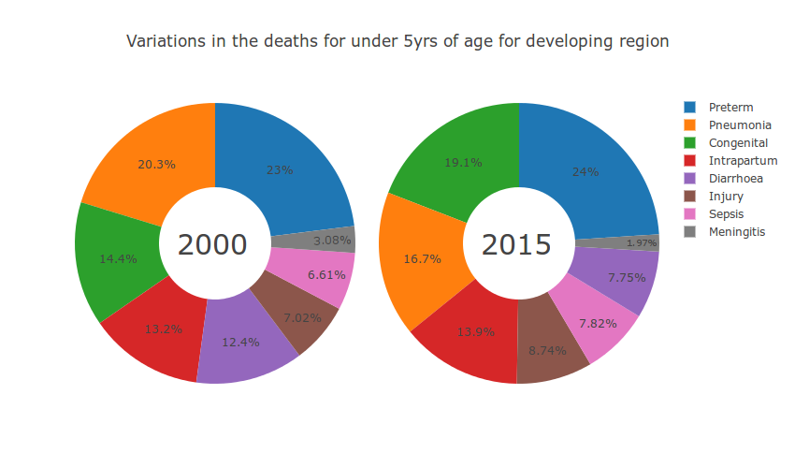
CONT…

Slide 13
CONCLUSION
From the analysis made we can find out which part of the world has more child mortality with this we can find out the reason behind it and take precautionary measure to reduce the child death

Slide 14
THANK YOU

