Slide 1

LECTURE 5 SUBQUERIES AND JOINS
Ankita Pai

Slide 2
AGENDA
Subqueries
The Subquery as Scalar Operand
Comparisons Using Subqueries
Subqueries with ANY, IN, or SOME
Subqueries with ALL
Row Subqueries
Subqueries with EXISTS or NOT EXISTS
Correlated Subqueries
Derived Tables
Subquery Errors
Optimizing Subqueries
Rewriting Subqueries as Joins
Joins and its Types

Slide 3
LEARNING OUTCOME
To understand
Usage of subqueries in SQL
Different Types of Joins

Slide 4
SUBQUERIES

Slide 5
Subqueries
A subquery is a SELECT statement within another statement.
SELECT "column_name1“ FROM "table_name1" WHERE "column_name2" [Comparison Operator](SELECT "column_name3"FROM "table_name2“ WHERE "condition");
eg: SELECT * FROM t1 WHERE column1 = (SELECT column1 FROM t2);
In this example, SELECT * FROM t1 ... is the outer query (or outer statement), and (SELECT column1 FROM t2) is the subquery.
We say that the subquery is nested within the outer query, and in fact it is possible to nest subqueries within other subqueries, to a considerable depth.
A subquery must always appear within parentheses.
A subquery can return a scalar (a single value), a single row, a single column, or a table (one or more rows of one or more columns). These are called scalar, column, row, and table subqueries.
A subquery's outer statement can be any one of: SELECT, INSERT, UPDATE or DELETE.
Notes:
[Comparison Operator] could be equality operators such as =, >, <, >=, <=. It can also be a text operator such as "LIKE". The portion in red is considered as the "inner query," while the portion in green is considered as the "outer query.“
A subquery's outer statement can be any one of: SELECT, INSERT, UPDATE, DELETE, SET, or DO.

Slide 6
Advantages of Subqueries
The main advantages of subqueries are:
They allow queries that are structured so that it is possible to isolate each part of a statement.
They provide alternative ways to perform operations that would otherwise require complex joins and unions.
Many people find subqueries more readable than complex joins or unions. Indeed, it was the innovation of subqueries that gave people the original idea of calling the early SQL “Structured Query Language.”

Slide 7
Subquery as a Scalar Operand
In its simplest form, a subquery is a scalar subquery that returns a single value.
A scalar subquery is a simple operand, and you can use it almost anywhere a single column value and you can expect it to have those characteristics that all operands have: a data type, a length, an indication that it can be NULL, and so on.
eg: CREATE TABLE t5 (s5 INT, s2 CHAR(5) NOT NULL);
INSERT INTO t5 VALUES(100, 'abcde');
SELECT (SELECT s2 FROM t5);
The subquery in this SELECT returns a single value ('abcde') that has a data type of CHAR, a length of 5, and an indication that the value in the column can be NULL.
Notes:
https://dev.mysql.com/doc/refman/8.0/en/scalar-subqueries.html

Slide 8
Comparisons using Subqueries
Two of the common subquery constructs are:
non_subquery_operand comparison_operator (subquery)
non_subquery_operand LIKE (subquery)
For a comparison of the subquery to a scalar, the subquery must return a scalar.
For a comparison of the subquery to a row constructor, the subquery must be a row subquery that returns a row with the same number of values as the row constructor (row subqueries).
Notes:
https://dev.mysql.com/doc/refman/8.0/en/comparisons-using-subqueries.html

Slide 9
Row Subqueries
A row subquery is a subquery variant that returns a single row and can thus return more than one column value.
A row constructor is used for comparisons with subqueries that return two or more columns.
Notes:
https://dev.mysql.com/doc/refman/8.0/en/row-subqueries.html

Slide 10
Subqueries with ANY, IN or SOME
operand comparison_operator ANY (subquery)
The ANY keyword, which must follow a comparison operator, means “return TRUE if the comparison is TRUE for ANY of the values in the column that the subquery returns.”
operand IN (subquery) operand
When used with a subquery, the word IN is an alias for = ANY.
comparison_operator SOME (subquery)
The word SOME is an alias for ANY.
Notes:
https://dev.mysql.com/doc/refman/8.0/en/any-in-some-subqueries.html

Slide 11
Subqueries with ALL
operand comparison_operator ALL (subquery)
The word ALL, which must follow a comparison operator, means “return TRUE if the comparison is TRUE for ALL of the values in the column that the subquery returns.”
NOT IN is an alias for <> ALL.
Notes:
https://dev.mysql.com/doc/refman/8.0/en/all-subqueries.html

Slide 12
Subqueries with EXISTS or NOT EXISTS
If a subquery returns any rows at all, EXISTS subquery is TRUE, and NOT EXISTS subquery is FALSE.
Traditionally, an EXISTS subquery starts with SELECT *, but it could begin with SELECT 5 or SELECT column1 or anything at all. MySQL ignores the SELECT list in such a subquery, so it makes no difference.
eg: SELECT column1 FROM t1 WHERE EXISTS (SELECT * FROM t2);
if t2 contains any rows, even rows with nothing but NULL values, the EXISTS condition is TRUE.

Slide 13
Correlated Subqueries
A correlated subquery is a subquery that contains a reference to a table that also appears in the outer query.
eg: SELECT * FROM t1 WHERE column1 = ANY (SELECT column1 FROM t2 WHERE t2.column2 = t1.column2);
Notice that the subquery contains a reference to a column of t1, even though the subquery's FROM clause does not mention a table1. So, MySQL looks outside the subquery, and finds t1 in the outer query.
Scoping rule: MySQL evaluates from inside to outside.
Notes:
https://dev.mysql.com/doc/refman/8.0/en/correlated-subqueries.html

Slide 14
Derived Tables
A derived table is an expression that generates a table within the scope of a query FROM clause. For example, a subquery in a SELECT statement FROM clause is a derived table:
SELECT ... FROM (subquery) [AS] tbl_name (col_list) ...
The [AS] tbl_name clause is mandatory because every table in a FROM clause must have a name.
Any columns in the derived table must have unique names.
Alternatively, tbl_name may be followed by a parenthesized list of names for the derived table columns
Notes:
https://dev.mysql.com/doc/refman/8.0/en/derived-tables.html

Slide 15
Subquery Errors
There are some errors that apply only to subqueries:
Unsupported subquery syntax
Incorrect number of columns from subquery
Incorrect number of rows from subquery
Incorrectly used table in subquery
Notes:
https://dev.mysql.com/doc/refman/8.0/en/subquery-errors.html

Slide 16
Optimizing Subqueries
The following list provides some interesting tricks that you might want to play with:
Replace a join with a subquery.
In some cases, converting a subquery to a join may improve performance.
Use a row subquery instead of a correlated subquery.
Use NOT (a = ANY (...)) rather than a <> ALL (...).
Use x = ANY (table containing (1,2)) rather than x=1 OR x=2.
Use = ANY rather than EXISTS.
For subqueries that always return one row, IN is always slower than =.
Notes:
https://dev.mysql.com/doc/refman/8.0/en/optimizing-subqueries.html

Slide 17
Rewriting Subqueries as Joins
Sometimes there are other ways to test membership in a set of values than by using a subquery.
It is not only possible to rewrite a query without a subquery, but it can be more efficient to make use of some of these techniques rather than to use subqueries.
A LEFT [OUTER] JOIN can be faster than an equivalent subquery because the server might be able to optimize it better.

Slide 18
JOIN

Slide 19
JOIN Syntax
You can use JOINS in the SELECT, UPDATE and DELETE statements to join the MySQL tables.
MySQL supports the following JOIN syntax for the table_references part of SELECT statements and multiple-table DELETE andUPDATE statements:
table_references: table_reference [,table_reference] ...
table_reference: table_factor | join_table
table_factor : tbl_name [[AS] alias]
| table_subquery [AS] alias [(col_list)]
| ( table_references )
join_table: table_reference [INNER | CROSS] JOIN table_factor [join_condition]
| table_reference STRAIGHT_JOIN table_factor
| table_reference STRAIGHT_JOIN table_factor ON conditional_expr
|table_reference {LEFT|RIGHT} [OUTER] JOIN table_reference join_condition
| table_reference NATURAL [INNER | {LEFT|RIGHT} [OUTER]] JOIN table_factor
join_condition: ON conditional_expr | USING (column_list)
Notes:
https://dev.mysql.com/doc/refman/5.5/en/join.html
https://dev.mysql.com/doc/refman/5.5/en/nested-join-optimization.html
https://dev.mysql.com/doc/refman/5.5/en/outer-join-optimization.html
https://stackoverflow.com/questions/3362079/is-there-a-reason-mysql-doesnt-support-full-outer-joins

Slide 20
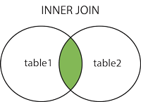
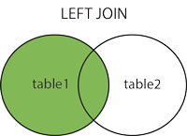
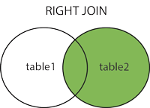
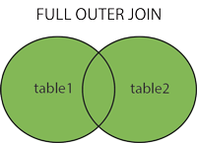
Different Types of JOINS
(INNER) JOIN: Returns records that have matching values in both tables
LEFT (OUTER) JOIN: Return all records from the left table, and the matched records from the right table
RIGHT (OUTER) JOIN: Return all records from the right table, and the matched records from the left table
FULL (OUTER) JOIN: Return all records when there is a match in either left or right table

Slide 21
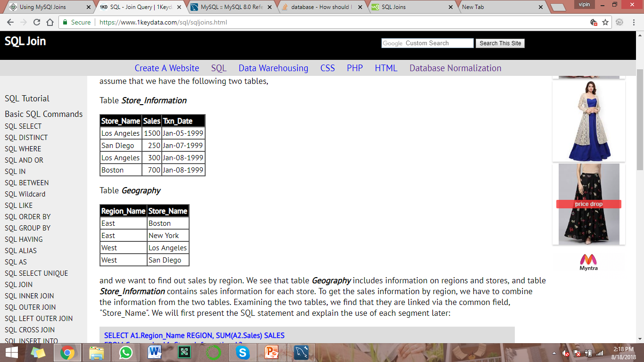
For Example:
SELECT A1.Region_Name REGION, SUM(A2.Sales) SALES FROM Geography A1, Store_Information A2 WHERE A1.Store_Name = A2.Store_Name GROUP BY A1.Region_Name;
Notes:
https://www.1keydata.com/sql/sqljoins.html
REGION SALES
East 700
West 2050

Slide 22
TASK
State whether the following statements are True or False:
In MySQL, we can modify a table and select from the same table in a subquery.
If a statement permits only a literal value, you cannot use a subquery.
NOT IN is an alias for <> ANY.
A row subquery can return more than one column value.
If a subquery returns any rows at all, EXISTS subquery is TRUE.
MySQL evaluates from outside to inside.
Converting a subquery to a join never improves performance.
For subqueries in HAVING clause, MySQL also looks for column names in the outer select list.
Aggregate functions in correlated subqueries can contain outer references, even when the function is contained in another function or expression.
An EXISTS subquery can only start with SELECT *.
Notes:
F; In MySQL, you cannot modify a table and select from the same table in a subquery. This applies to statements such as DELETE,INSERT, REPLACE, UPDATE, and (because subqueries can be used in the SET clause) LOAD DATA INFILE.
T; There are a few contexts in which a scalar subquery cannot be used. If a statement permits only a literal value, you cannot use a subquery. For example, LIMIT requires literal integer arguments, and LOAD DATA INFILE requires a literal string file name. You cannot use subqueries to supply these values.
F; NOT IN is not an alias for <> ANY, but for <> ALL.
T;A row subquery is a subquery variant that returns a single row and can thus return more than one column value.
T; If a subquery returns any rows at all, EXISTS subquery is TRUE, and NOT EXISTS subquery is FALSE.
F; MySQL evaluates from inside to outside.
F; Some subqueries can be transformed to joins for compatibility with older versions of MySQL that do not support subqueries. However, in some cases, converting a subquery to a join may improve performance.
T; For subqueries in HAVING or ORDER BY clauses, MySQL also looks for column names in the outer select list.
F; Aggregate functions in correlated subqueries may contain outer references, provided the function contains nothing but outer references, and provided the function is not contained in another function or expression.
F; Traditionally, an EXISTS subquery starts with SELECT *, but it could begin with SELECT 5 or SELECT column1 or anything at all. MySQL ignores the SELECT list in such a subquery, so it makes no difference.

Slide 23
References
Textbook:
Fundamentals of Database Systems by Ramez Elmasri, Shamkant Navathe
Database Management Systems by Raghu Ramakrishnan, Johannes Gehrke
Database System Concepts by Abraham Silberschatz, Henry Forth, Sudarshan
Web material:
https://www.1keydata.com/sql/sql.html
https://www.tutorialspoint.com/mysql/index.htm
https://dev.mysql.com/doc/refman/8.0/en/

Slide 24
Topics to be covered in next Lecture
Data Control Language
Transaction Control Language
Views
Reference for these topics above:
https://www.1keydata.com/sql/sql-data-types.html
We will have MCQ on this Lecture.

