Slide 1
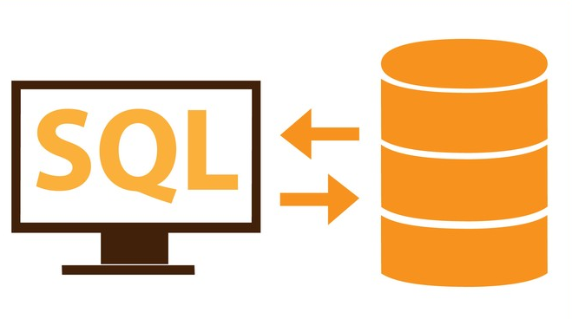
LECTURE 8 Normalization
Ankita Pai

Slide 2
AGENDA
Normalization
First Normal Form
Second Normal Form
Third Normal Form
Denormalization

Slide 3
LEARNING OUTCOME
To understand
Normalization
Denormalization

Slide 4
NORMALIZATION

Slide 5
What is Normalization?
Normalization is a database design technique which organizes tables in a manner that reduces redundancy and dependency of data.
It divides larger tables to smaller tables and links them using relationships.
Notes:
https://medium.com/@katedoesdev/normalized-vs-denormalized-databases-210e1d67927d
https://www.tutorialspoint.com/dbms/database_normalization.htm
https://en.wikipedia.org/wiki/Database_normalization SEARCH FOR EXAMPLES SIMILAR TO THE ONE GIVEN IN THIS
https://www.studytonight.com/dbms/database-normalization.php
https://www.geeksforgeeks.org/database-normalization-normal-forms/ FOR QUIZ, SCROLL DOWN THIS PAGE
http://www.exploredatabase.com/2015/01/normalization-solved-exercises.htmlFOR ASSGS
https://cs.senecac.on.ca/~dbs201/pages/Normalization_Practice.htmFOR ASSGS
https://www.scribd.com/document/127248726/Normalization-Questions-with-Answers FOR ASSGS

Slide 6
Why Normalization?
In an un-normalized design, there are 3 problems that can occur when we work with the data:
INSERT ANOMALY: This refers to the situation when it is impossible to insert certain types of data into the database.
DELETE ANOMALY: The deletion of data leads to unintended loss of additional data, data that we had wished to preserve.
UPDATE ANOMALY: This refers to the situation where updating the value of a column leads to database inconsistencies (i.e., different rows on the table have different values).
To address the 3 problems above, we go through the process of normalization => we increase the number of tables in the database, while decreasing the amount of data stored in each table.
The opposite of normalization is denormalization, where we want to combine multiple tables together into a larger table.
Notes:
Insert anomaly=> when u r not able to insert data into a table because some other data has not been inserted because its value is not available or is missing. For eg: inserting genre ID and type into the book table will not be allowed until book details are available.
Delete Anomaly=> eg: from the book table if we delete record whose bookID is 4 we will lose information about the genre ID and genre type 3 completely
Update Anomaly=>eg: if in the purchase table we update the purchase location of customer 4, then store id 3 will have 2 different purchase locations, like San Francisco and New Delhi, which is inconsistent

Slide 7
Normal Forms
The inventor of the relational model Edgar Codd proposed the theory of normalization with the introduction of First Normal Form, and he continued to extend his theory with Second and Third Normal Forms.
Later he joined with Raymond F. Boyce to develop the theory of Boyce-Codd Normal Form.
Theory of Data Normalization in SQL is still being developed further: there are discussions even on 6th Normal Form.
However, in most practical applications, normalization achieves its best in 3rd Normal Form.
Notes:
https://www.guru99.com/database-normalization.html

Slide 8
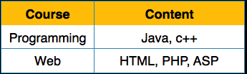
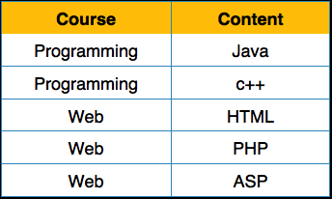
First Normal Form
It defines that all the attributes in a relation must have atomic domains.
The values in an atomic domain are indivisible units.
Each attribute must contain only a single value from its pre-defined domain.
Notes:
https://www.tutorialspoint.com/dbms/database_normalization.htm

Slide 9
Second Normal Form
Prime attribute − An attribute, which is a part of the primary-key, is known as a prime attribute.
Non-prime attribute − An attribute, which is not a part of the prime-key, is said to be a non-prime attribute.
A database is in second normal form if it satisfies the following conditions:
It is in first normal form
All non-prime attributes are fully functional dependent on the primary key
A table in the second normal form is free from partial functional dependency
Notes:
https://www.1keydata.com/database-normalization/second-normal-form-2nf.php

Slide 10
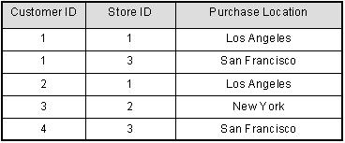
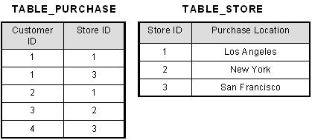
For Example
Notes:
This table has a composite primary key [Customer ID, Store ID]. The non-key attribute is [Purchase Location]. In this case, [Purchase Location] only depends on [Store ID], which is only part of the primary key. Therefore, this table does not satisfy second normal form.
To bring this table to second normal form, we break the table into two tables, and now we have the following:

Slide 11
Third Normal Form
A database is in third normal form if it satisfies the following conditions:
It is in second normal form
There is no transitive functional dependency
Transitive functional dependency=> If A is functionally dependent on B, and B is functionally dependent on C then A is transitively dependent on C via B.

Slide 12
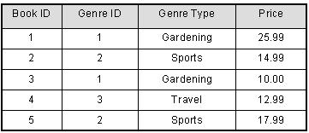
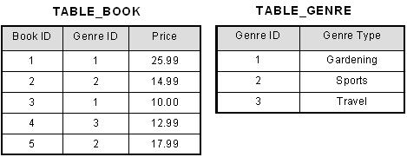
For Example
Notes:
This table has a composite primary key [Customer ID, Store ID]. The non-key attribute is [Purchase Location]. In this case, [Purchase Location] only depends on [Store ID], which is only part of the primary key. Therefore, this table does not satisfy second normal form.
To bring this table to second normal form, we break the table into two tables, and now we have the following:

Slide 13
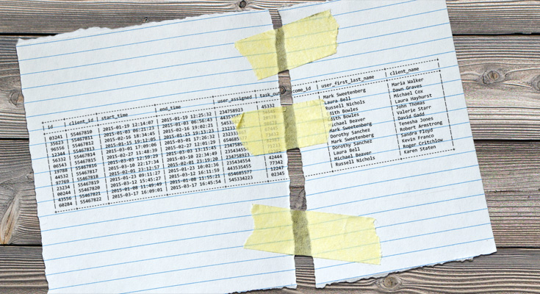
DENORMALIZATION
Notes:
https://en.wikipedia.org/wiki/Denormalization
https://www.geeksforgeeks.org/denormalization-in-databases/
https://www.1keydata.com/datawarehousing/query-optimization.html=> QUERY OPTIMIZATION
A database refactoring is a simple change to a database schema that improves its design while retaining both its behavioral and informational semantics.

Slide 14
What is Denormalization?
A strategy used on a previously-normalized database to increase performance.
Adds redundant data
Uses extra attributes in an existing table, adds new tables.
Goal is to decrease the running time of select queries by making data more accessible to the queries or by generating summarized reports in separate tables.
A normalized database is the starting point for the denormalization process.
Notes:
It’s important to differentiate from the database that has not been normalized and the database that was normalized first and then denormalized later. The second one is okay; the first is often the result of bad database design or a lack of knowledge.

Slide 15
Why Denormalization?
Maintaining history: Data can change during time, and we need to store values that were valid when a record was created.
Improving query performance: Some of the queries may use multiple tables to access data that we frequently need.
Speeding up reporting: Creating certain statistics that are needed very frequently from live data is quite time-consuming and can affect overall system performance.
Computing commonly-needed values up front: We want to have some values ready-computed so we don’t have to generate them in real time.
Notes:
When and Why to Use Denormalization
As with almost anything, you must be sure why you want to apply denormalization. You need to also be sure that the profit from using it outweighs any harm. There are a few situations when you definitely should think of denormalization:
Maintaining history: Data can change during time, and we need to store values that were valid when a record was created. What kind of changes do we mean? Well, a person’s first and last name can change; a client also can change their business name or any other data. Task details should contain values that were actual at the moment a task was generated. We wouldn’t be able to recreate past data correctly if this didn’t happen. We could solve this problem by adding a table containing the history of these changes. In that case, a select query returning the task and a valid client name would become more complicated. Maybe an extra table isn’t the best solution.
Improving query performance: Some of the queries may use multiple tables to access data that we frequently need. Think of a situation where we’d need to join 10 tables to return the client’s name and the products that were sold to them. Some tables along the path could also contain large amounts of data. In that case, maybe it would be wise to add a client_id attribute directly to the products_sold table.
Speeding up reporting: We need certain statistics very frequently. Creating them from live data is quite time-consuming and can affect overall system performance. Let’s say that we want to track client sales over certain years for some or all clients. Generating such reports out of live data would “dig” almost throughout the whole database and slow it down a lot. And what happens if we use that statistic often?
Computing commonly-needed values up front: We want to have some values ready-computed so we don’t have to generate them in real time.
It’s important to point out that you don’t need to use denormalization if there are no performance issues in the application. But if you notice the system is slowing down – or if you’re aware that this could happen – then you should think about applying this technique. Before going with it, though, consider other options, like query optimization and proper indexing. You can also use denormalization if you’re already in production but it is better to solve issues in the development phase.
What Are the Disadvantages of Denormalization?
Obviously, the biggest advantage of the denormalization process is increased performance. But we have to pay a price for it, and that price can consist of:
Disk space: This is expected, as we’ll have duplicate data.
Data anomalies: We have to be very aware of the fact that data now can be changed in more than one place. We must adjust every piece of duplicate data accordingly. That also applies to computed values and reports. We can achieve this by using triggers, transactions and/or procedures for all operations that must be completed together.
Documentation: We must properly document every denormalization rule that we have applied. If we modify database design later, we’ll have to look at all our exceptions and take them into consideration once again. Maybe we don’t need them anymore because we’ve solved the issue. Or maybe we need to add to existing denormalization rules. (For example: We added a new attribute to the client table and we want to store its history value together with everything we already store. We’ll have to change existing denormalization rules to achieve that).
Slowing other operations: We can expect that we’ll slow down data insert, modification, and deletion operations. If these operations happen relatively rarely, this could be a benefit. Basically, we would divide one slow select into a larger number of slower insert/update/delete queries. While a very complex select query technically could noticeably slow down the entire system, slowing down multiple “smaller” operations should not damage the usability of our application.
More coding: Rules 2 and 3 will require additional coding, but at the same time they will simplify some select queries a lot. If we’re denormalizing an existing database we’ll have to modify these select queries to get the benefits of our work. We’ll also have to update values in newly-added attributes for existing records. This too will require a bit more coding.

Slide 16
References
Textbook:
Fundamentals of Database Systems by Ramez Elmasri, Shamkant Navathe
Database Management Systems by Raghu Ramakrishnan, Johannes Gehrke
Database System Concepts by Abraham Silberschatz, Henry Forth, Sudarshan
Web material:
https://www.guru99.com/database-normalization.html
http://www.vertabelo.com/blog/technical-articles
https://dev.mysql.com/doc/refman/8.0/en/
https://cran.r-project.org/web/packages/sqldf/sqldf.pdf

