Slide 1
Remote Robot Controller using TCP/IP connection.
ERTS Embedded Systems lab project
IIT Bombay, 2012
Group 3
Saif Hasan (09005003)
Chinmay Chauhan (09005010)
Sagar Chordia (09005013)
Hemant Gangolia (09005015)

Slide 2
Problem Statement
This Project aims at controlling robot remotely through TCP/IP connection from any place in the world.
Assistance of Video feed is provided from robot to control it at user side.

Slide 3
Introduction
“Burglary Detection Robot”
Robot is put on surveillance with its camera on.
Whenever it detects motion it sends SMS to owner.
Owner then can watch video remotely coming from camera of robot.
User can also move robot remotely, he can turn on buzzer on robot remotely and this is constantly aided by video feed.

Slide 4
Requirements-General
Robot having following functionalities:
Processor to manage various tasks.
Capable of moving in all directions
Wi-Fi module to establish TCP/IP connection
Camera to provide Video feed
Buzzer to signal alarm
Android Phone/Any smart device to control robot remotely.
Wi-Fi module to establish TCP/IP link.

Slide 5
Requirements -Specific
Robot :
FireBird V
Supports motions, buzzer functionality and asynchronous communication using Atmega2560 ( slave controller) attached on robot.
Android phone mounted on FireBird V.
Camera on mobile phone is used for video feed.
Wi-Fi module in mobile is used to establish TCP/IP connection
Processor on mobile ( master controller) is used to manage all tasks
Remote Smart Device:
Android phone to control this robot remotely.

Slide 6
Specifications -
One Android Mobile phone
Wi-Fi, camera and Bluetooth
One Android Mobile phone
Wi-Fi module
Android phone
OS > 2.3.4 preferable on both
Firebird V robot
IOIO board/ Bluetooth module – for communication between android and Atmega2560

Slide 7
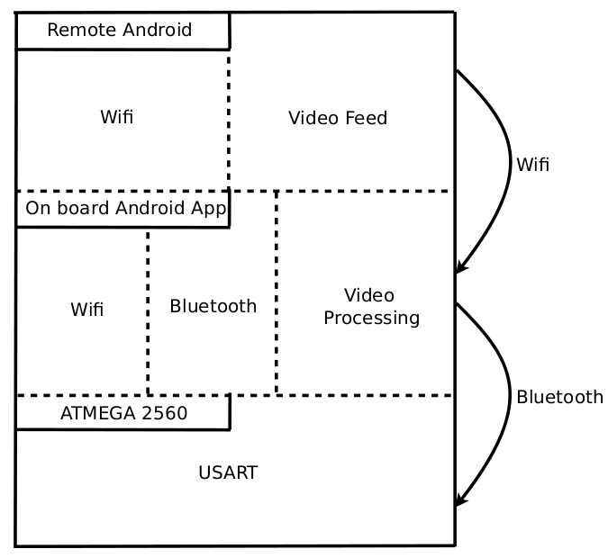
State Diagram

Slide 8
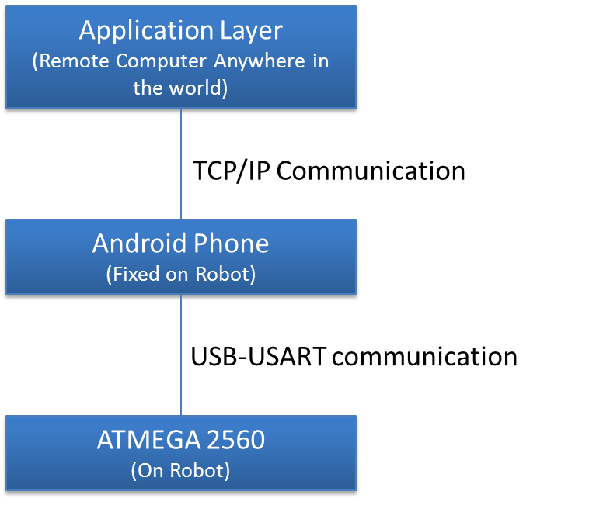
Modules

Slide 9
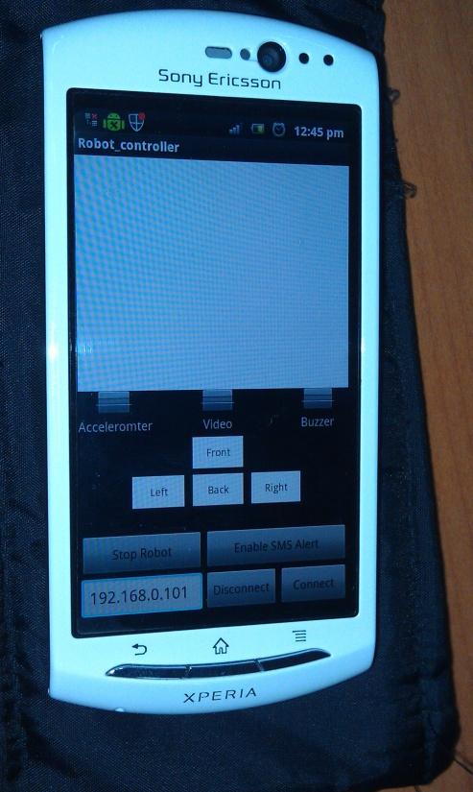
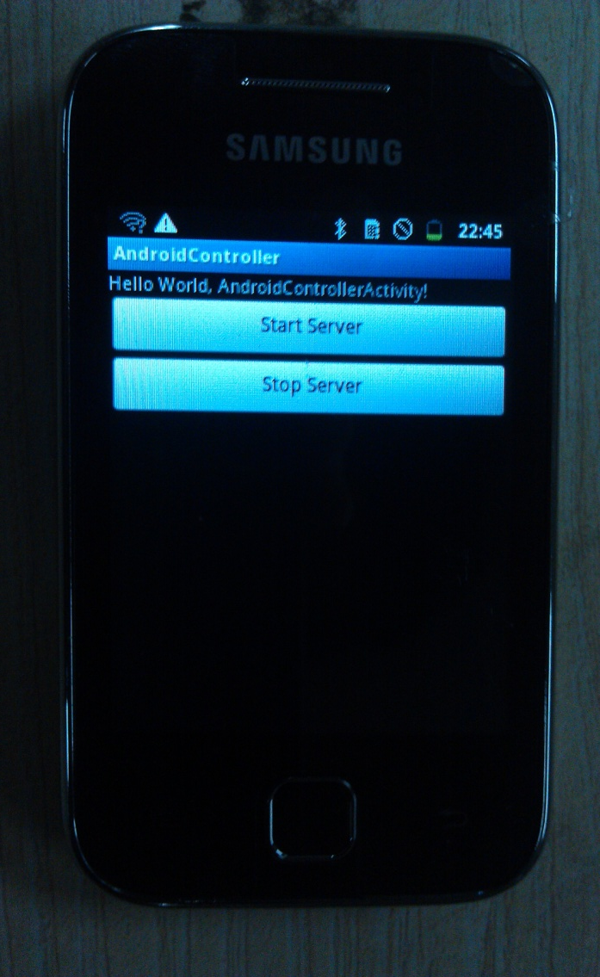
Android Application
Remote Controller
On Board Controller

Slide 10
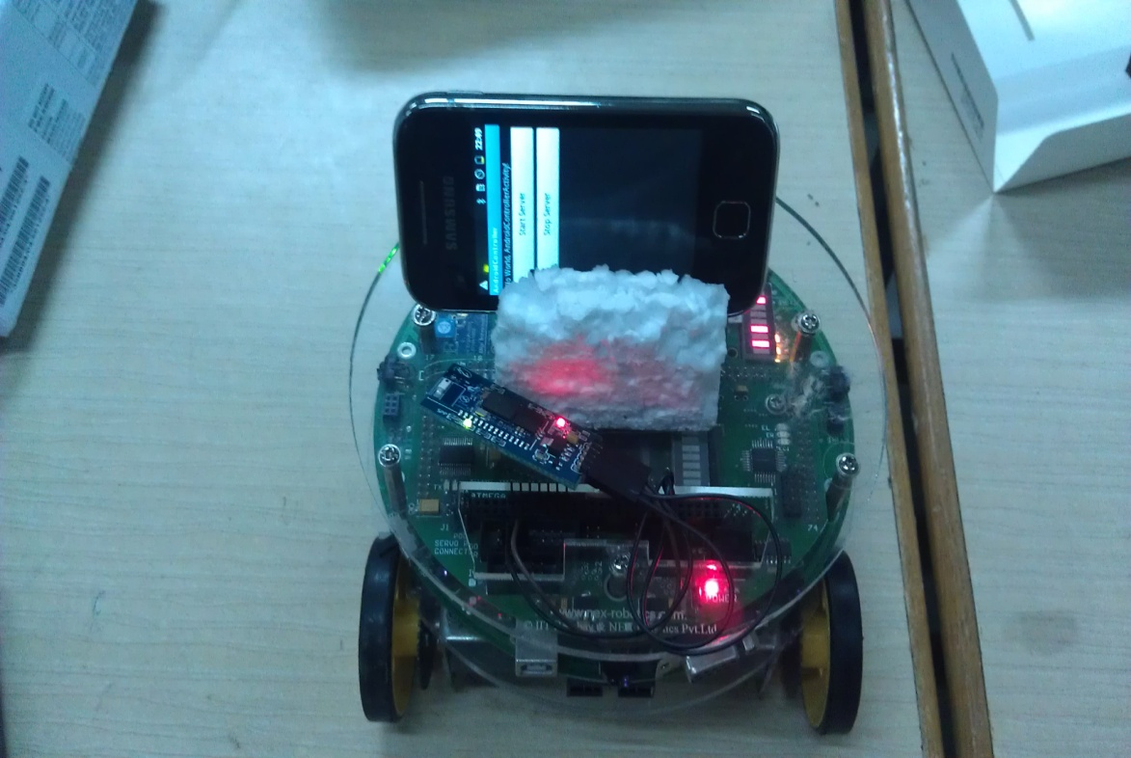
Robot Assembly

Slide 11
Modules
Three Modules of Processing:
ATMega2560 Application:
managing robot movement
Bluetooth receiver
On Board Android application
Managing Video transmission
Wi-Fi connection with remote android
Bluetooth communication with atmega2560
Remote Android application
Manages Video reception
Dashboard to move robot

Slide 12
Innovations
Established mechanism to have Wi-Fi communication between robot and remote device.
Developed code for Video transmission and reception over Wi-Fi.
Used IOIO board as means of communication between android and Bluetooth.

Slide 13
Project Plan
Parallel work was started in all three major modules.
Critical tasks and TimeLine
Getting Wi-Fi connection to work (Completed before 21 March)
Getting Video to work (30 March)
Getting IOIO/Bluetooth communication to work (4 April)
Work Division
Saif: Onboard Android application
Sagar, Saif - Remote android application
Sagar, Saif – TxtWeb Application
Hemant, Chinmay – FireBirdV robot coding
Sagar, Hemant, Chinmay – IOIO communication/Bluetooth communication
All : Final Testing, Documentation, Reports, Presentation

Slide 14
Tasks
Challenges Faced
Shorting of IOIO board while testing.
Reading raw video and audio data from Mobile Hardware
Converting the raw data into a proper image(audio) format in order to display(play) on computer
Response
Finally used Bluetooth instead of IOIO.
Use of core android libraries to extract raw data
Use of external library which can convert the raw image data provided by hardware into a readable format

Slide 15
Tasks
Challenge
Building multi tasking application on android which can simultaneously interact with robot as well as with user application along with audio and video streaming.
Response
Thread based programming. Separate Threads for Video transmission, Wi-Fi Connection, Bluetooth communication

Slide 16

Introduction
This Project aims at:
Controlling robot remotely from any place
Through TCP/IP connection like Wi-Fi/3G network.
Assistance of Video feed is provided from robot to control it at remote site.
One application. -“Burglary Detection Robot”
Robot is put on surveillance with its camera on.
On motion detection application sends SMS to owner.
Owner then can watch video remotely coming from camera of robot.
User can also move robot remotely, he can turn on buzzer on robot remotely and this is constantly aided by video feed.

Slide 17
Testing
Test Criteria
Layered Code structure
Each layer was tested independently using Android USB Debugging mode.
Proper communication between various layers.
Packets received over Wi-Fi are in order of their transmission.
Tested on three different platforms.
HTC Incredible S (Android 2.3.5)
Samsung Galaxy Y (Android 2.3.6)
Sony Xperia Neo V (Android 2.3.4)

Slide 18
Testing
Test Description
Android application development was done in Eclipse using Android SDK
Some things were tested on emulator, plug-in for eclipse.
Android Logcat was used extensively to view debugging messages.
Step by step testing on actual hardware device.
Getting Bluetooth link up
Getting Wi-Fi Link up
Getting Video transmission working
Getting control signals transmission working.

Slide 19
Performance Metrics
Quality vs. Reliability of video streaming
Currently we are transmitting 10 frames/sec from camera for video.
Each frame size ~ 10kb per frame.
Data Transfer - 10Kb * 10 = 0.1 Mb/sec
Maximum frame limit depends on available bandwidth of Wi-Fi. Android literature specifies upto 60 fps.
Improving number of frames may increase quality but because of heavy bandwidth utilization video starts lagging.

Slide 20
Performance Metrics
Ease of setup vs. cost
Android phone – costly but easy to setup.
Onboard android can be replaced by Beagle board and separate modules of Wi-Fi transmitter/receiver ,IP camera.
Reduces cost and makes on-board android phone redundant.
Difficult to setup and integrate these modules with FireBirdV.

Slide 21
Reusability
Generic communication model
For transmission and reception over TCP/IP connection.. Different applications can use it.
Generic Code
Some other data packets for example audio packets can be sent by using same code.
Independent of robot.
Bluetooth can be replaced with IOIO board. Firebird / Atmega2560 can be replaced by any robot.

Slide 22
Applications
Theft detection robot:
We have implemented prototype of this application by SMS alert facility.
Remote Surveillance robot:
Monitoring foreign terrain like border surveillance.

Slide 23
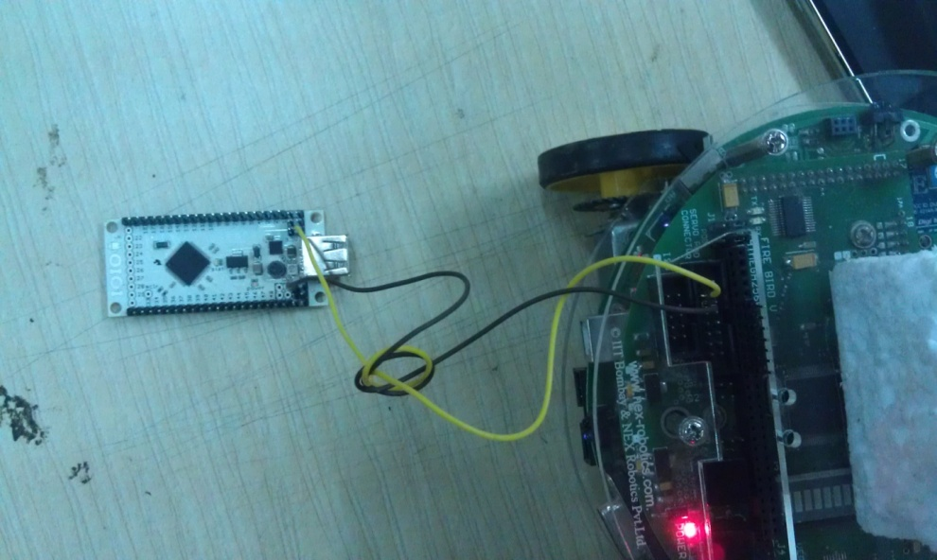
Future Work
Audio can be transmitted along with video for more information about robot’s environment.
Accelerometer on android can be used to control robot.
Using more reliable communication between android and Atmega like IOIO board.

Slide 24
References
http://developer.android.com/sdk/index.html
http://developer.android.com/guide/topics/usb/adk.html
http://www.sparkfun.com/products/10748
http://www.e-yantra.org/home/
http://www.nex-robotics.com/
Firebird V Atmega 2560 hardware and software manual.

Slide 25
THANK YOU
Entire ERTS team for providing excellent opportunity and support.
Special thanks:
Piyush, Akshat, Saurabh

