Slide 1

A Netflix Original — Data Story
DISCLAIMER :
This presentation is based on an analysis of Netflix content data after cleaning and preparation. Insights shown are derived solely from the dataset and are intended for strategic exploration and learning purposes

Slide 2
How Netflix’s Content Choices Translate Into Strategic Advantage
A data-driven content strategy story
Name: CHINMAY DAWAR Course: SBM IC1I MASTERCAMP Tools: Power BI | Python | Julius AI

Slide 3
Why Content Strategy Matters for Netflix
1.
3.
.
2.
Netflix competes on attention, not just content volume
Content decisions directly impact retention and lifetime value
Leadership needs clarity on what actually drives engagement

Slide 4




How This Analysis Was Built
Data cleaned & explored
AI-assisted analysis
Strategic framing
Interactive dashboard
The goal was not static analysis, but interactive decision support.

Slide 5
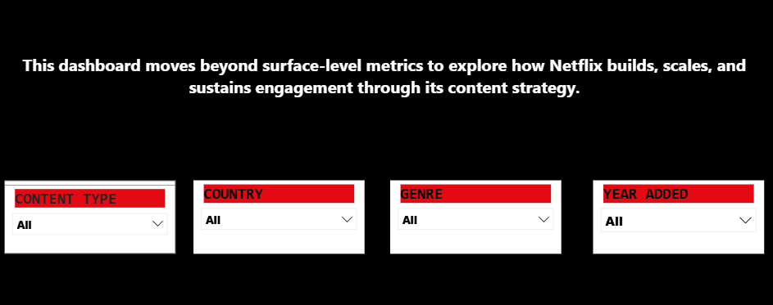
THE ENGINE
Allows leadership to explore content scale, retention drivers, maturity, and refresh pressure dynamically.

Slide 6
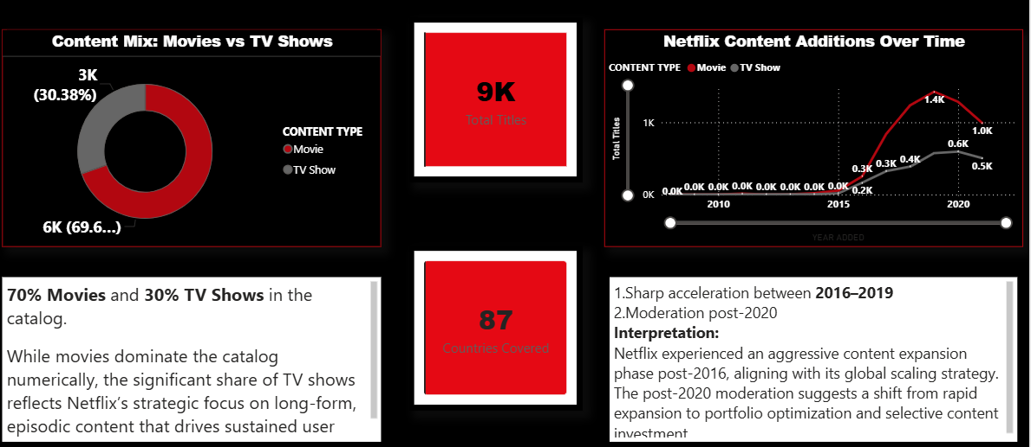
OBSERVATIONS
allows leadership to explore content scale, retention drivers, maturity, and refresh pressure dynamically.

Slide 7
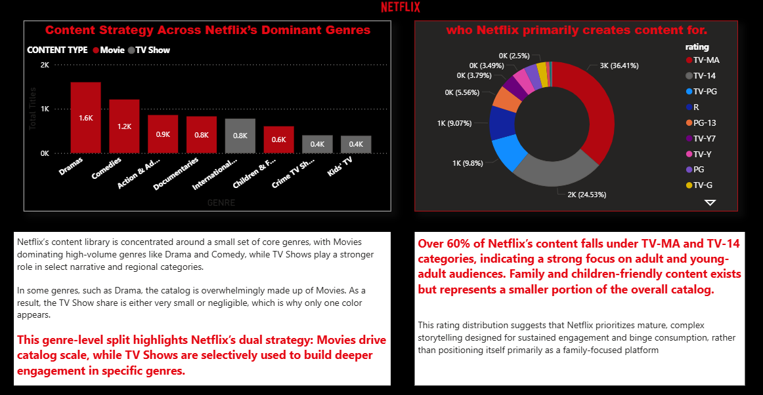
OBSERVATIONS
allows leadership to explore content scale, retention drivers, maturity, and refresh pressure dynamically.

Slide 8
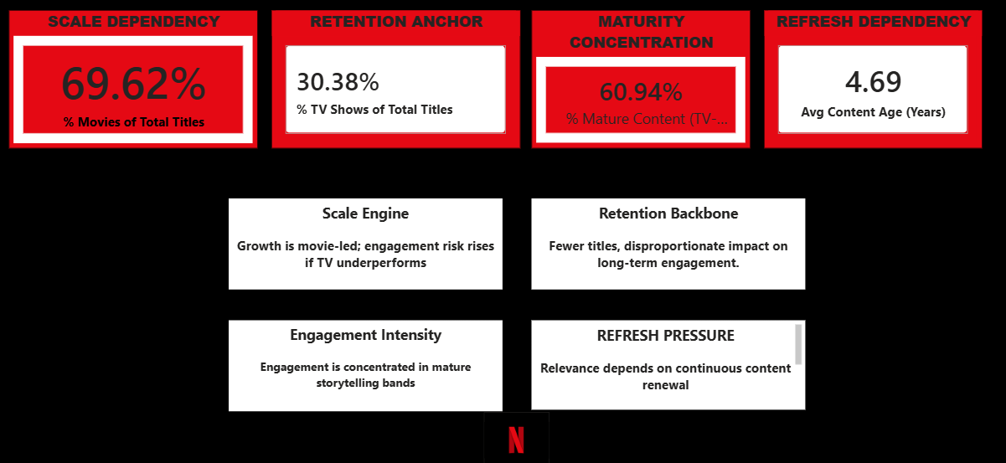
What This Means for Netflix Leadership

Slide 9

“Netflix wins not by producing more content, but by allocating content investment with precision.”
End of story.

