Slide 1


Memory Management: Segmentation and Paging
This presentation explores segmentation and paging in memory management.
We cover address translation, diagrams, and real-world examples.
by Chinmayee Rana

Slide 2
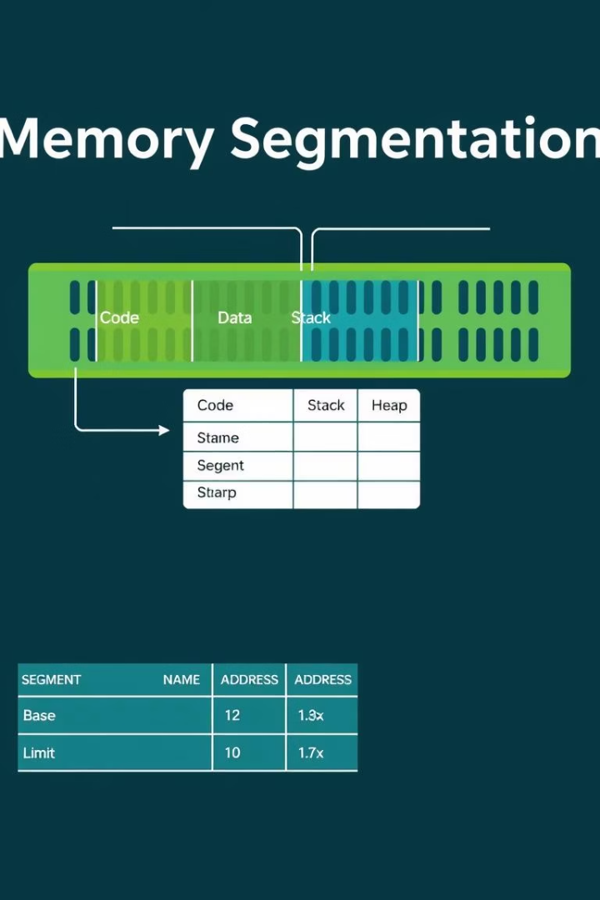
What is Segmentation?
Logical division
Segments
Memory is divided into variable-sized segments per program structure.
Each segment represents a logical unit like code, data, or stack.
Segment Table
Maps segment numbers to physical address with base and limit values.

Slide 3
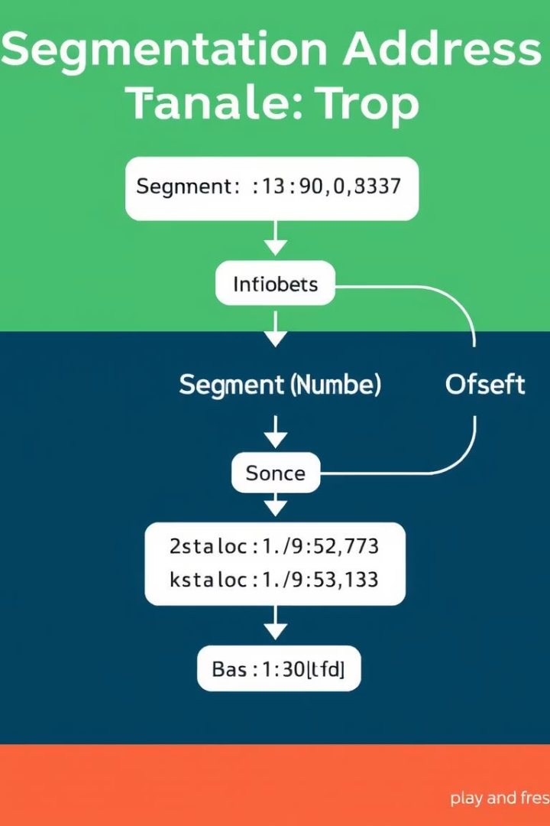
Segmentation Address Translation
1
Step 1
2
Step 2
Logical address split into segment number and offset.
Check offset against segment limit for validity.
3
Step 3
Add segment base to offset to get physical address.

Slide 4
What is Paging?
Fixed-size pages
Page table
Memory is divided into equal-sized pages.
Maps virtual pages to physical frames in memory.

Slide 5
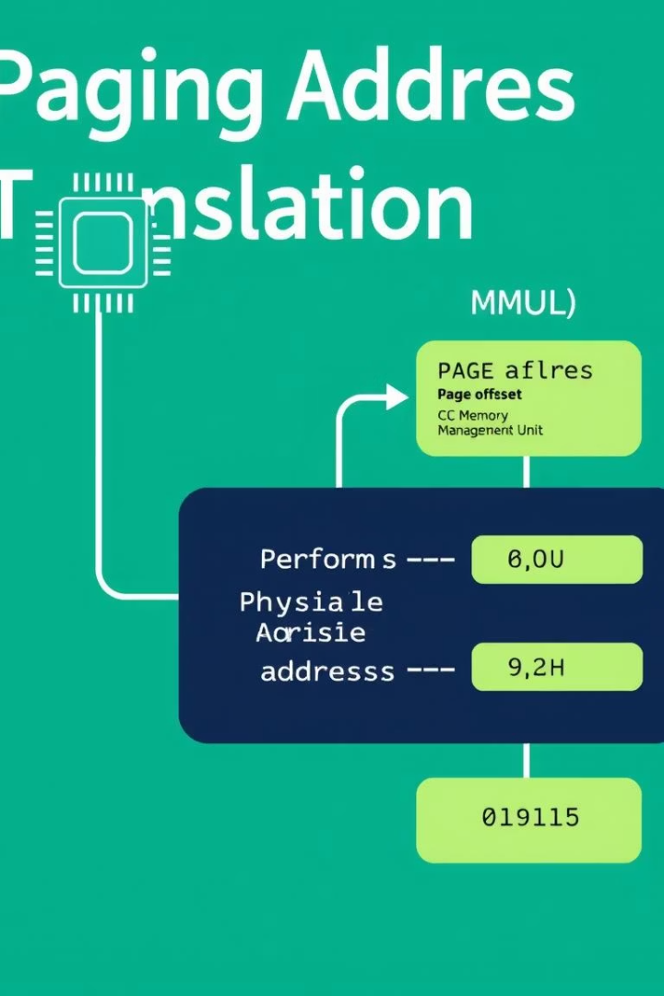
Paging Address Translation
1
Divide logical address
Split into page number and page offset.
2
Lookup frame
Page number indexes the page table to find frame.
3
Calculate physical address
Add frame base to page offset.
4
Access memory
Physical address accesses the required data.

Slide 6
Segmentation vs Paging
Segmentation
Paging
Variable size segments
Fixed size pages
Supports logical program view
Eliminates external fragmentation
Can cause external fragmentation
May suffer internal fragmentation

Slide 7
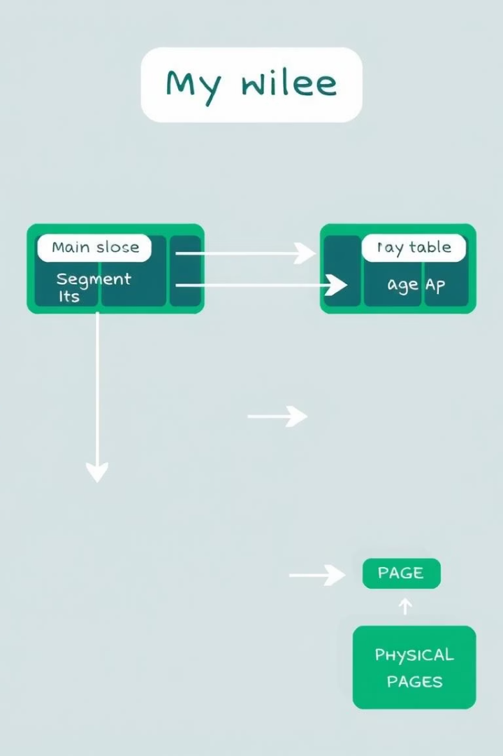
Combined Segmentation and Paging
Systems combine segmentation and paging for flexibility and efficiency.
Segments are divided into pages, allowing segmented logical view and paging benefits.

Slide 8

Key Takeaways and Next Steps
Segmentation
Paging
Logical division of memory with variable size, supports program structure.
Fixed-size pages eliminate external fragmentation using page tables.
Combined Usage
Combines advantages of both for efficient and flexible memory management.
Next, study real OS implementations and practice address translations.

