Slide 1
Secure Data Hiding in Image using Steganography
CAPSTONE PROJECT
Presented By: Chinmayee. Chintapanti
Student Name : Chinmayee. Chintapanti
College Name & Department : Gandhi Institute of Technology and Management
Department of Computer Science Engineering

Slide 2
OUTLINE
Problem Statement
Technology used
Wow factor
End users
Result
Conclusion
Git-hub Link
Future scope

Slide 3
Problem Statement
With increasing concerns about data security, there is a need for a method to hide sensitive information within digital images to prevent unauthorized access.
Traditional encryption techniques make data transmission secure but often attract attention.
Steganography provides a solution by embedding secret messages within images in a way that remains undetectable.
This project aims to develop a system that securely hides and retrieves messages from an image using a passcode, ensuring confidentiality, security, and integrity of the hidden data.

Slide 4
Technology used
Libraries:
OpenCV (cv2) – For reading, modifying, and saving images.
NumPy (numpy) – For efficient image processing and data handling (if needed).
Platforms:
Windows, Linux, macOS – Compatible across all major operating systems.
Python 3.x – The programming language used for implementation.
Technologies Used:
Steganography – The technique of hiding data within an image.
Image Processing – Storing and retrieving messages from the Red channel of an image.
Password-Based Security – Restricting access to encrypted data using a passcode.

Slide 5
Wow factors
Stealthy Data Hiding – Unlike traditional encryption, which makes data protection obvious, this project conceals messages within images, making them undetectable to unauthorized users.
Passcode Protection – Ensures secure access to the hidden message, preventing unauthorized decryption.
Lossless Image Modification – Uses PNG format to prevent image corruption and maintain quality after encryption.
Simple and Efficient Implementation – Uses minimal computational resources, making it suitable for low-power devices.

Slide 6
Wow factors
Custom End-of-Message Marker (EOF) – Ensures accurate message retrieval without unnecessary noise or data loss.
Cross-Platform Compatibility – Works seamlessly on Windows, Linux, and macOS without platform restrictions.

Slide 7
End users
Individuals & Professionals – People who need to securely communicate sensitive information without attracting attention.
Journalists & Activists – Those who require covert communication in sensitive environments.
Government & Intelligence Agencies – For secure data transmission and espionage protection.
Cybersecurity Enthusiasts & Researchers – To explore steganography techniques and enhance data security.

Slide 8
End users
Educational Institutions & Students – For learning about steganography, cryptography, and digital security.

Slide 9
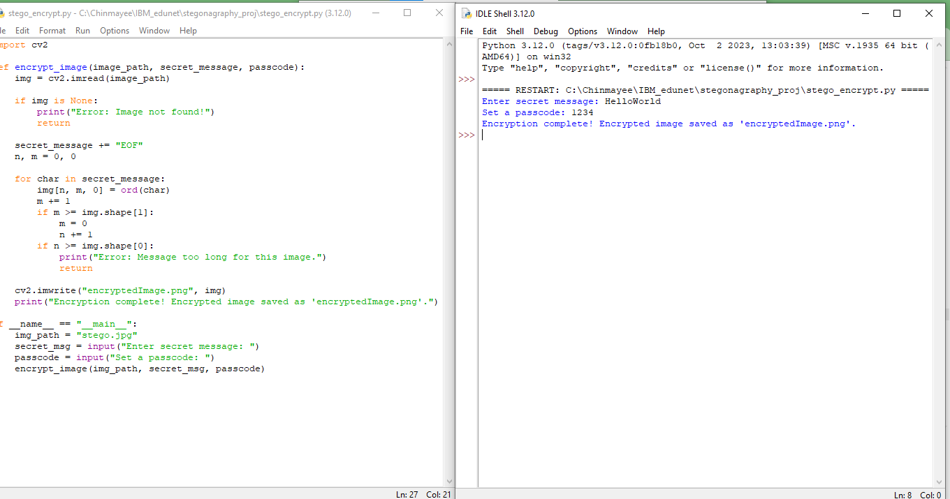
Results
Encryption Result

Slide 10
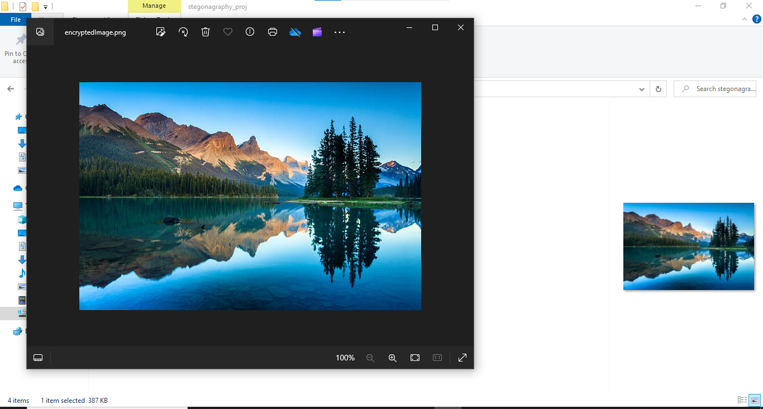
Results
EncryptedImage

Slide 11
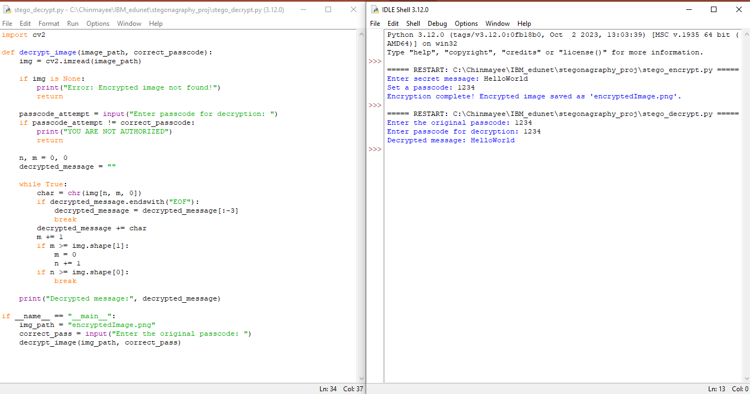
Results
Decryption Result

Slide 12
Conclusion
This project successfully implements secure data hiding in images using steganography, addressing the need for confidential and undetectable communication. Unlike traditional encryption, which can draw attention to sensitive data, this method embeds messages within images, making them nearly impossible to detect without the correct decryption key.
By incorporating password protection and an end-of-message marker (EOF), the system ensures data integrity, security, and controlled access. This approach provides a practical and efficient solution for secure information exchange, making it valuable for personal, professional, and governmental applications.

Slide 13
GitHub Link
https://github.com/chinmayeechintapanti/Secure-Data-Hinding-In-Image-Using-Steganography.git

Slide 14
Future scope(optional)
Enhanced Security: Implementing AES or RSA encryption before embedding the message to add an extra layer of protection.
Improved Steganography Techniques: Using LSB (Least Significant Bit) or DCT-based steganography for better concealment of data.
Error Detection and Correction: Adding error correction codes (ECC) to prevent data loss due to image modifications.
Support for Multiple File Formats: Expanding the project to hide data in videos, audio files, or PDFs for broader usability.

Slide 15
Future scope(optional)
Mobile and Web Integration: Developing a mobile app or web-based tool for easy encryption and decryption.

Slide 16
THANK YOU

