Slide 1
CLASSROOM QUIZ SHOW
Here is where your presentation begins

Slide 2
ROUND 01
Ragi Mudde & Roots

Slide 3
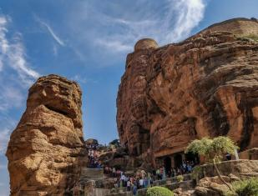
QUESTION 01
1)
2)
3)
4)
_____ is the modern name of the city that was previously known as “Vaatapi,” the capital of the early Chalukya dynasty, which ruled much of Karnataka from the 6th to 8th century.
Badami
Aihole
Pattadakal
Banavasi

Slide 4
Badami , Bagalkot district of Karnataka

Slide 5
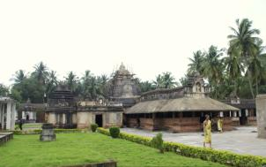
QUESTION 02
1)
2)
3)
4)
Banavasi is considered the oldest town in Karnataka. Which ancient dynasty made it their capital?
Chalukyas
Kadambas
Hoysalas
Rashtrakutas

Slide 6
Kadambas

Slide 7
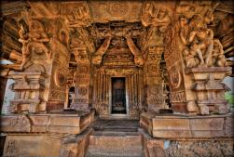
QUESTION 03
1)
3)
2)
4)
Aihole is famously known as the “Cradle of Indian Temple Architecture” because
It has the highest number of stepwells in India
It houses more than 120 early Chalukyan temples
It was the first capital of the Kadambas
It was a major Vijayanagara empire city

Slide 8
3) It houses more than 120 early Chalukyan temples showcasing experimental styles
📝 Explanation: Aihole was like an architectural laboratory for the Early Chalukyas (6th–8th century CE), where they experimented with different temple forms (Nagara, Dravidian, Vesara)

Slide 9
QUESTION 04
1)
2)
3)
4)
Which unique feature makes the Belur Chennakeshava Temple, built by the Hoysalas in 1117 CE, stand out in Indian temple architecture?
The temple walls contain thousands of detailed sculptures, no two of which are identical
It is the only granite temple in South India built on a star-shaped platform
It has the tallest gopuram (gateway tower) in Karnataka
The temple sanctum is completely underground

Slide 10
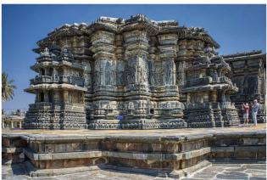
a) The temple walls contain thousands of detailed sculptures, no two of which are identical
📝 Explanation: Belur’s Chennakeshava Temple is world-famous for its soapstone carvings, where artisans ensured that no two figures were alike — a hallmark of Hoysala art.

Slide 11
QUESTION 05
1)
2)
3)
4)
Which UNESCO World Heritage Site from Karnataka is depicted on the ₹50 Indian currency note?
Belur – Chennakeshava Temple
Hampi – Stone Chariot (Vittala Temple)
Pattadakal – Virupaksha Temple
Shravanabelagola – Gomateshwara Statue

Slide 12
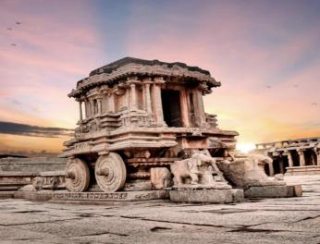
2) Hampi – Stone Chariot (Vittala Temple)

Slide 13
QUESTION 06
1)
2)
3)
4)
The Wodeyar dynasty of Mysore originally served as subordinate rulers under which empire before gaining independence?
Vijayanagara Empire
Mughal Empire
Bahmani Sultanate
Marathas

Slide 14
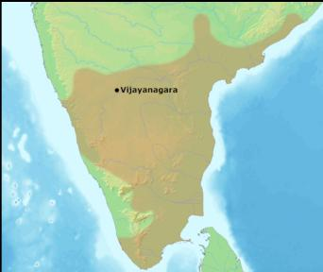
1) Vijayanagara Empire

Slide 15
ROUND 02
Guess who? Guess what?

Slide 16
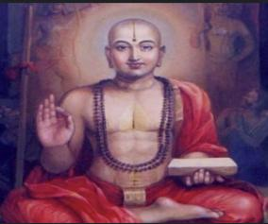
QUESTION 01
This 13th-century philosopher from Udupi, Karnataka founded the Dvaita (dualism) school of Vedanta?

Slide 17
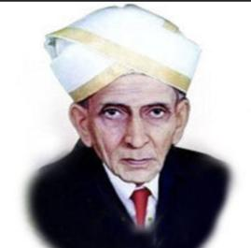
QUESTION 02
This Bharat Ratna awardee, engineer, and statesman’s birthday is celebrated as Engineers’ Day in India. Who is he?

Slide 18
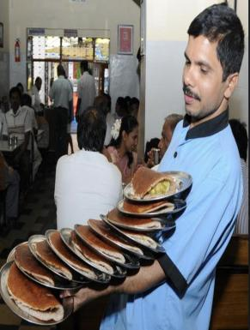
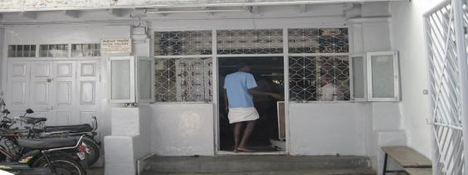
QUESTION 03
When you see waiters balancing 20 plates of dosa in one hand — and a queue longer than Bengaluru traffic — which legendary eatery are we talking about?

Slide 19

QUESTION 04
Looking at this picture, which Bengaluru café instantly comes to mind — the one that believes idlis and dosas should practically go swimming in ghee?

Slide 20

QUESTION 04
First multinational IT company to open an office in Bangalore

Slide 21
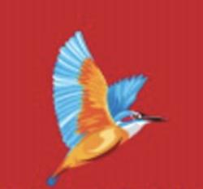
QUESTION 07
Once marketed as the “Fly the Good Times” airline, this Bengaluru-based carrier shut down after financial troubles, and its owner fled India. Identify the airline.

Slide 22
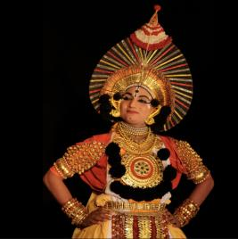
QUESTION 05
This vibrant traditional theatre form, popular in coastal Karnataka, blends dance, music, and storytelling from epics like the Ramayana and Mahabharata.

Slide 23
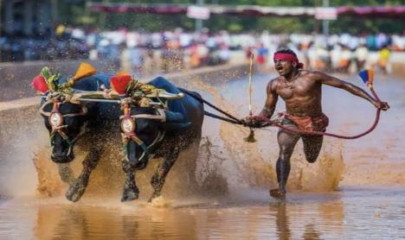
QUESTION 06
This traditional buffalo race held in coastal Karnataka paddy fields is a major cultural sport, often linked to Tulu Nadu traditions.

Slide 24
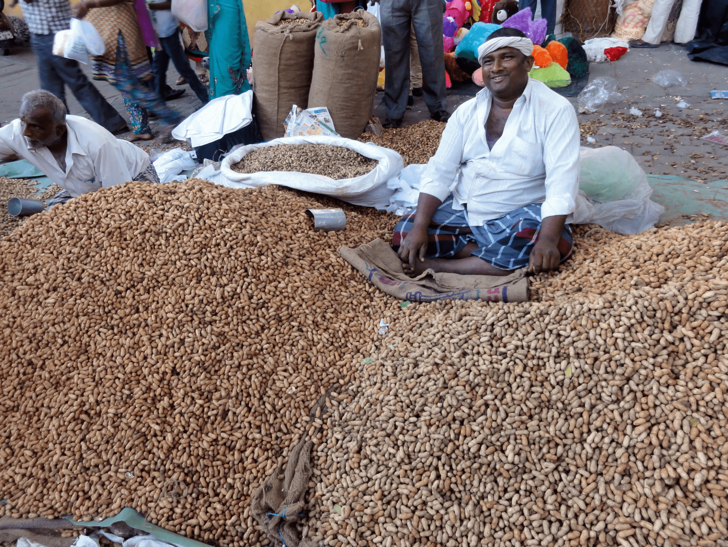
QUESTION 07
Every November, the streets around Bengaluru’s Bull Temple turn into a sea of groundnuts as farmers gather to sell their harvest. What is this famous fair called?

Slide 25
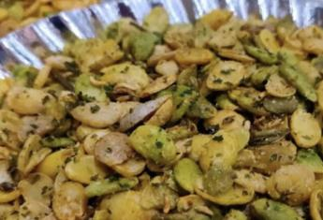
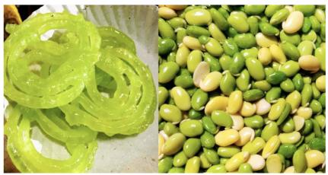
QUESTION 08
This food festival in Bengaluru is dedicated to the “winter crop of the city,” the broad bean.

