Slide 1
Student Dropout Analysis For School Education
CSE7101- Capstone Project
Review-2
Batch Number : CSE_204
Under the Supervision of,
Dr./Mr./Ms./Prof.
Professor / Associate Professor / Assistant Professor
School of Computer Science and Engineering
Presidency University
Roll Number 20221CSE0001 | Student Name K.N CHINMAY GOWDA
20221CSE0003 | PRAJWAL.M.S
20221CSE0017 | JEEVAN.M.B
Name of the Program : Bachelor of Technology (B.Tech)
Name of the HoD : Dr. Asif Mohammed , Dr. Blessed Prince
Name of the Program Project Coordinator : Dr. Jayavadivel Ravi , Mr. Muthuraju V
Name of the School Project Coordinators : Dr. Sampath A K , Dr. Geetha A

Slide 2
Content
Abstract
Literature Survey
Objectives
Existing methods and drawbacks
Proposed method and feasibility study
Architecture diagram
Modules
Hardware and software details
Timeline (Gantt Chart)
References

Slide 3
Abstract
Student dropout is one of the most critical challenges in the education sector, directly impacting literacy rates, socio-economic growth, and the overall quality of education. Early identification of at-risk students enables timely interventions that can significantly reduce dropout rates and improve retention. This project focuses on analyzing historical academic records, socio-economic conditions, and attendance data to uncover the key factors contributing to dropout. Using statistical methods and machine learning algorithms such as Logistic Regression, Random Forest, and XG Boost, the system develops a predictive model capable of forecasting dropout risk with high accuracy. The project integrates diverse data sources, performs exploratory data analysis, and implements feature engineering techniques to enhance prediction reliability. A dashboard is designed for educators and policymakers, providing actionable insights and early alerts for intervention. By leveraging data-driven approaches, the proposed system aims to minimize student dropout rates, support educational institutions in resource planning, and contribute to the creation of a sustainable and inclusive education ecosystem.

Slide 4
Literature Survey
Psyridou et al. (2024, Finland): Gradient boosting → AUC 0.65
Christie & Jarratt (2019, USA): Early warning system with logistic regression
Lee et al. (2019, Korea): Tree ensembles + SMOTE handle imbalance
Uekawa et al. (2010, USA): Attendance & grades strongest predictors
Bulut (2024, USA): Random Forest > Deep Learning; interpretable features
de Vasconcelos et al. (2023, Brazil): Psychological risk index
Vaarma et al. (2024, Finland): Data fusion improves higher-ed predictions
Venkatesan et al. (2023, India): Spatial analysis of dropout hotspots
Hassan et al. (2024, Somaliland): RF with 95% accuracy, socioeconomic predictors
Elbouknify et al. (2025, Morocco): SHAP interpretability, 88% accuracy

Slide 5
Objectives
Identify key factors influencing student dropout using academic performance, attendance, and socio-economic indicators.
Analyze historical academic and socio-economic data to detect meaningful patterns and correlations.
Develop predictive machine learning models (e.g., Logistic Regression, Random Forest, XG Boost) to forecast at-risk students.
Provide early alerts for students with a high probability of dropping out, enabling timely interventions.
Improve student retention rates through data-driven decision-making and targeted support strategies.
Design and deploy a user-friendly dashboard for educators and policymakers to visualize insights and act effectively.

Slide 6
Existing Methods
Manual Monitoring by Teachers
Tracking attendance, grades, and behavior manually.
Relies heavily on teacher intuition and observation.
Rule-Based Systems
Simple threshold-based methods (e.g., attendance < 75%, GPA < 2.0).
Students flagged only after performance falls below fixed cutoffs.
Traditional Statistical Models
Regression and correlation analyses used in earlier studies.
Identify relationships but struggle with large, complex datasets.
Basic Machine Learning Approaches
Logistic Regression and Decision Trees used in some research.
Limited scalability and often lack integration of socio-economic factors.

Slide 7
Drawbacks of Existing Methods
Reactive, not proactive → Detect issues only after performance drops significantly.
Narrow focus → Mostly depend on academics/attendance, ignoring socio-economic and psychological factors.
Low accuracy with imbalanced datasets (fewer dropouts compared to majority students).
Manual interventions → Time-consuming, error-prone, and inconsistent across institutions.
Lack of integration → No unified platform for combining academic, attendance, and family background data.
Poor generalization → Models built for one dataset/school often fail on different populations.

Slide 8
Proposed Method
Data Collection
  Academic performance records
  Attendance data
  Socio-economic background (family income, parental education, geographic location)
Data Preprocessing
  Handling missing values
  Encoding categorical variables
  Normalization and feature scaling
Exploratory Data Analysis (EDA)
  Identify trends and correlations between dropout and various factors.
  Visualize feature importance (e.g., attendance, grades, income).
Model Development
  Train and evaluate ML models (Logistic Regression, Random Forest, XG Boost).
  Apply hyperparameter tuning for better accuracy.
  Use techniques like SMOTE to handle dataset imbalance.
Prediction & Alert System
  Classify students as low-risk / medium-risk / high-risk of dropout.
  Generate early warning alerts for high-risk students.
Dashboard Deployment
  Use Flask/Stream lit to create an interactive interface.
  Provide educators with actionable insights and intervention strategies.

Slide 9
Feasibility Study
Technical Feasibility
Programming: Python (3.8+) with libraries (Pandas, NumPy, Scikit-learn, Matplotlib, Seaborn).
Database: MySQL / SQLite for storing student data.
Deployment: Lightweight deployment via Flask/Stream lit → accessible on any system.
Conclusion: Tools and technologies are readily available, making implementation feasible.
Operational Feasibility
Educators and policymakers can easily use the dashboard without technical expertise.
Early alerts help schools focus on preventive interventions instead of late corrections.
System fits into existing workflows (attendance records, academic reports).
Economic Feasibility
Uses open-source tools and libraries → minimal cost.
Requires only standard computing infrastructure (school servers or cloud hosting).
High potential benefit: reducing dropout improves school reputation, funding, and outcomes.
Time Feasibility
Development divided into clear phases: Data Collection → Preprocessing → Modeling → Deployment.
Project can be completed within the capstone timeline (as per review schedule).

Slide 10
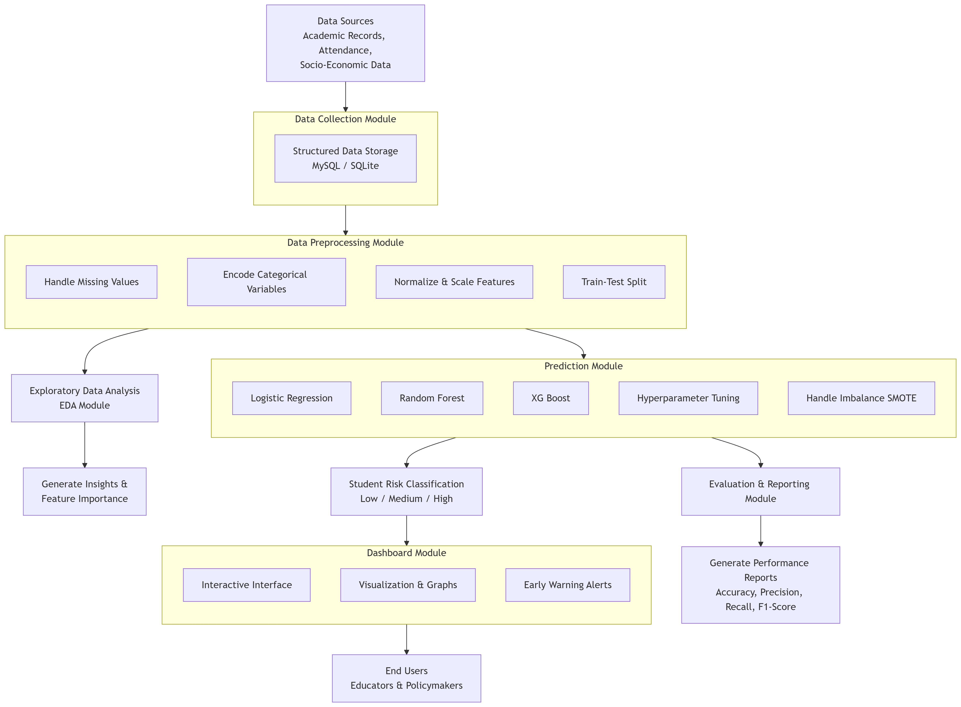
Architecture Diagram

Slide 11
Modules
Data Collection Module
Gathers data from academic records, attendance sheets, and socio-economic sources.
Stores data in a structured format (MySQL/SQLite).
Ensures secure and consistent data handling.
Data Preprocessing Module
Handles missing values and noisy data.
Encodes categorical variables (e.g., gender, parental education).
Normalizes/standardizes numerical features.
Splits data into training and testing sets.
Exploratory Data Analysis (EDA) Module
Generates statistical summaries and visualizations.
Identifies correlations among academic, attendance, and socio-economic factors.
Highlights most important predictors of dropout.

Slide 12
Prediction Module (Machine Learning Models)
Implements ML algorithms (Logistic Regression, Random Forest, XG Boost).
Applies feature engineering and hyperparameter tuning.
Handles imbalanced datasets using techniques like SMOTE.
Outputs student risk classification (Low, Medium, High).
Dashboard & Visualization Module
Provides an interactive interface using Flask/Stream lit.
Displays prediction results, graphs, and insights.
Allows educators to monitor at-risk students.
Generates early warning alerts for interventions
Evaluation & Reporting Module
Evaluates model performance using accuracy, precision, recall, and F1-score.
Compares different ML models.
Generates performance reports and recommendations.

Slide 13
Hardware Requirements
Processor: Intel Core i5 / AMD equivalent or higher
RAM: Minimum 8 GB (16 GB recommended for ML training)
Storage: 256 GB SSD or higher (for dataset storage and faster processing)
GPU (optional): NVIDIA GPU (e.g., GTX 1650 or higher) – for faster model training
System: Standard Desktop / Laptop, or Cloud-based VM (AWS, GCP, Azure)

Slide 14
Software Requirements
Operating System: Windows 10 / Ubuntu 20.04 / macOS
Programming Language: Python 3.8+
IDE / Tools:
  Jupyter Notebook
  VS Code / PyCharm
Libraries & Frameworks:
  Data Handling → Pandas, NumPy
  Visualization → Matplotlib, Seaborn
  Machine Learning → Scikit-learn, XG Boost
  Data Imbalance Handling → imbalanced-learn (SMOTE)
Database: MySQL / SQLite
Deployment Framework: Flask / Stream lit
Version Control: GitHub

Slide 15
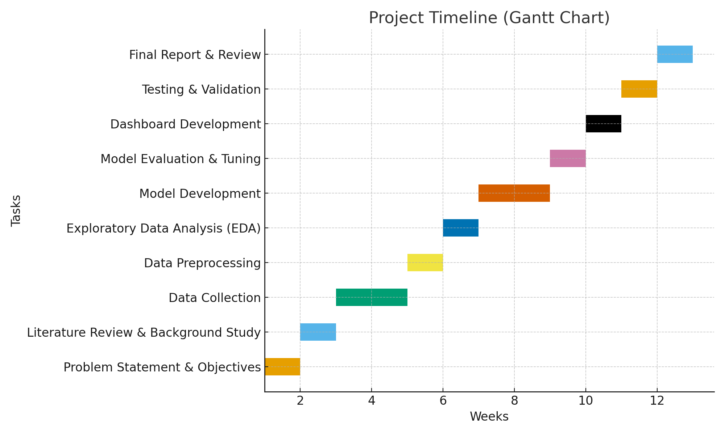
Timeline (Gantt Chart)

Slide 16
References
Psyridou et al., 2024
Christie & Jarratt, 2019
Lee et al., 2019
Uekawa et al., 2010
Bulut, 2024
de Vasconcelos et al., 2023
Vaarma et al., 2024
Venkatesan et al., 2023
Hassan et al., 2024
Elbouknify et al., 2025

Slide 17


