Slide 1
Inter-University Acceleartor Centre
Objective: To design Low pass, High-pass and Band Pass filter using RLC circuits on LT Spice and compare the simulation results with practical circuit analysis.

Slide 2
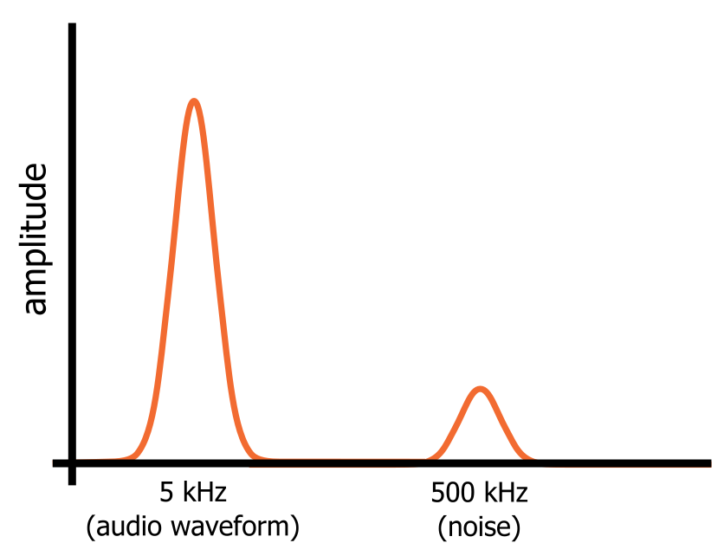
FILTER-DEFINITION
A filter is a circuit that removes, or “filters out,” a specified range of frequency components. In other words, it separates the signal’s spectrum into frequency components that will be passed and frequency components that will be blocked.

Slide 3
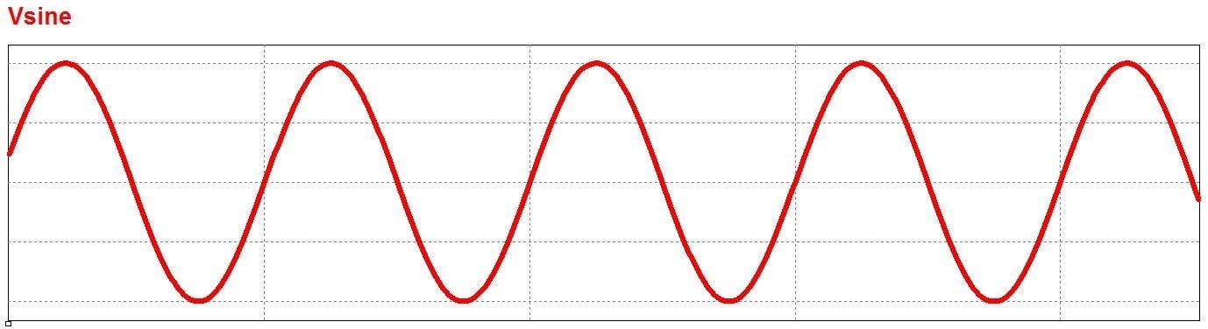
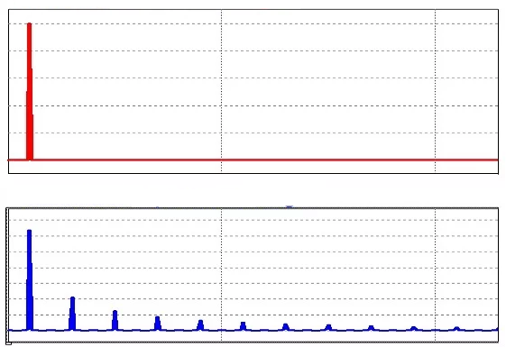
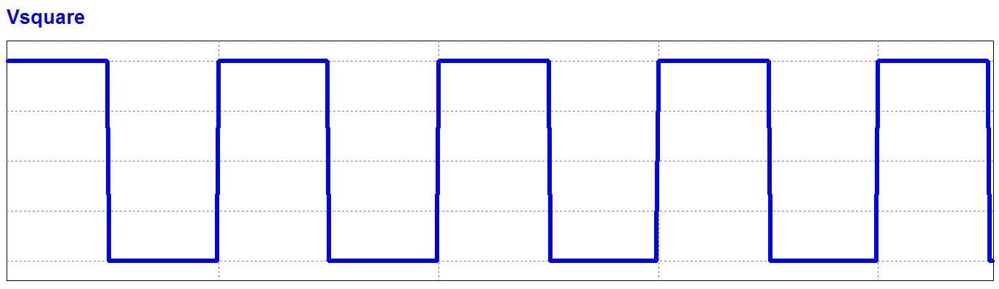
Time-domain and Frequency Domain Analysis
Time-domain analysis
Frequency domain(spectrum analysis)

Slide 4
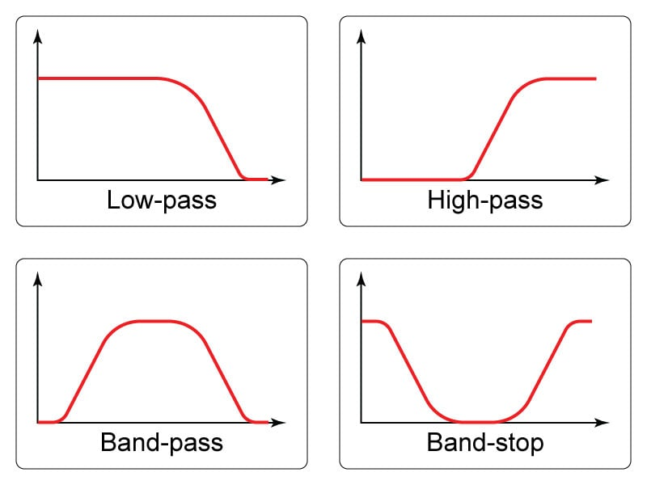
TYPES OF FILTERS
1)Low pass or Baseband filter
2)High pass filter
3)Band pass filter
4)Band stop or Band-notch filter

Slide 5
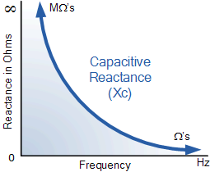
CAPACITIVE REACTANCE
Xc=1/(2*pi*f*C)
The capacitive reactance is high at lower frequencies and decreases subsequently as frequency is increased.

Slide 6
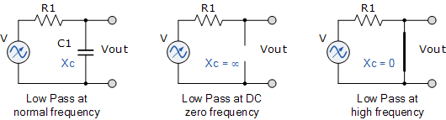
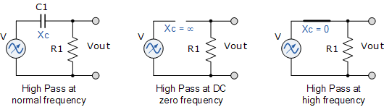
FILTERS USING RC CIRCUITS
LOW PASS FILTER
HIGH PASS FILTER

Slide 7
1)LOW-PASS FILTER
A filter which allows only signals with frequency lower than a particular threshold frequency to pass through it.
Filters designed using only passive components like resistors, capacitors and inductors are called passive filters.
They have no amplifying components like opamps (so no signal gain), so output is always less than input.

Slide 8
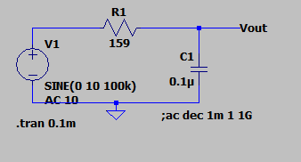
CIRCUIT DIAGRAM

Slide 9
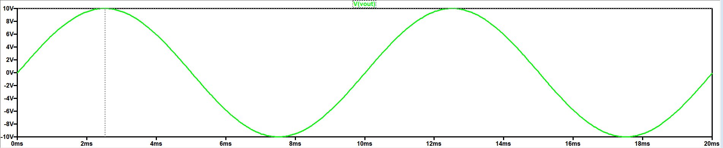
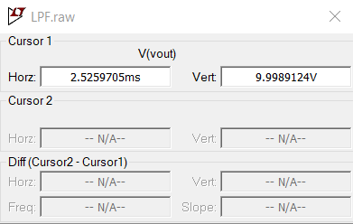
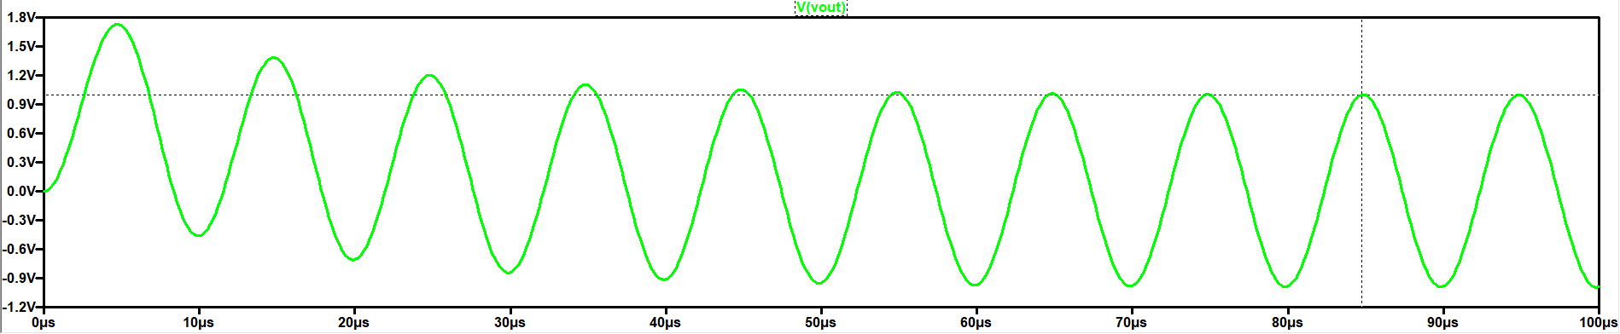
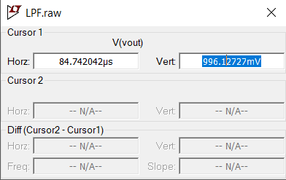
TRANSIENT ANALYSIS
f=100Hz
f=100kHz

Slide 10
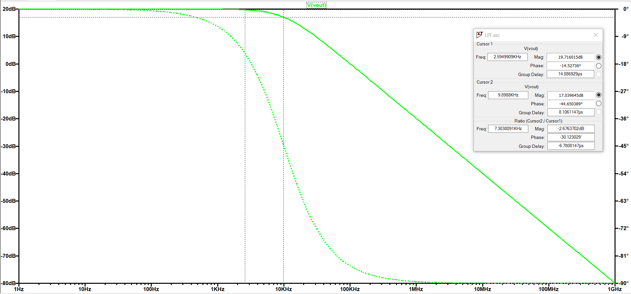
BODE PLOT
fc=1/(2*pi*R*C)
Phase Shift= -arctan(2*Pi*f*R*C)

Slide 11
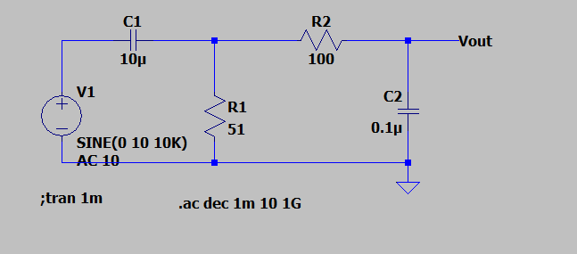
PASSIVE HIGH PASS FILTER

Slide 12
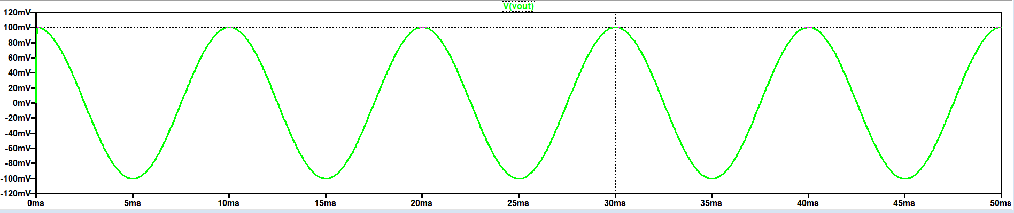
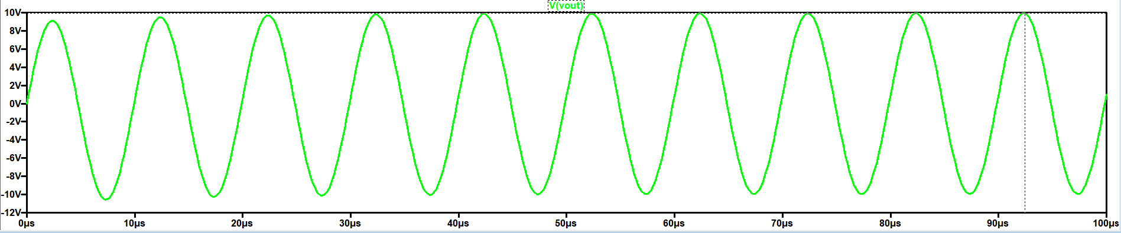
TRANSIENT ANALYSIS
f=100 Hz
f=100 kHz

Slide 13
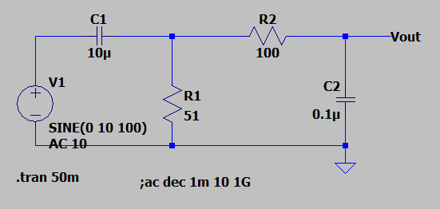
BAND PASS FILTER

Slide 14
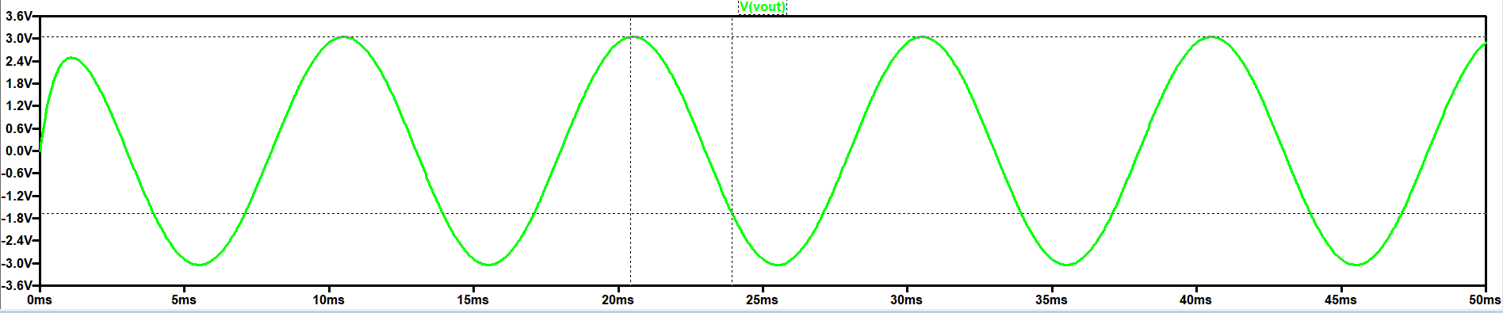
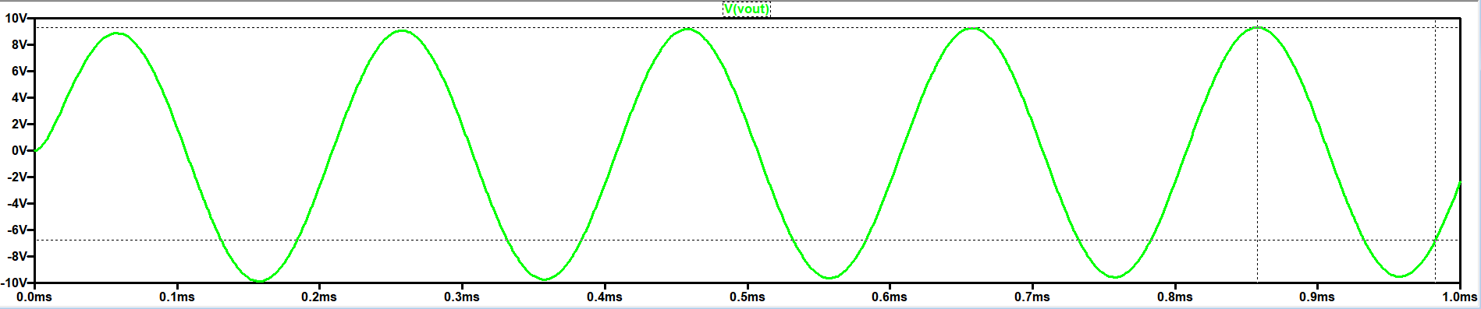
TRANSIENT ANALYSIS
F=100Hz
Vout(observed)=3.04V
Vout(theoretical)=3.05V
F=5kHz
Vout(observed)=9.32V
Vout(theoretical)=9.52V

Slide 15
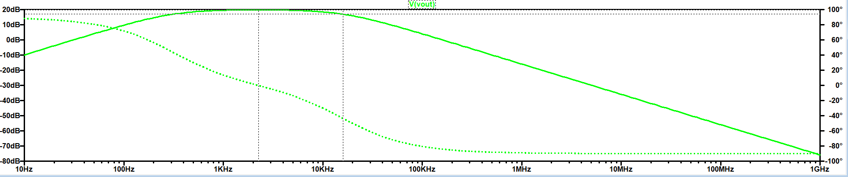
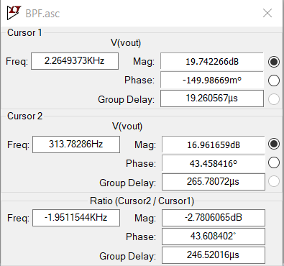
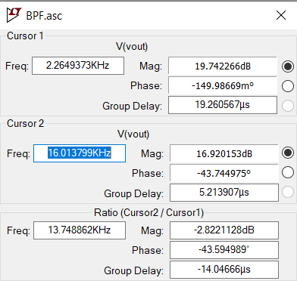
BODE PLOT

Slide 16
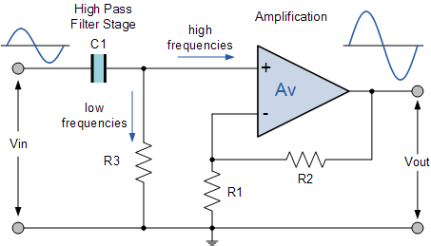
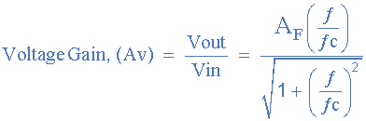


ACTIVE HPF
A first-order (single-pole) Active High Pass Filter as its name implies, attenuates low frequencies and passes high frequency signals.
It consists simply of a passive filter section followed by a non-inverting operational amplifier.
A_{F} = the Pass band Gain of the filter, ( 1 + R2/R1 )

Slide 17
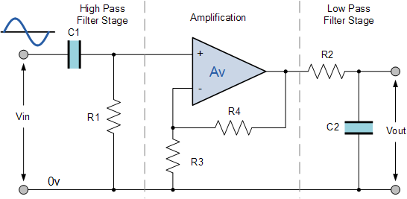
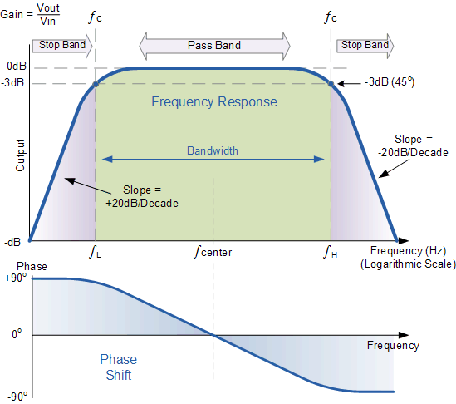
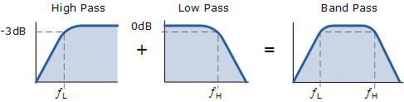
ACTIVE BAND PASS FILTER
The cut-off or corner frequency of the low pass filter (LPF) is higher than the cut-off frequency of the high pass filter (HPF) and the difference between the frequencies at the -3dB point will determine the “bandwidth” of the band pass filter.
The first stage of the filter will be the high pass stage that uses the capacitor to block any DC biasing from the source.

Slide 19
REFERENCES
What Is a Low Pass Filter? A Tutorial on the Basics of Passive RC Filters - Technical Articles (allaboutcircuits.com)
Passive Low Pass Filter - Passive RC Filter Tutorial (electronics-tutorials.ws)

